Slide 1
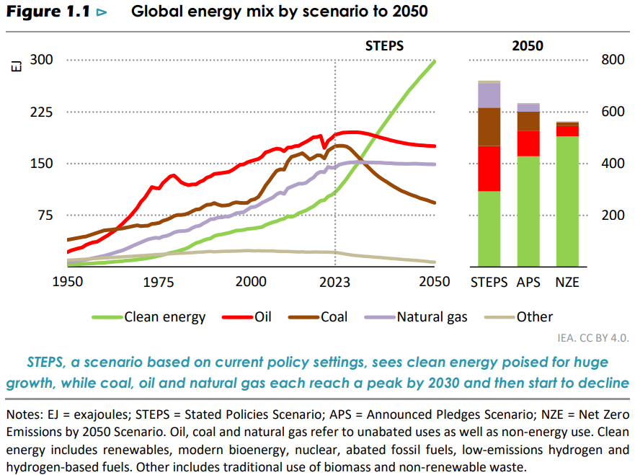
Energy Demand by source

Slide 2
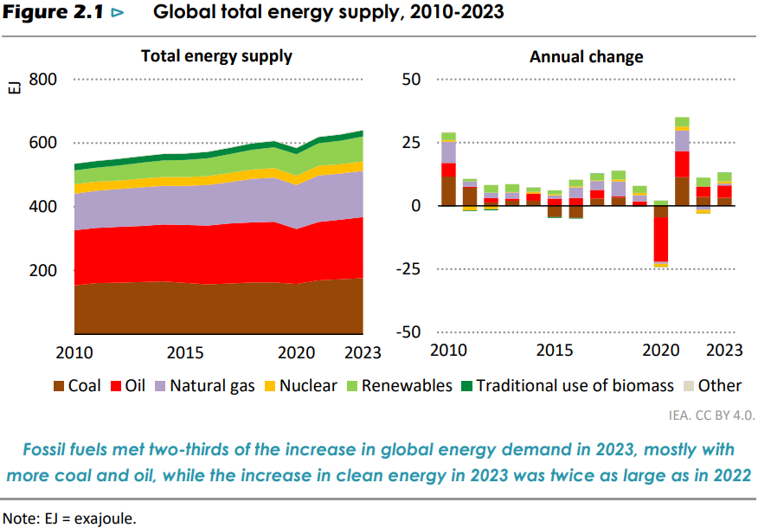
Energy Supply

Slide 3
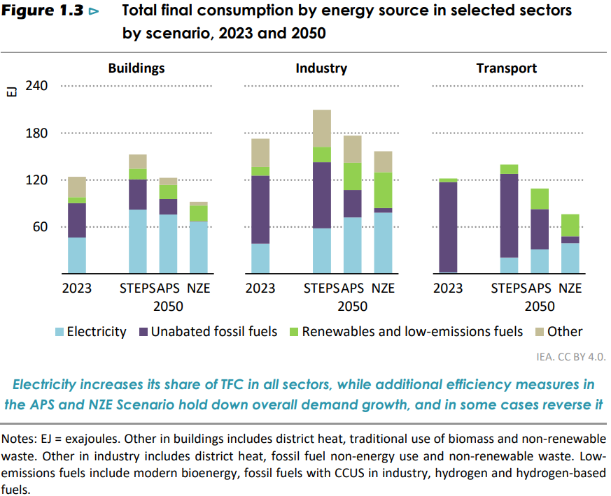
Total Final Consumption: Electricity as major source of energy

Slide 4
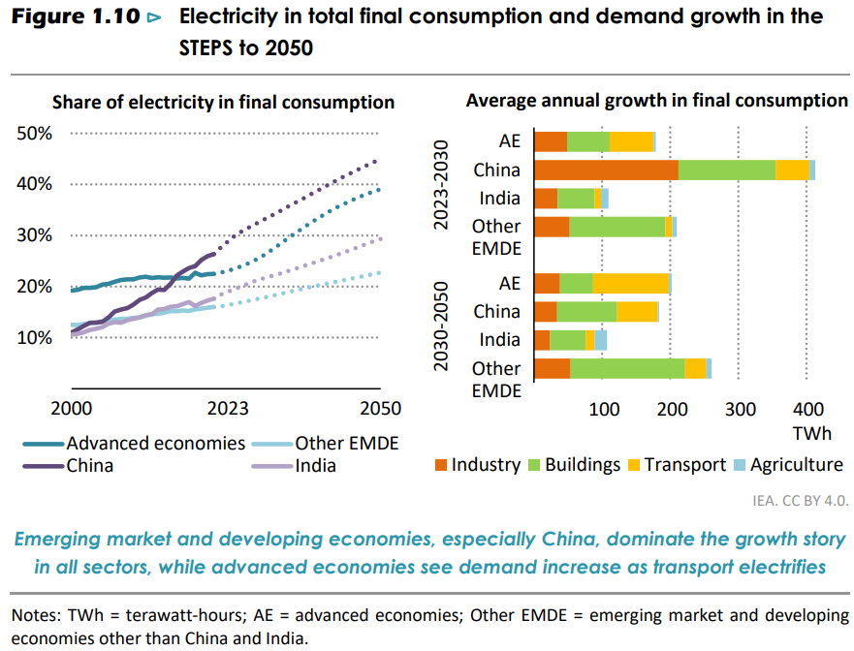
Electricity by country

Slide 5
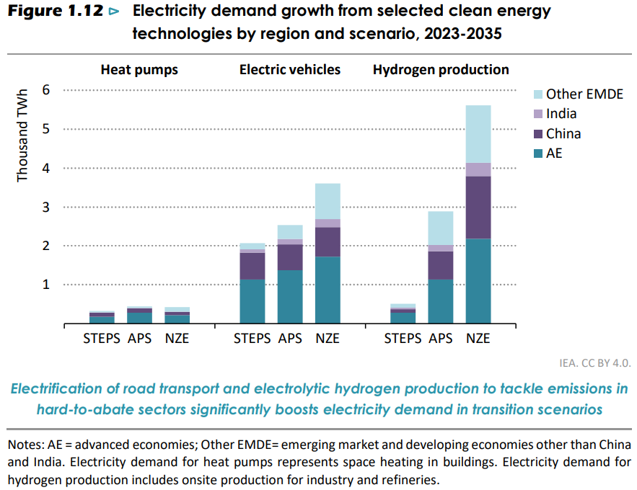
Major use of electricity
Notes:
The use of electricity to produce hydrogen, including onsite production for the steel, ammonia and refining industries, has the potential to increase demand for electricity very significantly. But the scale and timing are highly uncertain because they are contingent on how quickly different hydrogen production pathways and use develop. Electricity demand for hydrogen production increases from less than 5 TWh today to 9 000 TWh in the APS in 2050. In the NZE Scenario, electricity demand for hydrogen production reaches nearly 15 000 TWh in 2050, equivalent to over 55% of global electricity demand today.

Slide 6
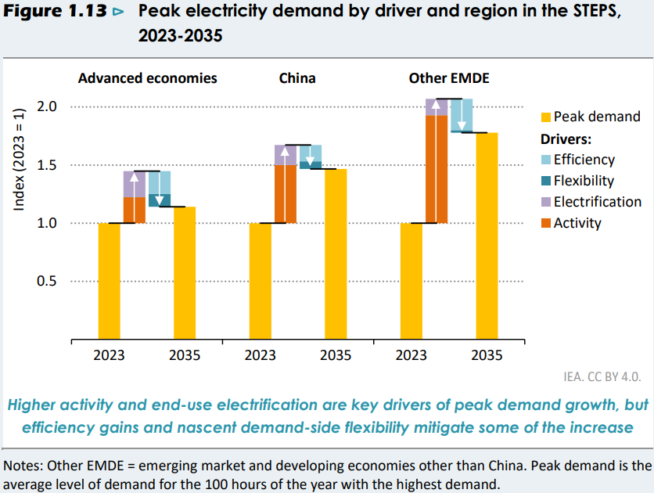
Electricity demand growth, driven by x offset by y
Notes:
Efficiency measures like improved insulation and more efficient appliances
demand-side flexibility such as smart meters and dynamic tariffs. Batteries become essential for dispatchable capacity
Electricity storage, stronger grids, demand-side response and dispatchable low-emissions sources of power are essential to meet flexibility requirements

Slide 7
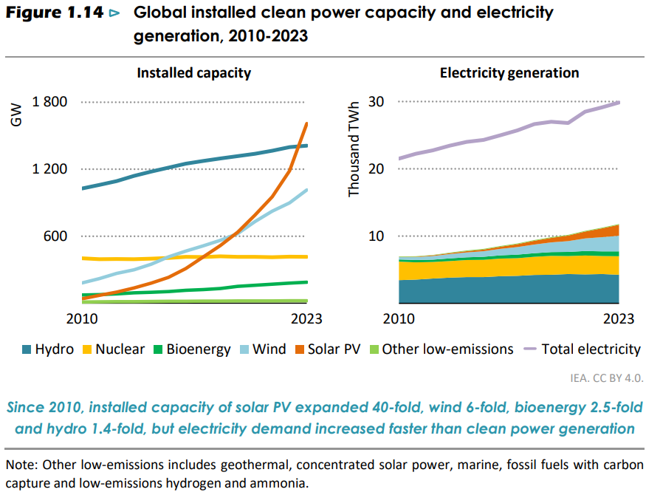
Electricity generation from green sources

Slide 8
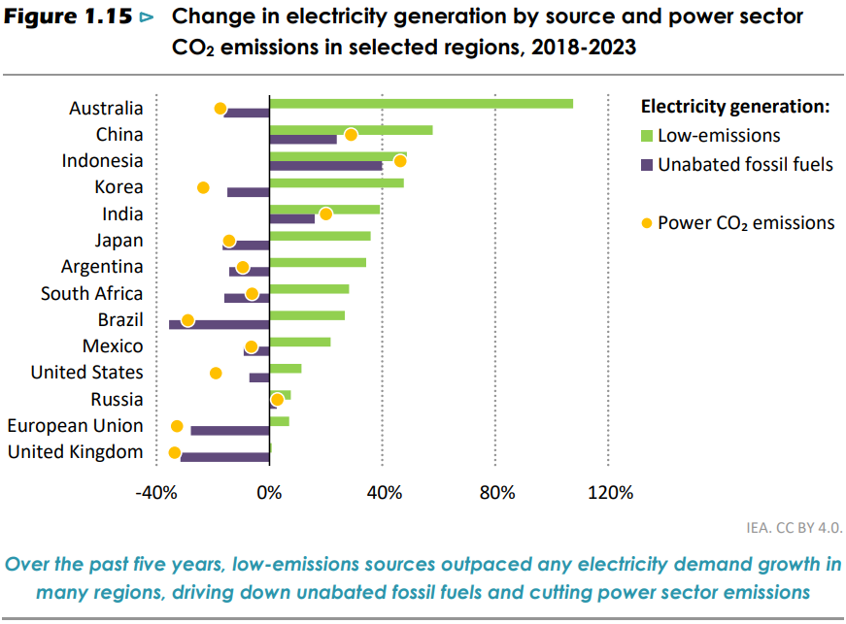
Electricity generation: green vs fossile

Slide 9
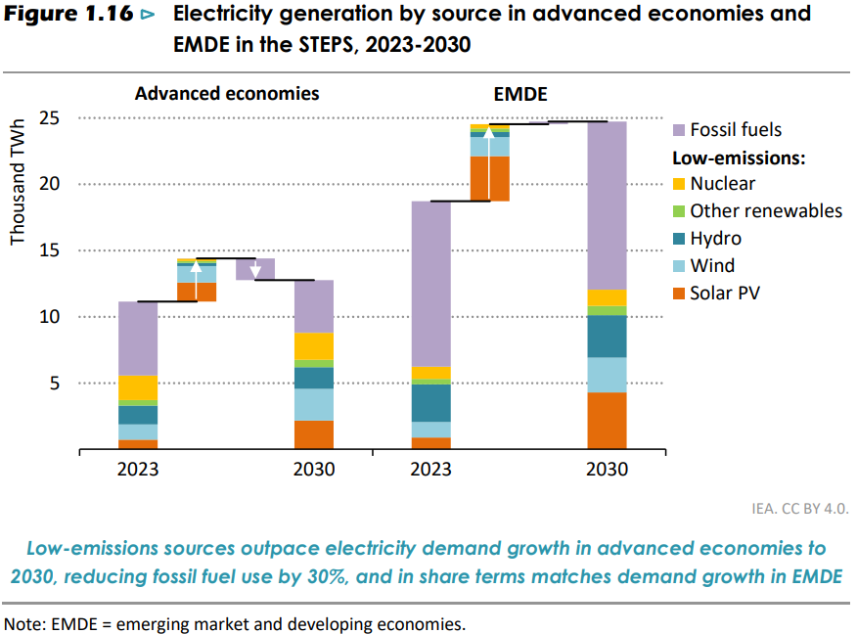
Electricity generation: green vs fossile

Slide 10
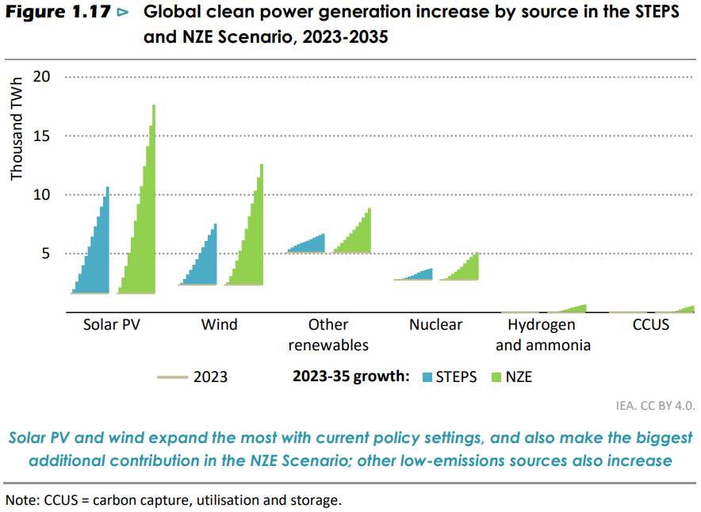
Electricity Generation: Green

Slide 11
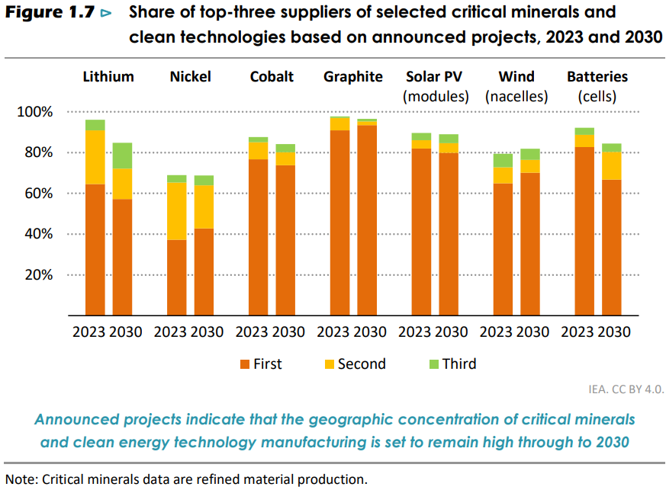
Concentration in key suppliers

Slide 12
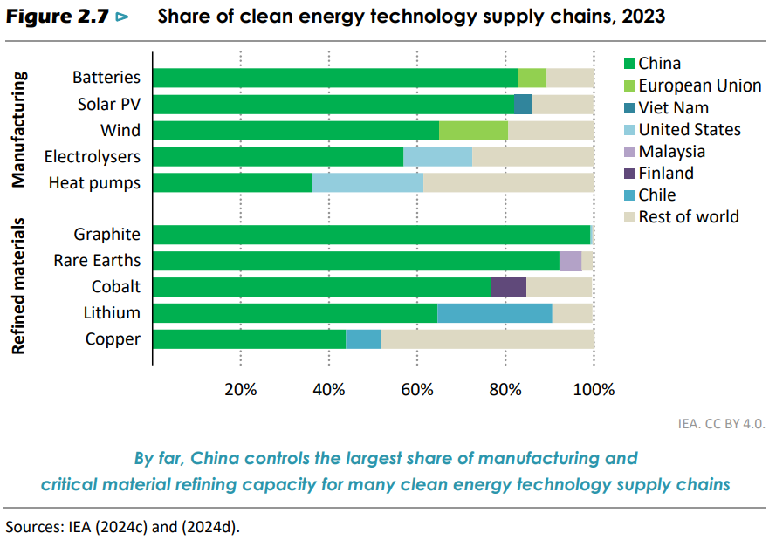
Monopoly/High concentration

Slide 13
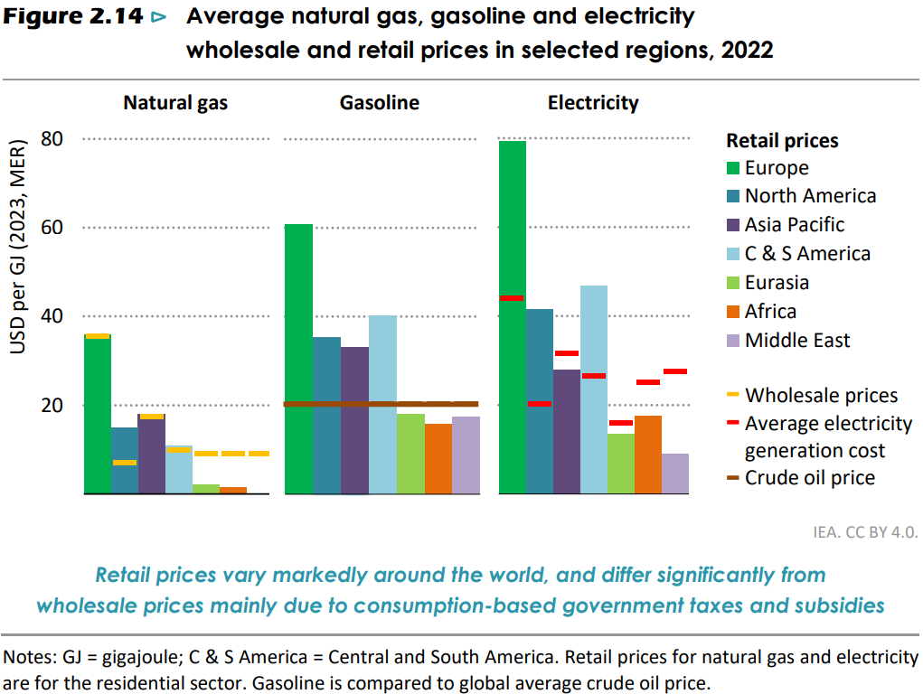
Natural Gas seems cheapest

Slide 14
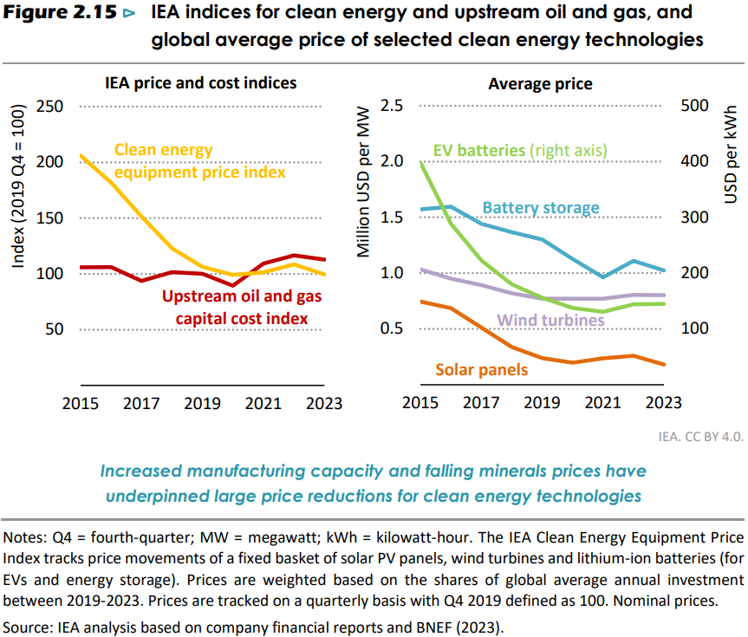
Reduced Cost

Slide 15
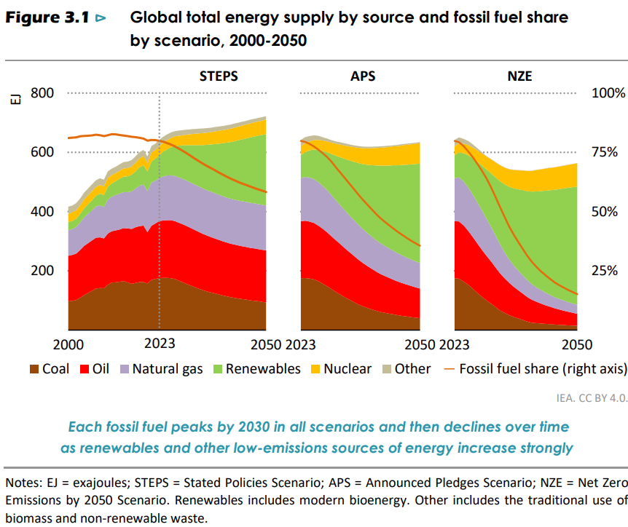

Slide 16
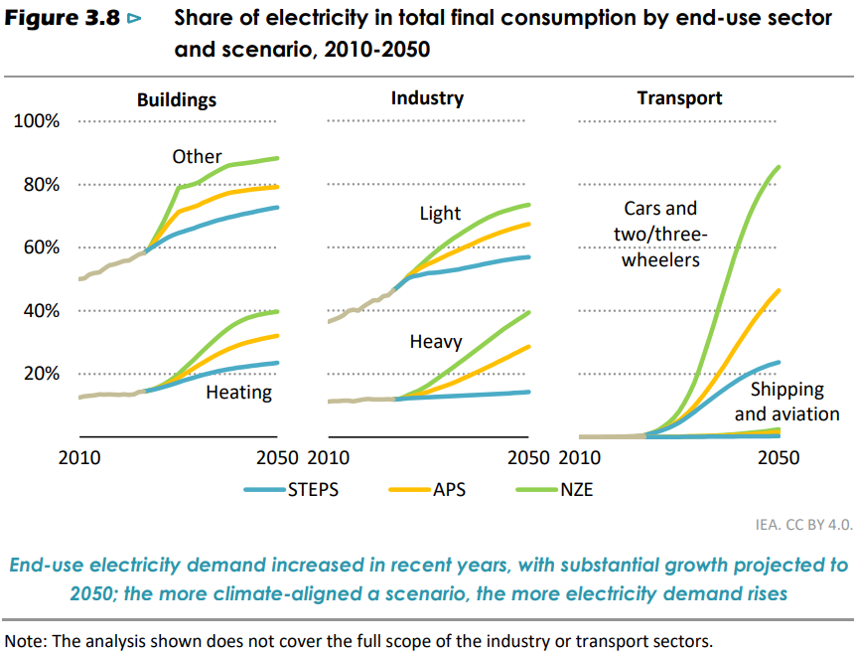

Slide 17
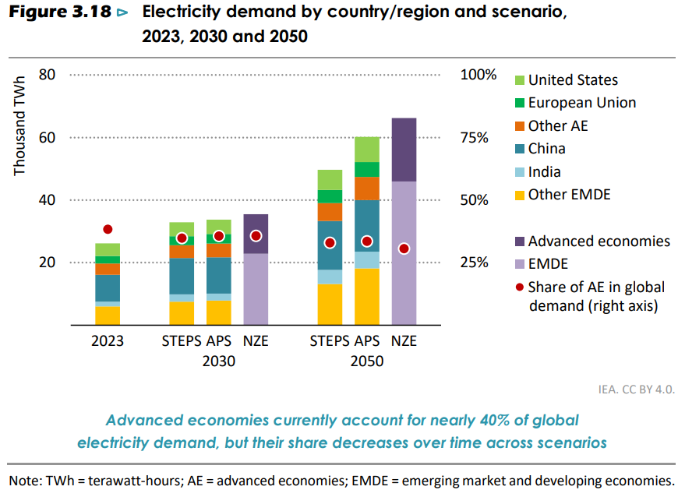
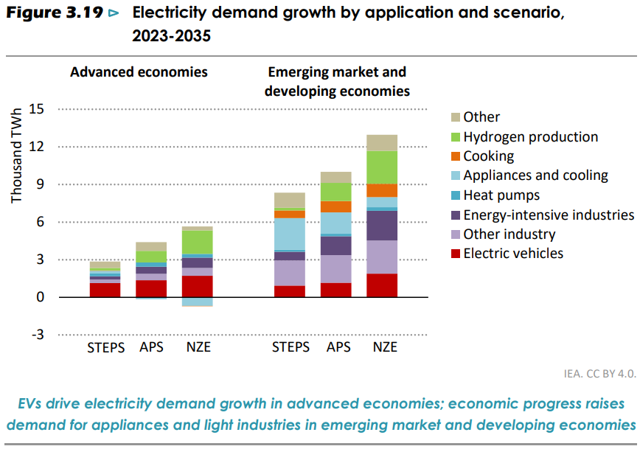

Slide 18
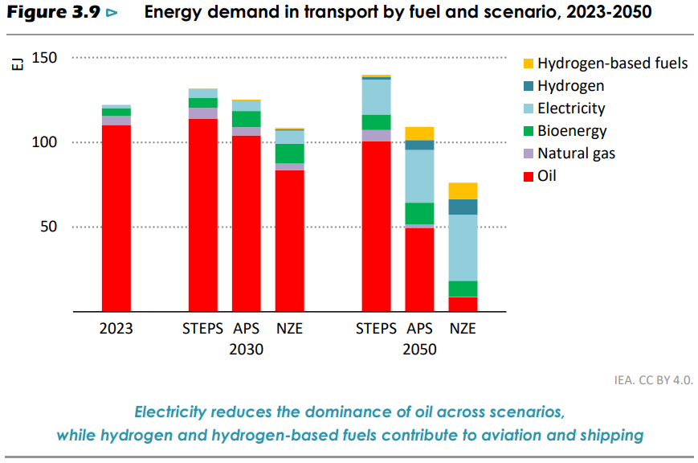
Energy in Transport

Slide 19
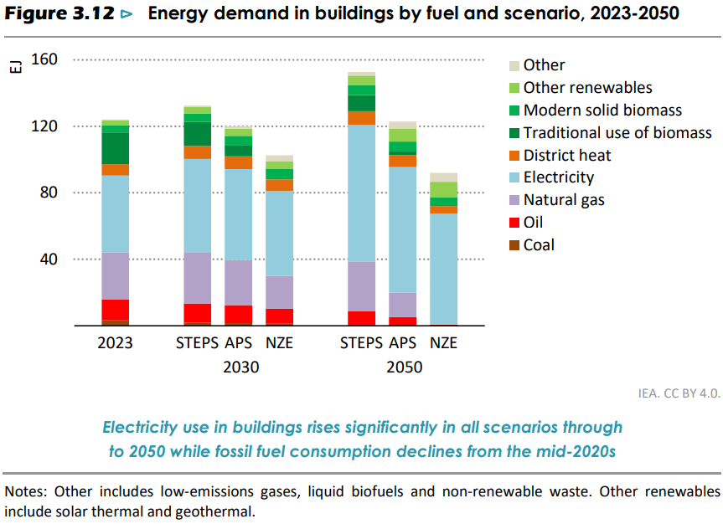
Energy in Building

Slide 20
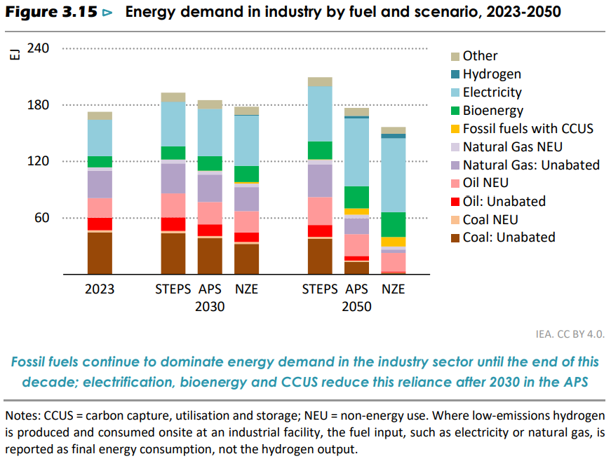
Energy in Industry

Slide 21
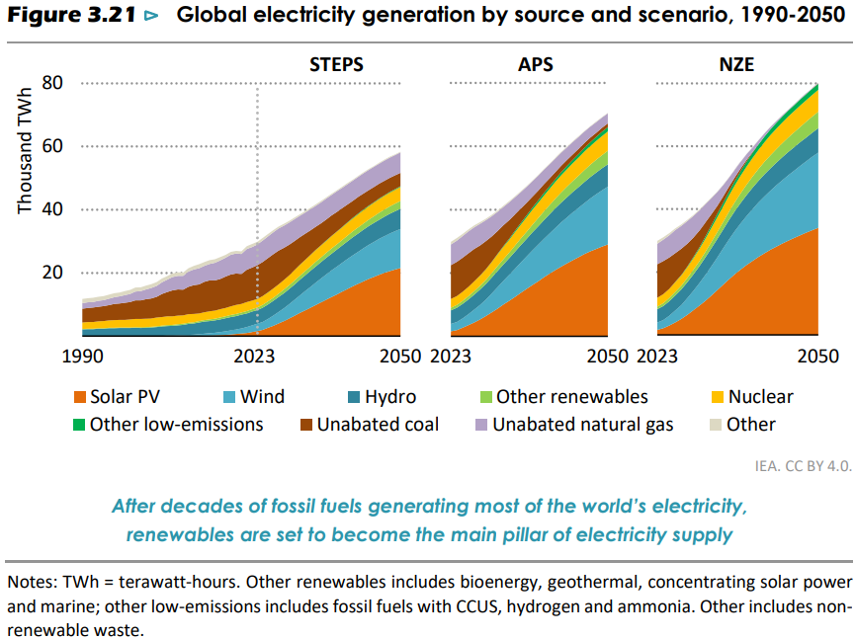
Forecast: Electricity Generation

Slide 22
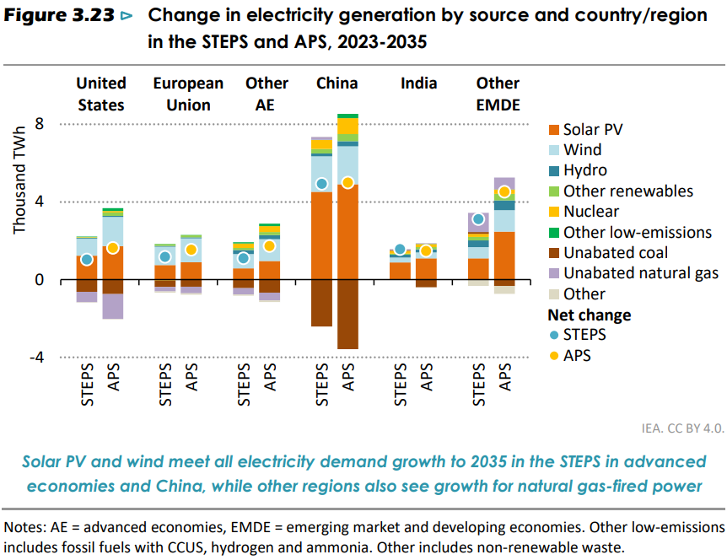
Forecast: Electricity generation

Slide 23
title

Slide 24
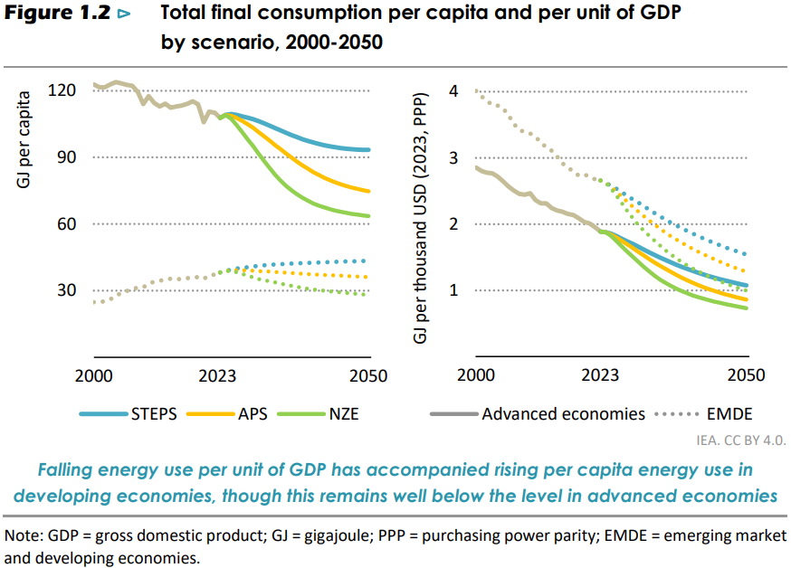
Total final consumption
Notes:
The first factor is improvements in the technical efficiency of energy use, via more efficient processes or equipment.
The second explanatory factor relates to changes in the structure of the global economy towards the provision of services, which require less energy, and away from energyintensive sectors.
The third factor, which is increasingly influential in our scenarios, relates to the effect on energy demand of introducing more renewables and more electrified end-uses into the energy system

Slide 25
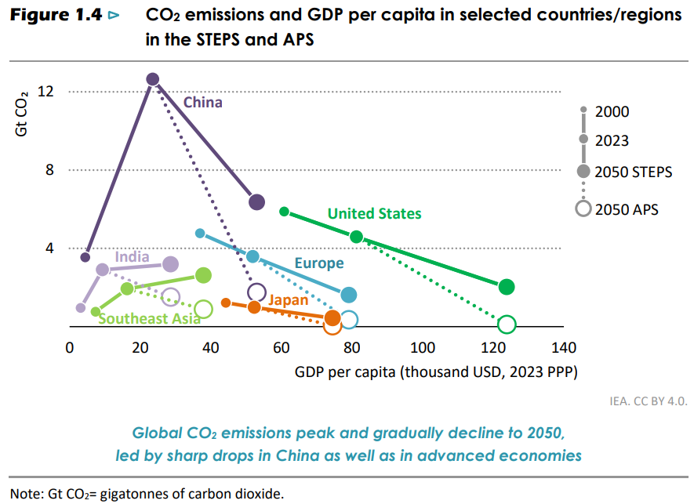
CO2 emissions reduction

Slide 26
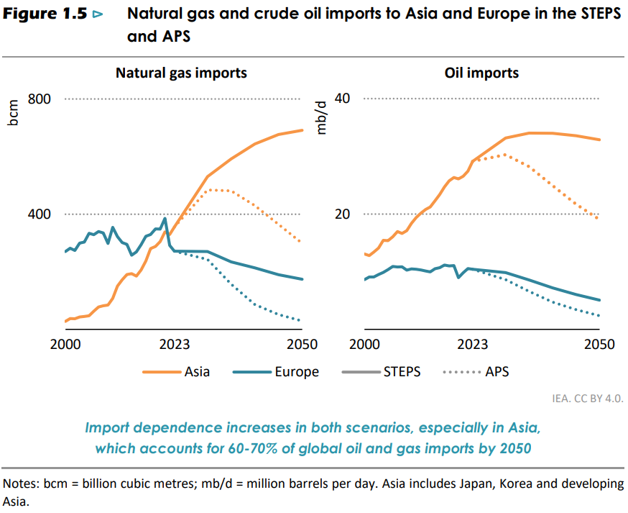
Asia and Europe: energy crisis

Slide 27
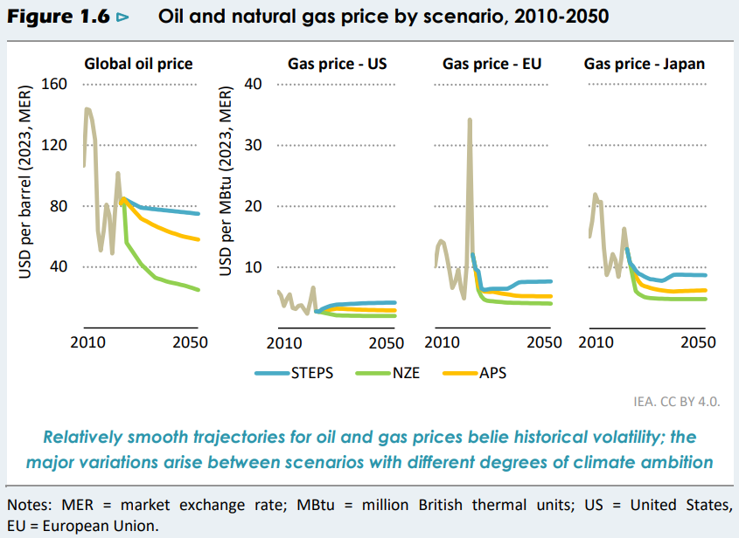
Gas prices: US way lower than EU / JP

Slide 28
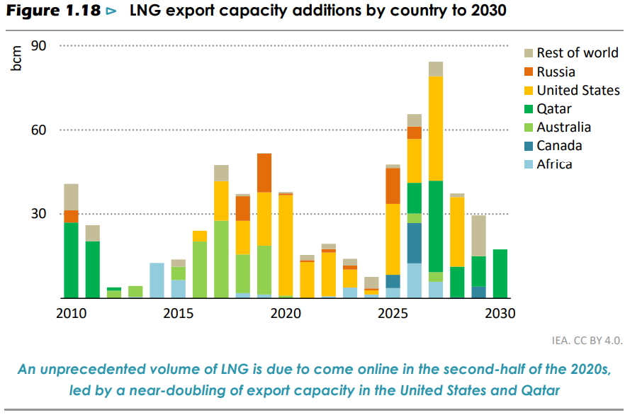
LNG Export Outlook

Slide 29
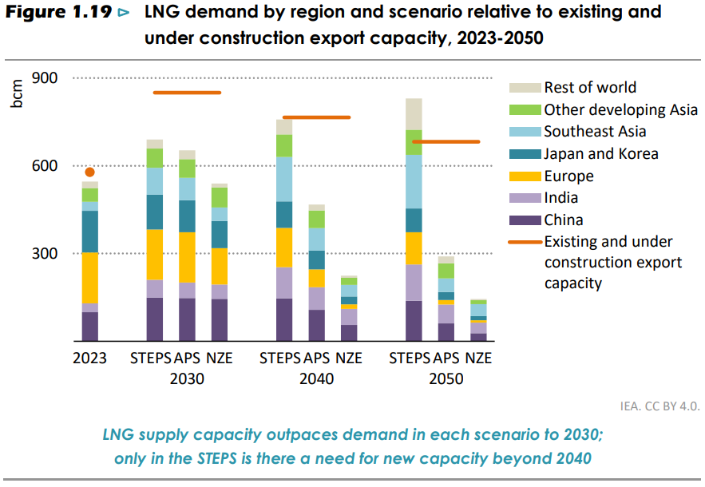
LNG over-supply
Notes:
Could natural gas demand keep growing into the 2030s and beyond?
Higher electricity demand
Higher demand in industry
Coal-to-gas switching
Wind and solar PV
Building retrofit rates
Heat pumps

Slide 30
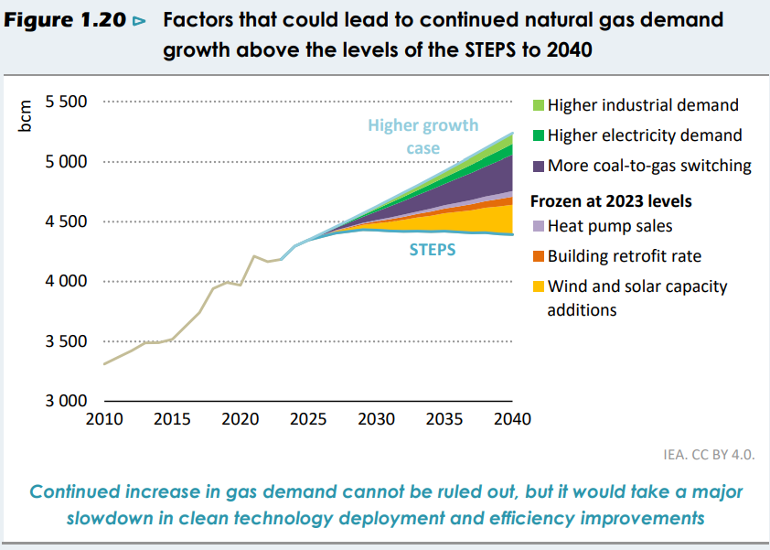
LNG still has a chance

