Slide 1
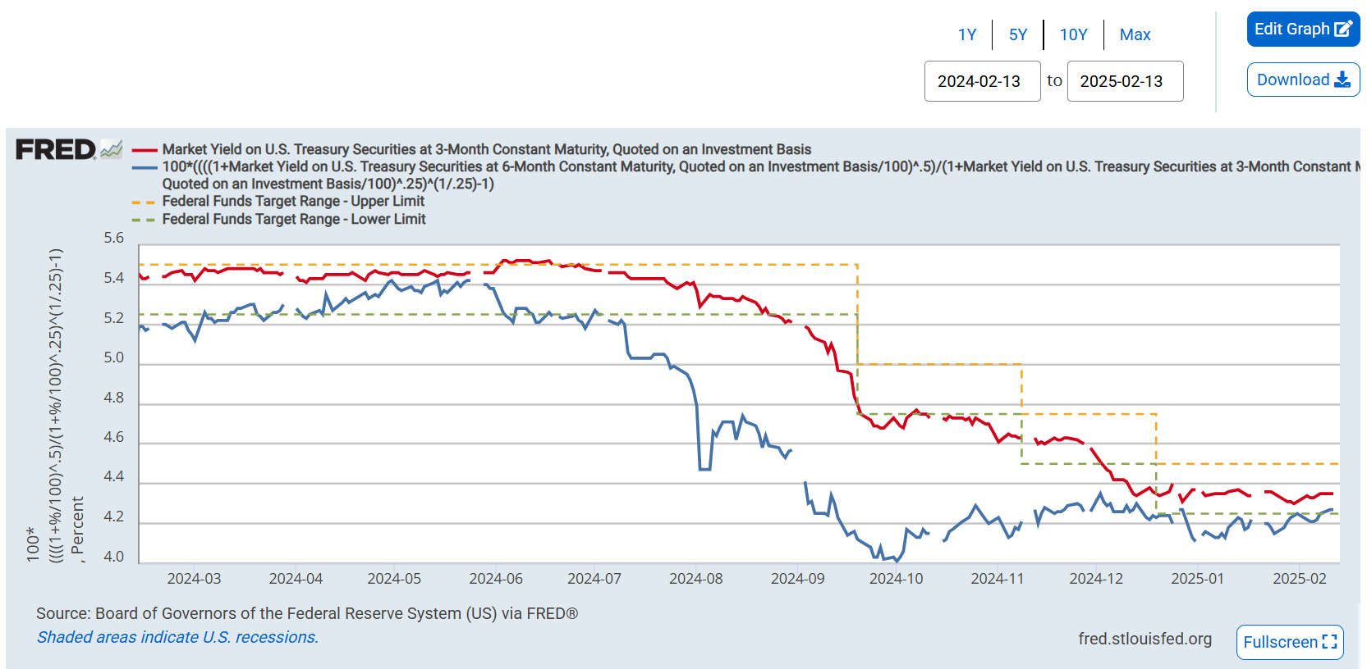
Federal Fund Rate

Slide 2
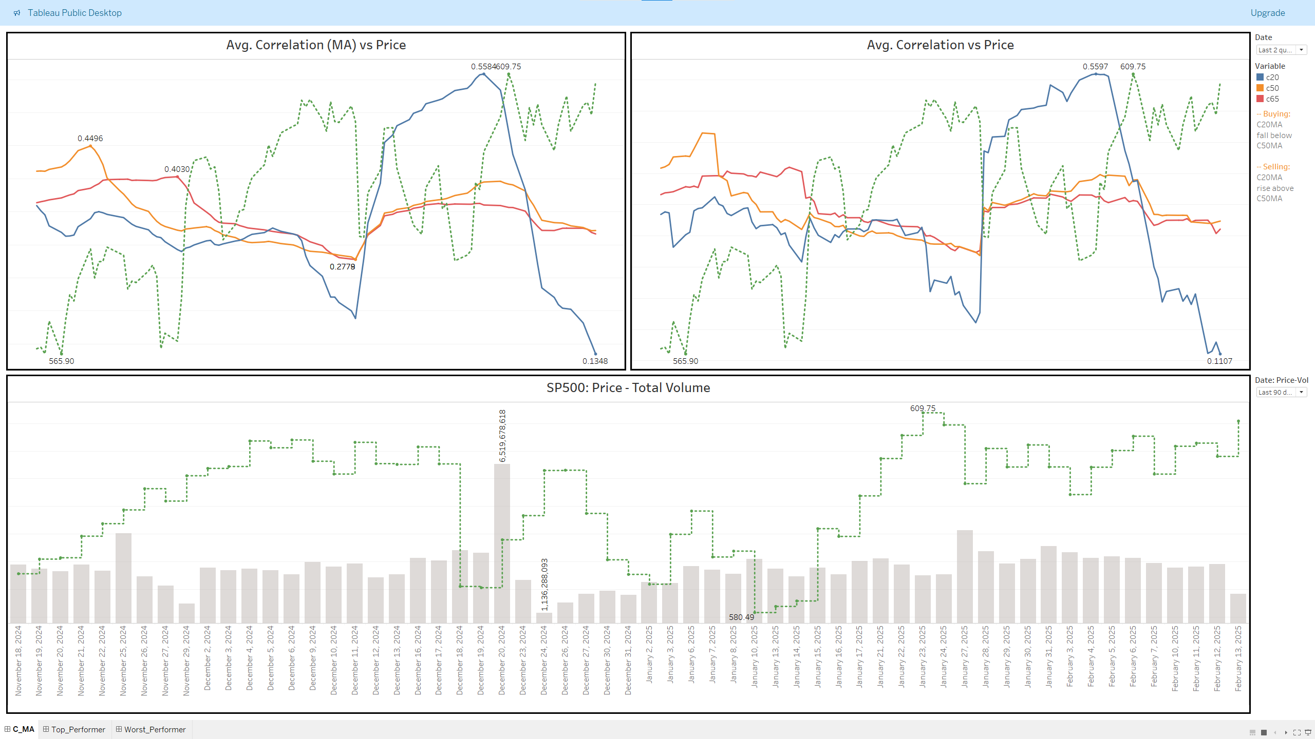
SP500 Implied Correlation

Slide 3
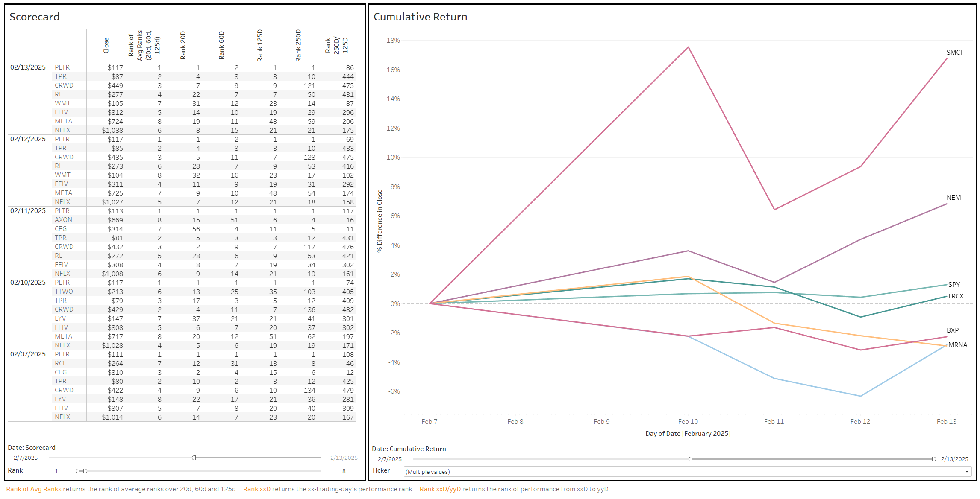
SP500 Implied Correlation - Scorecard

Slide 4
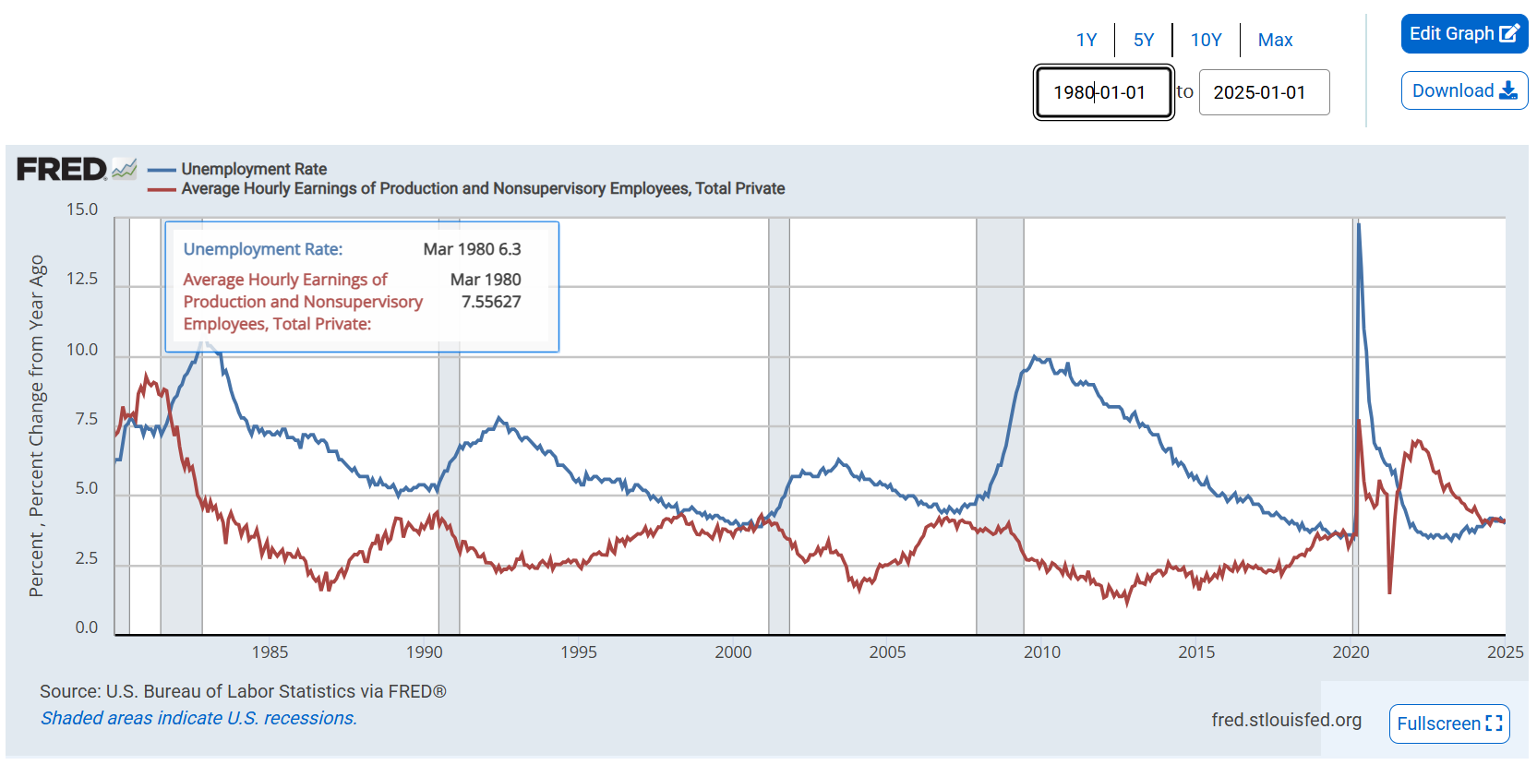
Unemployment

Slide 5
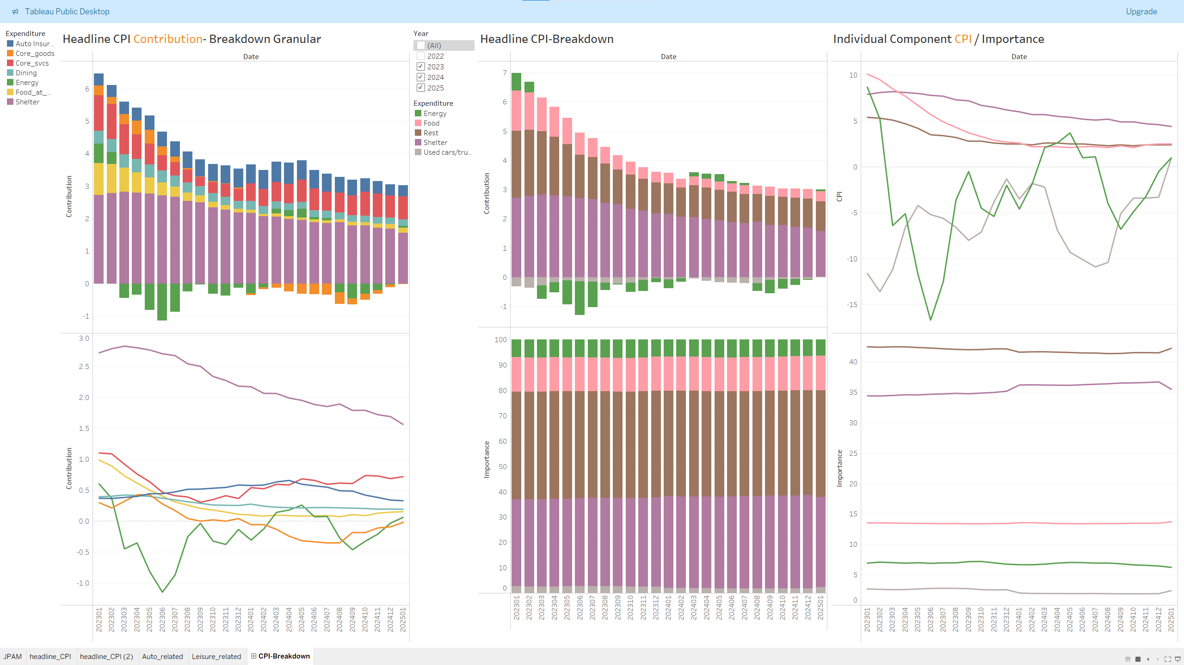
CPI De-construction – 2.13.2025

Slide 6
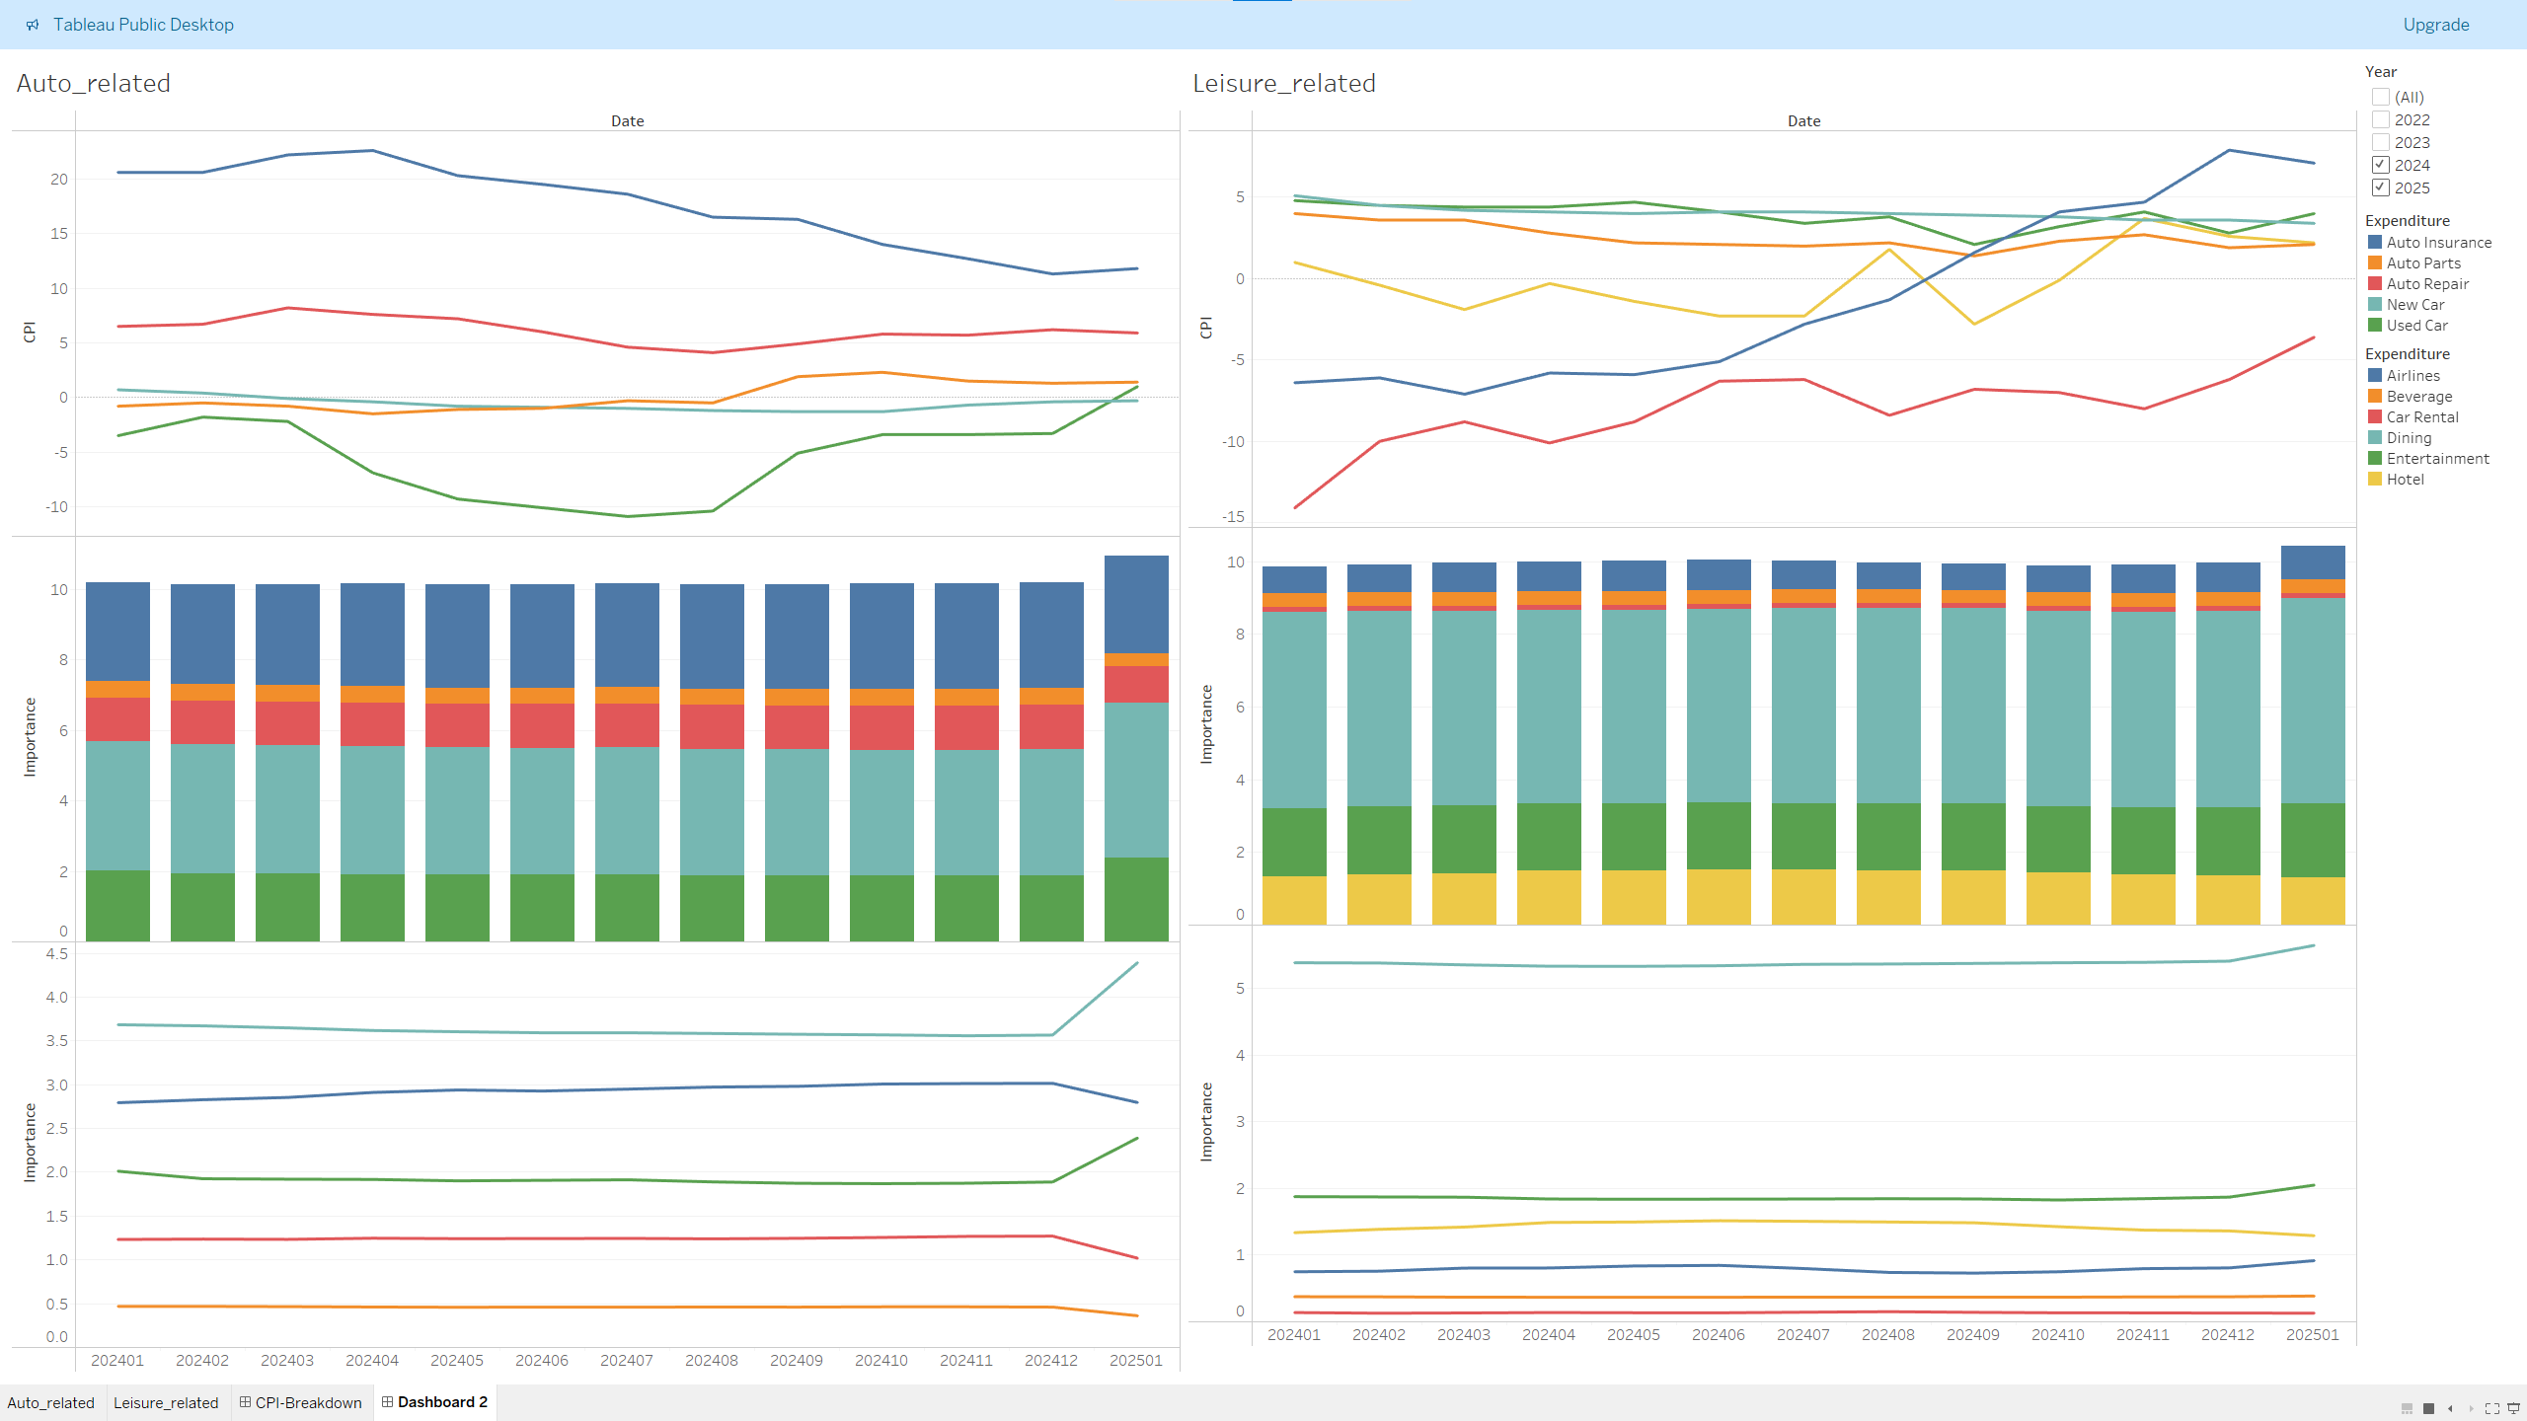
CPI De-construction: AUTO and Leisure – 2.13.2025

Slide 7
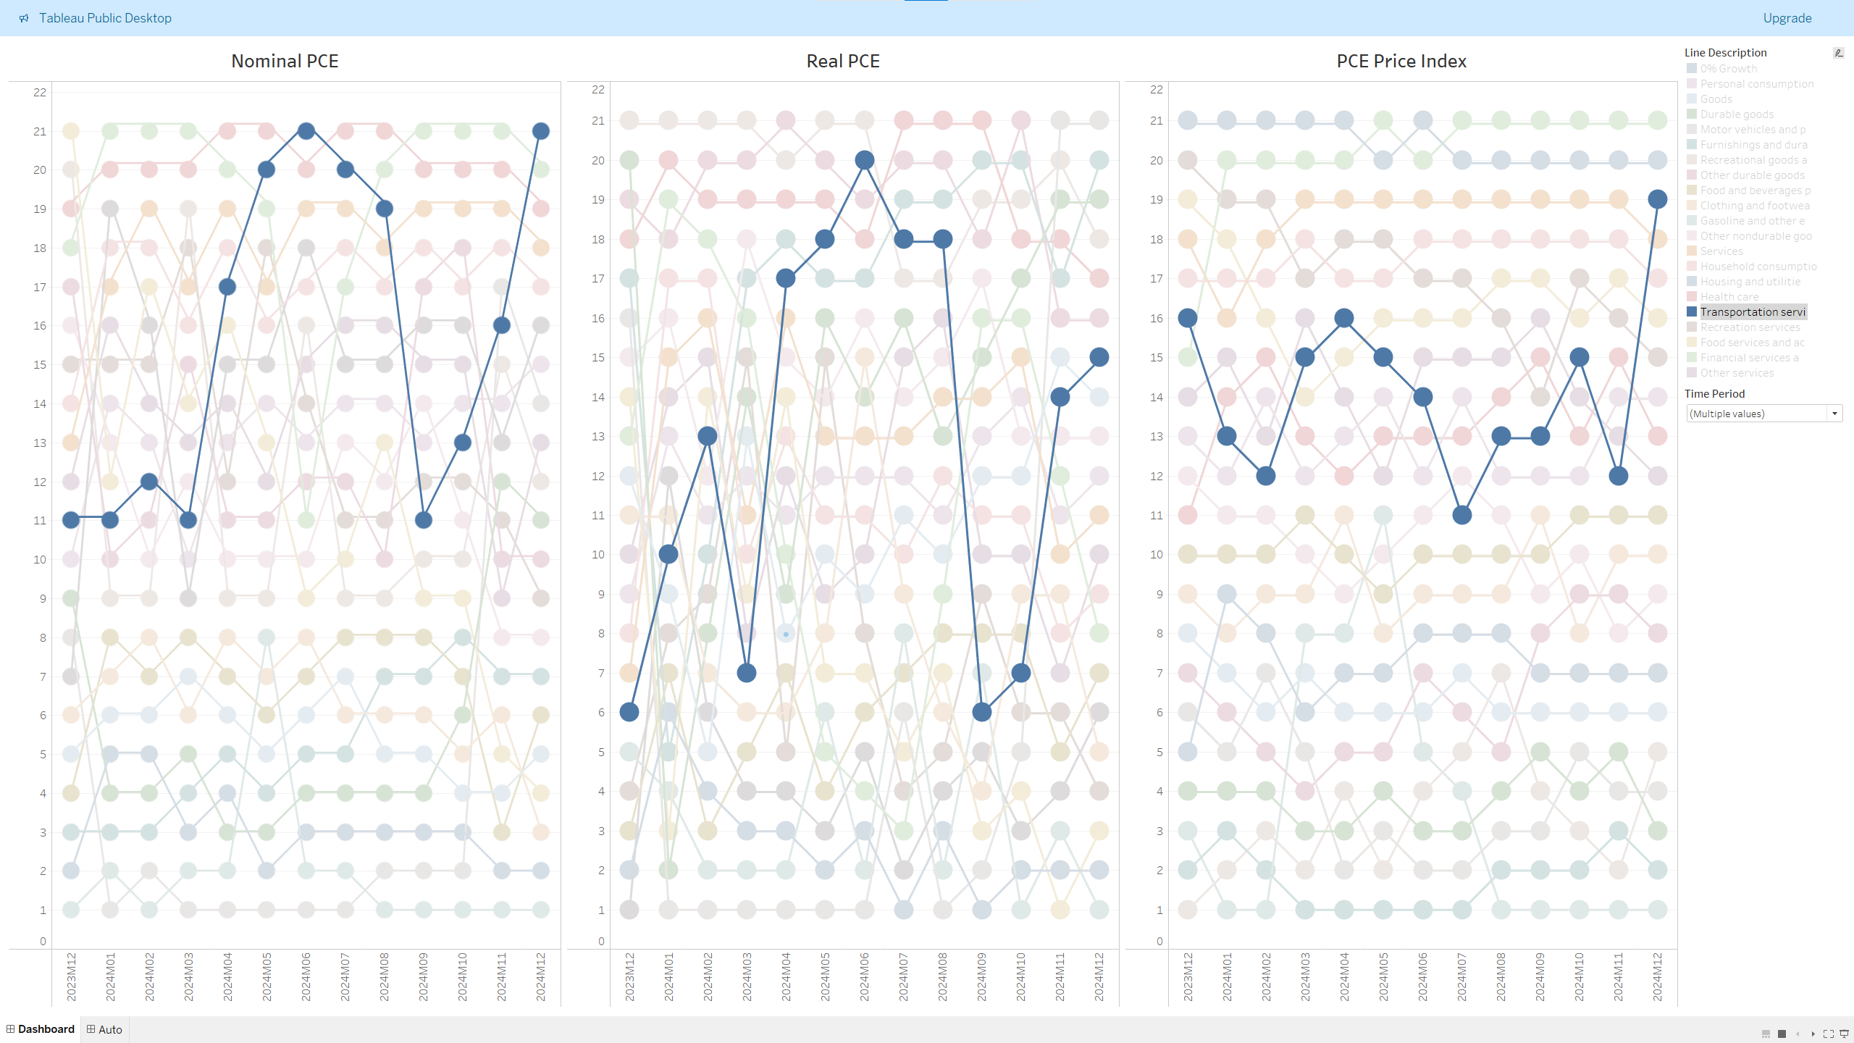
PCE De-construction – 1.31.2025

Slide 8
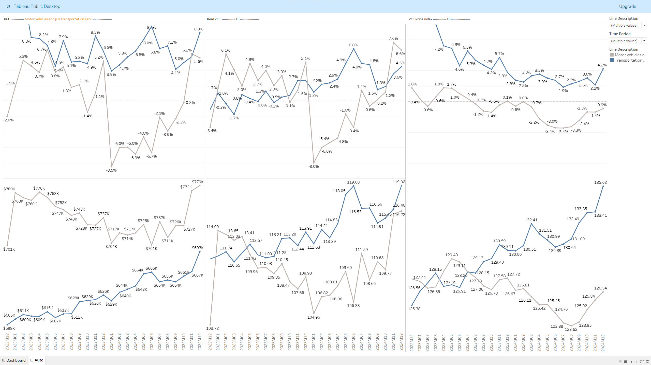
PCE Deep-Dive: Auto – 1.31.2025

Slide 9
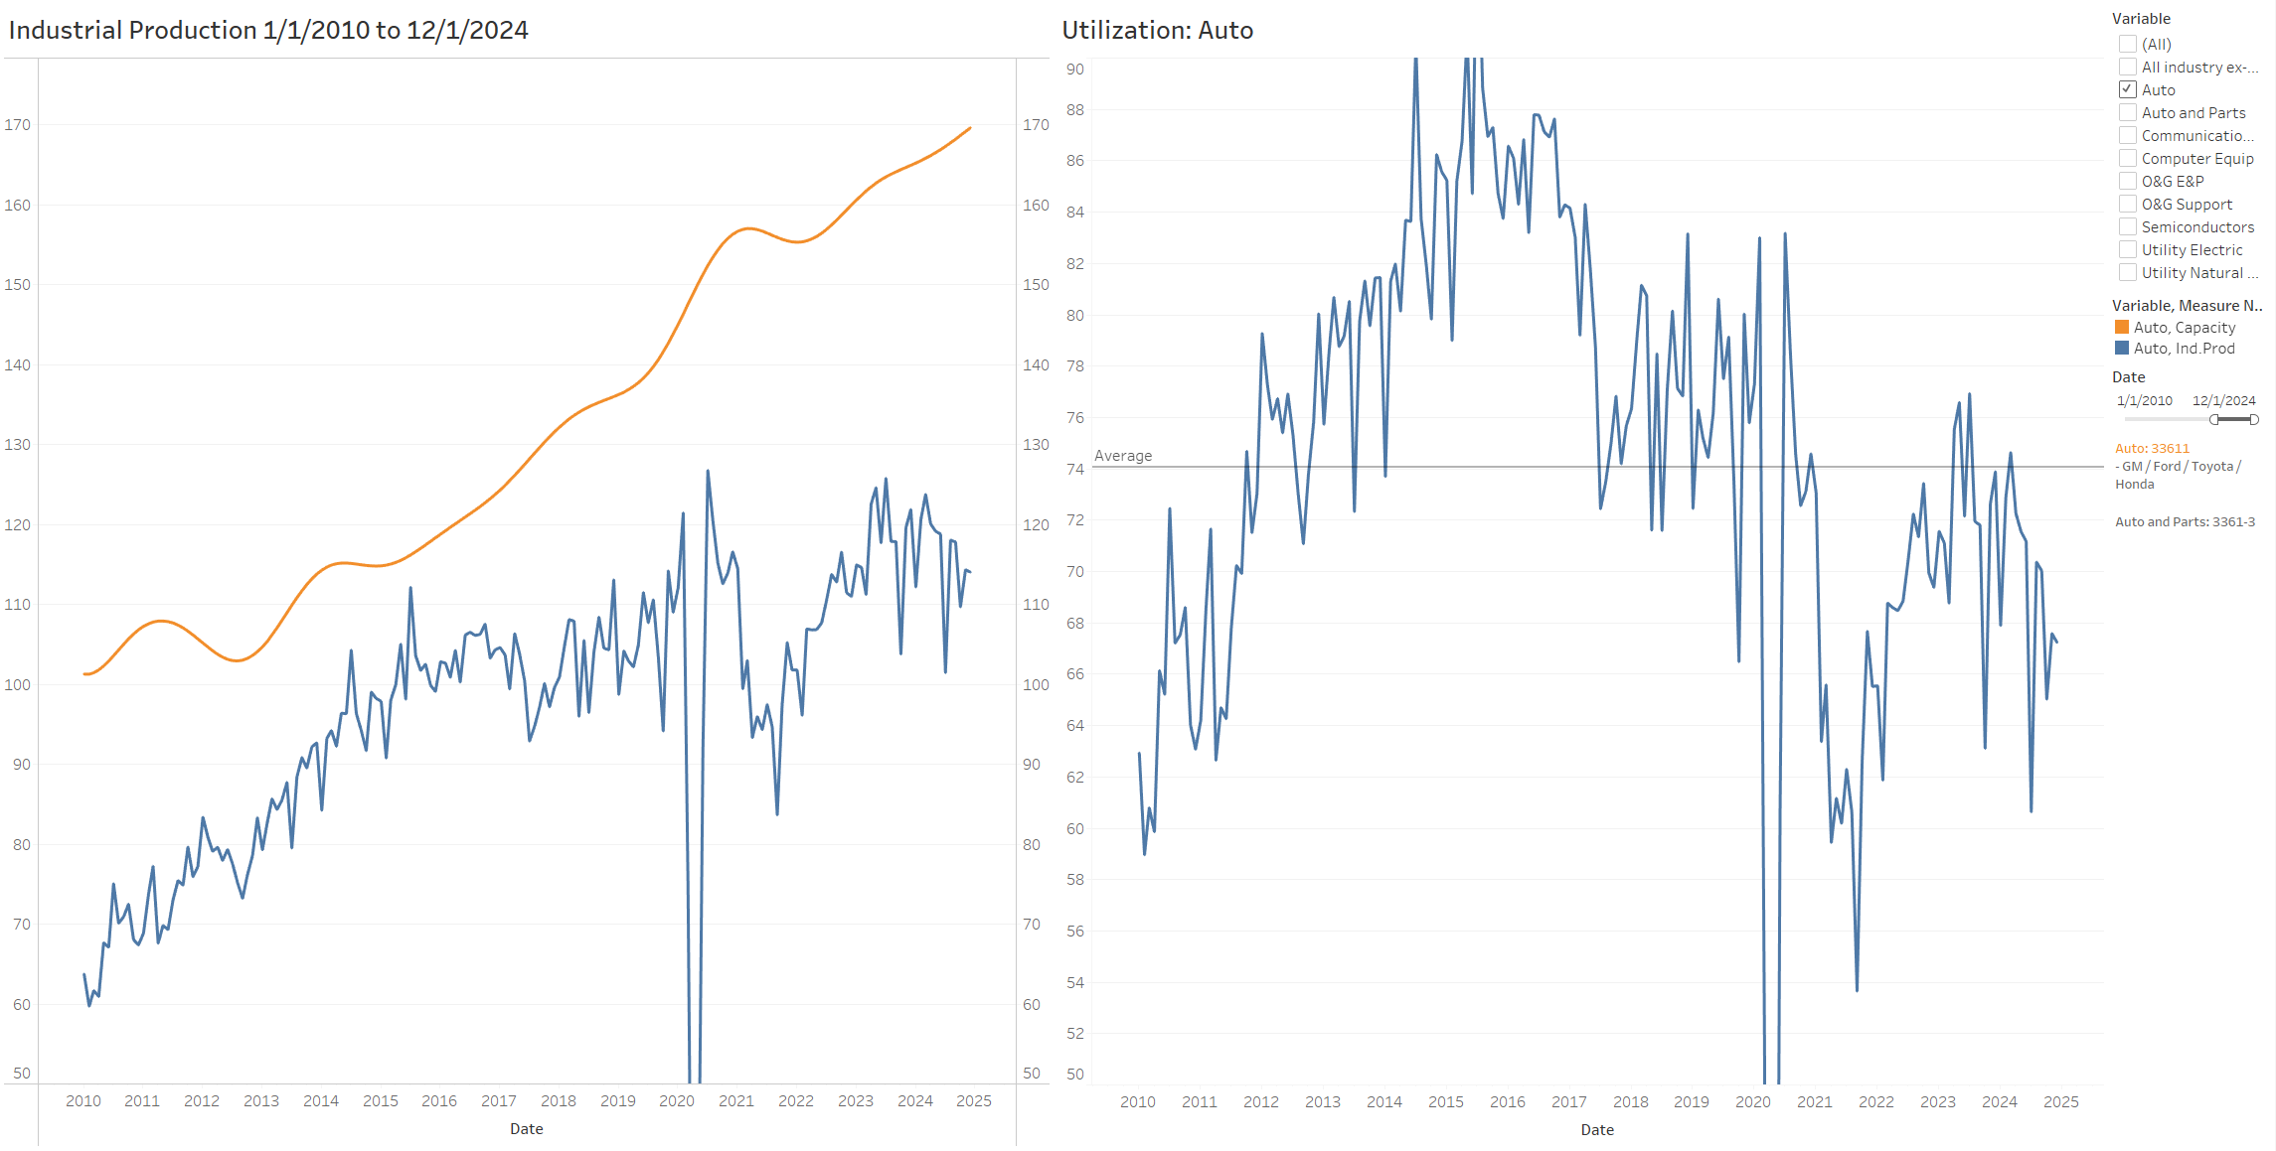
Industrial Production: Auto

Slide 10
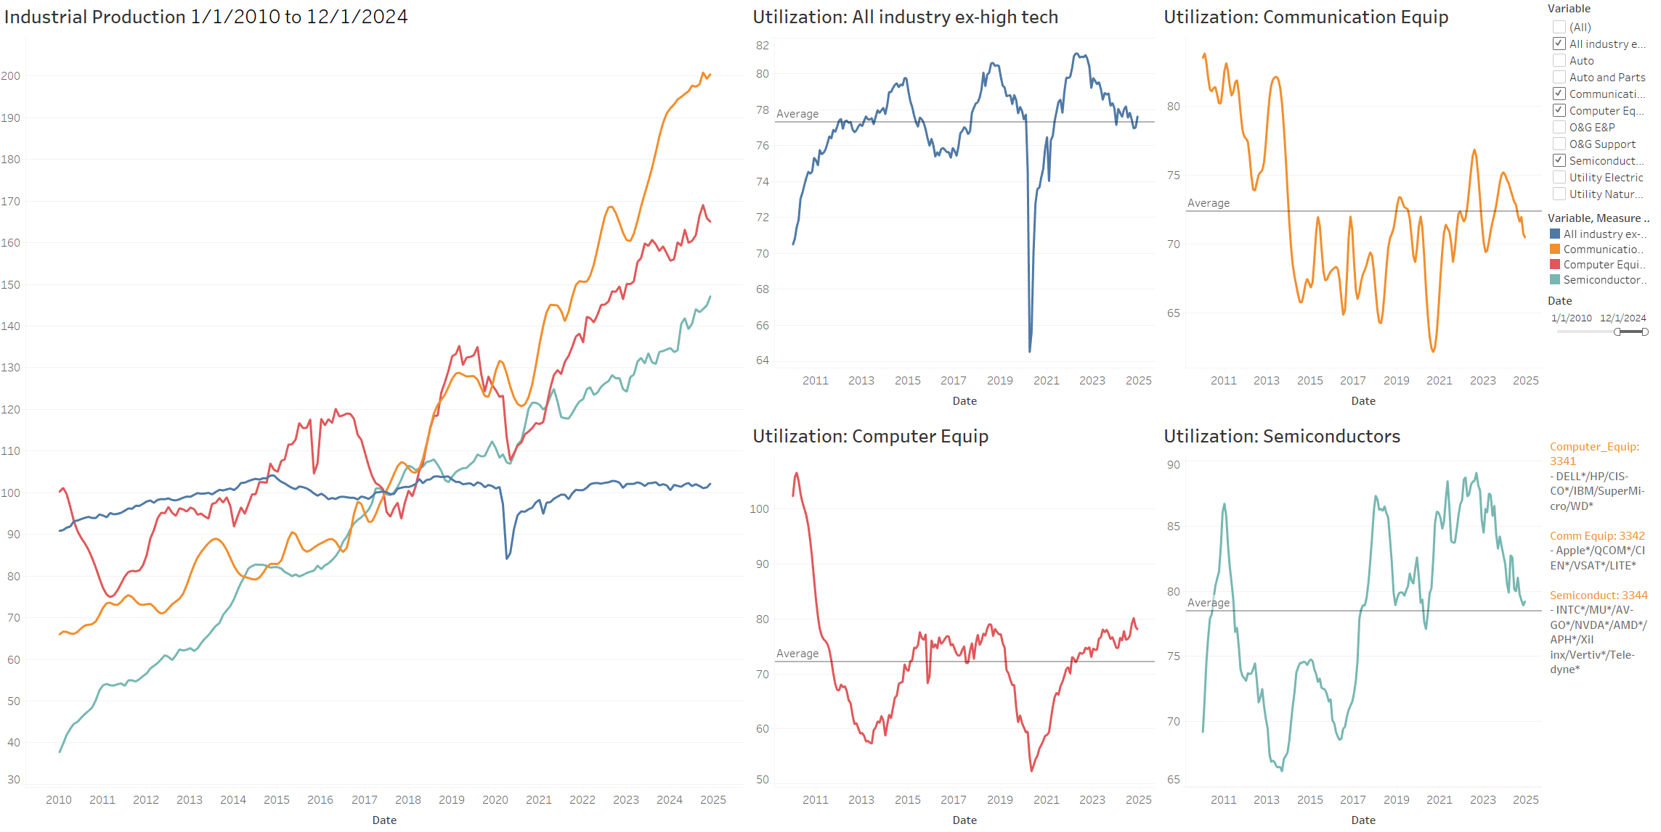
Industrial Production: High Tech (Semiconductor / Communication / Computer Equipment)

Slide 11
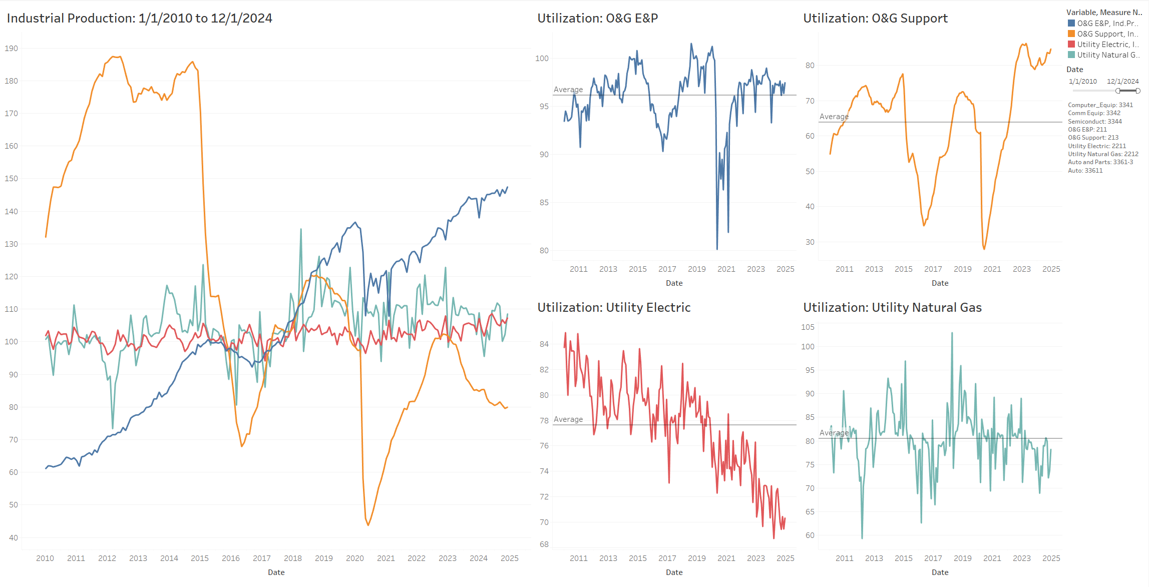
Industrial Production: Energy

Slide 12
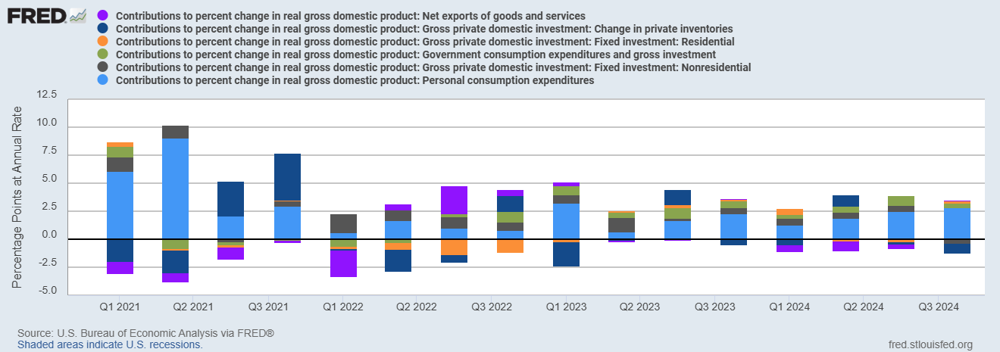
Real GDP and its components – 1.31.2025

Slide 13
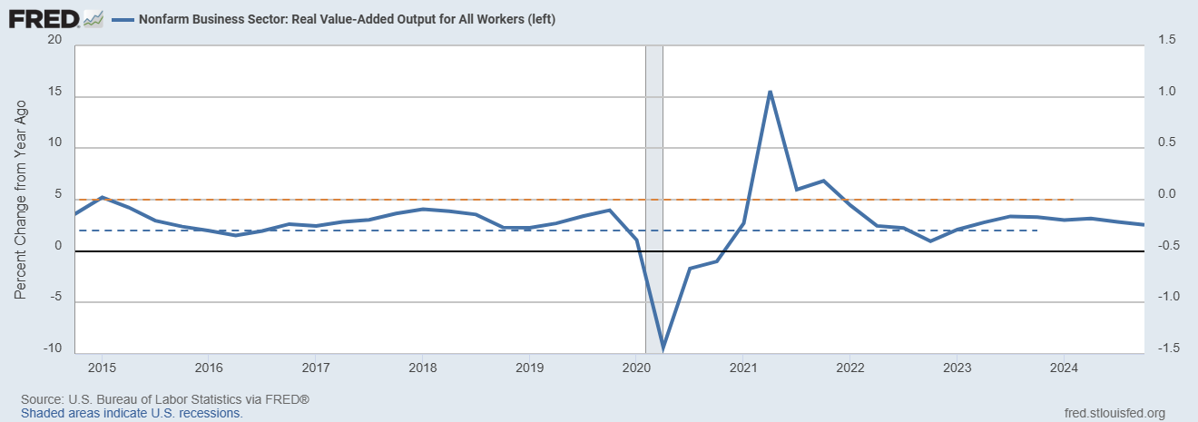
Labor Productivity – 1.31.2025

Slide 14
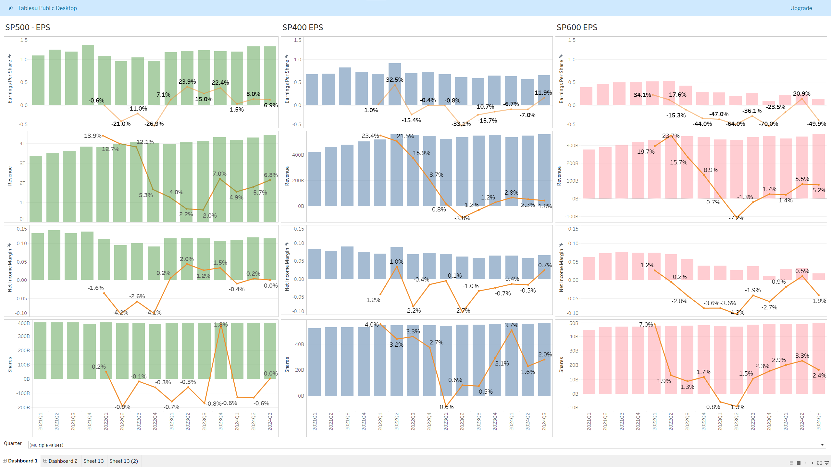
Stocks’ Earnings Breakdown

Slide 15
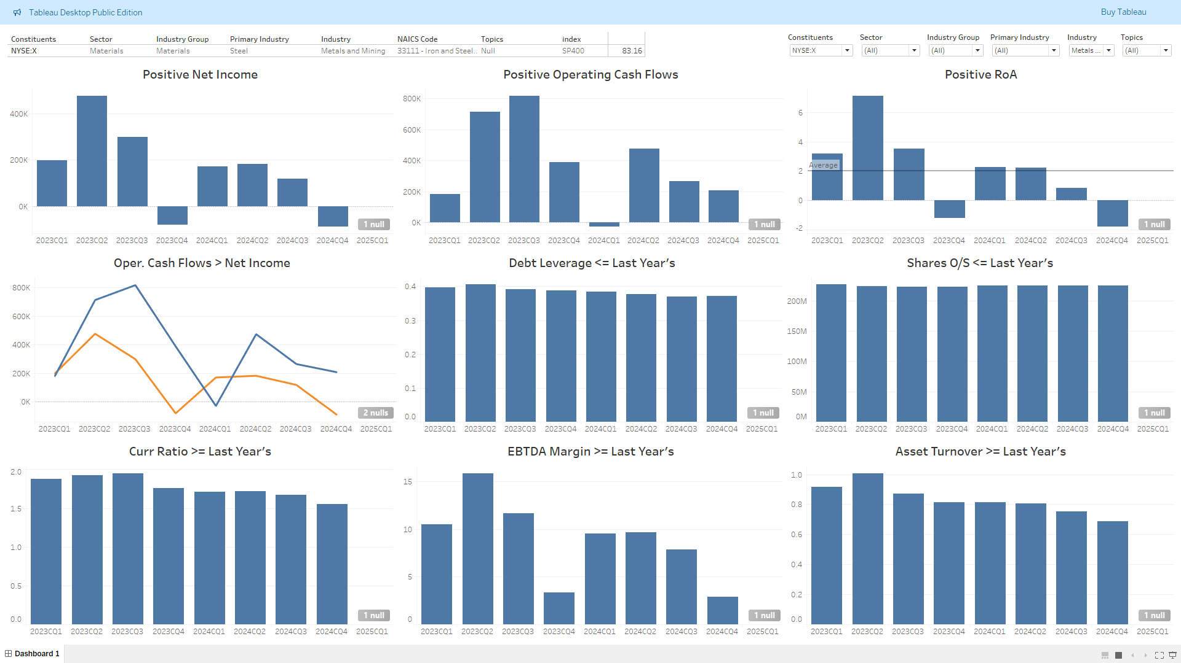
Fundamental Score

Slide 16
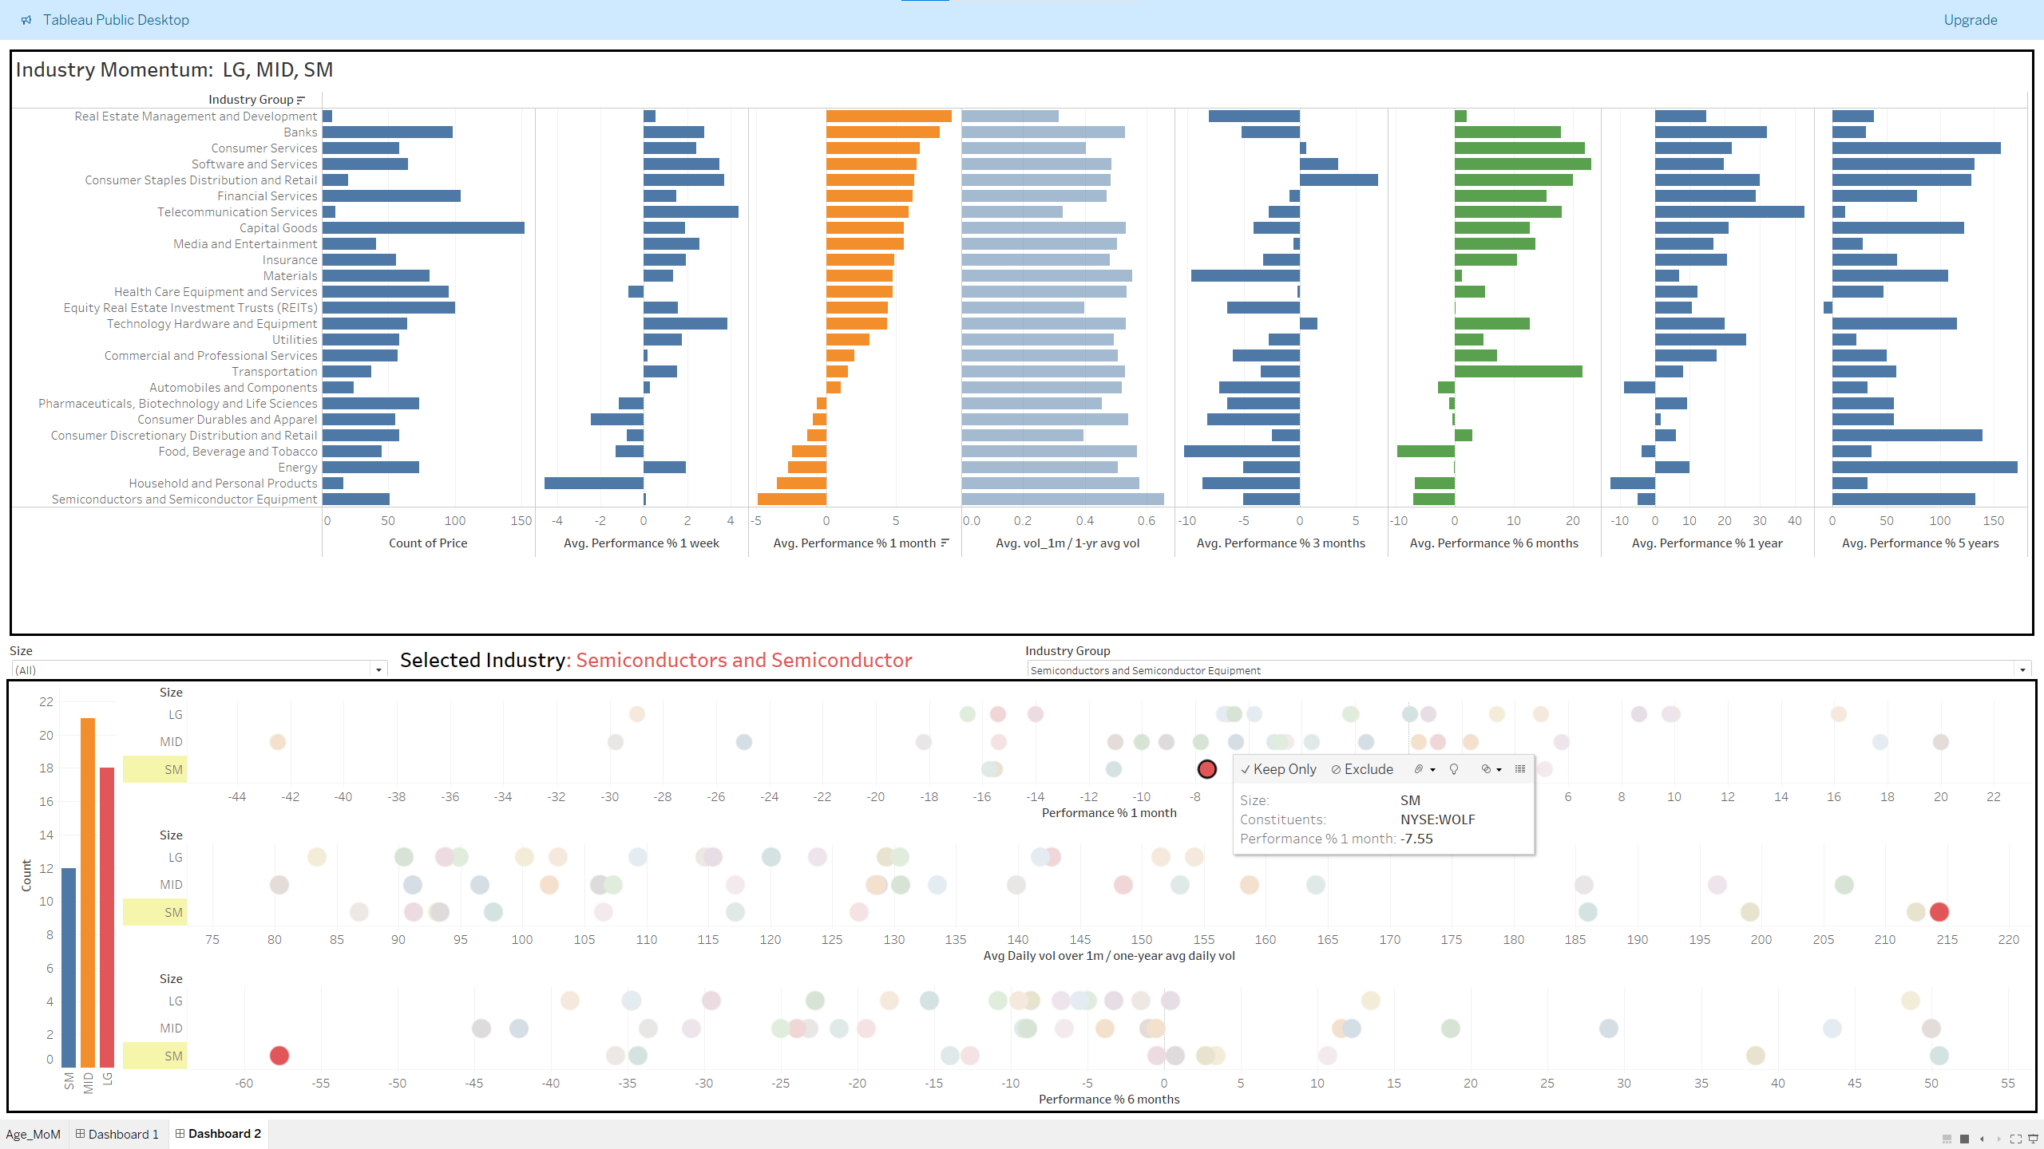
Momentum

Slide 17
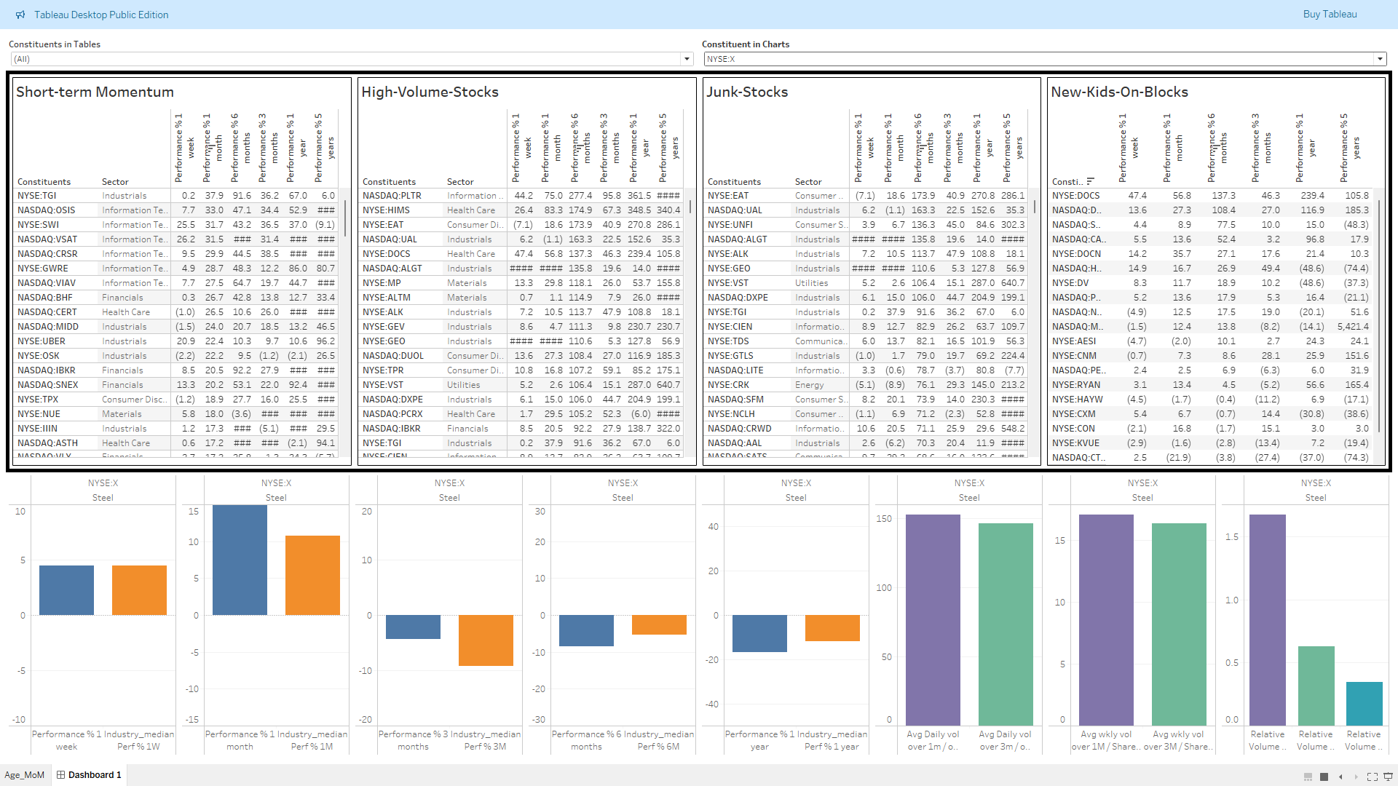
Industry Momentum

