Slide 1
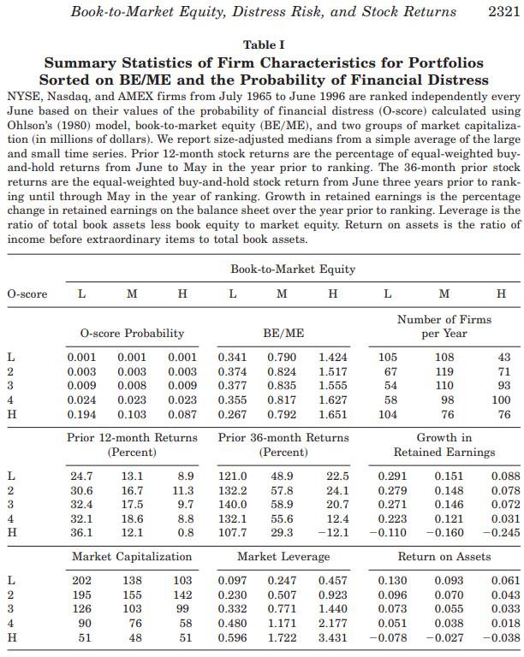
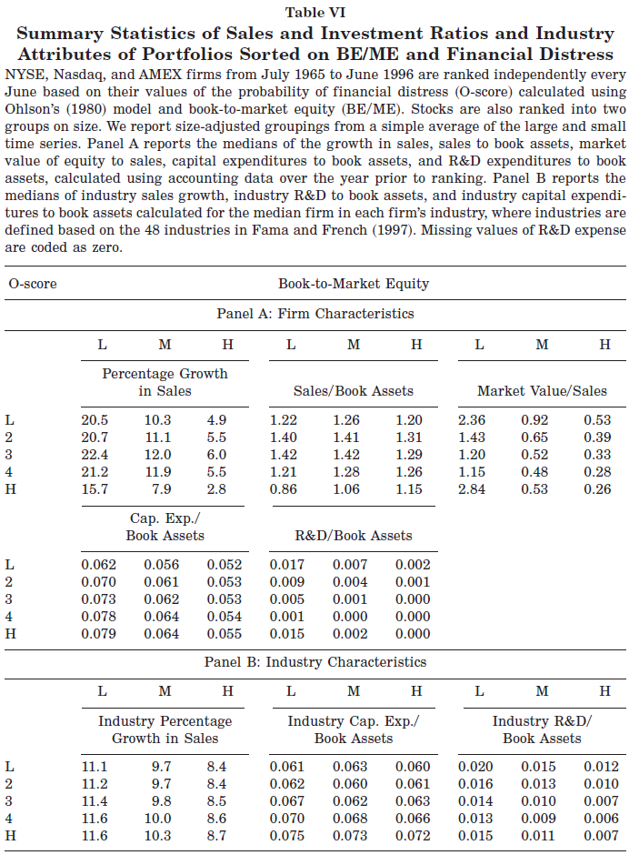
Horizontal arrow suggests the variable of interest is related to BE/ME,
Vertical arrow suggests it’s related to O-Score.
Diagonal arrow suggests it’s related to both BE/ME and O-score.
O-score was not differentiated by BEME
Notes:
Book‐to‐market equity, distress risk, and stock returns
JM Griffin, ML Lemmon
The Journal of Finance, 2002•Wiley Online Library
BQR-like PD: Ohlson’s O-score using accounting items from balance sheet and income statement.
https://en.wikipedia.org/wiki/Ohlson_O-score
Key takeaways 2002: The firms would underperform if they are growth-firms and have high PD.

Slide 2
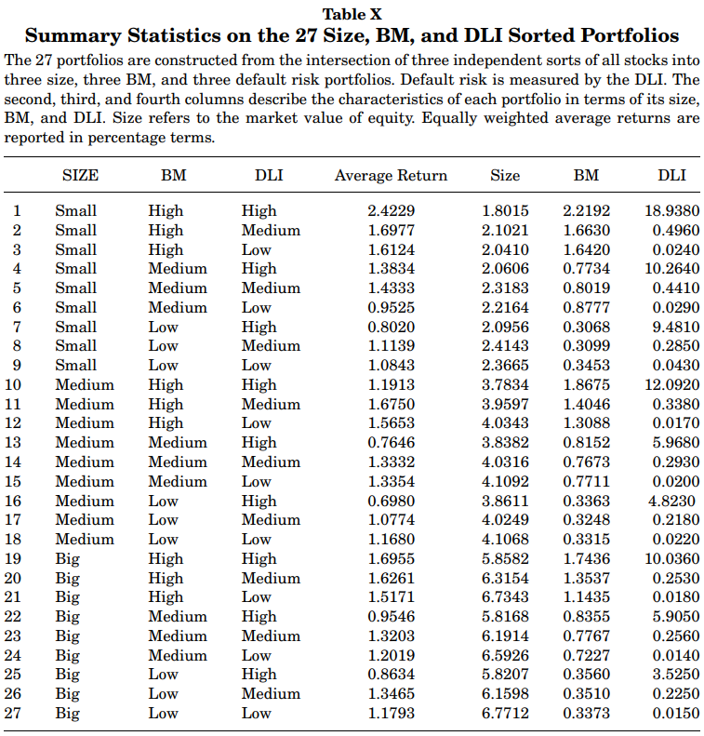
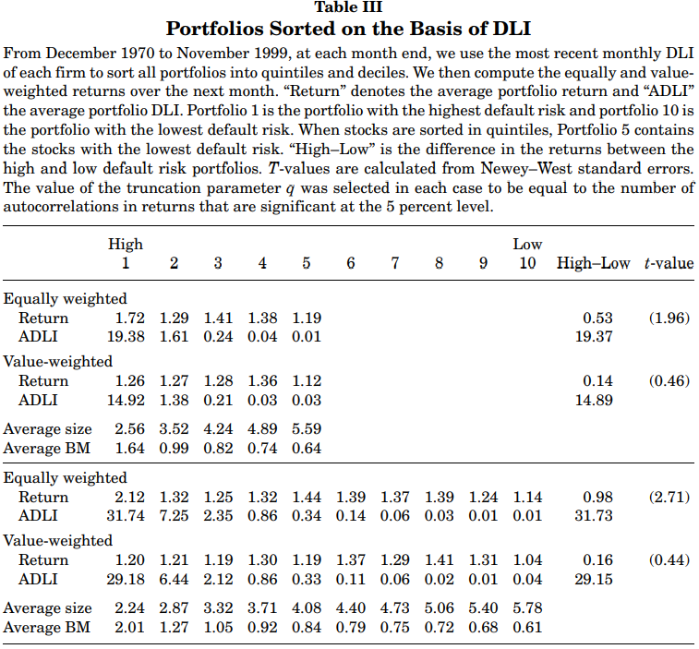
Notes:
Default risk in equity returns
M Vassalou, Y Xing -
The journal of finance, 2004 - Wiley Online Library
EDF-like PD: distance to default (DD), based on the call-put option using market + accounting data.
Key takeaways 2004: The firms would overperform if they are small in size, and value-firms (high BEME) and high PD.
Key takeaways 2002: The firms would underperform if they are growth-firms and have high PD.

Slide 3
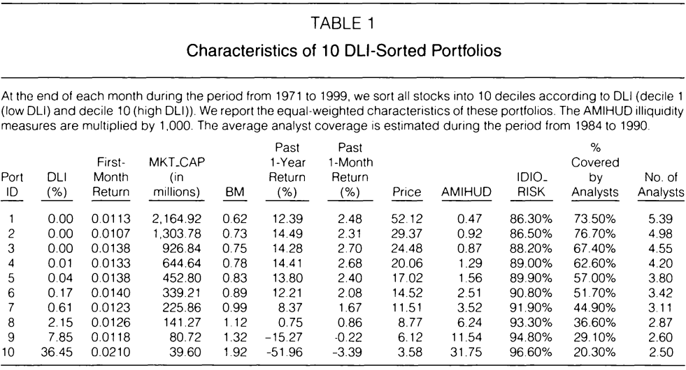









The abnormal return on high default risk stocks occurs only in the first month after portfolio formation and is concentrated in a small subset of high default risk stocks that recently experienced a large negative return (high PD and worst performers. Such compensation for high risk disappeared in the second month.
Small in size & value firms
ST reversal & illiquid stocks & Low coverage
Notes:
Default risk in equity returns
M Vassalou, Y Xing -
The journal of finance, 2004 - Wiley Online Library
EDF-like PD: distance to default (DD), based on the call-put option using market + accounting data.
Clientele change, liquidity shock, and the return on financially distressed stocks
Z Da, P Gao -
Journal of Financial and Quantitative Analysis, 2010 - cambridge.org
A challenge to Vassalou/Xing (2004)
Key takeaways 2004: The firms would overperform if they are small in size, and value-firms (high BEME) and high PD.
Da & Gao (2010) found the overperform of these firms was driven by short-term reversal.
Key takeaways 2002: The firms would underperform if they are growth-firms and have high PD.

Slide 4
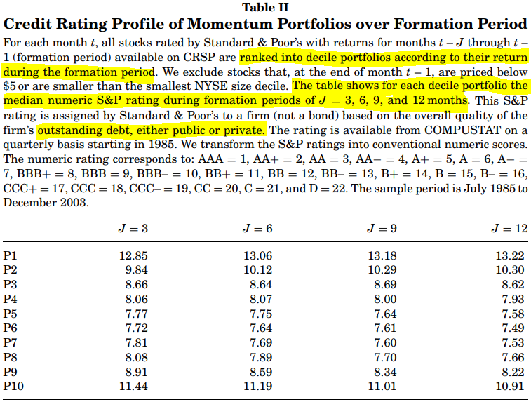
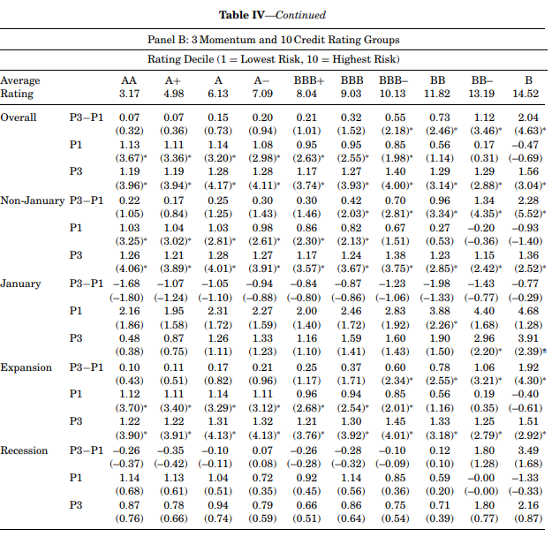
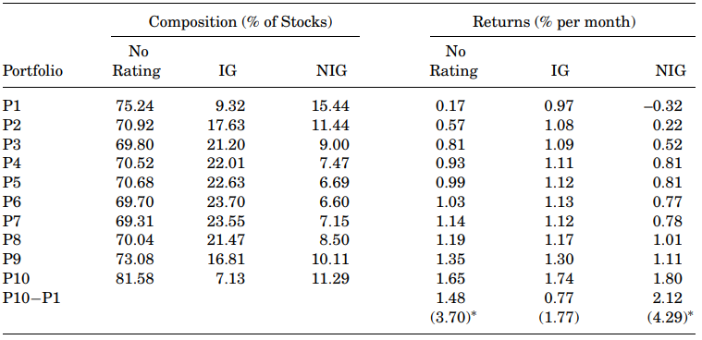
Extreme Losers
This suggests that the momentum strategy of buying previous losers and selling previous winners essentially takes long and short positions in firms with the highest credit risk.
Extreme Winner
The MoM payoff exists but differentiates across credit groups (No Rating, IG, and nonIG). It is particular prevalent in high PD.
MoM contradicts in January.
NBER definition
Notes:
Momentum and credit rating
D Avramov, T Chordia, G Jostova… -
The journal of finance, 2007 - Wiley Online Library
S&P issuer rating mapped to ordinal PD grid
Key takeaways 2007: The firms would overperform if they exhibit momentum and high PD. // Don’t buy firms with high PD and worst performing in past 6 month.
Key takeaways 2004: The firms would overperform if they are small in size, and value-firms (high BEME) and high PD.
Da & Gao (2010) found the overperform of these firms was driven by short-term reversal.
Key takeaways 2002: The firms would underperform if they are growth-firms and have high PD.

Slide 5
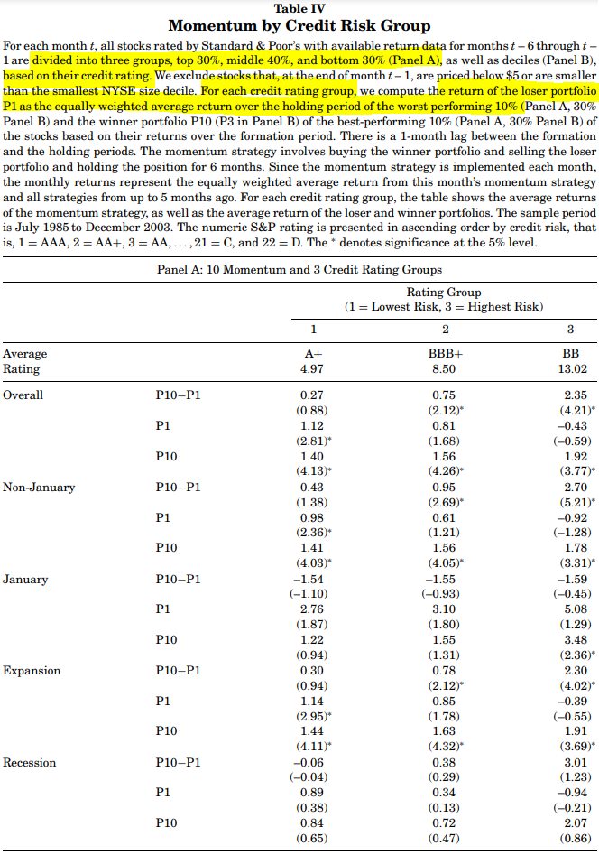
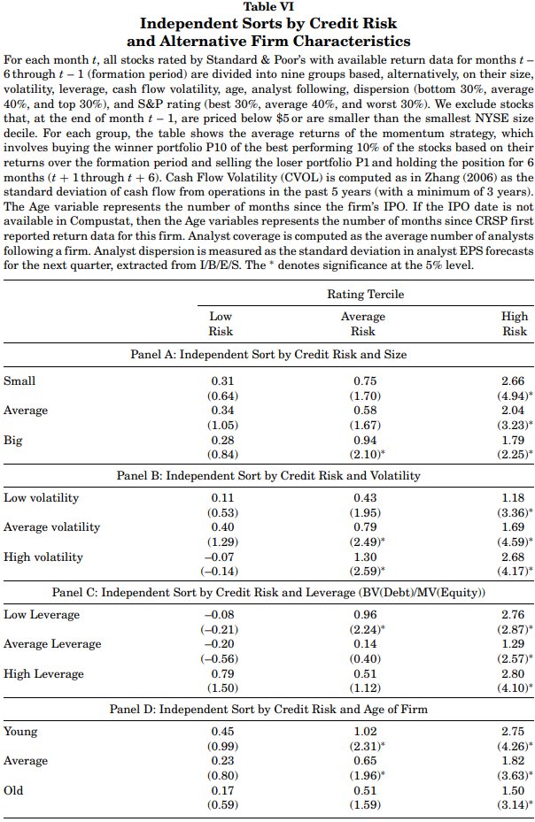
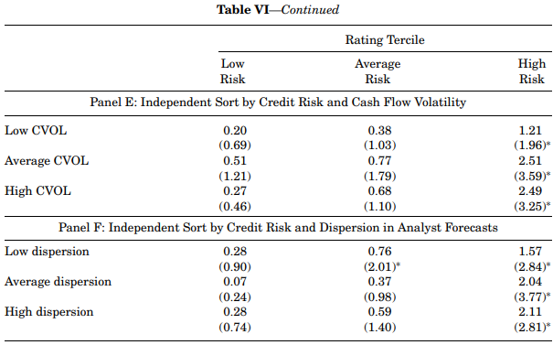
Notes:
Momentum and credit rating
D Avramov, T Chordia, G Jostova… -
The journal of finance, 2007 - Wiley Online Library
S&P issuer rating mapped to ordinal PD grid
;
Key takeaways 2007: The firms would overperform if they exhibit momentum and high PD. // Don’t buy firms with high PD and worst performing in past 6 month.
Key takeaways 2004: The firms would overperform if they are small in size, and value-firms (high BEME) and high PD.
Da & Gao (2010) found the overperform of these firms was driven by short-term reversal.
Key takeaways 2002: The firms would underperform if they are growth-firms and have high PD.

Slide 6
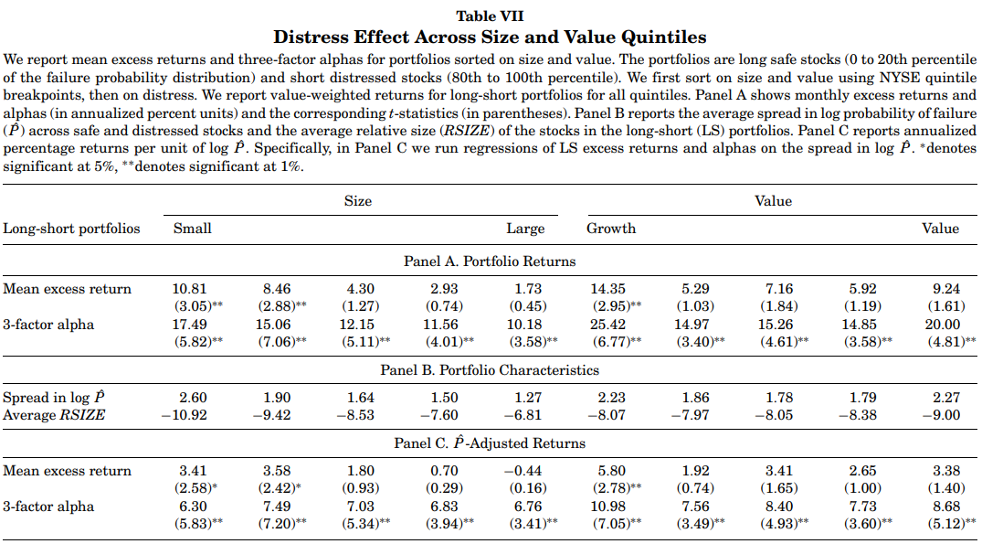
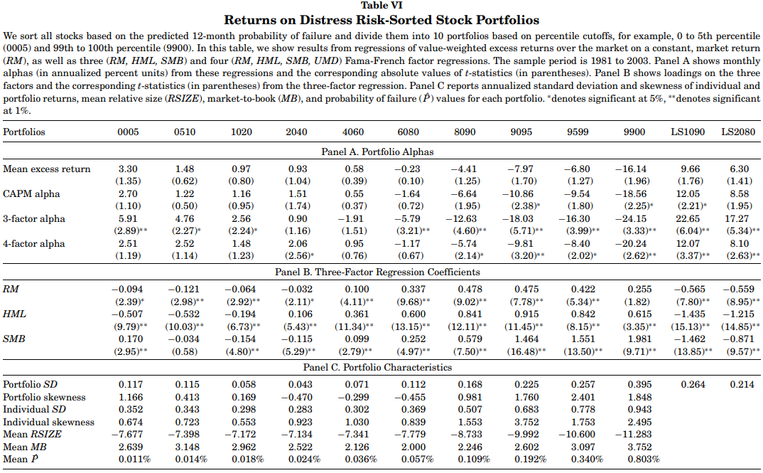
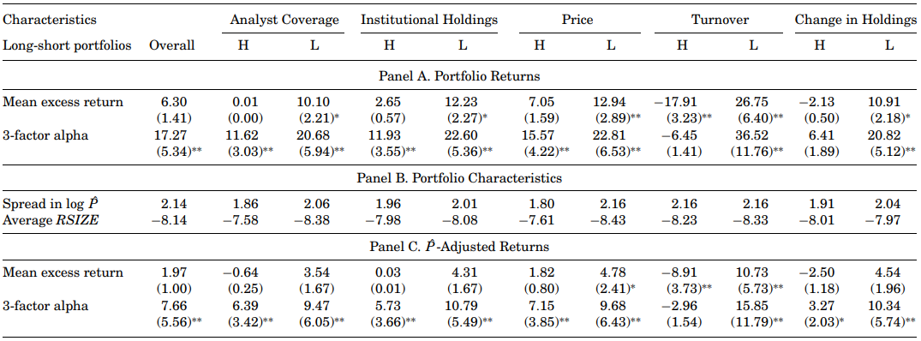
Annualized return
Notes:
In search of distress risk
JY Campbell, J Hilscher, J Szilagyi -
The Journal of finance, 2008 - Wiley Online Library
Logit PD model based on accounting and market data.
Key takeaways 2008-1: The low-PD firms would overperform if they’re small, growth, low analyst coverage, low institutional holding, and illiquid.
Key takeaways 2007: The firms would overperform if they exhibit momentum and high PD. // Don’t buy firms with high PD and worst performing in past 6 month.
Key takeaways 2004: The firms would overperform if they are small in size, and value-firms (high BEME) and high PD.
Da & Gao (2010) found the overperform of these firms was driven by short-term reversal.
Key takeaways 2002: The firms would underperform if they are growth-firms and have high PD.

Slide 7
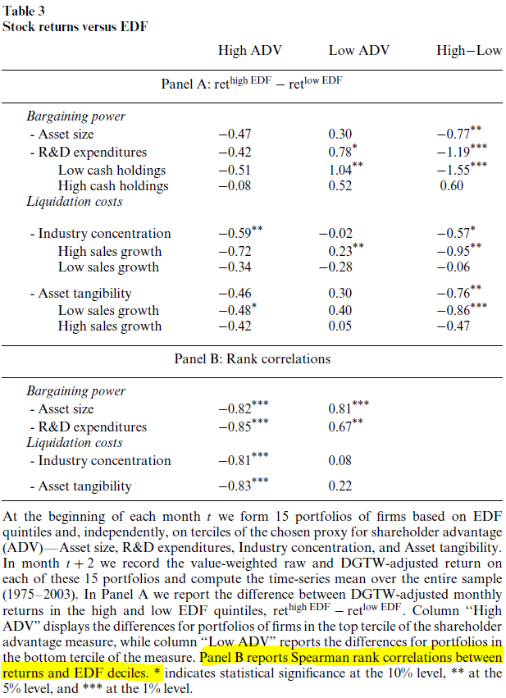
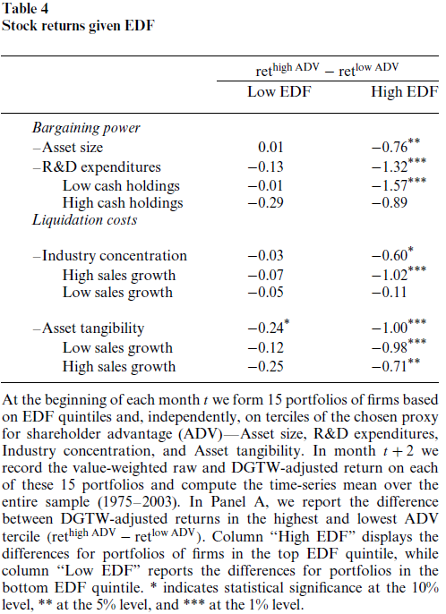
The takeaway is more relevant in the case of High EDF
Small firms outperform large firms by 0.76% per month
High R&D firms outperform by 1.32% per month
firms in less concentrated industry outperform by 1.32% per month
firms w. higher tangibility outperform by 1.00% per month
The takeaway is more relevant in the case of High ADV
Notes:
Default risk, shareholder advantage, and stock returns
L Garlappi, T Shu, H Yan -
The Review of Financial Studies, 2008 - academic.oup.com
EDF PD from Moody’s KMV. Shareholder Advantage (ADV). High ADV is proxied by 1) large Asset Size, 2) Low R&D/Asset Ratio, 3) More concentrated industry, 4) Low asset tangibility
Key takeaways 2008-2: Don’t buy high PD firms with high ADV (incl. big in asset size, have low R&D ratio, in a very concentrated industry, and have low tangible assets.)
Key takeaways 2008-1: The low-PD firms would overperform if they’re small, growth, low analyst coverage, low institutional holding, and illiquid.
Key takeaways 2007: The firms would overperform if they exhibit momentum and high PD. // Don’t buy firms with high PD and worst performing in past 6 month.
Key takeaways 2004: The firms would overperform if they are small in size, and value-firms (high BEME) and high PD.
Da & Gao (2010) found the overperform of these firms was driven by short-term reversal.
Key takeaways 2002: The firms would underperform if they are growth-firms and have high PD.

