Slide 1
Root-MUSIC, Range, and Doppler Estimations
09/01/2020

Slide 2
MATLAB Objects and Functions
Phase Array System Toolbox:
Objects/classes:
phased.RootMUSICEstimator
phased.RangeDopplerResponse
phased.RangeEstimator
phased.DopplerEstimator
Signal Processing Toolbox
Function:
rootmusic()

Slide 3
phased.RootMUSICEstimator
Multiple Signal Classification DoA Estimation
Properties
Important:
SensorArray: ULA (or UCA)
PropagationSpeed: speed of light or user specified
OperatingFrequency: central frequency of radar fc
NumSignalsSource: ‘Property’
NumSignals: #signal received by ULA (default: 1)
Others:
NumSignalsMethod: ‘AIC’ or ‘MDL’ (Akaike Information Criterion or Minimum Description Length Criterion)
SpatialSmoothing: 0
ForwardBackwardAveraging: false

Slide 4
phased.RootMUSICEstimator
H = phased.RootMUSICEstimator()
ANG = H(x)
For ULA use
Estimates the direction of arrival (DOA’s) from a signal x
X is a matrix whose columns correspond to the signal channels.
ANG is a row vector of estimated broadside angles in degrees.
ANG = H(x, ElAng)
For UCA use
ElAng = elevation angles of signals

Slide 5
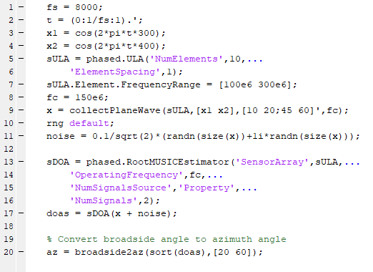
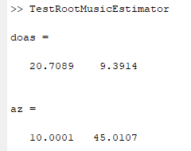
Example

Slide 6
phased.RangeDopplerResponse
Calculate filtered response to range data, perform peak detection, resolve range-Doppler coupling.
Important Properties (for FFT):
Range Method: FFT
Signal propagation speed
Sampling rate
Sweep slope
Range FFT Length
Doppler FFT Length
Operating Frequency
Doppler Output: frequency or Speed
[resp,rnggrid,dopgrid] = H(x)
plotResponse(H,x)

Slide 7
phased.RangeEstimator
Important Properties:
RMS Resolution
Noise Power source: ‘input port’ to enable input to step functions
Cluster Input Port: true to enable input
Variance output port: true to enable output

Slide 8
phased.RangerEstimator
H = phased.RangerEstimator()
rngest = H(resp,rnggrid,detidx)
[rngest,rngvar] = H(resp,rnggrid,detidx,noisepower)
[rngest,rngvar] = H(resp,rnggrid,detidx,clusterids)
[rngest,rngvar] = H(resp,rnggrid,detidx,clusterids,noisepower)
rnggrid = units for range dimension of the response data cube
detidx = detection position index

Slide 9
phased.DopplerEstimator
Important Properties
Num pulses: number of pulses in doppler-processed waveform
Noise power source
Cluster Input port
Variance output port

Slide 10
phased.DopplerEstimator
H = phased.DopplerEstimator()
dopest = H(resp,dopgrid,detidx)
[dopest,dopvar] = H(resp,dopgrid,detidx,noisepower)
[dopest,dopvar] = H(resp,dopgrid,detidx,clusterids)
[dopest,dopvar] = H(resp,dopgrid,detidx,noisepower,clusterids)

Slide 11
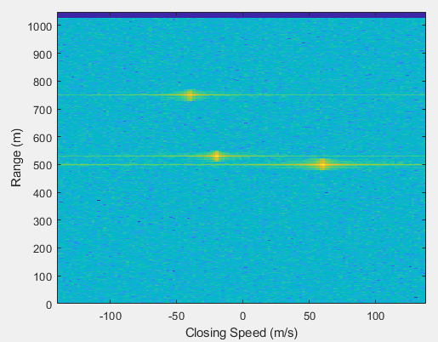
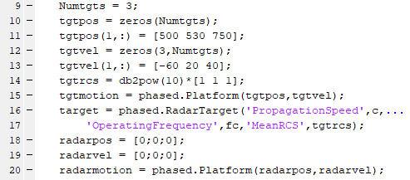
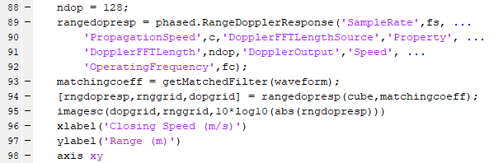
Example

Slide 12
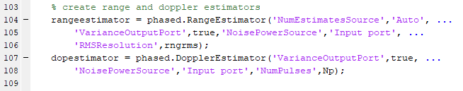
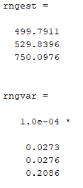
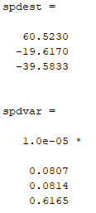
Example

Slide 13
rootmusic()
w = rootmusic(x,p)
[w,pow] = rootmusic(x,p)
[w,pow] = rootmusic(___,'corr')
[f,pow] = rootmusic(___,fs)
Inputs:
X = input signal
P = dimension of signal subspace
Fs = sampling frequency
Outputs:
a vector of frequencies, w (rad/sample) or f (Hz)
and a vector of correspond signal power, pow

