Slide 1
CFAR Constant False Alarm Rate Detection
08/27/2020

Slide 2
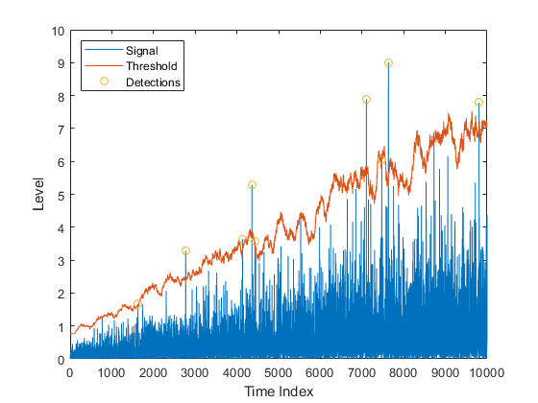
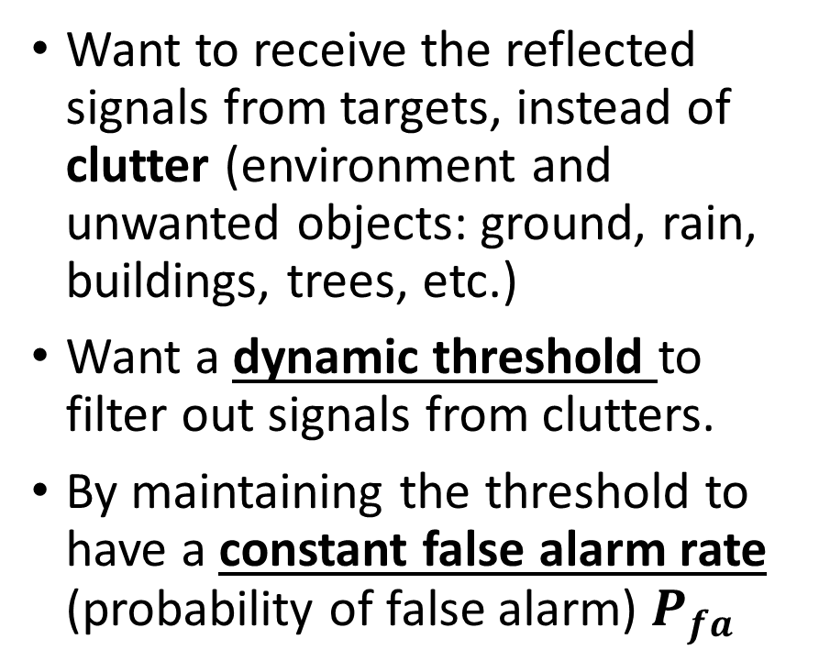
Motivation
Want to receive the reflected signals from targets, instead of clutter (environment and unwanted objects: ground, rain, buildings, trees, etc.)
Want a dynamic threshold to filter out signals from clutters.
By maintaining the threshold to have a constant false alarm rate (probability of false alarm) $P_{fa}$

Slide 3
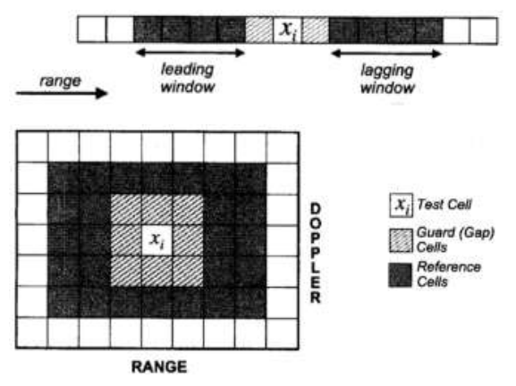
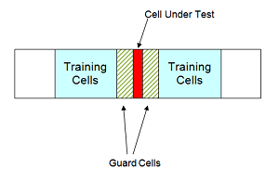
Schematics

Slide 4
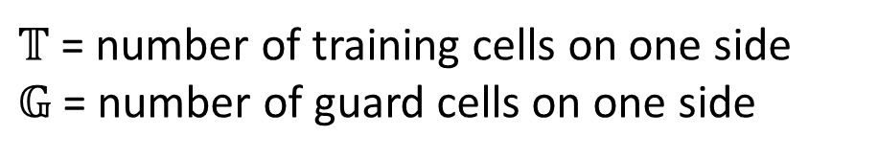
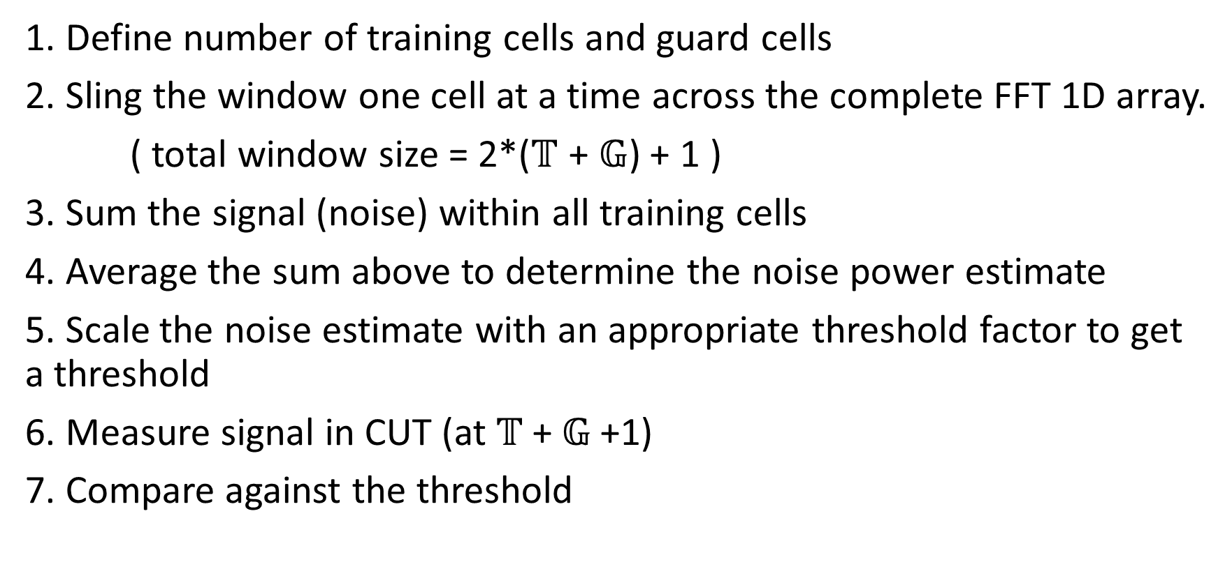
Implementation
$𝕋$ = number of training cells on one side
$𝔾$ = number of guard cells on one side
1. Define number of training cells and guard cells
2. Sling the window one cell at a time across the complete FFT 1D array.
( total window size = 2*($𝕋$ + $𝔾$) + 1 )
3. Sum the signal (noise) within all training cells
4. Average the sum above to determine the noise power estimate
5. Scale the noise estimate with an appropriate threshold factor to get a threshold
6. Measure signal in CUT (at $𝕋$+ $𝔾$+1)
7. Compare against the threshold

Slide 5
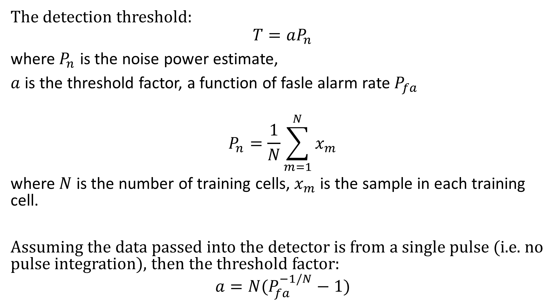
Equations
The detection threshold:
$$T=aP_{n}$$
where $P_{n}$ is the noise power estimate,
$a$ is the threshold factor, a function of fasle alarm rate $P_{fa}$
$$P_{n}=\frac{1}{N}\sum_{m=1}^{N}{x_{m}}$$
where $N$ is the number of training cells, $x_{m}$ is the sample in each training cell.
Assuming the data passed into the detector is from a single pulse (i.e. no pulse integration), then the threshold factor:
$$a=N(P_{fa}^{−1/N}−1)$$

Slide 6
phased.CFARDetector
Assuming it is a square law detector with white Gaussian noise
Important properties:
NumGuardCells
NumTrainingCells
Threshold factor
ProbabilityFalseAlarm
NumDetections
Y = H(X,cutidx)
[Y, TH] = H(X,cutidx)
X = input data, either a Mx1 column vector or MxN matrix
Cutidx = a length-D vector of indices of CUT
Y = detection results
TH = threshold

Slide 7
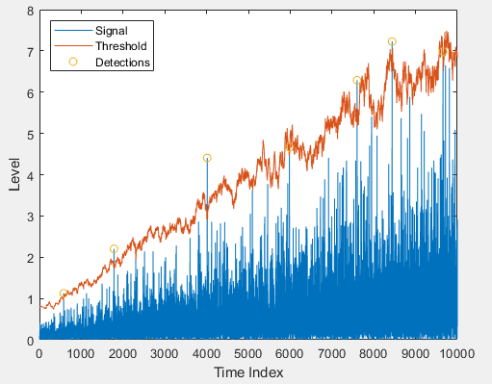
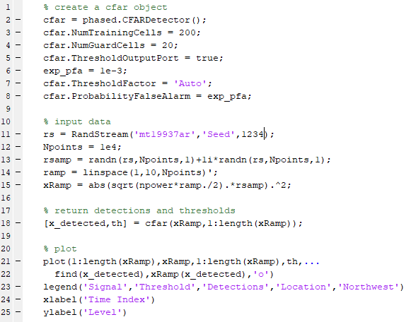
Example

