Slide 1

Spotify Music Sentiment Analysis
Group: West Coast
Teammates: Zhuoya Chen, Franco Hui, Bocheng Yin

Slide 2

Introduction
To create a Spotify sentiment analysis workflow that
Allows users to create their own playlists with sentiment scores by extracting songs from Spotify API, and extracting lyrics with MusicMatch API, and then generating sentiment scores with VADER library.
Users can enter the name of the artist and song name to receive a list of Top 20 most similar songs, and a list of Top 20 least similar songs based on the sentiment songs.
User can inspect and compare the sentiment scores generated by three different sentiment models
Goal:

Slide 3
Setup
Software Requirement:
VSCode or JetBrains (We highly recommend VSCode since it can execute ipynb like as you run it via jupyter notebook command)
jupyter notebook
Application components (Part 1 / 2 / 3):
Songs and lyrics extraction
Song recommender
Sentiment analysis models
User guide
Open the ipynb file with VSCode or run "jupyter notebook" at the project folder (part 1 / 2 / 3)
Install the required libraries and run the cells
If you would like to test with your own playlist, please follow the Use Your Own Playlist instruction

Slide 4
Data Source
Use Spotify account token to pull six different playlist into csv files, and then combine them into one file.
Call musicmatch api to retrieve lyrics for all songs in the six playlists
spotify_api.py
sentiment_analysis_2.py
Use VADER library to conduct sentiment analysis and log sentiment (Positive, Negative, Neutral) and their scores (0-100) into the my_playlist_sentiment_clean.csv.
Sentiments_app.ipynb
script: spotify_api.ipynb & sentiment_analysis.py
Franco Hui

Slide 5
User Story – Logic Flow
Generate two lists based on sentiment scores:
Top 20 most similar songs
Top 20 least similar songs
Enter the name of the Artist
No? Re-run the cell to enter again
Name found
Enter name of the song
Data Visualization with charts
No? Re-run the cell to enter again
Song found
script: Sentiments_app.ipynb
Franco Hui

Slide 6



Pick one model from Hugging Face
Sentence | Expect | Expect (Num)
“I love you” | Positive | 1
“I am having breakfast” | Neutral | 0
“I hate you” | Negative | -1
https://huggingface.co/
1 | distilbert-base-uncased-finetuned-sst-2-english
2 | ProsusAI/finbert
3 | yiyanghkust/finbert-tone
4 | finiteautomata/bertweet-base-sentiment-analysis
5 | albert-base-v2
script: HaggingFace_Models.ipynb
Bocheng Yin

Slide 7
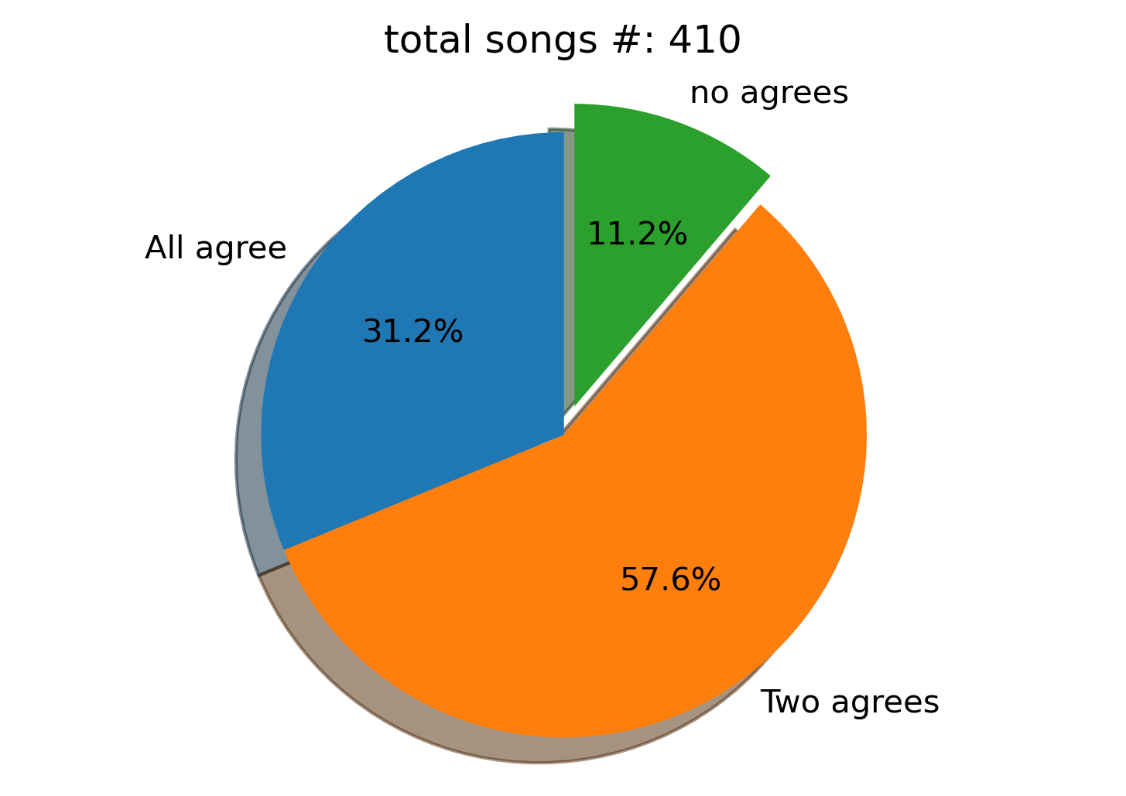
Comparison among pre-trained models
Vader
TextBlob
HF:Bertweet
Script: sentiment_analysis_eval_multi_models_comparison_final.py
Bocheng Yin

Slide 8
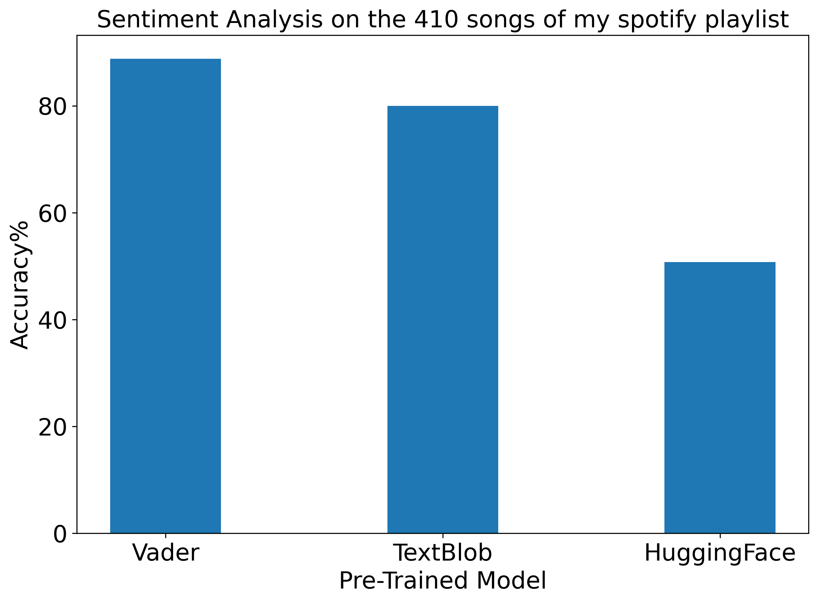
Model Accuracy
Manual evaluation
Compare the model prediction with the manual evaluation
Bertweet
Script: sentiment_analysis_eval_multi_models_comparison_final.py
Bocheng Yin

Slide 9
Conclusion
Part 1: Retrieve the playlist from Spotify. Fetch the lyrics from musixmatch.
Part 2: Using “Vader” to predict the sentiment on the lyric and do song recommendation based on sentiment score
Part 3: Compare three different sentiment-analysis models and rate the model accuracy referencing to the manual evaluation.

Slide 10
Future Goal
To enhance user experience, the project is recommended to be built into a single application that users can explore all functionalities that we created.

Slide 11
Reference
Spotify console
https://developer.spotify.com/console/
Musixmatch documentation
https://developer.musixmatch.com/documentation
Postman Tutorial - Getting started with Spotify API
https://www.youtube.com/watch?v=N34BM2CU_3g
Spotify Sentiment Analysis
https://towardsdatascience.com/spotify-sentiment-analysis-8d48b0a492f2
The-Most-Favorable-Pre-trained-Sentiment-Classifiers-in-Python
https://github.com/PetrKorab/The-Most-Favorable-Pre-trained-Sentiment-Classifiers-in-Python/blob/main/analysis.ipynb
Sentiment Analysis With Transformer Models Made Easy
https://www.youtube.com/watch?v=Ew72EAgM7FM
Hugging Face, AI community
https://huggingface.co/

Slide 12
Acknowledgement
Prof. Zhai, Chengxiang
All TAs: Assma Boughoula , Kevin Ros, Campos Daniel,
Yuxiang Liu, Harita Reddy, Priyanka Dey
Great Team Members: Zhuoya Chen, Franco Hui, Bocheng Yin

