Slide 1
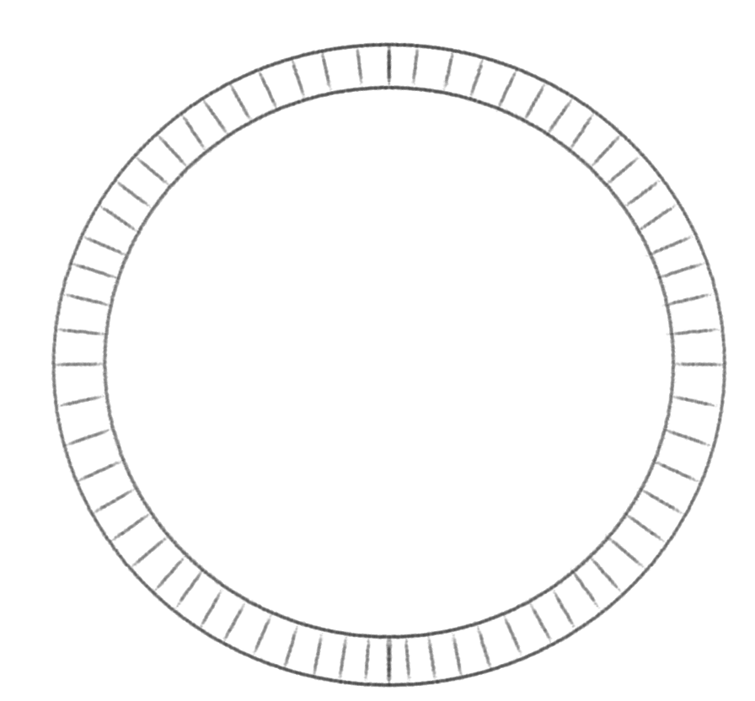
1
0
0
1
1
0
0
1
0
1
1
0
1
0
0
0
1
1
0
1
1
0
1
0
T_Settle trigger
0
1
1
0
1
0
0
ringbuffer
1
hel | Fast clock | BCM up | BCM down | ...
1
0
0
1
0
1
1
0
0
0
1
1
1
1
0
0
0
1
0
1
1
0
1
1
1
0
0
0
1
1
0
0
Detector signals
Physics Events

