Slide 1

„Lift verSUS StAIRS DETECTOR WITH BANGLE JS 2“
Bebeto Ateumo, Nuraiym Zhusupbekova

Slide 2


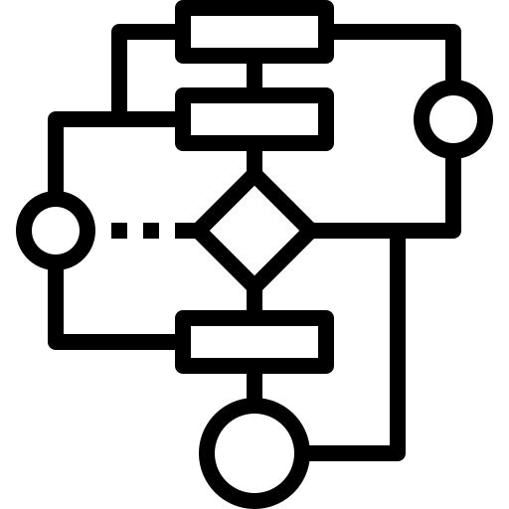


PROCESS OF THE PROJECT
Detecting Algorithm
Data Collection
Data Processing
Testing
Analyse

Slide 3
Data Collection
First Attempt: Collecting data from different available sensors at the same time
- Failed!
- GPS should be started under a clear view of the sky
- When starting the accelerometer, HRM and barometer at the same time, barometer data could not be collected correctly
Second Attempt: Collecting data from necessary sensors
- Accelerometer and barometer
- with the time interval of 1 Second

Slide 4
Data Processing
First step: Data aggregation
- aggregation of 10 data elements
- processing aggregated data
Second step: Differentiate 4 types of activities
- Still
- Walking
- Lift
- Stairs
Two types of sensor data to process: Altitude and Magnitude
Altitude
- using trendline (linear Regression)
- using the difference between the max and min values of the aggregated 10 elements
- using the difference between the first and last (timestamp or index) values of the aggregated 10 elements
Magnitude
- using the mean value of the magnitude of 10 elements

Slide 5
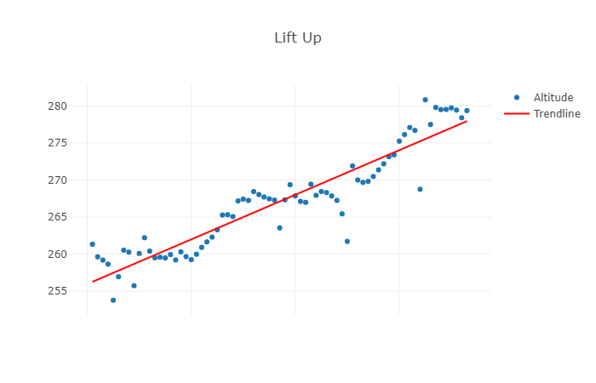
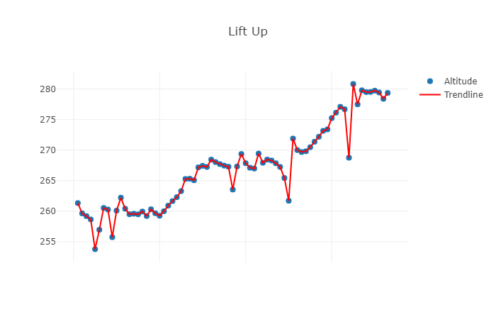
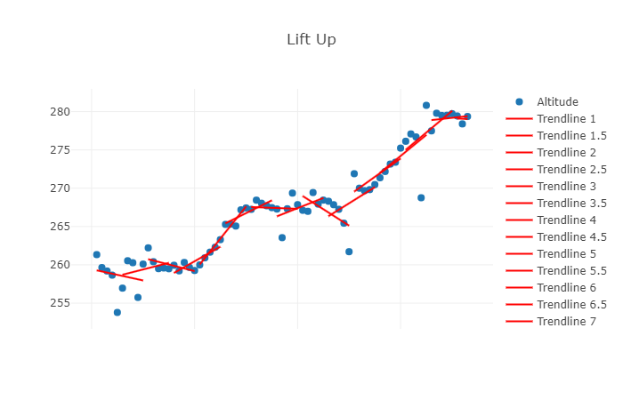
Data Processing: Altitude
Trendline
Trendline between two data elements
Trendline for 10 data elements

Slide 6
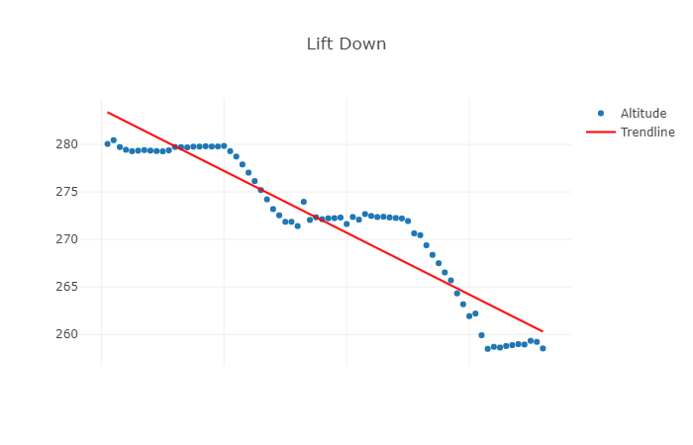
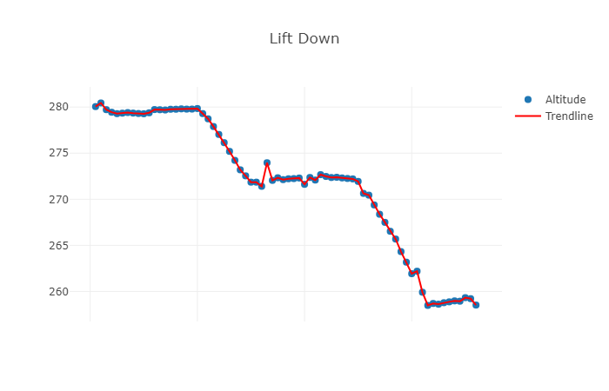
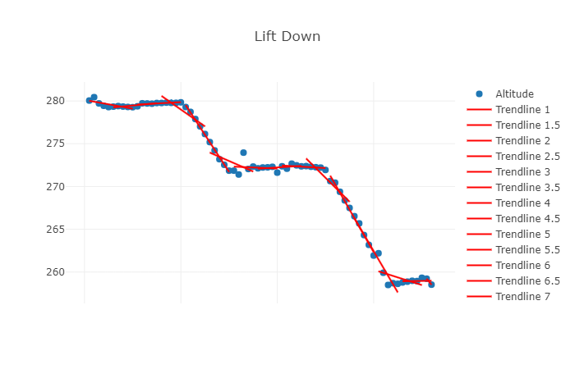
Data Processing: Altitude
Trendline
Trendline between two data elements
Trendline for 10 data elements

Slide 7
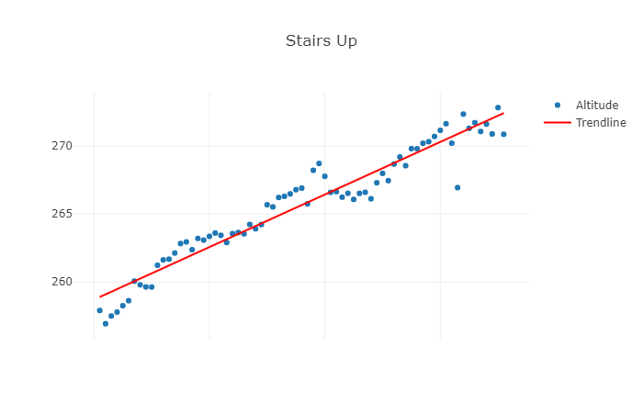
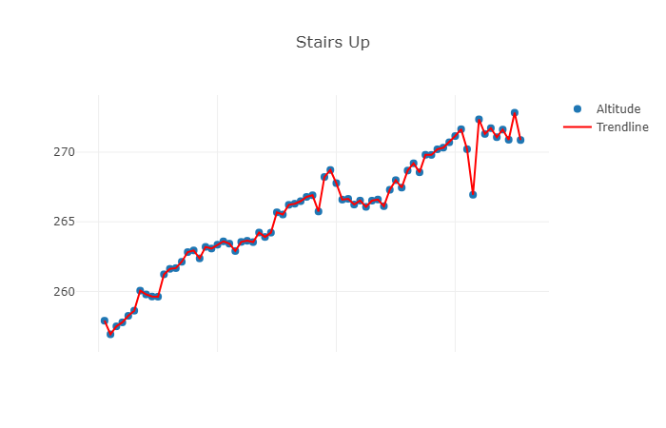
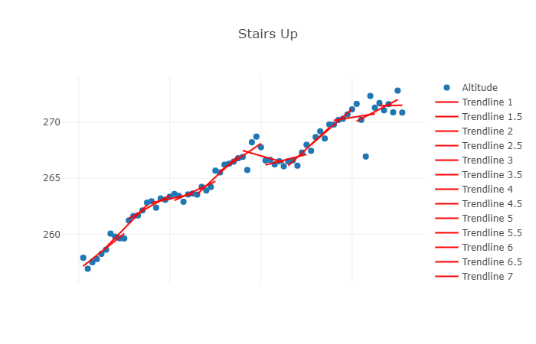
Data Processing: Altitude
Trendline
Trendline between two data elements
Trendline for 10 data elements

Slide 8
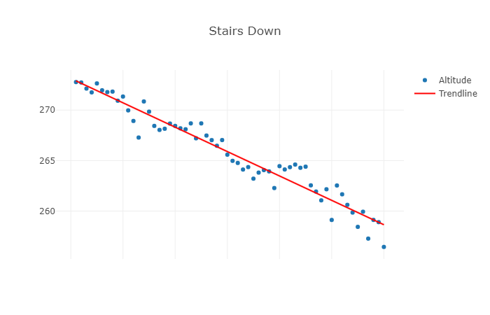
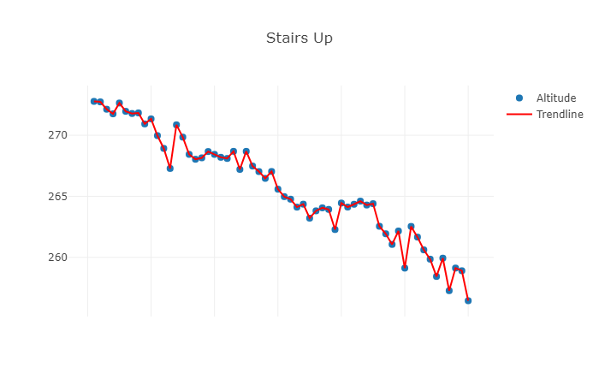
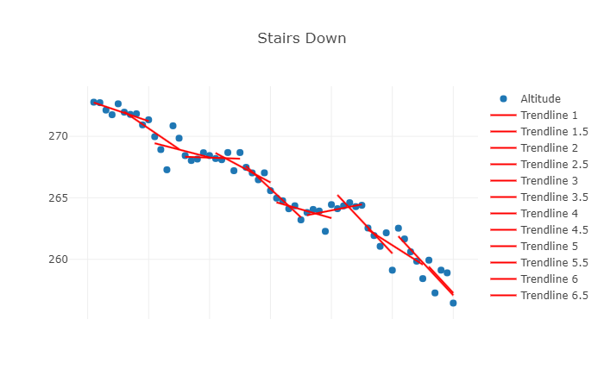
Data Processing: Altitude
Trendline
Trendline between two data elements
Trendline for 10 data elements

Slide 9
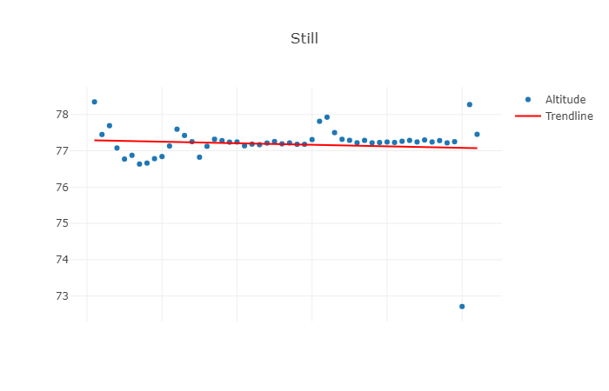
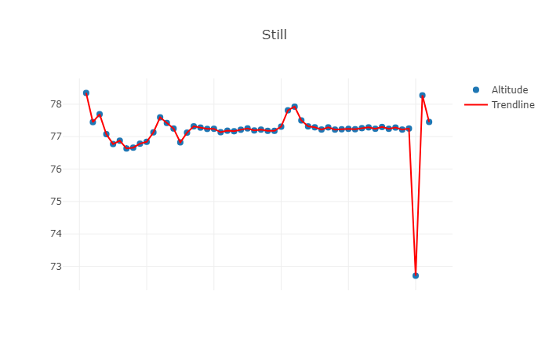
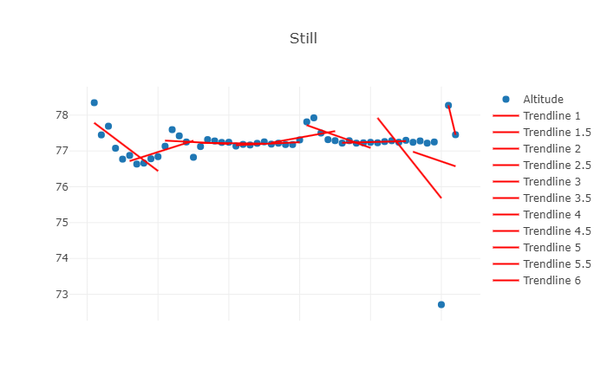
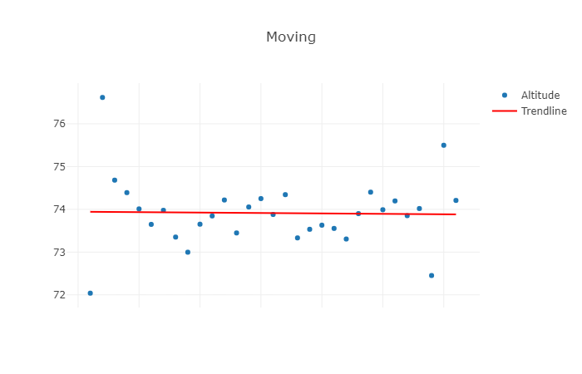
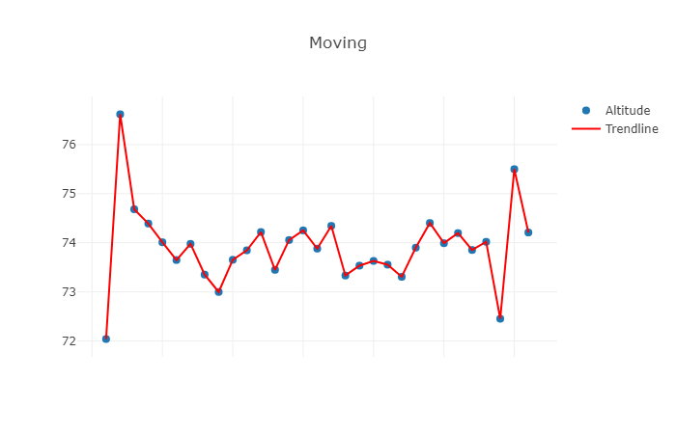
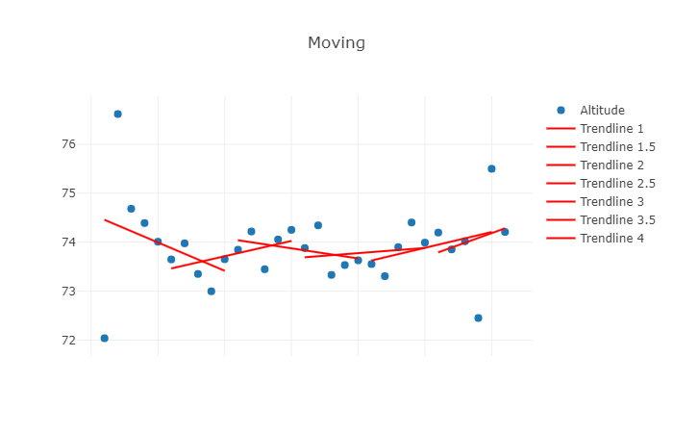
Data Processing: Altitude
Trendline
Trendline between two data elements
Trendline for 10 data elements

Slide 10
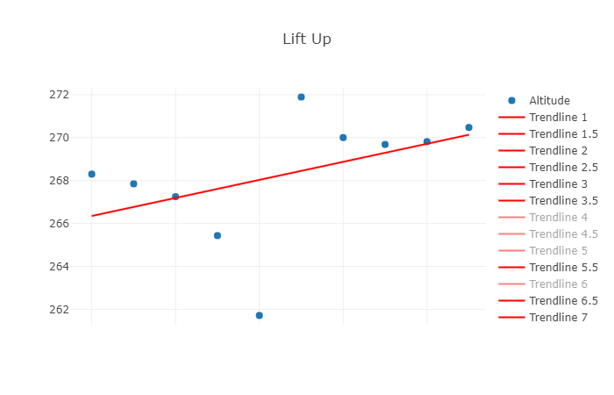
Data Processing: Altitude
max
last
first
min

Slide 11
Data Processing: Magnitude
Analyzing different mean values of the magnitude of 10 elements gave the threshold for moving or standing still
Advantages:
- helps detect movements (including when taking stairs)
Disadvantages:
- gives sometimes false results while moving in the lift
- for precise results more analysis is necessary
- threshold is only useful for data collected every 1 second and analysed every 10 data items
(no longer useful for another interval and analysing different number of elements)

Slide 12
Detecting Algorithm
First step:
- detecting a stair/lift using trendline
(but even with the bigger slope there is a possibly for being still or moving)
- or differentiate still/walking using the magnitude (<= 1.02 according to the analyzed data)
Second step:
- detecting a lift/still using mean value of magnitude (<= 1.02 according to the analyzed data)
- or a stairs/walking using mean value of magnitude
Third step:
- differentiate lift and still using max-min or first-last
- differentiate stair and walking using max-min or first-last

Slide 13
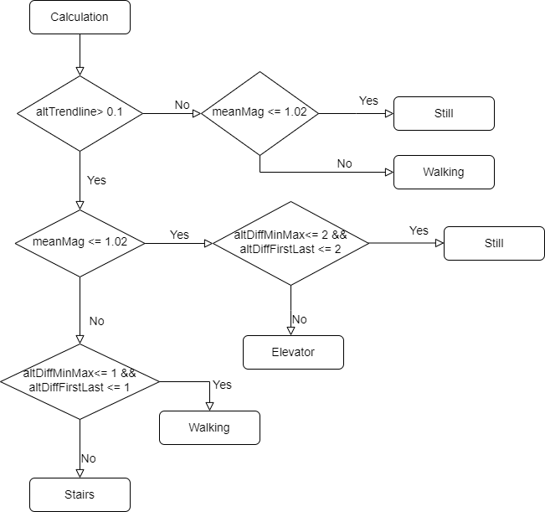
Detecting Algorithm

Slide 14
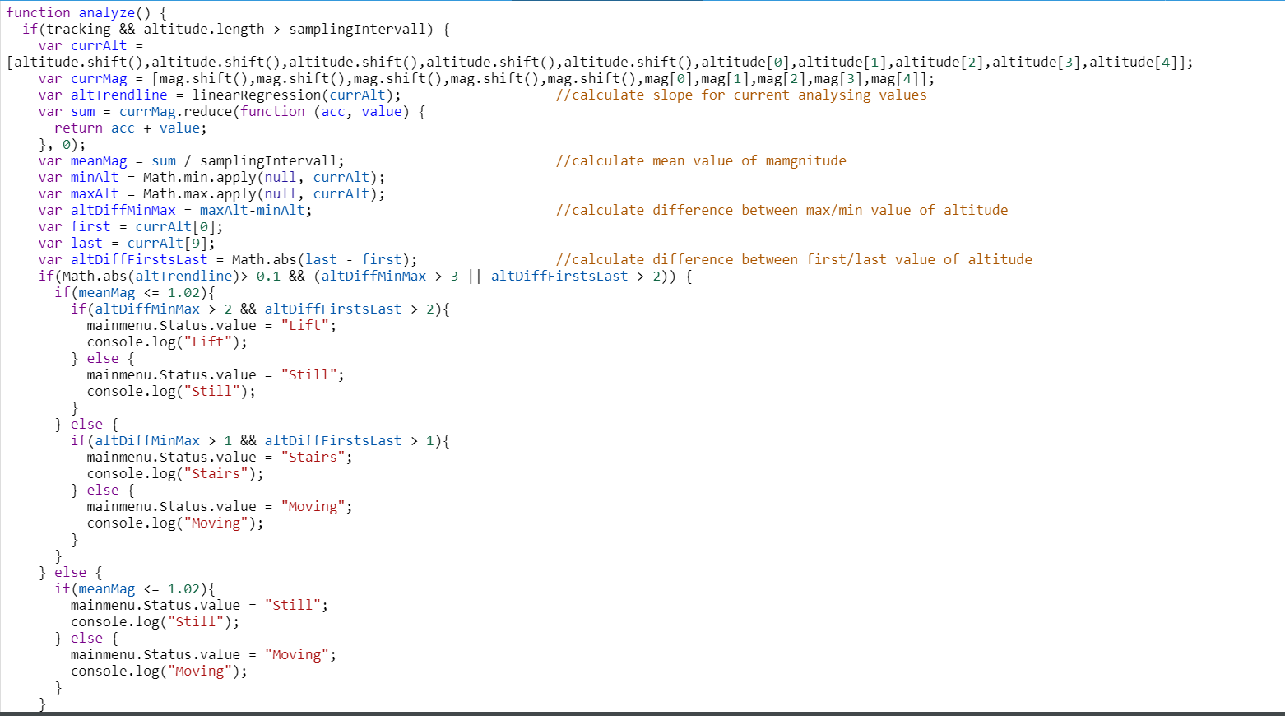
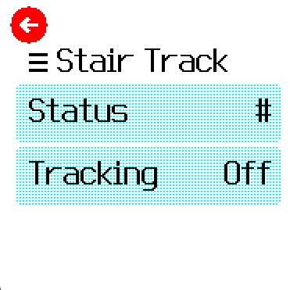
Implementing as a Bangle App
To start detecting, tracking should be on
Status will be shown here
with the delay of 5 seconds

Slide 15
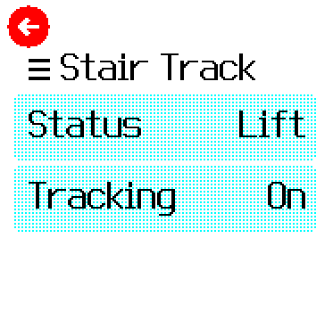
Testing
Still
Still
Still
Lift
Lift
Stairs
Still
Still
Still
Lift
Lift
Lift
Lift

Slide 16
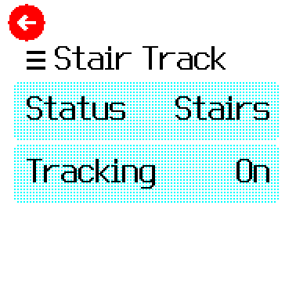
Testing
Stairs
Stairs
Stairs
Moving
Stairs
Stairs
Moving
Moving
Stairs
Stairs

Slide 17
Analyzing
- Implemented Bangle App is able to differentiate lift/stairs from walking/still using max-min, first-last and trendline
- It is possible to differentiate lift from stairs or walking from still using magnitude
- The result can be false, depends on the data (more precise algorithm necessary)
- The chosen threshold is only usable with the given interval and amount of analyzing data
- Tests for different intervals => new data processing and analyzing from the beginning
- first thing before data collection and processing => thinking about the time interval
- while moving, people have different speed => thinking about the time interval
The algorith doesn‘t perform well live on the bangle js watch and the fact that it handles data by intervals, results in the fact, that when we are done with a type of movement the watch stills need time to retrace our steps. This affects greatly the interpretation of the result, as we don‘t know, if an output is still on the way and consumes the batterie.

Slide 18

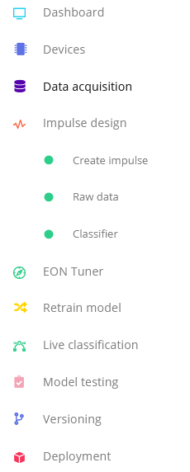
Different Approach: MACHINE LEARNING
Steps using Empulse
Using Empulse Edge :
-Datacollection from bangle JS watch
transfered to the Software
-visualization and training
doesn‘t need additional tools but more
advanced features could require and Enterprise version
-diverse exports possibilities
(WASM format too, can be used to setup app later on watch)

Slide 19
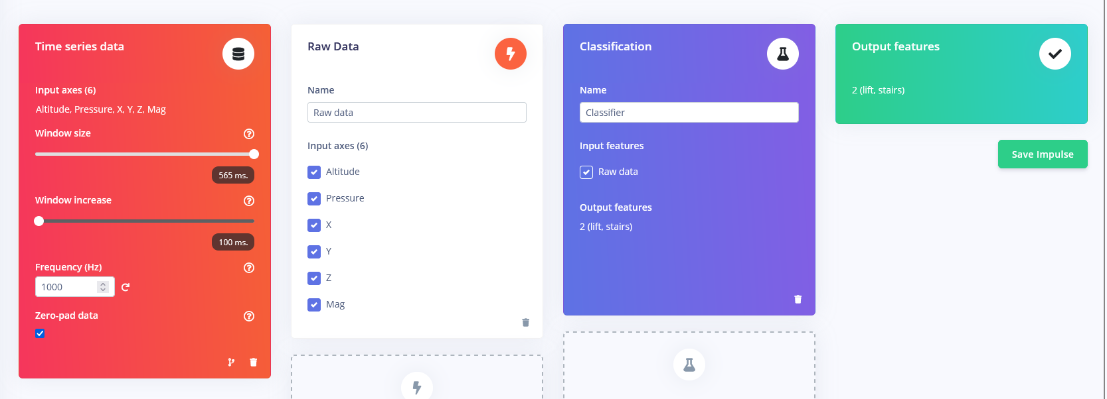
SteP1: DESIGN IMPULSE
In the design, we determine sampling‘s Parameters
and intervalls for the data collected. We also define wich features we
find relevant in the data , like pressure and altitude for eg.

Slide 20
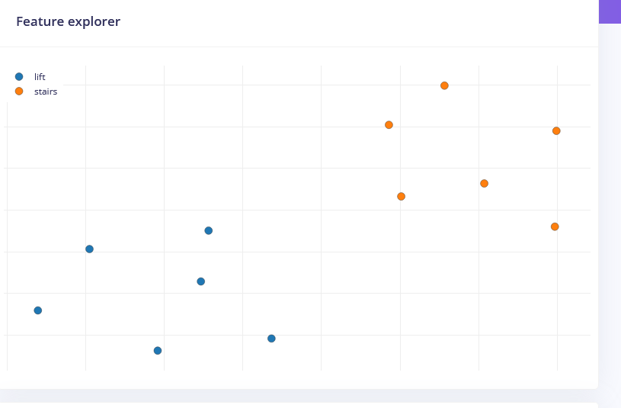
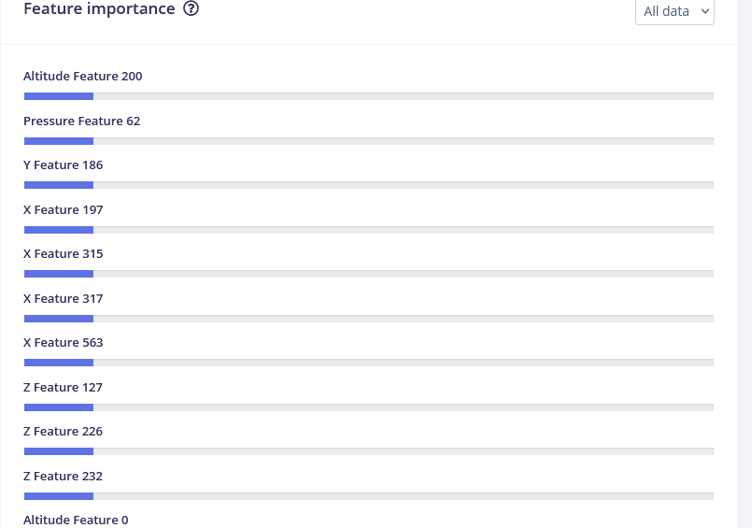
Step2: Visualisation with defined parameters

Slide 21
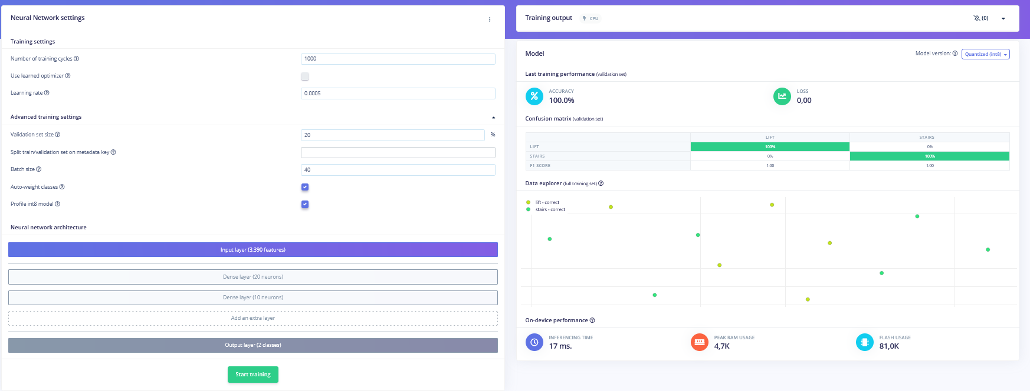
SteP3: Training

Slide 22
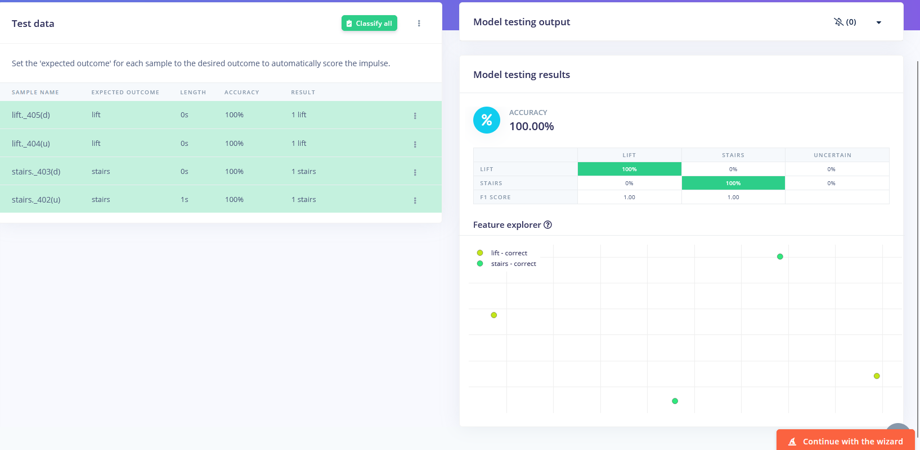
STEP4: Model testing

Slide 23
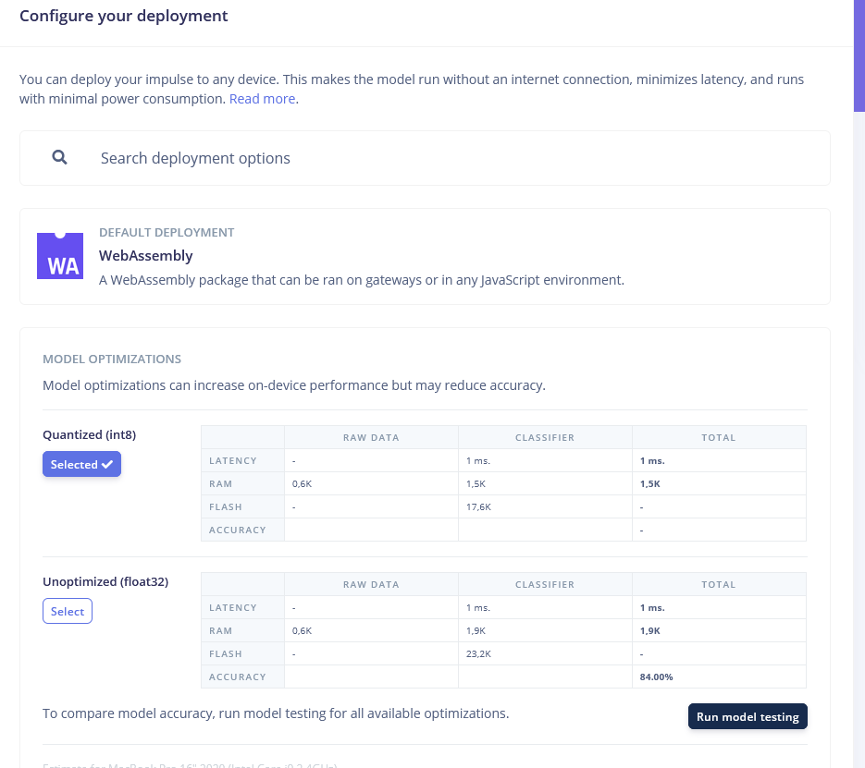
STEP5: DEPLoYING
Using the WASM format we can
Convert our model into a runnable
App.
We still need to modify it to
suit the bangle JS watch.

Slide 24
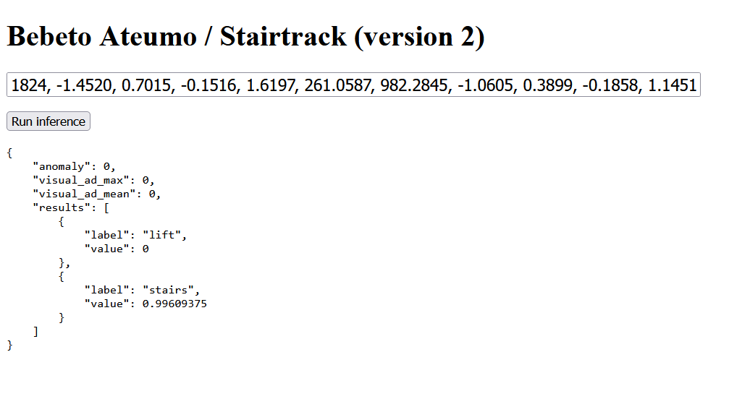
Deployment on WEBbrowser
DEPLOYMENT has not been tested on watch jet
Documentation for deploying and running in the webbrowser see:https://docs.edgeimpulse.com/

Slide 25
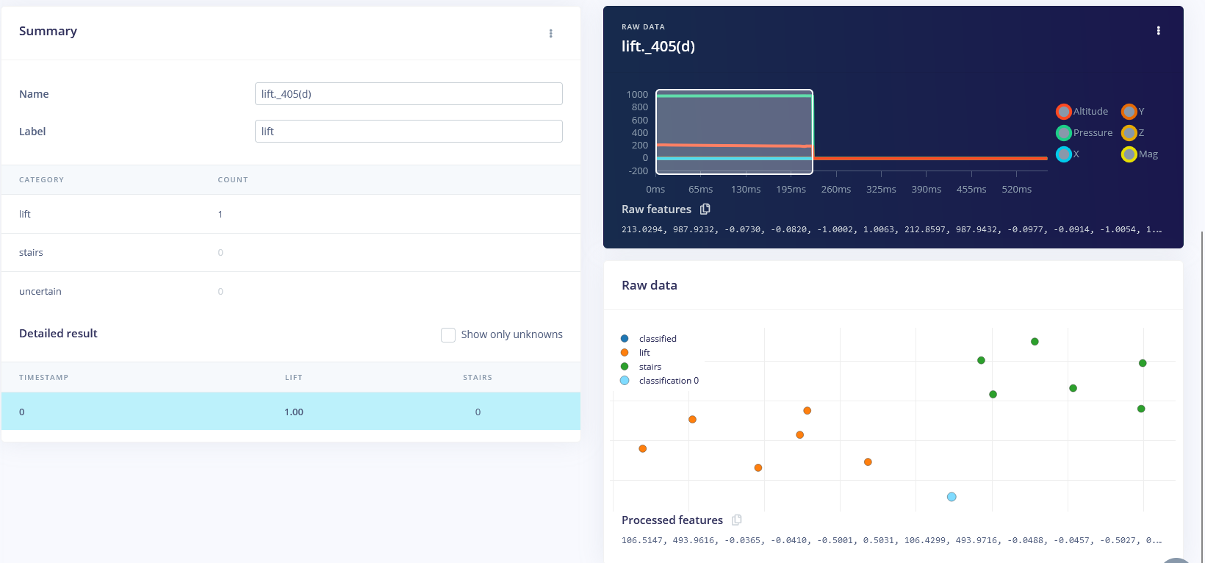
EXAMPLE CLASSIFICATION ACCURAcy on STEP4

Slide 26
Remaining goals
CLASSICAL ALGORITHM MACHINE LEARNING
- Choosing better sampling interval
- Analyzing data sampled with different intervals
- Choosing a fitting threshold (dynamic thresholds?)
- Using HR-Monitor
- Improve the algorithm regarding energy consumption as the processing of the data works per intervals.
While we still need the outputs’ results of
the tracking on the way after stopping.
The sensors are not needed anymore?
- more test and check with the accuracy on in the training phase
- test the deployed software from Empulse on bangle watch
-fine tune the app look and feel on the watch

Slide 27

Thank You!

