Slide 1
Introducing AI to Small and Medium-Sized Recruitment Companies
Moonlightsbreath
2025/10/09

Slide 2
Introduction
Objective statement: To acquire basic knowledge of AI and to provide an opportunity to consider the possibility of using AI in their own business.
Recognition of current situation: Growing interest in AI in the recruitment industry and expected benefits (increased business efficiency, improved matching accuracy, new value creation).

Slide 3
Agenda
1. basics of AI
2. latest AI technology trends and business applications
3. scenario of AI application in the recruitment industry
4. first steps for AI implementation and utilization

Slide 4
1. what is AI?
What is AI?
  Definition: computer mimicry of human intellectual activity.
  Historical overview: after boom and winter periods, why is it gaining attention now (evolution of data, computational power, algorithms)?
Machine Learning
  Clarify that it is the core technology of AI.
  Supervised learning:
    E.g., recommending the best jobs based on resume data, predicting the probability of successful hiring based on historical decision data.
    Importance of teaching "correct data."
  Unsupervised learning:
    Example: Extracting groups of candidates with similar skill sets from a large number of resumes.
    Discovering structures and patterns in the data.
  Reinforcement learning:
    (less direct application in recruiting, but touched on as a concept) Learning optimal behavior through trial and error.
Impact of Deep Learning (Deep Learning)
  A type of machine learning, specifically a multi-layered neural network that mimics the structure of the human brain.
  Brief description of breakthroughs in image recognition, speech recognition, and natural language processing.
Notes:
This part is to help you understand that AI is not magic and to give you a concrete image of what it is.
Have any of you ever used AI?

Slide 5
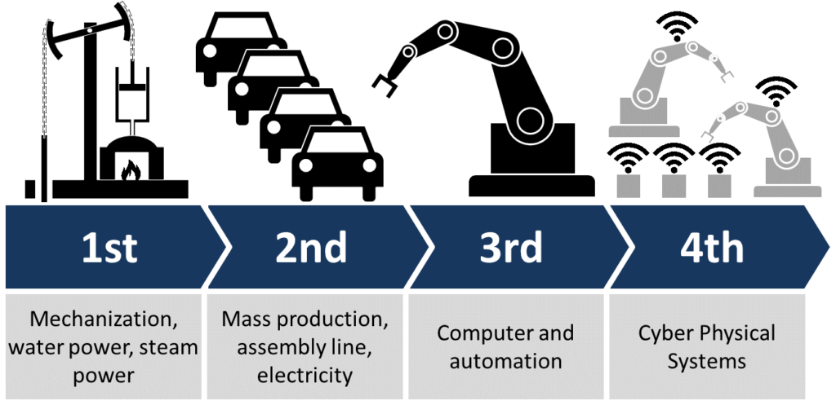
Industry Revolution (IR)
Contents of [reference material
Four phases in IR
IR 1.0 (18th century to the middle of the 19th^{th} century)
IR 2.0 (the late 19th century to the early 20th century)
IR 3.0 (the late 20th century to about 2015)
IR 4.0 (about 2015 ~)
Source:
https://en.wikipedia.org/wiki/Industrial_Revolution
https://en.wikipedia.org/wiki/Fourth_Industrial_Revolution
https://www.renaix.com/industry-4-0-the-fourth-industrial-revolution/

Slide 6
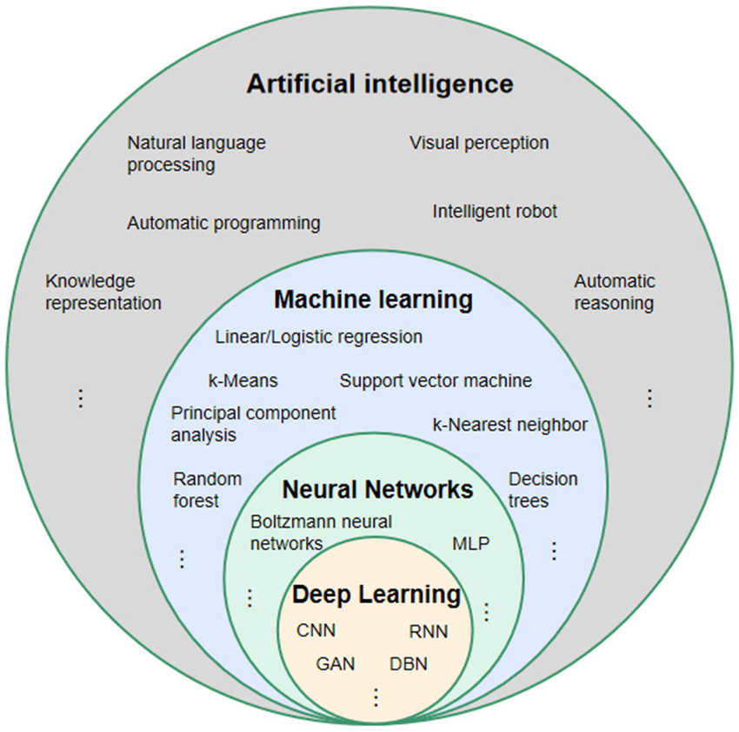

What is AI?
Contents of [reference material
A field that includes machine learning and neural networks.
  Machine Learning (ML)
    Has strong background on programming, algorithm development, statistical methodologies, and big data analytics. analytics.
    Compared to deep learning, some people call it shallow machine learning.
  Neural Network (NN)/Artificial Neural Network (ANN)
    A technique to process data in a way that mimics the human brain. neural networks can learn from experience and identify patterns in data.
      Multi-layer perceptron (MLP)
        Fully connected/dense layer feedforward networks: Each node connects to all nodes in the next layer.
        At least three layers of nodes: An input layer, one or more hidden layers, and an output layer.
        Non-linear Activation function: to learn more complex patterns that are not possible with a purely linear model.
  Deep learning
    More than tens or even hundreds of layers
    More complicated structures to enhance the problems of neural networks
Relationship between artificial intelligence, machine learning, neural networks, and deep learning.
(MLP: multi-layer perception/preceptron; CNN: convolutional neural network; RNN: recurrent neural network; DBN: deep belief network; GAN: generative adversative network) generative adversative network)
An example of MLP neural networks architecture
Source: https://www.researchgate.net/figure/Relationship-between-artificial-intelligence-machine-learning-neural-network-and-deep_ fig3_354124420

Slide 7
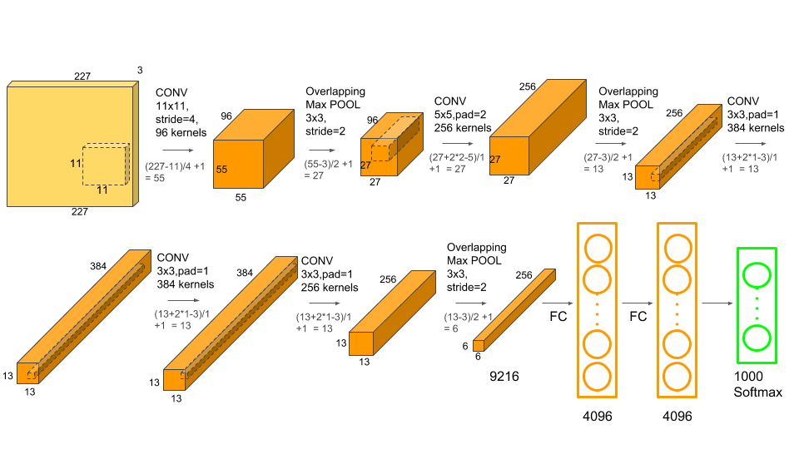
Image Recognition
Breakthrough: In the 2012 ImageNet Large Scale Visual Recognition Challenge (ILSVRC), a model using deep learning (AlexNet) achieved recognition accuracy that outperformed traditional methods. This enables computers to identify objects in photographs (e.g., cats, cars, faces, etc.) with equal or better accuracy than humans.
Impact: Accelerated practical applications in a wide range of fields, including automated driving, facial recognition, medical imaging, and anomaly detection.
AlexNet
Source: https://wiki.imindlabs.com.au/ds/dl/1_models/2-cnn/3_alexnet/

Slide 8
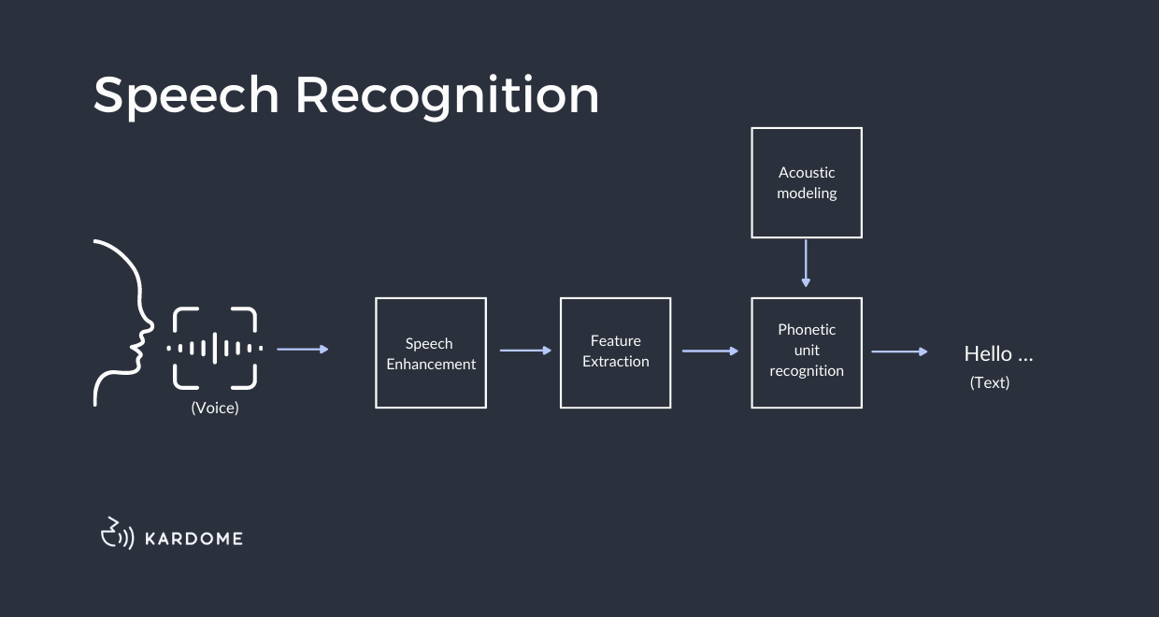
Speech Recognition
Breakthrough: The introduction of deep learning has dramatically improved the accuracy of speaker-independent general-purpose speech recognition. In particular, it is now able to handle background noise and diverse accents, and has significantly reduced the rate of misrecognition.
Impact: Smart speakers, voice assistants on smartphones (Siri, Google Assistant, etc.), automated minutes taking, automated call center answering, etc. have become widespread and deeply embedded in our lives.
Speech Recognition
Source: https://www.kardome.com/blog-posts/difference-speech-and-voice-recognition

Slide 9
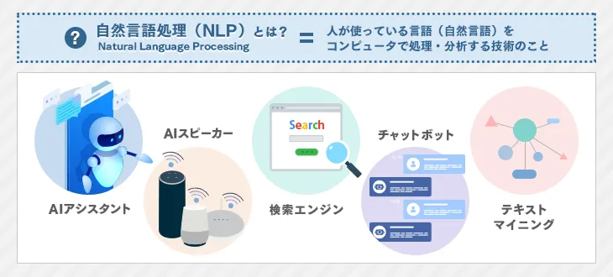
Natural Language Processing (NLP)
Breakthroughs: The advent of deep learning, especially new architectures such as Transformer, has enabled computers to better understand the meaning and context of words. This has led to improved machine translation accuracy, sentence summarization, sentiment analysis, and the emergence of high-performance chatbots and **large-scale language models (LLMs)** such as ChatGPT.
Impact: High-quality automated translation, text generation, question and answer systems, improved search engine accuracy, and AI capable of natural human interaction are just a few of the many applications that are emerging and transforming the way we gather information and communicate.
NLP
Source: https://it-trend.jp/textmining/article/124-0027

Slide 10
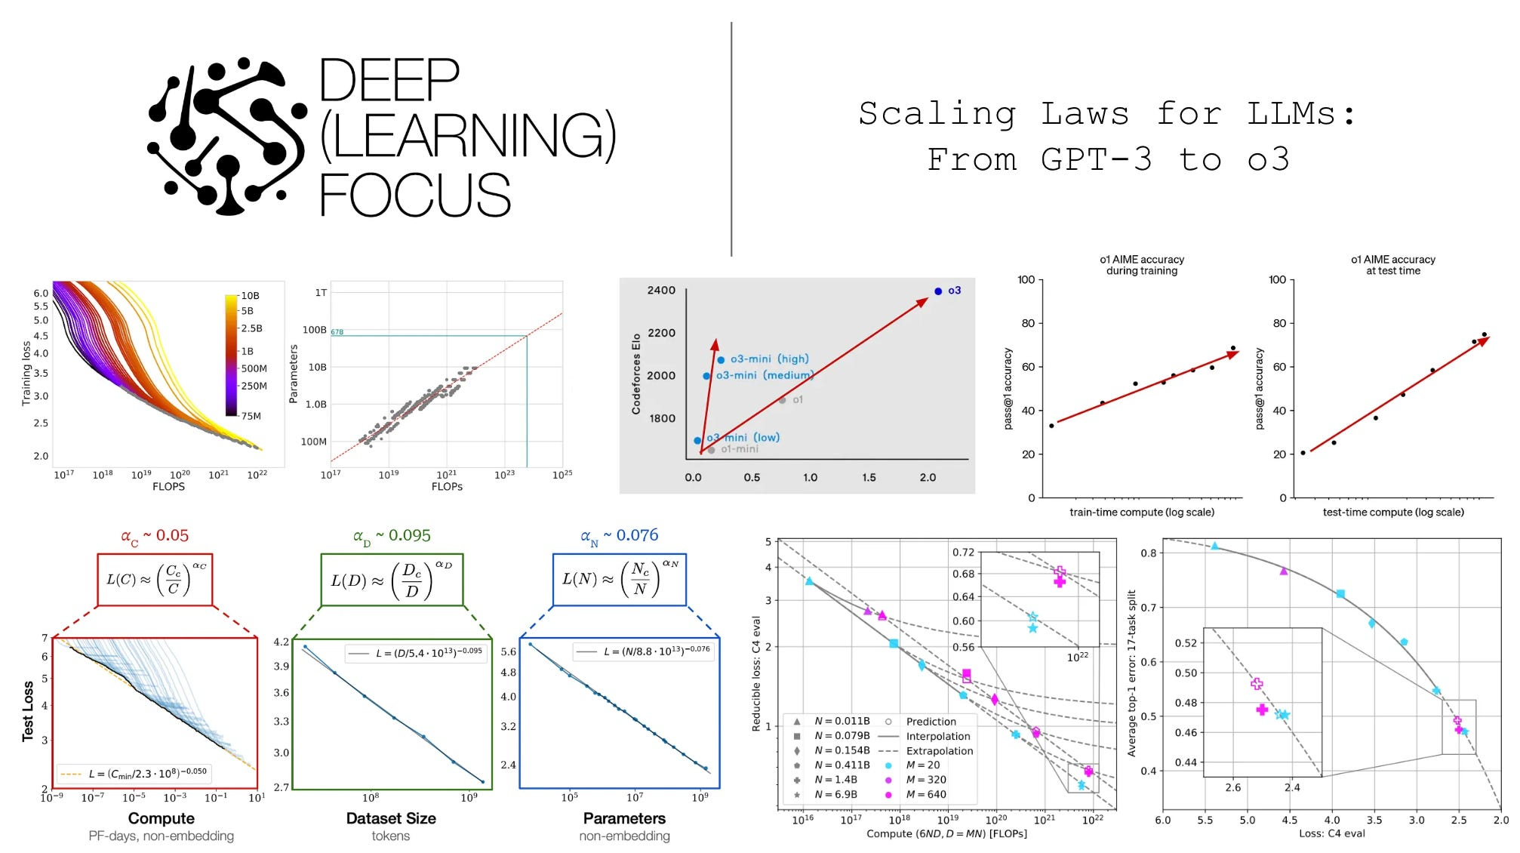
Necessary Elements for Breakthroughs
These breakthroughs have emerged as a result of the fusion of large amounts of data, high-performance computational resources (e.g., GPUs), and sophisticated algorithms.
Scaling Laws for LLMs
Source: https://cameronrwolfe.substack.com/p/llm-scaling-laws

Slide 11
2. trends in the latest AI technologies and business applications
Impact of Generative AI (especially large scale language models such as ChatGPT - LLM)
  What can it do?
    Brief description of principles: natural text generation (emails, resume correction, job posting assistance)
    Summarization (long-form candidate information, interview minutes)
    Translation
    Information retrieval, question and answer session
    Idea generation (career path proposal, list of interview questions)
  Predicting the next word from the last data.
  Explanation of actual examples:
    When you input "Create a job offer", the system generates a skeleton and sentences.
    When you type "Summarize this resume in 3 lines," a summary is generated.
Other Noteworthy Technologies
  Image recognition and video analysis:
    (e.g.) Possibility of analyzing nonverbal information from recruitment videos (future application), etc.
  Advancements in speech recognition and natural language processing:
    (e.g., automatic transcription of interview content, sentiment analysis, and work efficiency improvement through extraction of key points.
  Recommendation systems:
    Improvement of accuracy of job recommendation to candidates and candidate recommendation to companies.
Examples of business applications (broaden the image to include fields other than recruiting)
  Automatic customer service (chatbot)
  Personalization in marketing
  Quality inspection at manufacturing sites
Notes:
The presentation will focus on the recruitment industry and related technologies, with an emphasis on generative AI.

Slide 12
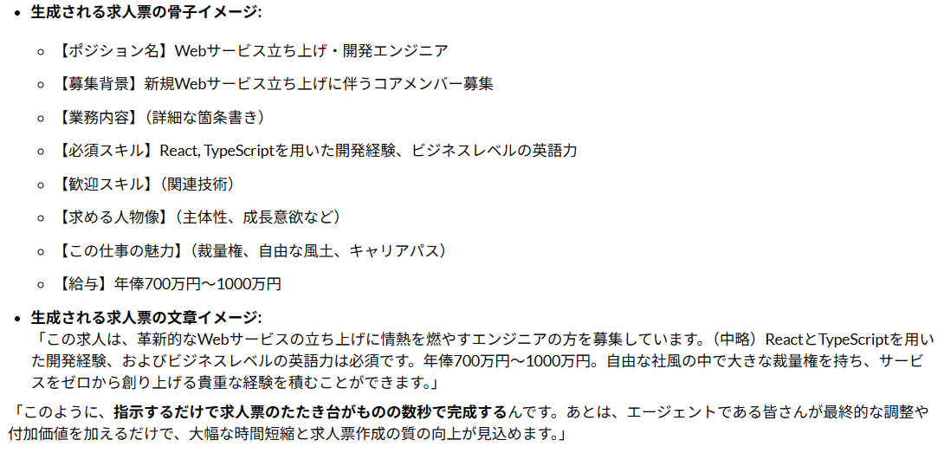
Example-1: Generating a skeleton and sentences by LLM (Generation AI) after inputting “Create a ●●job offer".
Prompt:
  "I need you to create a job posting for an engineer at an IT company as a member of a new web service launch. Required skills are React and TypeScript; English is business level. Salary is 7-10 million yen per year. The company's appeal is its free culture and discretionary power. "
LLM Generated Results:
●● Specific requirements of the job offer
Notes:
This is just an example, but one of the major benefits of generative AI is that it greatly reduces the "labor involved in writing" in your daily work in this way, allowing you to focus on more essential tasks.

Slide 13
Example-2: Resume Summarization Support by LLM (Generated AI)
Prompt.
  "Please summarize the content of this resume (or CV) in three lines, focusing specifically on your work experience and skills."
Example 2.1: For a resume for a sales position
  Summary: "Worked as a corporate solutions sales representative for a major financial institution for seven years. Consistently maintained a target achievement rate of 120% or higher and contributed to the development of new clients. Demonstrated leadership with project management experience."
Example 2.2: Resume for an engineering position
  Summary: "More than 5 years of experience in web application development, working on several projects with Python and AWS as key technologies. Particular strength in designing and implementing customer management systems. Extensive team development experience and strong technical problem solving skills."
In this way, you will be able to quickly and efficiently understand the candidate's core information without having to read through the entire detailed dossier. This speeds up the screening process and allows agents to spend more time on in-depth interviews and communication with candidates.
This can be a powerful tool to reduce the burden of information processing in daily work and dramatically improve productivity.

Slide 14
AI Application Scenarios in the Recruitment Industry
Streamline candidate management and scouting
  Automatic resume analysis and registration
  Recommendation of the most suitable jobs based on skills and experience
  Personalized scouting text creation support
Improvement of job search and matching
  Forecasting job needs based on market trend analysis
  Identification of candidates and companies with high probability of success based on historical data
  Non-trivial matching (uncovering hidden potential) based on vast amounts of data
Support of interview and selection process
  Automatic transcription and summary of interviews, analysis of candidate characteristics
  Support for preparation of proposal materials for companies
  Response to inquiries from applicants (FAQ chatbot)
Improvement of work productivity
  Automation of clerical work (document preparation, data entry)
  Email creation, support for taking meeting minutes
Notes:
This part is designed to help you think about the specifics of your company's operations.

Slide 15
4. first steps in introducing and utilizing AI
Importance of starting small: Don't seek perfection, but start with some operations.
Clarify objectives: What is the purpose of using AI?
Establish data infrastructure: AI is only possible with data. First of all, take stock of your data, organize it, and accumulate it.
Collaboration with vendors: Utilize the knowledge of experts.
Human resource development: Develop human resources who can master AI and co-create with AI.
Conclusion: AI is not a threat but a powerful partner.

Slide 16
If you have any questions, please feel free to contact me.

