Slide 1
MECH 498: Introduction to Robotics The Jacobian: Velocities and Static Forces
M. O’Malley

Slide 2
Got these out of order a bit. Inserting jacobian notes here. Then revert back into the linear/angular velocity lecture materials. Need to cover Jacobians first for next HW assignment. This is a decent enough starting point, but for next time, put the chunk of notes on jacobians at the START of the velocity lecture notes.

Slide 3
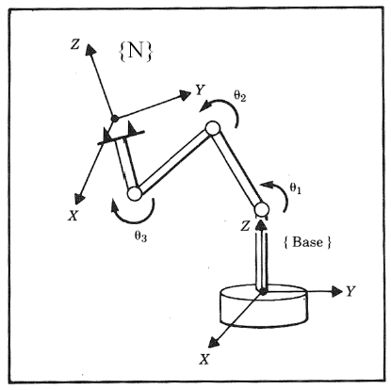
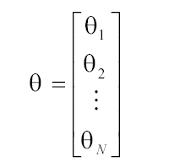
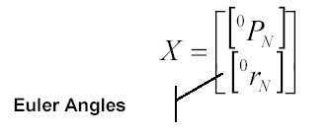
Kinematic Relations – Joint and Cartesian Spaces
A robot is often used to manipulate object attached to its tip (end effector).
The location of the robot tip may be specified using one of the following descriptions:
Joint Space
Cartesian Space

Slide 4
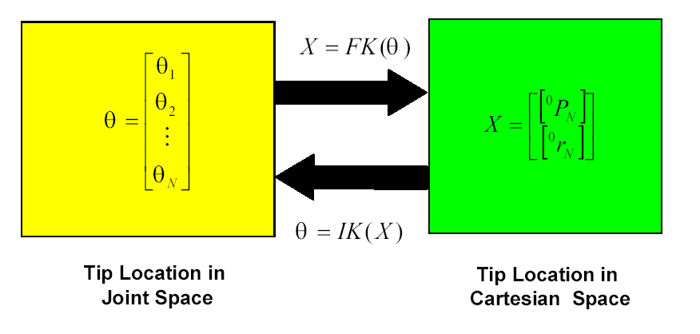
Kinematic Relations – Forward and Inverse
The robot kinematic equations relate the two descriptions of the robot tip location

Slide 5
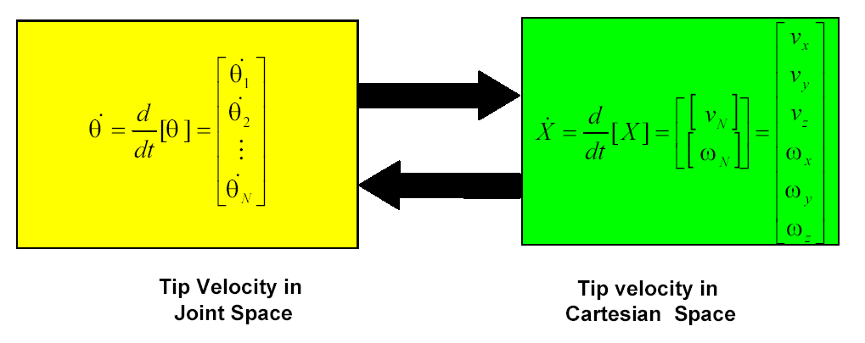
Kinematic Relations – Forward and Inverse

Slide 6
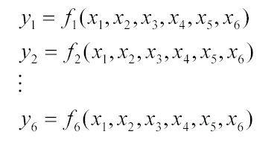

Jacobian Matrix - Introduction
The Jacobian is a multi-dimensional form of the derivative.
Suppose that for example we have 6 functions, each of which is a function of 6 independent variables
We may also use a vector notation to write these equations as

Slide 7
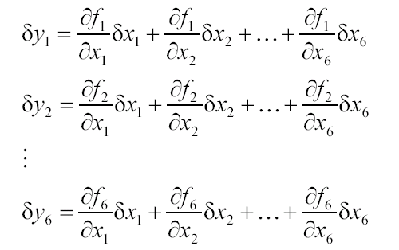
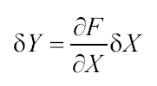
Jacobian Matrix - Introduction
If we wish to calculate the differential of y_{i} as a function of the differential x_{i} we use the chain rule to get
Which again might be written more simply using a vector notation as

Slide 8
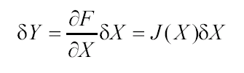

Jacobian Matrix - Introduction
The 6x6 matrix of partial derivative is defined as the Jacobian matrix
By dividing both sides by the differential time element, we can think of the Jacobian as mapping velocities in X to those in Y
Note that the Jacobian is time varying linear transformation

Slide 9
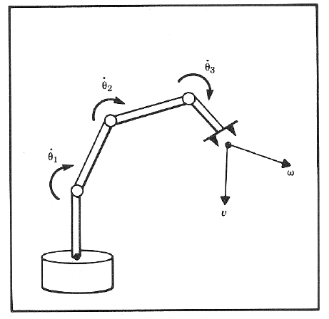
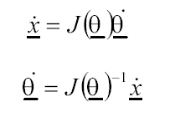
Jacobian Matrix - Introduction
In the field of robotics the Jacobian matrix describes the relationship between the joint angle rates ( ) and the translation and rotation velocities of the end effector ( )
This relationship is given by:

Slide 10
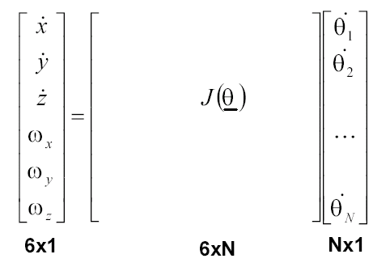
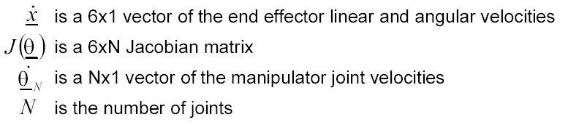
Jacobian Matrix - Introduction
This expression can be expanded to:
Where:

Slide 11
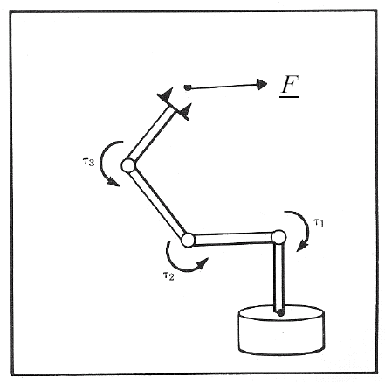

Jacobian Matrix - Introduction
In addition to the velocity relationship, we are also interested in developing a relationship between the robot joint torques ( τ ) and the forces and moments ( F ) at the robot end effector (Static Conditions).
This relationship is given by:

Slide 12
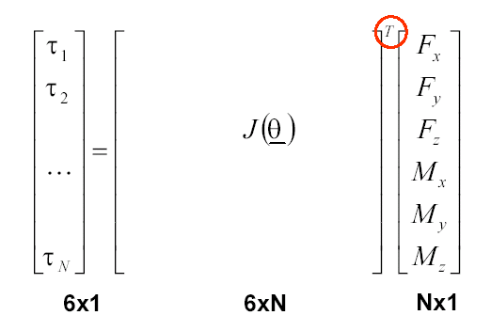
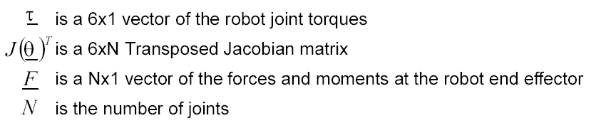
Jacobian Matrix - Introduction
This expression can be expanded to:
Where:
Nx1 Nx6 6x1
Nx1
Nx6
6x1

Slide 13
Jacobian Matrix – Calculation Methods
Differentiation of the Forward Kinematics Equations
Iterative
Jacobian Matrix

Slide 14
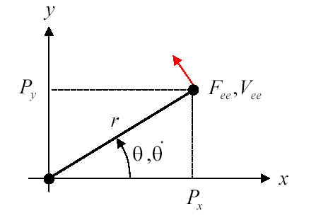
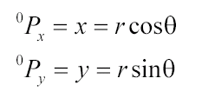
Joint Matrix by Differentiation – 1R
Consider a simple planar 1R robot
The end effector position is given by:

Slide 15
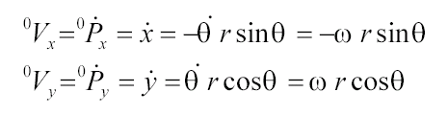
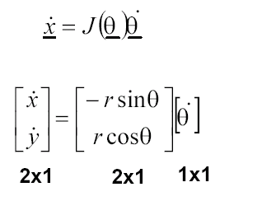
Joint Matrix by Differentiation – 1R
The velocity of the end effector is defined by:
Expressed in matrix form, we have:

Slide 16
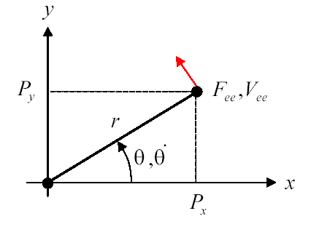

Joint Matrix by Differentiation – 1R
The moment about the joint generated by the force acting on the end effector is given by

Slide 17
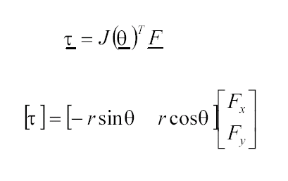
Joint Matrix by Differentiation – 1R
Expressed in matrix form, we have:

Slide 18
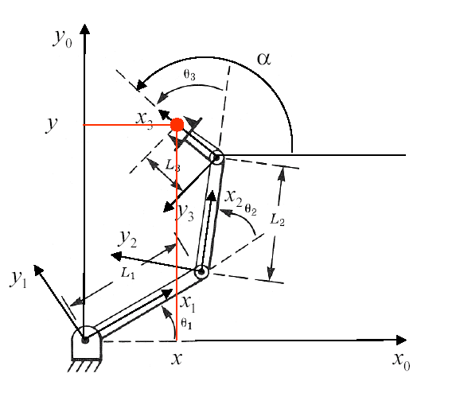
Joint Matrix by Differentiation – 3R
Consider the following planar 3-DOF manipulator:

Slide 19

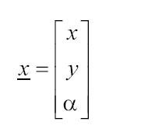
Joint Matrix by Differentiation – 3R
Problem:
Compute the Jacobian matrix that describes the relationship
Solution:
The end effector position and orientation is defined in the base frame by

Slide 20
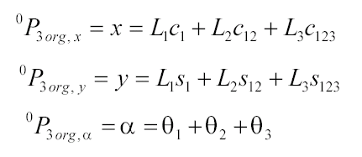
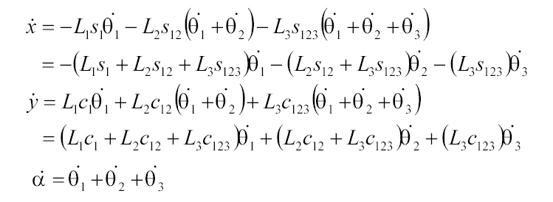
Joint Matrix by Differentiation – 3R
The forward kinematics gives us relationship of the end effector to the joint angles:
Differentiating the three expressions gives

Slide 21
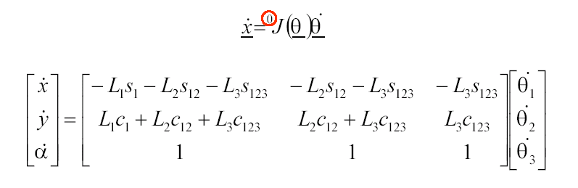
Joint Matrix by Differentiation – 3R
Using a matrix form, we get:
The Jacobian provides a linear transformation, giving a velocity map and a force map for a robot manipulator. For the simple example above, the equations are trivial, but can easily become more complicated with robots that have additional degrees a freedom. Before tackling these problems, consider this brief review of linear algebra.

Slide 22

Singularity – The Concept
Motivation:
We would like the hand of a robot (end effector) to move with a certain velocity vector in Cartesian space. Using linear transformation relating the joint velocity to the Cartesian velocity, we could calculate the necessary joint rates at each instance along the path.
Given:
a linear transformation relating the joint velocity to the Cartesian velocity (usually the end effector)
Question:
Is the Jacobian matrix invertible? (Or) Is it nonsingular?
Is the Jacobian invertible for all values of ?
If not, where is it not invertible?

Slide 23
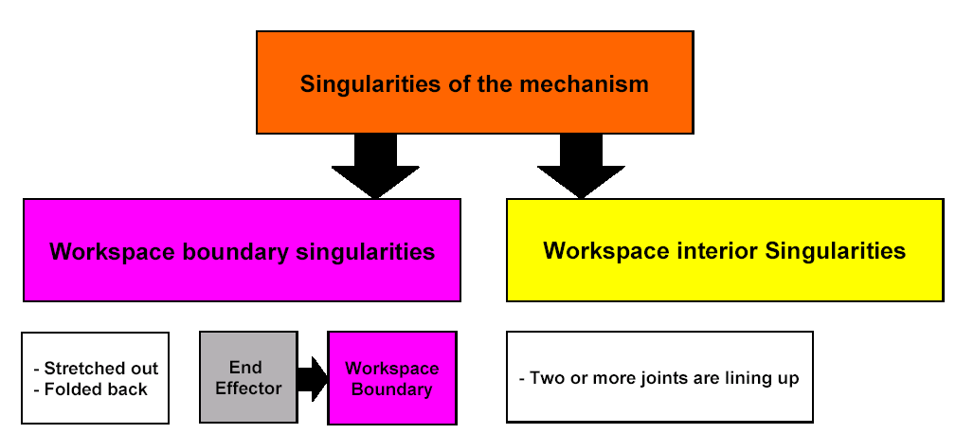
Singularity – The Concept
Answer (Conceptual): Most manipulator have values of where the Jacobian becomes singular . Such locations are called singularities of the mechanism or singularities for short

Slide 24
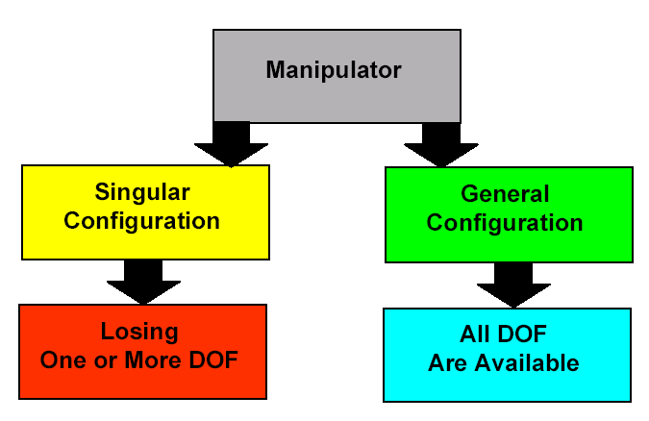
Singularity – The Concept
Losing one or more DOF means that there is a some direction (or subspace) in Cartesian space along which it is impossible to move the hand of the robot (end effector) no matter which joint rate are selected

Slide 25
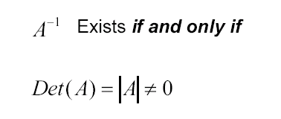
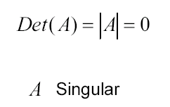
Brief Linear Algebra Review
Inverse of Matrix A exists if and only if the determinant of A is non-zero.
If the determinant of A is equal to zero, then the matrix A is a singular matrix

Slide 26
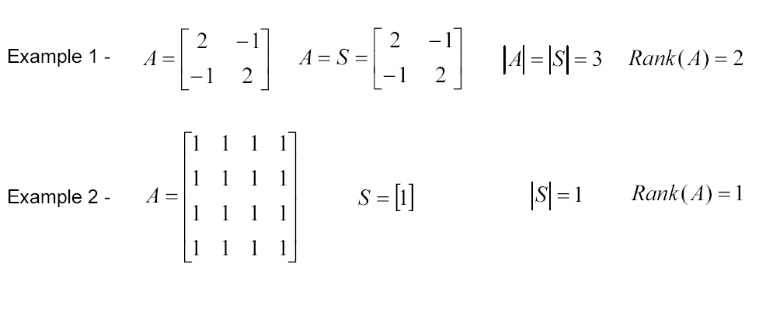
Brief Linear Algebra Review
The rank of the matrix A is the size of the largest squared Matrix S for which Det(S)≠0

Slide 27
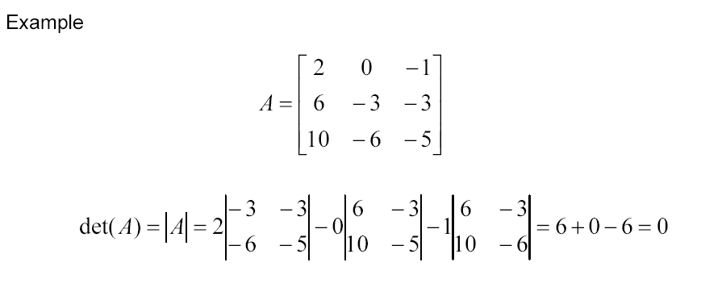
Brief Linear Algebra Review
If two rows or columns of matrix A are equal or related by a constant, then Det (A) = 0

Slide 28
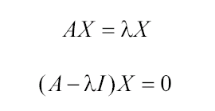

Brief Linear Algebra Review
Eigenvalues
Eigenvalues are the roots of the polynomial
If X ≠ 0, each solution to the characteristic equation λ (Eigenvalue) has a corresponding Eigenvector

Slide 29
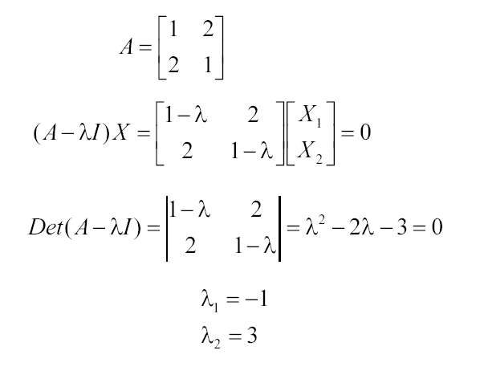
Brief Linear Algebra Review

Slide 30
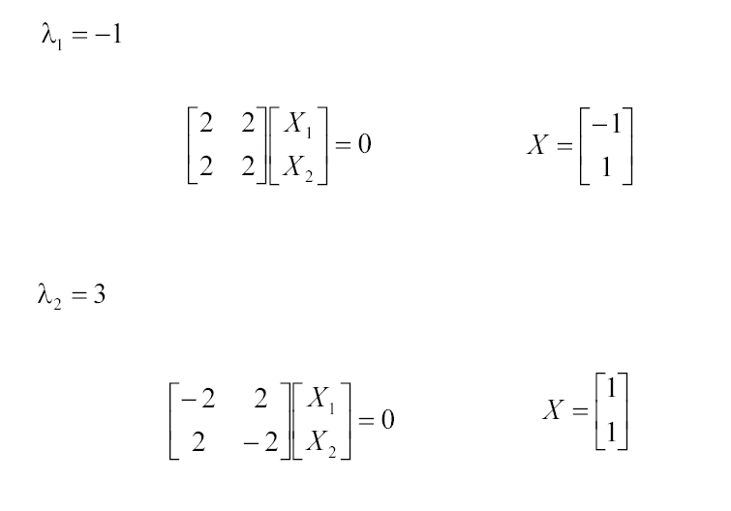
Brief Linear Algebra Review

Slide 31
Brief Linear Algebra Review
Any singular matrix ( Det(A) = 0 ) has at least one Eigenvalue equal to zero

Slide 32

Brief Linear Algebra Review
If A is non-singular ( Det(A) ≠ 0 ) and λ is an eigenvalue of A corresponding to eigenvector X, then

Slide 33
Brief Linear Algebra Review
If the n x n matrix A is of full rank (that is, Rank (A) = n), then the only solution to
AX = 0
is the trivial one
X = 0
If A is of less than full rank (that is, Rank (A) < n), then there are n-r linearly independent (orthogonal) solutions
x_{j} 0 ≤ j ≤ n-r
for which
Ax_{j} = 0

Slide 34
Brief Linear Algebra Review
If A is square, then A and A^{T} have the same eigenvalues

Slide 35
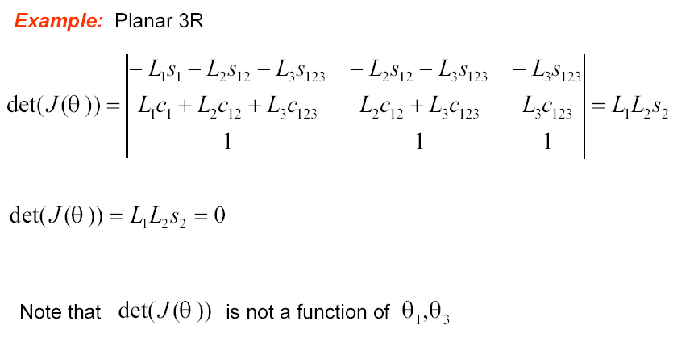
Properties of the Jacobian - Velocity Mapping and Singularities

Slide 36
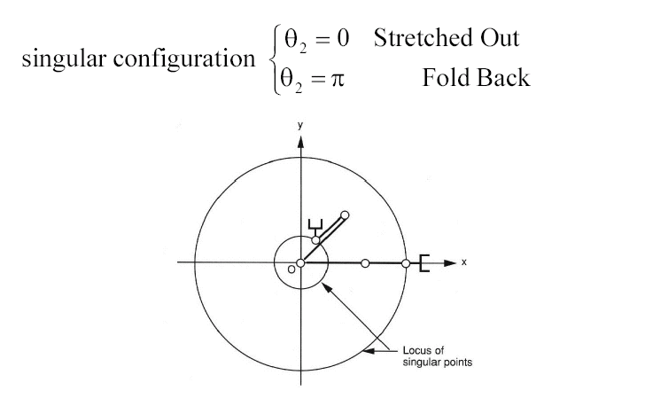
Properties of the Jacobian - Velocity Mapping and Singularities
The manipulator loses 1 DOF. The end effector can only move along the tangent direction of the arm. Motion along the radial direction is not possible.

Slide 37




Properties of the Jacobian - Force Mapping and Singularities
The relationship between joint torque and end effector force and moments is given by:
The rank of is equal to the rank of
At a singular configuration there exists a non trivial force F such that
In other words, a finite force can be applied to the end effector that produces no torque at the robot’s joints. In the singular configuration, the manipulator can “lock up.”

Slide 38
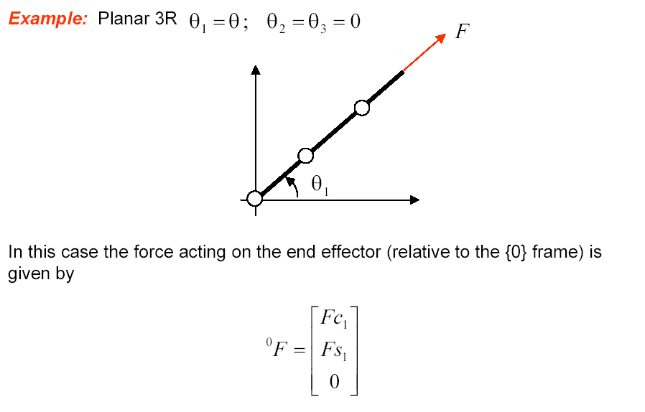
Properties of the Jacobian - Force Mapping and Singularities

Slide 39
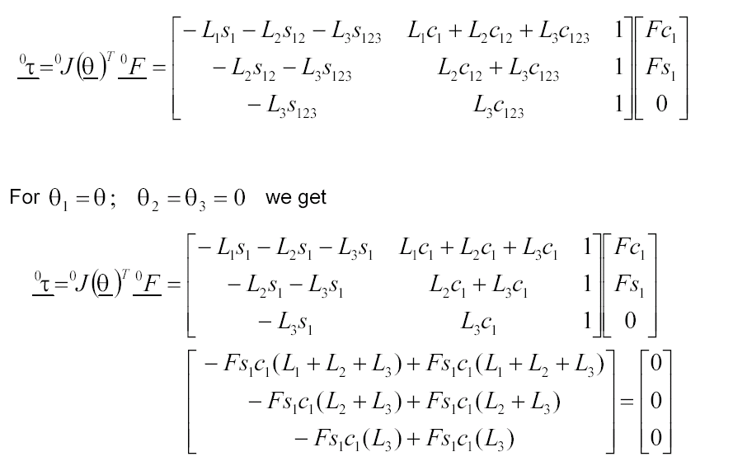
Properties of the Jacobian - Force Mapping and Singularities

Slide 40
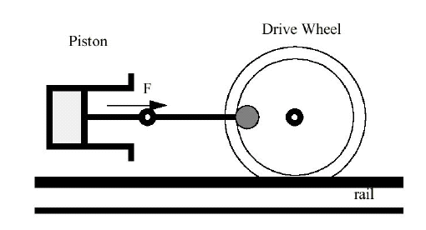
Properties of the Jacobian - Force Mapping and Singularities
This situation is an old and famous one in mechanical engineering.
For example, in the steam locomotive, “top dead center” refers to the following condition:
The piston force, F, cannot generate any torque around the drive wheel axis because the linkage is singular in the position shown.

Slide 41


Properties of the Jacobian - Velocity Mapping and Singularities
We have shown the relationship between joint space velocity and end effector velocity, given by
It is interesting to determine the inverse of this relationship, namely

Slide 42
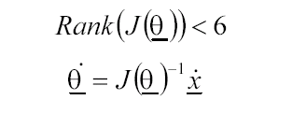

Properties of the Jacobian - Velocity Mapping and Singularities
Consider the square 6x6 case for J(θ)
If rank < 6 ( Det(J(θ)) = 0 ), then there is no solution to the inverse equation (see Brief Linear Algebra Review)
However, if the rank = 5, then there is at least one non-trivial solution to the forward equation (see BLAR). That is, for

Slide 43
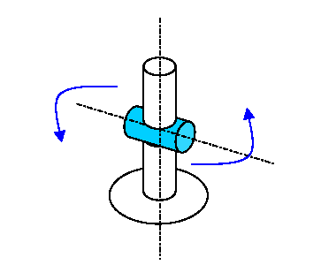
Properties of the Jacobian - Velocity Mapping and Singularities
The solution is a direction in the in joint velocity space for which joint motion produces no end effector motion.
We call any joint configuration θ = Q for which Rank (J(θ)) < 6 a singular configuration.

Slide 44
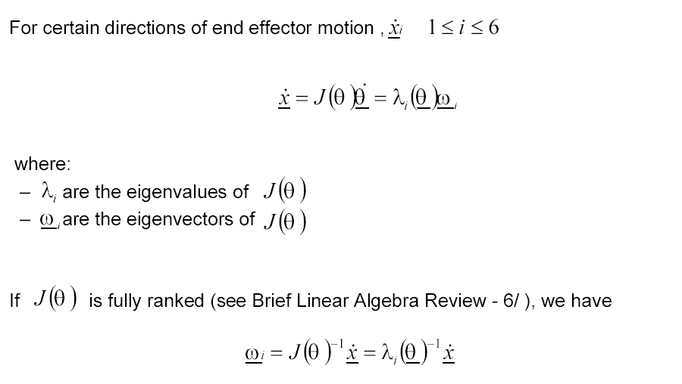

Properties of the Jacobian - Velocity Mapping and Singularities
For certain directions of end effector motion
Where
If J(θ) is fully ranked (see BLAR), we have

Slide 45
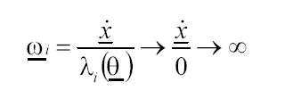

Properties of the Jacobian - Velocity Mapping and Singularities
As the joints approach a singular configuration θ = Q there is at least one eigenvalue for which λ_{i} → 0. This results in
In other words, as the joints approach the singular configuration, the end effector motion in a particular task direction causes the joint velocities to approach infinity. However, there are task velocities that can have solutions.
If J(θ) loses rank by only one, then there are n-1 eigenvectors in the task velocity space ( ) for which solutions do exist. However, there can be multiple solutions.

Slide 46
End of jacobian material
Resume velocity lecture notes

Slide 47
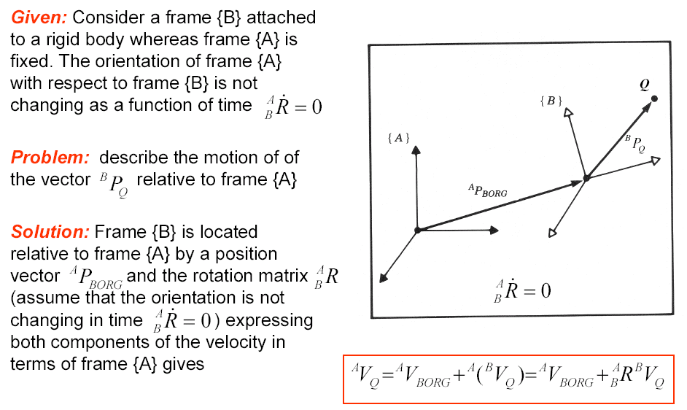
Linear Velocity – Rigid Body

Slide 48
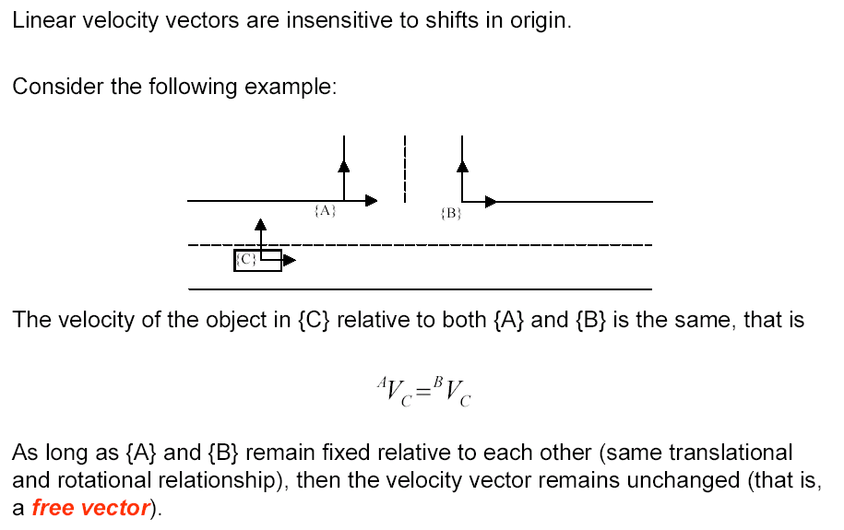
Linear Velocity – Free Vector

Slide 49
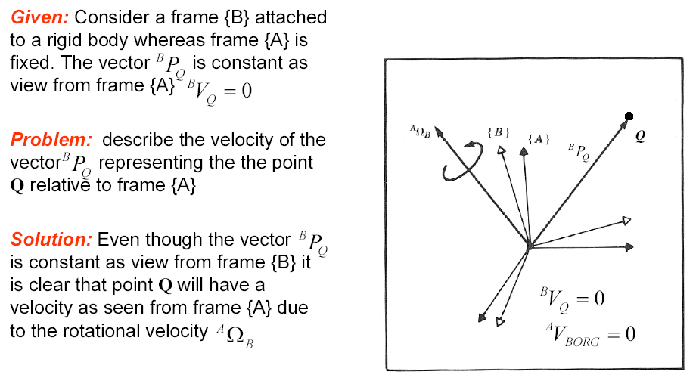
Angular Velocity – Rigid Body

Slide 50
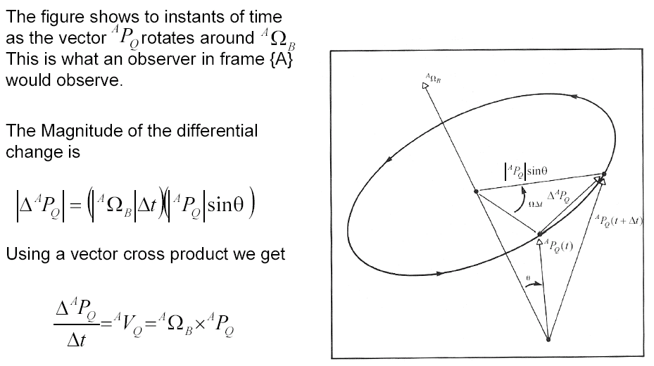
Angular Velocity – Rigid Body – Intuitive Approach
2

Slide 51
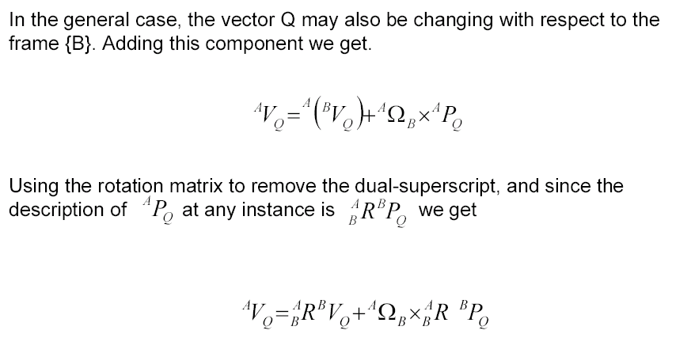
Angular Velocity – Rigid Body – Intuitive Approach

Slide 52

Simultaneous Linear and Rotational Velocity

Slide 53

Simultaneous Linear and Rotational Velocity - Vector Versus Matrix Representation

Slide 54


Changing Frame of Representation - Linear Velocity
We have already used the homogeneous transform matrix to compute the location of position vectors in other frames:
To compute the relationship between velocity vectors in different frames, we will take the derivative:

Slide 55


Changing Frame of Representation - Linear Velocity
Recall that
so that the derivative is

Slide 56



Changing Frame of Representation - Linear Velocity
So that
Substitute the previous results into the original equation:
we get

Slide 57


Changing Frame of Representation - Linear Velocity
This expression is equivalent to the following three-part expression:
Converting from matrix to vector form yields

Slide 58




Changing Frame of Representation - Angular Velocity
We use rotation matrices to represent angular position so that we can compute the angular position of {C} in {A} if we know the angular position of {C} in {B} and {B} in {A} by
To derive the relationship describing how angular velocity propagates between frames, we will take the derivative
Substituting the angular velocity matrix ,
we find

Slide 59

Changing Frame of Representation - Angular Velocity

Slide 60

Summary - Simultaneous Linear and Rotational Velocity

Slide 61
Velocity Propagation between Robot Links

Slide 62

Position Propagation
The homogeneous transform matrix provides a complete description of the linear and angular position relationship between adjacent links.
These descriptions may be combined together to describe the position of a link relative to the robot base frame {0}.
A similar description of the linear and angular velocities between adjacent links as well as the base frame would also be useful.

Slide 63

Motion of the Link of a Robot
In considering the motion of a robot link we will always use link frame {0} as the reference frame
Where:
v_{i} is the linear velocity of the origin of link frame (i) with respect to frame {0}
ω_{i} is the angular velocity of the origin of link frame (i) with respect to frame {0}

Slide 64


Velocities - Frame & Notation
Expressing the velocity of a frame {i} (associated with link i ) relative to the robot base (frame {0}) using our previous notation is defined as follows:
The velocities differentiate (computed) relative to the base frame {0} are often represented relative to other frames {k}. The following notation is used for this condition:

Slide 65

Velocity Propagation
Given: A manipulator - A chain of rigid bodies each one capable of moving relative to its neighbor
Problem: Calculate the linear and angular velocities of the link of a robot
Solution (Concept): Due to the robot structure we can compute the velocities of each link in order starting from the base.
The velocity of link i+1 will be that of link i , plus whatever new velocity components were added by joint i+1

Slide 66


Velocity of Adjacent Links – Angular Velocity
From the relationship developed previously
we can re-assign link names to calculate the velocity of any link i relative to the base frame {0}

Slide 67

Velocity of Adjacent Links – Angular Velocity

Slide 68

Velocity of Adjacent Links – Angular Velocity

Slide 69


Velocity of Adjacent Links – Angular Velocity
Angular velocity of frame {i+1} measured (differentiate) in frame {i} and represented (expressed) in frame {i+1}
Assuming that a joint has only 1 DOF. The joint configuration can be either revolute joint (angular velocity) or prismatic joint (Linear velocity).
Based on the frame attachment convention in which we assign the Z axis pointing along the i+1 joint axis such that the two are coincide (rotations of a link is preformed only along its Z- axis) we can rewrite this term as follows:

Slide 70

Velocity of Adjacent Links – Angular Velocity
The result is a recursive equation that shows the angular velocity of one link in terms of the angular velocity of the previous link plus the relative motion of the two links.

