Slide 1
MECH 498: Introduction to Robotics The Jacobian: Velocities and Static Forces
M. O’Malley

Slide 2
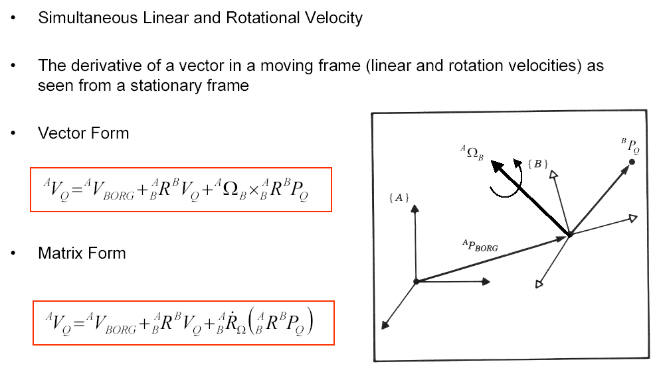
Velocity of Adjacent Links – Linear Velocity

Slide 3
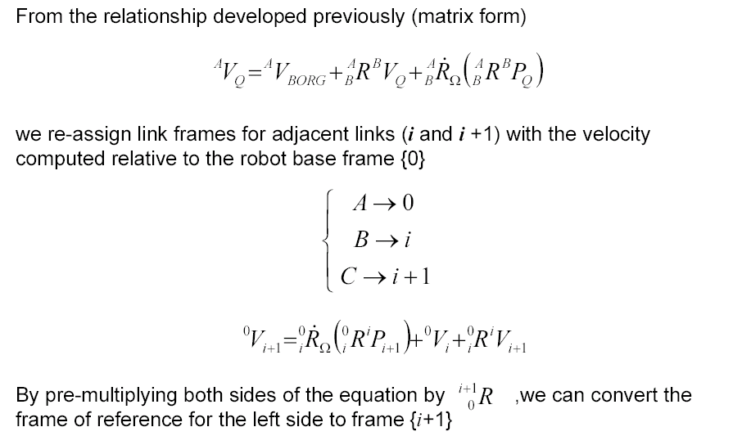
Velocity of Adjacent Links – Linear Velocity

Slide 4
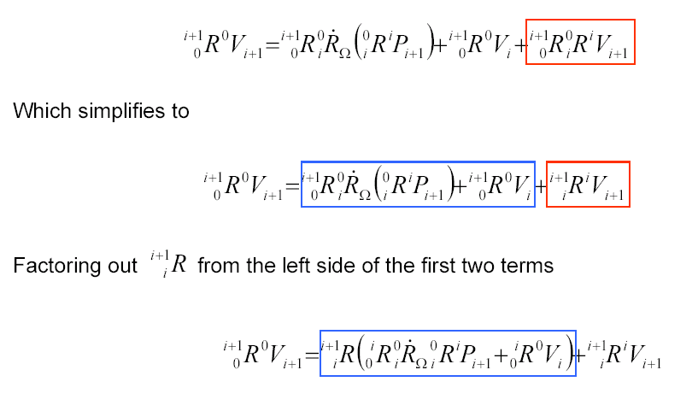
Velocity of Adjacent Links – Linear Velocity

Slide 5
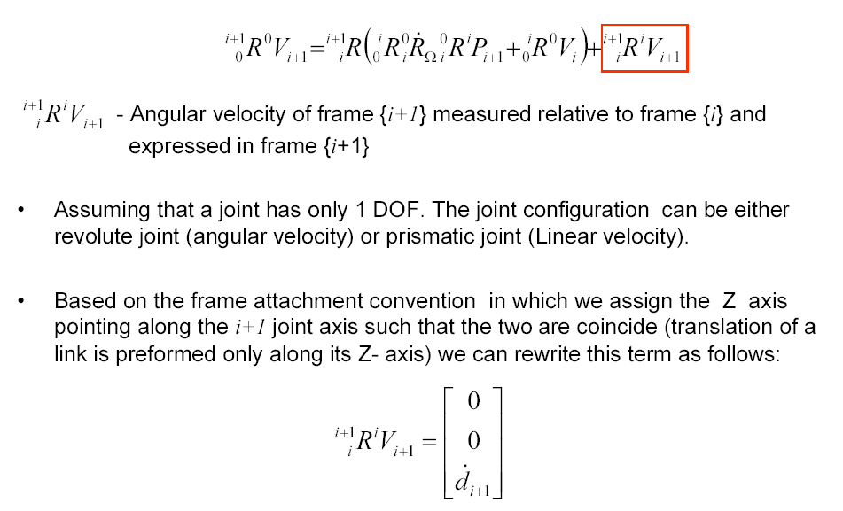
Velocity of Adjacent Links – Linear Velocity

Slide 6
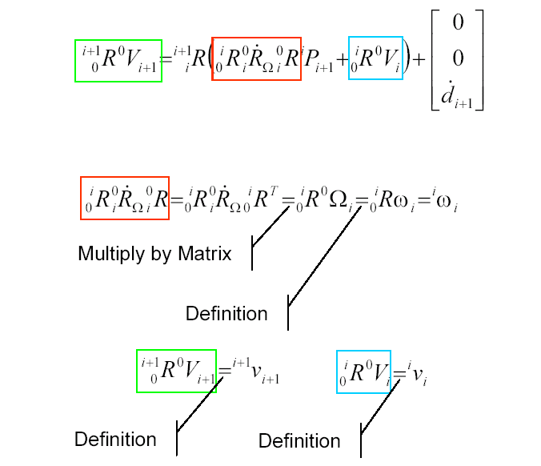
Velocity of Adjacent Links – Linear Velocity

Slide 7
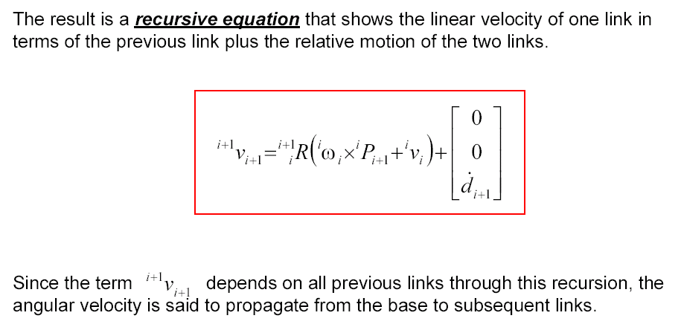
Velocity of Adjacent Links – Linear Velocity

Slide 8
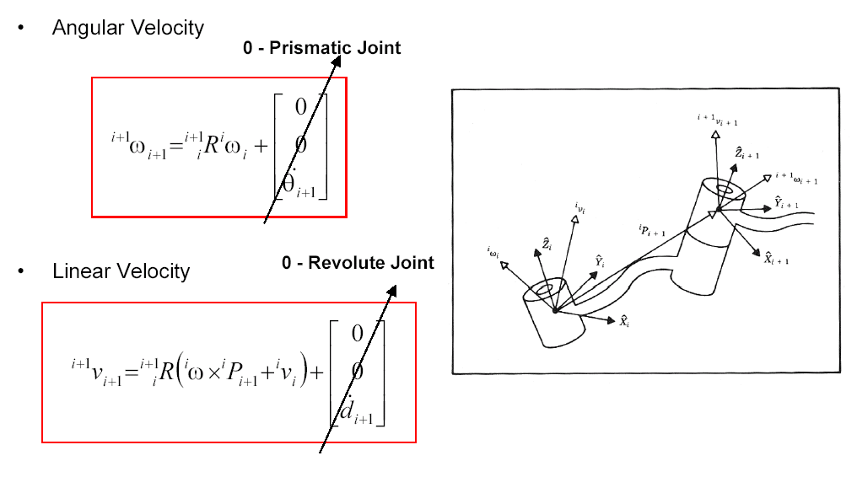
Velocity of Adjacent Links - Summary

Slide 9
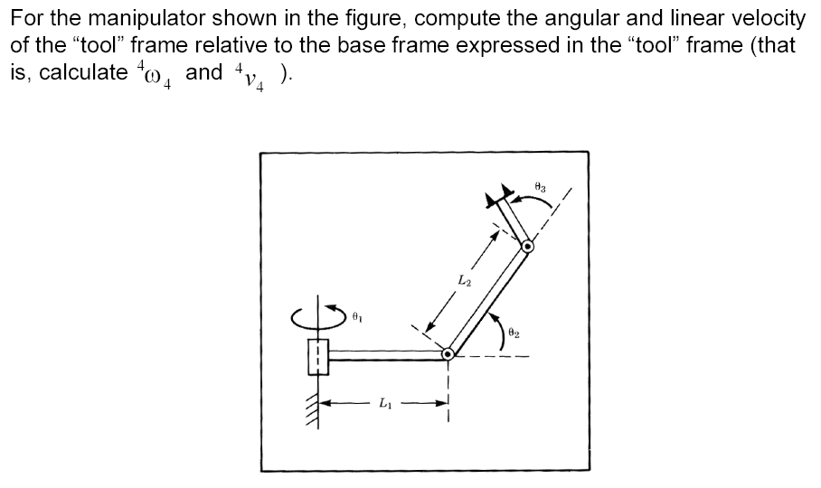
Angular and Linear Velocities - 3R Robot - Example

Slide 10
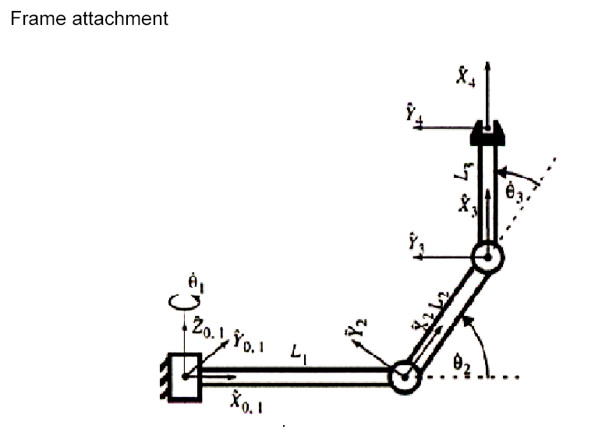
Angular and Linear Velocities - 3R Robot - Example

Slide 11
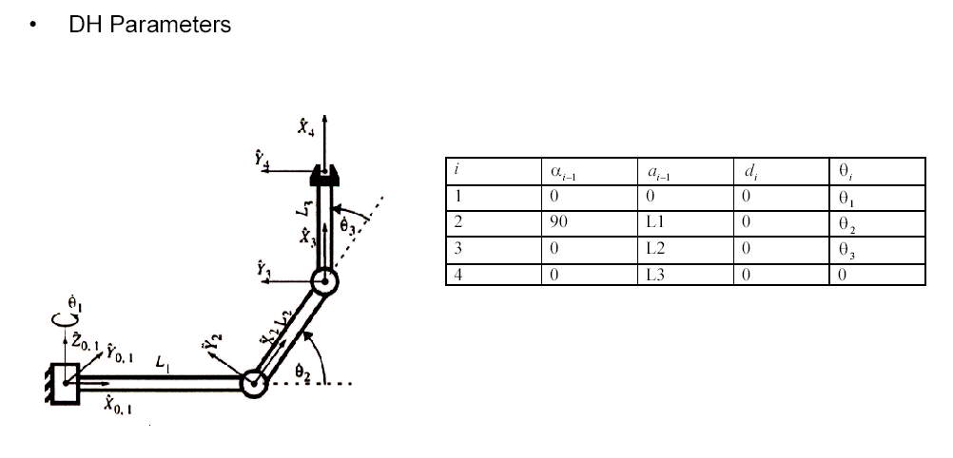
Angular and Linear Velocities - 3R Robot - Example

Slide 12
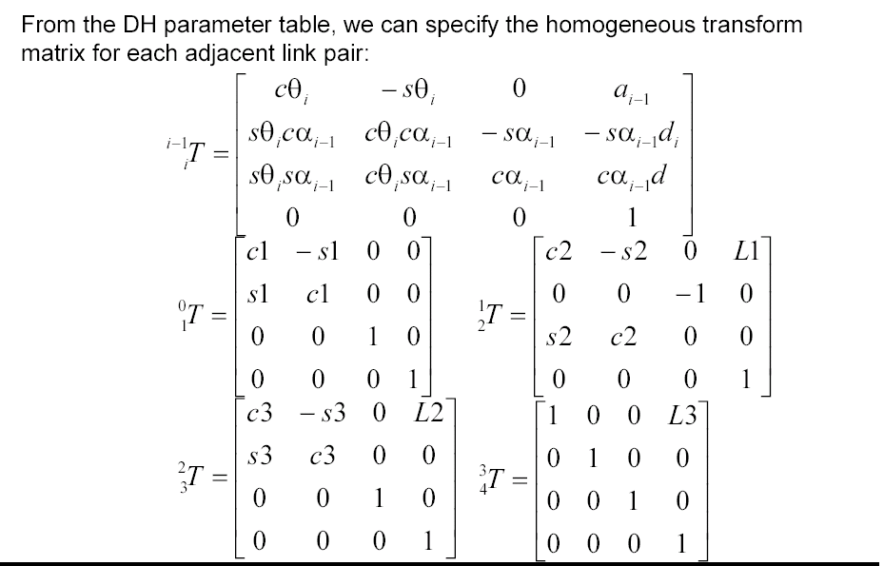
Angular and Linear Velocities - 3R Robot - Example

Slide 13
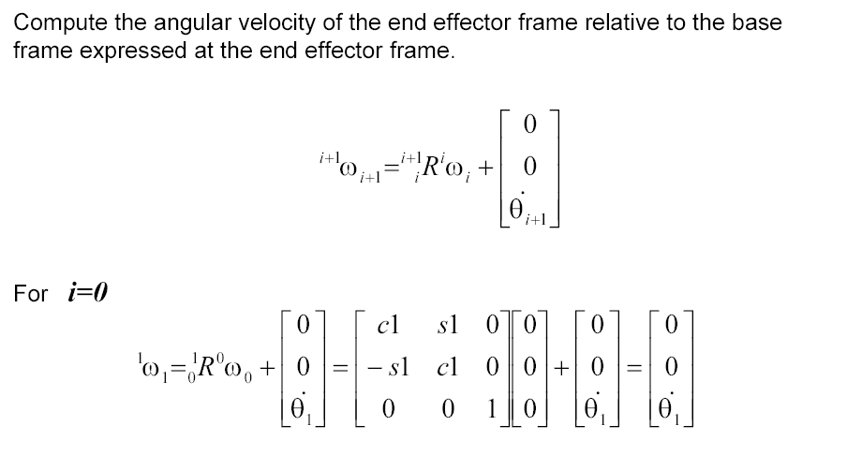
Angular and Linear Velocities - 3R Robot - Example

Slide 14
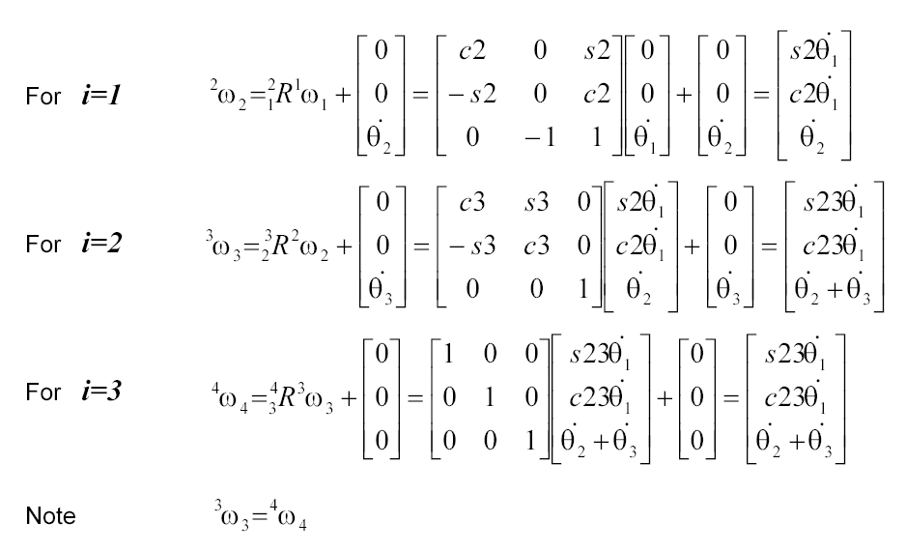
Angular and Linear Velocities - 3R Robot - Example
0
Notes:
The zero here was the mistake -

Slide 15
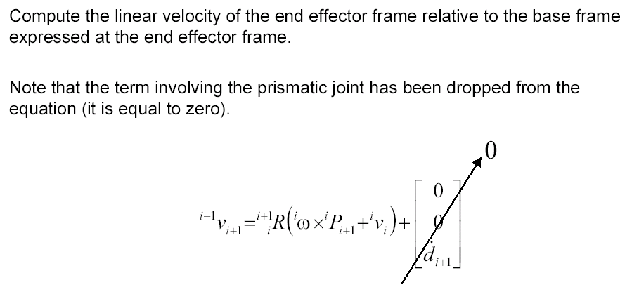
Angular and Linear Velocities - 3R Robot - Example

Slide 16
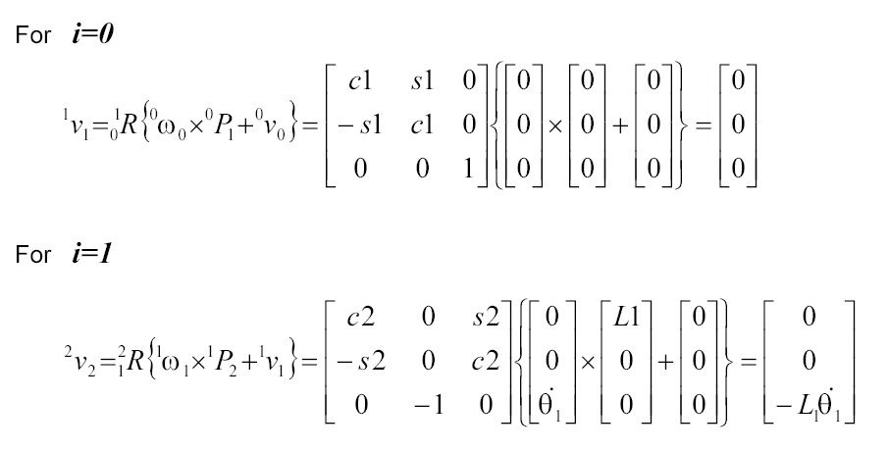
Angular and Linear Velocities - 3R Robot - Example

Slide 17
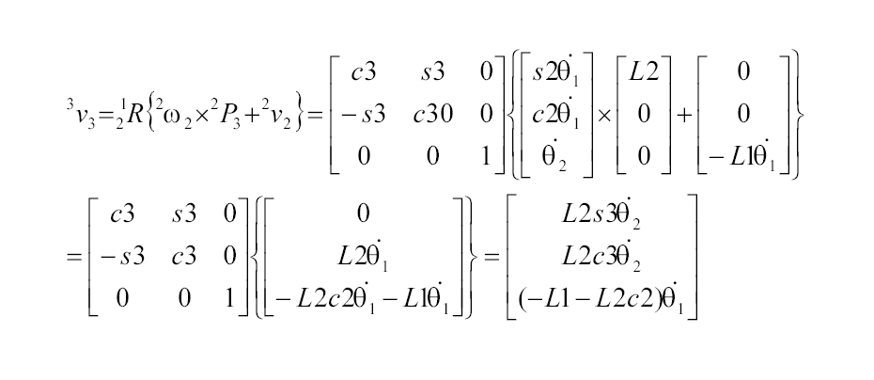
Angular and Linear Velocities - 3R Robot - Example
3

Slide 18
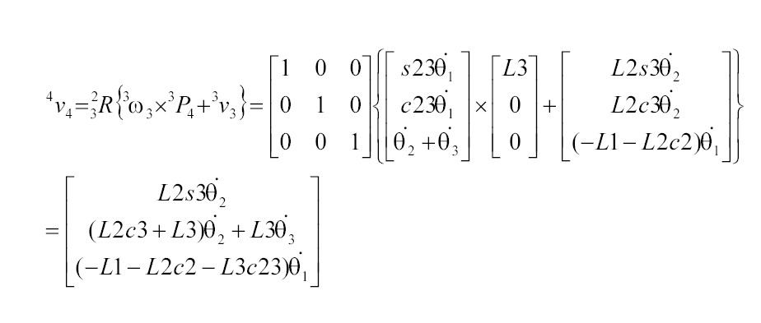
Angular and Linear Velocities - 3R Robot - Example

Slide 19
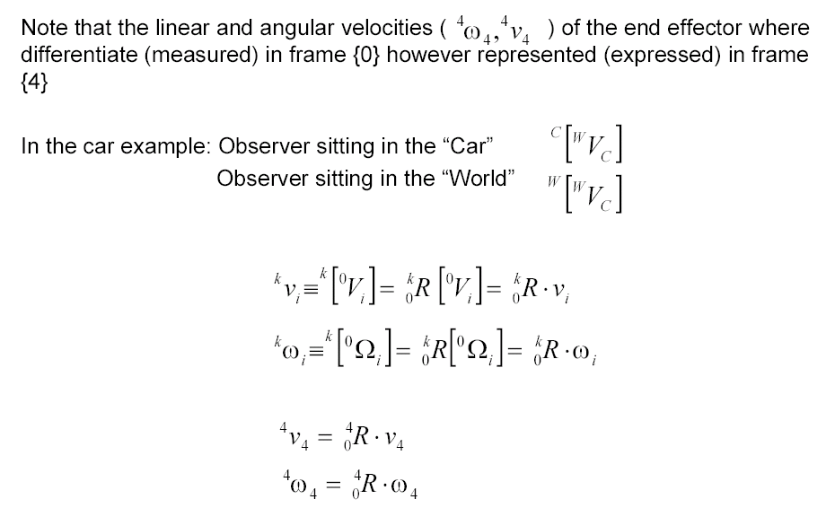
Angular and Linear Velocities - 3R Robot - Example

Slide 20
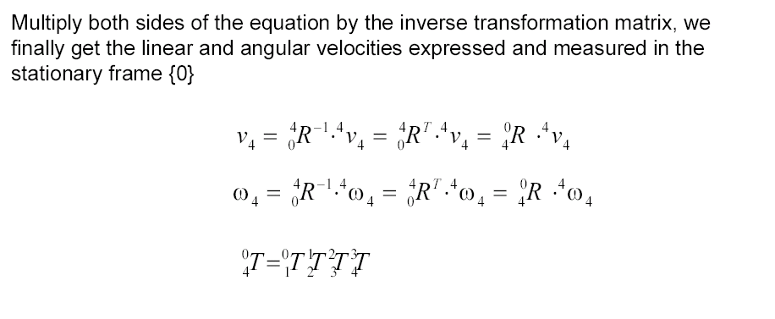
Angular and Linear Velocities - 3R Robot - Example

Slide 21
Jacobian – Velocity Propagation

Slide 22
Jacobian Matrix - Calculation Methods
Differentiation of the Forward Kinematics Equations
Iterative
Recursive Equations
Jacobian Matrix

Slide 23
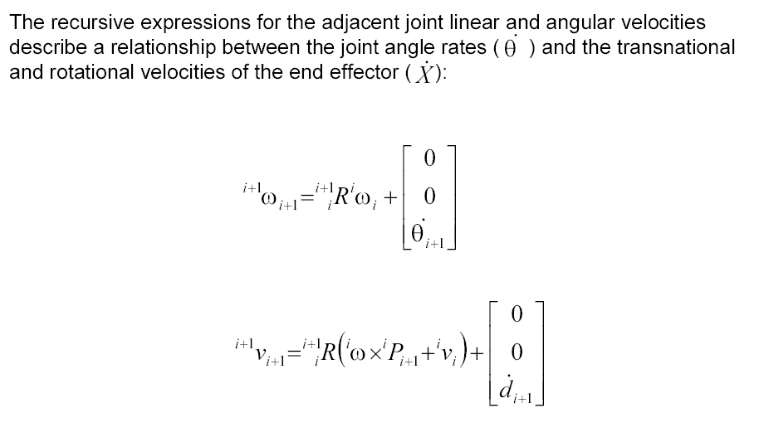
Jacobian: Velocity propagation

Slide 24
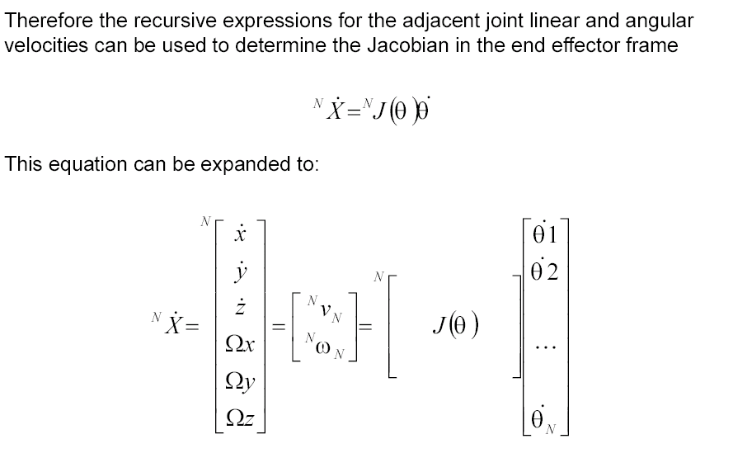
Jacobian: Velocity propagation

Slide 25
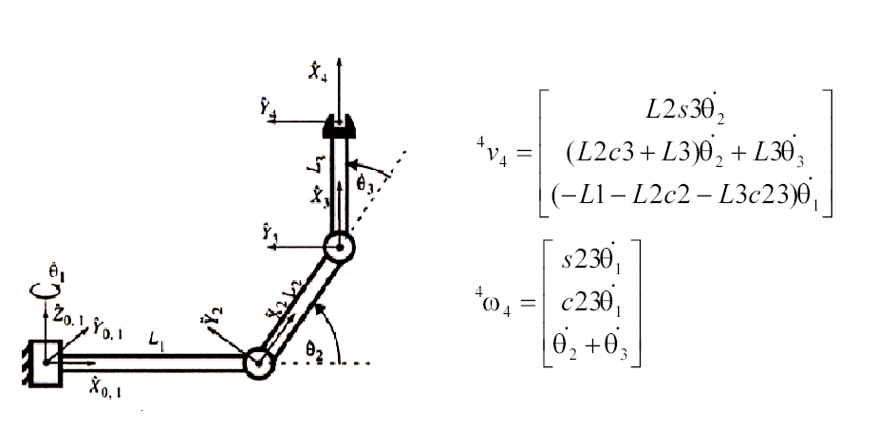
Jacobian - 3R – Example
The linear angular velocities of the end effector (N=4)

Slide 26
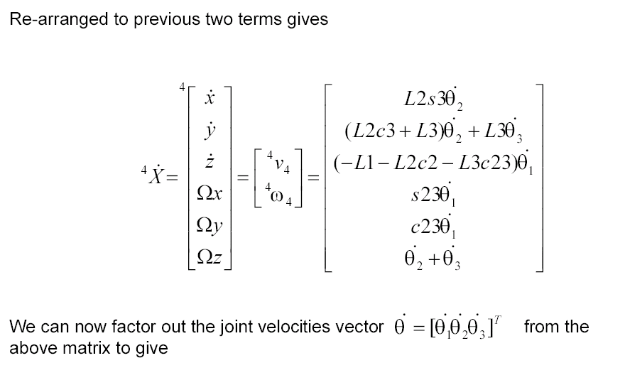
Jacobian - 3R – Example

Slide 27
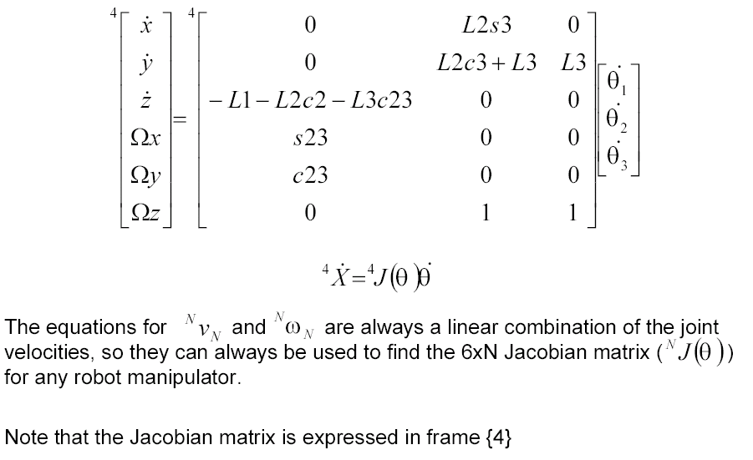
Jacobian - 3R – Example

Slide 28
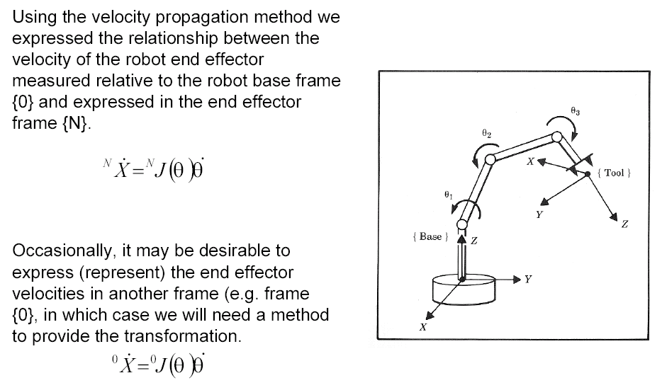
Jacobian: Frame of Representation

Slide 29
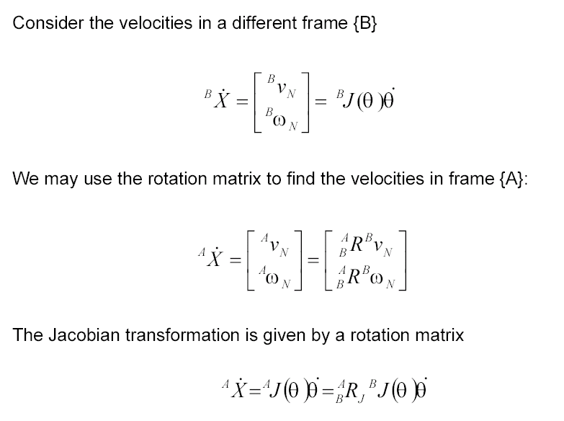
Jacobian: Frame of Representation

Slide 30
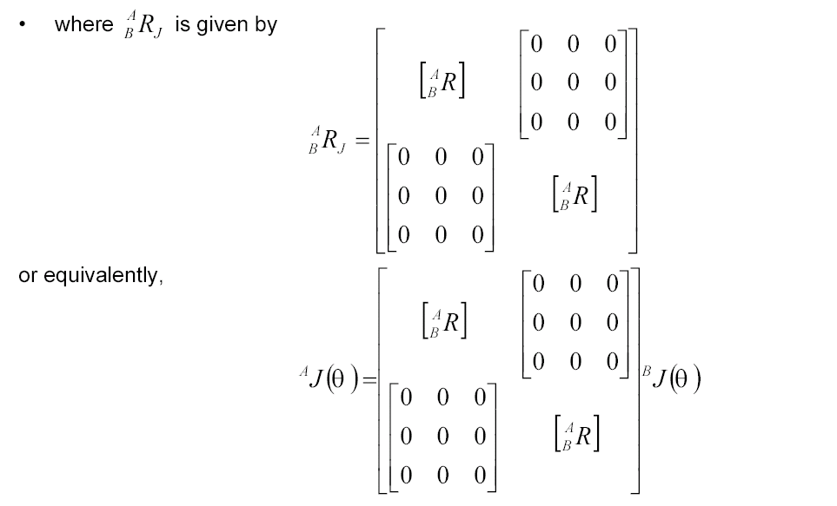
Jacobian: Frame of Representation

Slide 31
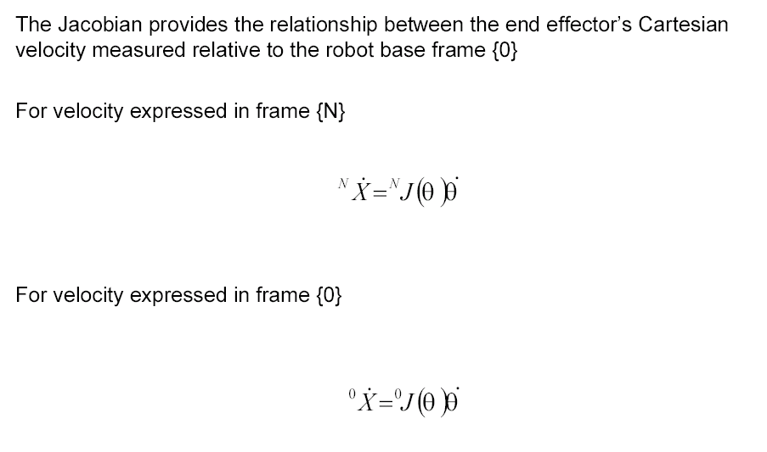
Jacobian: Frame of Representation

Slide 32
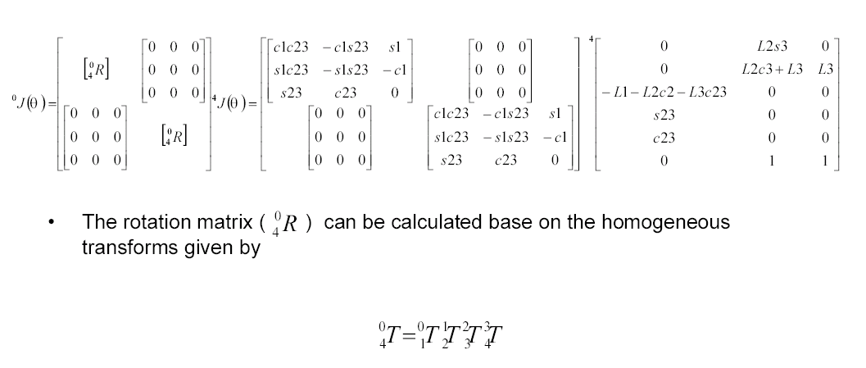
Jacobian: Frame of Representation - 3R Example

Slide 33
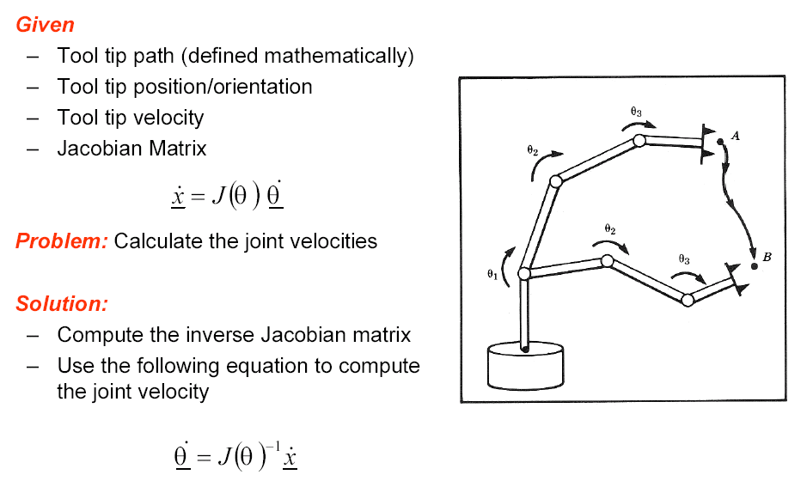
Inverse Jacobian

Slide 34
Inverse Jacobian
Cases in which the Jacobian matrix J(θ) is not invertible (does not exist)
Non-invertible matrix is called singular matrix
The Jacobian matrix is not squared
In general the 6xN Jacobian matrix may be non-square in which case the inverse is not defined
The determinant det(J(θ)) is equal to zero

Slide 35
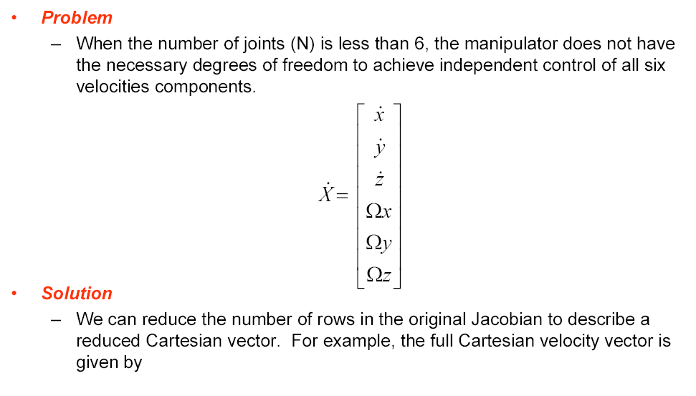
Inverse Jacobian – Reduced Jacobian

Slide 36
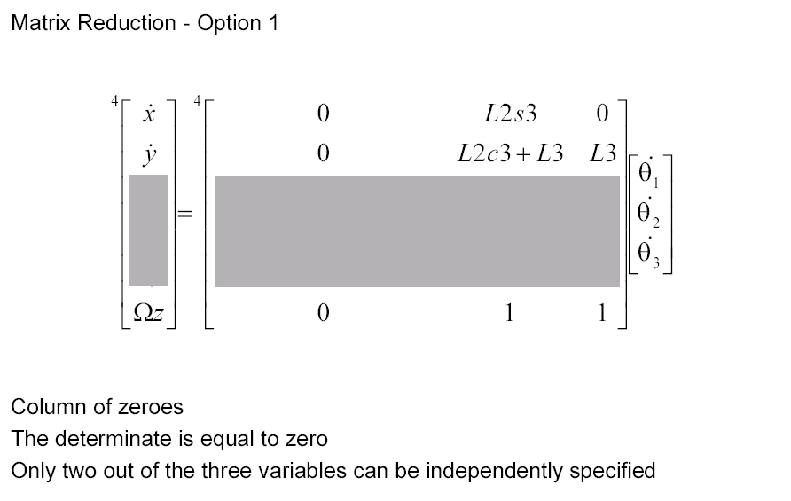
Jacobian: Reduced Jacobian – 3R example

Slide 37
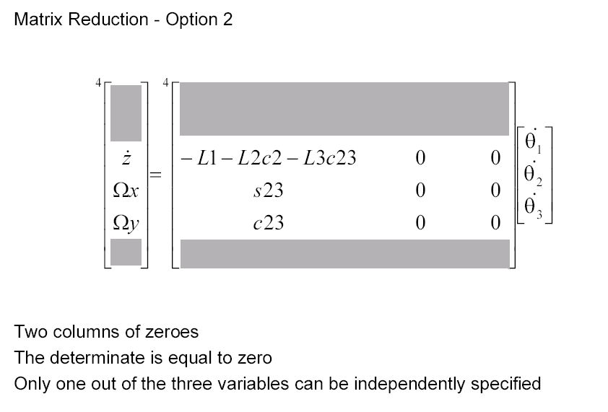
Jacobian: Reduced Jacobian – 3R example

Slide 38
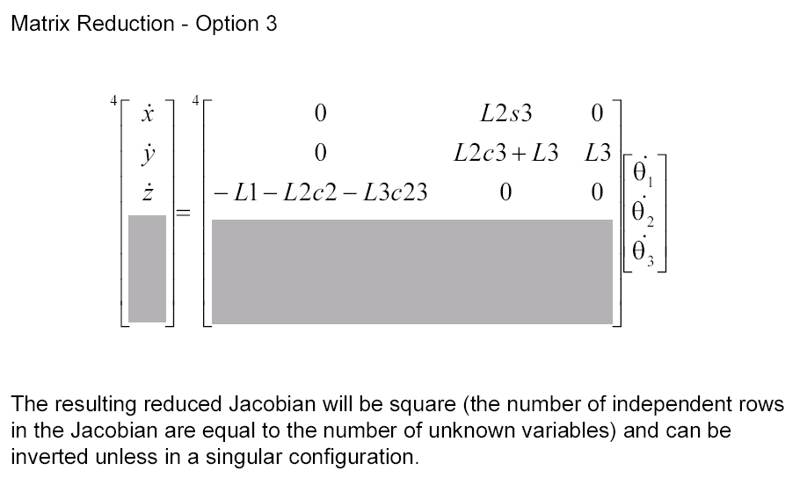
Jacobian: Reduced Jacobian – 3R example

Slide 39
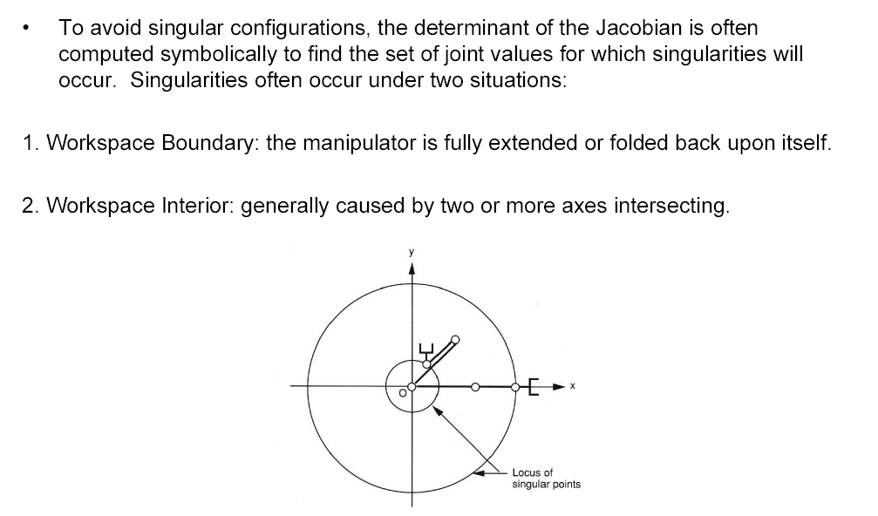
Jacobian - Singularities

Slide 40
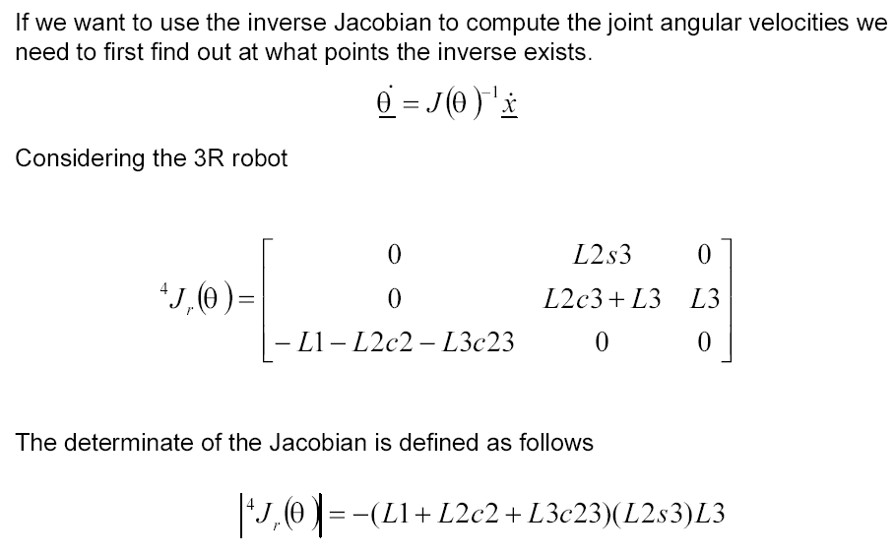
Jacobian: Singular Configuration - 3R Example

Slide 41
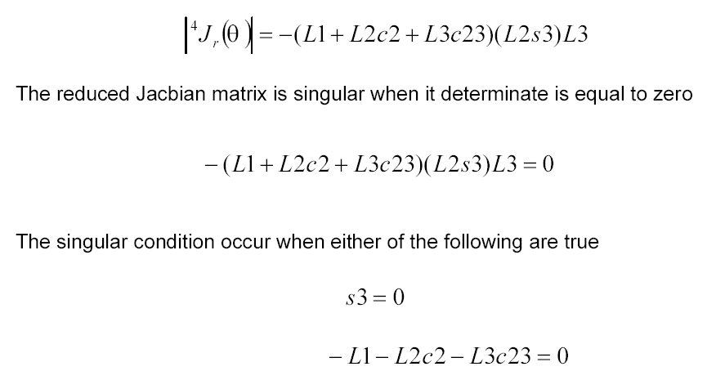
Jacobian: Singular Configuration - 3R Example

Slide 42
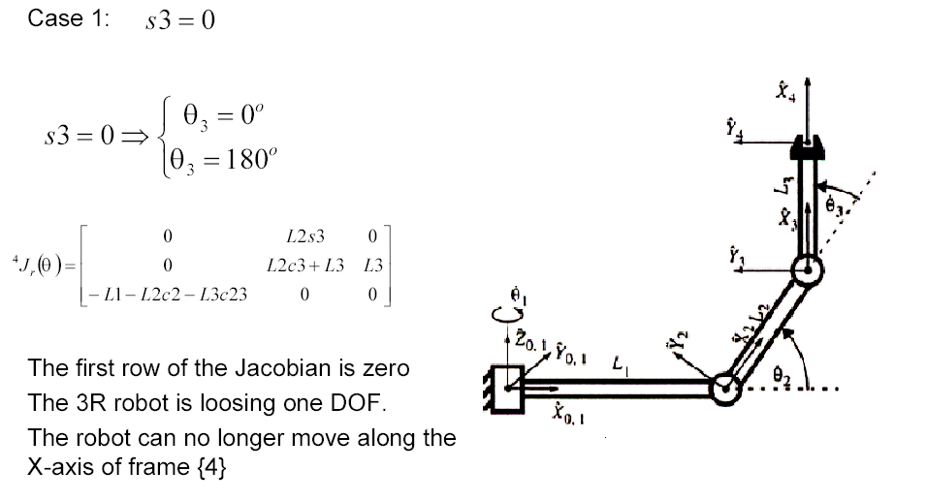
Jacobian: Singular Configuration - 3R Example

Slide 43
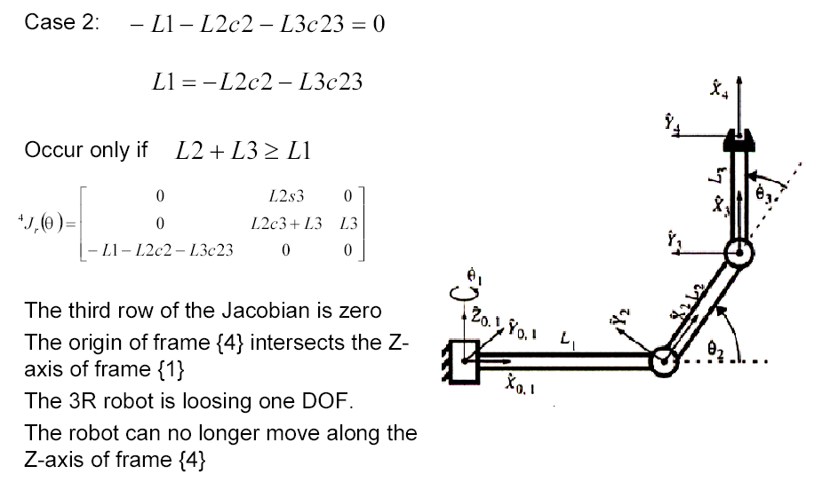
Jacobian: Singular Configuration - 3R Example

Slide 44
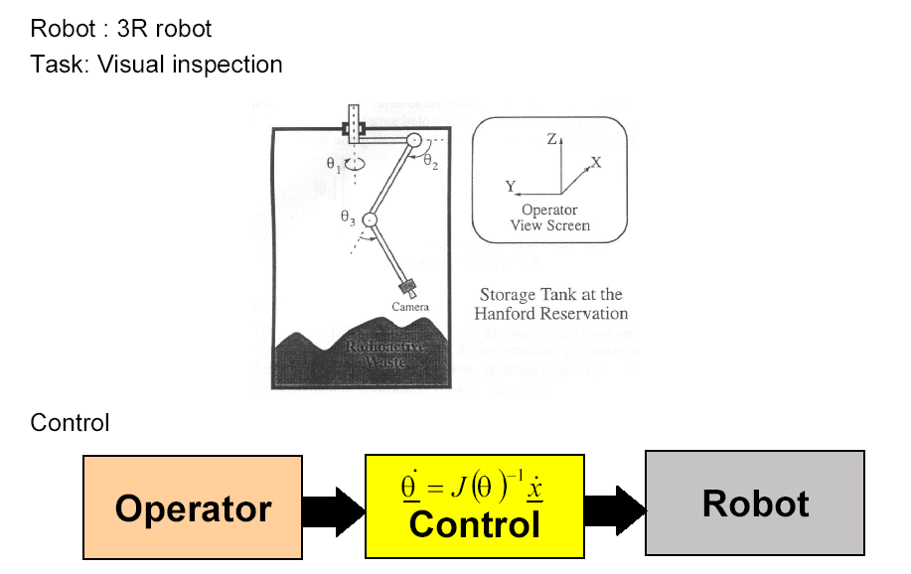
Joint Velocity Near Singular Position - 3R Example

Slide 45
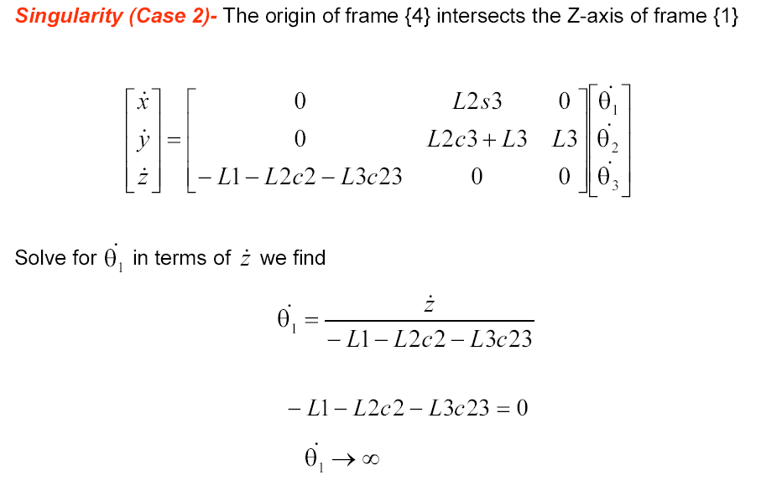
Joint Velocity Near Singular Position - 3R Example

Slide 46
Joint Velocity Near Singular Position - 3R Example
Problems:
The robot is physically limited from unusual high joint velocities by motor power constraints. Therefore, the robot will be unable to track the required joint velocity trajectory exactly resulting in some perturbation to the commanded Cartesian velocity trajectory.
The derivative of the angular velocity is the angular acceleration. The high acceleration of the joint resulting from approaching too close to a singularity may cause damage to the gear/shafts.

