Slide 1
MECH 498: Introduction to Robotics The Jacobian: Velocities and Static Forces
M. O’Malley

Slide 2
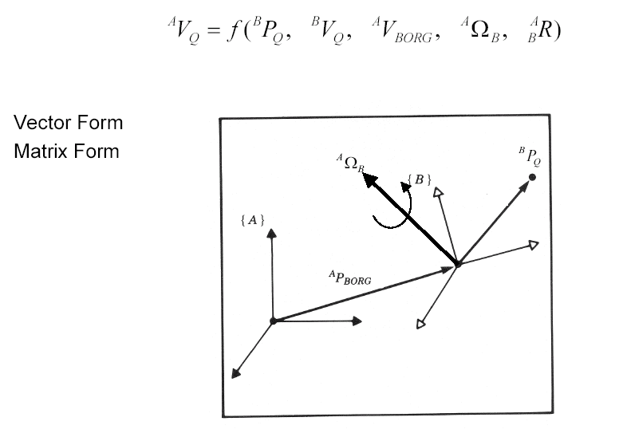
Central Topic - Simultaneous Linear and Rotational Velocity

Slide 3
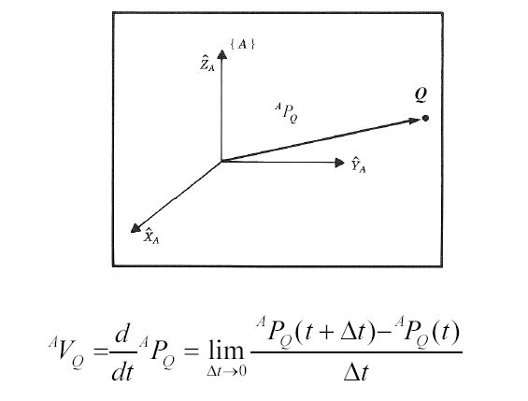
Definitions – Linear Velocity
Linear velocity - The instantaneous rate of change in linear position of a point relative to some frame.

Slide 4
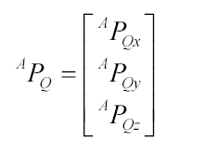
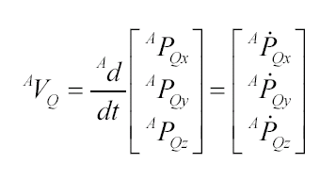
Definitions – Linear Velocity
The position of point Q in frame {A} is represented by the linear position vector
The velocity of a point Q relative to frame {A} is represented by the linear velocity vector

Slide 5
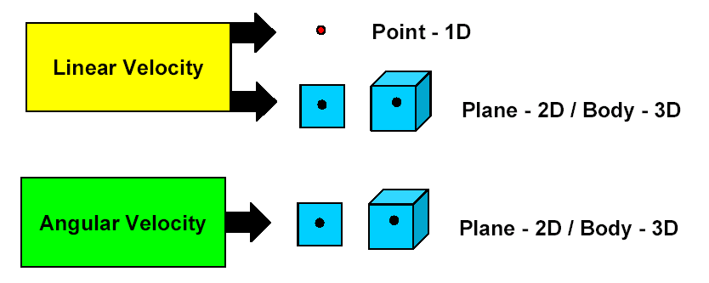
Definitions - Angular Velocity
Angular Velocity: The instantaneous rate of change in the orientation of one frame relative to another.

Slide 6
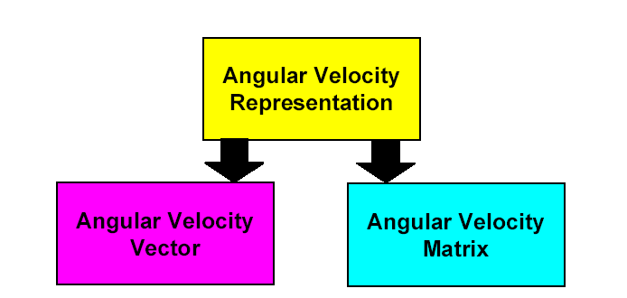
Definitions - Angular Velocity
Just as there are many ways to represent orientation (Euler Angles, Roll-Pitch-Yaw Angles, Rotation Matrices, etc.) there are also many ways to represent the rate of change in orientation.
The angular velocity vector is convenient to use because it has an easy to grasp physical meaning. However, the matrix form is useful when performing algebraic manipulations.

Slide 7
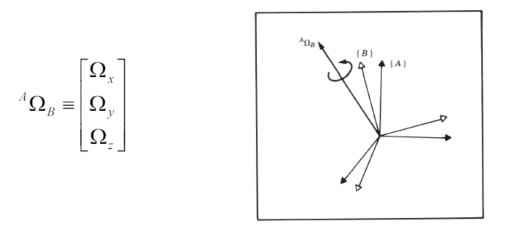
Definitions - Angular Velocity - Vector
Angular Velocity Vector: A vector whose direction is the instantaneous axis of rotation of one frame relative to another and whose magnitude is the rate of rotation about that axis.
The angular velocity vector describes the instantaneous change of rotation of frame {B} relative to frame {A}

Slide 8
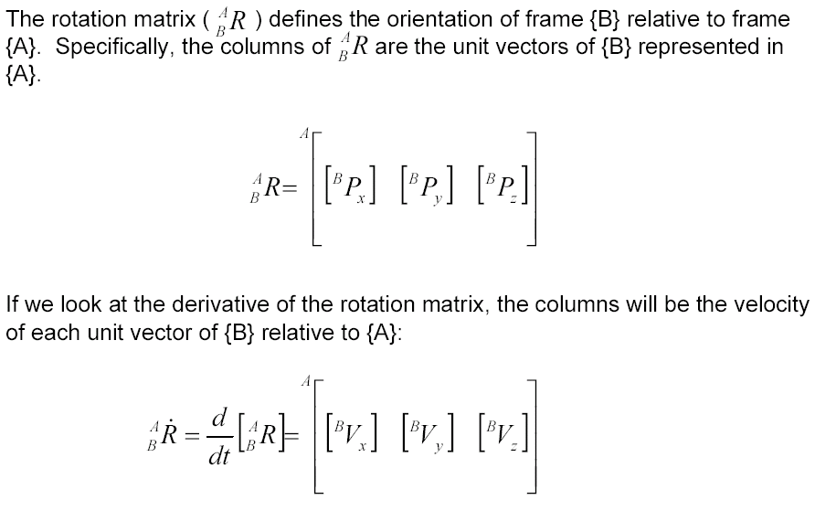
Definitions - Angular Velocity - Matrix

Slide 9
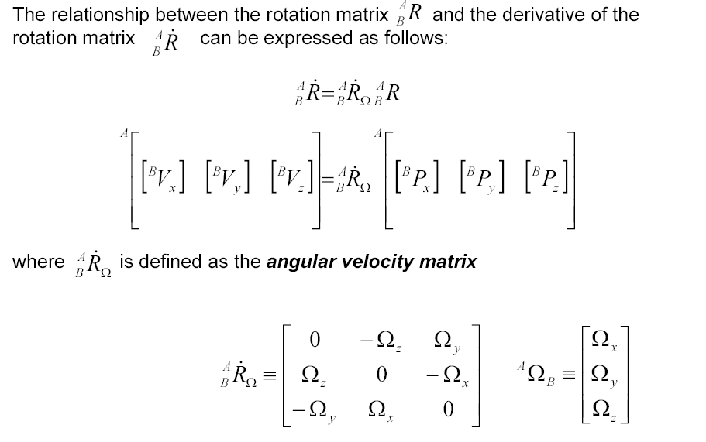
Definitions - Angular Velocity - Matrix

Slide 10
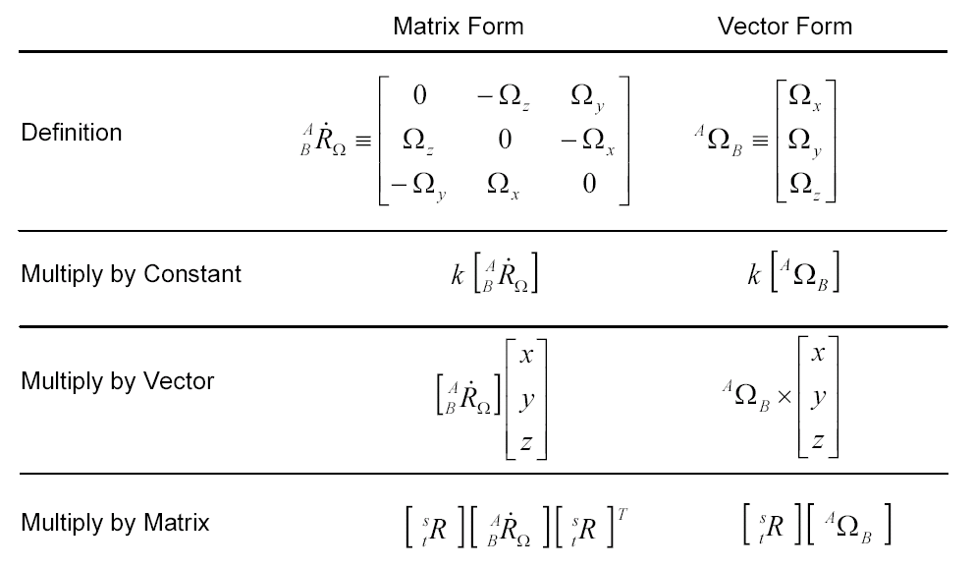
Angular Velocity – Matrix and Vector Forms

Slide 11
Linear & Angular Velocities - Frames
When describing the velocity (linear or angular) of an object, there are two important frames that are being used:
Represented Frame (Reference Frame) :
This is the frame used to represent (express) the object’s velocity.
Computed Frame
This is the frame in which the velocity is measured (differentiate the position).

Slide 12
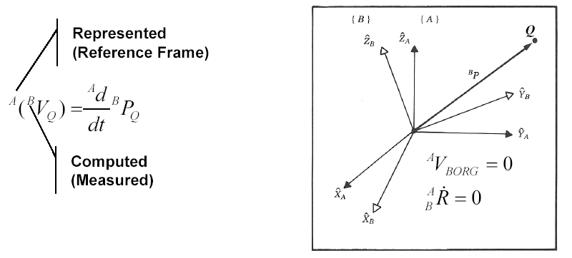
Frame - Velocity
As with any vector, a velocity vector may be described in terms of any frame, and this frame of reference is noted with a leading superscript.
A velocity vector computed in frame {B} and represented in frame {A} would be written

Slide 13






Frame - Linear Velocity
We can always remove the outer, leading superscript by explicitly including the rotation matrix which accomplishes the change in the reference frame
Note that in the general case because may be time-varying
If the calculated velocity is written in terms of of the frame of differentiation the result could be indicated by a single leading superscript.
In a similar fashion when the angular velocity is expressed and measured as a vector

Slide 14
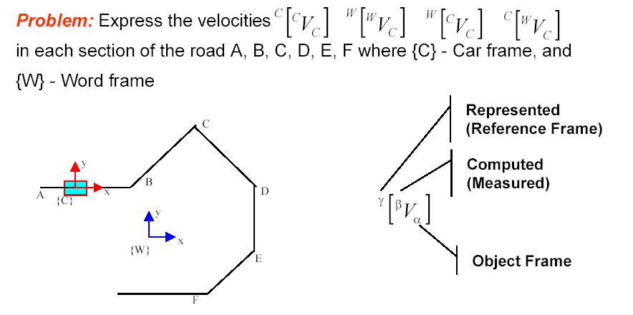
Frames - Linear Velocity - Example
Given: The driver of the car maintains a speed of 100 km/h (as shown to the driver by the car’s speedometer).
World frame

Slide 15
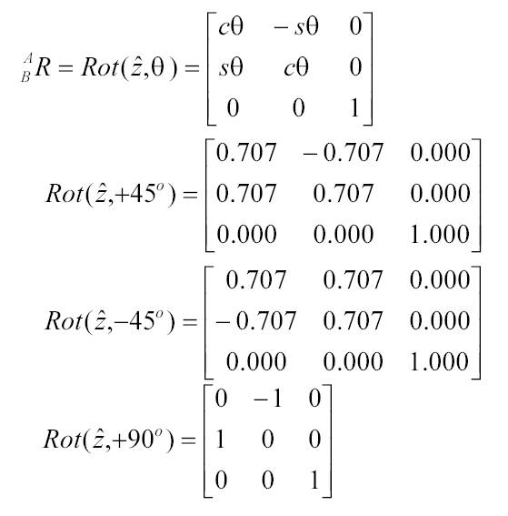
Frames - Linear Velocity - Example

Slide 16
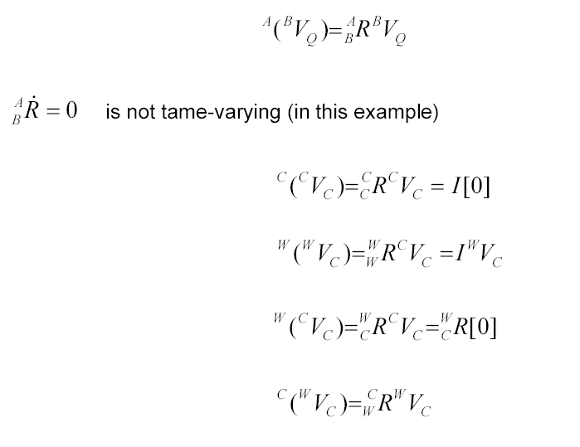
Frames - Linear Velocity - Example
is not time-varying (in this example)
^{W}V_{C} = I^{W}V_{C}

Slide 17
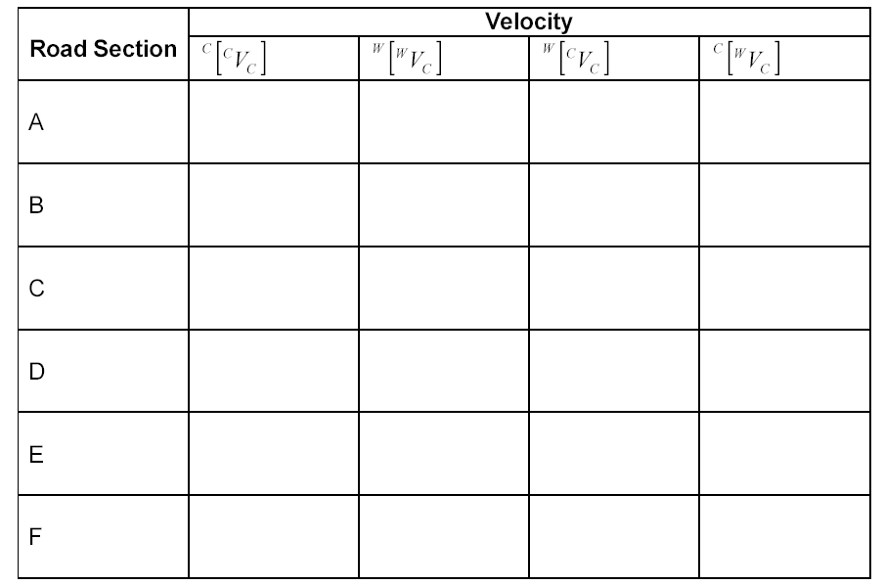
Frames - Linear Velocity - Example

Slide 18
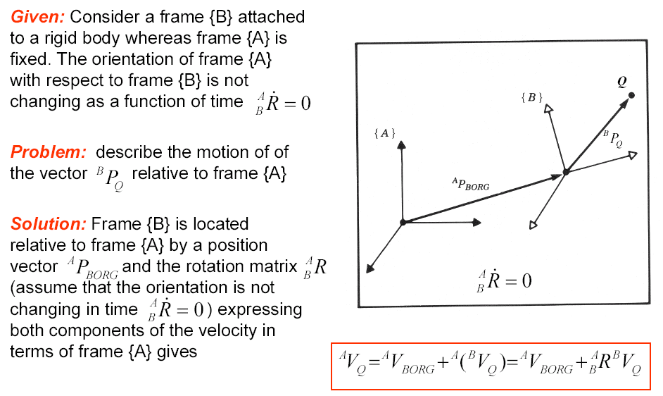
Linear Velocity – Rigid Body

Slide 19
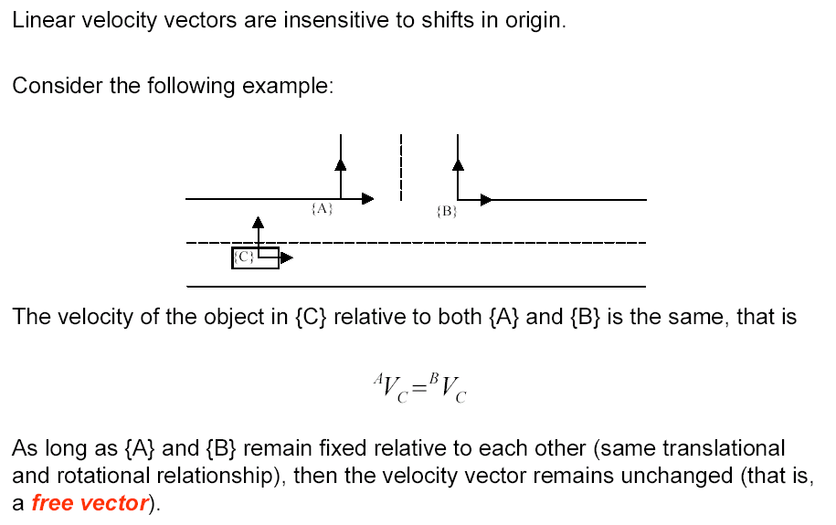
Linear Velocity – Free Vector

Slide 20
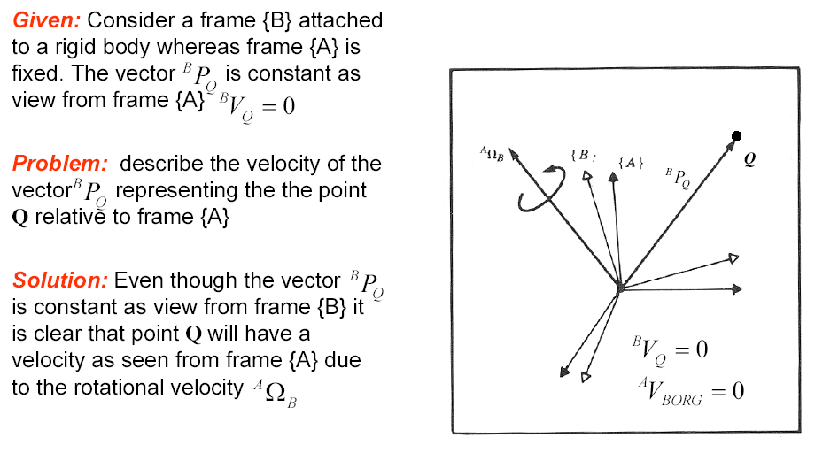
Angular Velocity – Rigid Body

Slide 21
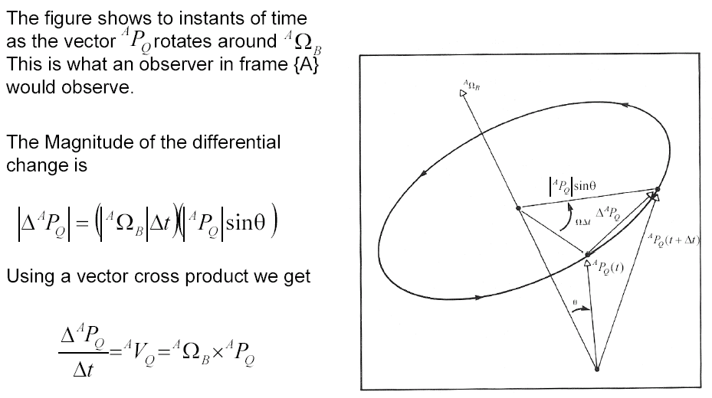
Angular Velocity – Rigid Body – Intuitive Approach
2

Slide 22
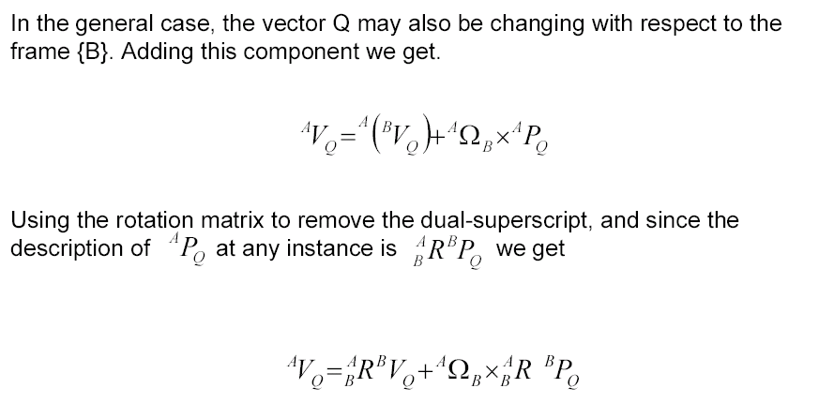
Angular Velocity – Rigid Body – Intuitive Approach

Slide 23
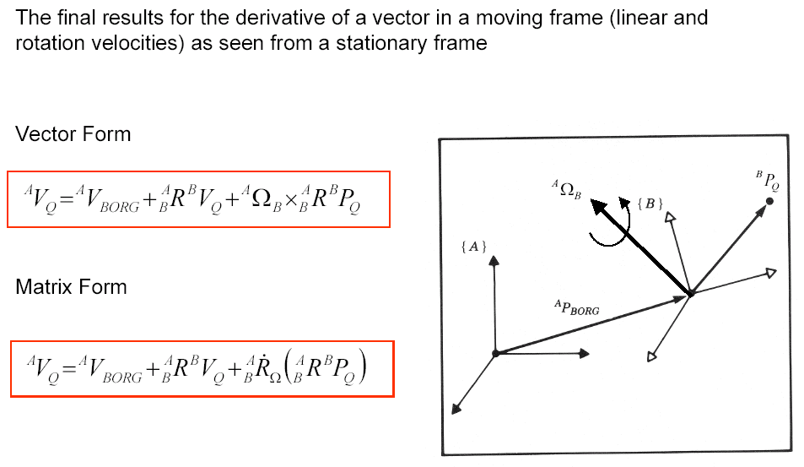
Simultaneous Linear and Rotational Velocity

Slide 24
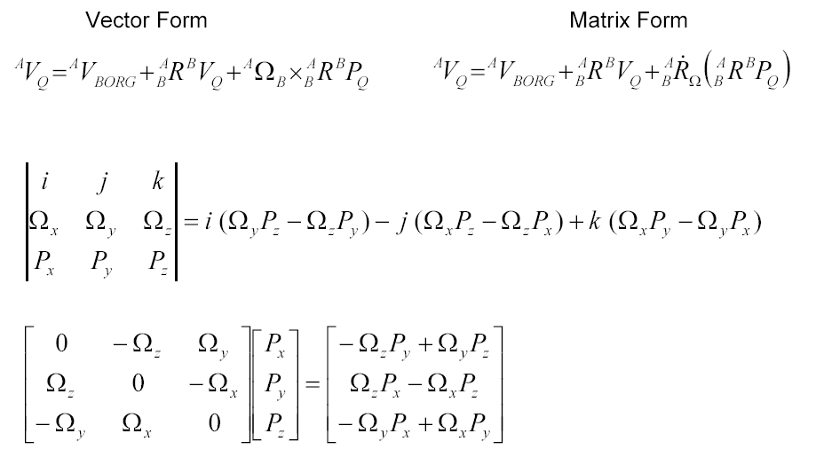
Simultaneous Linear and Rotational Velocity - Vector Versus Matrix Representation

Slide 25

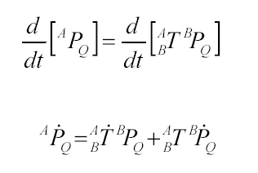
Changing Frame of Representation - Linear Velocity
We have already used the homogeneous transform matrix to compute the location of position vectors in other frames:
To compute the relationship between velocity vectors in different frames, we will take the derivative:

Slide 26
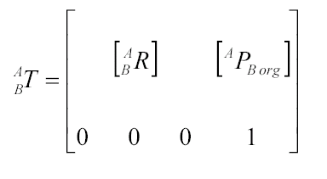
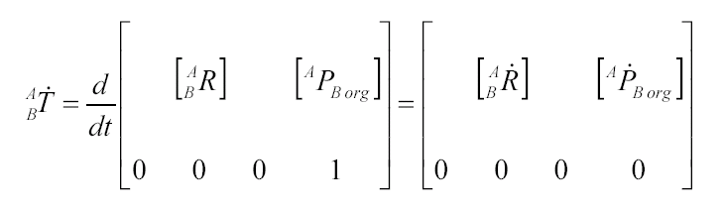
Changing Frame of Representation - Linear Velocity
Recall that
so that the derivative is

Slide 27
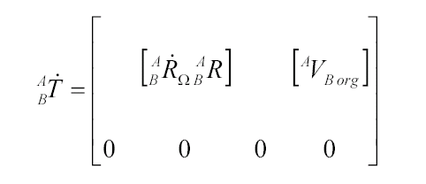

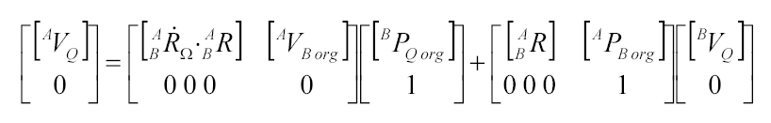
Changing Frame of Representation - Linear Velocity
So that
Substitute the previous results into the original equation:
we get

Slide 28
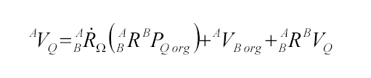

Changing Frame of Representation - Linear Velocity
This expression is equivalent to the following three-part expression:
Converting from matrix to vector form yields

Slide 29



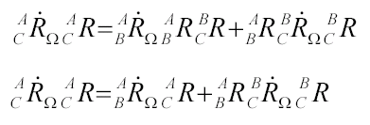
Changing Frame of Representation - Angular Velocity
We use rotation matrices to represent angular position so that we can compute the angular position of {C} in {A} if we know the angular position of {C} in {B} and {B} in {A} by
To derive the relationship describing how angular velocity propagates between frames, we will take the derivative
Substituting the angular velocity matrix ,
we find

Slide 30
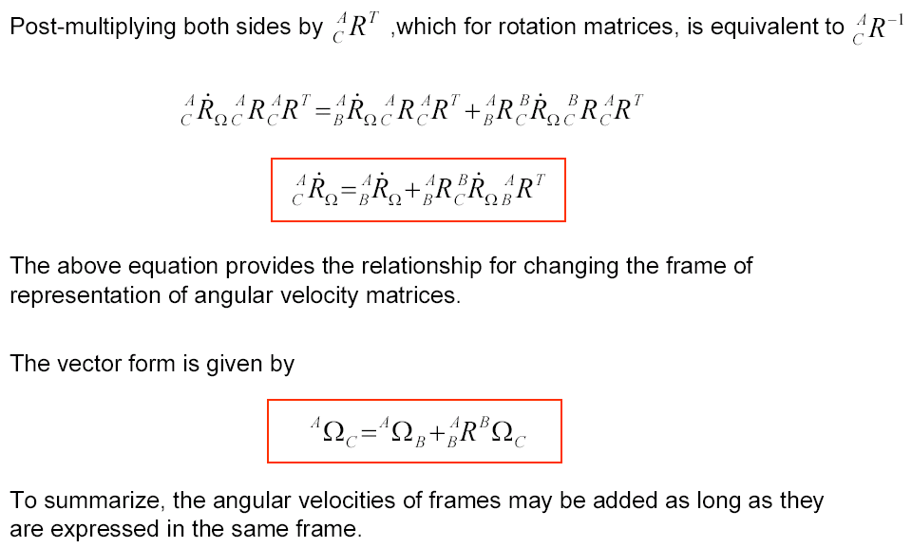
Changing Frame of Representation - Angular Velocity

Slide 31
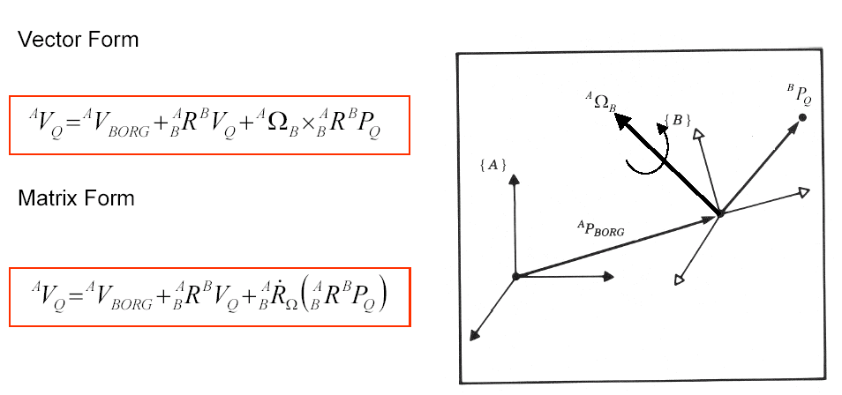
Summary - Simultaneous Linear and Rotational Velocity

Slide 32
Velocity Propagation between Robot Links

Slide 33

Position Propagation
The homogeneous transform matrix provides a complete description of the linear and angular position relationship between adjacent links.
These descriptions may be combined together to describe the position of a link relative to the robot base frame {0}.
A similar description of the linear and angular velocities between adjacent links as well as the base frame would also be useful.

Slide 34
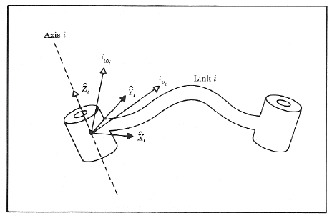
Motion of the Link of a Robot
In considering the motion of a robot link we will always use link frame {0} as the reference frame
Where:
v_{i} is the linear velocity of the origin of link frame (i) with respect to frame {0}
ω_{i} is the angular velocity of the origin of link frame (i) with respect to frame {0}

Slide 35
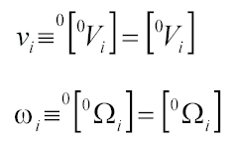
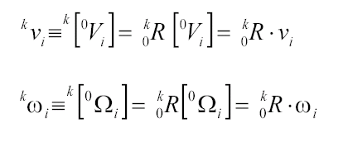
Velocities - Frame & Notation
Expressing the velocity of a frame {i} (associated with link i ) relative to the robot base (frame {0}) using our previous notation is defined as follows:
The velocities differentiate (computed) relative to the base frame {0} are often represented relative to other frames {k}. The following notation is used for this condition:

Slide 36
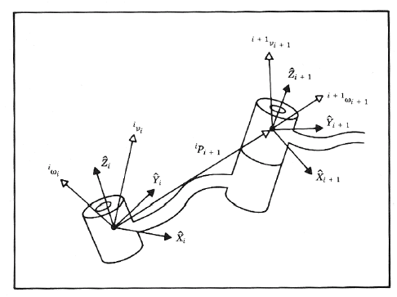
Velocity Propagation
Given: A manipulator - A chain of rigid bodies each one capable of moving relative to its neighbor
Problem: Calculate the linear and angular velocities of the link of a robot
Solution (Concept): Due to the robot structure we can compute the velocities of each link in order starting from the base.
The velocity of link i+1 will be that of link i , plus whatever new velocity components were added by joint i+1

Slide 37

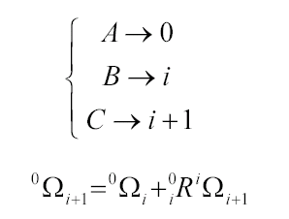
Velocity of Adjacent Links – Angular Velocity
From the relationship developed previously
we can re-assign link names to calculate the velocity of any link i relative to the base frame {0}

Slide 38
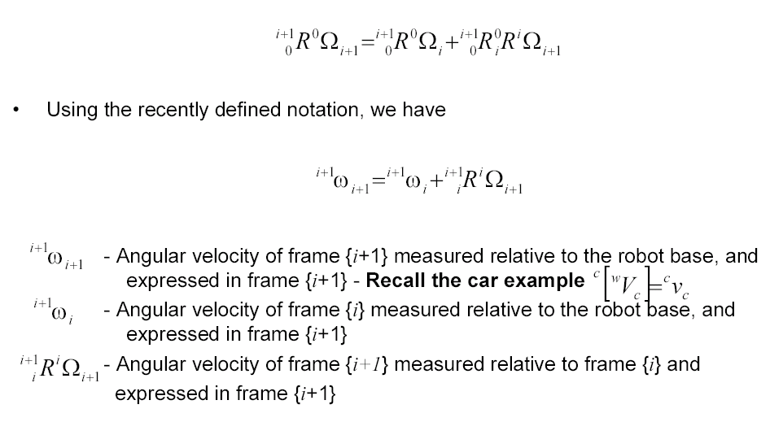
Velocity of Adjacent Links – Angular Velocity

Slide 39
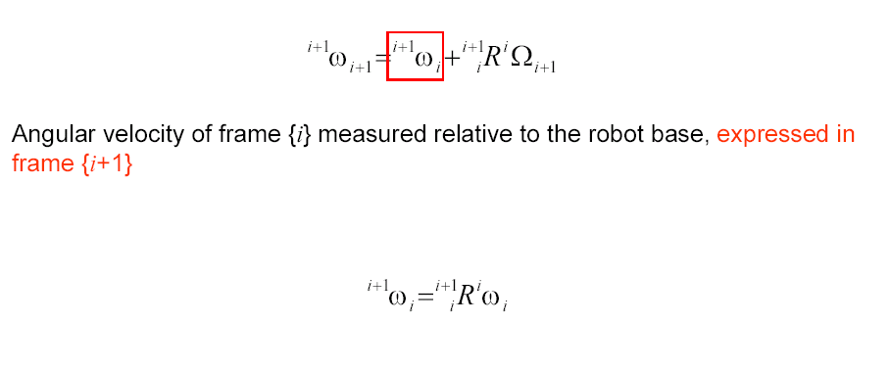
Velocity of Adjacent Links – Angular Velocity

Slide 40

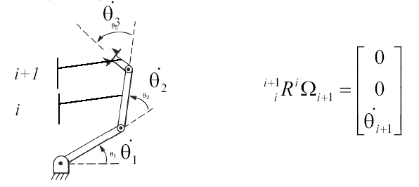
Velocity of Adjacent Links – Angular Velocity
Angular velocity of frame {i+1} measured (differentiate) in frame {i} and represented (expressed) in frame {i+1}
Assuming that a joint has only 1 DOF. The joint configuration can be either revolute joint (angular velocity) or prismatic joint (Linear velocity).
Based on the frame attachment convention in which we assign the Z axis pointing along the i+1 joint axis such that the two are coincide (rotations of a link is preformed only along its Z- axis) we can rewrite this term as follows:

Slide 41
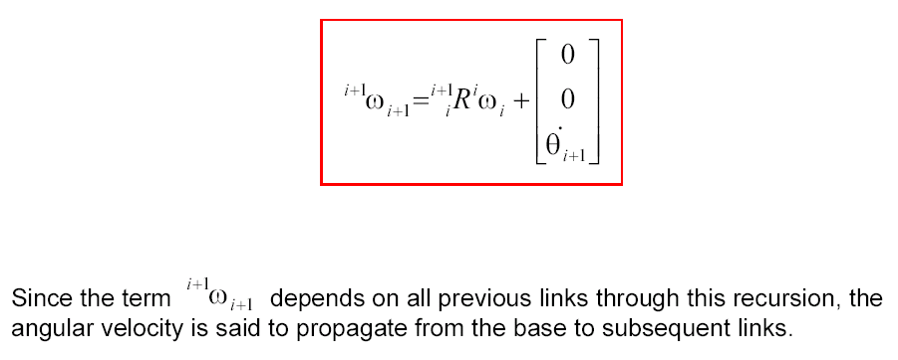
Velocity of Adjacent Links – Angular Velocity
The result is a recursive equation that shows the angular velocity of one link in terms of the angular velocity of the previous link plus the relative motion of the two links.

