Slide 1
Lecture 6
Forward Kinematics Examples

Slide 2
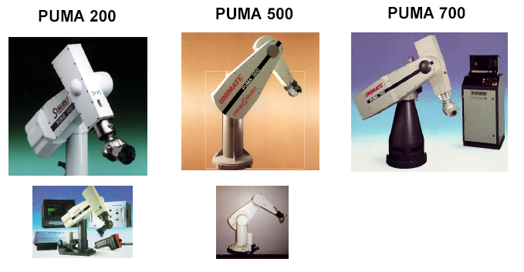
PUMA Family

Slide 3
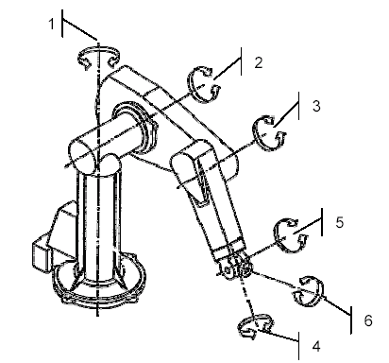
PUMA 560 – 6R

Slide 4
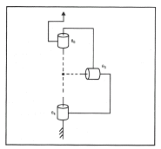
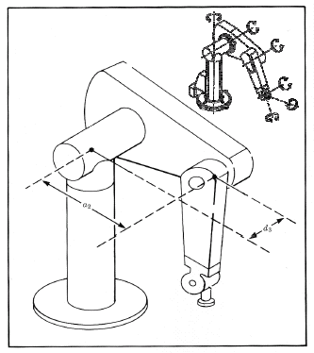
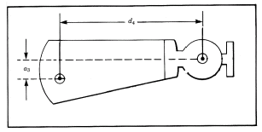
Kinematics of an Industrial Robot – PUMA 560
The robot position in which all joint angles are equal to zero

Slide 5
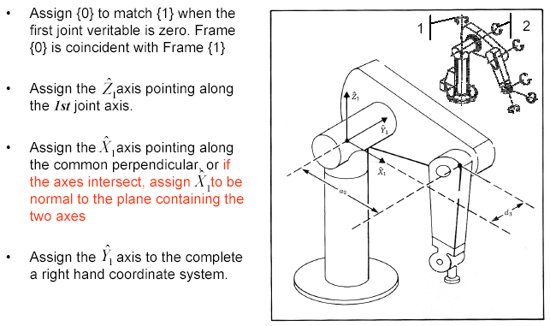
PUMA 560 – Frame Assignments – {0} and {1}
Assign {0} to match {1} when the first joint variable is zero. Frame {0} is coincident with Frame {1}

Slide 6
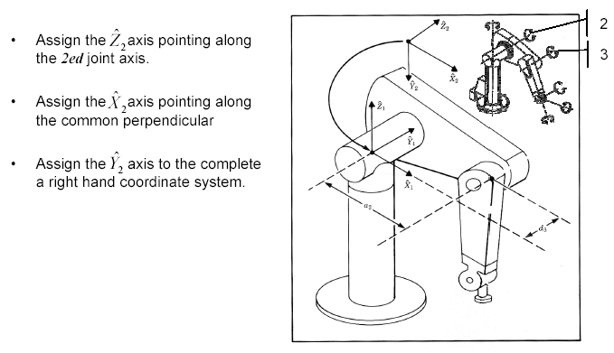
PUMA 560 – Frame Assignments – {2}
2nd joint axis.

Slide 7
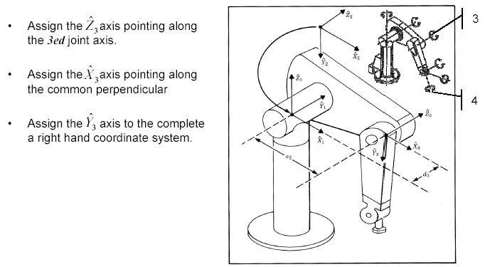
PUMA 560 – Frame Assignments – {3}
the 3rd joint axis

Slide 8
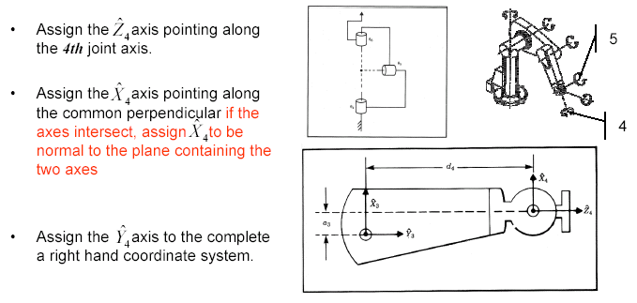
PUMA 560 – Frame Assignments – {4}

Slide 9
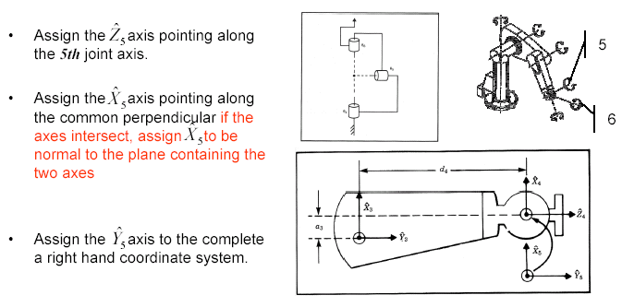
PUMA 560 – Frame Assignments – {5}

Slide 10
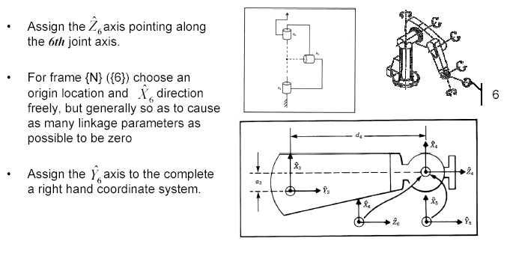
PUMA 560 – Frame Assignments – {6}

Slide 11
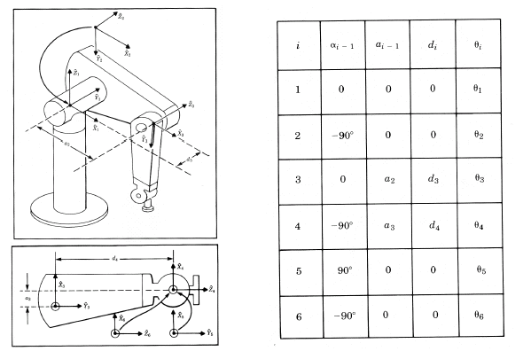
PUMA 560 – DH Parameters

Slide 12
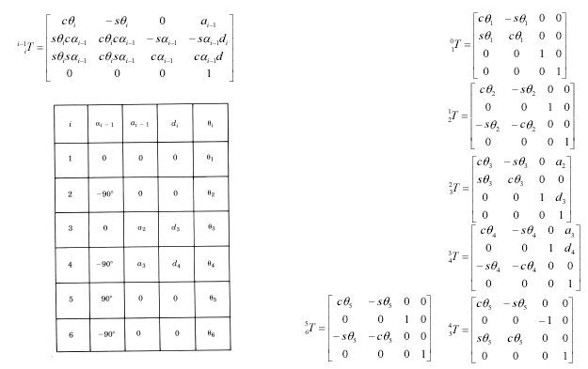
PUMA 560 – Link Transformations

Slide 13
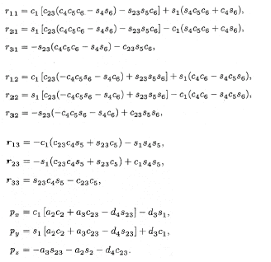
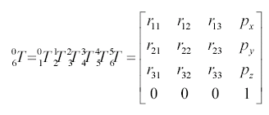

PUMA 560 – Kinematic Equations
The kinematics equations of PUMA 560 specify how to compute the position & orientation of frame {6} (tool) relative to frame {0} (base) of the robot. These are the basic equations for all kinematic analysis of this manipulator.
Notations:

Slide 14
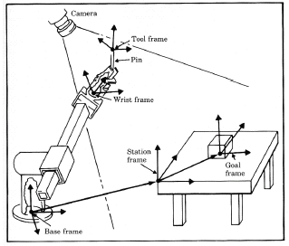
Frame with Standard Names
Base Frame {B} –
{B} is located at the base of the manipulator affixed to the nonmoving part of the robot (another name for frame {0})
Station Frame {S} –
{S} is located in a task relevant location (e.g. at the corner of the table upon the which the robot is to work). From the user perspective {S} is the universe frame (task frame or world frame) and all action of the robot are made relative to it. The station frame {S} is always specify with respect to the base frame {B}, i.e.

Slide 15
Frame with Standard Names
Wrist Frame {W} –
{W} is affixed to the last link of the manipulator – the wrist (another name for frame {N}). The wrist frame {W} is defined relative to the base frame i.e.
Tool Frame {T} –
{T} is affixed to the end of any tool the robot happens to be holding. When the hand is empty, {T} is located with its origin between the fingertips of the robot. The tool frame {T} is always specified with respect to the wrist frame {W} i.e.

Slide 16
Frame with Standard Names
Goal Frame {G} –
{G} is describing the location to which the robot is about to move the tool. At the end of the robot motion the tool frame {T} is about to coincide with the goal frame {G}. The goal frame is always specified with respect to the station frame {S} i.e.

Slide 17
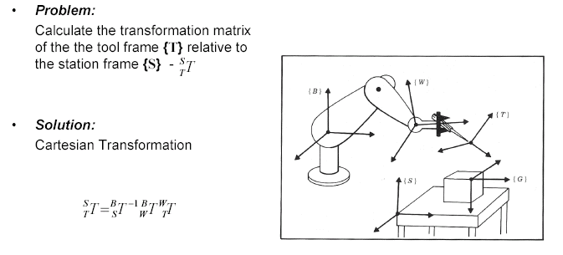
Where is the tool?

Slide 18
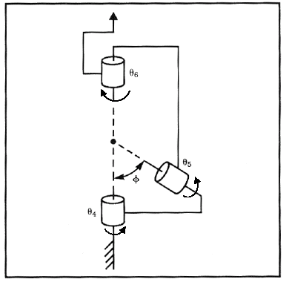
Manipulator Kinematics - Example - 3R - Wrist

Slide 19
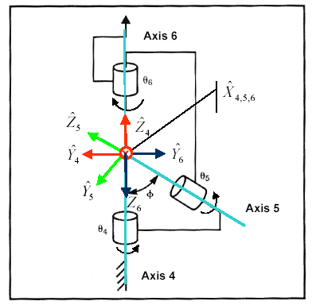
Manipulator Kinematics - Example - 3R - Wrist

Slide 20
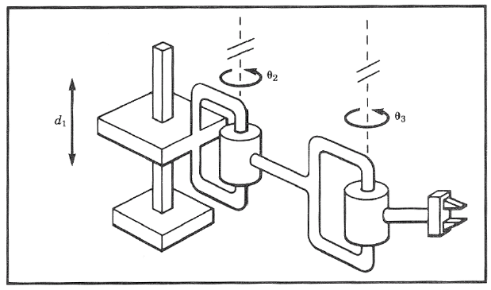
Manipulator Kinematics – Example - PRR

Slide 21
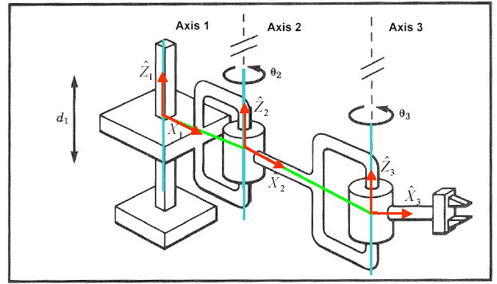
Manipulator Kinematics – Example - PRR

Slide 22
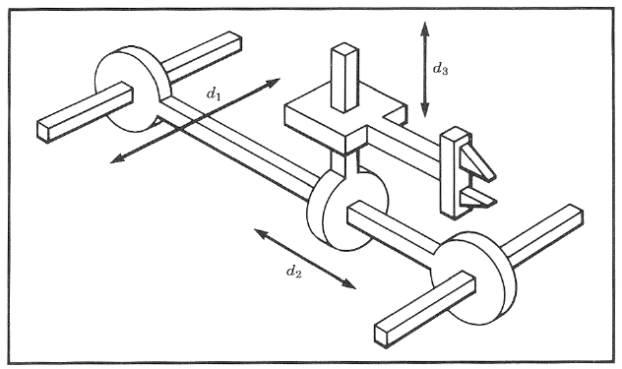
Manipulator Kinematics – Example – 3P

Slide 23
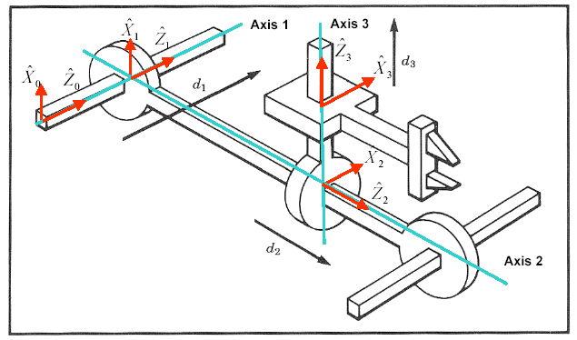
Manipulator Kinematics – Example – 3P

Slide 24
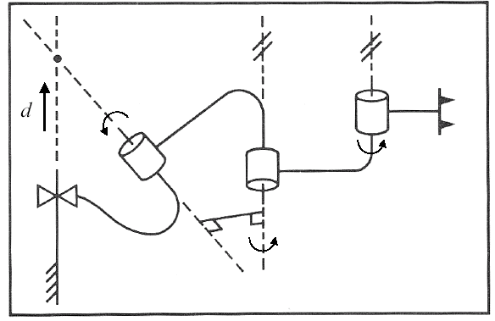
Manipulator Kinematics – Example – PRRR

Slide 25
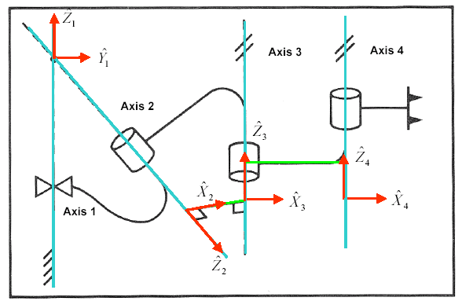
Manipulator Kinematics – Example – PRRR

Slide 26
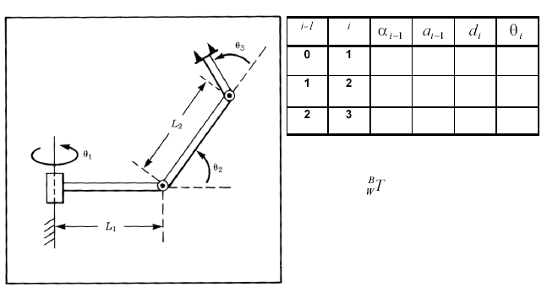
Manipulator Kinematics – Example – 3R

Slide 27
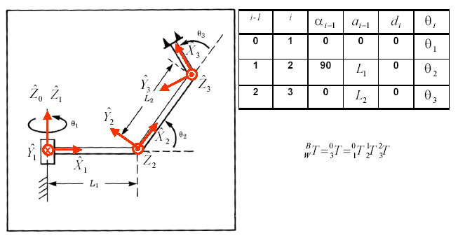
Manipulator Kinematics – Example – 3R

Slide 28
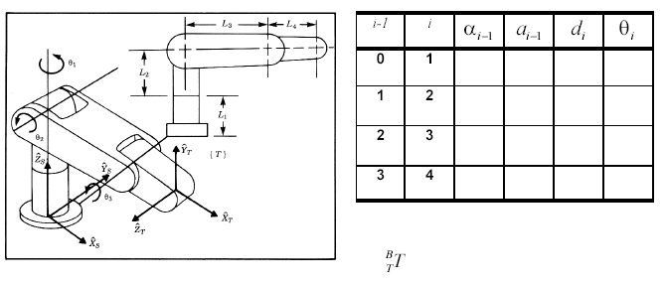
Manipulator Kinematics – Example – 3R

Slide 29
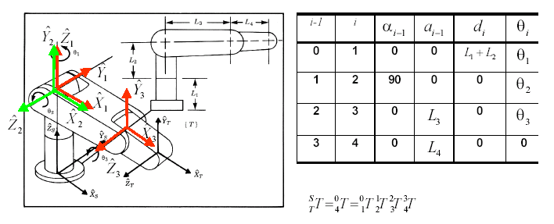
Manipulator Kinematics – Example – 3R

Slide 30
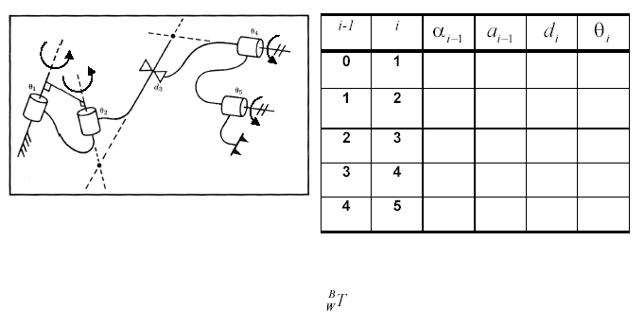
Manipulator Kinematics – Example – RRPRR

Slide 31
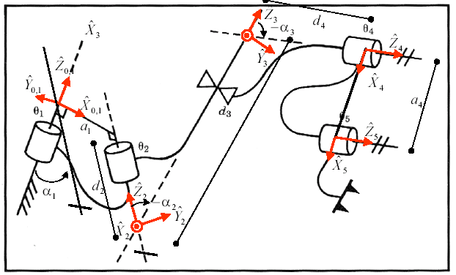
Manipulator Kinematics – Example – RRPRR (2RP2R)

Slide 32
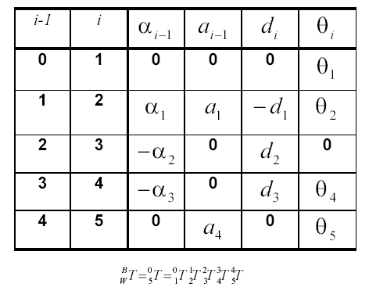
Manipulator Kinematics – Example – RRPRR (2RP2R)

Slide 33
Link Frame Attachment Procedure - Summary
Identify the joint axes and imagine (or draw) infinite lines along them. For step 2 through step 5 below, consider two of these neighboring lines (at axes i and i+1 )
Identify the common perpendicular between them, or point of intersection. At the point of intersection, or at the point where the common perpendicular meets the i th axis, assign the link frame origin.
Assign the axis pointing along the i th joint axis.
Assign the axis pointing along the common perpendicular, or if the axes intersect, assign to be normal to the plane containing the two axes
Assign the axis to complete a right hand coordinate system.
Assign {0} to match {1} when the first joint variable is zero. For {N}, choose an origin location and direction freely, but generally so as to cause as many linkage parameters as possible to be zero

Slide 34
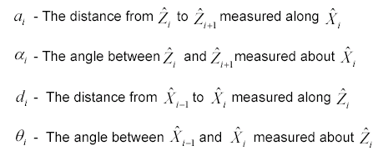
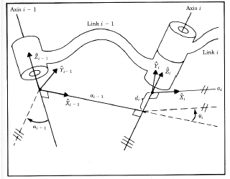
DH Parameters - Review
Note:
a_{i} ≥ 0 ,and α_{i} , d_{i} , and θ_{i} are signed quantities

Slide 35
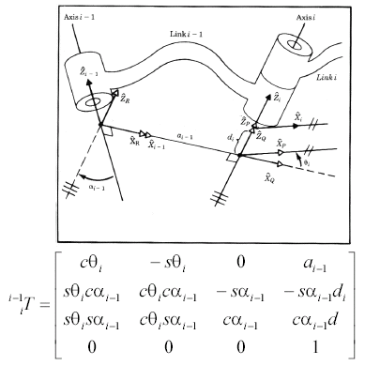
Derivation of Link Homogeneous Transformation
i

