Slide 1
Lecture 7
Representing Orientations

Slide 2
Representation of Rotation
Before we go further, we should consider a few different ways of representing orientation
Each has its own advantages / disadvantages

Slide 3
The space of rotations
Special orthogonal group(3):
Why ?
Rotations preserve distance:
Rotations preserve orientation:

Slide 4
The space of rotations
Special orthogonal group(3):
Why it’s a group:
Closed under multiplication: if then
Has an identity:
Has a unique inverse…
Is associative…
Why orthogonal:
vectors in matrix are orthogonal
Why it’s special: , NOT
Right hand coordinate system

Slide 5
Possible rotation representations
You need at least three numbers to represent an arbitrary rotation in SO(3) (Euler theorem). Some three-number representations:
ZYZ Euler angles
ZYX Euler angles (roll, pitch, yaw)
Axis angle
One four-number representation:
quaternions

Slide 6
ZYZ Euler Angles
To get from A to B:
Rotate about z axis
Then rotate about y axis
Then rotate about z axis

Slide 7
ZYZ Euler Angles
Remember that encode the desired rotation in the pre-rotation reference frame:
Therefore, the sequence of rotations is concatentated as follows:

Slide 8
ZYX Euler Angles (roll, pitch, yaw)
To get from A to B:
Rotate about z axis
Then rotate about y axis
Then rotate about x axis

Slide 9
ZYX Euler Angles (roll, pitch, yaw)
In Euler angles, the each rotation is imagined to be represented in the post-rotation coordinate frame of the last rotation
In Fixed angles, all rotations are imagined to be represented in the original (fixed) coordinate frame.
ZYX Euler angles can be thought of as:
ZYX Euler
XYZ Fixed

Slide 10
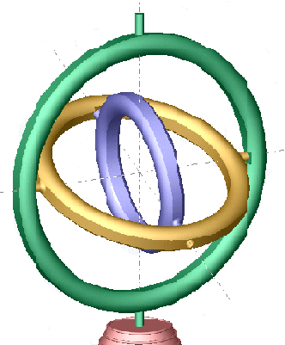
Problems w/ Euler Angles
If two axes are aligned, then there is a “don’t care” manifold of Euler angles that represent the same orientation
The system loses one DOF
, but the actual distance is

Slide 11
Problem w/ Euler Angles: gimbal lock
When a small change in orientation is associated with a large change in rotation representation
Happens in “singular configurations” of the rotational representation (similar to singular configurations of a manipulator)
This is a problem w/ any Euler angle representation

Slide 12
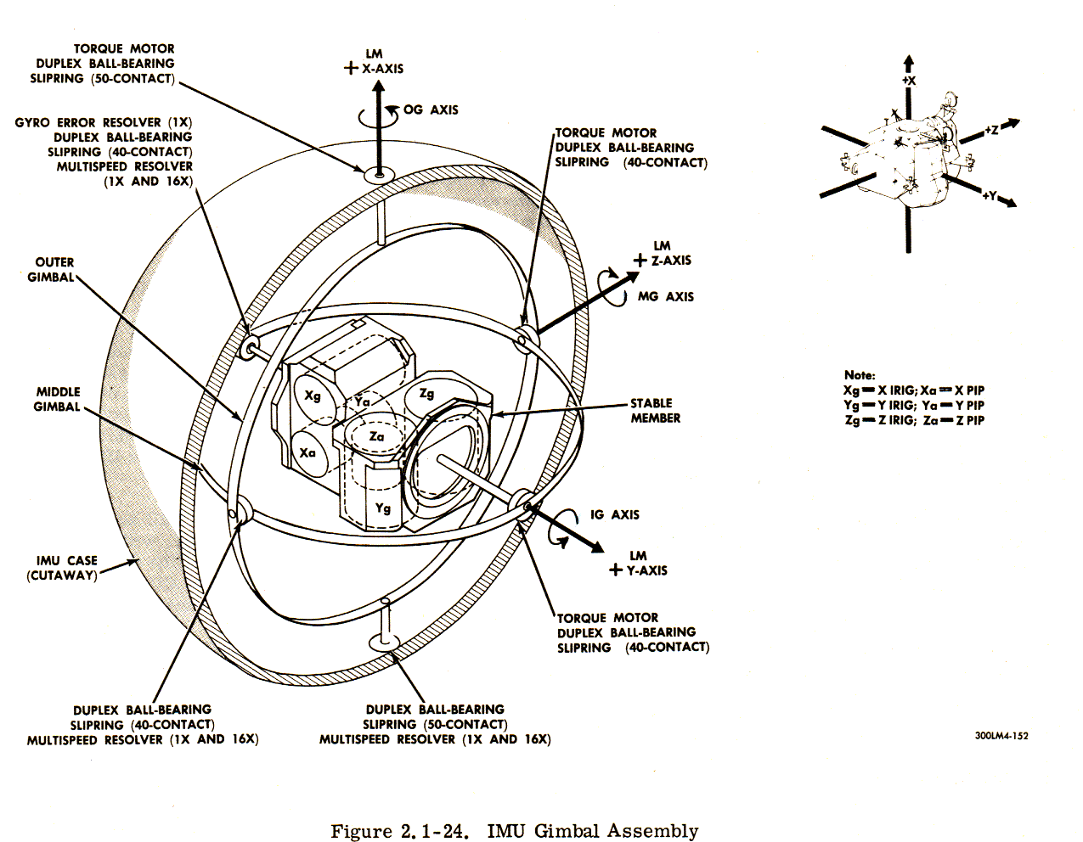
Problem w/ Euler Angles: gimbal lock

Slide 13
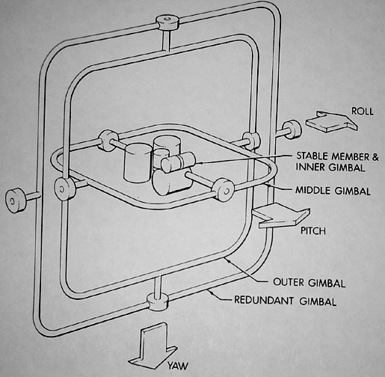
Problem w/ Euler Angles: gimbal lock

Slide 14
Quaternions
So far, rotation matrices seem to be the most reliable method of manipulating rotations. But there are problems:
Over a long series of computations, numerical errors can cause these 3x3 matrices to no longer be orthogonal (you need to “orthogonalize” them from time to time).
Although you can accurately calculate rotation differences, you can’t interpolate over a difference.’
Suppose you wanted to smoothly rotate from one orientation to another – how would you do it?
Answer: quaternions…

Slide 15
Quaternions
Generalization of complex numbers:
Essentially a 4-dimensional quantity
Properties of complex dimensions:
Multiplication:
Complex conjugate:

Slide 16
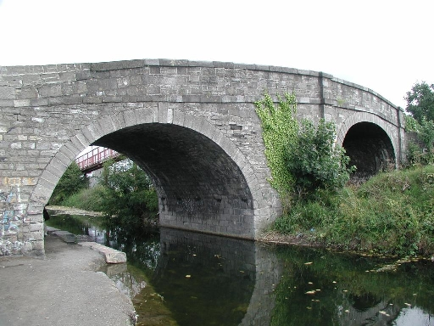
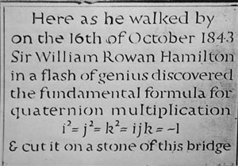
Quaternions
Invented by Hamilton in 1843:
Along the royal canal in Dublin…

Slide 17
Quaternions
Let’s consider the set of unit quaternions:
This is a four-dimensional hypersphere, i.e. the 3-sphere
The identity quaternion is:
Consider:
Therefore, the inverse of a unit quaternion is:

Slide 18
Quaternions
Associate a rotation with a unit quaternion as follows:
Given a unit axis, , and an angle, :
The associated quaternion is:
Therefore, represents the same rotation as
Let be the quaternion associated with the vector
You can rotate from frame a to b:
Composition:
Inversion:

Slide 19
Example: Quaternions
Rotate by

Slide 20
Example: Quaternions
Find the difference between these two axis angle rotations:

Slide 21
Quaternions: Interpolation
Suppose you’re given two rotations, and
How do you calculate intermediate rotations?
This does not even result in a rotation matrix
Do quaternions help?
Suprisingly, this actually works
Finds a geodesic
This method normalizes automatically (SphericalLinearintERPolpation):

