Slide 1
MECH 498: Introduction to Robotics Inverse Manipulator Kinematics
M. O’Malley

Slide 2
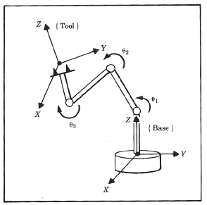
Direct vs. Inverse Kinematics
Direct (Forward) Kinematics
Given: Joint angles and links geometry
Compute: Position and orientation of the end effector relative to the base frame
Inverse Kinematics
Given: Position and orientation of the end effector relative to the base frame
Compute: All possible sets of joint angles and link geometries which could be used to attain the given position and orientation of the end effector

Slide 3
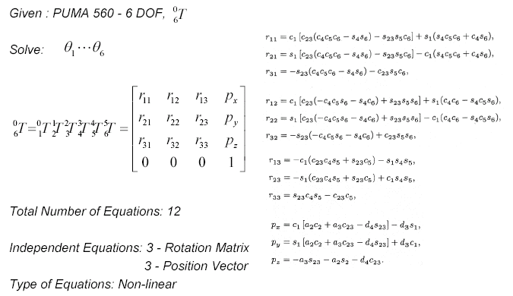
Solvability – PUMA 560

Slide 4
Solvability
Existence of Solutions
Multiple Solutions
Method of solutions
Closed form solution
Algebraic solution
Geometric solution
Numerical solutions

Slide 5
Solvability – Existence of Solution
For a solution to exist, must be in the workspace of the manipulator
Workspace - Definitions
Dexterous Workspace (DW): The subset of space in which the robot end effector can reach in all orientations.
Reachable Workspace (RW): The subset of space in which the robot end effector can reach in at least 1 orientation
The Dexterous Workspace is a subset of the Reachable Workspace

Slide 6
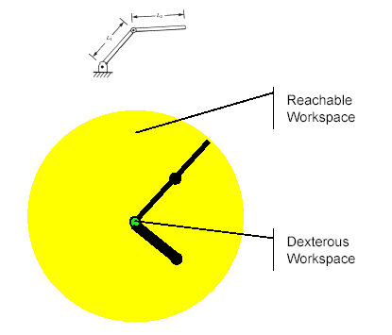
Solvability - Existence of Solution - Workspace - 2R Example 1 – L₁ = L₂

Slide 7
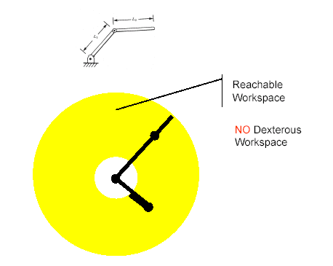
Solvability - Existence of Solution - Workspace - 2R Example 2 – L₁ ≠ L₂

Slide 8
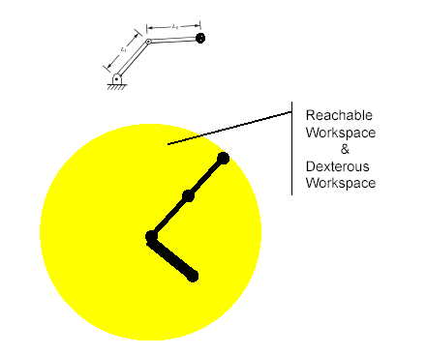
Solvability - Existence of Solution - Workspace - 3R Example 3 – L₁ = L₂

Slide 9
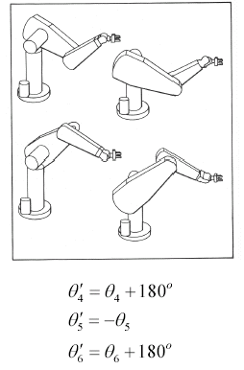
Solvability – Multiple Solutions
Multiple solutions are a common problem that can occur when solving inverse kinematics because the system has to be able to chose one
The number of solutions depends on the number of joints in the manipulator but is also a function of the link parameters (a_{i}, α_{i}, θ_{i}, d_{i})
Example: The PUMA 560 can reach certain goals with 8 different arm configurations (solutions)

Slide 10
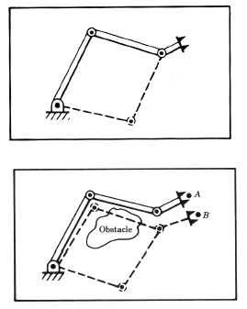
Solvability – Multiple Solutions
Problem: The fact that a manipulator has multiple solutions may cause problems because the system has to be able to choose one
Solution: Decision criteria
The closest (geometrically)
Minimizing the amount that each joint is required to move
Note 1: input argument - present position of the manipulator
Note 2: Joint Weight - Moving small joints (wrist) instead of moving large joints (Shoulder & Elbow)
Obstacles exist in the workspace
Avoiding collision

Slide 11
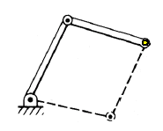
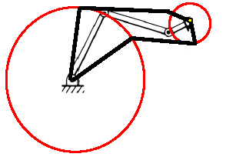
Solvability – Multiple Solutions – Number of Solutions
Task Definition - Position the end effector in a specific point in the plane (2D)
No. of DOF = No. of DOF of the task
Number of solutions:
2 (elbow up/down)
No. of DOF > No. of DOF of the task
Number of solutions: ∞
Self Motion - The robot can be moved without moving the end effector from the goal

Slide 12
Solvability – Methods of Solutions
Solution (Inverse Kinematics)- A “solution” is the set of joint variables associated with an end effector’s desired position and orientation.
No general algorithms that lead to the solution of inverse kinematic equations.
Solution Strategies
Closed form Solutions - An analytic expression includes all solution sets.
Algebraic Solution - Trigonometric (Nonlinear) equations
Geometric Solution - Reduces the larger problem to a series of plane geometry problems.
Numerical Solutions - Iterative solutions will not be considered in this course.

Slide 13
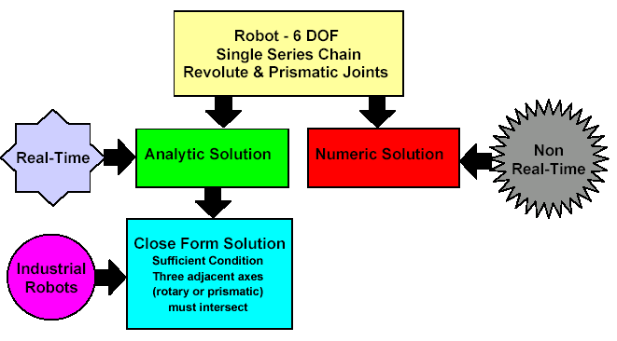
Solvability

Slide 14
Mathematical Equations
Law of Sines / Cosines - For a general triangle
Sum of Angles

Slide 15
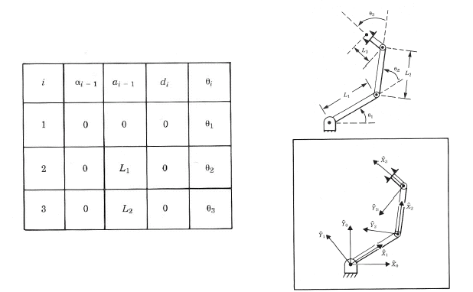
Inverse Kinematics - Planar RRR (3R) - Algebraic Solution

Slide 16
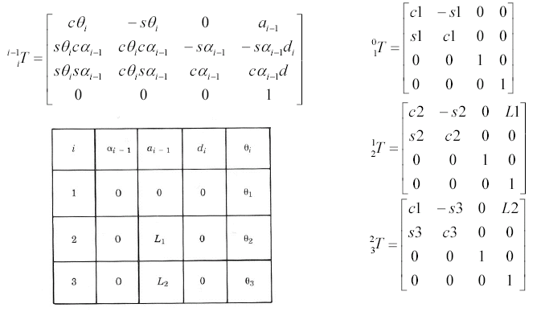
Inverse Kinematics - Planar RRR (3R) - Algebraic Solution

Slide 17
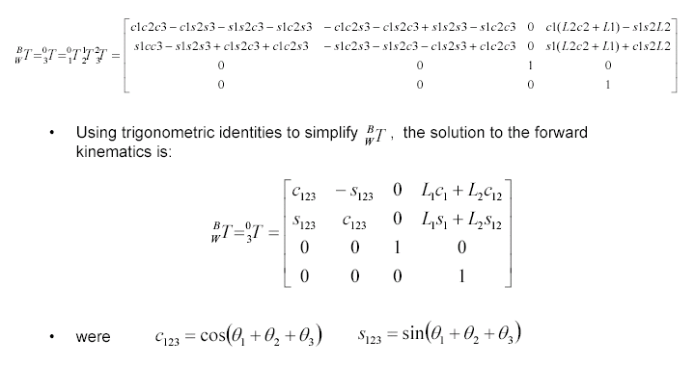
Inverse Kinematics - Planar RRR (3R) - Algebraic Solution
where

Slide 18
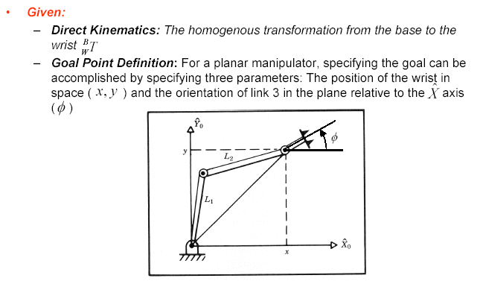
Inverse Kinematics - Planar RRR (3R) - Algebraic Solution

Slide 19
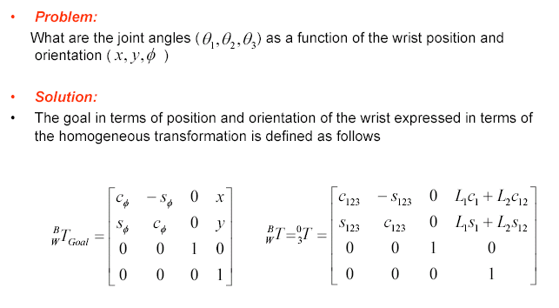
Inverse Kinematics - Planar RRR (3R) - Algebraic Solution

Slide 20
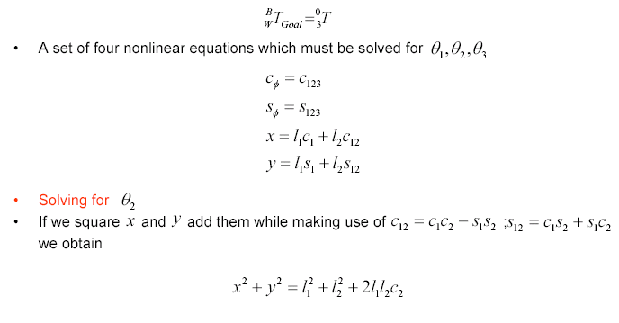
Inverse Kinematics - Planar RRR (3R) - Algebraic Solution

Slide 21
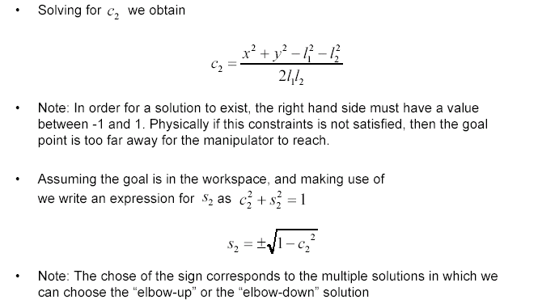
Inverse Kinematics - Planar RRR (3R) - Algebraic Solution
c₂² + s₂² = 1
Note: The choice of the sign corresponds to the multiple solutions in which we can choose the “elbow-up” or the “elbow-down” solution

Slide 22
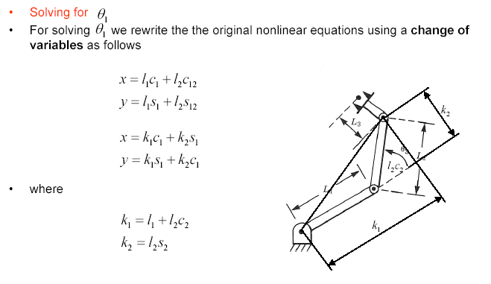
Inverse Kinematics - Planar RRR (3R) - Algebraic Solution

Slide 23
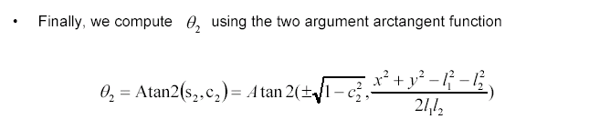
Inverse Kinematics - Planar RRR (3R) - Algebraic Solution

Slide 24
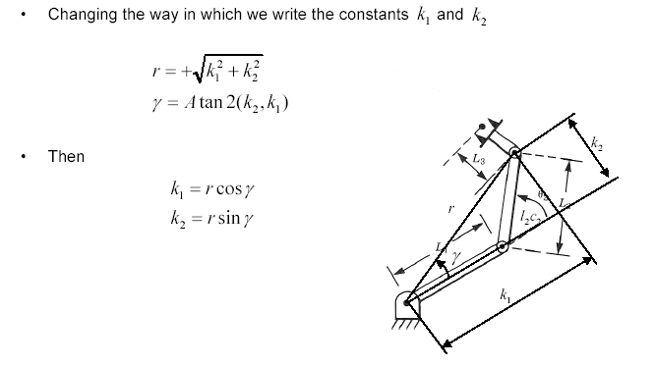
Inverse Kinematics - Planar RRR (3R) - Algebraic Solution

Slide 25
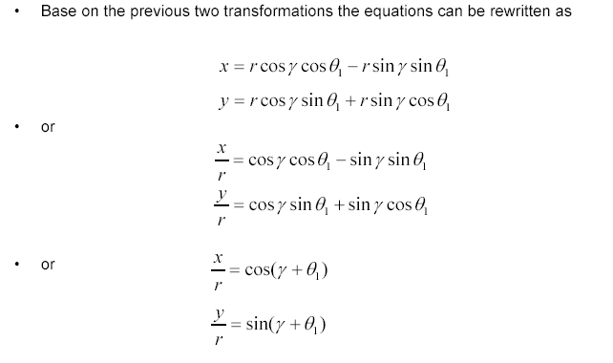
Inverse Kinematics - Planar RRR (3R) - Algebraic Solution
Based on the previous two transformations, the equations can be rewritten as:

Slide 26
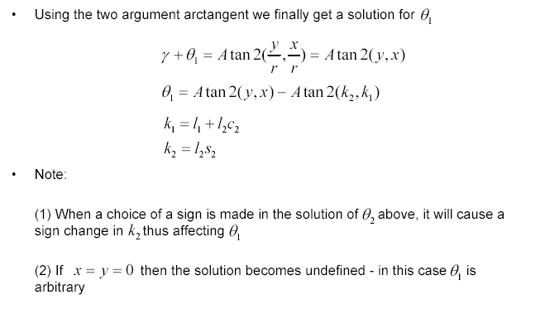
Inverse Kinematics - Planar RRR (3R) - Algebraic Solution

Slide 27
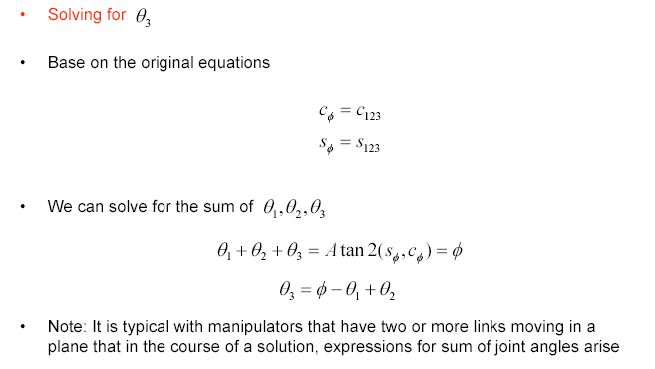
Inverse Kinematics - Planar RRR (3R) - Algebraic Solution
Based on the original equations,

Slide 28
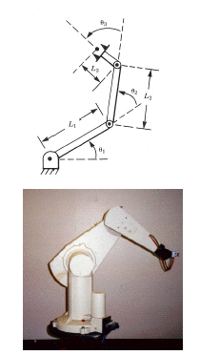
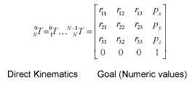
Central Topic – Inverse Manipulator Kinematics - Examples
Geometric Solution – Concept
Decompose spatial geometry into several plane geometry problems
Examples - Planar RRR (3R) manipulators - Geometric Solution
Algebraic Solution - Concept
Examples - PUMA 560 - Algebraic Solution

Slide 29
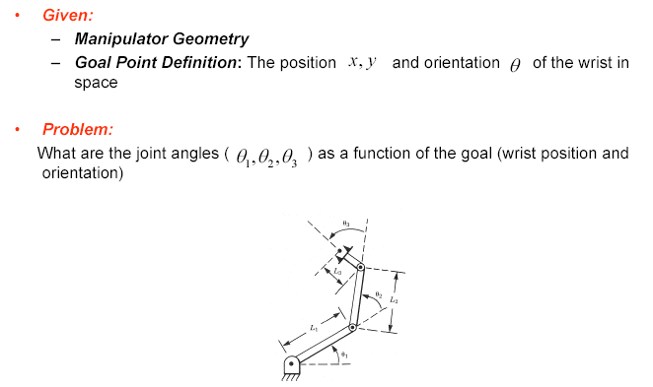
Inverse Kinematics - Planar RRR (3R) - Geometric Solution

Slide 30
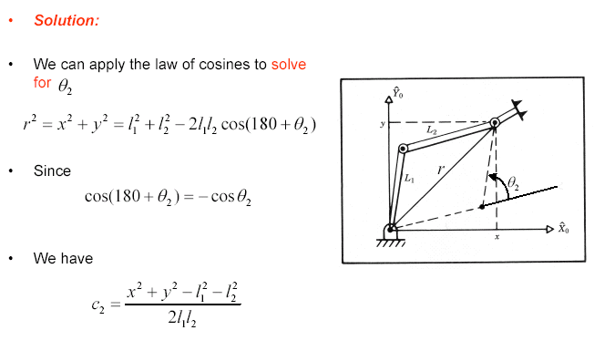
Inverse Kinematics - PUMA 560 - Geometric Solution

Slide 31
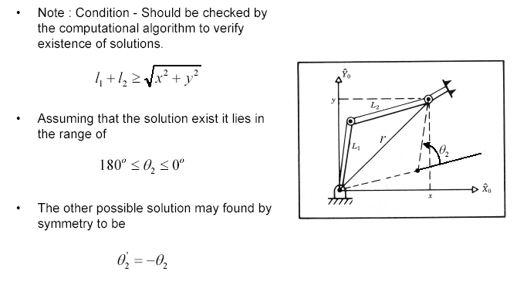
Inverse Kinematics - PUMA 560 - Geometric Solution

Slide 32
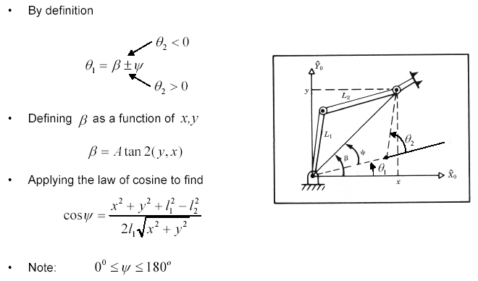
Inverse Kinematics - PUMA 560 - Geometric Solution

Slide 33
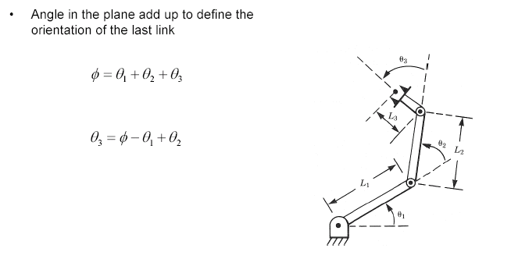
Inverse Kinematics - PUMA 560 - Geometric Solution

Slide 34
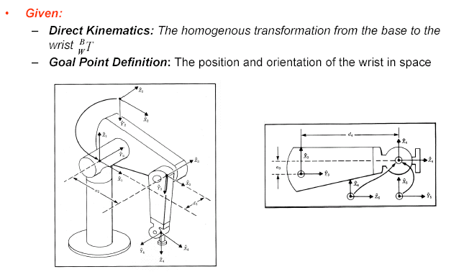
Inverse Kinematics - PUMA 560 - Algebraic Solution

Slide 35
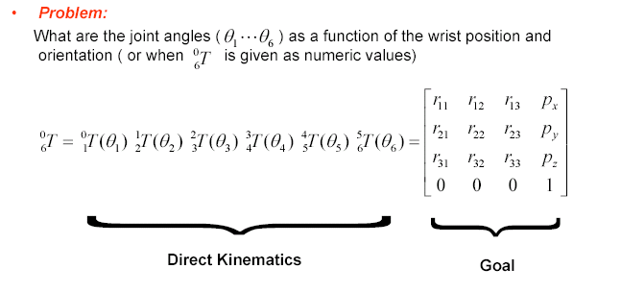
Inverse Kinematics - PUMA 560 - Algebraic Solution

Slide 36
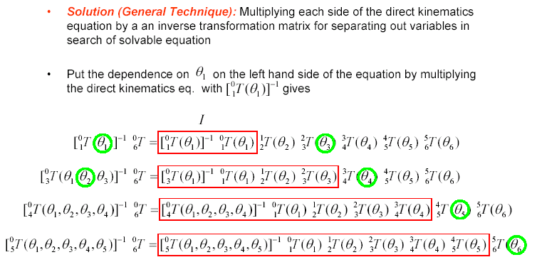
Inverse Kinematics - PUMA 560 - Algebraic Solution

Slide 37
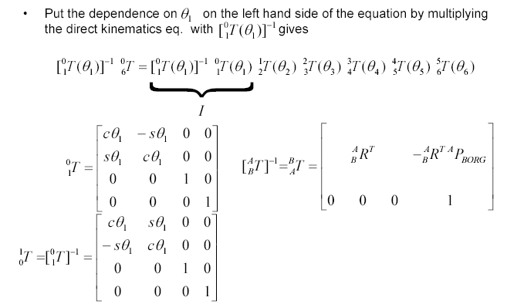
Inverse Kinematics - PUMA 560 - Algebraic Solution

Slide 38
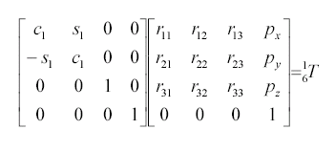
Inverse Kinematics - PUMA 560 - Algebraic Solution

Slide 39
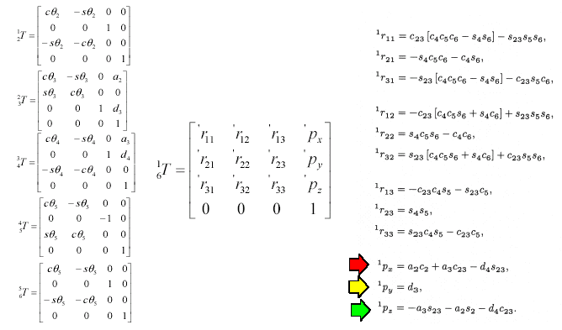
Inverse Kinematics - PUMA 560 - Algebraic Solution

Slide 40
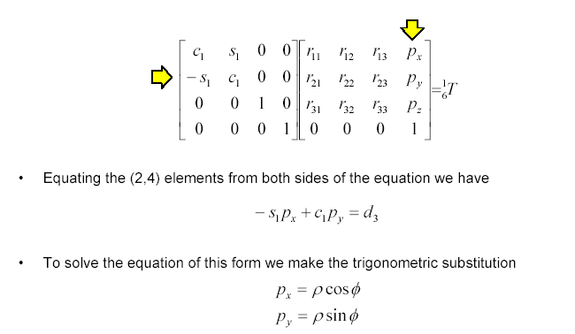
Inverse Kinematics - PUMA 560 - Algebraic Solution

Slide 41
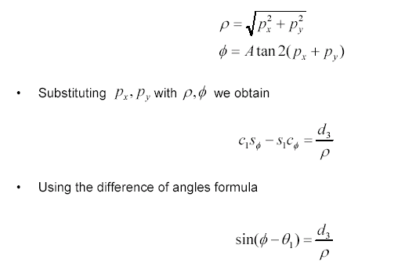
Inverse Kinematics - PUMA 560 - Algebraic Solution
,

Slide 42
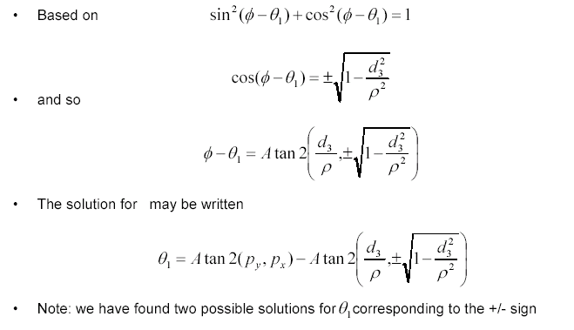
Inverse Kinematics - PUMA 560 - Algebraic Solution
The solution for θ₁

Slide 43
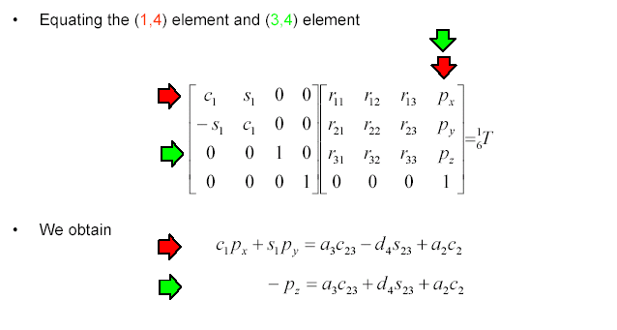
Inverse Kinematics - PUMA 560 - Algebraic Solution

Slide 44
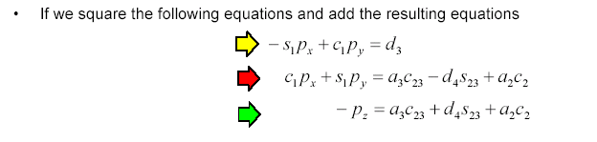
Inverse Kinematics - PUMA 560 - Algebraic Solution

Slide 45
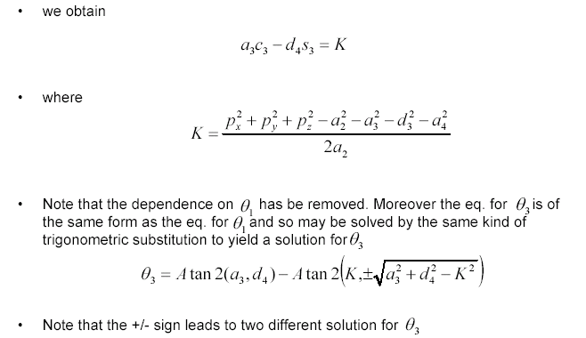
Inverse Kinematics - PUMA 560 - Algebraic Solution

Slide 46
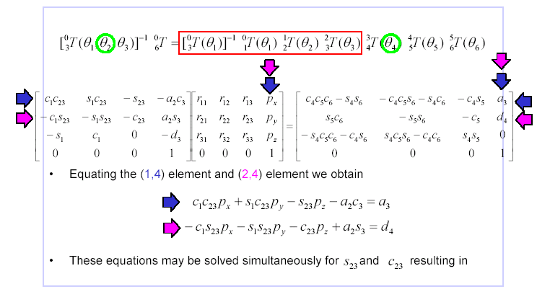
Inverse Kinematics - PUMA 560 - Algebraic Solution

Slide 47
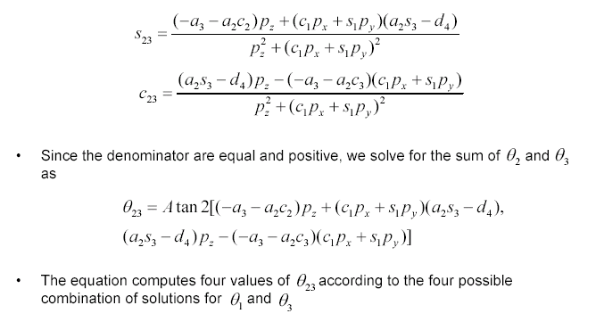
Inverse Kinematics - PUMA 560 - Algebraic Solution

Slide 48
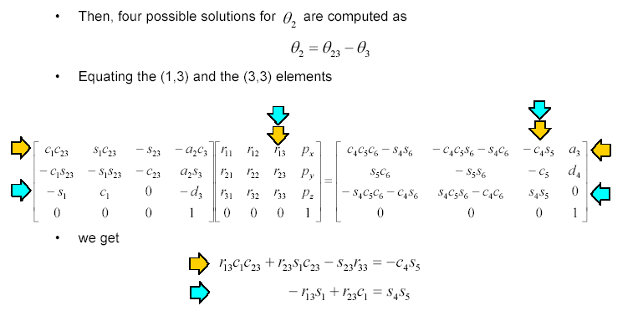
Inverse Kinematics - PUMA 560 - Algebraic Solution

Slide 49
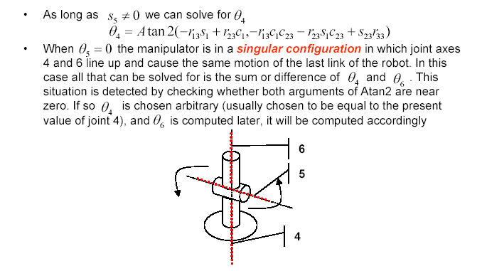
Inverse Kinematics - PUMA 560 - Algebraic Solution

Slide 50
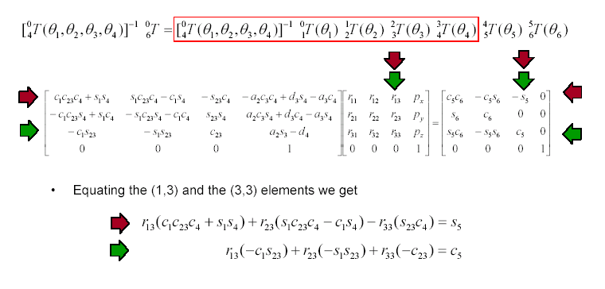
Inverse Kinematics - PUMA 560 - Algebraic Solution

Slide 51
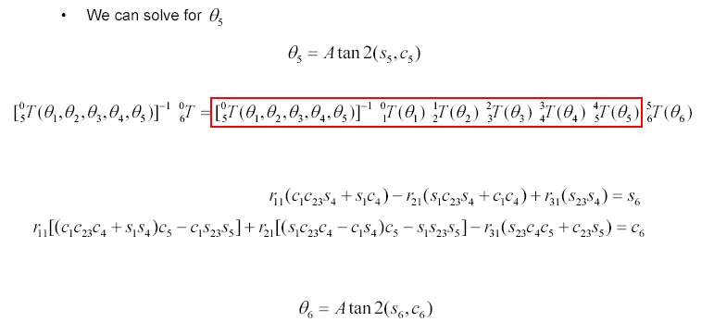
Inverse Kinematics - PUMA 560 - Algebraic Solution

Slide 52
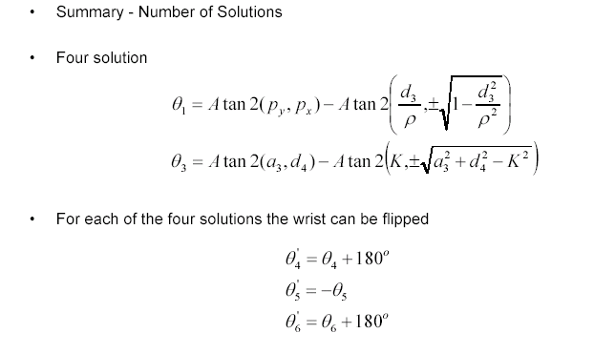
Inverse Kinematics - PUMA 560 - Algebraic Solution

Slide 53
Inverse Kinematics - PUMA 560 - Algebraic Solution
After all eight solutions have been computed, some or all of them may have to be discarded because of joint limit violations.
Of the remaining valid solutions, usually the one closest to the present manipulator configuration is chosen.

Slide 54
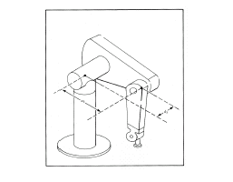
Central Topic - Inverse Manipulator Kinematics -Examples
Geometric Solution - Concept
Decompose spatial geometry into several plane geometry
Example - 3D - RRR (3R) manipulators - Geometric Solution
Algebraic Solution (closed form) –
Piepers Method - Last three consecutive axes intersect at one point
Example - Puma 560

Slide 55

Algebraic Solution by Reduction to Polynomial - Example

Slide 56

Algebraic Solution by Reduction to Polynomial - Example

Slide 57

Algebraic Solution by Reduction to Polynomial - Example

Slide 58

Algebraic Solution by Reduction to Polynomial - Example

Slide 59

Algebraic Solution by Reduction to Polynomial - Example

Slide 60

Algebraic Solution by Reduction to Polynomial - Example
By applying the law of cosines, we get
θ₃ = Atan2(

Slide 61

Algebraic Solution by Reduction to Polynomial - Example
β
α

Slide 62

Algebraic Solution by Reduction to Polynomial - Example

Slide 63

Algebraic Solution by Reduction to Polynomial - Example

Slide 64


Algebraic Solution by Reduction to Polynomial
Transcendental equations are difficult to solve because they are a function of cθ, sθ
Making the following substitutions yields an expression in terms of a single variable u
Using this substitution, transcendental equations are converted into polynomial equations

Slide 65

Algebraic Solution by Reduction to Polynomial - Example

Slide 66

Algebraic Solution by Reduction to Polynomial - Example
b² + a² – c²
b² + a² – c²

Slide 67

Solvability

Slide 68

Pieper’s Solution - Three consecutive Axes Intersect
Pieper’s Solution
Closed form solution for a serial 6 DOF in which three consecutive axes intersect at a point (including robots with three consecutive parallel axes, since they meet at a point at infinity)
Pieper’s method applies to the majority of commercially available industrial robots
Example: (Puma 560)
All 6 joints are revolute joints
The last 3 joints are intersecting

Slide 69

Pieper’s Solution - Three consecutive Axes Intersect
Given:
Manipulator Geometry: 6 DOF & DH parameters
All 6 joints are revolute joints
The last 3 joints are intersecting
Goal Point Definition: The position and orientation of the wrist in space
Problem:
What are the joint angles ( θ₁, θ₂, θ₃, θ₄, θ₅, θ₆ ) as a function of the goal (wrist position and orientation)

Slide 70


Pieper’s Solution - Three consecutive Axes Intersect
When the last three axes of a 6 DOF robot intersect, the origins of link frame {4}, {5}, and {6} are all located at the point of intersection. This point is given in the base coordinate system as
From the general forward kinematics method for determining homogeneous transforms using DH parameters, we know:

Slide 71

Pieper’s Solution - Three consecutive Axes Intersect

Slide 72

Pieper’s Solution - Three consecutive Axes Intersect

Slide 73

Pieper’s Solution - Three consecutive Axes Intersect

Slide 74

Pieper’s Solution - Three consecutive Axes Intersect

Slide 75

Pieper’s Solution - Three consecutive Axes Intersect
variable is zero

Slide 76

Pieper’s Solution - Three consecutive Axes Intersect

Slide 77

Pieper’s Solution - Three consecutive Axes Intersect

Slide 78

Pieper’s Solution - Three consecutive Axes Intersect

Slide 79

Pieper’s Solution - Three consecutive Axes Intersect

Slide 80

Pieper’s Solution - Three consecutive Axes Intersect

Slide 81

Pieper’s Solution - Three consecutive Axes Intersect

Slide 82

Pieper’s Solution - Three consecutive Axes Intersect

Slide 83

Pieper’s Solution - Three consecutive Axes Intersect

Slide 84

Pieper’s Solution - Three consecutive Axes Intersect

Slide 85

Central Topic - Inverse Manipulator Kinematics - Examples
Algebraic Solution (closed form) –
Piepers Method (Continued)
Last three consecutive axes intersect at one point

Slide 86

Three consecutive Axes Intersect - wrist
Consider a 3 DOF non-planar robot whose axes all intersect at a point.

Slide 87

Mapping - Rotated Frames - Z-Y-X Euler Angles

Slide 88

Mapping - Rotated Frames - ZYX Euler Angles

Slide 89

Three consecutive Axes Intersect - wrist
Because, in this example, our robot can perform no translations, we can write
The above transform provides the solution to the forward kinematics.

Slide 90

Three consecutive Axes Intersect - wrist
The inverse kinematics problem.
Given a particular rotation - Goal (again, this robot can perform no translations)
Solve: Find the Z-Y-X Euler angles

Slide 91

Three consecutive Axes Intersect - wrist

Slide 92

Three consecutive Axes Intersect - wrist

Slide 93

Three consecutive Axes Intersect - wrist

Slide 94

Three consecutive Axes Intersect - wrist

Slide 95

Three consecutive Axes Intersect - wrist

Slide 96

Three consecutive Axes Intersect - wrist

Slide 97

Three consecutive Axes Intersect - wrist

Slide 98

Three consecutive Axes Intersect - wrist
Unfortunately, while this seems like a simple solution, it is troublesome in practice because α is never exactly zero. This leads to singularity problems
For this example, the singular case results in the capability for self-rotation. That is, the middle link can rotate while the end effector’s orientation never changes.

