Slide 1
Package Tracker/Team 1
David Gao, Qiwei Ge, Pengxiang Zhang, Xinyi Zhu
Notes:
GE

Slide 2
Overview
Project Overview
Design
Implementation
Demonstration
Reflection
Notes:
GE

Slide 3
Project Description
We have designed the software to organize Professor Bohn’s Drones to Provide deliver&pick up packages service between Lincoln-Omaha.
Once a customer sends a delivery request, a SUAS(drone) will be dispatched automatically to pick up the package.
Once the sender publishes a send request, the drone will “fly” in the background while the user could be able to perform a new request at the same time.
Notes:
GE

Slide 4
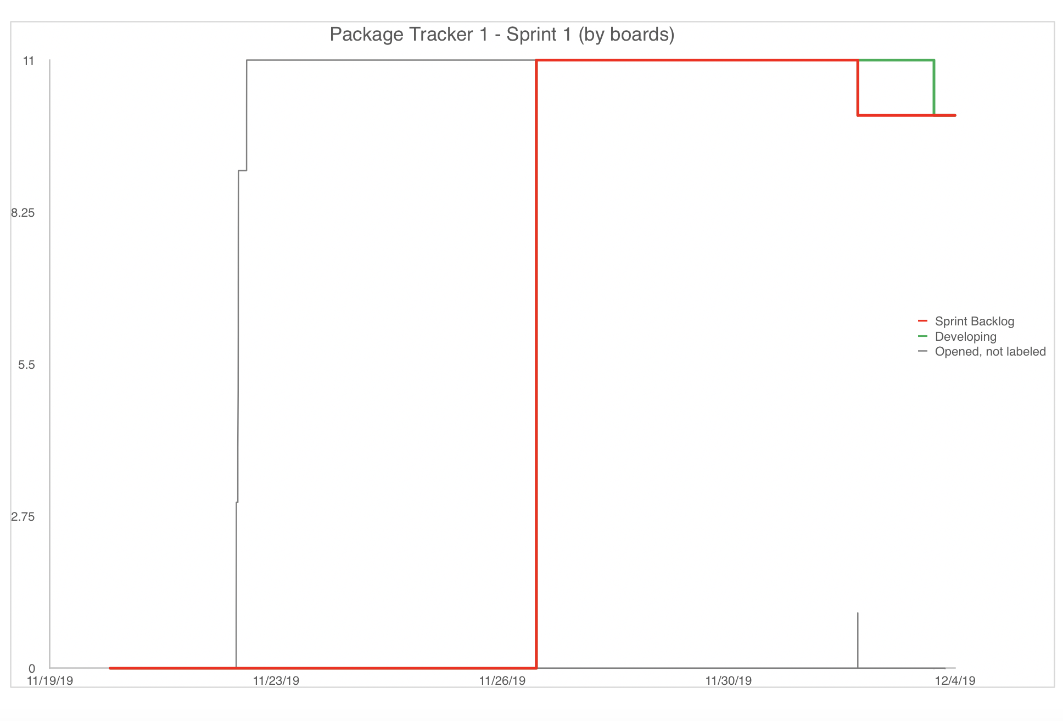
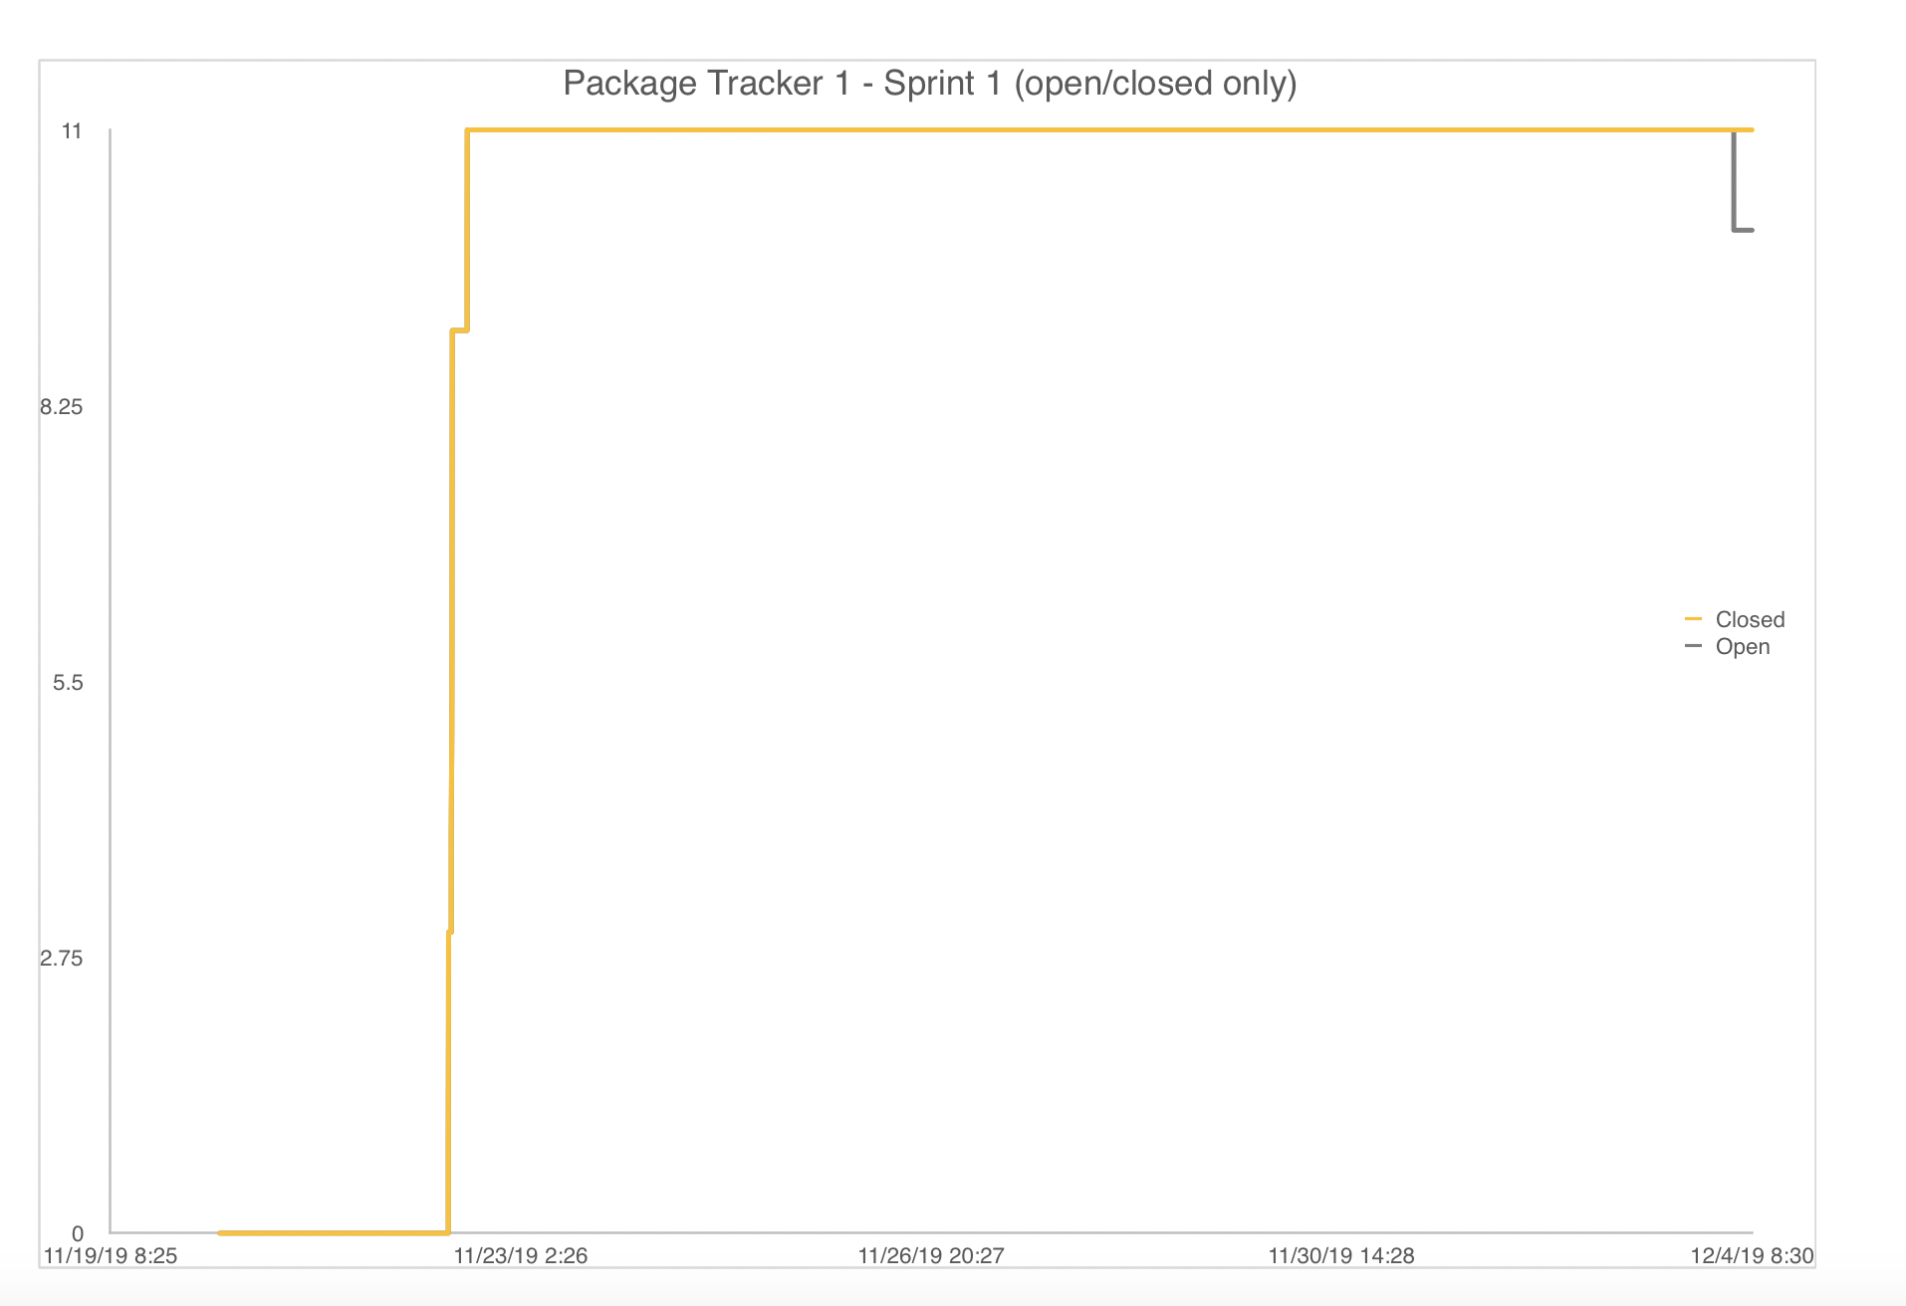
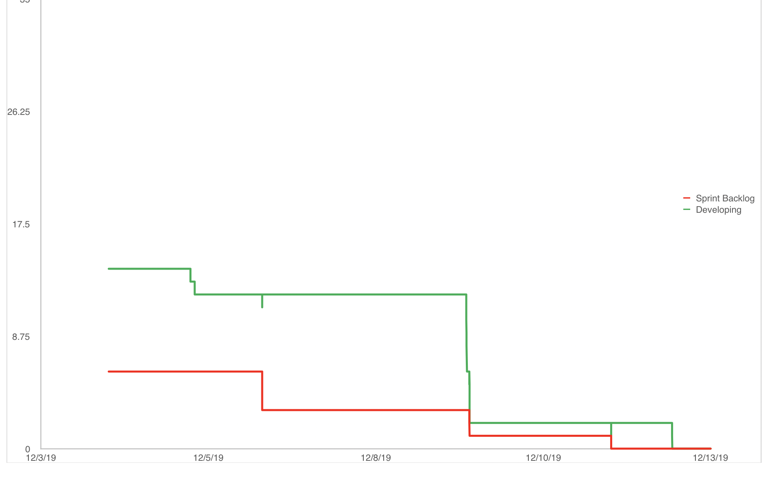
Burn Down Charts
Sprint 1
Sprint 2
Notes:
GE
During the sprint 1, we spent a long time implementing Hibernate connection with the code and testing different kinds of Hibernate search, we slowly learned how to use fuzzy search and specify search by writing test cases.
During the sprint 2, we found that we didn’t read project description carefully enough.We have a serious design problem: Our virtual drone deliver company doesn’t have multiple drones—instead, we have only one drone keep flying from one to another destination and it can flash back to origin once it finished delivering.
That because we designed packages doesn’t depend on drone to deliver.
Once hibernate and thread
We decide deal with this issue with multiple thread

Slide 5
Overview
Project Overview
Design
Implementation
Demonstration
Reflection
Notes:
GE

Slide 6
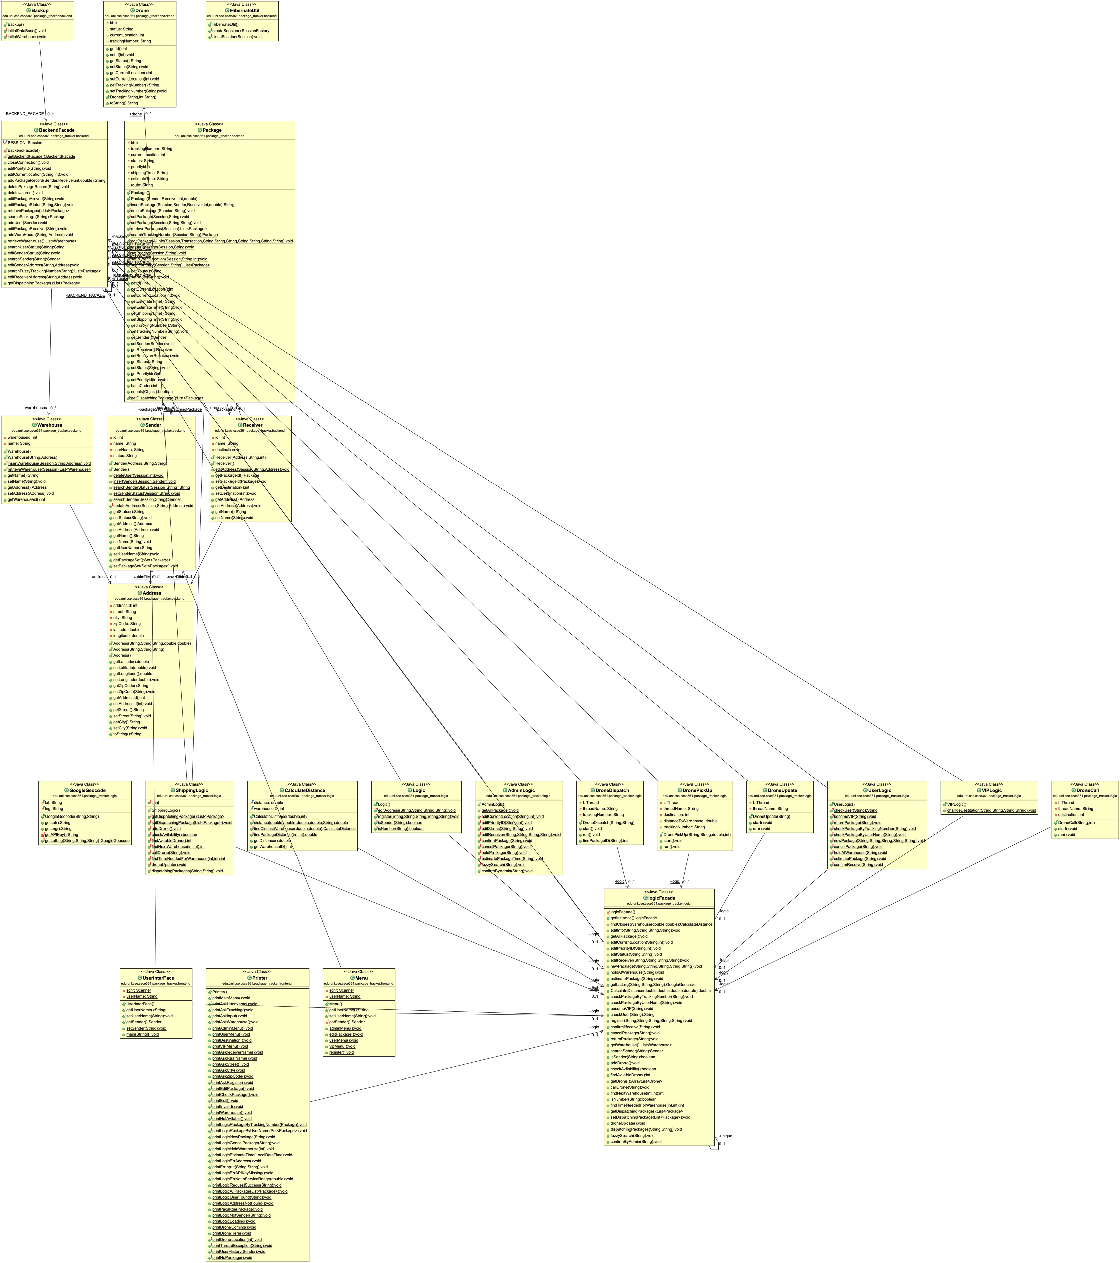
Subsystem Decomposition
Three-tier architecture for this project.
We allocated workload modularly.
It do not require too much group discussion since backend and frontend are individual depended.
Notes:
GE
During your presentation, you should discuss how the (architectural style )you chose will help you satisfy your design goals
Consider including an (architectural diagram) on this slide
Use the diagram as a visual aid to discuss your subsystem decomposition and subsystem services

Slide 7

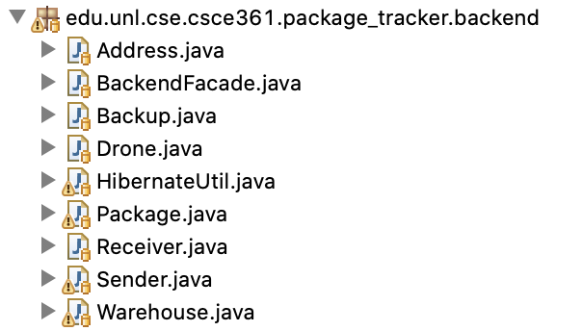
Subsystem Decomposition - backend
In the backend, it will prepare objects and Connect with database by using hibernate mapping.
Instead of design and implement sql database, we decide to use hibernate to help us populating database without query
Notes:
GAO/ZHU

Slide 8
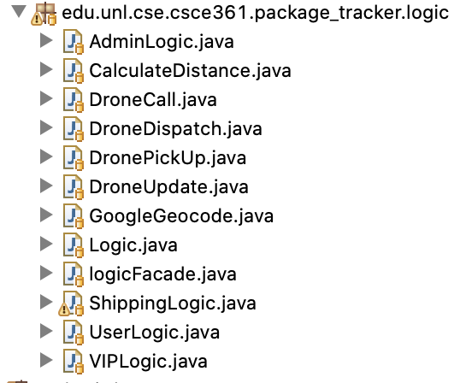
Subsystem Decomposition - logic
In the Logic , it implements services that customer request, and Pass to the front end through Facade.
Notes:
ZHANG

Slide 9
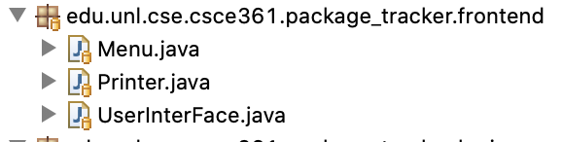
Subsystem Decomposition - front
In the frontend, all the menus depend on the user stories what we have. User interface designed according to users needs and necessary functions.
Notes:
GE

Slide 10
Other Architectural Issues
Logic
Google Cloud
Thread
Apache Http Components
Backend
Hibernate
Notes:
GAO/ZHU

Slide 11
Overview
Project Overview
Design
Implementation
Demonstration
Reflection
Notes:
GAO/ZHU

Slide 12
Implementation
Libraries / Dependencies: Hibernate.
Hibernate's job is to map relational data in the database to Java objects. (Object Relation Mapping)
Progress: Use hibernate's API to read, update, and delete our data.
Notes:
GAO/ZHU

Slide 13
Implementation
Libraries / Dependencies: Apache HttpComponents.
It allow us to sent HTTP request to use Cloud computing (Google Cloud) to convert user’s address to Geo Coordinates.
Notes:
ZHANG

Slide 14
Implementation
Libraries / Dependencies: Gson
It help us better manage the Http response after we sent the get request to Google Cloud.
Notes:
ZHANG

Slide 15
Implementation
Libraries / Dependencies: log4j
log4j can help us to record system error, allow us to easily maintenance, update or tracking programming errors
It is for helping mainly debug hibernate because there are too many possibilities that error occurs in hibernate that unrelated to our code
Notes:
GAO/ZHU

Slide 16
Experience Report
Hibernate-ORM:
Advantage:
It has its own HQL statement, which encapsulates SQL to a certain extent;
Various relational databases can basically support it;
Low development difficulty;
All aspects are relatively mature and complete, including transactions, caching and other ORMs that it should have;
Disadvantage:
Hibernate will be slower when the amount of data is large, especially delete and update operations;
Notes:
GAO/ZHU

Slide 17
Experience Report
Google Cloud Platform:
Advantage:
Geocoding API web service is easy to use.
Take advantage the Big data that google have.
It can help us to find user’s actual location.
We can contact support if we have any question we have.
Disadvantage:
It charge programmer or company.
I may not be use without internet connection.
If there is some wried bug, we will not able to resolve.
Notes:
ZHANG

Slide 18
Experience Report
Thread:
Advantage:
We can let programming running at the background. And get live update from the database.
We can observe the drone status at the background without any user input.
Disadvantage:
Not user friendly for console base system since it will push the system output.
Hard to manage Thread since it is running in the background.
Notes:
ZHANG

Slide 19
Overview
Project Overview
Design
Implementation
Demonstration
Reflection
Notes:
ZHANG

Slide 20
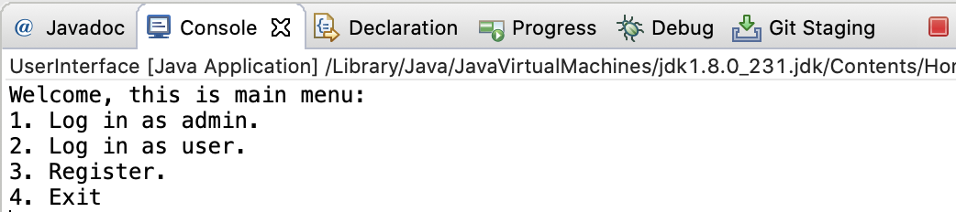
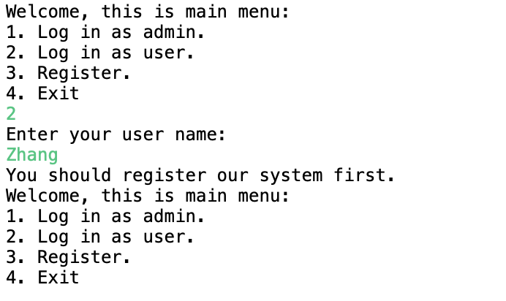
Live Demonstration
Main Menu
User Menu
Notes:
ZHANG

Slide 21
Overview
Project Overview
Design
Implementation
Demonstration
Reflection

Slide 22
Reflection What went well
We use database to store our data, even if we kill the program, the data is still saved.
We knew how to use Hibernate, which greatly reduced our workload.
We use threads to dispatch multiple drones with one run.
Notes:
GAO/ZHU

Slide 23
Reflection What didn’t go well
Hibernate is sometimes not stable, for example, too much data causes slowness.
It’s hard to debug Hibernate, which took the entire sprint 1 to stable the backend
We didn’t take drone seriously due to lack of understanding function requirements
Lack of communication between frontend’s members and backend’s(which might be a good things since we can design backend and frontend separately)
Notes:
GAO/ZHU

Slide 24
Reflection Lessons Learned
We should first solve the drones problem. We didn't think about taking drones until the whole program was about to end.
We should not miss any detail at the begin, we should read handout very carefully.
We should keep our SQL login information in the safest condition.
Have a better preliminary before we start the programming.
Notes:
GE

Slide 25
Credits
<google> https://developers.google.com/maps/documentation/geocoding/start
<Hibernate> https://hibernate.org/
<Gson> https://www.javadoc.io/doc/com.google.code.gson/gson/latest/com.google.gson/module-summary.html
<httpcomponents> https://hc.apache.org/
Notes:
GE

