Slide 1


GENN: Enable Flexible and Efficient AI For Resource-Constrained Platforms
Yan Zhu, Kaija Mikes, Karthik
Ganesan, Natalie Enright Jerger

Slide 2
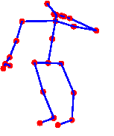
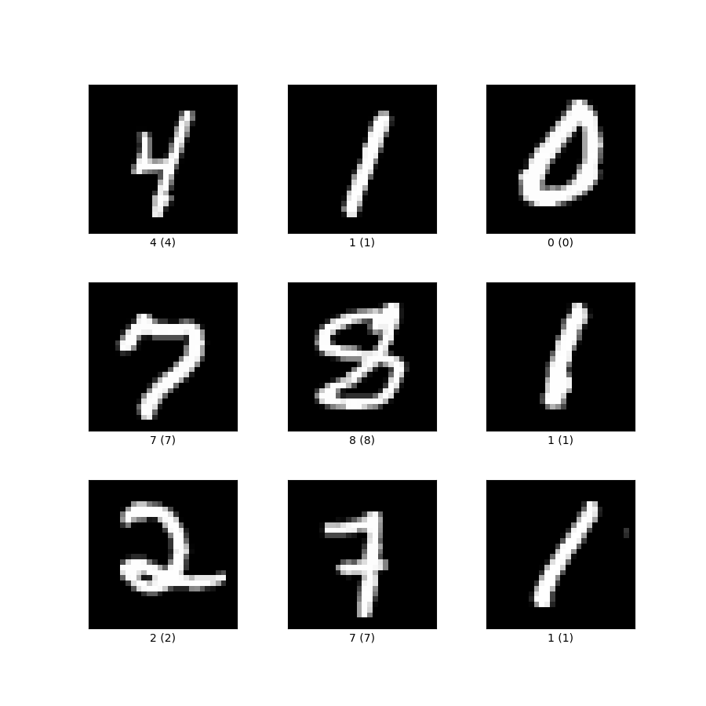


Why AI on Resource-Constrained Platform
Posture Detection
Health Monitoring
Signal Classification
Image Classification
1
Notes:
I think saying something else here would be nice. And then save this for the ‘benchmarks’ slide.
NEJ: I am not sure this is where I would start – I think you can lead with the research problem and then talk about the motivation behind it.

Slide 3
Motivation I: Limitations of Dominant Deep Learning Frameworks for Low-Performance Devices
PyTorch, TensorFlow
Platform Dependencies
Interpreted Languages
Extensive Libraries
Dynamic Memory Allocation
2
Notes:
NEJ: Focus on the limitations as they apply to IoT devices – these aren’t bad features of DL frameworks but just don’t work as well on a resource constrained IoT
‘
I feel like a list would be better here. So you can add a point for each?
Interpreted languages: add high overhead of resource constrained platforms
Extensive libraries: 1. adds space overhead and 2. are typically platform dependent
Dynamic memory allocation:
1. On CPU based systems, out of memory becomes a runtime error. With static allocation, we can identify memory space issues at compile time.
2. HLS tools do not support dynamic memory allocation

Slide 4
Motivation II: Drawbacks of Prior Works
 | GENN (Our Work) | CMSIS-NN | uTensor | TensorFlow Lite Micro
Platform Requirement | None | ARM Cortex-M Processor | Mbed OS | Dynamic Memory Allocation
Auto Generation | ✓ | ✗ | ✓ | ✓
DL Framework | PyTorch | None | TensorFlow | TensorFlow
Usability | Easy | Very Hard | Medium | Hard
Sparsity | ✓ | ✗ | ✗ | ✗
3
Comparison of GENN and prior works.
Notes:
NEJ: Maybe animate a box around the GENN column to highlight that this is your work

Slide 5
Research Goal: Develop a more portable and flexible PyTorch conversion tool that can better
serve AI research on low-performance platforms.
4
Notes:
NEJ: Consider putting this as the first slide after the title. I think with such a short talk, we should just get right to “what is the problem we are trying to solve”

Slide 6





Proposed Solution: GENN
PyTorch Model
GENN Convertor
Pre-defined DNN Functions in C
DNN layer extraction, Layer-wise parameter and weight collection
.c
.h
.h
Input Dataset
Dataset Conversion
.h
C Dataset
Efficient on high-performance devices
Support FL32, INT16, and sparse model conversion
Standalone C Models;
Efficient on resource-constrained platforms
No external library dependencies, OS constraints, or dynamic memory allocation requirements.
Quantization operations require zero floating-point operations.
5
Notes:
This slide is really packed. And it is the main slide about this work. So it might be better to split it into 2 slides at least.

Slide 7
GENN Benchmark
Eight deep learning models that are commonly used for IoT devices.
Generated by GENN converter and can be used out of the box.
6
Notes:
I think it would be fine to just list the different datasets and benchmarks. I don’t think adding the accuracy is very useful.
Also, starting the Y-axis at 75 is quite misleading. HAR CNN looks really bad but its still >80%.

Slide 8
Evaluation I: Simulation Results
Simulation on the Thumbulator -- a cycle-accurate simulator for the ARM Cortex-M0+ CPU, running at 24 MHz.
Significant speedup of quantized models due to the lack of HW support for floating point operations on the Cortex-M0+ CPU.
7
Notes:
NEJ: I’m not sure if you have time for two results slides in an 8 min talk. Perhaps just focus on the second results in case you are having trouble explaining this slide, you can just cut it.

Slide 9
Evaluation II: Real Device Results
Evaluation on the STM32-NUCLEO-F411RE board with a 32-bit ARM Cortex-M4 CPU, 128 KB of RAM and 512 KB of flash memory, 100 MHz.
Quantization and sparsity reduce the memory by 44% and 60%.
8

Slide 10
Next Steps & Potential Values
Compare the inference time and memory usage of GENN benchmark to the experiment results of the prior works.
Support the quantized sparse model conversion.
Enrich GENN converter’s features to further improve its usability.
9
Notes:
NEJ: Maybe combine next steps with some conclusions – use this opportunity to remind the audience what GENN is for.

Slide 11


GENN: Enable Flexible and Efficient AI For Resource-Constrained Platforms
Thank you!
This research was undertaken, in part,
thanks to funding from the Canada Research Chairs Program.

