Slide 1
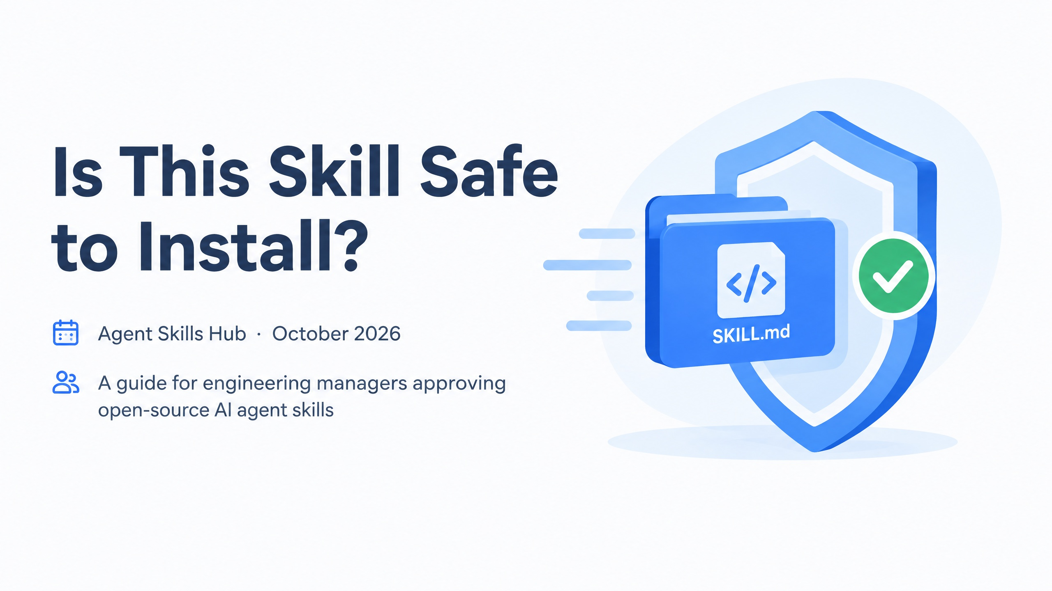
Notes:
The question on this slide is one most of us now answer several times a month, usually without noticing. Someone on the team finds a useful agent skill, installs it, and moves on.
In the next few minutes I want to give you a quick way to answer that question before the install happens, using Agent Skills Hub as the reference point.

Slide 2
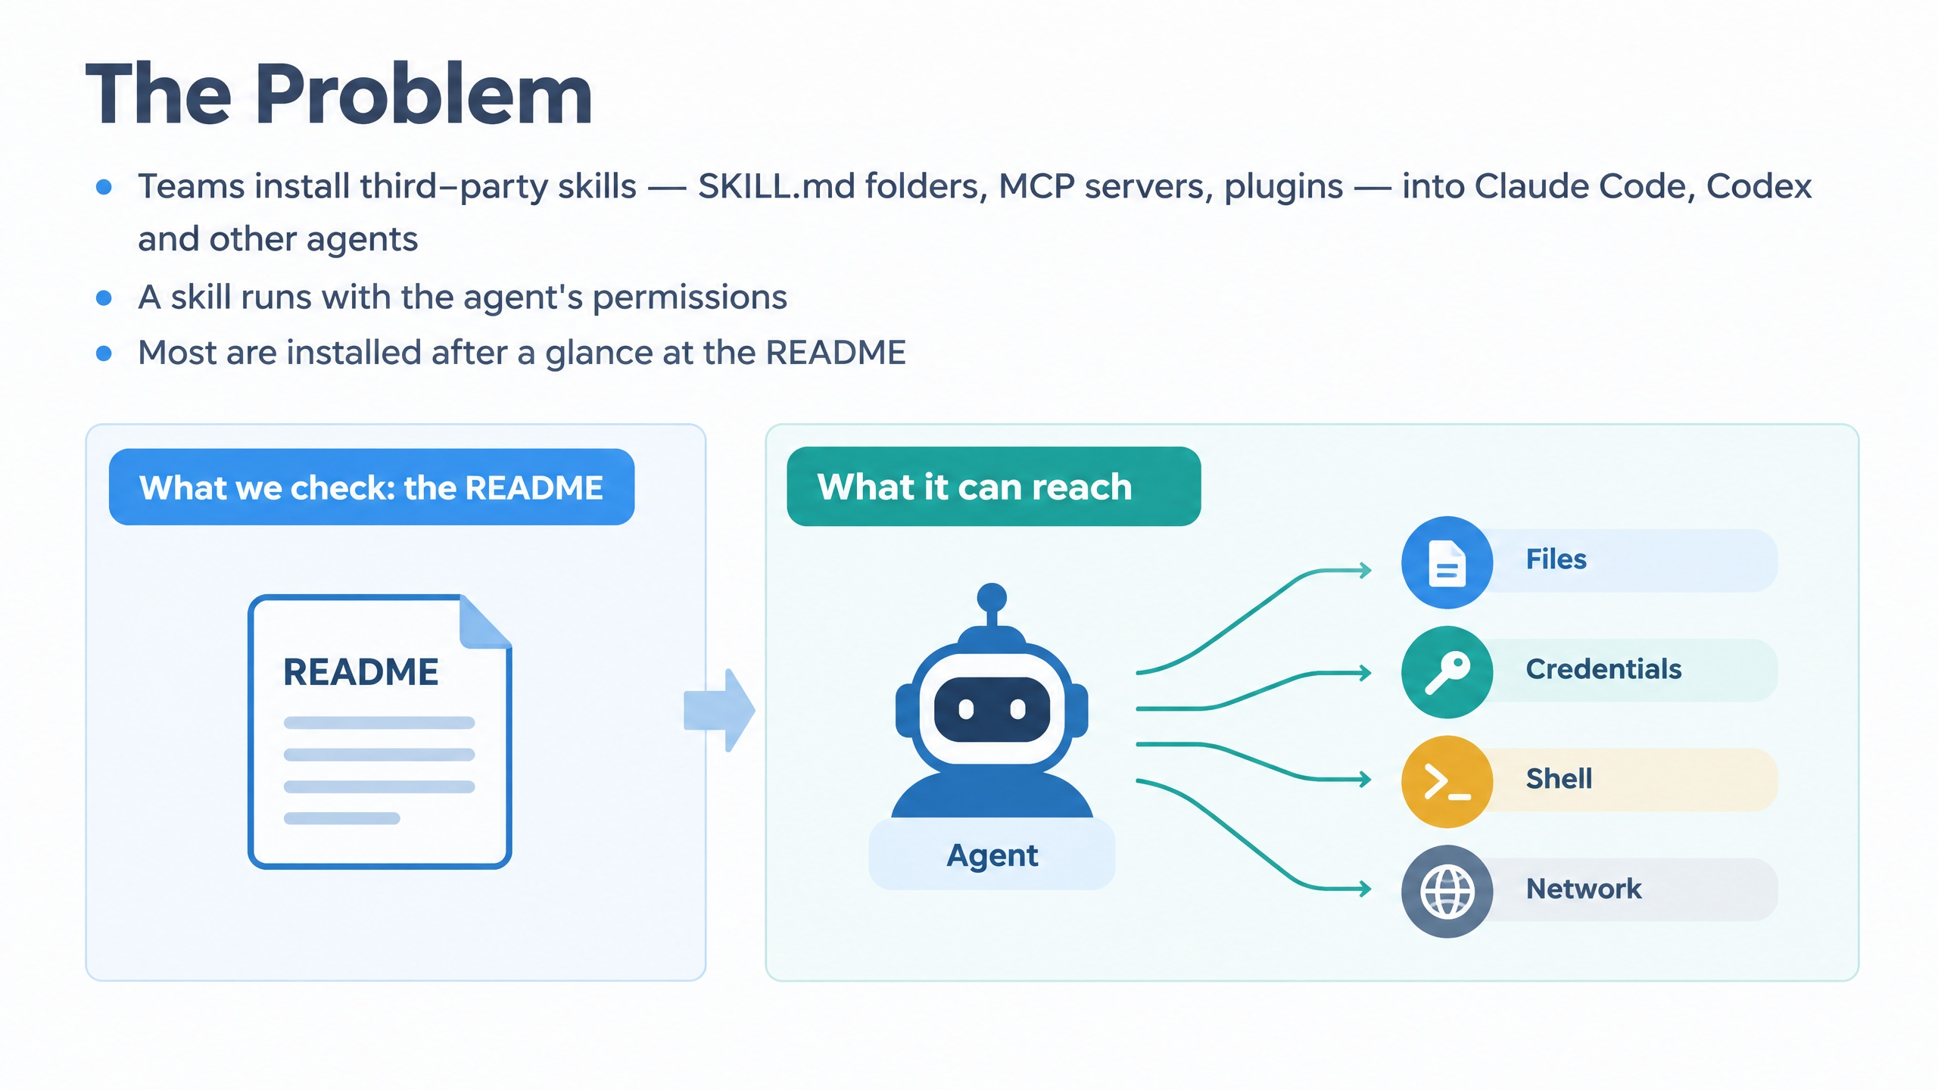
Notes:
Here's the situation. Our teams install third-party skills (SKILL.md folders, MCP servers, plugins) into Claude Code, Codex and other agents. That part is fine; these tools are useful.
The issue is on the right side of this slide. A skill doesn't run in a sandbox of its own. It runs with the agent's permissions, which means it can reach whatever the agent can reach: files, credentials, a shell, the network.
Compare that with the left side. In practice most skills are installed after someone glances at the README. So we're making a permissions decision based on marketing copy. The rest of this talk is about closing that gap cheaply.

Slide 3
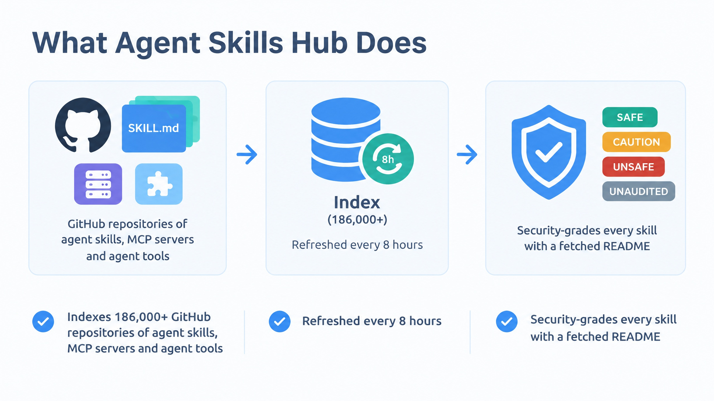
Notes:
Agent Skills Hub is one way to close it. Read this slide left to right.
It indexes more than 186,000 GitHub repositories of agent skills, MCP servers and agent tools, and refreshes that index every 8 hours, so new skills and new versions show up quickly.
Then, for every skill where it can fetch a README, it assigns a security grade. That grade is what you and your team should look at before anything gets installed.

Slide 4
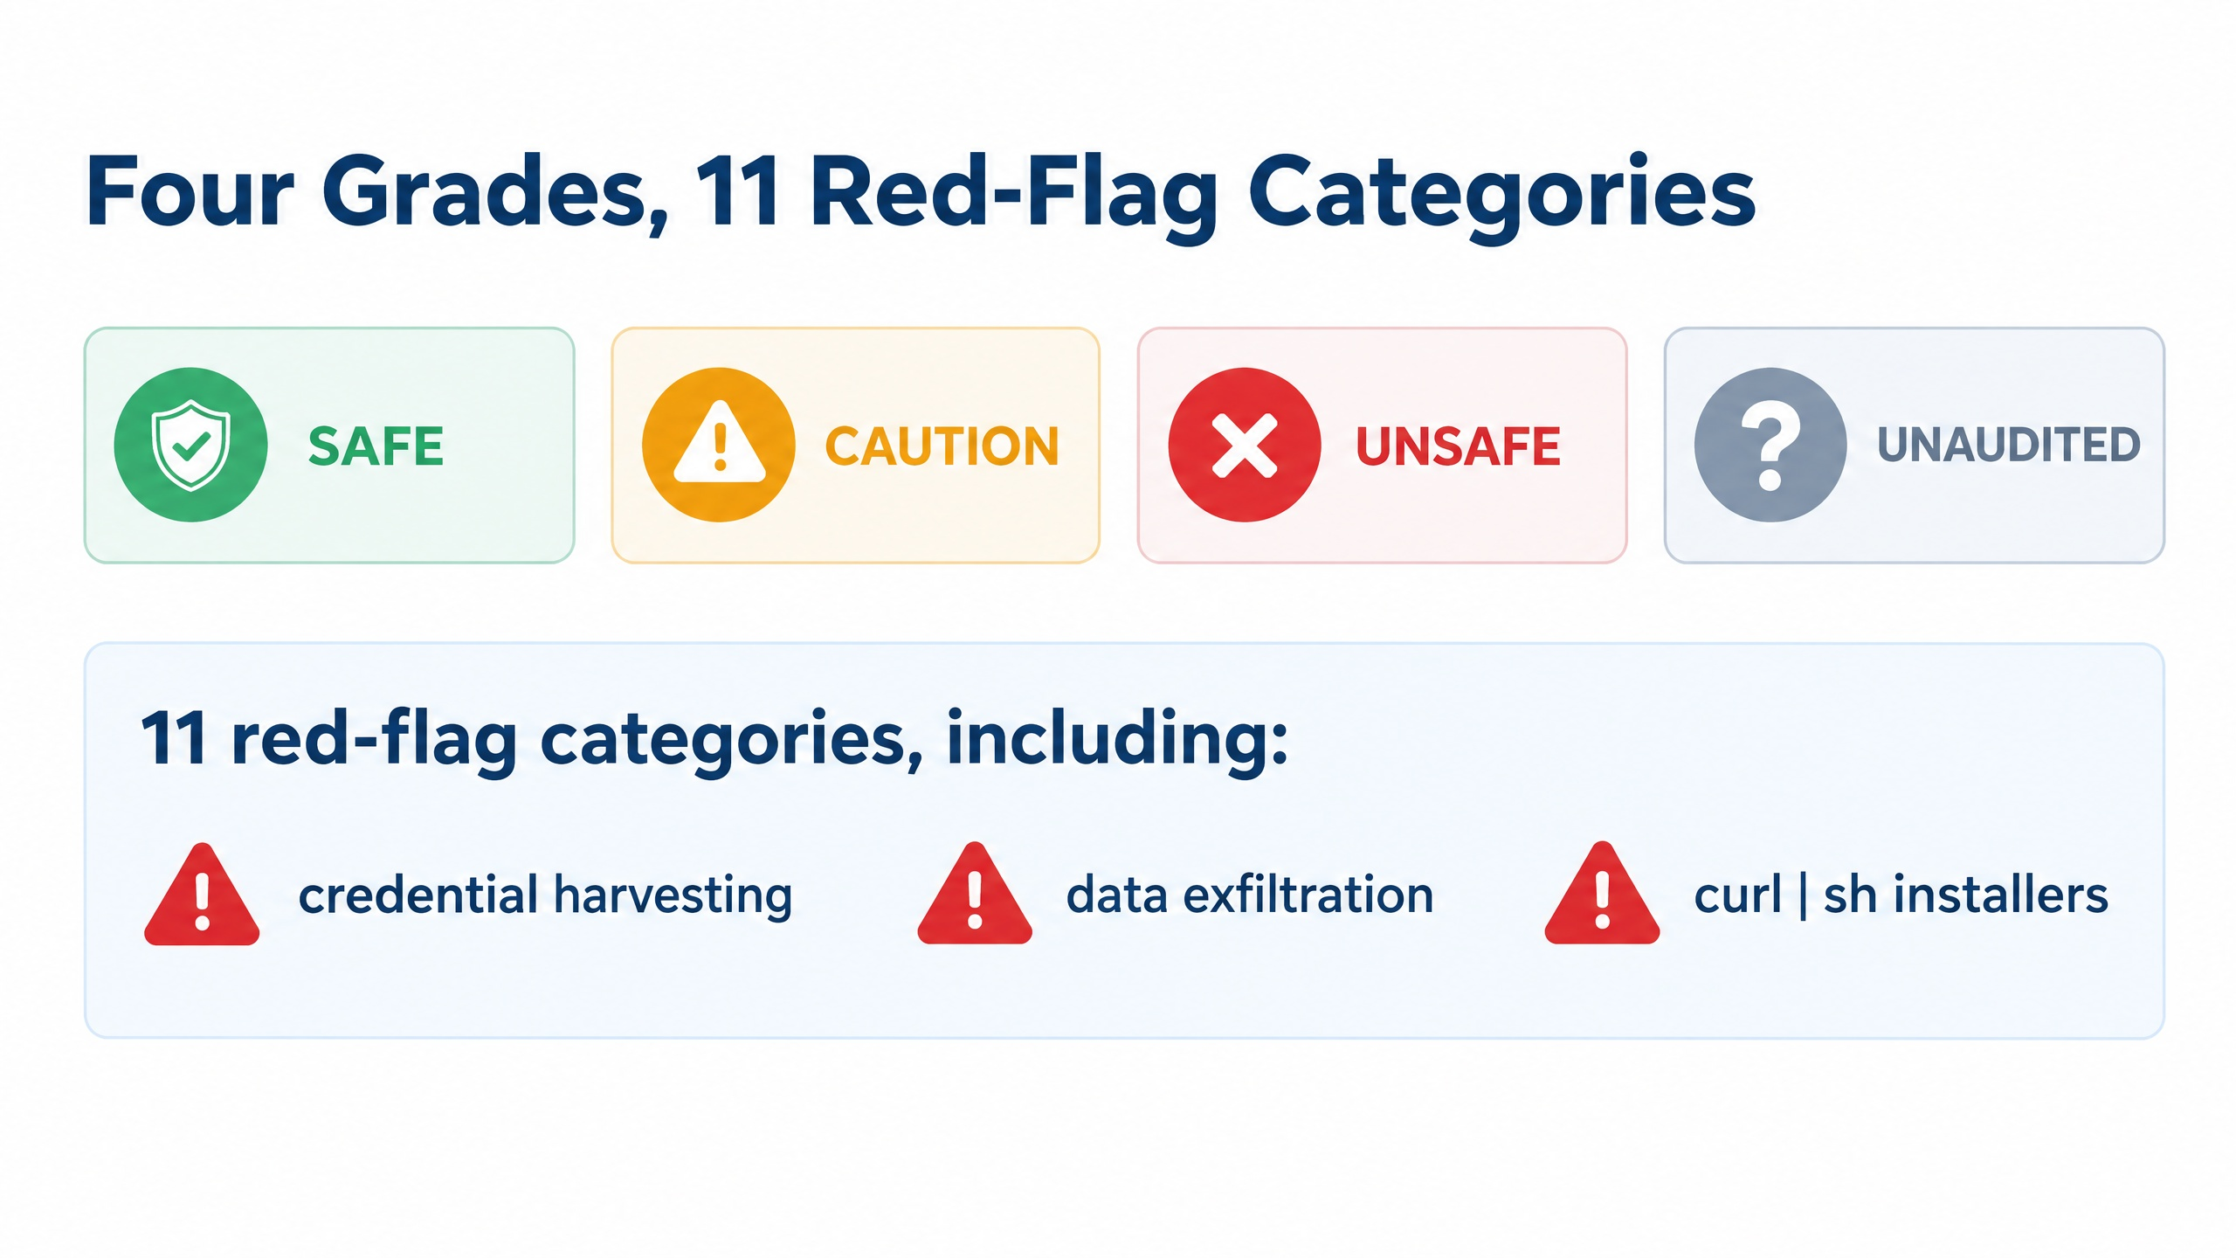
Notes:
There are four grades. SAFE means no red flags were found. CAUTION and UNSAFE mean something was flagged, with UNSAFE being the serious end. UNAUDITED means there wasn't enough to grade, and you should treat that as "unknown", not as "fine".
The grading checks 11 red-flag categories. The three at the bottom are the ones I'd point a team to first: credential harvesting, data exfiltration, and curl | sh installers that run remote code straight into a shell.

Slide 5
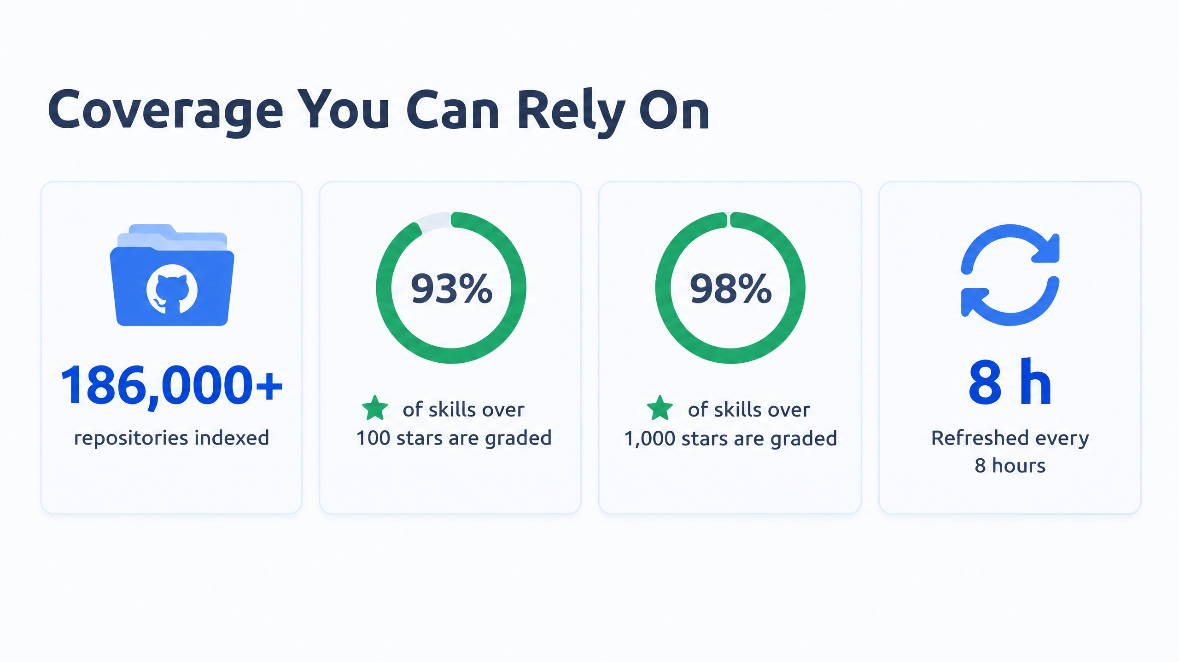
Notes:
A grade only helps if the skill you care about actually has one, so coverage matters.
Coverage is highest exactly where your team is most likely to look. 93% of skills with more than 100 GitHub stars are graded, and 98% of those with more than 1,000 stars. Combined with the 8-hour refresh, the odds are good that a popular skill already has a current grade when someone asks about it.

Slide 6
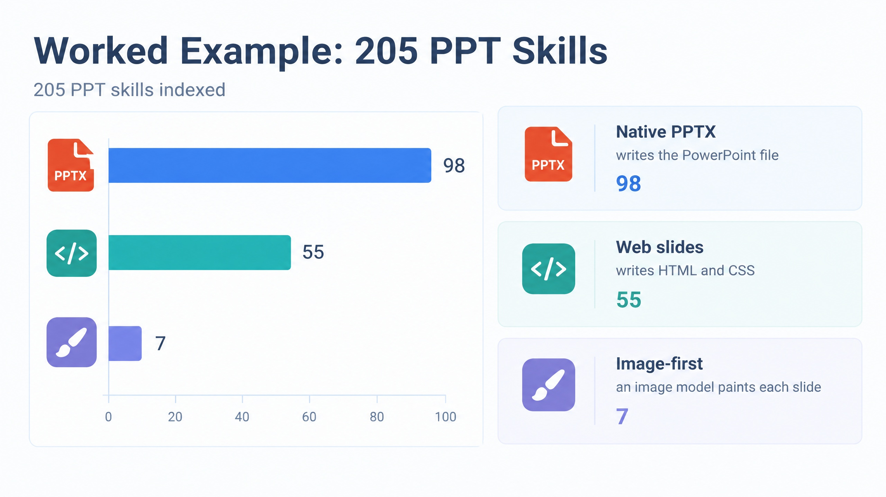
Notes:
Let's make this concrete with one category: skills that build slide decks. There are 205 of them in the index.
They take three routes. 98 write a native PowerPoint file. 55 write web slides in HTML and CSS. And only 7 are image-first, where an image model paints each slide.
This split matters for choosing a tool, which we'll come back to. But first, look at what the security grades say about this group.

Slide 7
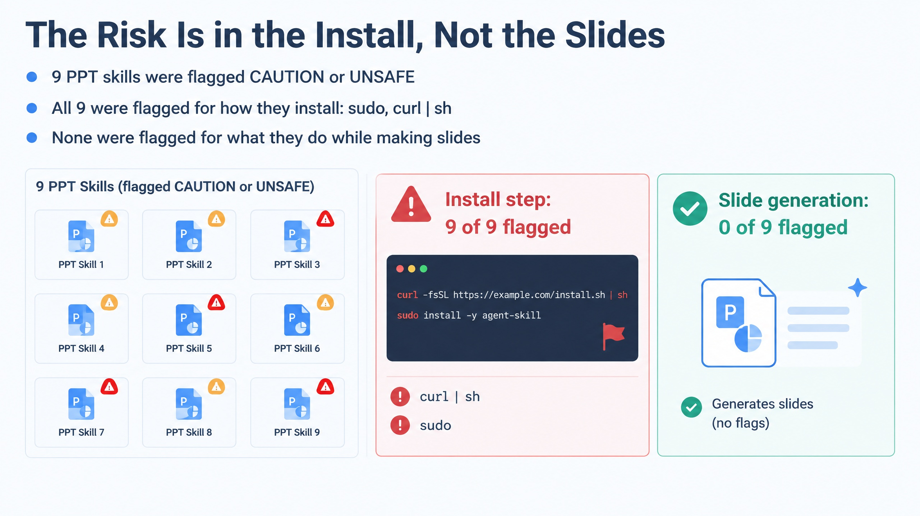
Notes:
Nine of these PPT skills were flagged CAUTION or UNSAFE. The interesting part is why.
All nine were flagged for how they install, things like requiring sudo or piping a remote script into a shell with curl | sh. None of them were flagged for what they actually do while making slides.
That's the practical lesson for managers. The dangerous moment is often the install step, not the day-to-day use. So the review needs to happen before installation, and it should look at the install instructions, not just the feature list.

Slide 8
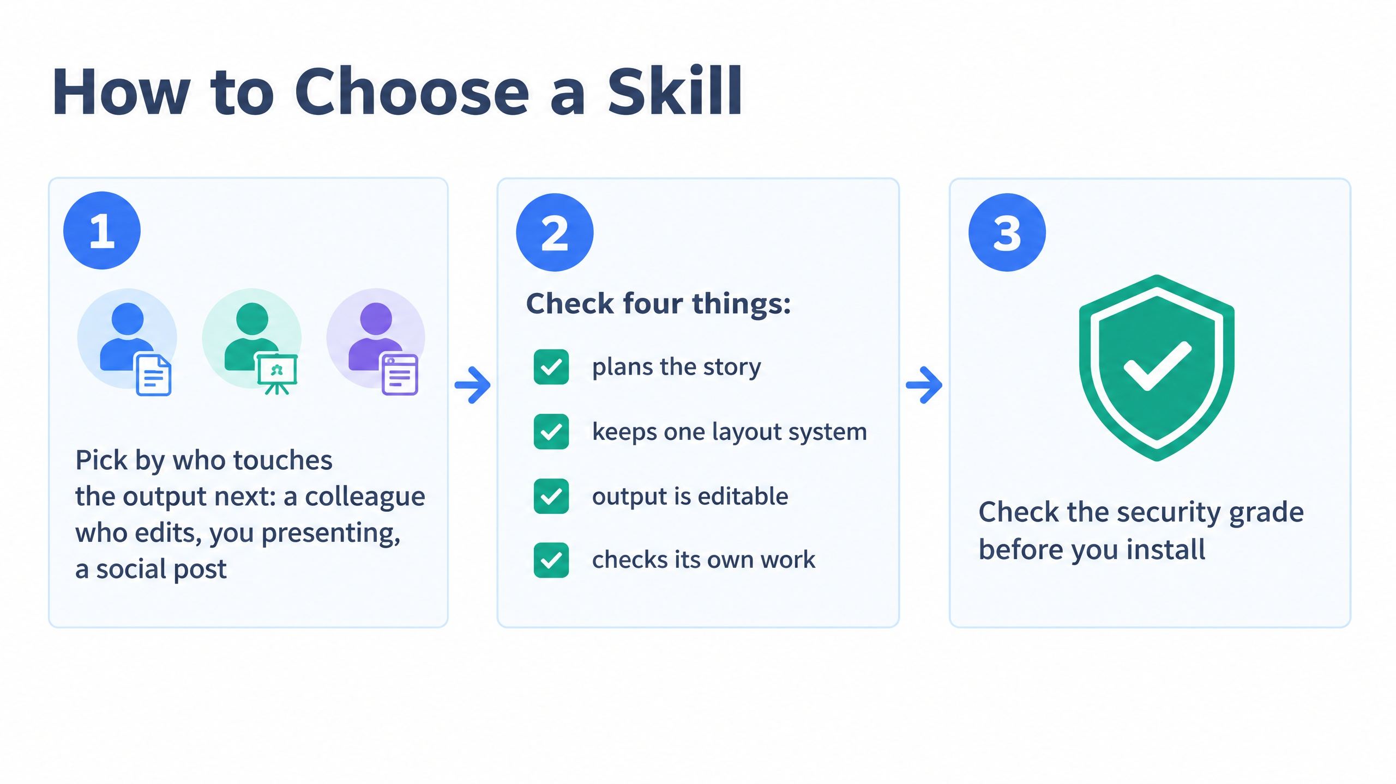
Notes:
So here's a simple three-step process you can hand to your team.
First, pick by who touches the output next. If a colleague will edit the file, you want native output. If you are presenting it yourself, or posting it on social media, other routes may be fine.
Second, check four things: does the skill plan the story, does it keep one consistent layout system, is the output editable, and does it check its own work.
Third, and this is non-negotiable, check the security grade before you install.

Slide 9
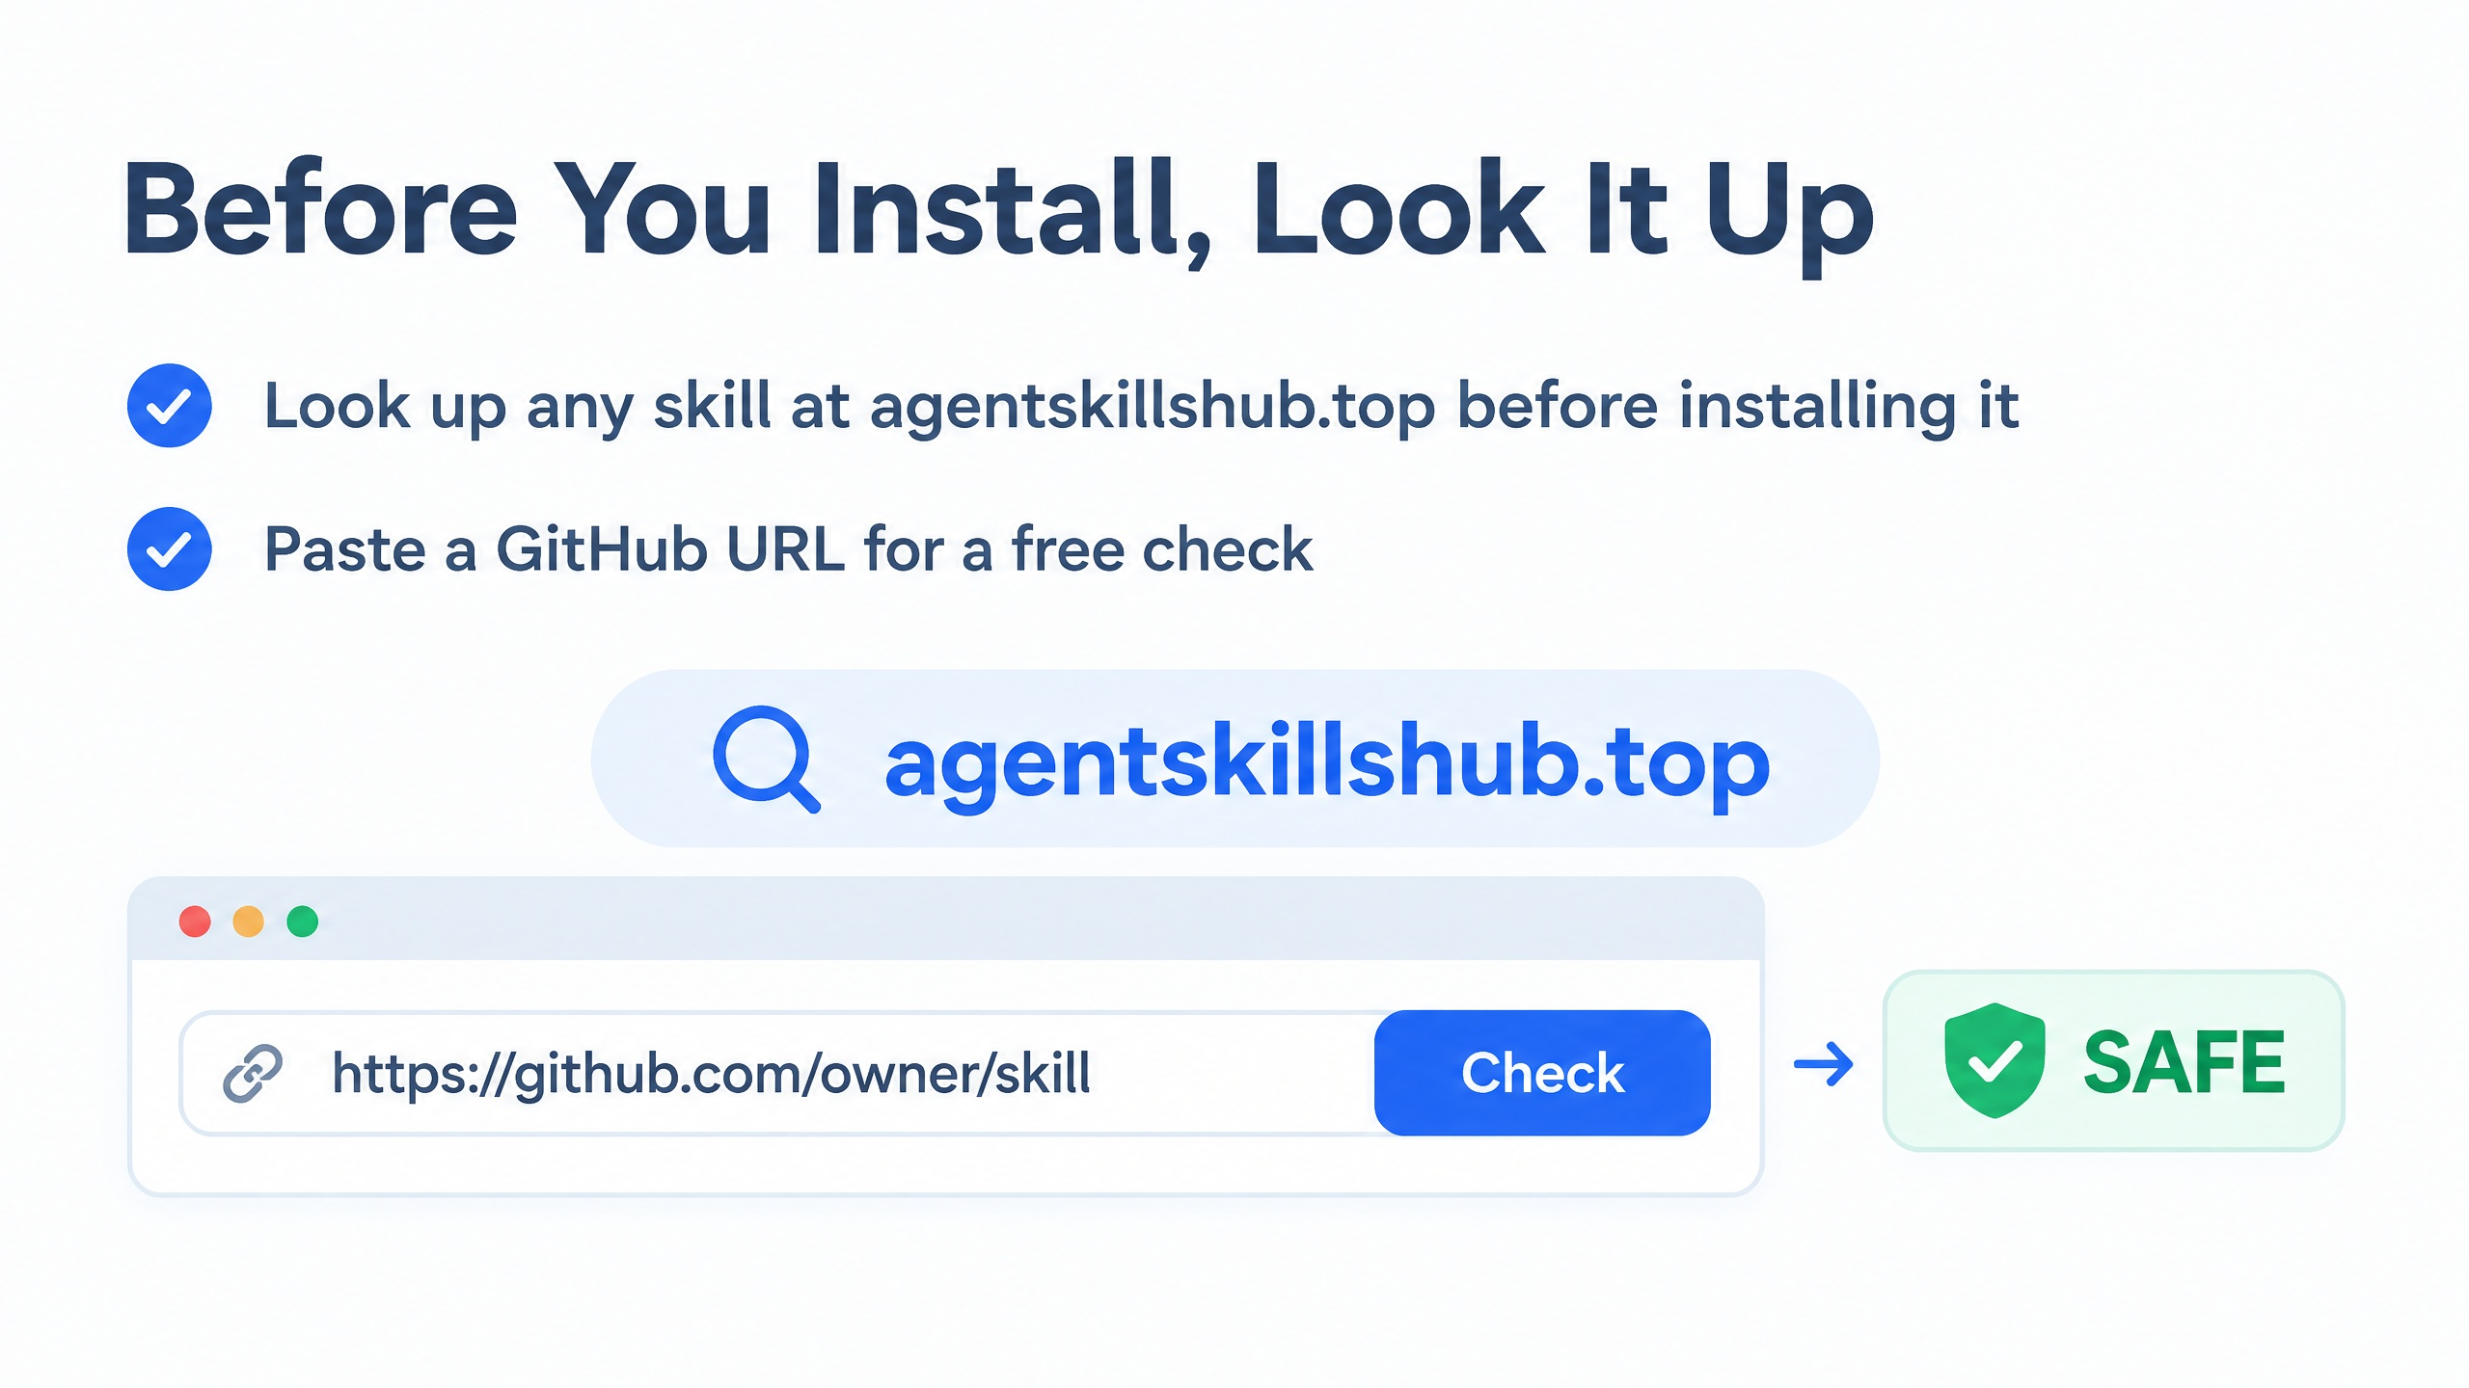
Notes:
That leads to the one action I'd like you to take away.
Before anyone on your team installs a skill, look it up at agentskillshub.top. If it isn't obviously listed, paste the GitHub URL and you get a free check.
It takes under a minute, and it moves the decision from "the README looked fine" to an actual security grade. Happy to take questions.

