Slide 1

10天剑桥A2核心词汇
Day 1 日常生活——购物与住所
主讲人：________
Notes:
用例句讲解词汇，例题形式为：1、英英释义（给选项）or 2、填空（重点词组考察搭配）

Slide 2
基础词汇——38个
1 | block | n.街区 | 10 | heating | n.供暖
2 | electricity | n.电 | 11 | ceiling | n.天花板
3 | fridge refrigerator | n.冰箱 | 12 | toothbrush/ toothpaste | n.牙刷/牙膏
4 | gas | n.燃气；气体 | 13 | rent | n.租金
5 | oven | n.烤箱 | 14 | garage | n.车库
6 | microwave | n.微波炉 | 15 | drawer | n.抽屉
7 | sink | n.洗碗槽 | 16 | wardrobe | n.衣橱
8 | furniture | n.家具 | 17 | accessory | n.配件/配饰
9 | goods | n.商品(仅复数) | 18 | jewellery jewelry | n.珠宝首饰
Notes:
基础词汇以串讲形式呈现，仅展示单词和释义

Slide 3
基础词汇——38个
19 | entrance/exit | n.入口/出口 | 27 | customer | n.顾客
20 | price | n.价格 | 28 | leather | n.皮革
21 | discount | n.折扣 | 29 | female/male | n.女性/男性
22 | receipt | n.收据 | 30 | size | n.尺码；大小
23 | customer | n.顾客 | 31 | lift/elevator | n.电梯（直梯）
24 | leather | n.皮革 | 32 | washing machine | 洗衣机
25 | female/male | n.女性/男性 | 33 | air conditioner | 空调
26 | receipt | n.收据 | 34 | credit card | 信用卡
 |  |  | 35 | cell phone/ mobile phone | 手机
Notes:
基础词汇以串讲形式呈现，仅展示单词和释义

Slide 4
spend
v. 花费
（时间/金钱）
Who do you spend your free time with?
The exhibitions are all worth visiting. But don't spend money on tickets now.
Q: How _________ do you spend? A: An hour.
Q: How _________ do you spend? A: 20 pounds.
Notes:
出处 1、口语部分对话；2、听力part3
答案 1、long（或how much time）；2、much（或how much money）

Slide 5
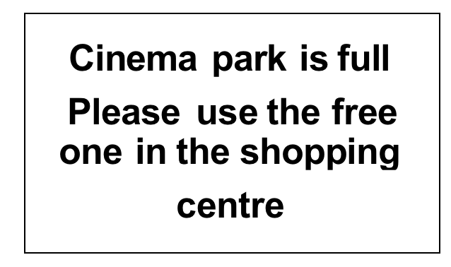
pay
v.支付
A. You should pay for cinema parking
in the shopping centre. ❌
C. Cinema visitors should use a
different car park. ✅
Notes:
出自阅读part1

Slide 6
bill
n.账单
One day I may have to do a few hours a week teaching just to pay the bills.
Question: What can be called a bill?
A. The money you spend on electricity
B. The money you get from parents
Notes:
出自阅读part3；答案A

Slide 7
belong
v.属于
The bakery belong to Aslam,who says that he sells 4,000 biscuits every day and 7,000 cups of tea.
Question: ‘belong to’ means
A. Someone has something.
B. Someone buys something.
Notes:
出自阅读part4完形填空；答案A

Slide 8
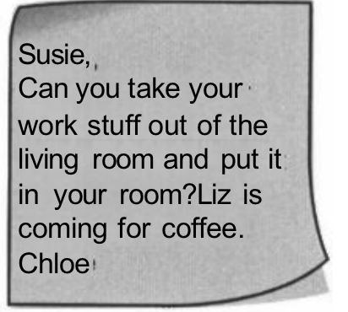
put
v.放置
1.
2. You will hear Gregory talking to Angelika about some things he has bought for his new house.
What is he going to put in each place?
Question:
Why don't you make a poster and ask Mrs.Taylor to put it ___ in the sports hall?
Notes:
出处1、阅读第1部分；2、听力题干；
题目来源阅读part4完形填--答案put it up（张贴）

Slide 9
tidy
v.收拾整理
Chloe wants Susie
C. to tidy up the living room. ✅
Notes:
出处：阅读第1部分

Slide 10
clean
v.清洗；使…干净
It was really exciting to see what the people at the museum were able to do to clean the pieces of silver.
Question: ‘clean’ here means .
A. wash the pieces of silver
B. not dirty
Notes:
题目出处：阅读第3部分
答案A

Slide 11
shower
bath
n.淋浴（间）
n.浴缸
Campsites usually have showers,
but when we got there, we found that this one had a real bath.
Question: Which one has a tub?
A. shower
B. bath
Notes:
答案B

Slide 12
wash up
washing-up
phra. 清洗
n. 洗餐具
... please wash up and put things away after you've used the kitchen.
I think I left it by the sink when l finished the washing-up.
Question: I can help with the .
A. washing-up B. wash up
Notes:
1出处 阅读part1、2出处听力part1
答案A

Slide 13
enough
adj. 充足的
adv. 足够地
lt's not very big, there isn't enough space for a cupboard. (enough+名词.)
Q：Where will we have the picnic?
A：At the local park--my yard isn't large
enough. (形容词.+enough)
Question: The weather is .
A. warm enough B. enough warm
Notes:
出处1、听力part5；2、听力part3
答案A

Slide 14
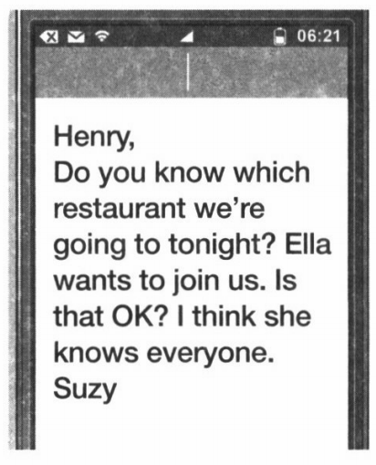
extra
adj. 额外的
We've got an extra set of keys at home.
What is Suzy doing?
A. asking Henry if she can bring an extra person to the restaurant tonight. ✅
Notes:
出自阅读part1

Slide 15
dressed
adj. 穿着衣服
Before the show starts,we get dressed, put our skates on, and wish each other good luck.
Which means ‘get dressed’?
A. dress up B. put on clothes
Notes:
出自阅读part3
答案B

Slide 16
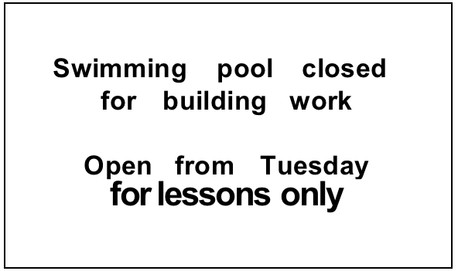
open
closed
adj. 营业的
adj. 不开放的
A. People who have swimming classes can go on Tuesday.
B. The pool will be closed to all customers after Tuesday.
C. Swimming lessons will be in a new pool on Tuesday.
Notes:
出自阅读part1
答案A

Slide 17
various
adj. 不同的；各种各样的
The adventures he plans include races across various countries.
Lily buys various clothes, which are possibly ________.
A. many dresses
B. dresses, shirts and trousers
Notes:
出处阅读part3

Slide 18
variety
n. 多样性
The shop in the next village has a good variety of food.
There are ______ of plants in the forest.
Notes:
出自阅读part2
答案 varieties

Slide 19

sale
n. 售卖；销售
What does the advert say?
A. The bike has a few things wrong with it.
B. Call Kevin to find out how much the bike costs.
C. You can use the bike in different kinds of places.
Notes:
出自阅读part1
答案B

Slide 20
live
v. 居住；活着
Honey bees live in groups.
The queen bee lives for several years, but the workers die after a few weeks.
Question: Where do you live?
A. I live in Beijing.
B. I live for 10 years.
Notes:
出处阅读part4（完形填空）
答案A

Slide 21
upstairs
downstairs
adv. 上/下楼；在楼上/下
It's very heavy, so let's keep it downstairs.
I live .
A. upstairs B. in downstairs.
Notes:
出处听力原文part5
答案A

Slide 22
prefer
v. 更喜欢；宁愿
Do you prefer wearing a watch or
using your phone to tell the time?
I'd prefer to see some famous paintings.
[In a restaurant]
Waiter: ______ do you prefer? Coffee or tea?
Notes:
出处1、口语问答部分；2、听力原文part3
答案 Which

Slide 23
cost
v. 花费
n. 费用
24 hour sale!
Download any 10 songs for 99p Then £1.99 per song as usual
B. The cost of each song is £1.99 after you buy more than ten songs. ✅
Notes:
出自阅读part1

Slide 24
(re)charge
v. 给…充电
I charged the battery but it only stays on for a few minutes.
He is using your mains electricity to recharge his car battery.
[compare]: charge & change
Notes:
出处听力原文part4

Slide 25
step
n.步骤
Then they add hair to the statue's (雕像的) head. This …… can take about 140 hours to finish.
A. | way | B. | step | C. | plan
Notes:
出处 模拟题阅读part4（完形填空）

Slide 26
ring
v.（给某人）打电话
I haven't seen her for a long time,but I think she'll come. I'll ring her.
Question: ‘ring’ here means:
A. call B.circle
Notes:
出处、听力第3部分

Slide 27
building
n.建筑物
It was strange being on the water among so many big buildings.
Which can be call a building?
A. ceiling B. lift C. castle
Notes:
出处 听力part4原文
答案C

Slide 28
bright
adj. 明亮的；鲜艳的
Yes, the moon was very bright.
The bright colours you've used for those roses you've painted are fantastic!
Which can be a bright color?
A. brown B. orange
Notes:
出处 1、听力part1原文；2、听力part4原文

Slide 29
light
n.光亮；灯
We've lots of cupboards,but I think we need more light. It's a bit dark.
I've already got a table in there.I got this little light to go on it.
A light can make your room _____.
A. bright B. dark
Notes:
出处 均来自听力part5原文
）

Slide 30
offer
v. 提供
Who says the camp offers water sports?
I also offered to help my uncle Alan.
An Outlet(奥特莱斯商场) is more likely to offer _____ .
A. expensive goods B. goods with discounts
Notes:
出处 1、阅读part 2；2、阅读part 3
答案B

Slide 31
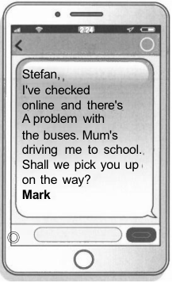
pick up
接送
Mark has texted Stefan
C. to offer him a lift. ✅
Notes:
出处 阅读part1

Slide 32
choose
v.选择
… women to join the US space programme. Six women, including Sally, were chosen to become astronauts.
Question: choose can be paraphrased by ____.
A. pick B. chase
Notes:
出处 阅读part4（完形填空）
答案A

Slide 33
try
v. 尝试
Try going for a walk or a run,and do some sport as often as you can. (try+名词)
Try not to do your homework at the last minute. (try+to do)
Please try hard ____ the project.
A. to complete B. complete
Notes:
出处 均来自阅读part 3
答案A

Slide 34
See you tomorrow🌙

