Slide 1
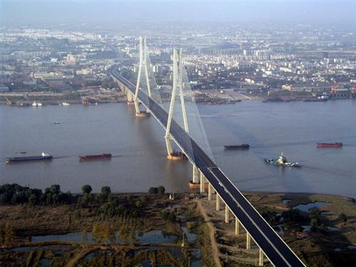
An Qing
https://baike.baidu.com/item/%E5%AE%89%E5%BA%86/350307?fr=aladdin
Student ID:2030024069
Chinese name：葛宇
English name：Ellene
Section number:1014

Slide 2
Content:
1.Introduction
2.Special Culture：Huang Mei opera
3.Famous people
4.Me——Living in this city

Slide 3
1. Introduction
1.1 location
In central part of China. Near the YangZi River.
1.2 Name
Dongjin poet Guo Wei once called "this place Yicheng", so Anqing also alias "Yicheng".

Slide 4
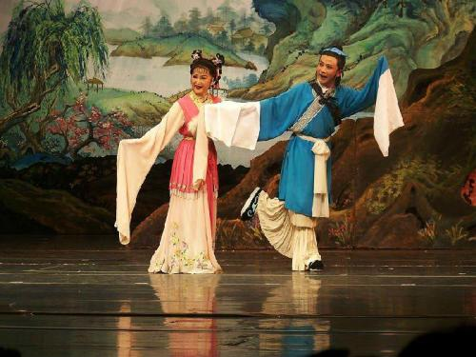
2. Special Culture：Huang Mei opera
Huang Mei opera is composed of mountain songs, anthems, tea songs, tea lamps, flower drumming, before the countryside, and then into the city, and gradually form a kind of drama developed. It absorbs the factors of Chinese opera, Chu opera, high cavity, tea-picking drama, Beijing opera and so on, and gradually forms its own artistic characteristics.
3. Famous people
Name | Gender | Birth year | Job | Famous event
Chen Duxiu | Male | 1879 | revolutionist | advocate "Commander-in-Chief of the May Fourth Movement"
Han Zaifen | Female | 1986 | Theater actress | 《Nu fu ma》
Yan Fengying | Female | 1930 | Theater actress | 《Goddess Marriage》

Slide 5
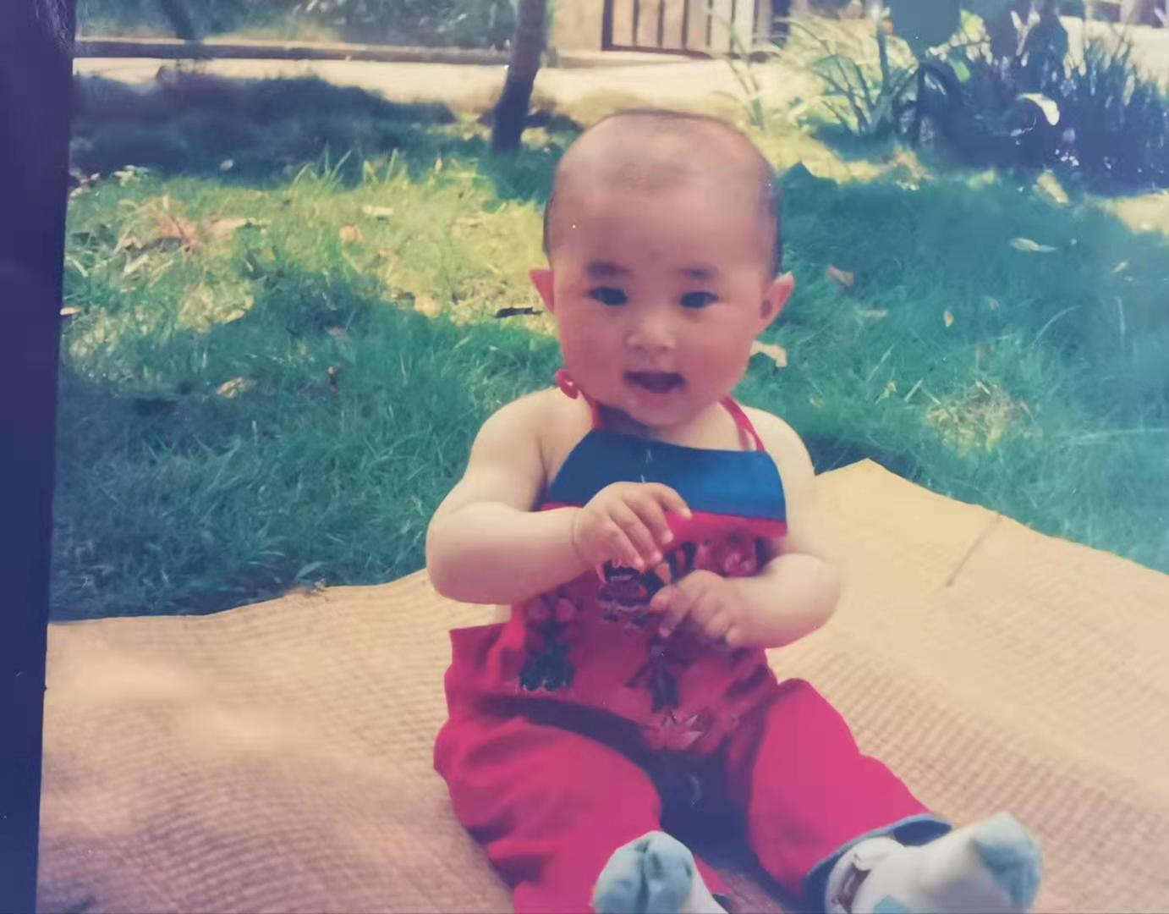
4.Me——Living in this city
I have lived in this city for 18 years.
I always live with my parents, and sometimes my grandparents look after me.
I like to play with my cousins.
My favorite place is the park near a lake.
A beautiful scenic in here is the bridge of YangZi River.

