Slide 1



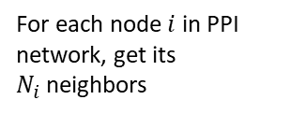


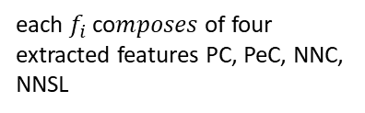
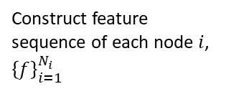

PC
PeC
$$i$$
NNC
NNSL
$$f_{i,1}$$
$$f_{i,2}$$
$$f_{i,3}$$
$$f_{i,4}$$
$$f_{i,5}$$
For each node$i$ in PPI network, get its $N_{i}$neighbors
Construct feature sequence of each node $i$, ${\left\{f\right\}}_{i=1}^{N_{i}}$
each $f_{i}$ co𝑚𝑝𝑜𝑠𝑒𝑠 of four extracted features PC, PeC, NNC, NNSL

