Slide 1
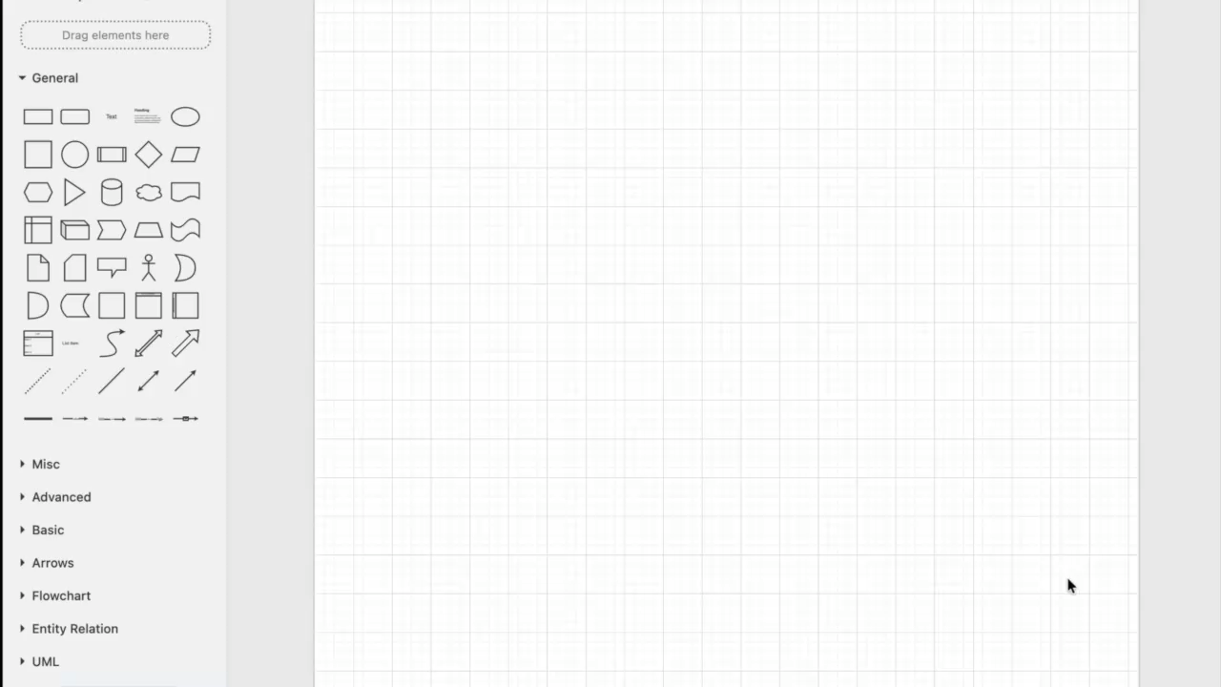
Hongrui Zhang · Kaiying Han · Yaran Yang · Jason Zhu
StructAgent
Persistent Symbolic UI Representations for Agentic Computer Use
One-sentence summary
An agentic framework for closed-UI apps: a persistent symbolic scene graph + a leveled, composable, JSON-defined tool catalog — the LLM plans over structure, not pixels.

Slide 2
Motivation / Background / Overall Intro
-Many software tools lack exposed APIs for automation
- Screenshot then act -> unreliable and slow for complex multi-step tasks
- Reusable tool abstractions from low-level GUI actions
- Agentic framework for GUI software automation
- Composed tools and LLM planning

Slide 3
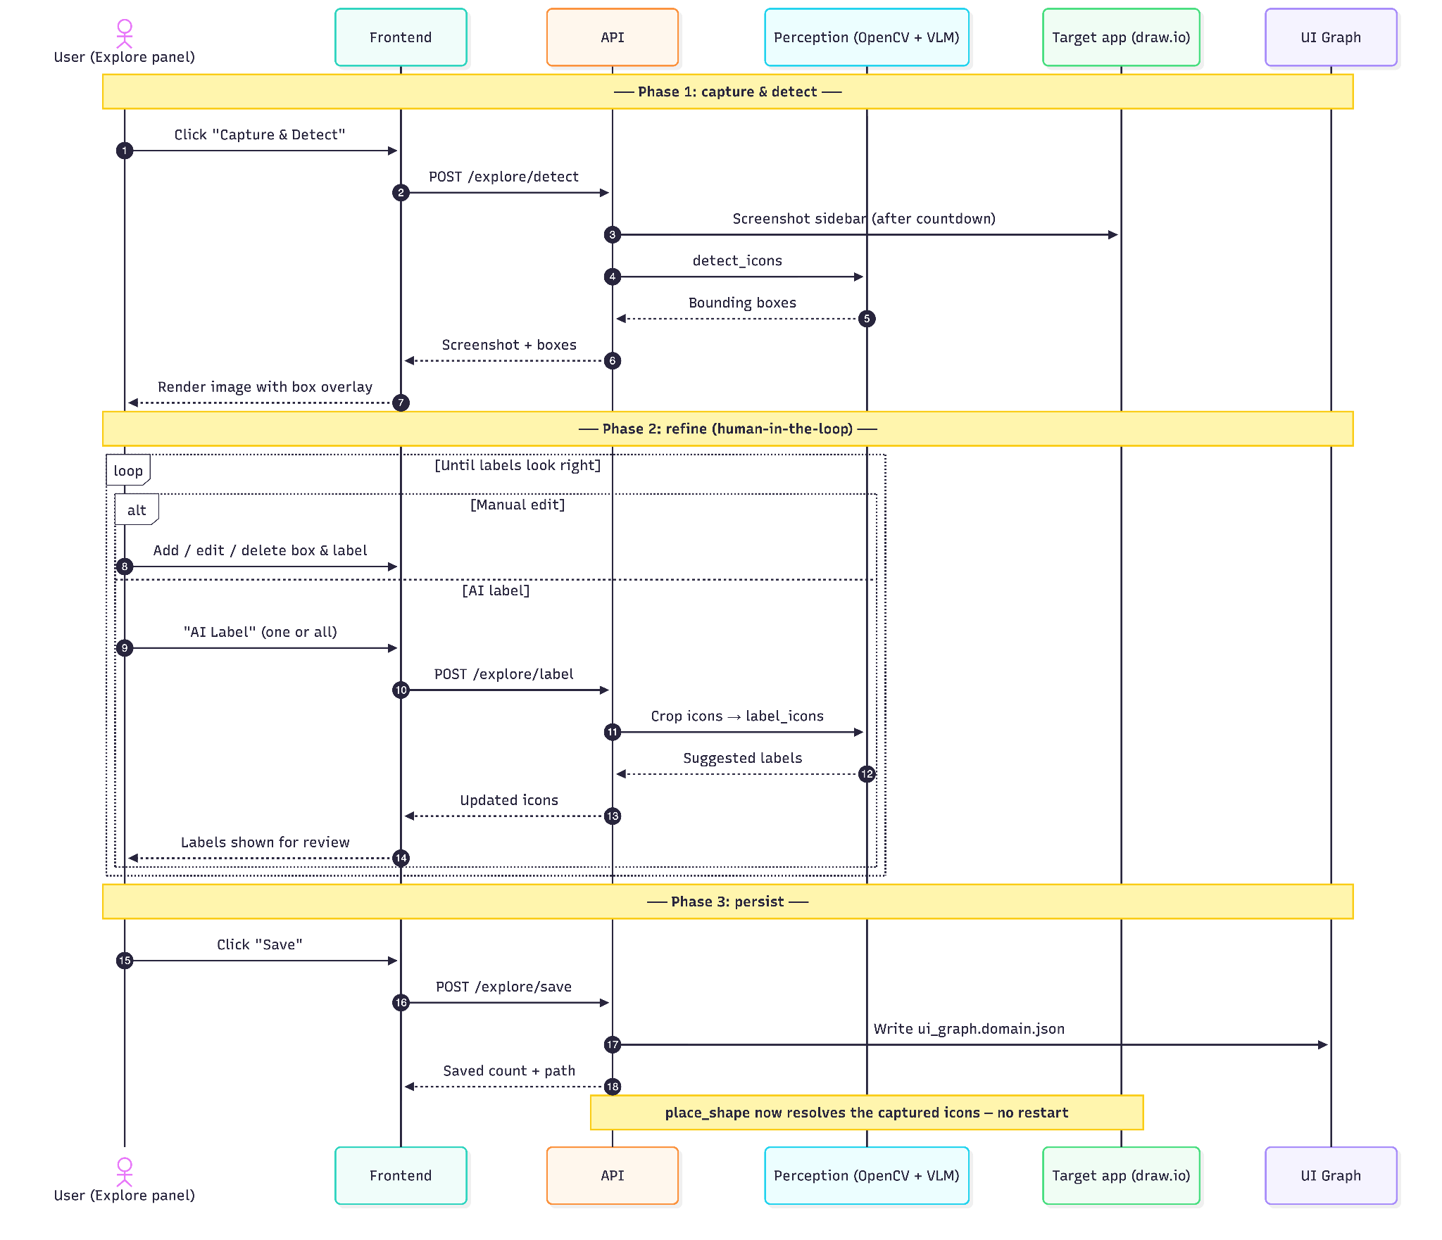
Capture & Labelling (Add demo video)

Slide 4
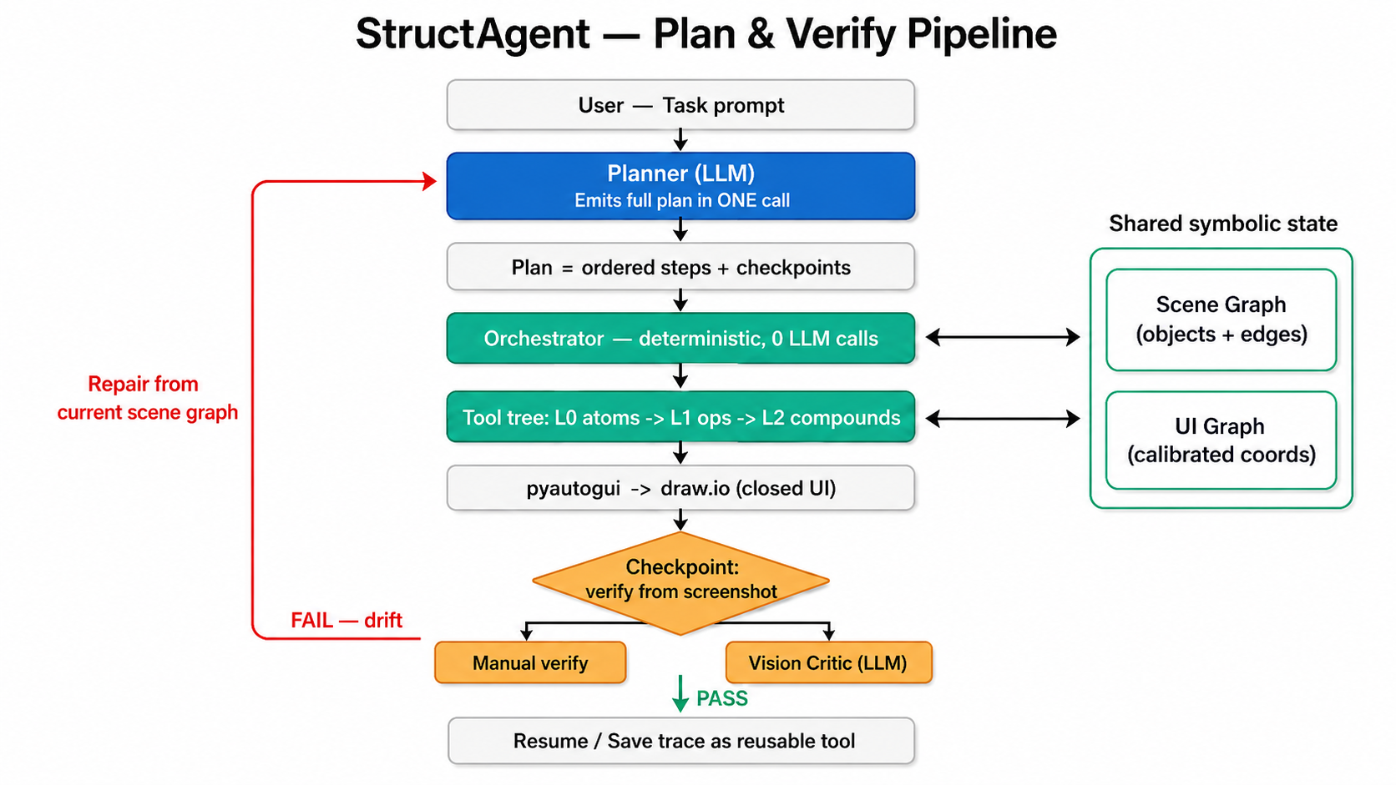
Plan & Verify (Add demo video)

Slide 5
Frontend Demo (drawio demo video)

