Slide 1
Yelp Recommendation System Design
An offline, scalable, supervised recommendation model for user-to-business rating Implementation
Yuntong Zhu
March - April 2024

Slide 2
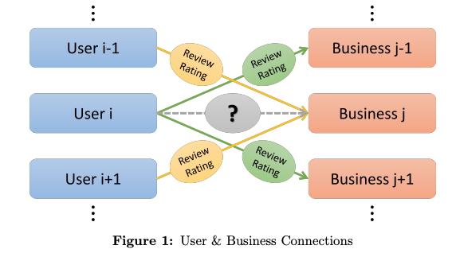

Naive Model-Based Approach
Simple features
No normalization
RMSE About 0.985
ISSUE: Has ceiling boundaries (RMSE approx. 0.970 is the best score you may achieve)

Slide 3
Recommend.Sys Design 1.0
Data Cleaning
Feature Selection
Filter and combine features
Model-based
CF(xgb &others )
Item-based
CF w/ LSH
weighted Models Prediction
Competition.py
Predict user/bus similarities
e.g. sim.csv
Existing Modules
Content-Based
Method
Proposed Modules
N-Fold Cross Validation
NLP-related
Gensim
Q. No other files allowed to submit w/ competition.py
1st week (04/08) Update: Optimized via Pandas/SparkRDD

Slide 4
1st week summary: Bad, RMSE 0.972~0.978
Bad News:
Graph Embedding
Poor features readability & hard to understand
Node2vec not supported in the system
No pre-trained models allowed
Not fully utilized XGB
Confused w/ combining different models output and features
Data Analysis w/ no particular focus
Individual project, limited time, aims to achieve results pretty quickly (1-2 week)
UNCERTAINTY OF THE OUTCOME
Good News
Restructured pipeline w/ Spark & Pandas, ensure scalability
provide a basic data processing and training workflow
(data extract, clean, and DF ➔ train & test)

Slide 5
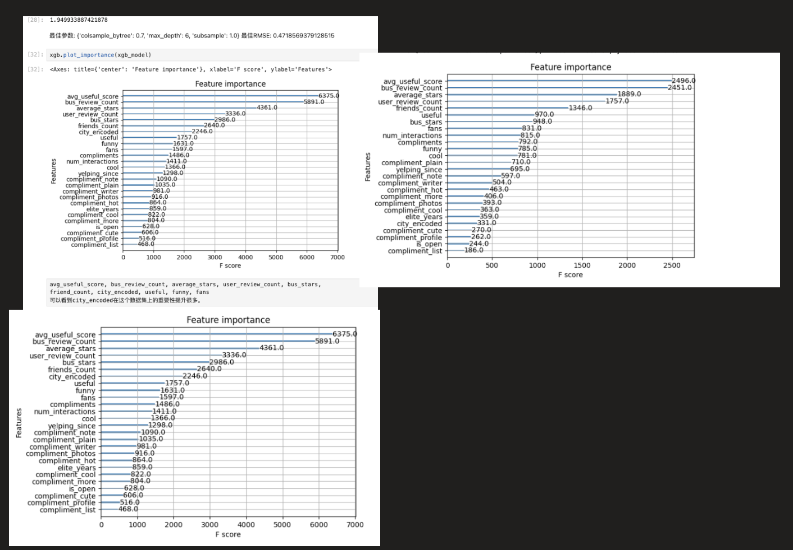
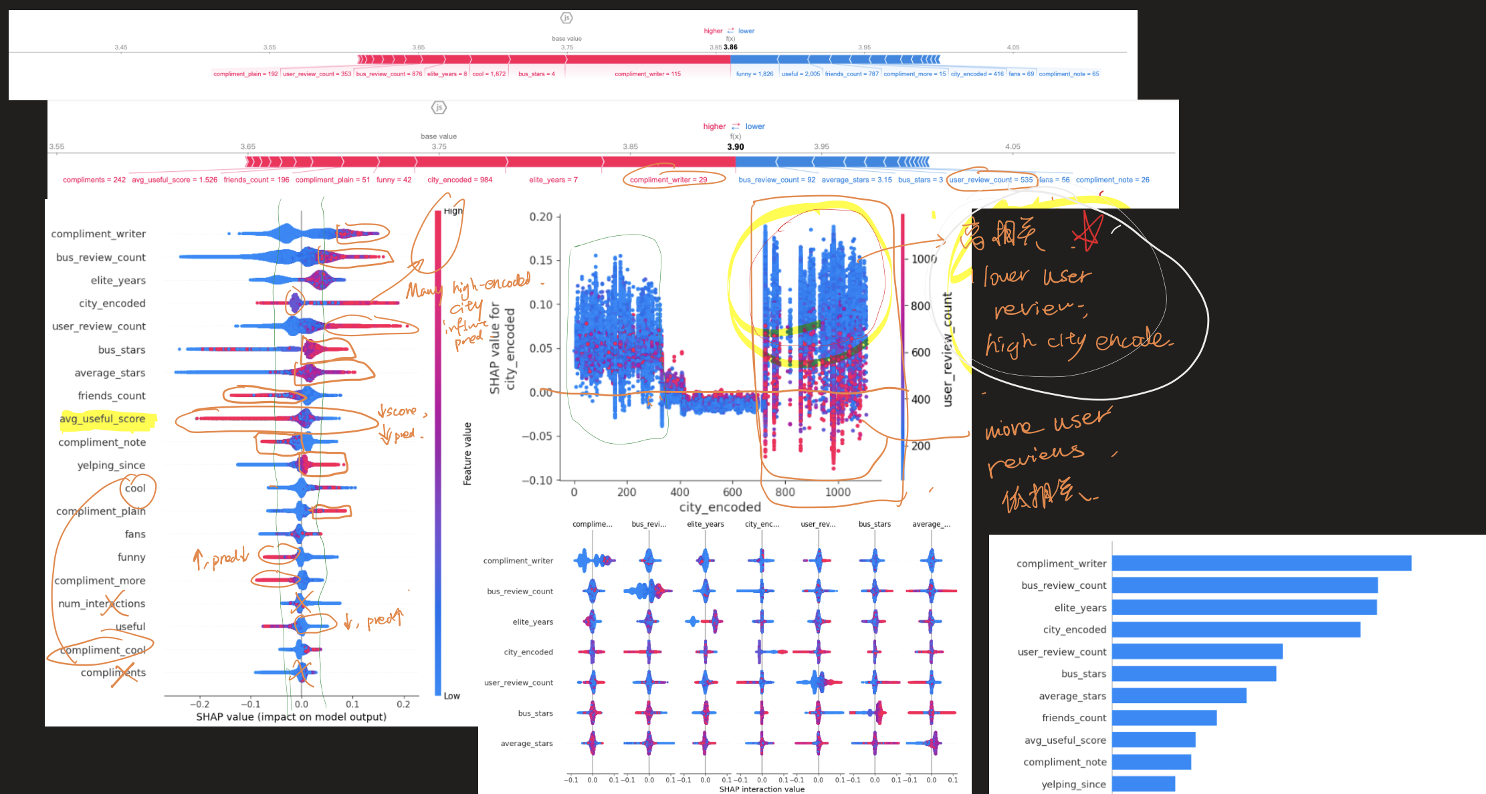
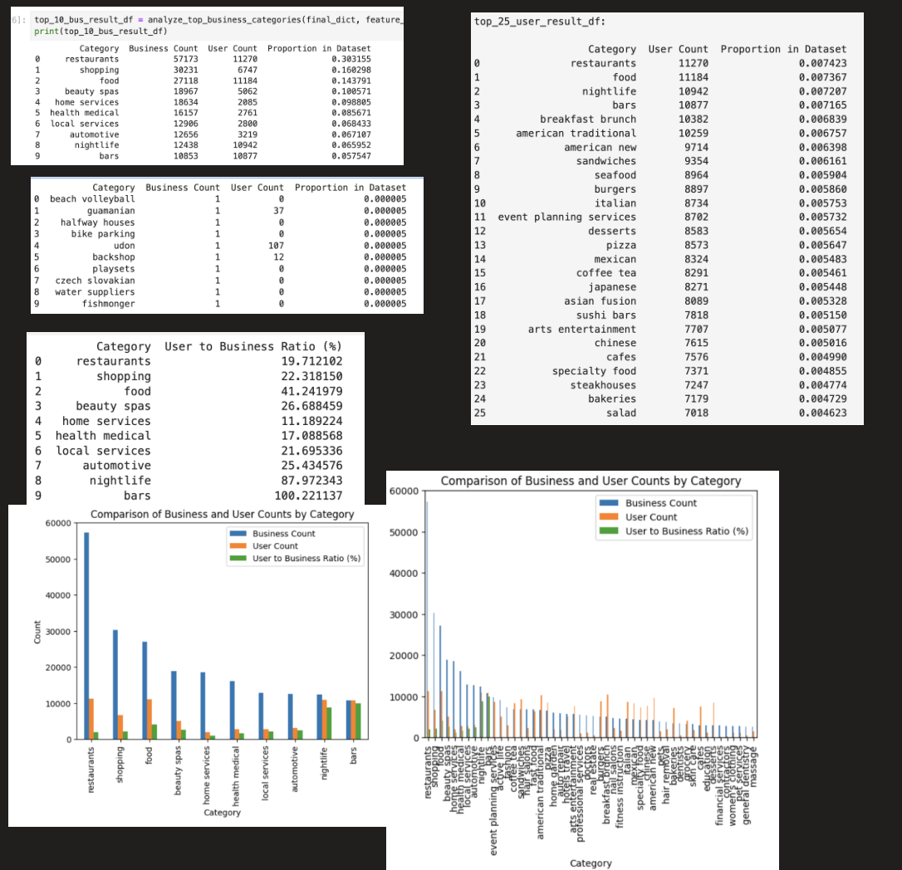
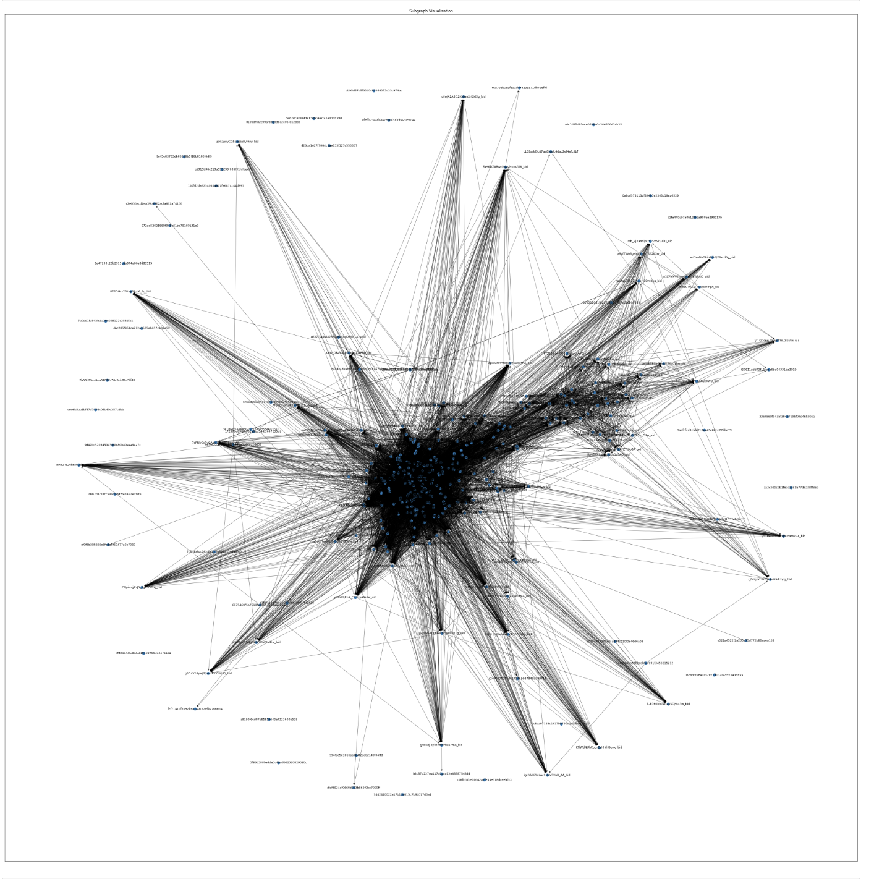
Some unorganized analysis on data, model performance, features importance

Slide 6
Some ideas which had popped up and explored...
Neural Network Brute force...
Categorize data by cities to learn patterns
Learn pattern from community algorithms
Word Embedding and semantic analysis ➔ review features based on text
...
Still, no deterministic models / features / framework

Slide 7
2nd week: Re-Design and Implementation
Hybrid approach – handle multiple features and be trained on different objectives

Slide 8
Model Taxonomy
Hybrid: Supervised learning to combine both approaches:
Content-based
Collaborative
Terms:
Models: ALS Matrix Factorization approach, K-means, XGBRegressor
Packages/framework: SparkRDD, spark.ml, (gensim, spacy, tensorflow, ... )
Scaling
Evaluation Metrics

Slide 9
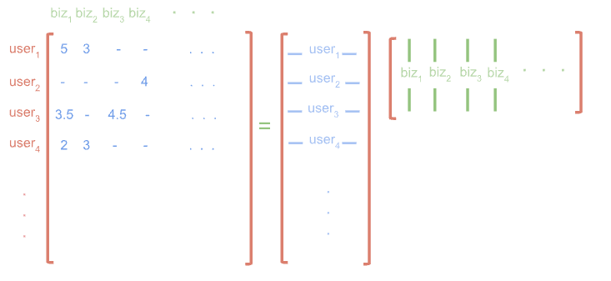
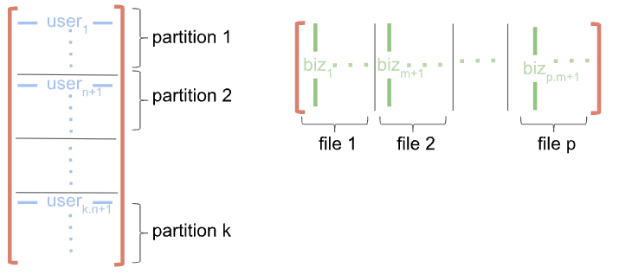
Yelp Recommend.Sys Design 2.0
Interactions matrix and leveraged by divide and save business matrix into p different files and leveraged by PySpark’s mapPartition w/ BLAS modules
Review-level embedding
Entity-level embedding
Review Text
Review Embedding
Interaction Matrix M
User vectors U
Biz vectors V
Feature Compute
User-Biz interactions
Matrix Factorization
XGBoost Reg.
User-Biz Interactions
User level
Existing Modules
Interaction Features
Biz level
Proposed Modules
User-biz level
Add-on Modules
Feature
Sampling
Training samples/Recall for Prediction
Data Cleaning

Slide 10



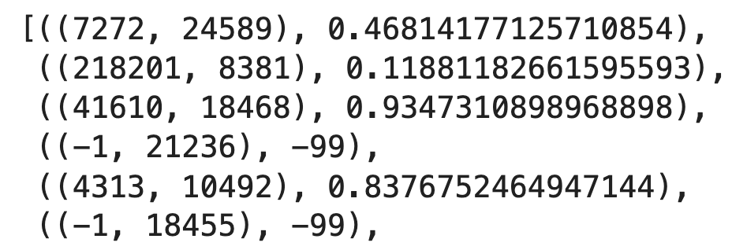
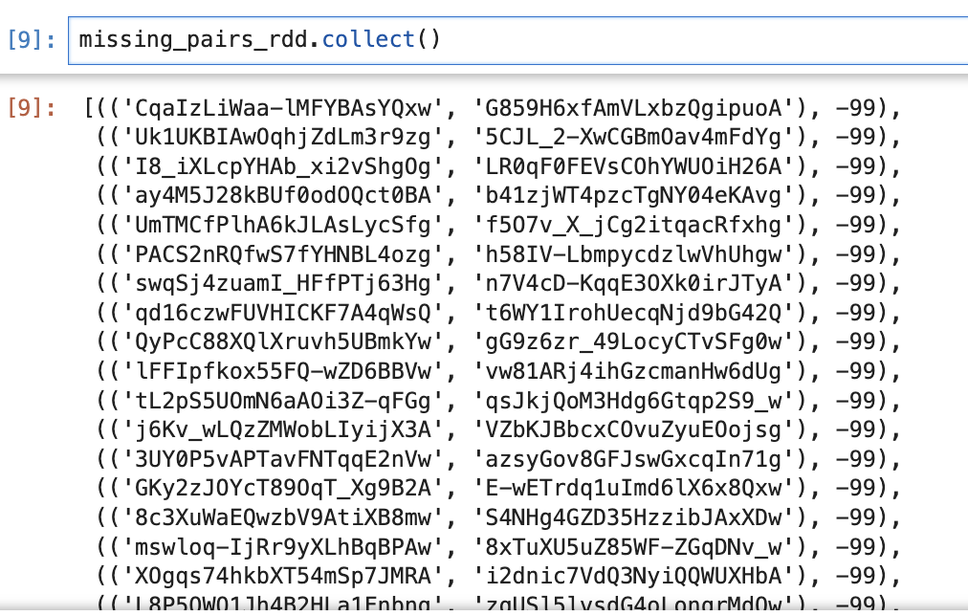
10-50K pairs
yelp_pairs.csv
Solution: extract (user, biz) pairs Batch which indeed require to be calculated
Interaction Matrix M
User vectors U
Biz vectors V
User-Biz interactions
Calculate Affinity score for
every
pairs in the pair file
Matrix Factorization
implicit features learning:
ALS decompose vectors as user & bus embeddings
We have tip.json (short comments from user)
Note: other implicit interactions data may help even more.
But we don’t have the data!
Technical challenges & issue handling:
Cold start: (user, biz) may never appeared in tip.json;
Cartesian-product: OOM if simply pre-calculate score matrix for every (user, biz) seen in tip.json (over 1.2Million lines, 25406 user, 121526 business!!!)

Slide 11
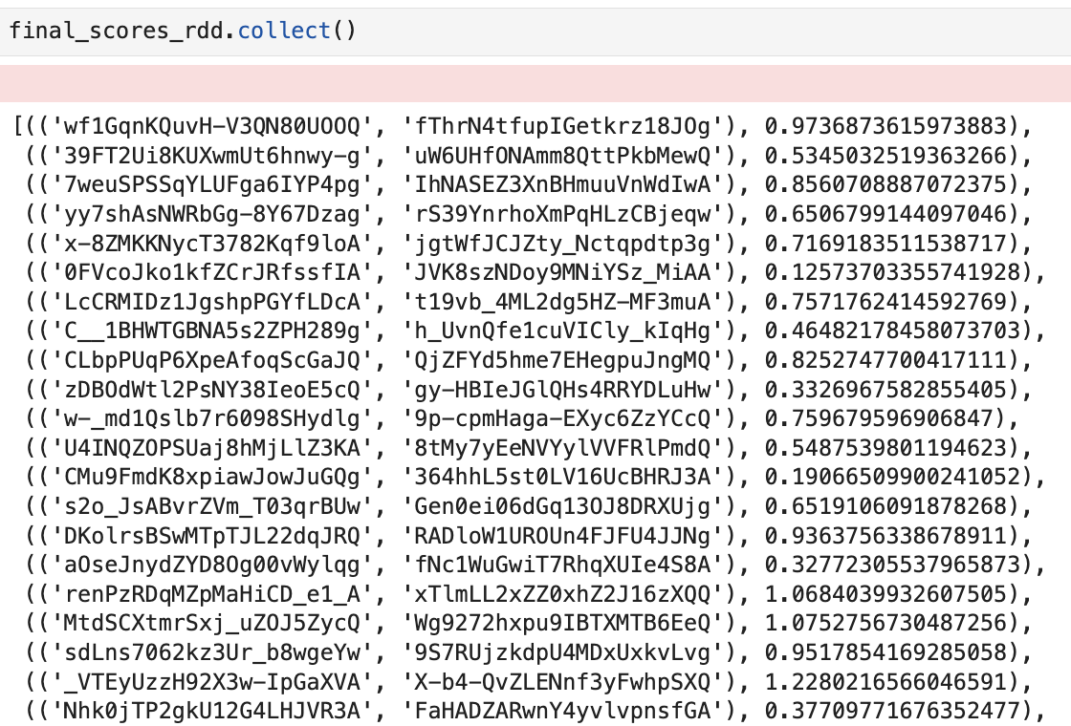
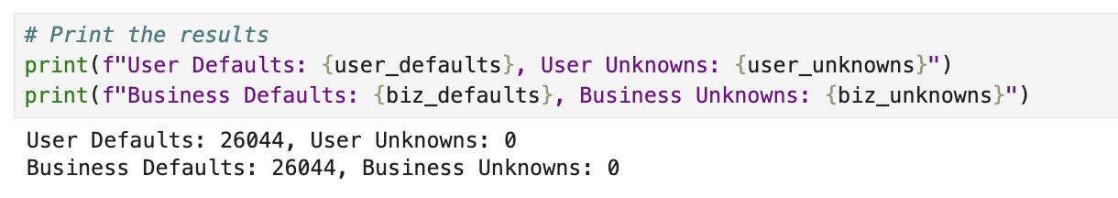
Drawbacks of M.F.:
1. Good, but Don’t Forget COLD START
2. inability to add content-based features

Slide 12
Yelp Recommend.Sys Design 2.0
Interactions matrix and leveraged by divide and save business matrix into p different files and leveraged by PySpark’s mapPartition w/ BLAS modules
Review-level embedding
Entity-level embedding
Review Text
Review Embedding
Interaction Matrix M
User vectors U
Biz vectors V
Feature Compute
User-Biz interactions
Matrix Factorization
XGBoost Reg.
ALS module ✅
User-Biz Interactions
User level
Existing Modules
Interaction Features
Biz level
Proposed Modules
User-biz level
Add-on Modules
Feature
Sampling
Training samples/Recall for Prediction
Data Cleaning

Slide 13
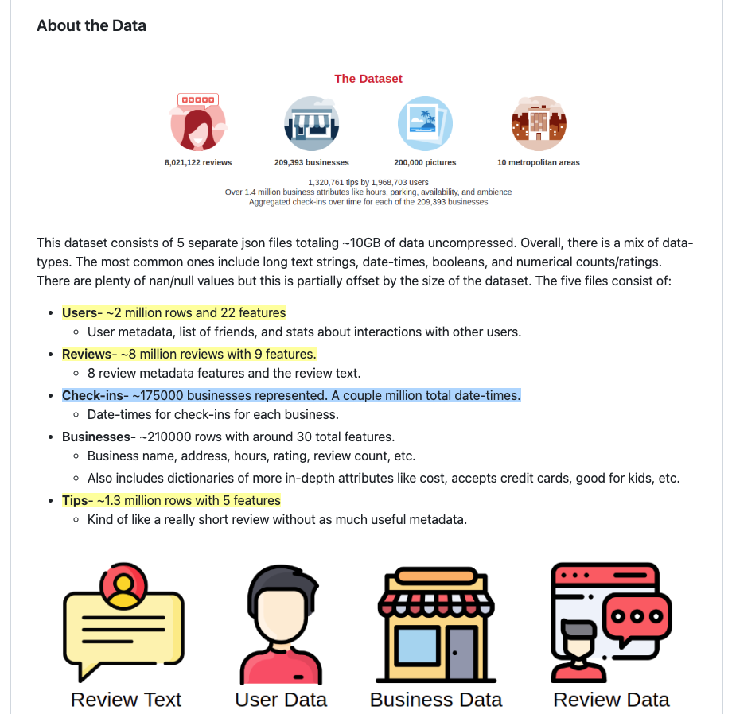
Define and Process more Interaction features
User-Biz Interactions
User level
Interaction Features
Biz level
User-biz level
Feature
Data Cleaning

Slide 14
Yelp Recommend.Sys Design 2.0
Interactions matrix and leveraged by divide and save business matrix into p different files and leveraged by PySpark’s mapPartition w/ Numpy BLAS lib optimization
Review-level embedding
Entity-level embedding
Review Text
Review Embedding
Interaction Matrix M
User vectors U
Biz vectors V
Feature Compute
User-Biz interactions
Matrix Factorization
XGBoost Reg. (1-5 Stars)
By 04/19 ✅
RMSE: from 0.98 to 0.91
User-Biz Interactions
User level
Completed Modules
Interaction Features
Biz level
TODO Modules
User-biz level
Add-on Modules
Feature
Sampling
Training samples/Recall for Prediction
Data Cleaning

Slide 15
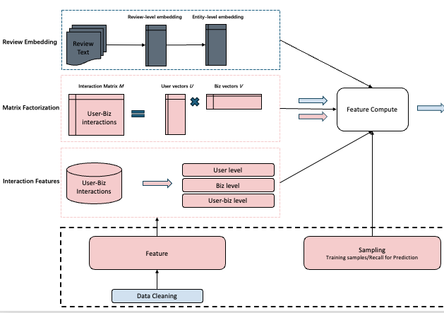
Scaling using Localized Group
K-means city-user-biz clusters
Feature Compute
XGBoost Reg.

Slide 16
Review-level embedding
Entity-level embedding
Review Text
Review Embedding
TODO: Review Embedding
Universal Sentence Encoder ➔ Pooling ➔ Fixed-Size Vector

