Slide 1


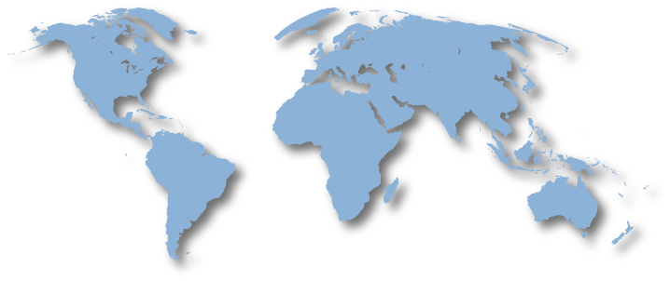
WuXi, China
Launch in Sep, 2014
Korat, Thailand
Launch in Feb, 2015
SuZhou, China
Launch in Dec, 2014
Guadalajara, Mexico
Launch in Nov, 2015
Seremban, Malaysia
Launch in Jul, 2015

