Slide 1
2D Atomistic model
2D square lattice*, assume lattice constant is 0.5 nm
Co_{0.7}Gd_{0.3}, red for Gd, blue for Co
Atoms are randomly distributed
* note: 2D square lattice is commonly used for system with DMI [1,2,3]

Slide 2
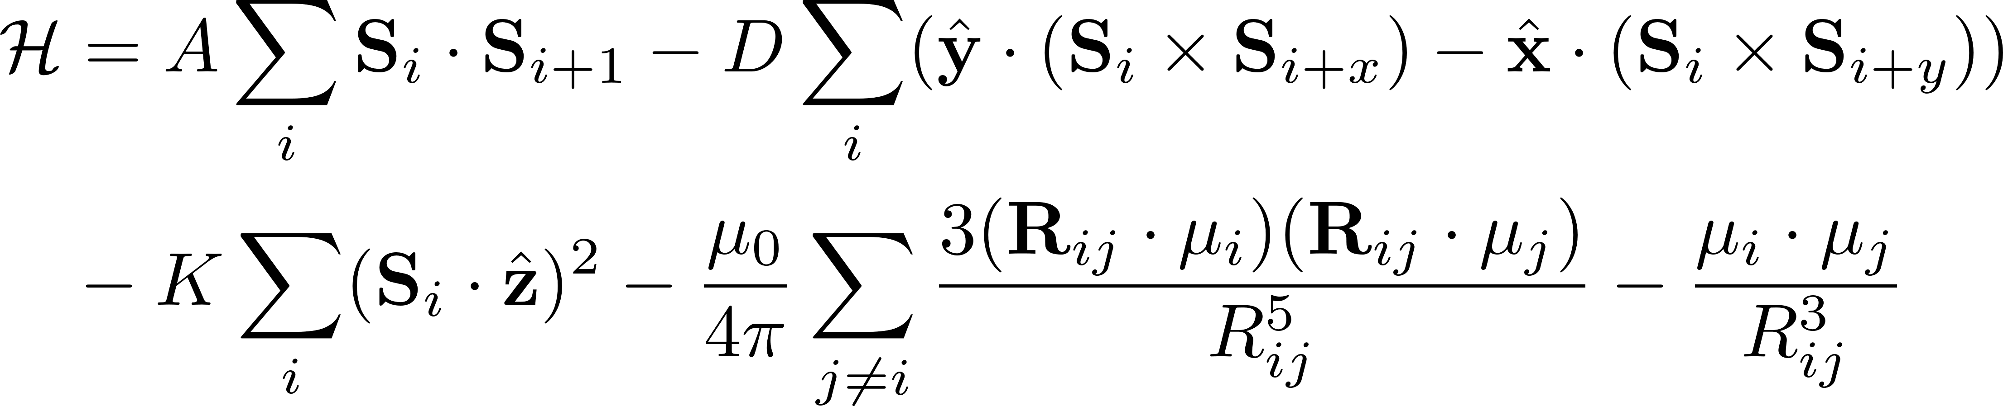
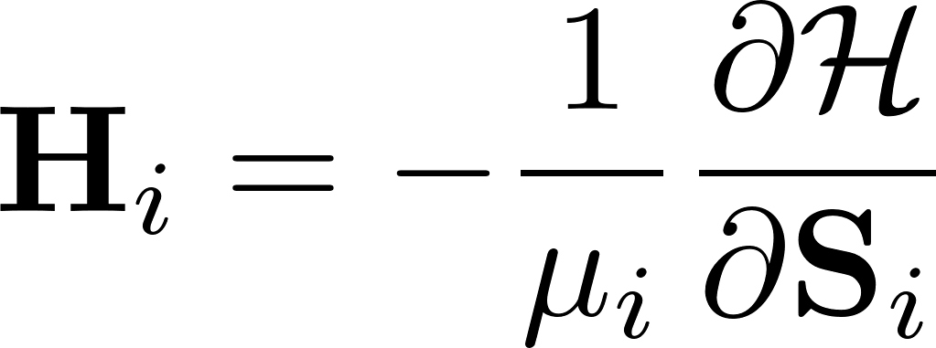
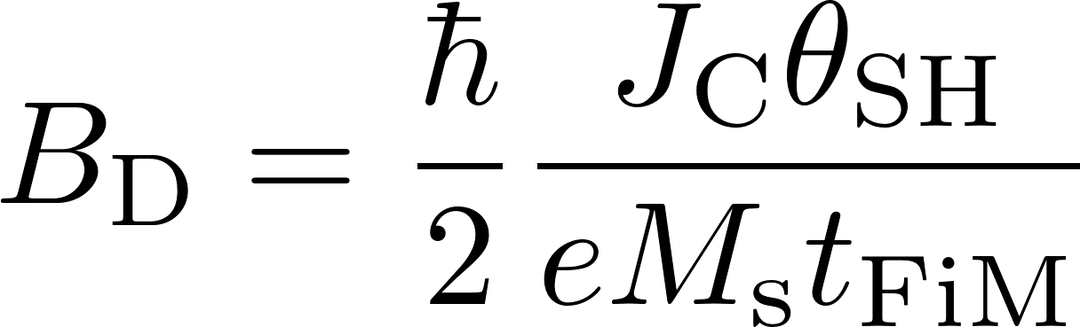
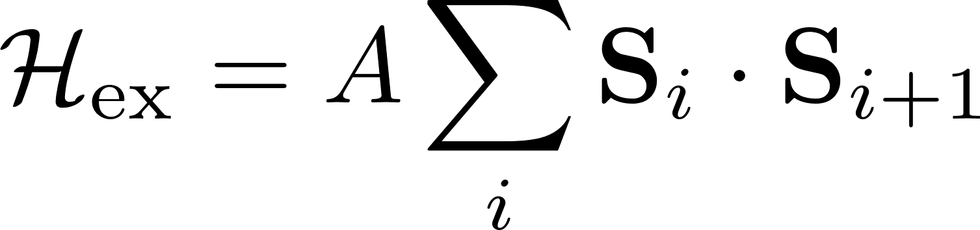
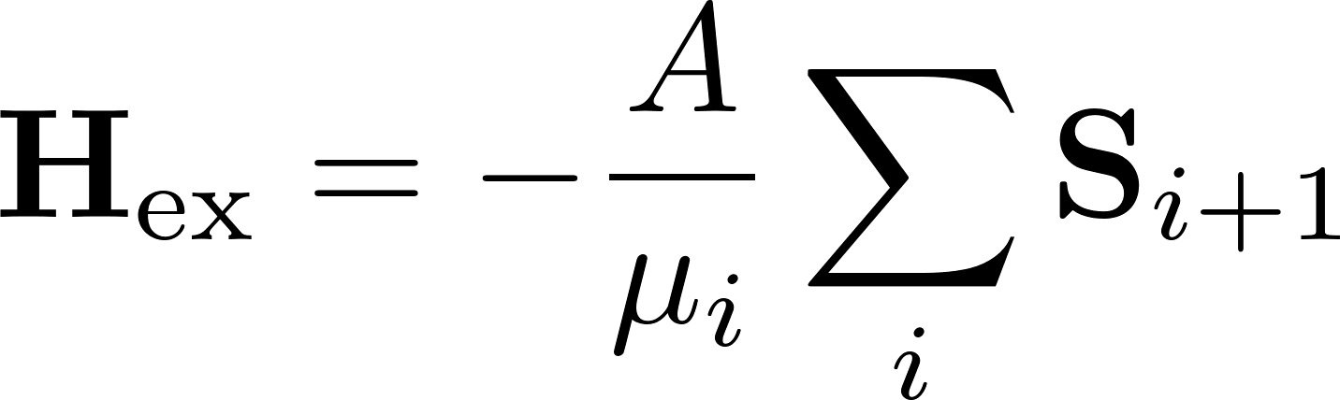
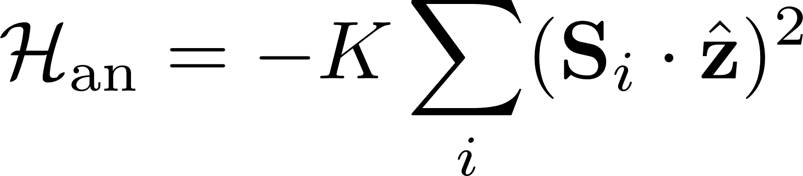
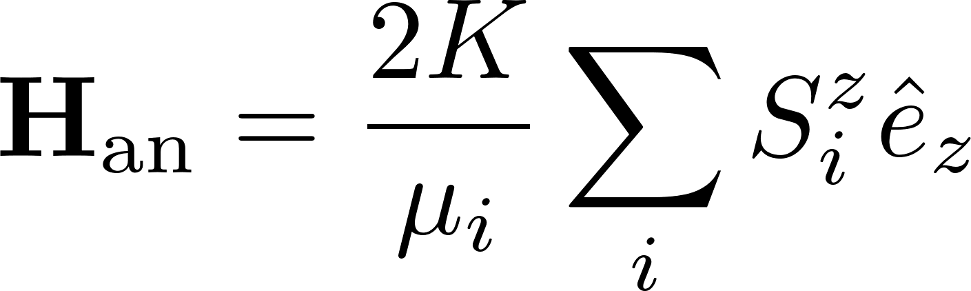
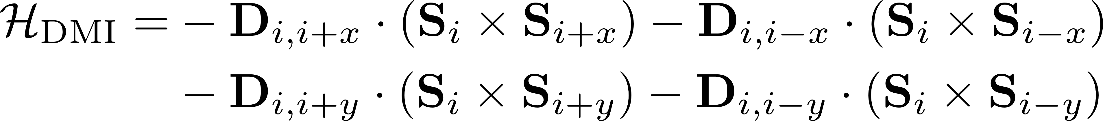
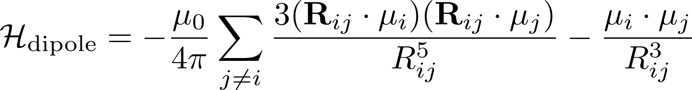
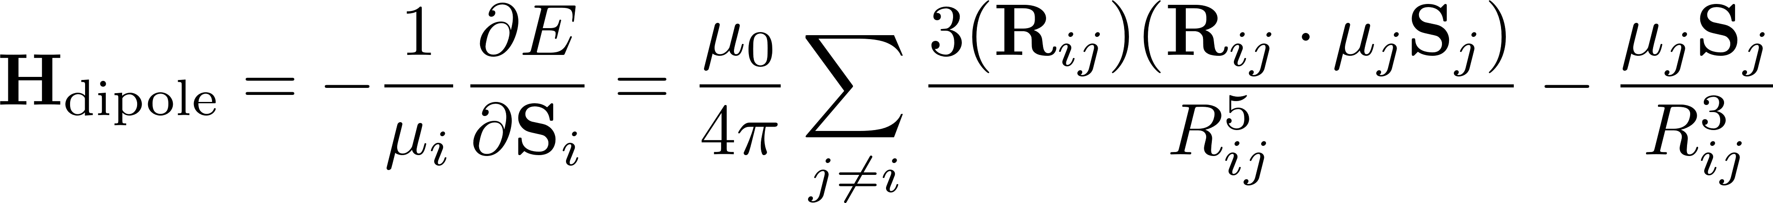
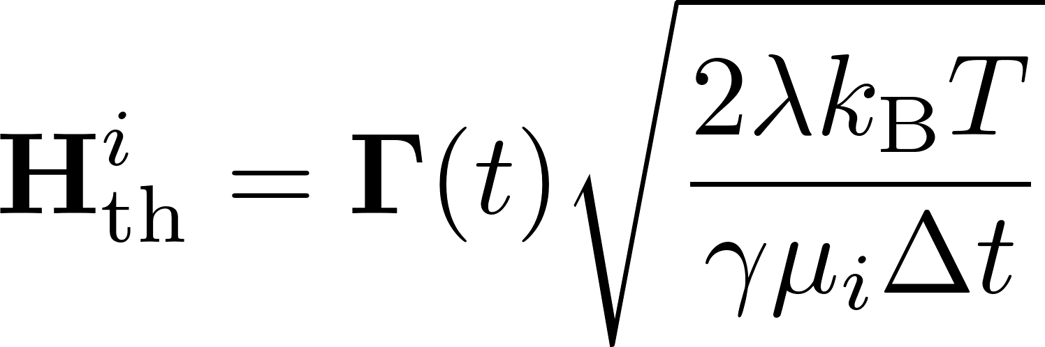
Methodology
Referring to Dropbox\phd\presentations\summary-atomistic model.ppt, 2D model
[5]

Slide 3
Ordering in the W direction
Matrix numbering in MATLAB
L
1,1
1,2
1,5
1,6
2,1
3,1
W
4,1
5,1
Note that the ordering of W is opposite to the ordering of matrix numbering in matlab, this is to ensure the increasing direction of W is identical to the positive direction of y direction, e.g., m_{y}, H_{y}, etc.

Slide 4
Plot order
Matrix numbering in MATLAB
COSMAL Plot in MATLAB
Quiver3 Plot in MATLAB
1,1
1,2
1,5
1,6
1,1
1,2
1,5
1,6
2,1
2,1
3,1
3,1
3,1
4,1
4,1
2,1
5,1
5,1
1,1
1,2
1,5
1,6
Use COSMAL 3D plot code (github) gives correct ordering that identical to the ordering of matrix number
Use quiver3(mmx, mmy, mmz) results in opposite ordering in the vertical direction
It is reflected in the reversed order in the code circled in red
Notes:
COSMAL 3D plot code (github): https://github.com/zhuzibn/general/tree/master/3D_vector_plot

Slide 5
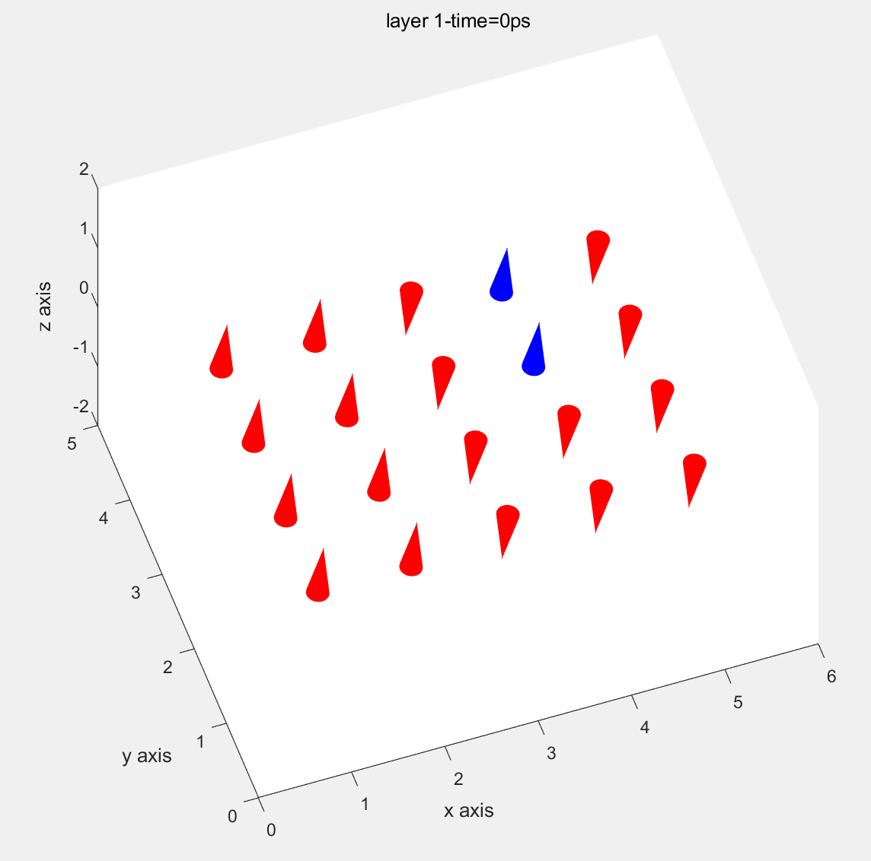
Initial state
The result shows the plot of W and L directions are correct. See the atom configuration in “goodnotes, Benchmark 3x5, Oct.08”
OneDrive\code_softwares\atomistic_model\2D\docs\compare_plot

Slide 6
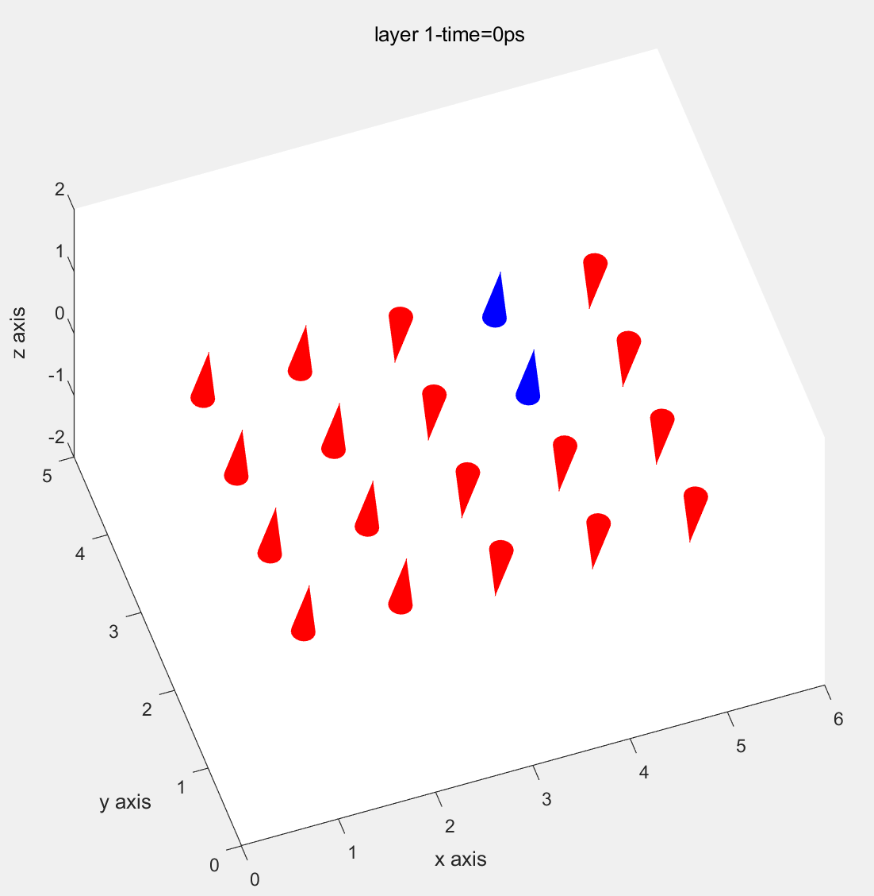
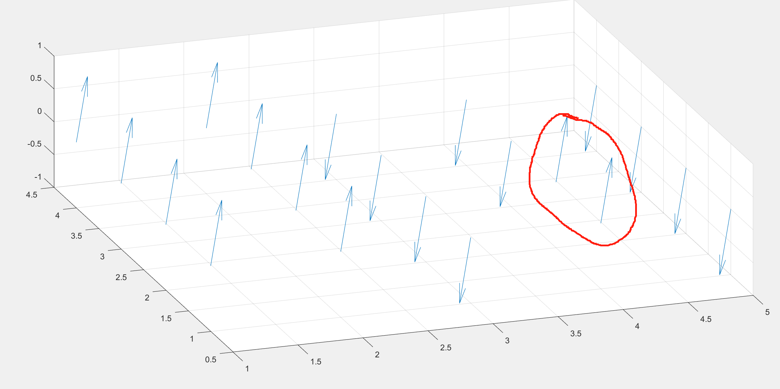
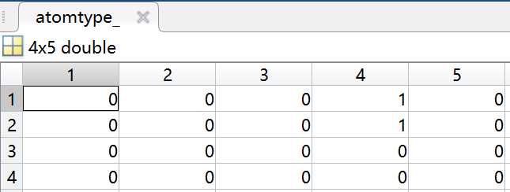
Plot order
Matrix numbering in MATLAB
COSMAL Plot in MATLAB
Quiver3 Plot in MATLAB
These two Gd atoms are in wrong location
Notes:
To generate the comparison figures, see C:\Users\zzf-m\OneDrive\code_softwares\atomistic_model\2D\docs\compare_plot

