Slide 1
The 2-year influence of Hard drug on HIV treatment response after initiating HAART Wenru Zhou
Baseline,
Visit 0 N=715
Null hypotheses:
there is no association between two-year changes in SF36 MCS score, SF36 PCS score, CD4 positive cells, viral load and hard drug use status at baseline
Table 0. Missing data for Baseline and Visit 2
No hard drug use at baseline
N=649
hard drug use at baseline
N=66
Characteristic | Baseline, Visit 2,N=506
SF36 MCS score | 1 (0%), 6(1%)
SF36 PCS score | 1 (0%), 6(1%)
# of CD4 positive cells (helpers) | 8 (2%), 19 (4%)
Standardized viral load (copies/ml) | 9 (2%), 19 (4%)
Hard drug at baseline | 0 (0%)
Age, years at baseline | 0 (0%)
BMI(kg/m2) at baseline | 18 (4%)
Race at baseline | 0 (0%)
Education at baseline | 0 (0%)
Smoke status at baseline | 0 (0%)
Adherence to meds taken since last visit | 0 (0%)
Missing N=182
Missing N=27
No hard drug use at baseline N=467
hard drug use at baseline N=39
Visit2, N=506
18 (3.6%) obs
1 obs BMI=514.2514
5 obs BMI with Insufficient data
7 obs BMI=Improbable value
5 obs BMI=NA
Are covariates
available?
Final dataset N=488

Slide 2
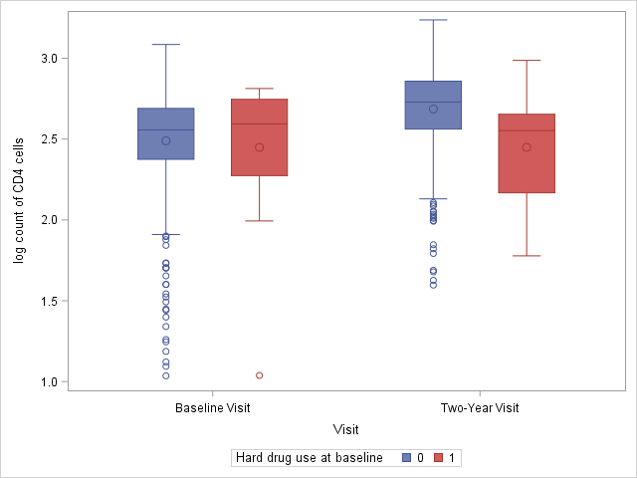
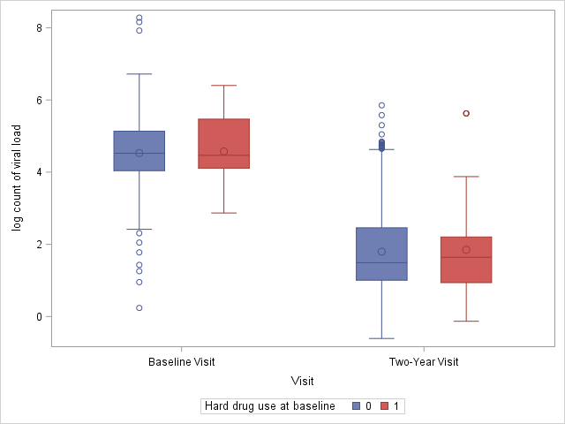
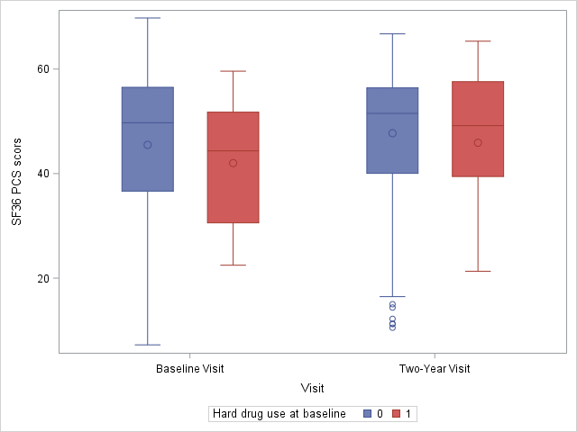
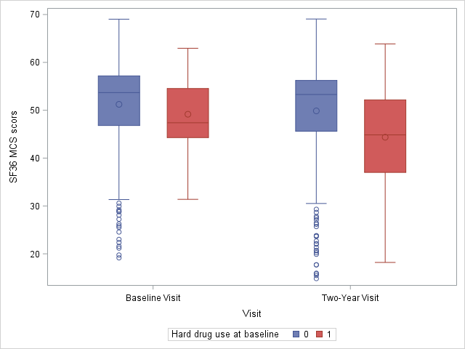
Table 1. Demographic information at baseline and Visit 2
Characteristic at baseline | All (n=488) | No hard drug use at baseline (n=452) | Hard drug use at baseline (n=36)
SF36 MCS score# | 45.24±13.67 | 45.5±13.8 | 42.01±11.64
SF36 PCS score# | 51.08±9.04 | 51.23±9.17 | 49.16±7.05
Number of CD4 positive cells# (helpers)# | 375.43±203 | 376.66±203.34 | 360.04±200.8
Standardized viral load (copies/ml^{)#} | 32600.5 (11186.22, 136972.5) | 33291.5 (11009.25, 136952.75) | 29255.5 (12909, 293871)
Age, years | 43.16±8.83 | 43.1±8.78 | 43.89±9.52
BMI(kg/m2) ## | 25.26±4.41 | 25.39±4.46 | 23.62±3.45
Race
Non-White | 158 (32%) | 141 (31%) | 17 (47%)
White | 330 (68%) | 311 (69%) | 19 (53%)
Education
less than college | 280 (57%) | 254 (56%) | 26 (72%)
college | 101 (21%) | 100 (22%) | 1 (3%)
greater than college | 107 (22%) | 98 (22%) | 9 (25%)
Smoke
Noncurrent smoker | 302 (62%) | 293 (65%) | 9 (25%)
Current smoker | 186 (38%) | 159 (35%) | 27 (75%)
Characteristic at 2-year visit | All (n=488) | No hard drug use at baseline (n=452) | Hard drug use at baseline (n=36)
SF36 MCS score# | 47.6±11.94 | 47.73±11.76 | 45.9±14.06
SF36 PCS score# | 49.45±10.34 | 49.86±10.1 | 44.36±11.96
Number of CD4 positive cells (helpers)# | 543.03±267.99 | 557.15±264.85 | 371.22±248.8
Standardized viral load (copies/ml)# | 31.02 (10, 251.25) | 31 (10.17, 285.84) | 44 (8.85, 160.25)
If Adherence to meds since last visit
No | 48 (10%) | 47 (10%) | 1 (3%)
Yes | 440 (90%) | 405 (90%) | 35 (97%)
# there were 14 missing in count of CD4 cells and viral load. There were 7 missing in SF36 MCS score and SF36 PCS score; ##There were 18 invalid BMI: 1 record with impossible BMI. 5 records with insufficient data. 7 records with improbable value. 5 records with missing BMI.

Slide 3
Analyses plan:
1. Outcome:
a. Change in SF36 MCS score
b. Change in SF36 PCS score
c. Change in # of CD4 positive cells
d. log(Standardized viral load at Visit2)-
log(Standardized viral load at baseline)
2. Predictors and covariates:
If used hard drug at baseline, age BMI,
adherence (ADH), race,
income and smoking status
3. Method: Multivariate Linear Regression
Table 2. Multivariate regression- Frequentist approach
Characteristics | Change in log₁₀ number of CD4 positive cells(N=474) |  | Change in log₁₀ number of virus load (N=474) |  | Change in mental score (N=481) |  | Change in physical score (N=481)
 | Regression coefficient | P-value | Regression coefficient | P-value | Regression coefficient | P-value | Regression coefficient | P-value
Baseline measurements# | -0.473±0.0272 | <.0001** | -0.508±0.0571 | <.0001** | -0.511±0.0334 | <.0001** | -0.301±0.0429 | <.0001**
Age | -0.00140±0.00103 | 0.2 | -0.00517±0.00602 | 0.4 | 0.0582±0.0528 | 0.3 | -0.0946±0.0434 | 0.03*
BMI | 0.00349±0.00209 | 0.1 | -0.0205±0.0122 | 0.09 | 0.0182±0.105 | 0.9 | 0.0680±0.0848 | 0.4
White (Non-white as reference) | -0.0130±0.0199 | 0.5 | -0.185±0.118 | 0.1 | 0.281±1.0118 | 0.8 | -0.352±0.829 | 0.7
Education (<College as reference) |  | 0.6 |  | 0.048* |  | 0.04* | -0.227±0.953 | 0.8
College | 0.0116±0.0232 |  | -0.292±0.136 |  | 1.564±1.184
>College | 0.0220±0.0234 |  | 0.0659±0.139 |  | 2.990±1.192 |  | 0.126±0.961 | 0.9
Smoke (Non-current smoker as reference) | -0.0105±0.0194 | 0.6 | 0.0325±0.113 | 0.8 | 1.544±0.988 | 0.1 | -1.471±0.795 | 0.07
Whether use hard drug at baseline (No hard drug as reference) | -0.213±0.0345 | <.0001** | -0.0711±0.202 | 0.7 | -0.702±1.766 | 0.7 | -3.528±1.419 | 0.013*
Whether adherence to medicine (Non-adherence as reference) | 0.0937±0.0296 | 0.002** | -0.466±0.174 | 0.008** | 2.387±1.524 | 0.1 | 2.463±1.226 | 0.045*
Model types:
1. Non-Baysian framework
Use least square method to
estimate the coefficients
2. Baysian framework
a. The coefficients have
normal distribution, N(0,100,000)
b. The variance of error has
inverse gamma distribution
(shape = 2.001,scale = 1.001)
*p-value<0.05; **p-value<0.01; #log number of CD4 positive cells, log number of virus load, log number of mental score and log number of physical score at baseline accordingly for four columns.

Slide 4
Table 3. Multivariate regression- Bayesian approach
Characteristics | Change in log₁₀ number of CD4 positive cells(N=474) |  |  | Change in log₁₀ number of virus load (N=474)
 | Regression coefficient, DIC=-207.330 | Regression coefficient without hard drug at baseline, DIC=-172.322 | Regression coefficient, DIC=1462.723 |  | Regression coefficient without hard drug at baseline, DIC=1460.933
Baseline | -0.471±0.0285 | -0.470±0.0298 | -0.506±0.0571 |  | -0.507±0.0562
Age | -0.00139±0.00108 | -0.00148±0.00113 | -0.00505±0.00600 |  | -0.00517±0.00623
BMI | 0.00350±0.0022 | 0.00440±0.00228 | -0.0206±0.0121 |  | -0.0201±0.0122
Race (Non-white as reference) | -0.0130±0.0209 | -0.00509±0.0219 | -0.1869±0.119 |  | -0.183±0.118
Education (<College as reference)
College | 0.0125±0.0245 | 0.0262±0.0251 | -0.297±0.136 |  | -0.290±0.134
>College | 0.0220±0.0244 | 0.0171±0.0254 | 0.0693±0.139 |  | 0.0565±0.141
Smoke (Non-current smoker as reference) | -0.0116±0.0203 | -0.0331±0.0207 | 0.0319±0.113 |  | 0.0261±0.112
Whether use hard drug at baseline (No hard drug as reference) | -0.211±0.0367 |  | -0.0757±0.204
Whether adherence to medicine (Non-adherence as reference) | 0.0933±0.0313 | 0.0755±0.0318 | -0.465±0.175 |  | -0.469±0.173
Variance of the errors σ² | 0.0408±0.00267 | 0.0437±0.00286 | 1.2484±0.0818 |  | 1.2466±0.0818

Slide 5
Table 3. Multivariate regression- Bayesian approach-continued
Characteristics | Regression coefficient, DIC=3571.608 | Regression coefficient without hard drug at baseline, DIC=3569.714 | Regression coefficient, DIC=3361.911 | Regression coefficient without hard drug at baseline, DIC=3366.382
Baseline | -0.511±0.0336 | -0.510±0.0333 | -0.302±0.0423 | -0.301±0.0426
Age | 0.0577±0.0531 | 0.0582±0.0537 | -0.0940±0.0422 | -0.0965±0.0437
BMI | 0.0186±0.1032 | 0.0229±0.107 | 0.0658±0.0854 | 0.0872±0.0848
Race (Non-white as reference) | 0.290±1.0252 | 0.328±1.012 | -0.380±0.826 | -0.254±0.817
Education (<College as reference)
College | 1.538±1.198 | 1.634±1.188 | -0.238±0.925 | 0.00822±0.945
>College | 2.953±1.221 | 2.980±1.191 | 0.136±0.939 | 0.0321±0.972
Smoke (Non-current smoker as reference) | 1.532±1.0145 | 1.499±0.949 | -1.469±0.773 | -1.836±0.775
Whether use hard drug at baseline (No hard drug as reference) | -0.700±1.763 |  | -3.461±1.410
Whether adherence to medicine (Non-adherence as reference) | 2.413±1.522 | 2.313±1.526 | 2.487±1.237 | 2.171±1.221
Variance of the errors σ² | 95.438±6.176 | 95.231±6.190 | 61.744±4.010 | 62.420±4.035

Slide 6
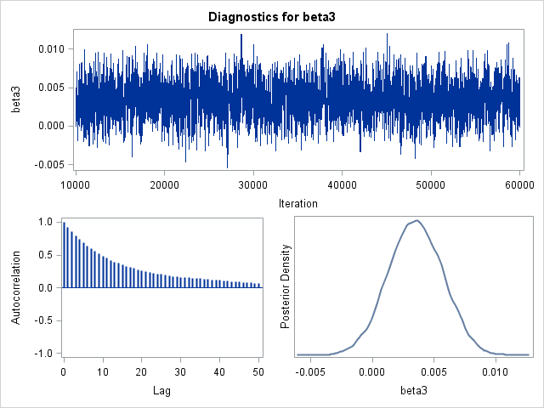
discussion
Missing values
Autocorrelations time is high
(30-50)
Trace plot, density plot, and autocorrelation plot of BMI when modeling change in log10 of CD4 counts.

