Slide 1
The 2-year influence of Hard drug on HIV treatment response after initiating HAART Wenru Zhou
Baseline,
Visit 0 N=715
Table 0. Missing data for Baseline and Visit 2
Characteristic | Baseline, Visit 2,N=506
SF36 MCS score | 1 (0%), 6(1%)
SF36 PCS score | 1 (0%), 6(1%)
# of CD4 positive cells (helpers) | 8 (2%), 19 (4%)
Standardized viral load (copies/ml) | 9 (2%), 19 (4%)
Hard drug at baseline | 0 (0%)
Age, years at baseline | 0 (0%)
BMI(kg/m2) at baseline | 18 (4%)
Race at baseline | 0 (0%)
Income at baseline | 17 (3%)
Smoke status at baseline | 0 (0%)
Adherence to meds taken since last visit | 0 (0%)
No hard drug use at baseline
N=649
hard drug use at baseline
N=66
Missing N=182
Missing N=27
No hard drug use at baseline N=467
hard drug use at baseline N=39
Visit2, N=506
18 (3.6%) obs
1 obs BMI=514.2514
5 obs BMI with Insufficient data
7 obs BMI=Improbable value
5 obs BMI=NA
17 (3.4%) obs refused to answer income
Are covariates
available?
Final dataset N=471

Slide 2
Table 1. Demographic information at baseline and Visit 2
Characteristic at baseline | All (n=488) | No hard drug use at baseline (n=452) | Hard drug use at baseline (n=36) | P Value
SF36 MCS score | 45.24±13.67 | 45.5±13.8 | 42.01±11.64 | 0.10
SF36 PCS score | 51.08±9.04 | 51.23±9.17 | 49.16±7.05 | 0.11
# of CD4 positive cells (helpers) | 375.43±203 | 376.66±203.34 | 360.04±200.8 | 0.64
Standardized viral load (copies/ml)* | 32600.5 (11186.22, 136972.5) | 33291.5 (11009.25, 136952.75) | 29255.5 (12909, 293871) | 0.88
Age, years | 43.16±8.83 | 43.1±8.78 | 43.89±9.52 | 0.63
BMI(kg/m2) | 25.26±4.41 | 25.39±4.46 | 23.62±3.45 | 0.006
Race** |  |  |  | 0.35
White, non-Hispanic | 313 (64%) | 294 (65%) | 19 (53%)
Black, non-Hispanic | 129 (26%) | 115 (25%) | 14 (39%)
Other | 5 (1%) | 5 (1%) | 0 (0%)
Hispanic | 41 (8%) | 38 (8%) | 3 (8%)
income** |  |  |  | 0.058
Less than $10,000 | 101 (21%) | 87 (20%) | 14 (39%)
10,000-19,999 | 49 (10%) | 46 (11%) | 3 (8%)
20,000-29,999 | 82 (17%) | 79 (18%) | 3 (8%)
30,000-39,999 | 68 (14%) | 61 (14%) | 7 (19%)
40,000 or more | 171 (36%) | 162 (37%) | 9 (25%)
Smoke |  |  |  | <0.0001
Never smoked | 139 (28%) | 139 (31%) | 0 (0%)
Former smoker | 163 (33%) | 154 (34%) | 9 (25%)
Current smoker | 186 (38%) | 159 (35%) | 27 (75%)
Adherence to meds taken since last visit** (at Visit 2) |  |  |  | 0.61
100% | 204 (42%) | 186 (41%) | 18 (50%)
95-99% | 236 (48%) | 219 (48%) | 17 (47%)
75-94% | 35 (7%) | 34 (8%) | 1 (3%)
<75% | 13 (3%) | 13 (3%) | 0 (0%)
*Kruskal–Wallis
**Fisher exact test

Slide 3
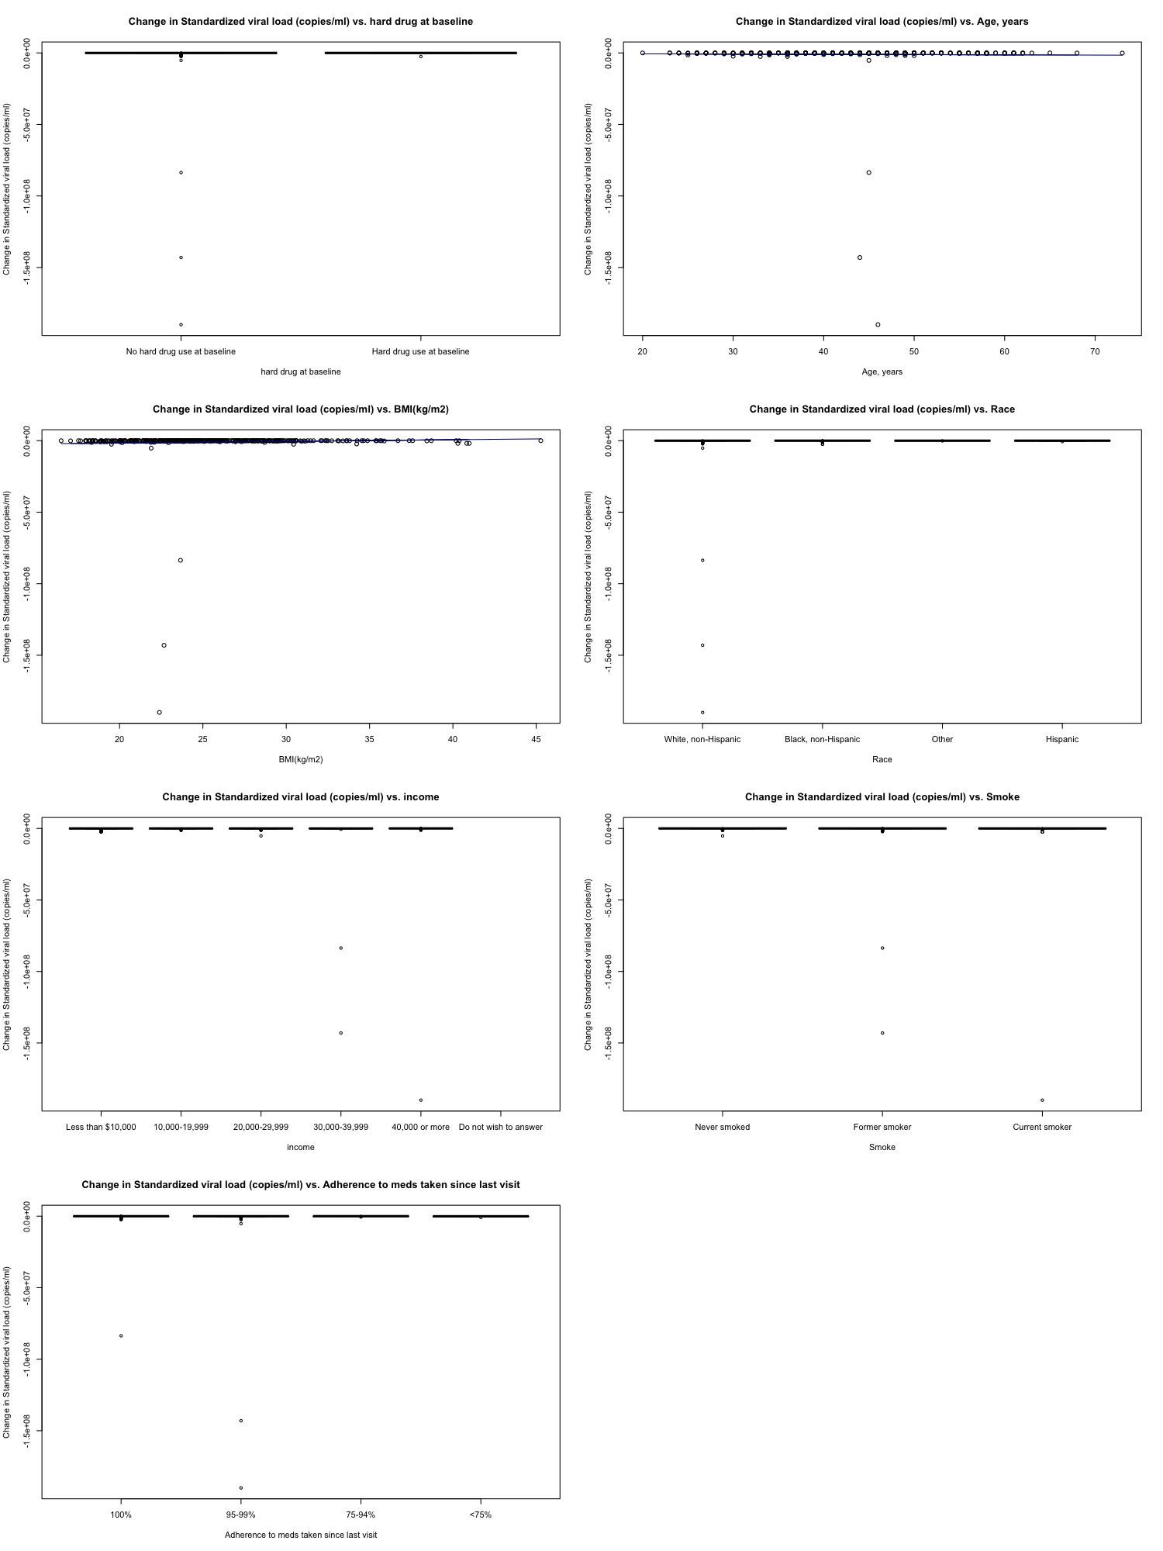
Change in viral load vs. hard drug use at baseline
Change in viral load vs. age at baseline
Analyses plan:
1. Outcome:
a. Change in SF36 MCS score
b. Change in SF36 PCS score
c. Change in # of CD4 positive cells (helpers)
d. log(Standardized viral load at Visit2)-
log(Standardized viral load at baseline)
2. Predictors and covariates:
If used hard drug at baseline, age BMI, adherence (ADH), race,
income and smoking status
3. Method: Multivariate Linear Regression
Model types:
1. Non-Baysian framework
Use least square method to estimate the coefficients
2. Baysian framework
a. The coefficients have normal distribution
b. The variance of error has inverse gamma distribution
Next step:
Fit Non-Baysian multivariate linear model
Continue to do literature mining
to set the initial value for Baysian model.
Contact to investigator to discuss the prior
If nothing is found, non-informative prior will be used.
Hard drug at baseline
Age
Change in viral load vs. BMI at baseline
Change in viral load vs. race at baseline
BMI(kg/m2)
RACE
Change in viral load vs. income at baseline
Change in viral load vs. smoke status at baseline
Income
Smoke
Change in viral load vs. adherence to meds taken since last visit
Adherence to meds taken since last visit

