Slide 1
School of Computing Science
Simon Fraser University
CMPT 471: Networking II
Transport Layer
Instructor: Mohamed Hefeeda

Slide 2
Transport services and protocols
provide logical communication between app processes running on different hosts
transport protocols run in end systems
send side: breaks app messages into segments, passes to network layer
rcv side: reassembles segments into messages, passes to app layer
more than one transport protocol available to apps
Internet: TCP and UDP
application
transport
network
data link
physical
network
data link
physical
network
data link
physical
network
data link
physical
logical end-end transport
network
data link
physical
network
data link
physical
application
transport
network
data link
physical

Slide 3
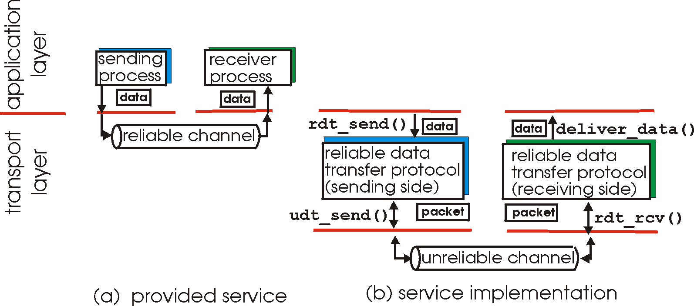
Reliable data transfer
important in application, transport, and link layers
top-10 list of important networking topics!

Slide 4
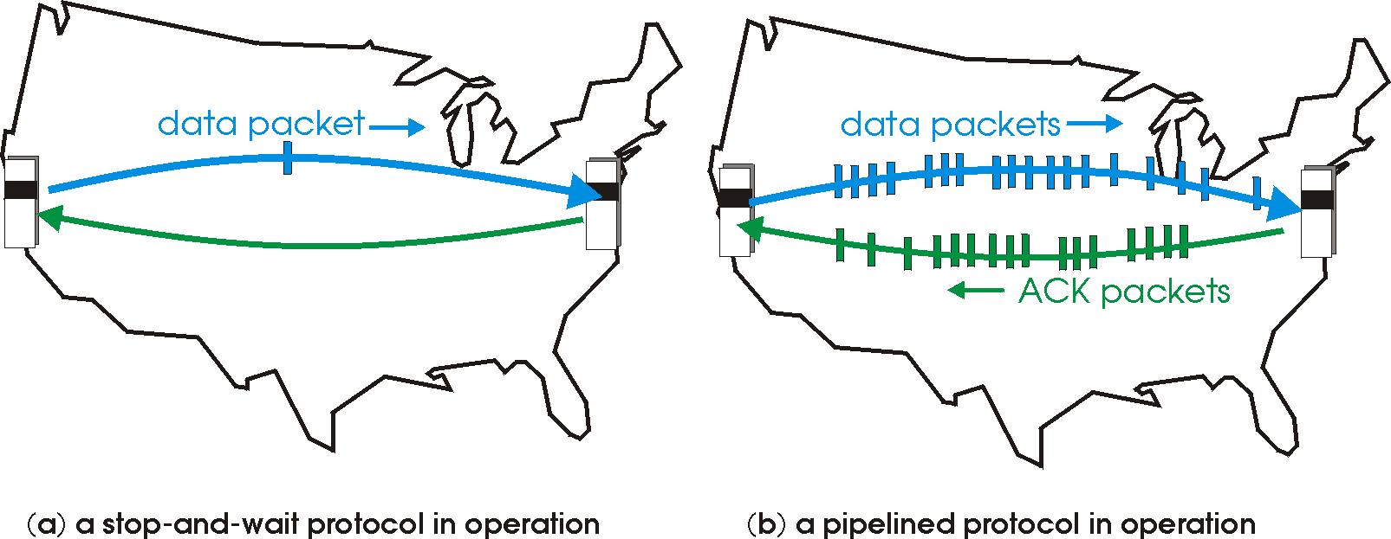
Pipelined (Sliding Window) Protocols
Pipelining: sender allows multiple, “in-flight”, yet-to-be-acknowledged pkts
range of sequence numbers must be increased
buffering at sender and/or receiver
Two generic forms of pipelined protocols: go-Back-N, selective repeat

Slide 5
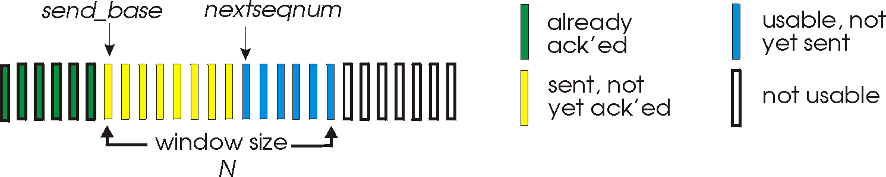
Go-Back-N
Sender:
k-bit seq # in pkt header
“window” of up to N consecutive unack’ed pkts allowed
ACK(n): ACKs all pkts up to and including seq # n -- cumulative ACK
may receive duplicate ACKs
timer for each in-flight pkt
timeout(n): retransmit pkt n and all higher seq # pkts in window
i.e., go back to n

Slide 6
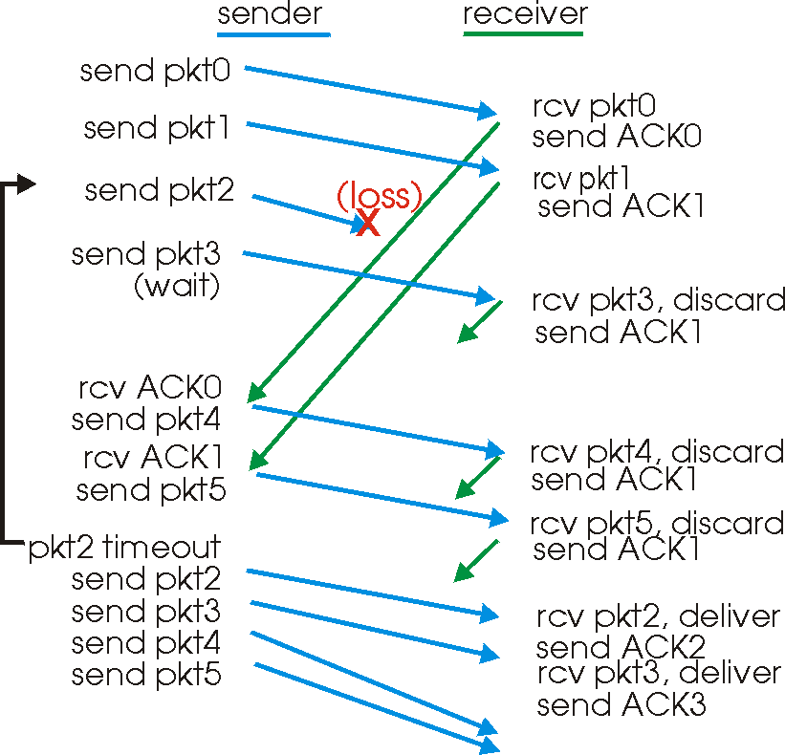
GBN in action
Go back to 2
Window size, N = 4

Slide 7
Go-Back-N: Problems?
Delay
Bandwidth
consider high-speed links with long delays
(called large bandwidth-delay product pipes)
GBN can fill that pipe by having large N ➔
many unACKed pkts could be in the pipe
A single lost pkt could cause re-transmission of huge number (up to N) of pkts ➔ waste of bandwidth
Solutions??

Slide 8
Selective Repeat
receiver individually acknowledges correctly received pkts
buffers pkts, as needed, for eventual in-order delivery to upper layer
sender only resends pkts for which ACK not received
sender timer for each unACKed pkt
sender window
N consecutive seq #’s
again limits seq #s of sent, unACKed pkts

Slide 9
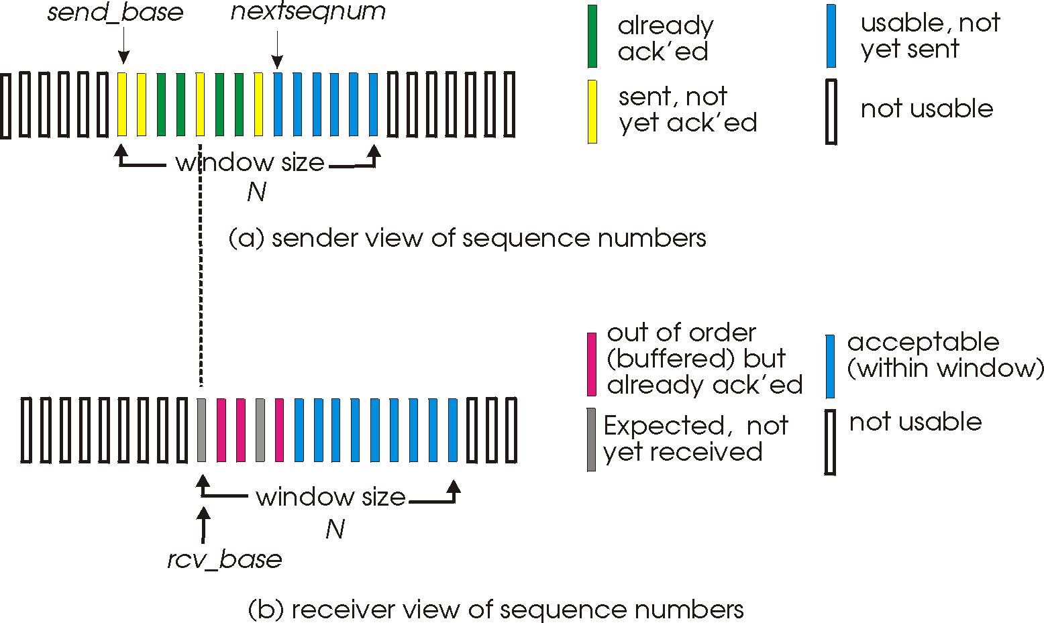
Selective repeat: sender, receiver windows

Slide 10
TCP reliable data transfer
TCP creates rdt service on top of IP’s unreliable service
Pipelined segments
Cumulative acks
TCP uses single retransmission timer
Why single timer?
Retransmissions are triggered by:
timeout events
duplicate acks
Initially consider simplified TCP sender:
ignore duplicate acks
ignore flow control, congestion control
Notes:
Why single timer? Timers are expensive especially for high speed links.

Slide 11
TCP: retransmission scenarios
Host A
Host B
Host A
Host B
Seq=92, 8 bytes data
Seq=92, 8 bytes data
Seq=100, 20 bytes data
ACK=100
Seq=92 timeout
timeout
X
ACK=100
ACK=120
loss
Seq=92, 8 bytes data
Sendbase
= 100
Seq=92, 8 bytes data
SendBase
= 120
Seq=92 timeout
ACK=120
ACK=100
SendBase
= 100
SendBase
= 120
time
time
lost ACK scenario
premature timeout

Slide 12
TCP retransmission scenarios (more)
Host A
Host B
Seq=92, 8 bytes data
ACK=100
timeout
Seq=100, 20 bytes data
X
loss
SendBase
= 120
ACK=120
time
Cumulative ACK scenario

Slide 13
TCP Round Trip Time and Timeout
If TCP timeout is
too short: premature timeout ➔ unnecessary retransmissions
too long: slow reaction to segment loss
Q: how to set TCP timeout value?
Based on Round Trip Time (RTT), but RTT varies with time!
➔ We estimate current RTT
EstimatedRTT = (1- α)*EstimatedRTT + α*SampleRTT
Exponential weighted moving average
influence of past sample decreases exponentially fast
typical value: α = 0.125 (➔ efficient computation why?)
Notes:
0.125 =1/8 ➔ shift left operation

Slide 14
Example RTT estimation:

Slide 15
TCP Round Trip Time and Timeout
Setting the timeout
EstimtedRTT plus safety margin
large variation in EstimatedRTT -> larger safety margin
first estimate how much SampleRTT deviates from EstimatedRTT:
DevRTT = (1-β)*DevRTT +
β*|SampleRTT - EstimatedRTT|
(typically, β = 0.25)
Then set timeout interval:
TimeoutInterval = EstimatedRTT + 4*DevRTT
Notes:
β = 0.25 = ¼ ➔ efficient computation.
Why not use Standard Deviation instead of the above formula? SD is robust and known in statitics. Again because of efficient computation. SD needs square root and float point operations. But the DevRTT is implemented all in efficient integer operations

Slide 16
Fast Retransmit
Time-out period often relatively long:
long delay before resending lost packet
Detect lost segments via duplicate ACKs.
Sender often sends many segments back-to-back
If segment is lost, there will likely be many duplicate ACKs.
If sender receives 3 ACKs for the same data, it supposes that segment after ACKed data was lost:
fast retransmit: resend segment before timer expires

Slide 17
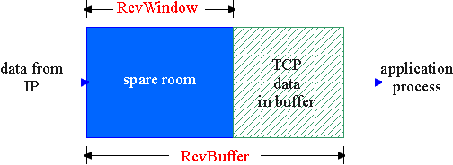
TCP Flow Control
flow control
receive side of TCP connection has receive buffer:
sender won’t overflow
receiver’s buffer by
transmitting too much,
too fast
speed-matching service: matching send rate to receiving app’s drain rate
Flow control is end to end
app process may be slow at reading from buffer

Slide 18
TCP Flow control: how it works
Rcvr advertises spare room by including value of RcvWindow in segments
Sender limits unACKed data to RcvWindow
guarantees receive buffer doesn’t overflow
(Suppose TCP receiver discards out-of-order segments)
spare room in buffer
= RcvWindow
= RcvBuffer-[LastByteRcvd - LastByteRead]

Slide 19
Congestion Control
Congestion: sources send too much data for network to handle
different from flow control, which is e2e
Congestion results in …
lost packets (buffer overflow at routers)
more work (retransmissions) for given “goodput”
waste of upstream links’ capacity
Pkt traversed several links, then dropped at congested router
long delays (queuing in router buffers)
poor performance (less responsive app)
premature (unneeded) retransmissions

Slide 20
TCP congestion control: Approach
Approach: probe for usable bandwidth in network
increase transmission rate until loss occurs then decrease
Additive increase, multiplicative decrease (AIMD)
Saw tooth
behavior: probing
for bandwidth
Rate (CongWin)
time

Slide 21
TCP Congestion Control
Sender keeps new variable, Congestion Window (CongWin), and limits unacked bytes to:
LastByteSent - LastByteAcked ≤ min {CongWin, RcvWin}
For our discussion: assume RcvWin is large enough
Above equation achieves both flow and congestion control
Roughly, what is the sending rate as a function of CongWin?
Ignore loss and transmission delay
Rate = CongWin/RTT (bytes/sec)
So, rate and CongWin are somewhat synonymous

Slide 22
TCP Congestion Control
Congestion occurs at routers (inside the network)
Routers do not provide any feedback to TCP
How can TCP infer congestion?
From its symptoms: timeout or duplicate acks
Define loss event ≡ timeout or 3 duplicate acks
TCP decreases its CongWin (rate) after a loss event
TCP Congestion Control Algorithm: three components
AIMD: additive increase, multiplicative decrease
slow start
Reaction to timeout events

Slide 23
AIMD
additive increase: (congestion avoidance phase)
increase CongWin by 1 MSS every RTT until loss detected
TCP increases CongWin by: MSS x (MSS/CongWin) for every ACK received
Ex. MSS = 1,460 bytes and CongWin = 14,600 bytes
With every ACK, CongWin is increased by 146 bytes
multiplicative decrease:
cut CongWin in half after loss
CongWin
Notes:
Why do we increase for each ACK not the whole RTT? So that we do not need to keep track of when RTT starts and ends. TCP is usually referred to as “self clocking” protocol, which means it regulates the transmission of segments by itself—no need for external triggers.

Slide 24
TCP Slow Start
When connection begins, CongWin = 1 MSS
Example: MSS = 500 bytes & RTT = 200 msec
initial rate = CongWin/RTT = 20 kbps
available bandwidth may be >> MSS/RTT
desirable to quickly ramp up to respectable rate
Slow start:
When connection begins, increase rate exponentially fast until first loss event. How can we do that?
double CongWin every RTT. How?
Increment CongWin by 1 MSS for every ACK received

Slide 25
TCP Slow Start (cont’d)
Increment CongWin by 1 MSS for every ACK
Summary: initial rate is slow but ramps up exponentially fast
Host A
Host B
one segment
RTT
two segments
four segments
time

Slide 26
Reaction to a Loss event
TCP Tahoe (Old)
Threshold = CongWin / 2
Set CongWin = 1 MSS
Slow start till threshold
Then Additive Increase // congestion avoidance
TCP Reno (most current TCP implementations)
If 3 dup acks // fast retransmit
Threshold = CongWin / 2
Set CongWin = Threshold + 3 MSS // fast recovery
Additive Increase
Else // timeout
Same as TCP Tahoe

Slide 27
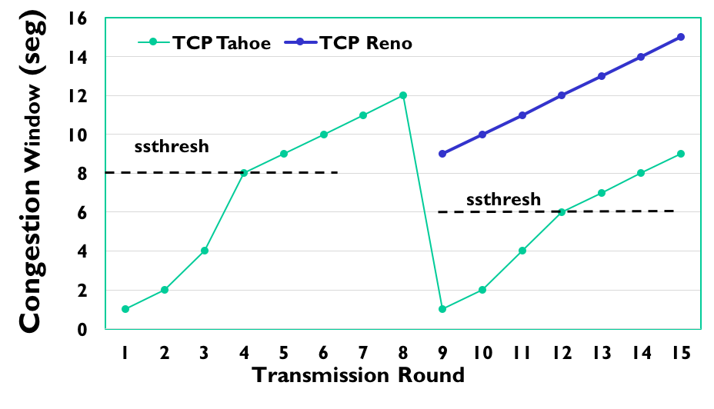
Reaction to a Loss event (cont’d)
Why differentiate between 3 dup acks and timeout?
3 dup ACKs indicate network capable of delivering some segments
timeout indicates a “more alarming” congestion scenario

Slide 28
TCP Congestion Control: Summary
Initially
Threshold is set to large value (65 Kbytes), has no effect
CongWin = 1 MSS
Slow Start (SS): CongWin grows exponentially
till loss event occurs (timeout or 3 dup ACks) or reaches Threshold
Congestion Avoidance (CA): CongWin grows linearly
3 duplicate ACK occurs:
Threshold = CongWin/2;CongWin = Threshold +3 MSS; CA
Timeout occurs:
Threshold = CongWin/2; CongWin = 1 MSS; SS till Threshold
Notes:
Applet for TCP fairness: http://media.pearsoncmg.com/aw/aw_kurose_network_4/applets/fairness/index.html

Slide 29
TCP Throughput Analysis
Understand the fundamental relationship between
Packet loss probability,
RTT, and
TCP performance (throughput)
We present simple model, with several assumptions
Yet it provides quite useful insights

Slide 30
TCP Throughput Analysis
Any TCP model must capture
Window Dynamics (internal and deterministic)
Controlled internally by the TCP algorithm
Depends on the particular flavor of TCP
We assume TCP Reno (the most common)
Packet Loss Process (external and uncertain)
Models aggregate network conditions across all nodes on the TCP connection path
Typically modeled as Stochastic Process with probability p that a packet loss occurs
TCP responds by reducing the window size
We usually analyze the steady state
Ignore the slow start phase (transient)
Although many connections finish within slow start, because they send only a few kilobytes

Slide 31
Simple (Periodic) Model
loss occurs
Packet losses occur with constant probability p
TCP window starts at W/2 grows to W, then halves, repeat forever … ➔
TCP Throughput ranges between:
Min: MSS *(W/2) / RTT, and
Max: MSS* W / RTT ➔
W
W/2
period
time (RTT)
Avg throughput = MSS * (3/4 W) / RTT (1)

Slide 32
Simple (Periodic) Model
Avg throughput = MSS * (3/4 W) / RTT (1)
Now, we want to relate W (max window size) with the packet loss rate in the network p
So that we have the TCP throughput as function of RTT and loss rate (both are external network parameters)

Slide 33
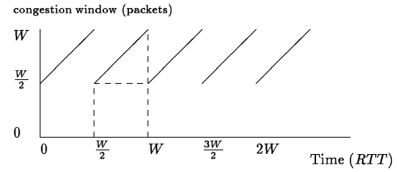
Simple (Periodic) Model
T
Throughput X(t) = green area (packets sent) / T
(2)

Slide 34
Simple (Periodic) Model
On the other hand, we have average packet loss rate of p
How many packets we send until we observe a loss?
1/p
Throughput X(t) = number of packets sent / T ➔
Solve (2) and (3) ➔
(3)

Slide 35
Simple (Periodic) Model
Substitute w in (1):
Called inverse square-root-p law
TCP throughput is inversely proportional to the square root of the packet loss probability

Slide 36
Impact of Loss Rate on TCP

Slide 37
Impact of RTT & loss on TCP

Slide 38
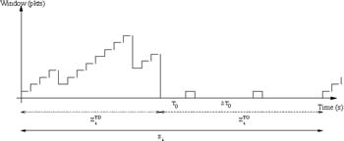
In More Realistic Models …
Packet loss probability is not constant and is bursty
Consider effect of duplicate ACKs and Timeouts
Consider receiver window limit

Slide 39
TCP Over High Speed Links
Assume 1 Gbps link, RTT 100ms, what is the max packet loss rate for TCP to achieve 1 Gbps throughput? Assume MSS = 1000 bytes
p = ~ 10^(-8)
At most one segment lost each 100 millions sent. That is way too low even for fiber optic links

Slide 40
High Speed TCP & other Flavors
To support high bandwidth-delay product links
(detected when congWin gets very large)
Idea: Increase congWin by larger amount than standard TCP
E.g., in CUBIC (implemented in Linux), FAST TCP,…
More flavors at:
https://en.wikipedia.org/wiki/TCP_congestion_control

Slide 41
TCP over Wireless Networks
Performance of TCP suffers:
First recall that TCP interprets loss as congestion
But in wireless networks, packets can be lost because of bit-errors (usually high) and handoff (long delays)
Thus, TCP may un-necessarily decrease its sending rate (congestion window)
Solutions?

Slide 42
Enhancing TCP Performance in Wireless Networks
Make TCP aware of the wireless link
Usually uses probabilistic inference models
Distinguish loss due to congestion from others (e.g., wireless bit errors)
Decrease sending rate if congestion only

Slide 43
Enhancing TCP Performance in Wireless Networks
Split TCP connections
One from mobile to base station, and another from base station to the other end
Over the wireless part, we can use either standard TCP (shorter delay now) or custom/new transport protocols, e.g. reliable UDP, TCP with selective repeat
Used in cellular networks, significant improvement in TCP
Notes:
FEC: forward error correction. It adds R redundant packets to N original packet such that any received N packets out of N+R packets can be used to recoverthe whole data.

Slide 44
Enhancing TCP Performance in Wireless Networks
Local (link) Recovery
ARQ: local retransmission (e.g., in 802.11)
FEC: for long-delay networks (e.g., cellular, satellite)
Adds R redundant packets to N original packet such that any received N packets out of N+R packets can be used to recover the whole data.
Notes:
FEC: forward error correction. It adds R redundant packets to N original packet such that any received N packets out of N+R packets can be used to recoverthe whole data.

Slide 45

TCP Fairness
fairness goal: if K TCP sessions share same bottleneck link of bandwidth R, each should have average rate of R/K
TCP connection 1
bottleneck
router
capacity R
TCP connection 2

Slide 46
Why is TCP fair?
two competing sessions:
additive increase gives slope of 1, as throughout increases
multiplicative decrease decreases throughput proportionally
R
equal bandwidth share
Connection 2 throughput
loss: decrease window by factor of 2
congestion avoidance: additive increase
loss: decrease window by factor of 2
congestion avoidance: additive increase
Connection 1 throughput
R

Slide 47
Fairness (more)
Fairness and UDP
multimedia apps often do not use TCP
do not want rate throttled by congestion control
instead use UDP:
send audio/video at constant rate, tolerate packet loss
Fairness, parallel TCP connections
application can open multiple parallel connections between two hosts
web browsers do this
e.g., link of rate R with 9 existing connections:
new app asks for 1 TCP, gets rate R/10
new app asks for 11 TCPs, gets R/2

Slide 48
Network-Assisted Congestion Control
Network (routers) help sources in detecting congestion
Example: Explicit Congestion Notification (ECN)
Uses 2 bits in the IP header (ToS filed)
1 bit to indicate to routers that source can use their help
The other bit is set by any router on the path that observes congestion (e.g., large queue length)

Slide 49
Explicit Congestion Notification (ECN)
network-assisted congestion control:
two bits in IP header (ToS field) marked by network router to indicate congestion
congestion indication carried to receiving host
receiver (seeing congestion indication in IP datagram) ) sets ECN bit on receiver-to-sender ACK segment to notify sender of congestion
source
TCP ACK segment
destination
application
transport
network
link
physical
ECE=11
application
transport
network
link
physical
ECN=11
ECN=10
ECN=11
IP datagram

Slide 50
Summary
Transport layer: logical channel between processes
Main protocols: TCP and UDP
TCP:
Reliable
Congestion control
Flow control
Simple analytic model for TCP
Throughput inversely proportional with RTT and greatly affected by packet loss rate
TCP performance over wireless networks may suffer: performance mitigation

