Slide 1
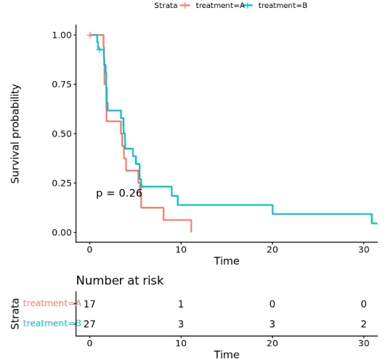
Q1: difference in PFS between treatment groups
Surv(time.pfs, event.pfs) ~ treatment
Considering the small-sample bias

Slide 2
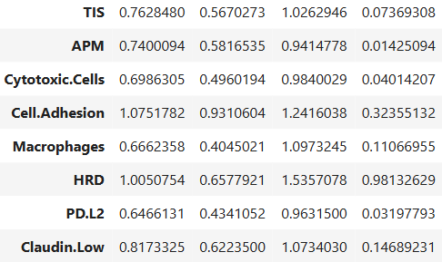

Q2: gene expression scores’ association with PFS
Surv(time.pfs, event.pfs) ~ gene_expression + strata(treatment)
Benjamini-Hochberg
adjustment
q_value

Slide 3
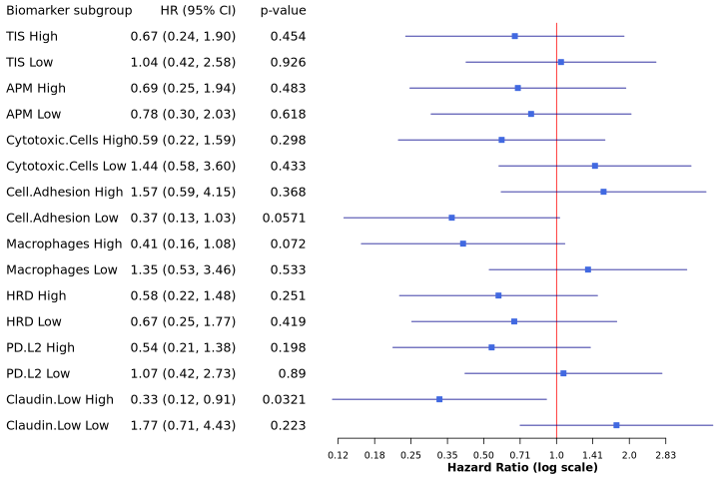
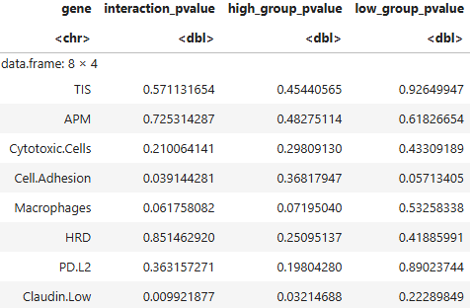
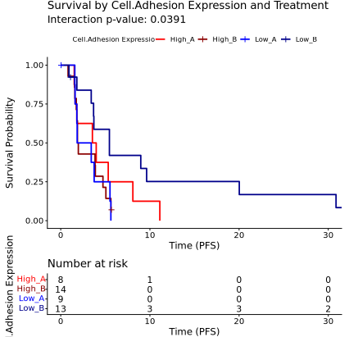
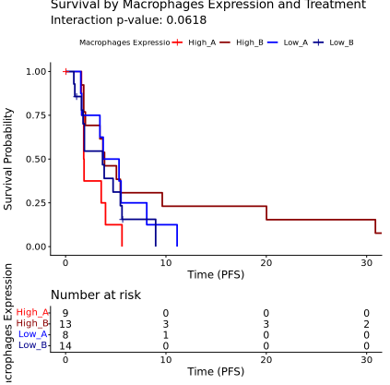
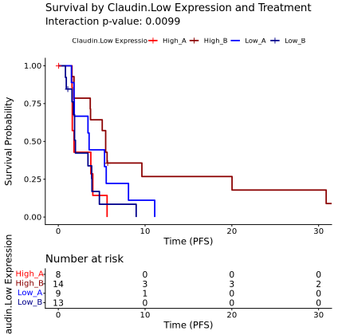
Q3: predictive biomarker for the treatment
Surv(time.pfs, event.pfs) ~ gene_expression + treatment + gene_expression:treatment
Surv(time.pfs, event.pfs) ~ treatment
Potential improving strategies:
Original continuous values
Multiple categories
STEPP
Machine learning

