Slide 1
FIT3152 Data Analytics 2023: Assignment 3
Lee Zhen Xuan 31860532

Slide 2
Q1 Area of interest and documents
Area of interest: Reviews of instruments
Acoustic guitars
Electric guitars
Bass guitars
Acoustic pianos
Keyboards (digital pianos)
Reviews are collected from the same website: https://www.rogerebert.com/reviews to maintain the consistency of the writing of documents
Total of 20 documents collected

Slide 3
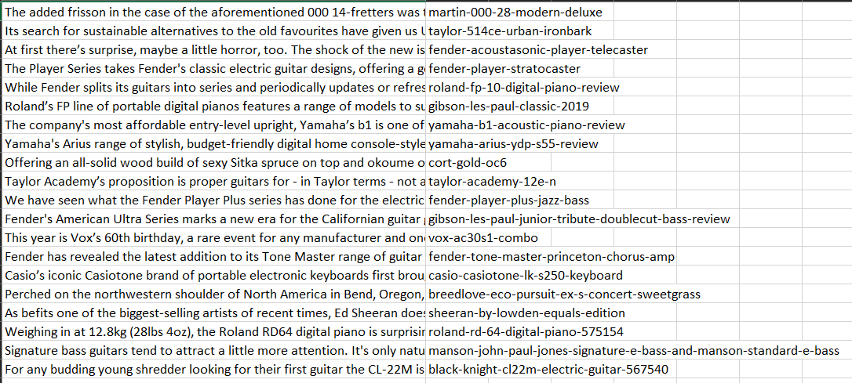
Q2: Corpus
Corpus is built from the text data file “Instruments.csv”
Content of the reviews in the first column, instrument name as identifier as second column
First 20 letters are selected as identifiers

Slide 4
Q3: Document-Term Matrix (DTM)
Basic pre-processing done:
Removing numbers as they are considered noise in text analysis.
Removing punctuations as they are usually not relevant in text analysis.
Converting the documents to lowercase to standardize the documents.
Removing stop words as they do not carry much meaning and will affect the highest frequency tokens.
Stemming as English language to reduce the words to their base/root form, where similar words are considered the same.
Sparse terms removed: 2639 terms to 22 terms.

Slide 5
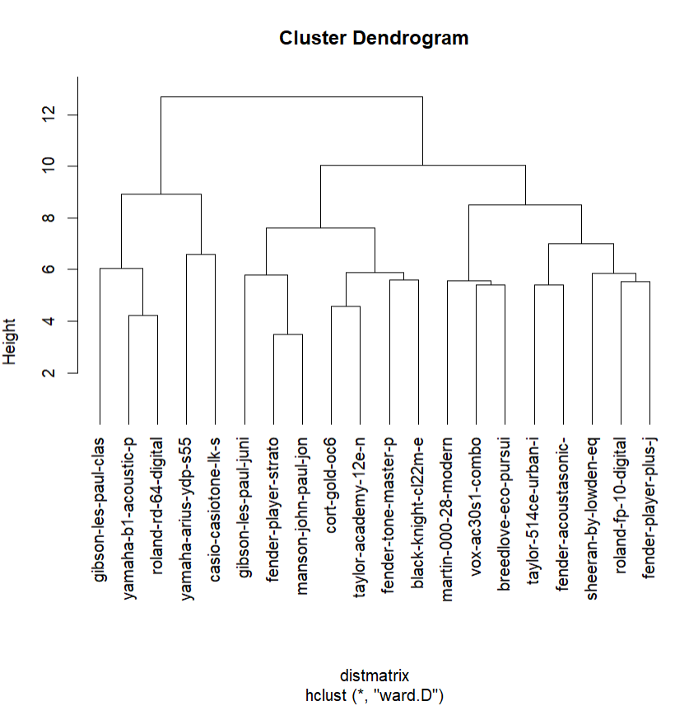
Q4: Hierarchical clustering
Hierarchical clustering is performed by calculating distance matrix using cosine distance measure, minimizing total within-cluster variance.
Dendrogram cut into 20 clusters and assigned a cluster label to each of the documents.

Slide 6
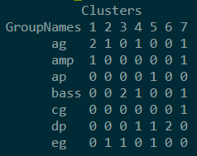
Q4: Hierarchical clustering
Quantitative measure of quality of the clustering:
Creating list of topics/types of instruments that corresponds to the rows of the corpus
Plotting the cluster table
Calculating accuracy: Reported an accuracy of 0.25, only 25% of the assignments in the cluster table matches the true labels.

Slide 7
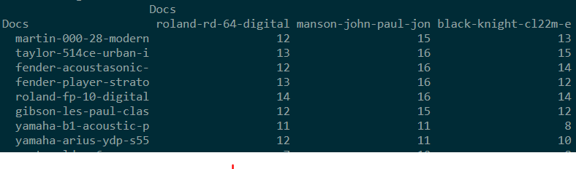
Q5: Single-mode network
Strength of documents are created:

Slide 8
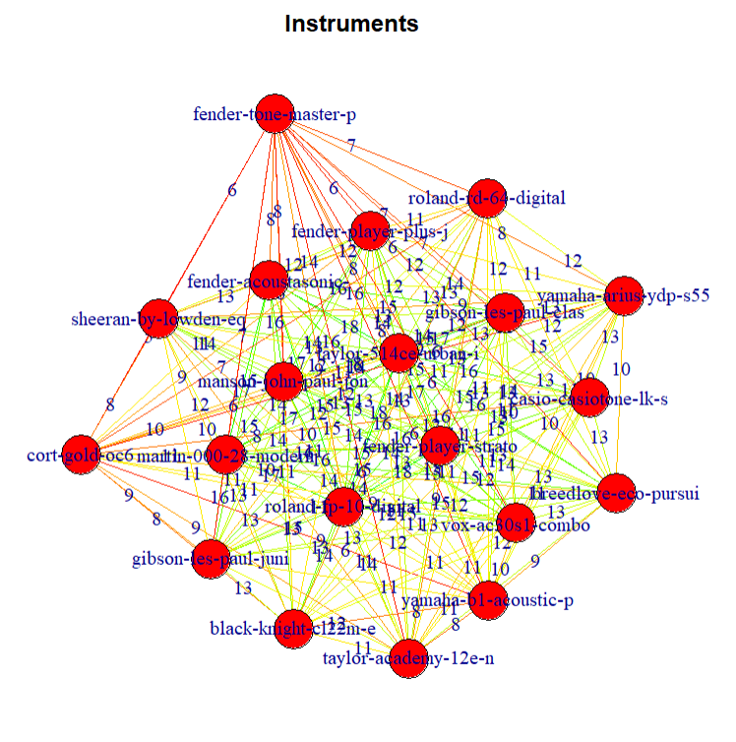
Q5: Single-mode network (documents)
Stronger weights are coloured green, while weaker weights are coloured red.
Most of the edges in the middle of the network are mostly green - documents are closely related to each other in terms of commonly used words for instruments reviews
Outliers: “fender-tone-master-p” node which lies at the far top of the network has weak weighted edges

Slide 9
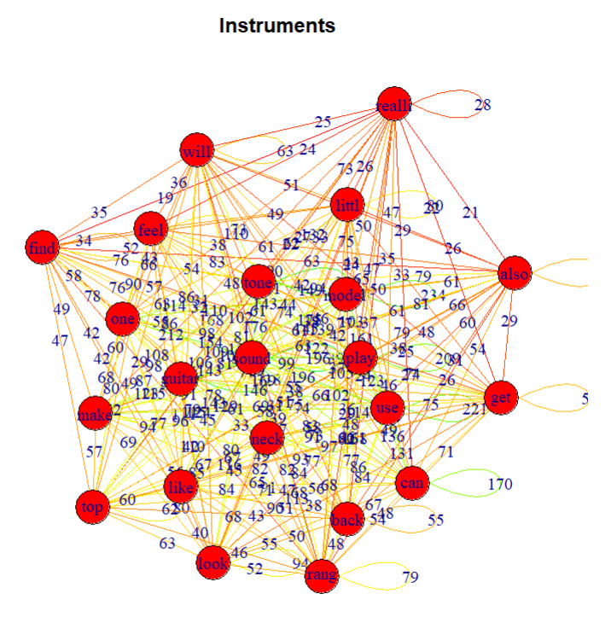
Q6: Single-mode network (words)
Strength between words are created.
Network does quite well in predicting important words
Commonly used words for instruments: “sound”, “tone”, “model”, “play” in middle of network with high weighted edges.

Slide 10
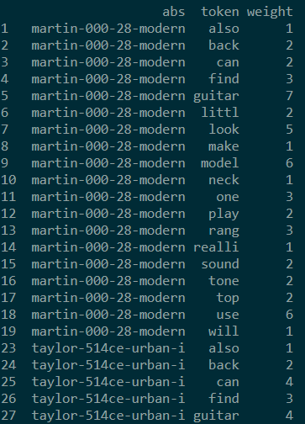
Q7 Bipartite network
Strength of nodes between the documents and words

Slide 11
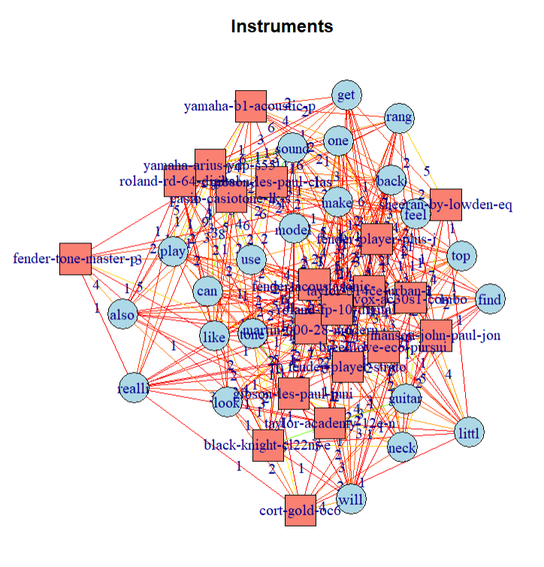
Q7 Bipartite network
Two types of nodes: Documents (red squared), tokens (blue circles)
Clear groups of documents:
#Group 1: pianos
#Group 2: guitars
Words for #Group 1 and #Group 2: “play”, “use”, “model”, “make” as commonly used terms for all instruments
Words for #Group 2: “guitar” “neck”, “top” as commonly used terms for guitars only.

Slide 12
Conclusion
Text analysis can be used to analyse the relationships between individual text based documents
Find important similarities, differences, and how closely they are related to each other.

