Slide 1
Support vector machines
Predominate application: classification
Regression possible but seldom used
Advantage: built in generalization (wide margins)

Slide 2
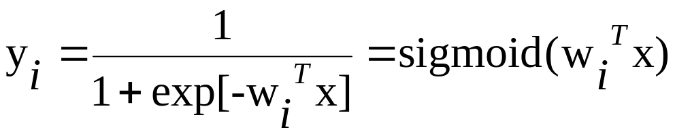
Support Vector Machines: Background
Recall HW4: instances can be classified by their “risk score”
w^{T}x, without calculating their probability of a heart attack.
Approximates class posterior P(C_{i}|x)
Given the linear discriminant w^{T}x = 0,
we can classify the data without
estimating P(C_{i}|x).
Lecture Notes for E Alpaydın 2010 Introduction to Machine Learning 2e © The MIT Press (V1.0)

Slide 3
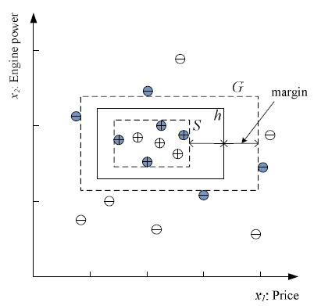
Support Vector Machines: Background
Recall family car classification problem:
Discriminant (axis aligned rectangle) defined in terms of support
vectors
Hypothesis with
greatest distance
between S and G
Filled circles are the subset
of training examples required
to define the version space and
the hypothesis with maximum
margins

Slide 4
Support Vector Machines: Background
Linear discriminants in d > 2 dimensions are called
“hyperplanes”
In SVM, we find the optimal hyperplane by minimizing a
quadratic function of attribute vectors subject to linear
constraints.
Minimize f(x) = ½x^{T}Qx + c^{T}x subject to Ax < b
where Q is a positive definite matrix
Since Q is a positive definite, f(x) is convex.
If f(x) is convex and bounded from below, a unique
global minimum exist in the solution space.

Slide 5
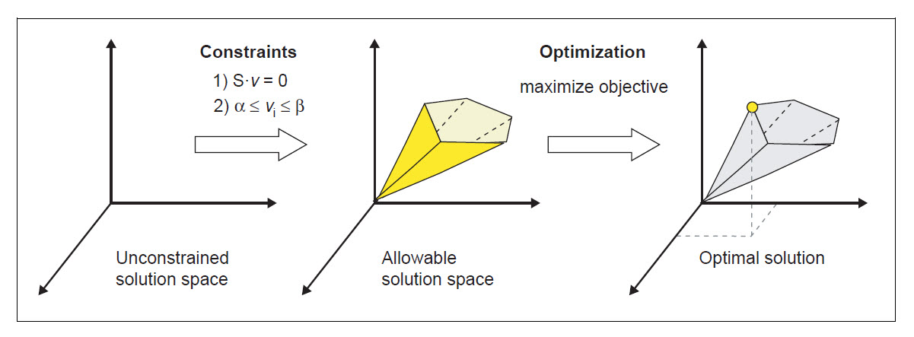
Support Vector Machines: Background
The quadratic programing problem, min f(x) = ½x^{T}Qx + c^{T}x
subject to Ax < b becomes a linear programing problem if
Q is zero (not the case for SVM). Solved by Simplex algorithm
Optimal x is at a vertex of convex hull

Slide 6
Active set in the quadratic programming problem
The active set determines which constraints will influence
the final result of optimization.
In the linear programming problem, the active set defines the
allowed convex solution space and the vertex that is a solution.
In a convex quadratic programming problem, the solution is
not necessarily at a vertex but the active set still guides the
search for a solution.
In the SVM quadratic programming problem, support vectors
define the active set.

Slide 7
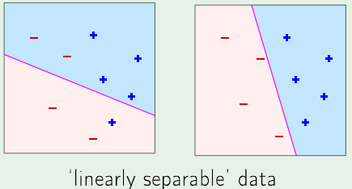
Problem 1: Given linearly separable 2-class data,
find the linear discriminant with zero E_{in} and the
widest margins.

Slide 8
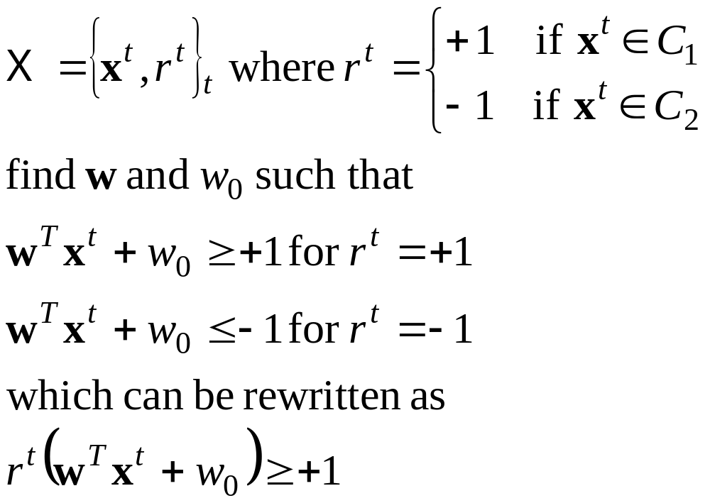
Optimum Separating Hyperplane: 2 classes

Slide 9

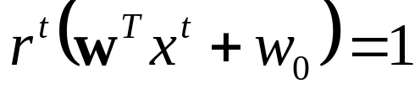
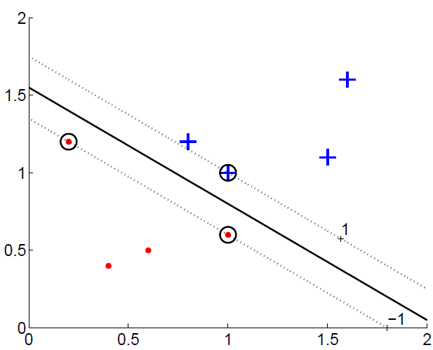
Linearly-separable 2-class problem: find weights such that
for all instances. Those with
are support vectors that determine the margins.
Separating hyperplane
Support vectors
margins
Lecture Notes for E Alpaydın 2010 Introduction to Machine Learning 2e © The MIT Press (V1.0)

Slide 10
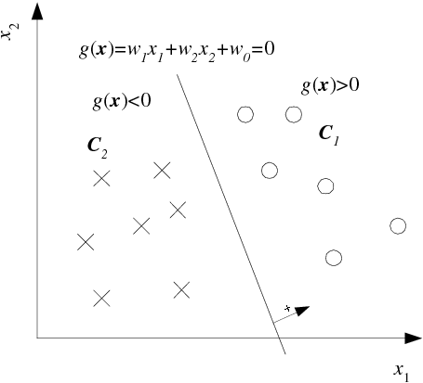
Distance of x^{t} from hyperplane g(x) = 0
Let x_{a} and x_{b}
be points on
the hyperplane
w^{T}x_{a} + w₀ = w^{T}x_{b} + w₀
w^{T}(x_{a} – x_{b}) = 0
x_{a} – x_{b} is in hyperplane
w must be normal to
hyperplane
r^{t} = -1
r^{t} = 1
Lecture Notes for E Alpaydın 2010 Introduction to Machine Learning 2e © The MIT Press (V1.0)

Slide 11
Distance of x^{t} from hyperplane g(x) = 0
Decompose any point x
into components parallel and perpendicular to the
hyperplane
x = x_{p} + d w/||w||
x_{p} is projection of x on
hyperplane
d is distance of x from
hyperplane
w/||w|| is unit normal of
hyperplane
r^{t} = -1
r^{t} = 1
Lecture Notes for E Alpaydın 2010 Introduction to Machine Learning 2e © The MIT Press (V1.0)

Slide 12
Distance of x^{t} from hyperplane g(x) = 0
g(x_{p}) = 0 = g(x - d w/||w||)
0 = w^{T}(x – d w/||w||) + w₀
w^{T}w = ||w||²
0 = w^{T}x + w₀ – d ||w||
d = |w^{T}x + w₀|/||w||
d^{t} = |g(x^{t})|/||w||
d^{t} = r^{t}(w^{T}x^{t} + w₀)/||w||
r^{t} = 1
r^{t} = -1
Lecture Notes for E Alpaydın 2010 Introduction to Machine Learning 2e © The MIT Press (V1.0)

Slide 13
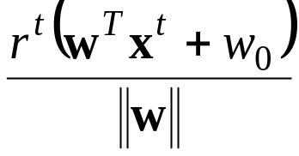
Maximizing margins
Distance of x^{t} to the hyperplane is d =
To maximize d,
Result is a linear discriminant, w^{T}x^{t} + w₀ = 0, for binary classification with maximum margins (smallest distance of any x^{t} from the discriminant for both classes)
Number of constraints = size of the training set
Solve by Lagrange multipliers
Lecture Notes for E Alpaydın 2010 Introduction to Machine Learning 2e © The MIT Press (V1.0)

Slide 14
duality in constrained optimization
In constrained optimization, it is often possible to convert the primal problem
(i.e. the original form of the optimization problem) to a dual form.
In the Lagrangian dual problem, minimizing the Lagrangian results in primal
variables expressed as functions of the Lagrange multipliers, which are called dual variables.
Maximizing the dual form with respect to the Lagrange multipliers, under their derived constraints (at least, non-negativity), results in optimal expressions for primal variables.
In general, solution of the dual problem provides only an upper bound on
the solution of the primal problem. (called duality gap)
For convex optimization problems with linear constraints, the duality gap
is zero, which is the case for the problem of a discriminant with maximum
margins

Slide 15
Review: Distance of x^{t} from hyperplane g(x) = 0
g(x_{p}) = 0 = g(x - d w/||w||)
0 = w^{T}(x – d w/||w||) + w₀
0 = w^{T}x + w₀ – d ||w||
d = |w^{T}x + w₀|/||w||
d^{t} = |g(x^{t})|/||w||
d^{t} = r^{t}(w^{T}x^{t} + w₀)/||w||
r^{t} = 1
r^{t} = -1
Goal of SVM: find the discriminant that maximizes d^{t} for all instances
Lecture Notes for E Alpaydın 2010 Introduction to Machine Learning 2e © The MIT Press (V1.0)

Slide 16
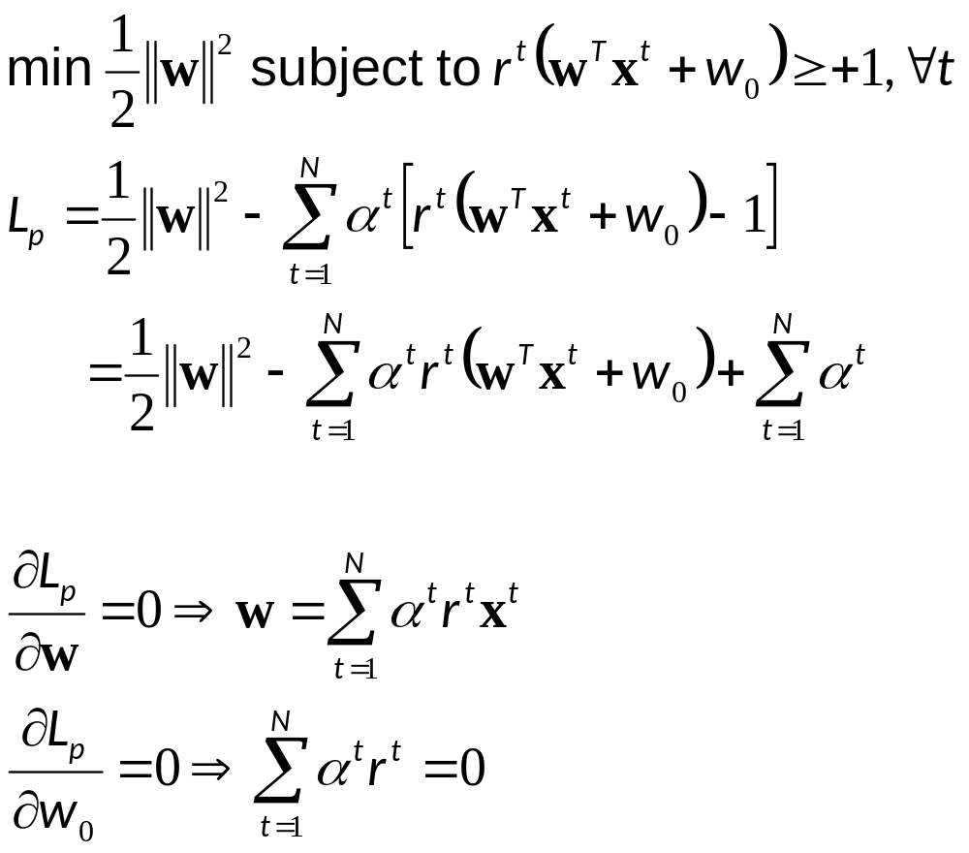
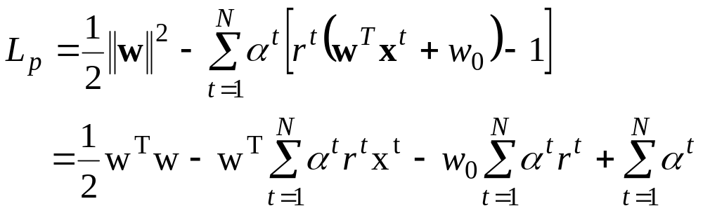
Solution by Lagrange multipliers
Sub p denotes Lagrangian of “primal” optimization problem
Primary variable related
dual variables
Constraint on dual variables
Lecture Notes for E Alpaydın 2010 Introduction to Machine Learning 2e © The MIT Press (V1.0)

Slide 17
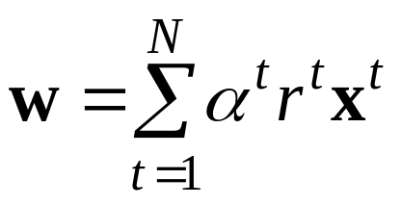
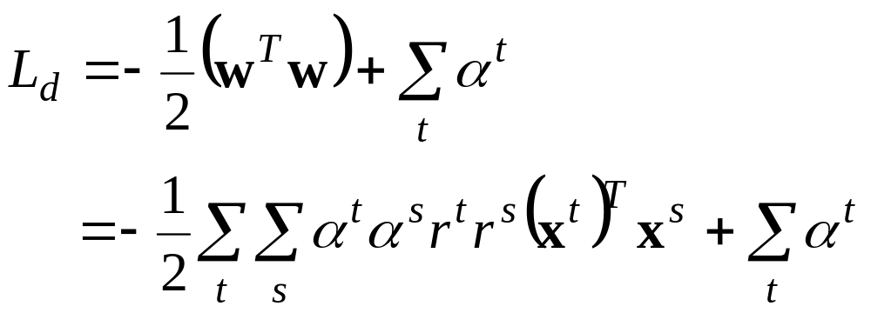
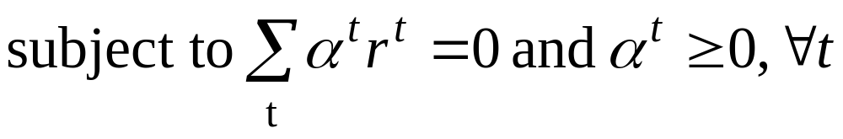
Expanded L_{p}
Eliminate w using
Sub d denotes dual optimization problem with variables α^{t}
maximize L_{d}
Lecture Notes for E Alpaydın 2010 Introduction to Machine Learning 2e © The MIT Press (V1.0)

Slide 18
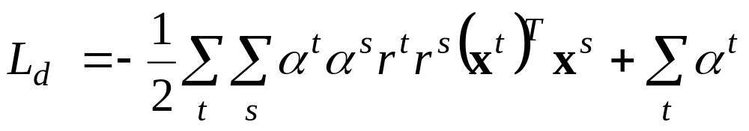

Maximize
Set α^{t} = 0 for data point sufficiently far from discriminant to be ignored in the search for hyperplane with maximum margins. Find remaining α^{t} > 0 by quadratic programing
Given the α^{t} > 0 that maximize L_{d} calculate
Still need to find w₀
For support vectors (x^{t} on margin), r^{t} (w^{T}x^{t} + w₀) = 1
(r^{t})² = 1; therefore w₀ = r^{t} - w^{T}x^{t}
Usually average w₀ calculated from all support vectors
Lecture Notes for E Alpaydın 2010 Introduction to Machine Learning 2e © The MIT Press (V1.0)

Slide 20
Review: SVM for linearly-separable 2-class problem
In-sample error is zero; focus on generalization by maximizing margins
Separating hyperplane
Support vectors
margins

Slide 21
Review:
To be maximized
set α^{t} = 0 for data point sufficiently far from discriminant to be ignored in the search for hyperplane with maximum margins.
Only support vectors have α^{t} > 0. Usually a small fraction of data.
Called “sparsity of solution”. Makes complexity proportional to number of support vectors independent of number of attributes.
Finding the non-zero α^{t} is an iterative process because, initially, we don’t know which data points will be far from discriminant.
Suggest a way to obtain an initial guess of which instances have attributes that are near the separating hyperplane.

Slide 22
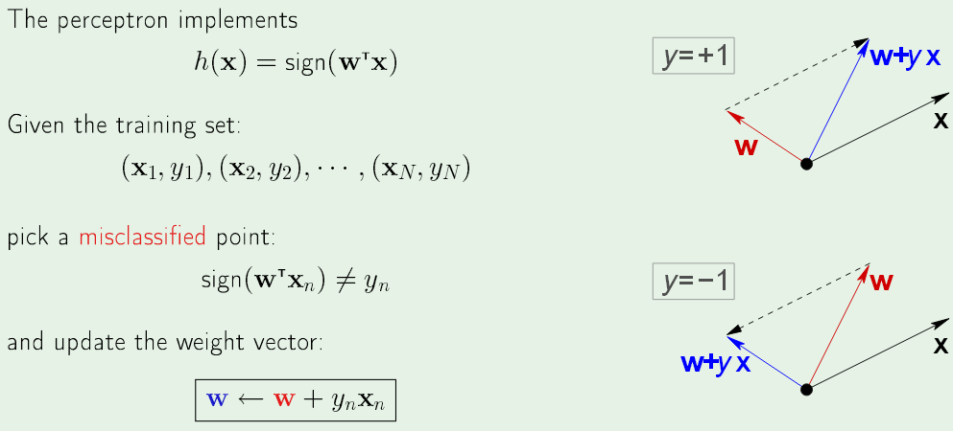
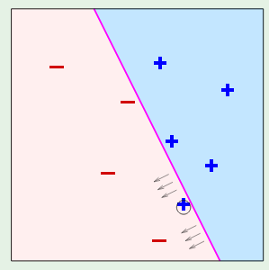
Perceptron learning algorithm (PLA)
sign(w^{T}x) negative
sign(w^{T}x) positive
Each iteration pulls discriminant in direction that tends to correct the
misclassified data point. If linearly separable, eventually all classified
correctly.

Slide 23
Review: Active set in constrained optimization
What is the “active set” in constrained optimization?
How does maximization of the dual make constraints on
support vectors the active set?

Slide 24
Review:
To be maximize
set α^{t} = 0 for data point sufficiently far from discriminant to be ignored in the search for hyperplane with maximum margins.
After finding the non-zero α^{t} by iterative quadratic programing
calculate
and w₀ = <r^{t} – w^{T}x^{t}>,
where < > denotes average over all support vectors

Slide 26
Application of SVM to classes that are not linearly
Separable
Introduce “slack variables” to allow for incorrect
classification and correctly classified instances
in the margins. Called “soft-margin hyperplanes”
Instances in margins and misclassified become
support vectors (α^{t} > 0) in addition to instances
on margins

Slide 27
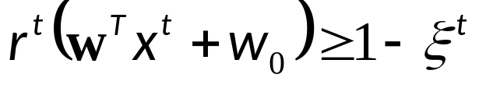
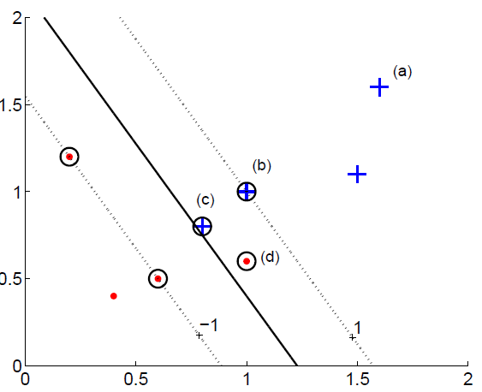
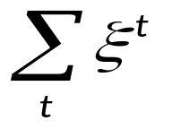
Slack variables soften constraints
ξ^{t} > 0 new primal variables in L_{p}
(a) & (b) classified correctly ξ^{t} = 0
(c) correct but in margin 0<ξ^{t}<1
(d) misclassified ξ^{t} >1
soft error =
Lecture Notes for E Alpaydın 2010 Introduction to Machine Learning 2e © The MIT Press (V1.0)

Slide 28
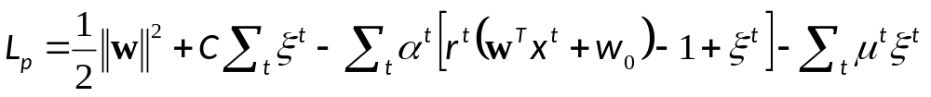
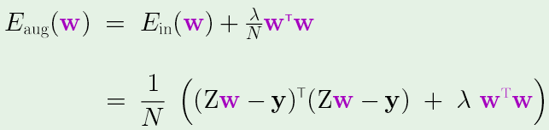
slack variables are new primal variables in L_{p}
C is regularization parameter; α^{t} and μ^{t} are Lagrange multipliers
Same principal as weight decay for extended linear models.
Weight decay
Smaller C penalizes soft error less. ||w||² more important in minimizing L_{p}. Gives larger margins but more data points in the margins. Use validation set to find best choice of C.

Slide 29
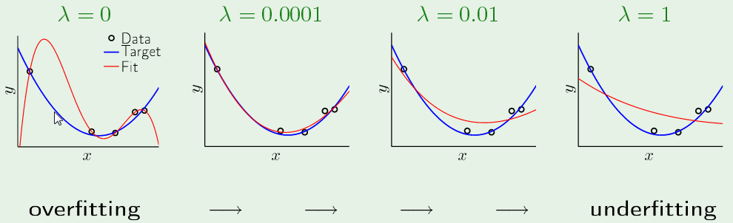
Large λ is like small C. Gives more tolerance of
mismatch between model and data
As with λ, a validation set is used to determine the
best choice of C

Slide 30
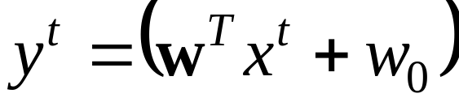
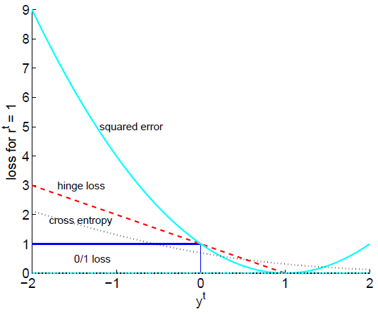
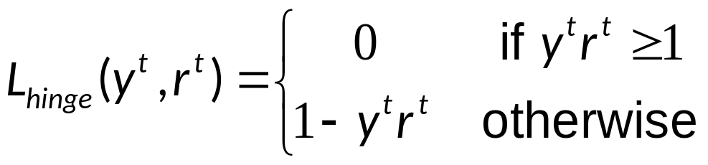
Soft error also called “hinge” loss function
is output r ^{t} is target
if y^{t}r ^{t} >1, x^{t} is correctly classified and not in margin
L_{hinge}(y^{t}, r^{t})=
Penalty for correctly classified
data in margin
Penalty increases linearly for data misclassified
Lecture Notes for E Alpaydın 2010 Introduction to Machine Learning 2e © The MIT Press (V1.0)

Slide 31
Review: SVM with slack variables (aka C-SVM)
ξ^{t} > 0 new primal variables in L_{p}
(a) & (b) classified correctly ξ^{t} = 0
(c) correct but in margin 0<ξ^{t}<1
(d) misclassified ξ^{t} >1
soft error =
In C-SVM the Lagrangian is
Find discriminant with widest margins for any value of C
Lecture Notes for E Alpaydın 2010 Introduction to Machine Learning 2e © The MIT Press (V1.0)

Slide 32
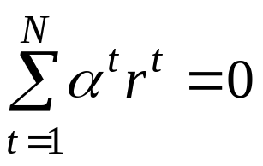
Setting derivatives of L_{p} with respect to the “primal”
variables, w, w₀, and ξ^{t} equal to zero gives
and C - α^{t} - μ^{t} = 0 which implies
μ^{t} =C-α^{t} and 0 < α^{t} < C because Lagrange multiplier are non-negative
Substitution into L_{p} gives the dual
To be maximized subject to
and 0<α^{t}<C for all t
α^{t}=0 for instances correctly classified with sufficient margin
0<α^{t}<C for instances on margins
α^{t} = C for instances in margins and/or misclassified
Lecture Notes for E Alpaydın 2010 Introduction to Machine Learning 2e © The MIT Press (V1.0)

Slide 33
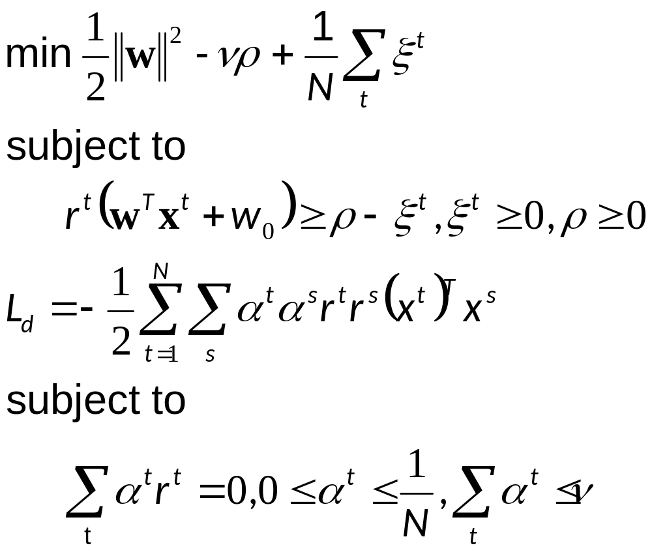
ν-SVM: another approach to soft margins
ν = regularization parameter shown to be an upper bound on fraction of instances in margin
ρ = primal variable related to margin width = 2ρ/||w||
Other primal variables are w, w₀, and slack variables
maximize dual

Slide 34
C-SVM verses ν-SVM
Both regularization parameters serve the same purpose:
tradeoff between small soft error and wide margins.
A validation set is used in both cases to get the best
tradeoff
Unlike C, the value of ν has an important interpretation

Slide 35
E_{out} < # support vectors
Support vectors include instances in the margins and misclassified
as well as instances on margins.
Training examples in the margins and misclassified, are typical
of instances in the universe of examples where we expect
accurate classification will be difficult.
Hence, we expect # support vectors to be an upper bound on
out-of-sample classification error.
Vapnik (1995) showed <P(error)> < <#support vectors>/N,
where P(error) is probability of classification error and < > is
average over training sets of size N.

Slide 37

Application of Support Vector Machines using Weka software
Find package manager under Setup and Tools
Find libsvm in list of packages
In Explorer, open Classify
Under Choose find libsvm under functions
Data set:
Breast cancer diagnostics; UCI Machine Learning Repository
http://archive.ics.uci.edu/ml/machine-learning-databases/breast-cancer-wisconsin./

Slide 38
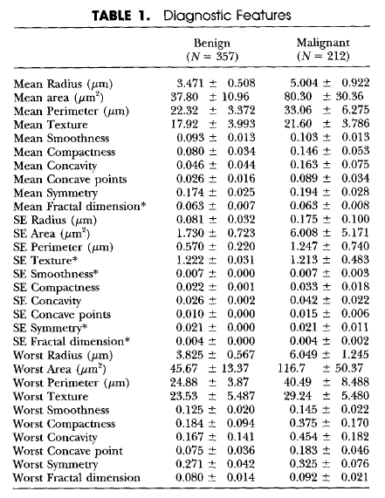

Slide 39
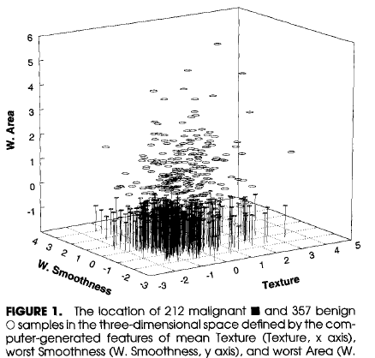

Slide 40
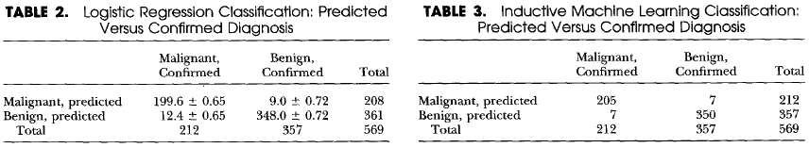
Classification with selected attributes
10-fold CV repeated 100 times
Selected attributes:
worst radius, worst texture, and
worst concave points
3 out of 5 repeats of 10-fold CV
Selected attributes:
worst area, mean texture, and
worst smoothness
Single separating plane
Accuracy 97.54%

Slide 41
Extra-credit assignment
5pts added to average HW score
Use columns 4 (mean texture), 22 (worst area) and 25 (worst smoothness)
of dataset WisBreastCancerSVMTrain.csv (class web page) to develop a
classifier that discriminates between malignant and benign breast cancer.
Use Weka’s MLP classifier with default setting (as in HW10).
Report accuracy and confusion matrix.
Use Wela’s SVM classifier with the following settings:
linear u’*v kernel
C-svm Classification
cost=0.9, coeff0=0.01
soft labels (setting under probability estimates)
Report accuracy and confusion matrix

