Slide 1
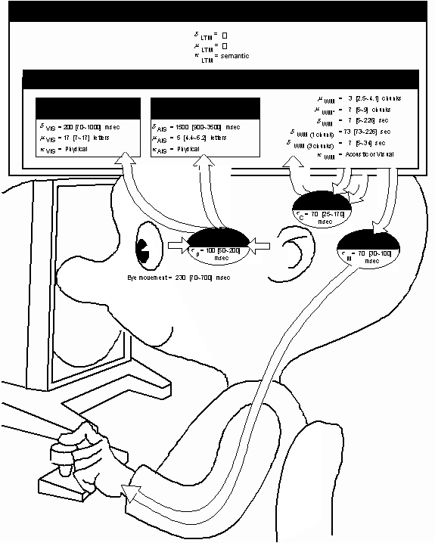
17-GOMS & KLM (KLM Supplement)

Slide 2
On the Model Human Processor that is foundational to GOMS/KLM
“Our purpose…is to convey a version of the existing psychological science base in a form suitable for analyzing human-computer interaction. To be practical to use and easy to grasp, the description must necessarily be an oversimplification of the complex and untidy state of present knowledge…Our tack…is to organize the discussion around a simple model…[of the] human mind [as] an information-processing system.”
--Card, Moran, & Newell, pp. 23-25

Slide 3
17-GOMS & KLM
Key topics/questions for this lecture
Evaluation approaches
The Model Human Processor
Predictive models: GOMS & KLM
IA #5: KLM Study

Slide 4
Key Evaluation Approaches
Analytical evaluation
Field study
Controlled experiment
Usability testing
Formative vs. Summative

Slide 5
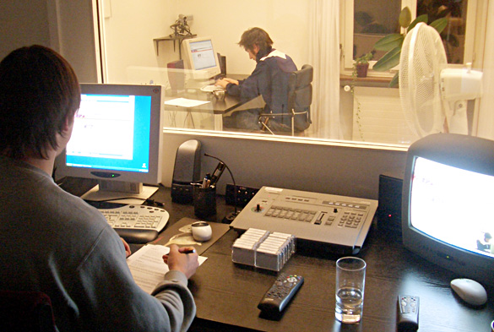
Approach 1: Usability Testing
http://magazin.unic.com/wp-content/uploads/2011/06/SBB_Usability-Testing.jpg
Notes:
Involves recording typical users’ performance on typical tasks in controlled settings (the “lab”)
As the users perform tasks, they are watched & recorded on video
Data are used to calculate performance times, identify errors and interface problems, to help explain why the users did what they did, and to gauge progress w.r.t. usability goals.
User satisfaction questionnaires & interviews are often used afterwards to elicit users’ opinions, and to measure progress w.r.t. user experience goals.

Slide 6

Approach 2: Field Studies
https://blinkux.com/wp-content/uploads/2014/09/DSCF3113%C2%A9mark_gsellman.jpg
Notes:
Use of any ethnographic field technique (observation, interviews, etc.) to study users in naturalistic settings
Aim is to understand what users do naturally and how technology impacts them
We use these in early design to establish requirements
As an evaluation approach, we can use field studies to evaluate prototypes in their actual situations of use (in situ)

Slide 7
Approach 3: Analytical Evaluation
Heuristic evaluation
Cognitive Walkthrough
User Modeling
Notes:
Heuristic evaluation: Experts apply their knowledge of typical users, often guided by heuristics, to predict usability problems.
Cognitive walkthrough: Experts walk through core tasks and ask directed questions to uncover usability problems.
User modeling: Model user behavior using detailed knowledge of tasks, coupled with theoretically-based predictions of human performance
A key feature of predictive evaluation is that users need not be present
Relatively quick & inexpensive

Slide 8
Test your understanding: Question 1
Early tests of printed scenarios and user guides is an example of
Formative evaluation
Summative evaluation

Slide 9
Test your understanding: Question 2
Evaluation that does not involve end users is known as
Formative evaluation
Summative evaluation
Analytical evaluation
Controlled experiments

Slide 10
Test your understanding: Question 3
A type of lab study in which many aspects of the study are tightly regulated:
Beta test
Usability study
Contextual inquiry
Ethnographic study

Slide 11
Test your understanding: Question 4
The Olympic Messaging System used in the 1984 Olympic Games underwent a field-test at an international event shortly before the Olympic games. This was an example of
Formative evaluation
Usability testing
Summative evaluation
Analytic evaluation

Slide 12
Comparison of usability, field, and analytical approaches
 | Usability testing | Field studies | Analytical
Users | Perform tasks | Act in natural setting | Are not involved
Location | Controlled setting | Natural setting | Anywhere
When | When prototype is available | Early on | When prototype is available
Data Collected | Primarily quantitative | Primarily qualitative | Problems
Feedback Obtained | Measures and errors | Descriptions | Problems
Type | Applied | Naturalistic | Expert

Slide 13
17-GOMS & KLM
Key topics/questions for this lecture
Evaluation approaches
The Model Human Processor
Predictive models: GOMS & KLM
Assignment #6: KLM Study

Slide 14
Model Human Processor (MHP) (Card, Moran & Newell, 1983)
Notes:
most influential model of human processing
Three interacting subsystems
Cognitive, perceptual & motor
Each with processor & memory
described by parameters such as capacity, cycle time
Capable of serial & parallel processing

Slide 15
MHP Principles and Parameters
10 Principles of operation
Describe subsystem behavior under certain conditions
e.g. Fitts’s Law, Power Law of Practice
Processors have
cycle time (τ)
Memories have
storage capacity (μ)
decay time of an item (δ)
info code type (κ)
physical, acoustic, visual & semantic
Parameters based on empirical studies of word processing tasks

Slide 16
Example: Perceptual Subsystem Parameters
Processor
cycle time (τ) = 100 msec
Visual Image Store
storage capacity (μ) = 17 letters
decay time of an item (δ) = 200 msec
info code type (κ) = physical
physical properties of visual stimulus, e.g., intensity, color, curvature, length

Slide 17
17-GOMS & KLM
Key topics/questions for this lecture
Evaluation approaches
The Model Human Processor
Predictive models: GOMS & KLM
Assignment #6: KLM Study
Hand back/discuss midterm exams

Slide 18

Prediction Without Users
Notes:
Predictive (User) Modeling provides specific performance predictions without testing users
Good when user testing isn’t feasible
Idea is to construct a rough model of the user based on what is known about the limits of human performance
We’ll consider two well-known models: GOMS and its “daughter,” the Keystroke Level Model

Slide 19
GOMS Overview
Proposed by Card, Moran, & Newell (1983)
Models cognitive processes that take place as users interact with systems (text processing was original focus)
Uses “model human processor” to predict performance of tasks in user interface

Slide 20
GOMS in More Detail (CMN-GOMS)
Goals: what the user wants to achieve
Operators: the cognitive processes and physical actions available to achieve those goals
Methods: Learned procedures for accomplishing goals (routinized operators)
Selection rules: Determine which method to use in cases in which more than one is available at a given point
Notes:
GOMS models goal-directed user interaction
GOMS is based on a careful task analysis, leading to identification of G, O, M, and S

Slide 21
GOMS: Simple Example
Goal: Obtain list of web pages containing keyword “squirrel”
Method 1: URL field
Step 1: Recall “squirrel” is keyword for search
Step 2: Recall presence of URL field in browser
Step 3: Accomplish goal by typing “squirrel” into text field and hitting return
Step 4: Return with goal accomplished
Method 2: Google main page
Step 1: Recall “squirrel” is keyword for search
Step 2: Recall “google.com” is URL of Google main page
Step 3: Locate URL field in web browser
Step 4: Type “google.com” into URL field and hit return
Step 5: Type “squirrel” into search field on Google main page and hit return
Step 6: Return with goal accomplished

Slide 22
GOMS: Simple Example (cont.)
Operators used:
Move cursor to text field
Click mouse
Depress keyboard key
Selection rules
If aware of URL field, type keyword directly into URL field
If unaware of URL field, first navigate to Google home page, then type keyword into text field

Slide 23
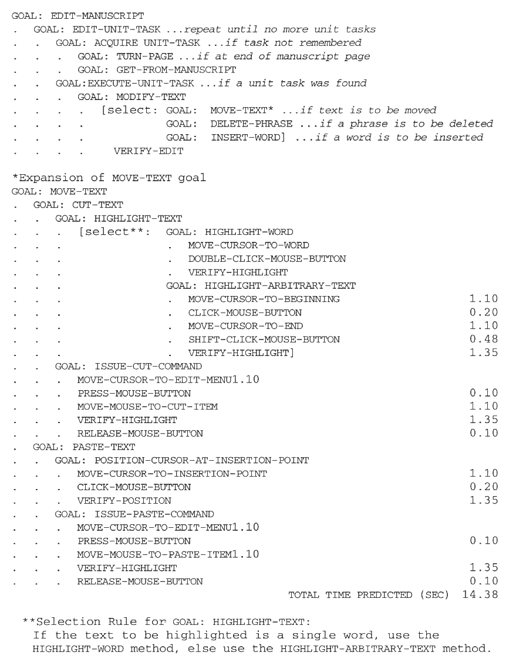
More Complex Text-Editing Example

Slide 24
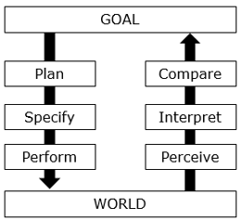
Clicker: Where is GOMS/KLM situated within Seven Stages of Action model?
A
B
C
D
Notes:
C

Slide 25
For Discussion…
What are the limitations or weaknesses of the GOMS model?
Notes:
Does not provide directions for task analysis (hard to determine appropriate granularity)
Only models serial (instead of parallel) perceptual processing, contrary to MHP
Only one active goal at a time
Assumes error-free expert performance
Can’t handle fatigue or learning
Does not account for problem solving or evaluation, as does Norman’s Action Cycle

Slide 26
Keystroke Level Model (KLM)
A finer grained “daughter” to GOMS developed by Card, Moran, & Newell (1983)
Looks at specific user actions, without consideration of overall goals (no hierarchical decomposition of tasks)
Based on Card, Moran, & Newell’s empirically-derived times for basic human operations (e.g., keystrokes, homing)
See KLM.pdf on OSBLE for a highly-readable, detailed treatment of the Keystroke Level Model

Slide 27
KLM Operators
A single keystroke (K): 0.35 sec
ctrl key counts as separate keystroke: 0.08 sec)
Pointing at target (P): 1.10 sec
Mouse click (B): 0.1 for “mouse down,” and 0.1 for “mouse up”)
Homing: 0.40 sec.
Mental preparation (M): 0.6 – 1.35 sec.; use 1.2 sec on average
Wait for system (W): t (variable)

Slide 28
KLM Example 1
Formula for predicting task time: T_{exec} = T_{K} + T_{P} + T_{B} + T_{H} + T_{M} + T_{W}
Example:
Task: Use URL bar to obtain list of web pages with keyword “squirrel”:
Point at URL bar: T_{P} = 1.10 sec
Click in URL bar: T_{BB} = 0.20 sec
Home to keyboard: T_{H} = 0.40 sec
Mentally prepare for typing: T_{M} = 1.20 sec
Type in “squirrel”: T_{K} = 8 * 0.28 sec
Type return key: T_{K} = 0.28 sec
Wait for system response: T_{w} = 0.5 sec (estimated)
Total: 5.92 sec
Notes:
Note: Assume here that hand is already on mouse, so no initial homing is necessary

Slide 29
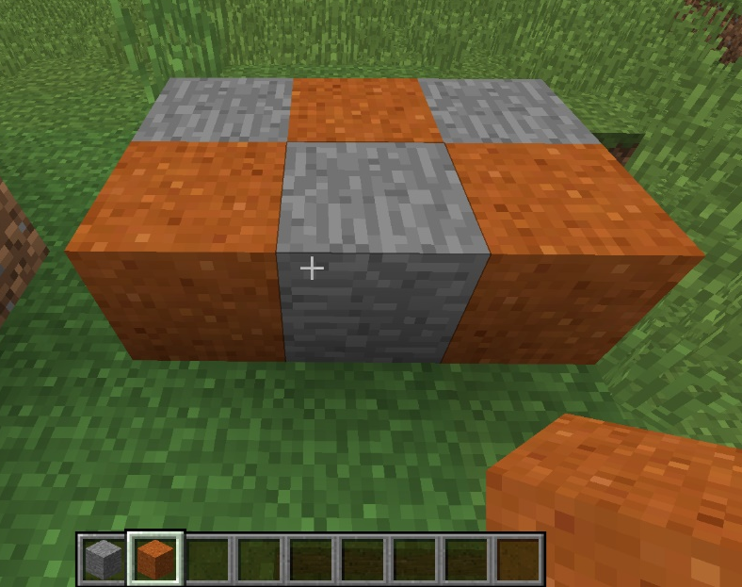
KLM complex example 6-block Minecraft task
Build alternating 6-block structure in Minecraft
I’ll demo task first
We’ll construct model
We’ll have a volunteer perform task
We’ll compare model against actual data
We’ll reflect and adjust model
Notes:
Open up KLM Model Minecraft.xlsx once we get started with model

Slide 30
Minecraft 6-block task: KLM Model
Task Step | Operator | Time
Type “1” | K | 0.28
Home to Mouse | H | 0.4
Right click | BB | 0.2
Point to next square | P | 1.1
Home to keyboard | H | 0.4
Type “2” | K | 0.28
Home to mouse | H | 0.4
Right click | BB | 0.2
Point to next square | P | 1.1
Home to keyboard | H | 0.4
Type “1” | K | 0.28

Slide 31
Clicker: Test your knowledge
In order to predict human performance, predictive models need to know
what specific task is to be performed
How long it typically takes a person to do components of a task
the specific user who will perform the task
A & B
A & C

Slide 32
Clicker: Test your knowledge
A key limitation of the GOMS and KLM models is that
They assume error-free performance
They cannot account for serial human processing
they do not produce actual time predictions
All of the above
More than one of the above

Slide 33
Clicker: Test your knowledge
Which of the following is the most common source of prediction errors in a KLM?
Misplaced M operators
Misplaced H operators
Misplaced K operators
Misplaced P operators

Slide 34
Pros and Cons of User Modeling
Advantages
No working prototype needed; interface must be specified at level of task sequences, not interface elements
No users are required; in Card, Moran, & Newell’s studies of expert performance, models predicted performance with 80% accuracy
Disadvantages
Models do not account for learning or fatigue (expert performance assumed)
Models do not account for human errors! (assumed to be a “wash,” but in practice, can be substantial part of task times, especially in non-expert performance)
In Keystroke Level Model, knowing where to place mental preparation times can be difficult
No guidelines provided by GOMS for appropriate level of granularity
GOMS and KLM cannot handle parallel processing

Slide 35
Summary
Formative evaluation used to verify evolving design; summative evaluation used to verify final design
Three general evaluation paradigms: usability studies, field studies, predictive evaluation
User modeling leverages past empirical studies of limits of human info processing in order to make concrete predictions regarding goal-directed human performance

Slide 36
17-GOMS & KLM
Key topics/questions for this lecture
Evaluation approaches
The Model Human Processor
Predictive models: GOMS & KLM
Assignment #6: KLM Study

Slide 37
Individual Assignment #5: User modeling
Given a specific word processing task:
model the task and obtain predictions using KLM
Recruit three participants to use your procedure to perform the tasks error-free while you time them
Build a table of your results
Discuss your results relative to predictions
Due next Tuesday at start of class (you may present!)

Slide 38
Where we are in the Team Project
Dates | Activities
2/21 – 2/24 | Team formation, visioning and scoping of project
2/25 – 3/6 | Do background research and conduct contextual inquiries
3/7 – 3/23 | Write early data gathering report (TPD #1; due 3/23)
3/24 – 3/31 | Design/refine low fidelity prototypes
4/1 – 4/4 | Create lo fi prototype demo video (TPD #2a; due 4/4)
4/5 – 4/6 | Review other team’s demo videos (TPD #2b; due 4/6)
4/7 – 4/18 | Implement hi fi prototype and run usability studies
4/18 – 4/20 | Prepare project presentation
4/20, 25, 27 | Give final project presentation (TPD #3)
4/20 – 4/27 | Write up usability study report (TPD #4; due 4/27)

Slide 39
Final Team Presentation Schedule
Thursday, April 20
Thursday, April 27
Time | Team
10:35 | ESL Skill Building
10:50 | Social Gaming
11:05 | WSU Schedule Planner
11:20 | EECS Grad Student App
11:35 | WSU SRC App
Time | Team
10:35 | EECS Stack Overflow
10:50 | Hiking App
11:05 | Mixed Drink App
11:20 | Pullman Bus App
11:35 | Skiing App
Tuesday, April 25
Time | Team
10:35 | Cycling App
10:50 | Running App
11:05 | Women’s Transit App
11:20 | Lifting App
11:35 | WSU Wayfinder

