Slide 1
Nested Named Entity Recognition
By Jenny Rose Finkel and Christopher D.Manning

Slide 2
What is the NER ?
Named entity recognition is the task of finding entities, the subtask of information extraction that seeks to locate and classify named entities in text into pre-defined categories such as the names of persons, organizations, locations, expressions of times, etc.
Example:
Input structured x
Jim bought 300 shares of Acme Corp. in 2006
Output structured y
[Jim]_{Person} bought 300 shares of [Acme Corp.]_{Organization} in [2006]_{Time}

Slide 3
Nested NER
Entities are nested within each other
Such as
Washington State University (Organization with nested Location)
[[Washington State]_{Location} University]_{Organization}
Nested entities are common in biomedical data, because different biological entities of interest are often composed of one another.

Slide 4
Approach
Before we move to novel solution to Nested NER introduced by the paper, please allow me to talk about the general approach to solve NER problem
CRF (Conditional Random Field) is the most commonly used method in NER problem.

Slide 5

CRF (Conditional Random Field)
Representation:
Φ = {Φ₁(X₁, Y₁), …, Φ_{k}(X_{k}, Y_{k})}
Unnormalized measure:
P_{Φ}(X,Y)= $\prod_{i=1}^{k}{\text{Φ}i(\text{X}\text{i}\text{, }\text{Yi})}$
Normalization constant:
Z_{Φ}(X)=$\sum_{Y}{\text{P}\text{Φ}\text{(}\text{X}\text{,}\text{Y}\text{)}}$
Normalized Distribution:
P_{Φ}(Y|X) =$\frac{1}{\text{Z}\text{Φ}\text{(}\text{X}\text{)}}$P_{Φ}(X,Y)

Slide 6


Detailed CRF Example
Input Sentence: Bob drank coffee at Starbucks
Feature function f: a sentence S, position of the word i, the label l_{i} of current word, the label l_{i-1} of previous word (each kind of label assigned with a uique feature function, e.g. ADVERB, the ith word ends in “-ly”; 0 otherwise )
Score function: score(l|S) = (lamda weight or coefficient vector)
Training: for each sample go through each f_{i}
Make perdiction:

Slide 7
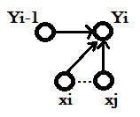

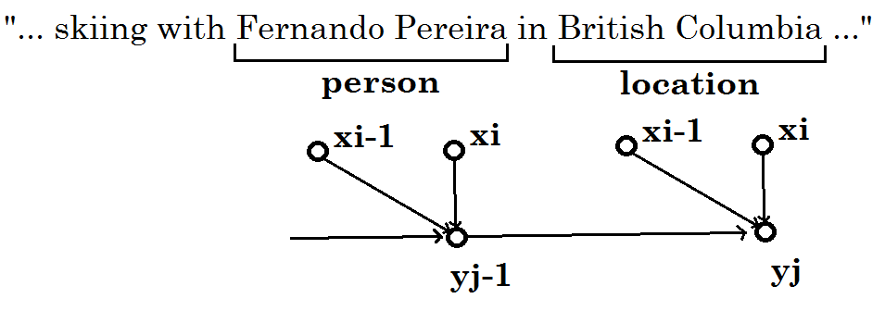
Semi-Markovian CRF
Markov principle: transitions determined (only) by immediate neighbors
Extension: Okay to use a segment of x[i:j], for some yi
Trivial modification to feature function: rewrite as a function of an x-range, instead of single xi.
NER Example:

Slide 8
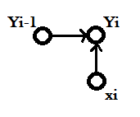
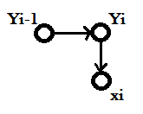
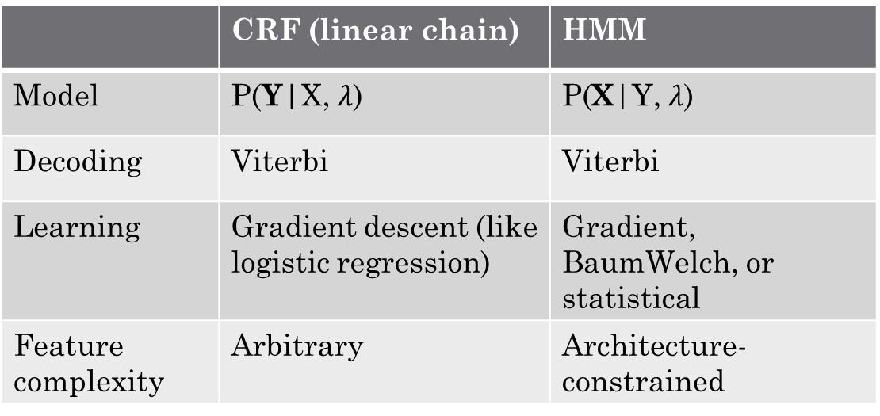
CRF vs. HMM
 | CRF (linear chain) | HMM
Model | P(Y|X, $λ$) | P(X|Y, $λ$)
Decoding | Viterbi | Viterbi
Learning | Gradient descent (like logistic regression) | Gradient, BaumWelch, or statistical
Feature complexity | Arbitrary | Architecture-constrained
Both robust, practical models for decoding, sequence modeling
Every HMM can (loosely) be converted into a CRF, but CRF’s strictly more expressive

Slide 9
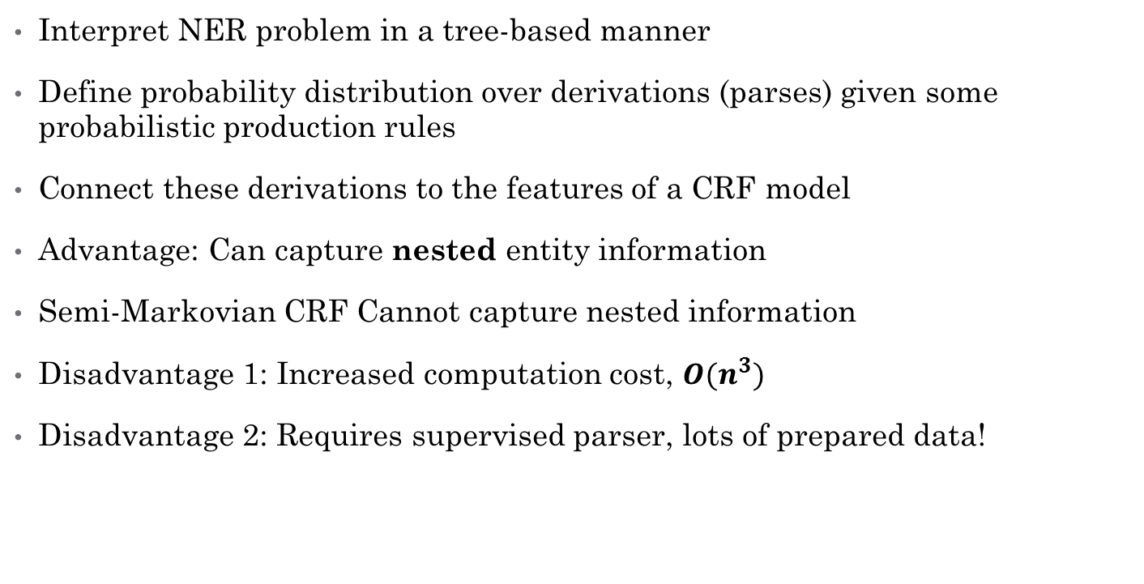
Parse-based NER: Finkel and Manning
Interpret NER problem in a tree-based manner
Define probability distribution over derivations (parses) given some probabilistic production rules
Connect these derivations to the features of a CRF model
Advantage: Can capture nested entity information
Semi-Markovian CRF Cannot capture nested information
Disadvantage 1: Increased computation cost, $O(n^{3})$
Disadvantage 2: Requires supervised parser, lots of prepared data!

Slide 10
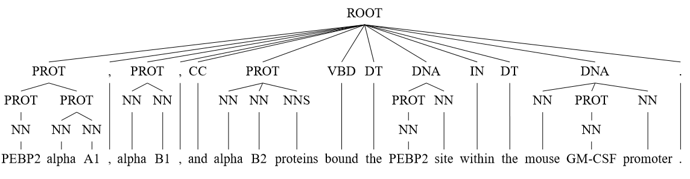
Example Derivation of Nested Entities
Probabilistic CRF-CFG parser generates parts-of-speech and named entities
Fig. 1, (Finkel, 2009)

Slide 11
Sources and Further Reading
Finkel, Jenny Rose, and Christopher D. Manning. "Nested named entity recognition." Proceedings of the 2009 Conference on Empirical Methods in Natural Language Processing: Volume 1-Volume 1. Association for Computational Linguistics, 2009.
Sunita Sarawagi and William W. Cohen. 2004. Semi-markov conditional random ﬁelds for information extraction. In In Advances in Neural Information Processing Systems 17, pages 1185–1192.
Rabiner, Lawrence R. "A tutorial on hidden Markov models and selected applications in speech recognition." Proceedings of the IEEE 77.2 (1989): 257-286.
Excellent CRF tutorial:
http://blog.echen.me/2012/01/03/introduction-to-conditional-random-fields/

Slide 12
Discussion

