Slide 1
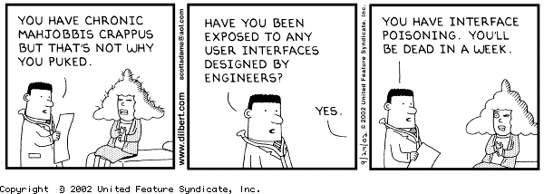
Lecture #01: It’s All About Good Design

Slide 2
This Course is About Good Design
Key Questions for Today’s Class
Q1. Why are you here?
Q2. Why is software hard to design?
Q3. Why does good design matter (a.k.a., why should I care?)
Q4. How can we create better designs?
Q5. How can we learn to be good designers?

Slide 3
Free Writing Exercise (10 min.)
Take out a sheet of paper
Put your name and WSU ID at the top of the page
Write a brief essay that responds to the following writing prompt: Why are you in college, and what does this class on technology design have to do with it?

Slide 4
Share with your Neighbors (10 minutes)
Break into small groups (3-4 students)
Discuss your essays with each other
Identify common themes

Slide 5
This Course is About Good Design
Key Questions for Today’s Class
Q1. Why are you here?
Q2. Why is software hard to design?
Q3. Why does good design matter (a.k.a., why should I care?)
Q4. How can we create better designs?
Q5. How can we learn to be good designers?

Slide 6
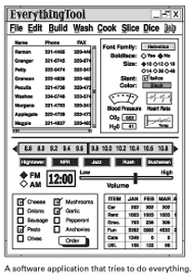
Average UI Has 40 Flaws (Landauer, 1995)
Difficult to use (poor usability)
Doesn’t support the functionality that people actually need (not useful)
Taken from Johnson, J. (2007). GUI Bloopers 2.0, Second Ed. p. 31.

Slide 7
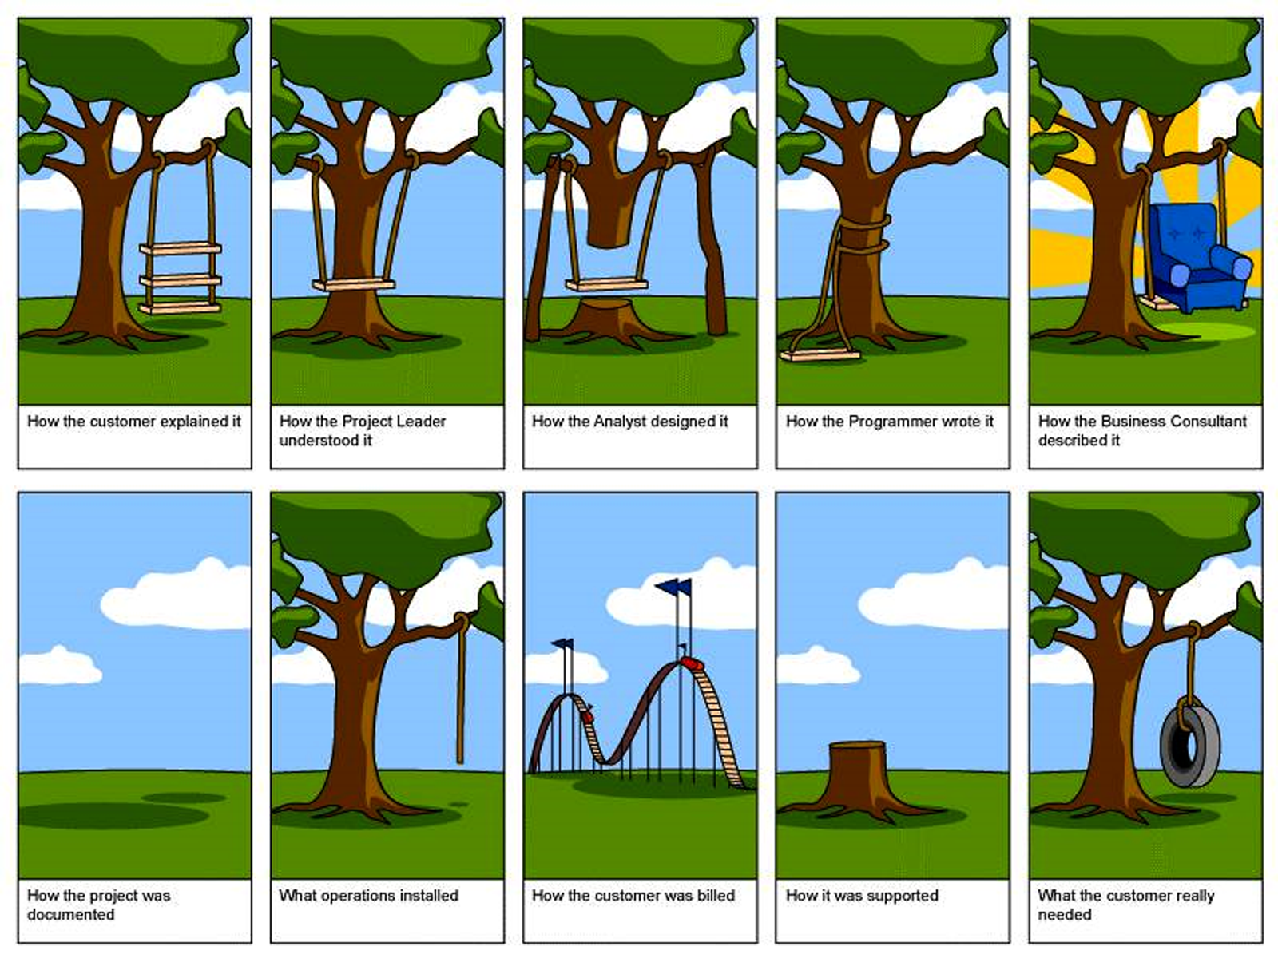
Q1: Why is Software Difficult to Design?
Hard to get requirements right
Hard to translate requirements into usable and useful software

Slide 8
More Reasons Software is Difficult to Design
Human behavior is difficult to predict
No exact prediction methods
Impossible to anticipate all possible conditions of use
User interfaces aren’t standardized
Users must learn each one, at least to some extent
Even with modern UI programming tools, UI development is expensive (50+% of overall code on average; see Rosson & Myers, 1992)

Slide 9
This Course is About Good Design
Key Questions for Today’s Class
Q1. Why are you here?
Q2. Why is software hard to design?
Q3. Why does good design matter (a.k.a., why should I care?)
Q4. How can we create better designs?
Q5. How can we learn to be good designers?

Slide 10
Poorly Designed Software Has Negative Consequences
Decreased sales
Dissatisfied customers/negative perceptions
Poor reviews
Increased need for training
It can even cause death and catasrophes e.g.,
Therac-25 overdoses
American Airlines Flight 965 crash
Three-Mile Island nuclear disaster
________
See Ross, J. (2014). “The Business Value of User Experience.” http://d3.infragistics.com/wp-content/uploads/2015/07/The_Business_Value_of_User_Experience1.pdf.

Slide 11
Turn to Your Neighbor…
What software product, piece of technology, or everyday object in the world do you find most annoying or difficult to use?
Have you ever personally experienced suffering or frustration as a result of a using a software product, tech product or everyday object? Elaborate.

Slide 12
This Course is About Good Design
Key Questions for Today’s Class
Q1. Why are you here?
Q2. Why is software hard to design?
Q3. Why does good design matter (a.k.a., why should I care?)
Q4. How can we create better designs?
Q5. How can we learn to be good designers?

Slide 13
Design Is Not an Exact Science
Experience + Methodology + Aesthetics = Good Design
Usable Designs
Possible Designs
(The “Design Space”)
Notes:
Key contraints (could also pose as question) of this design space: People, Tasks, Implementation technology, Design Process

Slide 14

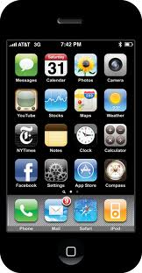

We Need to Approach Design in the Right Way
“Techno-Centric” Development
“Designer-Centric” Development

Slide 15


Human- or User-Centered Development
Guided by empirical studies with actual users
Users incorporated into the design process early on
Users sometimes even join design team

Slide 16
Human-Computer Interaction is All About Design…
“A discipline concerned with the design, implementation, and evaluation of interactive computer systems for human use”
Interaction design
“Designing interactive products to support people in their everyday and working lives” (Rogers, Sharp & Preece, 2011)
“The design of spaces for human communication and interaction” (Terry Winograd)
Notes:
Highly interdisciplinary field, drawing on CS (software engineering), social sciences (psych, anthro, sociology), engineering (iterative refinement), graphic design

Slide 17
Key Goals of Human-Computer Interaction
To develop and refine theories and principles of human-computer use and human-computer communication
To develop techniques and practices for designing and evaluating humanly-usable software.
Notes:
Research angle and practitioner angle

Slide 18
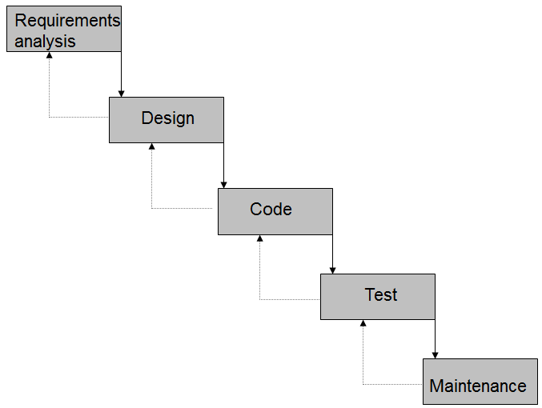
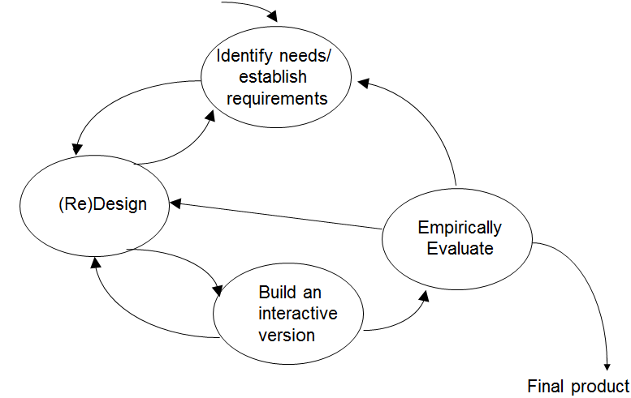
The UCD Design Process Contrasts with the Traditional Waterfall Lifecycle
Waterfall Lifecycle vs. User-Centered Design Process
Notes:
UCD:
Focus early on users and tasks
Requires observation, attention to task environments, and involvement of users
Usability and user experience requirements need to be identified at the beginning of the project
Empirical evaluation is central
Users’ reactions to, and performance with prototypes within actual scenarios of use are observed, recorded, and analyzed
Iteration is essential
UCD is an iterative engineering process in which evaluation leads to re-design and re-evaluation. We know we’re done when our usability requirements are met

Slide 19
Review: Functional Requirements
State what users of your software should be able to accomplish
Always state from perspective of user
Example: “Users must be able to create new appointments”

Slide 20
New: Usability Requirements
Establish human performance goals for your software in observable, measurable terms
Sample human performance metrics:
Number of errors
Task completion time
Safety metrics
Time to learn (learnability)
Memorability (how long remembered, once learned)
Sample usability requirement: “Users must be able to create a new appointment in 20 seconds.”

Slide 21
New: User Experience Requirements
Establish human subjective experience goals in observable, measurable terms
Sample human subjective experience metrics:
ease of use - rewarding
fun - helpful
enjoyable - motivating
entertaining - confident
Sample user experience requirement: “On a scale of 1 to 10, users should rate the system a 9 with respect to ease of use”

Slide 22
This Course is About Good Design
Key Questions for Today’s Class
Q1. Why is software hard to design?
Q2. Why does good design matter (a.k.a., why should I care?)
Q3. How can we create better designs?
Q4. How can we learn to be good designers?

Slide 23
How would you react if you were to encounter a problem that’s beyond your current ability?
Extremely positive reaction
Somewhat positive reaction
Neutral reaction
Somewhat negative reaction
Extremely negative reaction
Based on your reaction, what would you do?
Notes:
This is, in fact, an indication of your mindset.

Slide 24
Fixed vs. Growth Mindset (Carol Dweck)
Fixed mindset | Growth mindset
Intelligence can’t be changed | Intelligence can be improved
Avoid challenges | Embrace challenges
Desire to look smart | Desire to learn
Regard effort as pointless | Effort is a path to mastery
Ignore criticism | Use criticism to advantage
Threatened by others’ success | Inspired by others’ success
Notes:
Individuals who learn to work hard and cope with setbacks go further than those who don’t, even if they have “talent” (Michael Jordan is a prime example of an athlete with a growth mindset.)
Organizations that cultivate a fixed mindset remain stagnant, whereas organizations that cultivate a growth mindset continually improve. A classic example is IBM in the 1980s. Employees were trying to be better than each other and maintain status. In 1993, a new CEO, LouGerstner, was stepped in. He had a growth mindset, got rid of the uptight culture, and IBM increased in value by 800%

Slide 25
The Power of “Yet”: How to Promote a Growth Mindset Environment in Class
Present skills as learnable; set achievable goals (the brain is a muscle that gets stronger with practice)
Praise learning and perseverance, not intelligence
Give feedback, and propose strategies, that promote learning and improvement
Focus on the value of the learning process, not grades
Design activities that involve cooperative work, rather than competition or individual work
Regard teachers as resources for learning (you still have to do the work!)
see https://youtu.be/kkE1lC4CpIE and http://tinyurl.com/zldbrjq for more
Notes:
What I will try to promote in the classroom

Slide 26
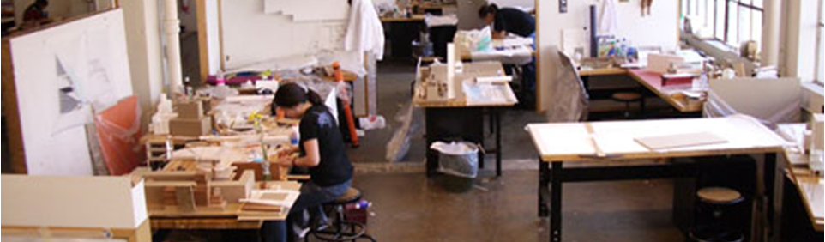
Learning to be a Good Designer is Within Your Reach!
Design is best learned by doing
Studio pedagogy used in architecture and fine arts education is highly appropriate for learning UI design skills
This class leverages the design studio approach

Slide 27
This Course is About Good Design
Key Questions for Today’s Class
Q1. Why is software hard to design?
Q2. Why does good design matter (a.k.a., why should I care?)
Q3. How can we create better designs?
Q4. How can we learn to be good designers?
Main questions addressed! Course info to follow…

Slide 28
Contacting Teaching Personnel
Instructor:
Dr. Chris Hundhausen EME 231 hundhaus@wsu.edu (use in emergencies only!) Office hours: Tuesday and Thursday immediately after class and by appt.
TA Carla De Lira carla.delira@wsu.edu EME 228 Office hours: MW 12:00-1:30 p.m.

Slide 29
Learning by Doing in this Course
Interactive lectures (with clickers!) provide models of how to apply course concepts and techniques
Studio activities engage you in actual design and critical review
In-class activities provide you with opportunites to practice key skills
Course assignments and projects provide further practice

Slide 30
Course Learning Objectives Focus on Skills for Good Design
By end of course, you should be able to
design and evaluate interactive software by applying appropriate design principles and concepts
employ user-centered design methods
design, conduct, and analyze empirical studies, most notably usability studies
apply analytical methods to the evaluation of interactive software.
communicate about, reason about, and critically review user interface designs through sketching, oral discussions, peer reviews, and well-written documents
Be familiar with basic and current HCI research (grad)

Slide 31

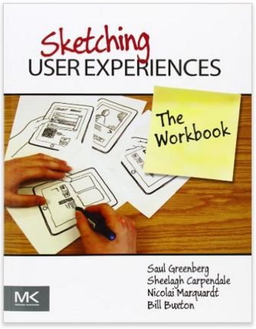
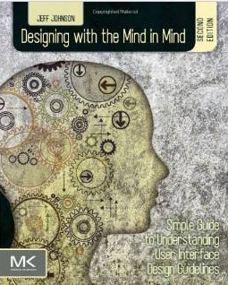
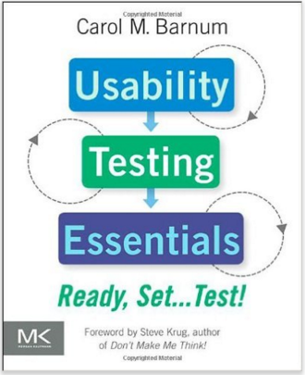
Textbooks Serve as Excellent Starting Points
(R) Norman, D (2013). The Design of Everyday Things (Revised and expanded ed.) New York: Basic Books (ISBN: 978-0465-050659).
(R) Johnson, J. (2014). Designing with the Mind in Mind: Simple Guide to Understanding User Interface Design Rules (2nd ed.). Burlington, MA: Morgan Kaufman (ISBN: 978-0-12-407914-4).
(O) Greenberg, S., Carpendale, S., Marquardt, N., & Buxton, B. (2012). Sketching User Experiences: The Workbook. San Francisco: Elsevier. (ISBN: 9780123819598).
(*) Barnum, C. (2010). Usability Testing Essentials: Ready, Set…Test! Burlington, MA: Morgan Kaufman (ISBN ISBN-13 978-0-12-375092-1)
(O) Cairns, P., & Cox, A.L., eds. (2008). Research Methods for Human-Computer Interaction. Cambridge: Cambridge University Press. ISBN: 9780521690317)
Notes:
(*) = I am not yet sure if it’s required. I’ll know at the time of the midterm, so don’t buy it yet.

Slide 32
Online Presence: OSBLE http://plus.osble.org
OSBLE came out of a CptS 443/543 course project in 2007!
It’s the online hub for this course
Activity feed
Assignment submission and critical review
Repository for course materials
Course gradebook
E-mail system
Course calendar
Consider turning on e-mail forwarding
Please upload a profile picture

Slide 33
Clickers Support Active Course Participation
You will participate in this course with an iClicker
Purchase your iClicker at the bookstore, or use your smart phone by signing up for a REEF account
Register at http://www.iclicker.com
If you forget your iClicker, you cannot get credit for participating in the class

Slide 34
Some Additional Software and Hardware Will Help
Adobe Reader
A Web Browser
A camera
software capable of generating and reading PDF
Camtasia Studio (for usability study)
Microsoft Powerpoint (for reading lecture slides)
An interface prototyping tool of your choice for the project. A few possiblities include Microsoft Expression Studio, Visual Studio .NET, HTML forms, and Macromedia Director

Slide 35
This Course Does Not Focus on Programming, but…
For course project, you will implement computer-based prototype
It is assumed that your programming background will enable you to implement the prototype in a language of your choice
Talk to me if you have concerns

Slide 36
Course Grading
Participation (10%)
Reading (10%)
Midterm Exam on 3/9 (15%)
Individual Assignments (25%)
Group Project (40%)
Grad. Students only: 2 Research Assignments (+10%)

Slide 37
Differences Between 443 and 543
Graduate students are expected to assume more of a research orientation
Will be required to complete three research assignments
Will be required to complete take-home essays as part of midterm exam
Will be required to complete supplement to final exam
Graduate students will be graded to higher standard (grad. students must work with other grad. students on group project)

Slide 38
Some Key Policies (see Syllabus for More)
Except in emergency, please e-mail me through OSBLE!
Assignments and Project Deliverables
Must hand in through OSBLE in .pdf format
Late policy: Up to 24 hours late, 10% late penalty
Have one week to challenge grade
Will receive graded rubric through OSBLE
Academic dishonesty
No plagarism! (Must cite all sources, and work you hand in must be your own). Plagiarism violation will result in minimum penalty of “0” on assignment, and maximum penalty of “F” in course.
Group members must contribute equally (confidential peer evaluation forms must be submitted with each group project deliverable)
Clicker cheating will result in automatic “F” in course

Slide 39
For Next Class…
Make sure you have a Clicker or REEF account by next Tuesday
Read Norman Chapters 1 and 4

