Slide 1
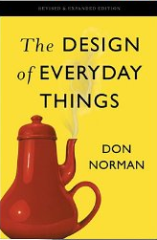
Lecture #02: Norman’s Design Concepts

Slide 2
Intro Thoughts: On Design Thinking
Let’s listen to a 90 second clip from Episode 56 (“Getting Unstuck”) of the NPR Hidden Brain podcast, which was published Jan. 3, 2017.
Notes:
This clip is an apt characterization of what we’re up to in this course. Note that a key idea of iterative development is failure: “You have a chance to evaluate your initial ideas, which are probably wrong!” You can’t shy away from failure in design; it’s inevitable! The key is to use failure to your advantage—just as you do if you have the kind of growth mindset we talked about in last class. In today’s class, we’ll start to lay a foundation for iterating by exploring some concepts we can use to evaluate design ideas.

Slide 3
This Class is About Norman’s Design Concepts (Ch. 1 and 4)
Key Questions for Today’s Class
What are Norman’s design concepts?
How can they be applied to everyday objects?

Slide 4
Design Concepts are Generalizable Abstractions
Generalizable abstractions for thinking about different aspects of design
Help determine what to provide and what not to provide in the interface
Derived from a mix of theory-based knowledge, experience and common-sense
For discussion: What’s your initial sense of how easy design concepts are to apply?

Slide 5
Clicker Question 1
Which of the following best describes affordance?
Relationship between a person and an object that suggests what can be done with object
Properties of an object that suggest what can be done with it
Properties of an object that make it usable to humans
None of the above

Slide 6
Affordances (Gibson)
Relationship between interacting agent (usually a person) and an object
Interacting agent has capabilities and intentions that dictate how object might be used
The object has properties that suggest how it might be used
Relationship between what you want to do and what is possible with the object

Slide 7
Affordances are NOT properties of objects
“The presence of an affordance is jointly determined by the qualities of the object and the abilities of the agent that is interacting. This relational definition of affordance gives considerable difficulty to many people. We are used to thinking that properties are associated with objects. But affordance is not a property. An affordance is a relationship. Whether an affordance exists depends upon the properties of both the object and the agent.” --Norman
Notes:
One could argue that affordances are determined by situation as well as object and agent. An example would be the object of a banana. When in relation to a monkey, the affordance is always “eat.” When in relation to a human, the affordance could be at least two things, depending on the situation. At a meal, the affordance would be “eat.” But on stage in an improv production, the affordance could be “hold next to ear” so as to mimmick a phone.

Slide 8
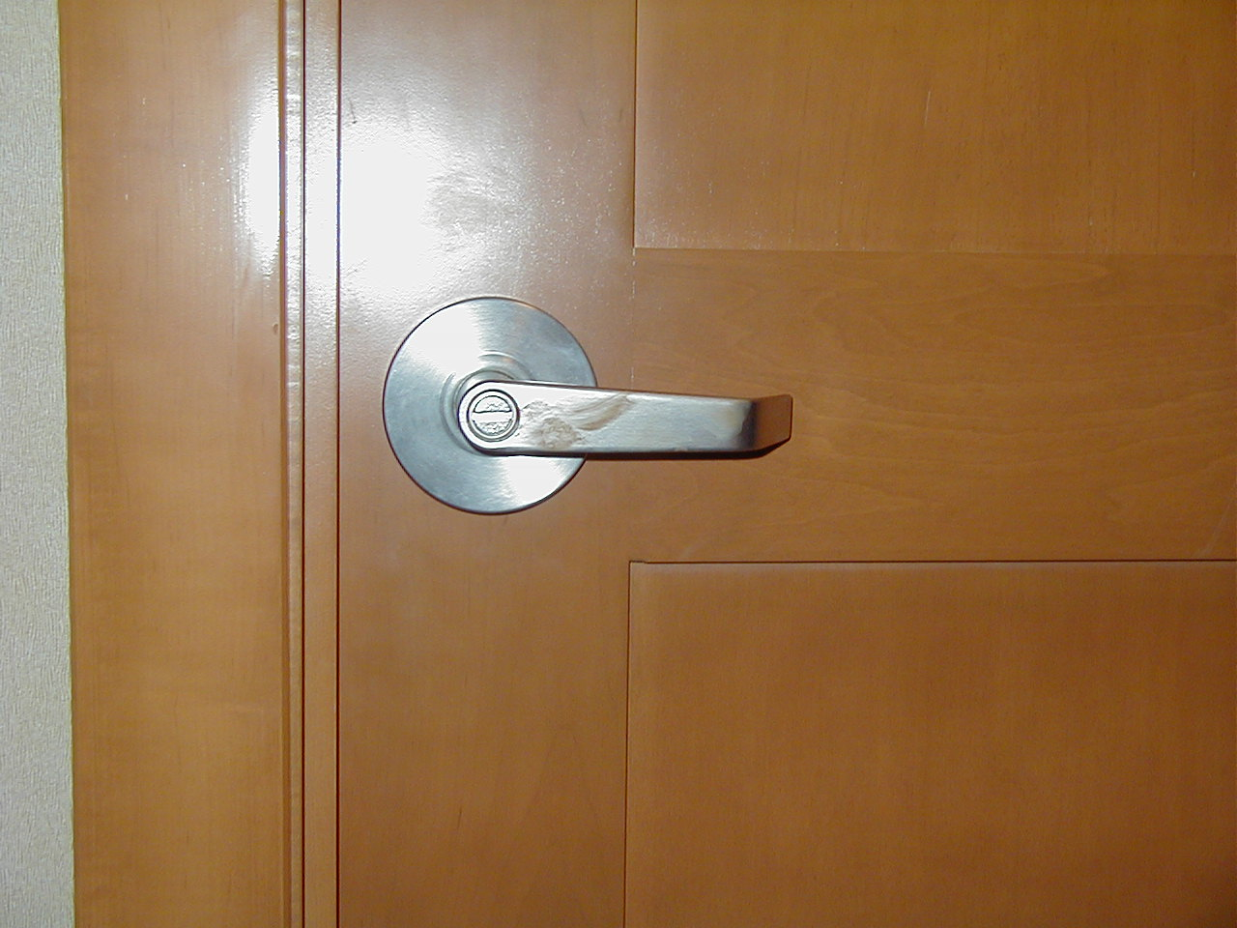
Doorknob affords (is for) turning
Notes:
What is the relationship of the object and the agent in this affordance?

Slide 9
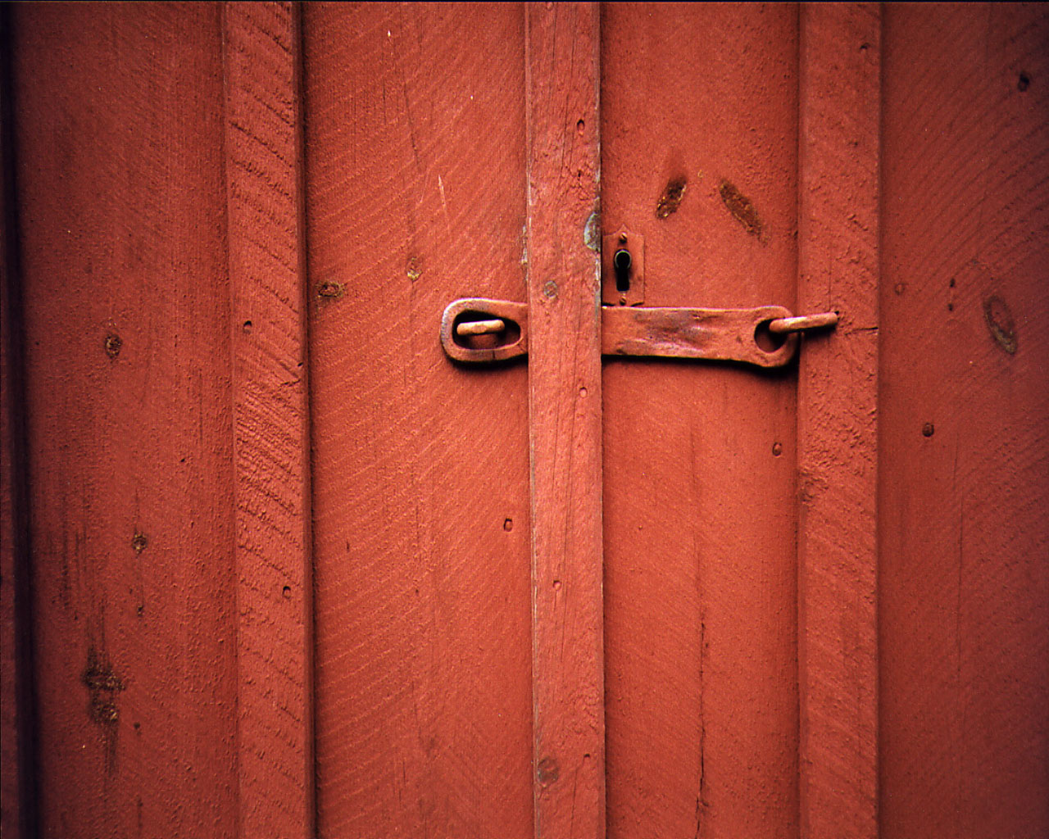
Doorknob (2) affords ??

Slide 10
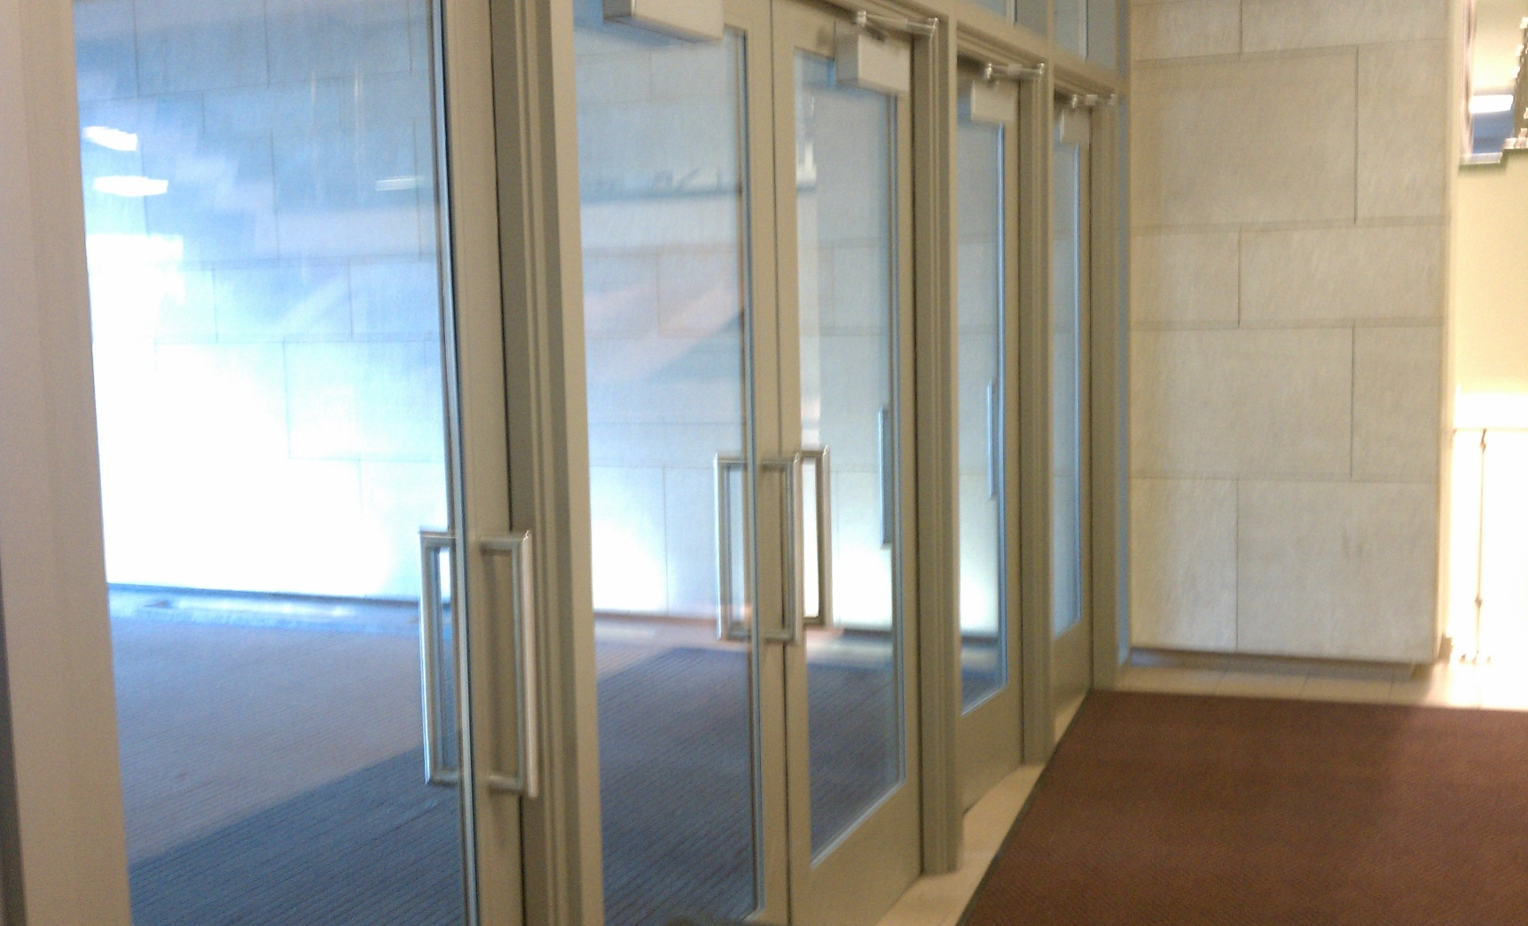
Door handles at CUB afford ??

Slide 11
Clicker Question 2
Which of the following best describes signifier?
A property of an object that suggests what can be done with it
A marking, label, or other indication of what can be done with an object or where action on object should take place
It’s actually just another word for affordance
A sign indicating where an object should be
None of the above

Slide 12
Signifiers “signify” affordances
Affordances → what is possible (relationships)
Signifiers → where the action should take place (labels, markers, sounds or other perceivable indicator)

Slide 13
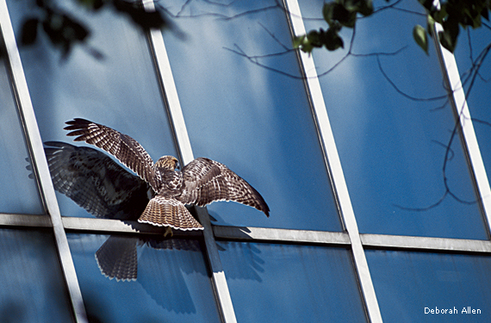
Affordances must be perceivable!
https://www.nwf.org/News-and-Magazines/National-Wildlife/Birds/Archives/2014/Bird-Safe-Windows.aspx
Notes:
The “anti affordance” of glass is that objects cannot pass through it. Yet numerous birds and humans are injured every year when they run into clear windows. The anti-affordance fails here since it cannot be seen. It needs a signifier.

Slide 14
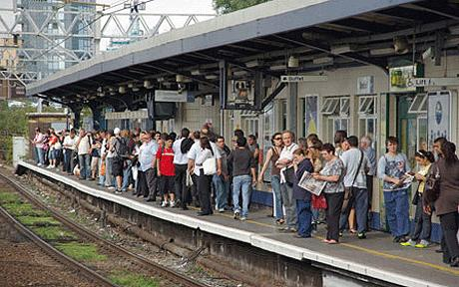
Signifier: People waiting on train platform
http://www.telegraph.co.uk/news/uknews/road-and-rail-transport/7905376/Unprofitable-rail-services-could-be-axed-under-Government-proposals.html

Slide 15
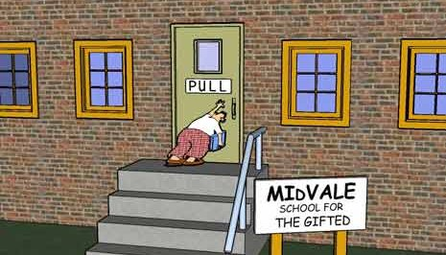
Signifier: Door Label
https://www.linkedin.com/pulse/pulling-door-says-push-jeff-odie-espenship

Slide 16
Door handles at CUB need signifiers!

Slide 17

Why might a bookmark be an “accidental signifier?”
https://start2finish.org/bookmark/
Notes:
In addition to signifying one’s place in book, a bookmark also signifies HOW MUCH OF BOOK IS REMAINING

Slide 18
Clicker Question #3 (Self-Assessment)
Do you understand the difference between an affordance and a signifier well enough that you could explain it to someone else?
Yes
No
I am not sure

Slide 19
Clicker Question #4
Within the context of design, what is a mapping?
It is a set of cues to indicate the spatial layout of a control
It is the relationship between a set of controls and the items they control
It is the relationship between a control and the action it produces
It specifies the layout of a user interface
B & C
Notes:
(D) Natural mappings are relationships between controls and (a) the objects they control, or (b) the actions they produce
Natural mappings take advantage of spatial analogies to enhance understanding of the relationships.
Natural mappings can
be culturally understood (e.g., thumbs up vs. thumbs down)
Follow from perceptual principles (e.g., Gestalt)

Slide 20
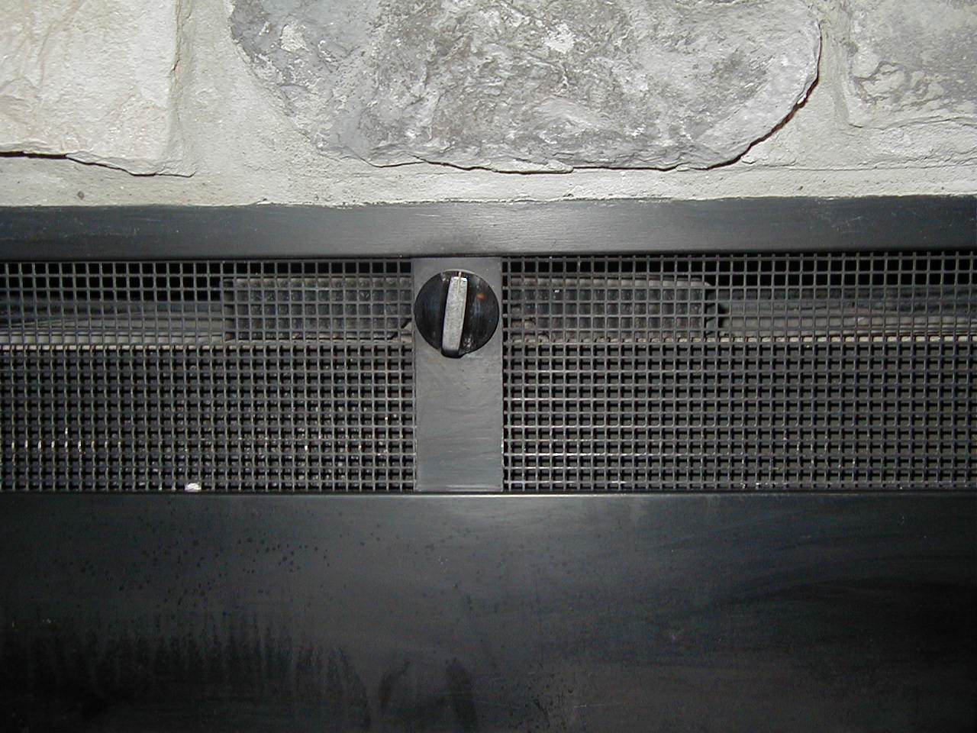
Mapping: How does knob position relate to flue?

Slide 21
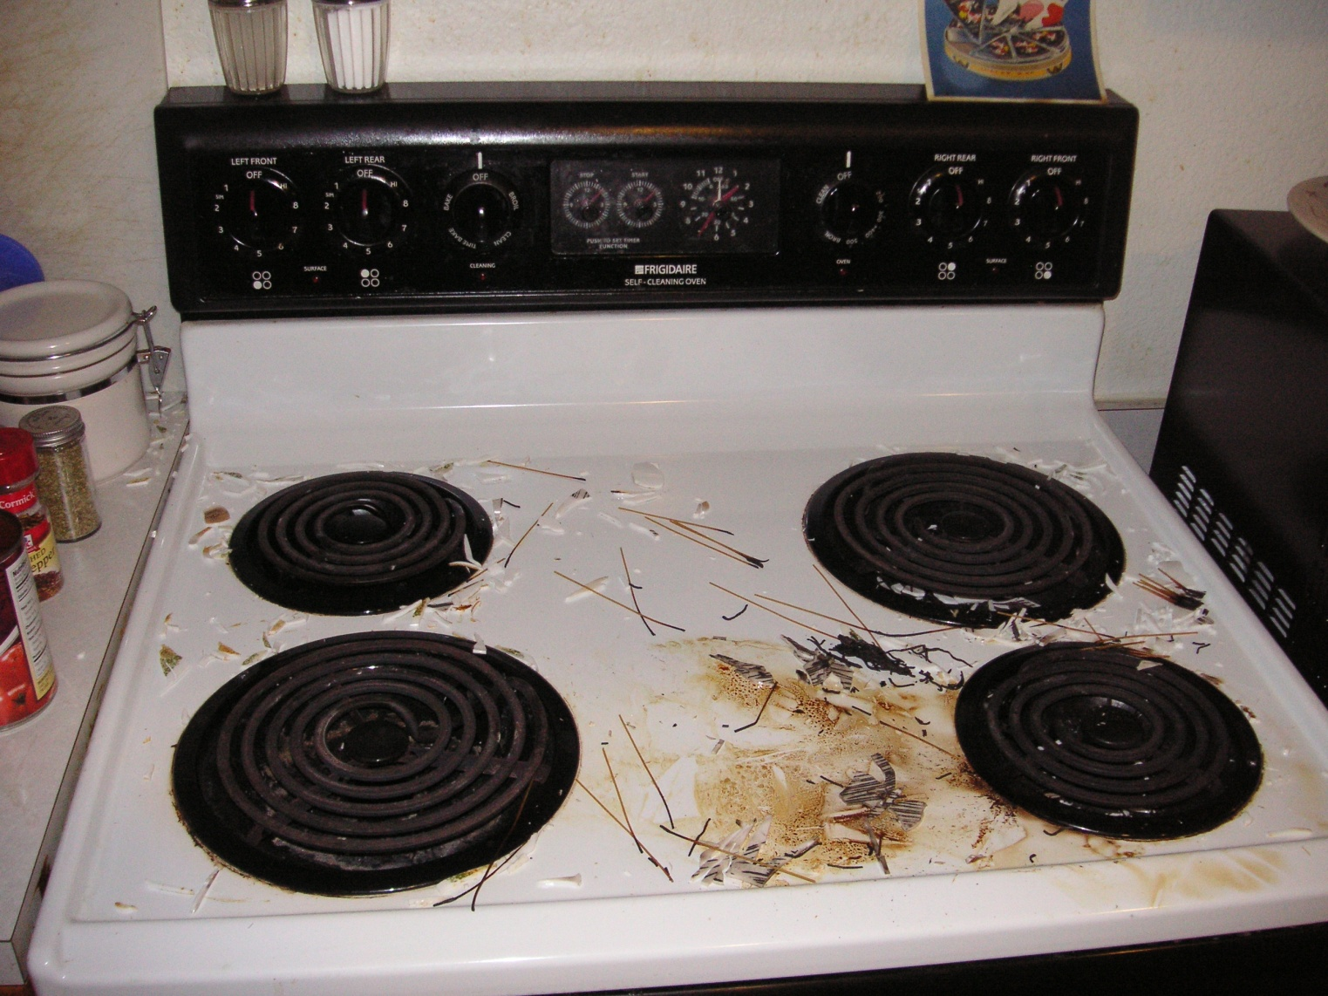
Mapping: How do burner controls relate to burners?

Slide 22

Mapping: How do burner controls relate to burners?

Slide 23
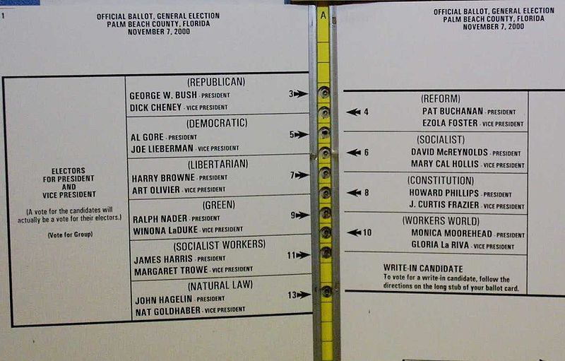
Mapping: How do butterfly ballot choices relate to candidates?

Slide 24
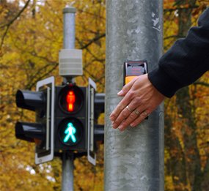
Clicker Question #5
Have you ever repeatedly hit the “walk sign” button at a crosswalk while you wait for the traffic light to turn?
Yes
No
http://www.abc.net.au/science/articles/2010/05/04/2889699.htm
Notes:
Why have you done this?

Slide 25
Feedback
Sending information back to the user about what has been done
Includes sound, tactile, and visual feedback
Feedback should
be immediate (people get frustrated quickly)
be prioritized (a cacophony doesn’t help)
be not too little or too much
help the user know whether progress toward goal has been made
“ccclichhk”

Slide 26
What feedback is provided when manipulating a fireplace flue?

Slide 27
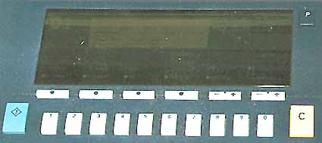
What feedback is provided by a copying machine?

Slide 28
Clicker Question #6
Which of the following best describes conceptual model?
An analysis of the usability of a given device
A set of interrelated concepts relevant to a device
A description, usually simplified, of how a device works
A low-level model of a device’s design
None of the above
Notes:
Conceptual model: A simplified description (or model) of how something works, including parts and possible actions and effects
Conceptual model resides in the head of person using the thing
When person has the “correct” conceptual model of something, person can perform a simplified mental simulation of how it works
Simplified models only work if underlying assumptions hold true; they can break down in unfamiliar conditions (e.g., network connection fails)

Slide 29
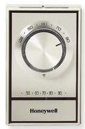
Clicker Question #7: How does this thermostat work?
What does turning the knob do?
Turns the heat on or off, based on whether current temp is higher or lower than goal temp.
Turns heat higher or lower, depending on relationship of current temp to goal temp?
Neither

Slide 30
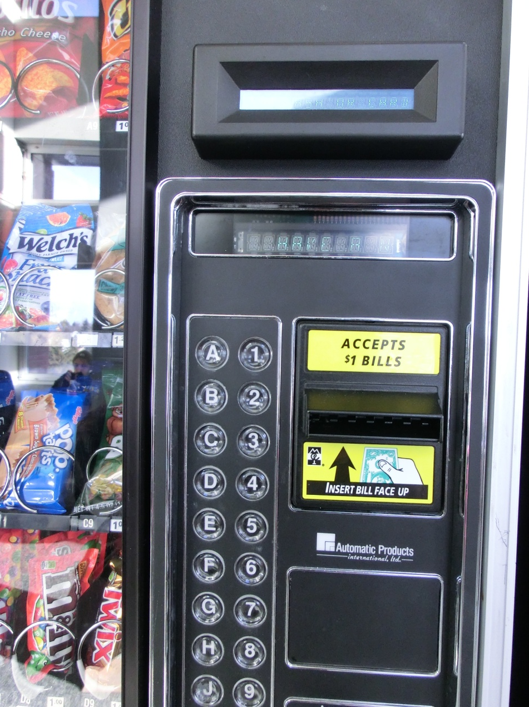
Conceptual Model: How does vending machine at SRC work?

Slide 31
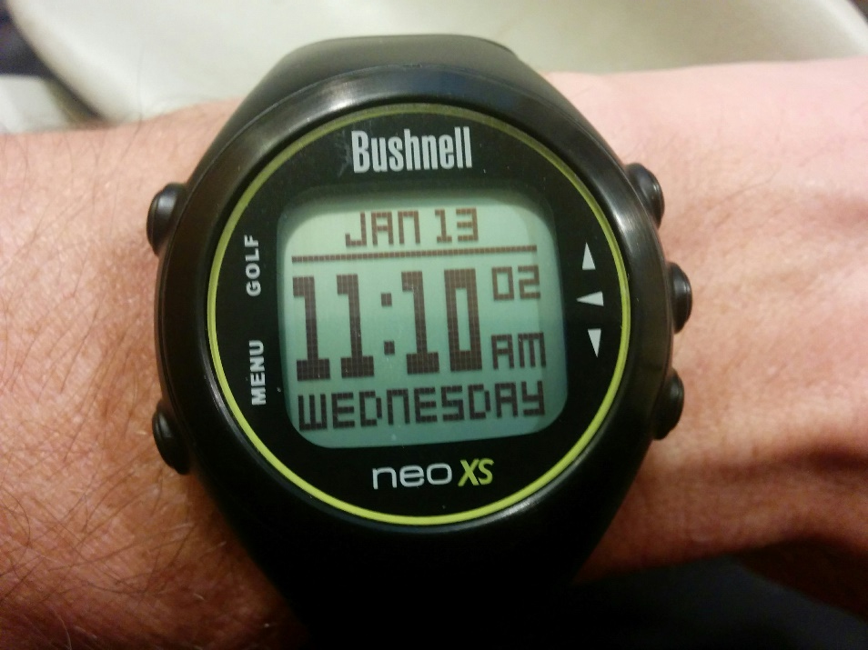
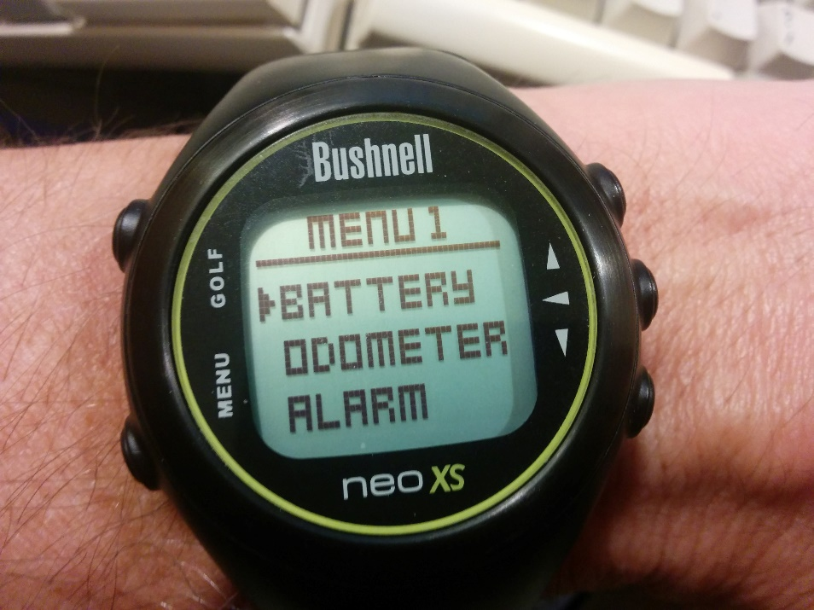
Conceptual model: My watch is more learnable than the author’s watch!

Slide 32
Announcements
Individual Assignment #1 will be due at the start of class on Tuesday
There will be a reading quiz on Norman concepts on Tuesday!
The following students will be asked to present their results to the class:
Sananeh
Jeff A.
Sandra
William
Oliver
Josh

