Slide 1
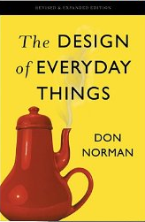
Seven Stages of Action (Norman 2)

Slide 2
Norman on the importance of understanding people
“Why do we need to know about the human mind? Because things are designed to be used by people, and without a deep understanding of people, the designs are apt to be faulty, difficult to use, difficult to understand. That is why it is useful to consider the seven stages of action…Most of us start by believing we already understand both human behavior and the human mind…But the truth is, we don’t. Most of human behavior is a result of subconscious processes. We are unaware of them. As a result, many of our beliefs about how people behave— including beliefs about ourselves— are wrong.” (p. 44)

Slide 3
This class is about how humans act in the world (Norman Ch. 2)
Key Questions for Today’s Class
How does Norman’s “seven stages of action” model account for human behavior?
How do human emotions influence action?
How can the “seven stages of action” model help guide design?
Design Studio: Programmable Thermostat

Slide 4
Reading Quiz Question #1
Where in the Seven Stages of Action model do Gulfs of Execution occur?
1. Form the goal
2. Plan the action sequence
3. Specify the action sequence
4. Execute the action sequenced
5. Perceive state of the system
6. Interpret state of system
7. Compare outcome to goal
Chose from:
A: Stages 2-4
B: Stages 5-6
C: Stages 4-5
D: Stages 5-7
E: Stages 1-7
Notes:
B

Slide 5
Reading Quiz Question #2
Where in the Seven Stages of Action model do Gulfs of Evaluation occur?
1. Form the goal
2. Plan the action sequence
3. Specify the action sequence
4. Execute the action sequenced
5. Perceive state of the system
6. Interpret state of system
7. Compare outcome to goal
Chose from:
A: Stages 2-4
B: Stages 3-4
C: Stages 4-5
D: Stages 5-7
E: Stages 1-7
Notes:
E

Slide 6
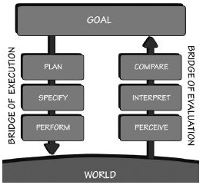
Seven Stages of Action Model
Establish goal
Plan course of action to meet goal
Specify sequence of action steps
Perform the steps
Perceive the state of the system
Interpret the perception
Compare outcome against goal

Slide 7
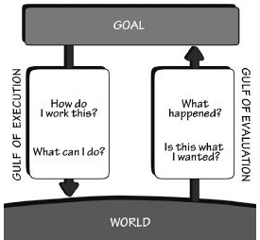
Gulf of Execution occurs when user can’t map intention to action
Execution: Stages 2-4
Planning (a specific action to satisfy the goal)
Specifying the action (within the system)
Executing the action (within the system)
Can user perform action without extra effort?
Do system-level actions match the ones the user wants to perform?

Slide 8
Gulf of Evaluation occurs when user can’t tell whether action succeeded
Evaluation: Stages 5-7
Perceiving the state of the system
Interpreting the state of the system
Comparing the outcome against the goal
Does system provide physical representation that enables user to easily interpret result of action?
System should provide info. on its state that
is easy to obtain
is easy to interpret
matches the way the user thinks about system

Slide 9
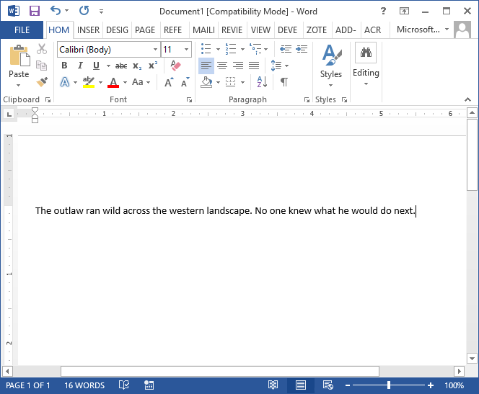
Example: Shortening a Microsoft Word Document
Goal: Shorten the document
Plan: Delete the word “outlaw”
Specify: Position cursor to right of word and hit delete multiple times (other actions are possible too)
Execute: actually perform deletion
Perceive: Letters are disappearing. . .
Interpret state: Word is being deleted
Compare: Goal met!

Slide 10
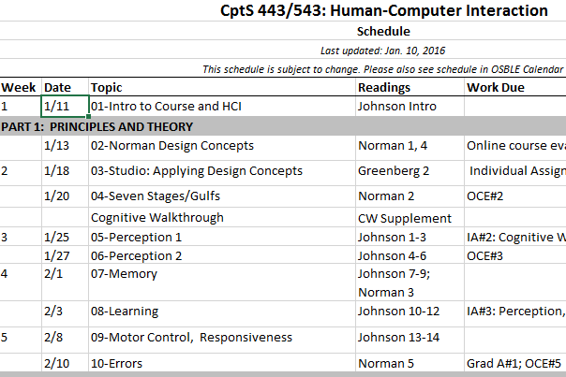
Example: Change Course Schedule in MS Excel
Goal: Change class dates on 2015 schedule so that they match new 2016 dates
Plan: Change date of first class from 1/11 to 1/12
Specify: Position cursor in cell of first date, type in 1/12
Execute: Perform the steps
Perceive: All dates are changing instantly
Interpret: All dates are one more than previously shown
Compare: Goal achieved!

Slide 11
You Try It: MS Word Editing Sequence
Type the following into a blank document: “The quick brown fox jumps over the quick and lazy dog.”
Establish the following goal: Replace all instances of “quick” with “swift”
Following the previous examples, walk though the seven stages of action, providing a brief description of each step.

Slide 12
For reflection…
Did you identify any gulfs of execution or evaluation when you performed the task?
Do you have any ideas for eliminating them?

Slide 13
Possible solution (Possible Gulf of Exec. in Blue)
Goal: Replace all instances of “quick” with “swift”
Plan: Use find-replace
Specify: Click on “Replace” in File Ribbon, then enter “quick” and “swift” into text boxes, then click “Replace All”
Execute: Execute above sequence
Perceive: quick replaced with swift in document, and modal dialog stating “All done. We made 2 replacements.”
Interpret: quick replaced with swift in two places
Compare: Success—goal met
Notes:
Potential gulf of execution with finding “replace” functionality, which is way to right on ribbon.

Slide 14
In practice, things aren’t so simple (or so complicated!)
There may be numerous sequences with multiple feedback loops that build on each other
Subgoals and subplans may need to be created (e.g., satisfy hunger → cook meal → read recipe → turn on light)
Goals may be discarded or forgotten; they may be opportunistic rather than planned
These stages often proceed without conscious effort
Most behavior does not require all stages

Slide 15
This Class is About How Humans Act in the World (Ch. 2 + CW Supplement)
Key Questions for Today’s Class
How does Norman’s “seven stages of action” model account for human behavior?
How do human emotions influence action?
How can the “seven stages of action” model help guide design?
Design Studio: Programmable Thermostat

Slide 16
Reading Question #3
What emotional state does Norman associate with the Plan and Compare stages of action?
Visceral
Behavioral
Reflective
Contemplative
None of the above

Slide 17
Reading Question #4
What emotional state does Norman associate with the Specify and Interpret stages of action?
Visceral
Behavioral
Reflective
Contemplative
None of the above

Slide 18
Reading Question #5
What emotional state does Norman associate with the Perform and Perceive stages of action?
Visceral
Behavioral
Reflective
Contemplative
None of the above

Slide 19
Three levels of cognitive and emotional processing
Visceral | Behavioral | Reflective
Reaction to present state (pre-emotional) | Reaction to matches between present state and learned patterns | After-the-fact reasoning, analysis, and decision-making
Responses are fast and subconscious, producing affective state | Responses are largely subconscious, producing actions we can’t explain | Reponses are slow, deep, and conscious
Linked to musculature: tense = positive, relaxed =negative | Linked to thoughts: We think of a goal and behavioral level takes care of it | Linked to assigning causality to past, present, and future events
Examples: startle reflex, fear of heights, dislike of bitter tastes | Examples: Picking up cup, hitting a ball, talking | Examples: Guilt, pride, praise, blame
Notes:
Emotions generated at behavioral level arise from expectations: satisfaction if expectations met, disappointment if they are not.

Slide 20
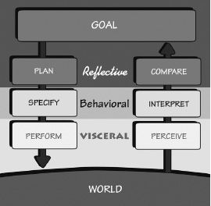
Three levels of processing fit seamlessly into action model
Visceral emotions generated in performing and perceiving: calmness or anxiety
Behavioral emotions generated by expectations relative to specifying or interpreting: Relief or despair
Reflective emotions generated by planning or comparing: satisfaction, pride, blame
Notes:
Flow state (behavioral level) sometimes a goal of human-computer interaction: “The flow state occurs when the challenge of the activity just slightly exceeds our skill level, so full attention is continually required. Flow requires that the activity be neither too easy nor too difficult relative to our level of skill. The constant tension coupled with continual progress and success can be an engaging, immersive experience sometimes lasting for hours.”

Slide 21
This Class is About How Humans Act in the World (Ch. 2 + CW Supplement)
Key Questions for Today’s Class
How does Norman’s “seven stages of action” model account for human behavior?
How do human emotions influence action?
How can the “seven stages of action” model help guide design?
Design Studio: Programmable Thermostat

Slide 22
Reading Question #6 (Extra Credit!)
Norman’s concept of feedback is most relevant to which of the following stages of the “Seven Stages of Action” model?
Planning the action
Specifying the action
Forming the goal
Interpreting the outcome
It’s equally relevant to all of the above
Notes:
D

Slide 23
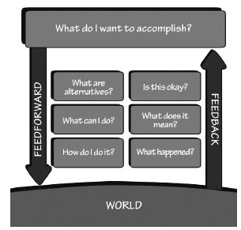
Norman’s model of human action has implications for design
Visibility, signifiers
Affordances
Feedback
Conceptual model, natural mappings, constraints
Notes:
Transition: There are also implications for design based on Norman’s analysis of humans’ emotional experiences when interacting with technology…

Slide 24
Design implication: Do not blame the user! (p. 65)
People’s difficulties are clues as to where products can be improved
Replace error messages with help and guidance
Allow problems to be corrected directly from help and guidance messages
Allow people to continue, even when they have difficulties
Help users think positively!
Notes:
Implication of analysis of emotion: Idea that a person (as opposed to technology) is at fault when something goes wrong is deeply entrenched (learned helplessness). Human error is intrinsic; technology should be designed to take it into account

Slide 25
This Class is About How Humans Act in the World (Ch. 2 + CW Supplement)
Key Questions for Today’s Class
How does Norman’s “seven stages of action” model account for human behavior?
How do human emotions influence action?
How can the “seven stages of action” model help guide design?
Design Studio: Programmable Thermostat

Slide 26
Designer Studio: Programmable Thermostat
Design a simple programmable thermostat to be mounted on the interior wall of a home. Users of the thermostat must be able to accomplish the following three tasks:
Set the temperature. Users of the thermostat must be able to set the thermostat to maintain a given temperatures during four different periods throughout the day: morning (7 am - 11:59 am), afternoon (12 noon - 4:59 pm), evening (5 pm - 9:59 pm), and night (10 pm – 6:59 am). Users should be able to set temperatures ranging from 50 degrees to 80 degrees Fahrenheit.
Override the temperature. Users must be able to override the preset temperature at any time.
Hold the temperature. Users must be able to hold a given temperature indefinitely.
Notes:
Can concepts be used to inspire design?
Start with conceptual model. How should we organize the design?

Slide 27
A Possible Design Method (Based on “10+10” Method in optional Greenberg text)
Generate at several alternate design ideas
Brainstorm!
Don’t judge the merits of ideas at this time
Draw on familiar interfaces as appropriate, but don’t let them box you in
Focus on finding a suitable conceptual model for organizing the interface
Sketch design concepts in quick drawings
Choose most promising one as starting point
Flesh it out in greater detail
Iteratively refine based on feedback
Notes:
As I come up with design ideas, I like to use design principles as inspiration. Be inspired by principles of natural mapping, affordance, feedback, constraints, visibility, transfer effects, etc.
Model my own brainstorming on this as students look on, but also elicit participation as appropriate…
Sketch ideas on whiteboard…

Slide 28
Announcements
Complete IA#2 by next Tuesday
Presenters for IA#2
Sayonsom
Wai Lok
Shyam
Ryan
Justin
Read Cognitive Walkthrough Supplement by next Tuesday
Have a GREAT weekend!

