Slide 1
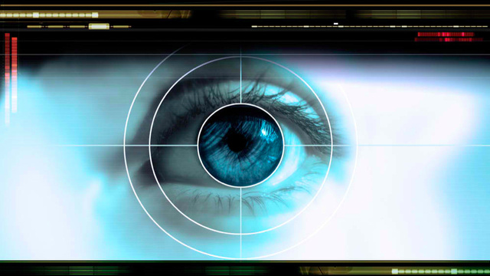
Human Perception (Part 1)
(Johnson 1-3)
http://io9.gizmodo.com/5926643/10-fundamental-limits-to-human-perception----and-how-they-shape-your-world
Notes:
Artist Jackson Pollock

Slide 2
Johnson on the ambiguity of user interface design guidelines
“Following user-interface design guidelines is not as straightforward as following cooking recipes. Design rules often describe goals rather than actions. They are purposefully very general to make them broadly applicable, but that means that their exact meaning and applicability to specific design situations is open to interpretation.” (p. 44)

Slide 3
This Class is About How Human Perception Works (Johnson 1-3)
Agenda for Today’s Class
Preface: What’s the deal with user interface guidelines?
How is human perception biased, and what are implications for design?
How is human vision optimized to see structure, and what are implications for design?
How do humans seek and use visual structure, and what are implications for design?
Synthesis: Design Task

Slide 4
Shneiderman has advocated the same set of guidelines since 1987
Strive for consistency
Cater to universal usability
Offer informative feedback
Design task-flows to yield closure
Prevent errors
Permit easy reversal of actions
Make users feel they are in control
Minimize short-term memory load
Notes:
Ben Shneiderman published UI design guidelines in 1987 in book “Designing the User Interface”.
Essentially the same guidelines have been in all editions of the book up to now.

Slide 5
Much overlap in Nielsen’s UI design guidelines (1995)
Visibility of system status
Match between system & real world
User control & freedom
Consistency & standards
Error prevention
Recognition rather than recall
Flexibility & efficiency of use
Aesthetic & minimalist design
Help users recognize, diagnose, & recover from errors
Provide online documentation & help
Notes:
Nielsen and Molich published guideliines for guiding Website design and evaluation.
They are similar to Shneiderman’s guidelines. Why? Plagarism?

Slide 6
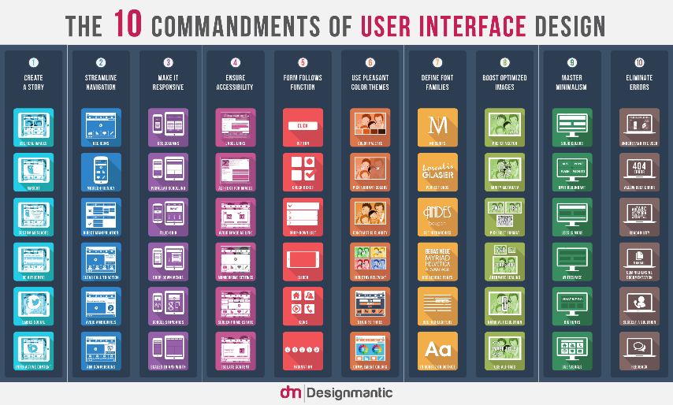
Guidelines are based on human psychology
UI Guidelines are based on how people perceive, think, learn, act
UI guidelines are not rote recipes
Applying them effectively requires understanding their scientific basis
  Determining rule applicability & precedence
  Balancing trade-offs between competing rules
http://www.designmantic.com/blog/infographics/the-10-commandments-of-ui-design/
Notes:
Sets of guidelines tend to be similar because they are all based on human psychology—they have a common scientific foundation

Slide 7
This Class is About How Human Perception Works (Johnson 1-3)
Agenda for Today’s Class
Preface: What’s the deal with user interface guidelines?
How is human perception biased, and what are implications for design?
How is human vision optimized to see structure, and what are implications for design?
How do humans seek and use visual structure, and what are implications for design?
Synthesis: Design Task
Notes:
We tend to quickly scan for relevant information. To facilitate such scanning, designers need to present information in a terse, structured way. Chapter 3 presents some examples of this. Let’s take a look.

Slide 8
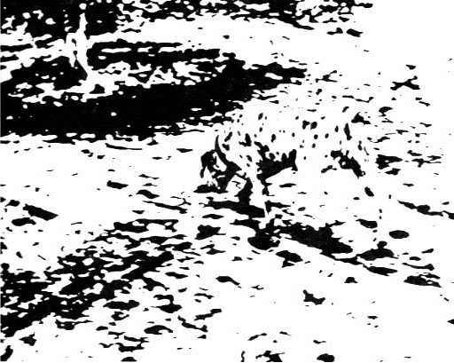
1. If I tell you that this is a picture of a Dalmatian sniffing the ground near a tree, what are you likely to see? Why? Use concepts from Johnson text to explain.
Notes:
Get out a sheet of paper and write down your answers.
I’m going to show you a black and white splatter painting by Jackson Pollack. (click) (pause) (remove)
Now I’m going to show you a degraded picture of a dalmatian dog sniffing the ground near a tree. Once you’ve seen the dog, it’s hard to not see it. Famous visual example by R.C. James. (perceptual priming)

Slide 9
2. How are you likely to perceive the two buttons on this page if you aren’t paying attention? Why?
Page 1
Page 2
Page 3
Page 4
Back
Back
Back
Next
Next
Next
Next
Back
Notes:
If a sequence of screens or web-pages has Back and Next buttons in that order,
that’s what you expect.
You’re not really paying attention to that, so you may not notice if one page has
the buttons in the opposite order.

Slide 10
3. How are you likely to read the words below? Why?
T
E
C
T
Notes:
Viewed alone, these two symbols are identical.
<click>
In words, the first symbol is usually seen as a crooked H, and the second as a cut-off A.
The context affects what we see.

Slide 11
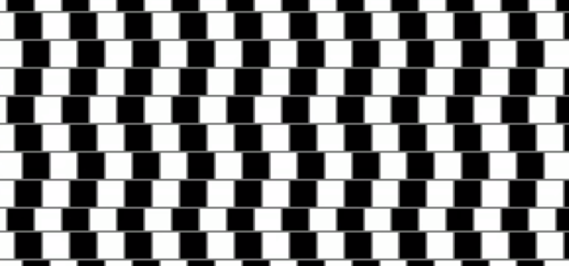
4. Are the gray lines straight? Explain what is going on with human perception
Notes:
Context also affects vision with graphical displays. “This and other optical illusions (see Fig. 1.7) trick us because our visual system does not use accurate, optimal methods to perceive the world. It developed through evolution, a semi-random process that layers jury-rigged— often incomplete and inaccurate— solutions on top of each other. It works fine most of the time, but it includes a lot of approximations, kludges, hacks, and outright “bugs” that cause it to fail in certain cases.”
See numerous additional examples in the book.

Slide 12
Our perception is biased by context
See YouTube video on McGurk Effect:
https://www.youtube.com/watch?v=PWGeUztTkRA
Notes:
Context affects perception even *across sensory modalities*.
McGurk Effect.
Video posted by unidentified blogger on YouTube.

Slide 13
Video demo: Basketball
(Credit: Viscog Productions)
I am going to show you a video and give you a difficult viewing task. This task will require sustained attention and concentration. The video you are about to see depicts people on two teams passing a basketball. COUNT THE NUMBER OF PASSES MADE BY THE WHITE TEAM.
Notes:
Basketball demo can be launched from “Basketball Demo” folder, a subfolder of LectureSlides

Slide 14
Clicker: How many passes did you count?
15
16
17
18
19

Slide 15
Clicker: Did you see anything besides the people passing basketballs?
Yes
No

Slide 16
Demo illustrates “inattentional blindness”
When people are engaged in an attention-demanding task, they often fail to notice unexpected objects or events
Approximately 50% of observers fail to notice anything out of the ordinary in the basketball video
Credit: Viscog Productions

Slide 17

Implication for design:
Avoid Ambiguity
Ensure users interpret information displays uniformly
If ambiguity is unavoidable
  Use standards or conventions
  “Prime” users to resolve ambiguity

Slide 18
Implication for design:
Be consistent
Users will have expectations based on context
They will expect controls and information to be in consistent locations
They will also expect them to have the same functions and appearance across different screens
Page 4
Back
Next

Slide 19
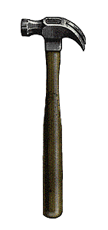
Implication for design: Understand users’ goals
Users’ goals strongly influence what they perceive
Ensure that exactly the information and functionality needed are readily available at every step of interaction
Realize that users may not notice or discover items unrelated to their goals

Slide 20
Synthesis: How are these implications related to Norman’s principles?
Prime users to resolve ambiguity → ?
Be consistent → ?
Understand users’ goals → ?

Slide 21
This Class is About How Human Perception Works (Johnson 1-3)
Agenda for Today’s Class
Preface: What’s the deal with user interface guidelines?
How is human perception biased, and what are implications for design?
How is human vision optimized to see structure, and what are implications for design?
How do humans seek and use visual structure, and what are implications for design?
Synthesis: Design Task
Notes:
We tend to quickly scan for relevant information. To facilitate such scanning, designers need to present information in a terse, structured way. Chapter 3 presents some examples of this. Let’s take a look.

Slide 22
Our Vision is Optimized to See Structure
Gestalt Principles of Visual Perception
Proximity
Similarity
Continuity
Closure
Symmetry
Figure/ground
Common fate
Notes:
Gestalt is German for “form” or “shape.” The theory comes from a group of early twentieth century German psychologists who wanted to explain how perception works. The punchline: We see things holistically; we impose structure automatically to perceive larger clusters or groupings. Today, Gestalt theory is regarded more as a descriptive framework than a predictive theory, even though the predictive theories of neurophysiological researchers, which are based on the neurophysiology of the eye, optic nerve, and brain, tend to support the observations of Gestalt theory.

Slide 23
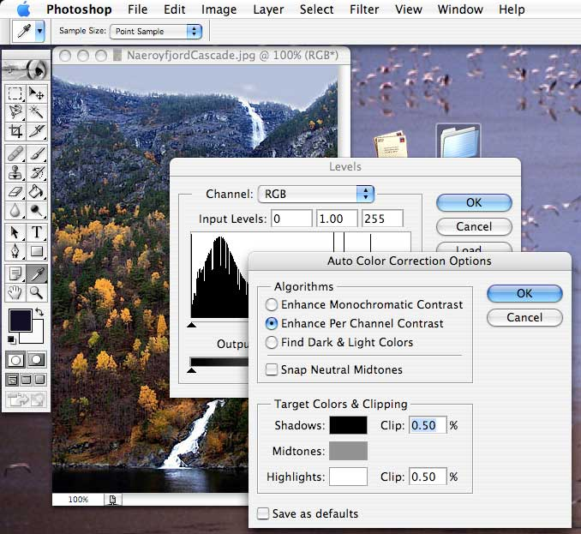
4. Identify three Gestalt principles that are at play in this figure. Explain how they influence perception of specific objects in the figure.
Principles
Proximity
Similarity
Continuity
Closure
Symmetry
Figure/ground
Common fate

Slide 24
4. Identify three Gestalt principles that are at play in this figure. Explain how they influence perception of specific objects in the figure.
Closure
Continuity, symmetry: Bg window continues behind fg window
Figure/ground
Common fate, proximity: Windowed items are grouped
Notes:
Some possible answers…

Slide 25

5. Which Gestalt principle explains why blue stars appear as rows, and orange stars appear as columns?
Proximity B. Similarity C. Symmetry
D. Closure E. Continuity
Notes:
(Can skip these slides if time is short.)
A. Proximity

Slide 26
6. Which gestalt principle explains why we see the figure below as two crossing lines, and not as > and <?
Proximity B. Similarity C. Continuity
D. Closure E. Symmetry
Notes:
Continuiity: We tend to see continuous forms, even if continuity is in disrupted.

Slide 27
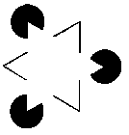






7. Which Gestalt principle explains why we see the following as overlapping triangles?
Similarity B. Proximity C. Symmetry
D. Closure E. Continuity
Notes:
Closure: We tend to see whole, closed objects, not collections of fragments
We see here overlapping circles & triangles, not odd fragments

Slide 28
8. Which Gestalt Principle explains why we see all of the following as overlapping diamonds, and not more complex combinations?
Proximity B. Symmetry
C. Common Fate D. Closure E. Continuity
Notes:
Symmetry: We tend to see simple figures rather than complex ones.

Slide 29
9. Which Gestalt principle explains why the items that move together are perceived as being grouped?
Symmetry B. Proximity C. Closure
D. Continuity E. Common Fate
Notes:
Common fate

Slide 30
This Class is About How Human Perception Works (Johnson 1-3)
Agenda for Today’s Class
Preface: What’s the deal with user interface guidelines?
How is human perception biased, and what are implications for design?
How is human vision optimized to see structure, and what are implications for design?
How do humans seek and use visual structure, and what are implications for design?
Synthesis: Design Task
Notes:
We tend to quickly scan for relevant information. To facilitate such scanning, designers need to present information in a terse, structured way. Chapter 3 presents some examples of this. Let’s take a look.

Slide 31
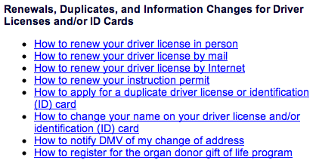
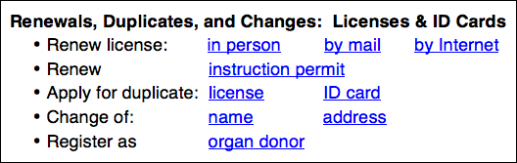
Which interface would promote faster task completion?
(A)
(B)
Notes:
Structured info is easier to perceive. Create visual structure using headers, indentation, typeface, etc. Organize info to accommodate known tasks.
We don’t read carefully when seeking information online. We just scan quickly. Therefore UIs should be designed to help people get info while scanning.

Slide 32

Even the ALVIS interface exploits structure

Slide 33
This Class is About How Human Perception Works (Johnson 1-3)
Agenda for Today’s Class
Preface: What’s the deal with user interface guidelines?
How is human perception biased, and what are implications for design?
How is human vision optimized to see structure, and what are implications for design?
How do humans seek and use visual structure, and what are implications for design?
Synthesis: Design Task
Notes:
We tend to quickly scan for relevant information. To facilitate such scanning, designers need to present information in a terse, structured way. Chapter 3 presents some examples of this. Let’s take a look.

Slide 34
Design Task: Vending Machine
Design a vending machine that sells the following products (prices in parentheses below):
Users of the vending machine must be able to pay with cash or credit card. In the case of cash, any excess payment should be returned to the user (exact change is not required).
Sketch out some designs. Justify design choices using principles from today’s class (see next slide)
Thneads
Thnads
Thrugs
Thrads
Thuds
($1.25)
($1.50)
($1.75)
($1.00)
($2.25)
Thrids
Thacts
Thents
Thraves
Thags
($2.25)
($1.55)
($3.00)
($2.75)
($2.55)

Slide 35
Design principles to keep in mind
Avoid ambiguity
Be consistent
Understand users’ goals
Proximity
Similarity
Continuity
Closure
Symmetry
Figure/ground
Common fate
Visually structure info to match task

Slide 36
To do between now and next class
Keep working on vending machine design problem!
Read Johnson Ch. 4-6
IA#3 due next Tuesday

