Slide 1
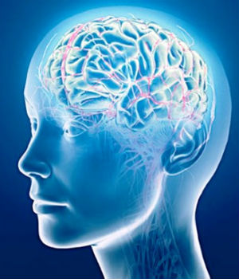
Human Memory (Johnson 7-9, Norman 3)
http://www.catholic.org/news/technology/story.php?id=64369
Notes:
Artist Jackson Pollock

Slide 2
Norman on the difficulty of remembering nonsensical things
“How can we remember all these secret [passwords]? Most of us can’t, even with the use of mnemonics to make some sense of nonsensical material. Books and courses on improving memory can work, but the methods are laborious to learn and need continual practice to maintain. So we put the memory in the world, writing things down in books, on scraps of paper, even on the backs of our hands. But we disguise them to thwart would-be thieves. That creates another problem: How do we disguise the items, how do we hide them, and how do we remember what the disguise was or where we put it? Ah, the foibles of memory” (p. 88)

Slide 3
This Class is about human memory (Johnson 7-9 and Norman 3)
Key topics/questions for Today’s Class
How does human memory work, and what are implications for design?
How do attentional limits shape human thought and action, and what are implications for design?
Recognition is easier than recall. What are the implications for design?
IA#4: Swimmer’s Helper
Notes:
Congratulations: Today is a reading questions holiday!

Slide 4

Traditional distinction between short-term and long-term memory
Short-term or “working” memory: (fractions of) seconds to minutes
Long-term memory (hours, days, years)
Traditional view:

Slide 5
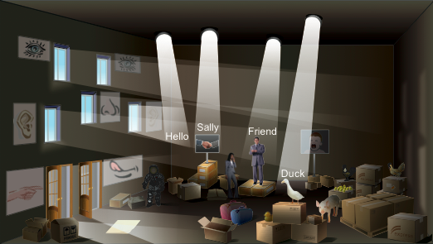
Modern view of memory integrated with perception
Notes:
Warehouse metaphor:
* Long-term Memories are stored haphazardly in a large,musty warehouse.
Perceptions enter through one of our five senses (taste, touch, sight, hearing, smell) (the DOORS on the left). The perceptions are briefly illuminated by the light from outside, but the doors quickly shut, and the perceptions are quickly pushed (by more perceptions coming in) into the memory piles
Spotlights represent our focus of attention right now. They swing around (controlled by executive function of attention), briefly illuminating memory piles. Working memory is what is illuminated by the spotlights right now: the few items attended to at any moment

Slide 6
Working Memory represents what we are attending to NOW
Not a separate store; it’s foci of attention in LTM
Capacity: 3-5 unrelated items
“Magical number 7” was over-estimate
Goals, numbers, words, objects (actually features)
New items can “grab” attention from old
Easy to forget immediate goals or info
Notes:
Short-term memory
Our attention: What we’re conscious of doing right now. Those of you who are paying attention, my last few words go into your STM, and then are quickly combined into one item: an assertion, and you quickly forget the exact words I used.
STM only holds 3-5 items.
If items in STM don’t get combined or rehearsed, they are at risk of being bumped out by later items.
Dropping items out of STM corresponds to forgetting or losing track of something you were doing.
Who here has gotten up from studying to go into another room to get something, but when you get there you can’t remember what you came for?
Who here has, after taking a phone call, not been able to remember what they were doing?
This limit is one reason that UI design guidelines say to avoid UIs that have modes: people forget what mode the system is in and do the wrong thing.

Slide 7
A working memory test
Memorize: 3 8 4 7 5 3 9
Say your phone number backwards
Memorize: 3 1 4 1 5 9 2
Memorize: 1 3 5 7 9 11 13
Memorize: town river corn string car shovel
Memorize: what is the meaning of life
Notes:
Short-term Memory Test
Memorize numbers. (wait 10 seconds, cover)
What were they? (get answers, uncover)
(cover)
Say your phone number backwards.
What were the numbers?
Saying your phone number backwards uses up a lot of STM slots.
Knocks other items out.
Memorize these numbers. (wait 10 seconds, cover)
What were they? (get answers, uncover)
It’s easier if you noticed these are the first seven digits of pi.
Memorize these numbers. (wait 10 seconds, cover)
What were they? (get answers, uncover)
It’s easier if you noticed these are the first seven odd integers.
Memorize these words (wait 15 seconds, cover)
What were they? (get answers, uncover)

Slide 8
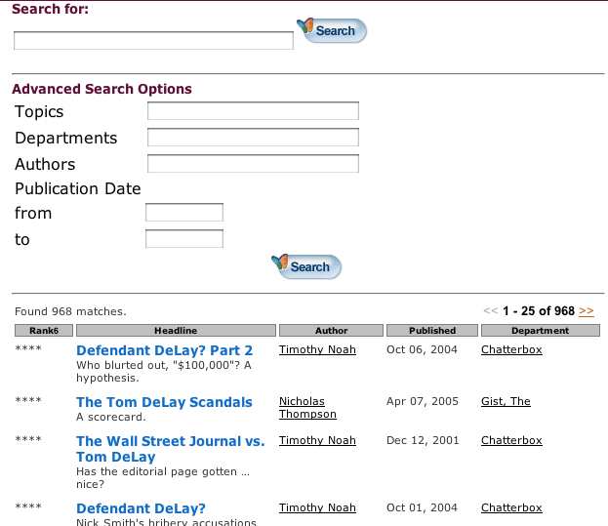
Design implication: Don’t make users remember things across screens
Slate.com

Slide 9
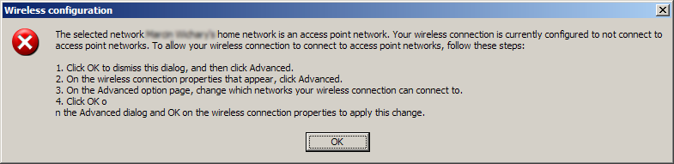
Design implication: allow users to see instructions while doing things
Microsoft Windows
Notes:
Sometimes known as the “Vietnam helicopter” blooper.

Slide 10
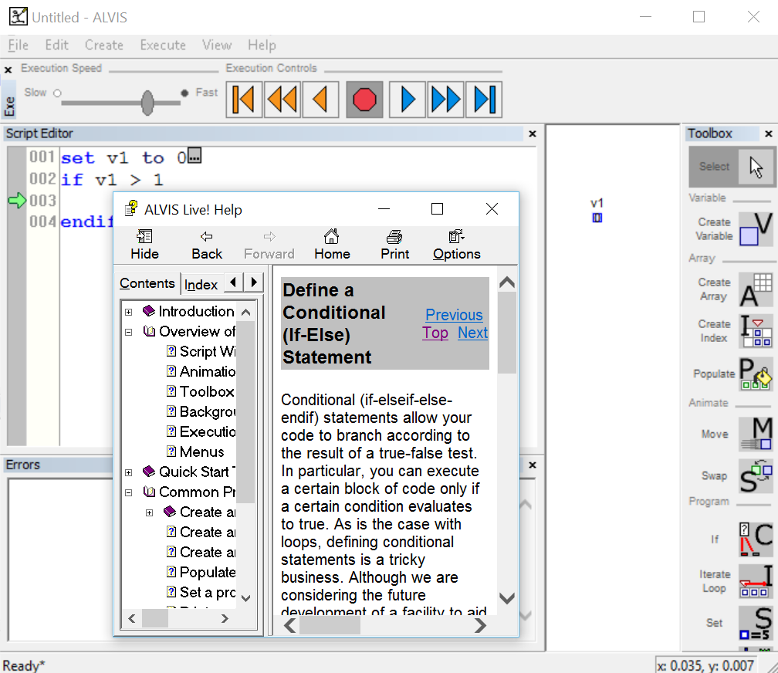
Design implication for ALVIS: Allow help to be dockable!
Notes:
Non-dockable help could be an issue!

Slide 11
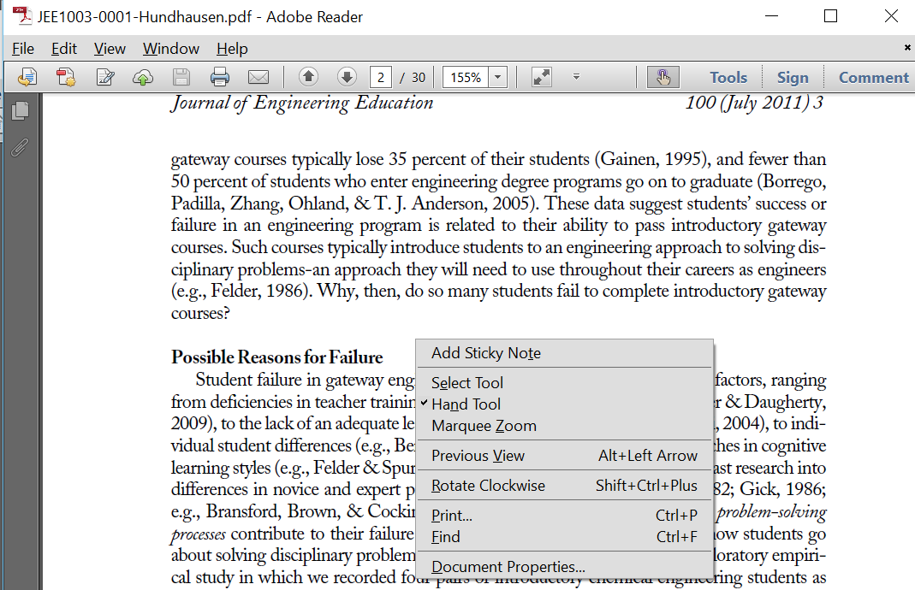
Design implication: Be careful with modes
Notes:
Why can’t I select text in Adobe Reader?

Slide 12
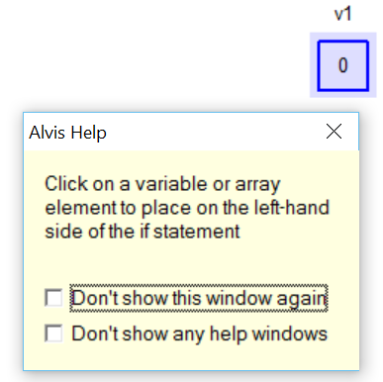
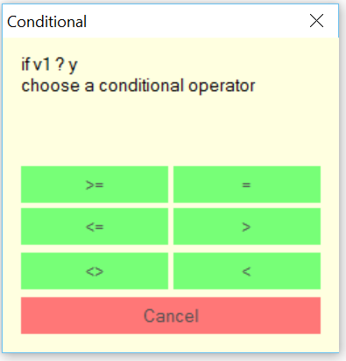
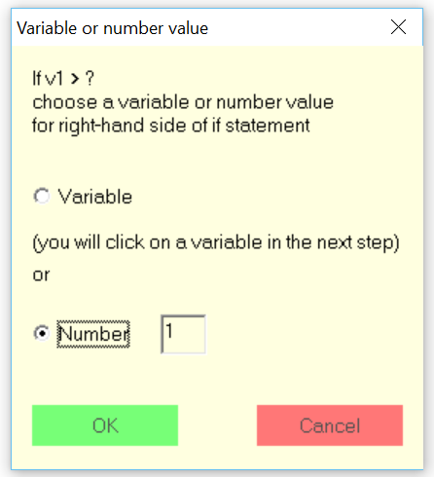
Design implication: One “call to action” per page
Notes:
Corollary: Once a user is working down a goal path, don’t distract the user!

Slide 13
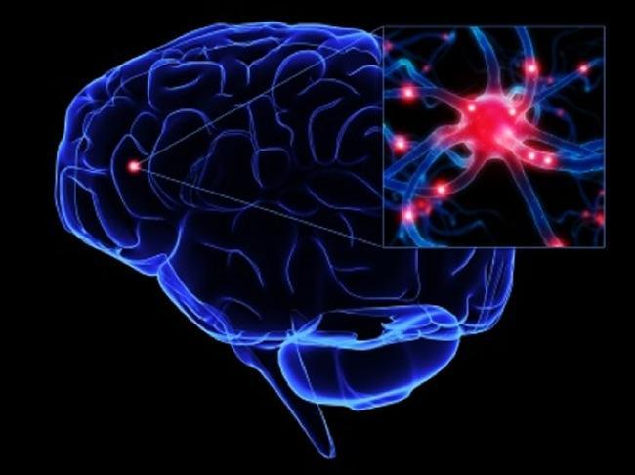
Long-term memories are patterns of neural activity
Experiences trigger patterns corresponding to features
Similar experience triggers same pattern → recognition
Internal neural activity triggers pattern → recall
The more frequently a pattern is triggered, the easier it is to recognize and recall
http://license.umn.edu/technologies/z05027_algorithm-for-non-invasive-source-localization-of-neural-activity
Notes:
Long-term memory
Everything we’ve ever experienced is stored in there, but…
It’s full of errors
I have a vivid memory of being run over by a plow as a child, but my father says it happened to my brother. One of us has a faulty memory.
Microsoft Word users remember a command to insert a page number, but not which menu it was on.
Memories are weighted based on the emotions we felt at the time.
I remember my first day at nursery school, but not my fifth day.
The dog was excited when he saw a cat in the bush, so that memory was strong & vivid.
Because our LTM is unreliable, we invent and use memory aids:
writing, making lists, mneumonics (every good boy…), phone directories, datebooks, PDAs, computers
Memories change over time:
E.g., on an ocean cruise, you see a whale-shark, but later you assure your friends you saw a whale.
President Reagan remembered being in Europe in WW2, but was only in a movie about it.

Slide 14
Long-term memory is faulty
error-prone, impressionist, free-associative, easily biased
Memories change when features are dropped or added
See whale-shark, remember whale
Seldom-followed routines hard to recall
We need written food recipes
Pilots need checklists
Notes:
* Uses “lossy” compression methods

Slide 15

Long-term memory (LTM) test
Sing first line of the national anthem.
What was your previous phone number?
Random ink spots or dalmatian dog?
Notes:
Long-term memory
In that slide showing tools, was there a roll of tape? (Yes)
What was your previous phone number?
Pollack painting or dalmatian

Slide 16
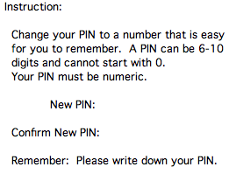
Implication: Don’t burden long-term memory
Don’t burden long-term memory
Notes:
Thumbs down

Slide 17
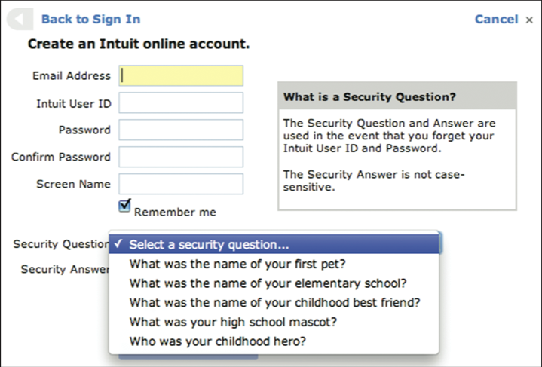
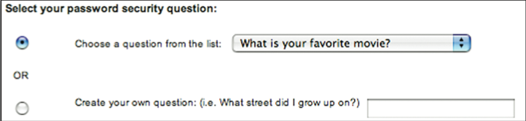
Implication: Don’t burden long-term memory
Don’t burden long-term memory
Notes:
Better, but still burdens memory, since people may have trouble answering these questions. Some questions could have many possible answers.

Slide 18
Implication: Consistency
If menu items are always in the same place, it will be easier to remember where they are
If menus are always in the same order, it will be easier to remember where they are
If items are always in the same place on ribbons, it will be easier to remember where they are
Notes:
Powerpoint, Word, and Excel all exhibit consistency

Slide 19
This Class is about human memory (Johnson 7-9 and Norman 3)
Key topics/questions for Today’s Class
How does human memory work, and what are implications for design?
How do attentional limits shape human thought and action, and what are implications for design?
Recognition is easier than recall. What are the implications for design?
IA#4: Swimmer’s Helper
Notes:
Congratulations: Today is a reading questions holiday!

Slide 20
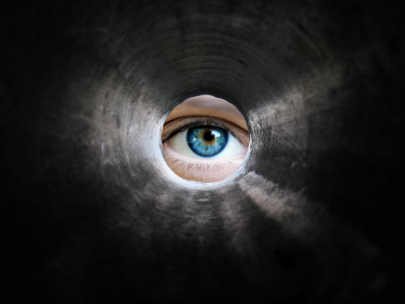
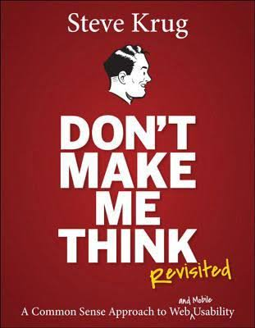
Limits on attention shape our thought and action
Users barely pay attention to computer tools
Focus attention on own goals, data
Think about computer, UI superficially
Krug: Don’t Make Me Think (about your software)
Intently focused on achieving goal
Prefer familiar paths over exploration
User: “I’m in a hurry, so I’ll do it the long way.”
Akin to following “scent” toward goal

Slide 21
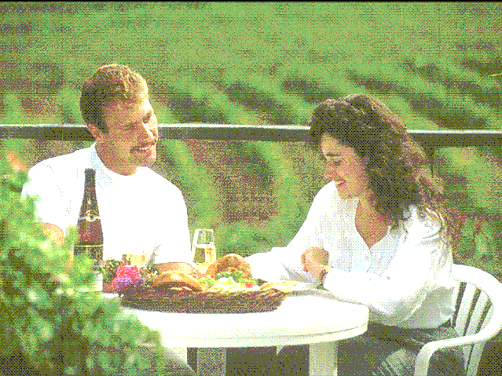
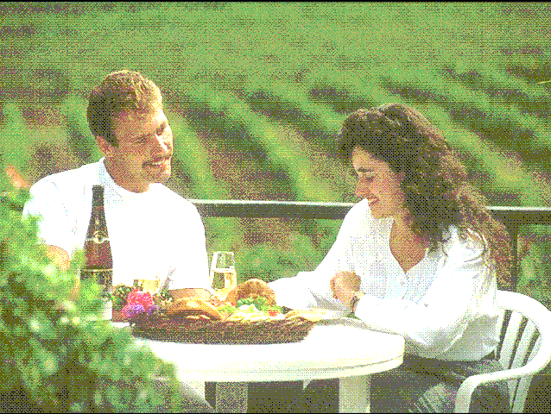
When focused on tasks, we don’t notice other things
Keeping track of extra features in short-term memory is work
We notice and remember only those features crucial to task
➔ We don’t notice objects/events that we would have otherwise noticed (inattentional blindness)
➔ We are “blind” to changes (change blindness)
Notes:
Also check out “Door study” at YouTube.
And “Derren Brown Person Swap” show.

Slide 22
Demo 1: Demonstration of inattentional/change blindness
These videos show participants in change detection studies
What are participants attending to?
Do you think you would have noticed the changes?
Notes:
Show demos 1, 2, and 3

Slide 23
Demo 2: To experience change blindness, try the flicker task
We will view a series of flickering photographs
Each photograph will disappear and reappear with one thing in the scene changing repeatedly.
Raise your hand once you detect the change
Remain quiet while others continue looking for change
Notes:
Show flicker task demos (all five demos as time allows)

Slide 24
Design implication: Make changes obvious!
Examples
Use animation (e.g., vibration) to draw attention to an object (e.g., an error message)
See http://www.centigrade.de/blog/en/article/animations-in-user-interface-design-essential-nutrient-instead-of-eye-candy/
Use animation to highlight that one object has changed into another object
See http://digitalsynopsis.com/design/gif-icons-menu-transition-animations/

Slide 25
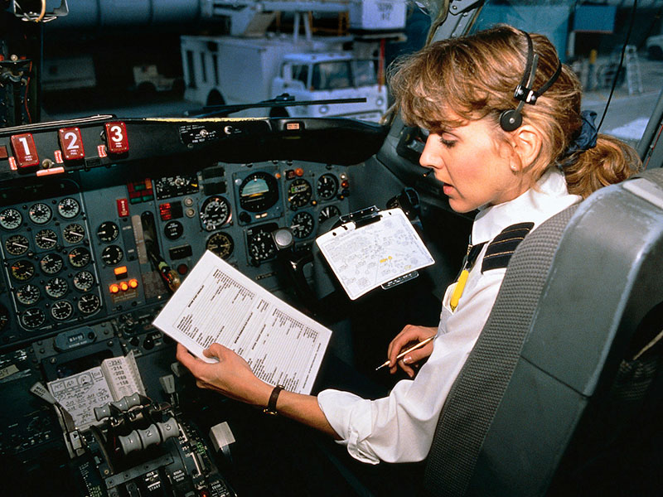
We use external memory aids to help us keep track of things
Counting objects, laps, or other things (What one am I on?)
Reading books (Where did I leave off?)
Doing math (I need to carry the 1)
Checklists (what needs to be done? What have I done so far?)
http://johannesmutzke.com/?p=1232
Notes:
Relate story of missed flaps checklist on takeoff in two MD-80 accidents about a year about in the late 1980s. Checklists were laminated sheets of paper not meant to be checked/marked up. In complex takehoff scenarios involving changes in runways due to bad weather, pilots actually forgot to deploy flaps at takeoff, leading to immediate crash. To top it off, the warning systems on board had been intentionally dismantled, because they tended to go off during taxing and annoyed pilots, so they flipped the circuit breakers.

Slide 26
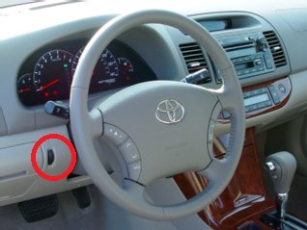
We quickly forget when we reach a goal
When we reach goal, we often let everything related to it fall out of STM
We often forget “loose ends” of tasks:
Removing last page of document from copier
Turning car headlights OFF
Switching device or software back to normal mode
Notes:
EXERCISE: More examples?
Telephones are left off-hook
Turn signals are left blinking
Computers in libraries are left with the user still logged in
EXERCISE: What are common solutions?
Spring-loaded modes
Reminder sounds in cars: lights are ON
Hmmm… could copiers notice page was left? How would they know user is done?

Slide 27
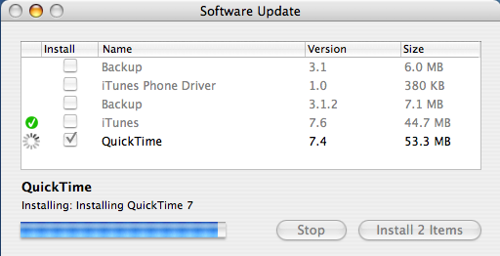
Implication: Provide external memory aids to indicate progress

Slide 28
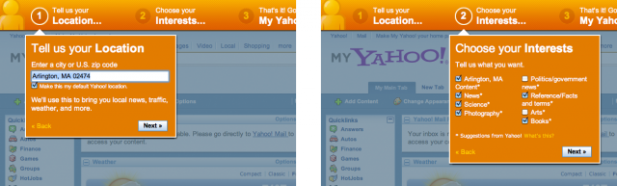
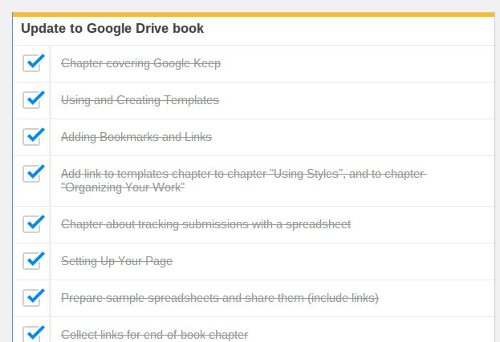
Implication: Allow user to keep track of progress
Example: Labeled wizard steps
Example: Digital checklists
http://designinginterfaces.com/patterns/wizard/
https://scottnesbitt.net/weblog/updating-an-ebook/
Notes:
This type of checklist could have prevented the MD-80 accidents. Warnings could have gone off that the checklist items had not yet been completed.

Slide 29
Implication: Help users complete loose ends of task
Remind users of loose ends
E.g., Toyota: beep when headlights left on and engine is off)
Automatically tie up loose ends
E.g., subaru: Lights go off automatically when engine is turned off)
Revert to “normal” modes automatically
E.g. in ALVIS, after variable is created, “select” mode is restored (is this good?)

Slide 30
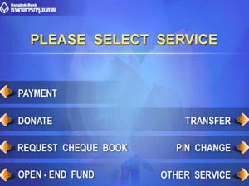
We follow the information scent
Intent focus on goal leads to literal interpretation of interface items
Assume these goals:
Pay a bill
Open a new account
Purchase travelers’ cheques
Which items would attract your attention?

Slide 31
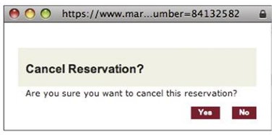
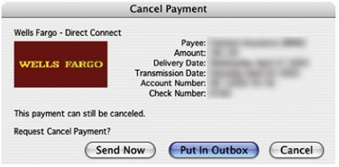
Implication: Anticipate users’ goals at each decision point
Need to match options to user’s moment-to-moment goals
Which is better (clicker)?
A
B

Slide 32
“I’m in a hurry; I’ll do it the long way”
Familiar path is preferred to new path, even if new path is more efficient
More comfortable
Less thought (we’re mentally lazy)
Implications
Make seldom-used systems (e.g., ATMs) easy to use at the expense of efficiency
Guide users toward goals (wizards can help)
Provide expert paths for those willing to learn

Slide 33
This Class is about human memory (Johnson 7-9 and Norman 3)
Key topics/questions for Today’s Class
How does human memory work, and what are implications for design?
How do attentional limits shape human thought and action, and what are implications for design?
Recognition is easier than recall. What are the implications for design?
IA#4: Swimmer’s Helper
Notes:
Congratulations: Today is a reading questions holiday!

Slide 34
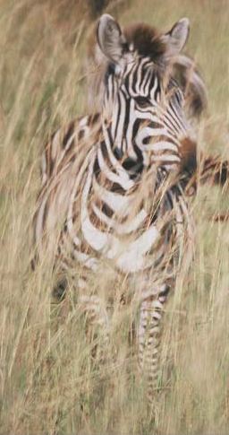
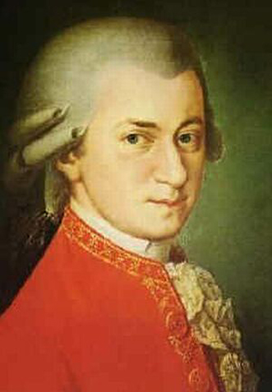
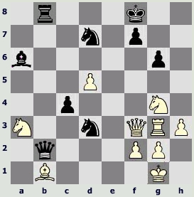
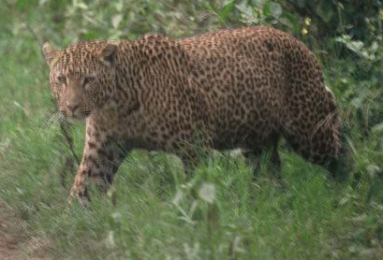
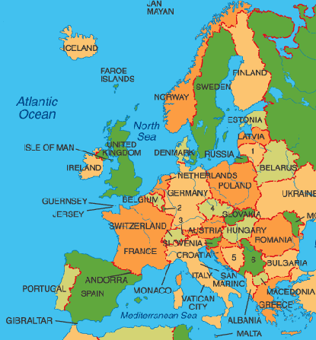
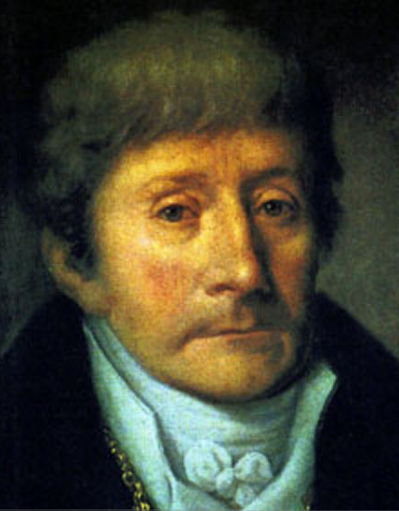
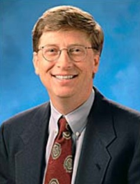
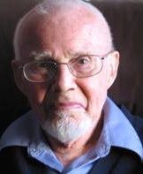
Recognition is easy
We evolved to recognize things quickly
We assess situations very quickly
We recognize faces blindingly fast
We recognize complex patterns
Notes:
We’ve already learned why this is the case: Perceptions activate neural patterns; similar perceptions cause similar patterns of neural activity; repeated activations make subsequent activations easier. Activations stimulated by perceptions are easier than activations stimulated by other brain activity. Recognition amounts to perception and long-term memory working hand-in-hand
One important feature of long-term memory:
Recognition is easy; recall is hard.
Leopard vs. zebra
Mozart & Bill Gates (facial recognition is done by dedicated mechanisms)
Salieri & friend’s father
Europe & Kasparov v. Karpov 1986 (pattern recognition must be learned over time)

Slide 35
Recall is hard
We did not evolve to recall arbitrary facts
Tricks for memorizing use recognition to stimulate recall, e.g., mnemonic devices
We developed writing to avoid memorizing
We rely on external memory aids: alarms, lists, calendars
Notes:
Greek method emphasized spatial storytelling. You imagined a map and remembered items relative to points in the map.

Slide 36
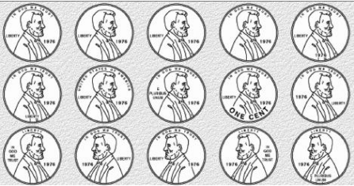
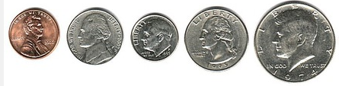
Implication: Make choices distinctive
Are these choices distinctive?
Are these choices distinctive?

Slide 37
Implication: Exploit natural and cultural constraints
Natural constraints (in the world) dictate what can be done with objects
Cultural constraints and conventions (in the head) are broadly applicable to a variety of situations
If these are exploited, need to learn and recall facts can be minimized

Slide 38
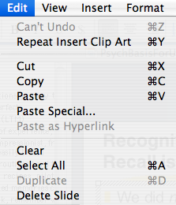
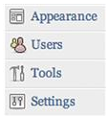

Implication: Show options and dually encode with pictures
Easier to select from menu of options than remember commands
Commands can be made more recognizable through pictures (icons) that connote meaning
>
Remove
Notes:
Dual-coding theory (not mentioned in book) is also applicable here. We encode pictures and words separately in the brain. When we build connections between visual and textual stores in the brain, we have an easier time with recall, because we can draw on multiple connections.

Slide 39
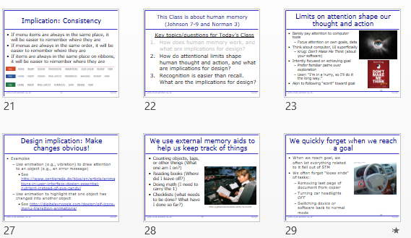
Implication: Use thumbnail images to facilitate quick navigation to already-seen images
Example: Microsoft Powerpoint Slide Sorter

Slide 40
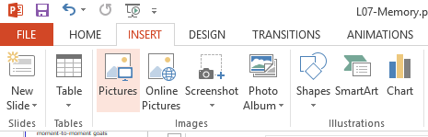
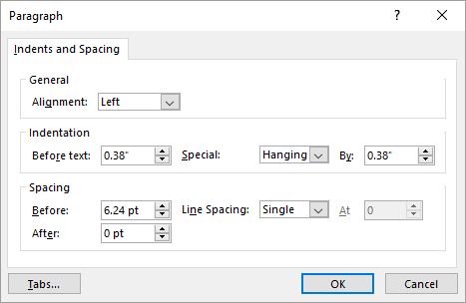
Implication: 80-20 rule for UI Design
20% of functionality accessed 80% of the time
Make the most frequently-accessed functionality readily visible, so people don’t have to recall it
Less frequently-used functionality can be “buried”
These functions always visible in MS Office apps
Paragraph settings infrequently used

Slide 41
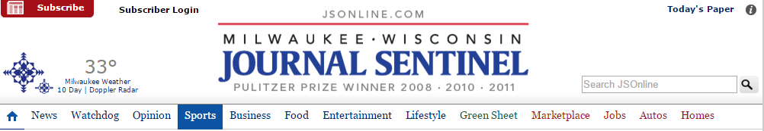
Implication: Give apps/websites distinctive visual appearance
This assures users they are where they think they are

Slide 42
Implication: Facilitate recall of authentication information
Avoid “burdensome” password restrictions (e.g., exactly n characters)
Allow users to create custom password hints
Allow users to create custom challenge questions
Biometrics could ultimately be a solution, but raises privacy concerns

Slide 43
Tying it all together: Designing with human memory in mind
Place instructions in context in which they're needed
Make modes visible
Focus user on single subtask in multi-step sequence
Provide users with assistance in recalling security credentials
Be consistent in placement of UI elements across pages/apps
Make changes to objects/states in UI obvious
Provide/support external memory aids of progress
Remind users of "loose ends" at end of task
Anticipate users' goals, and match options to goals
Make commonly-used functionality easy to access
Show available options rather than requiring them to be remembered
Represent options with both pictures and text to enhance recognizability
Make range of choices readily distinguishable
Use thumbnail images to index previously-viewed images

Slide 44
This Class is about human memory (Johnson 7-9 and Norman 3)
Key topics/questions for Today’s Class
How does human memory work, and what are implications for design?
How do attentional limits shape human thought and action, and what are implications for design?
Recognition is easier than recall. What are the implications for design?
IA#4: Swimmer’s Helper
Notes:
Congratulations: Today is a reading questions holiday!

Slide 45
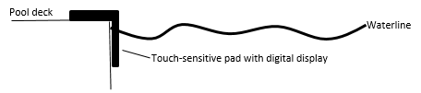
Swimmer’s Helper
Tasks to be supported through touch-sensitive display:
Set date, time, pool units
Specify a workout (total distance or set of intervals)
Just swim
Monitor current workout
Pause or modify workout
Upload data via Bluetooth

Slide 46
To do between now and next class
Create preliminary sets of sketches for two possible swimmer’s helper apps
Each set of sketches should show, in detail, how each task is supported
Provide design justification for each set of sketches
Submit sketches through OSBLE by start of Tuesday’s class
Some students will present designs for discussion and feedback on Tuesday (we’ll work down list)
You will have a chance to refine designs in class on Tuesday
Notes:
I’ll be out of town on Tuesday, so Carla and Daniel will run the class. You be good for them!

