Slide 1
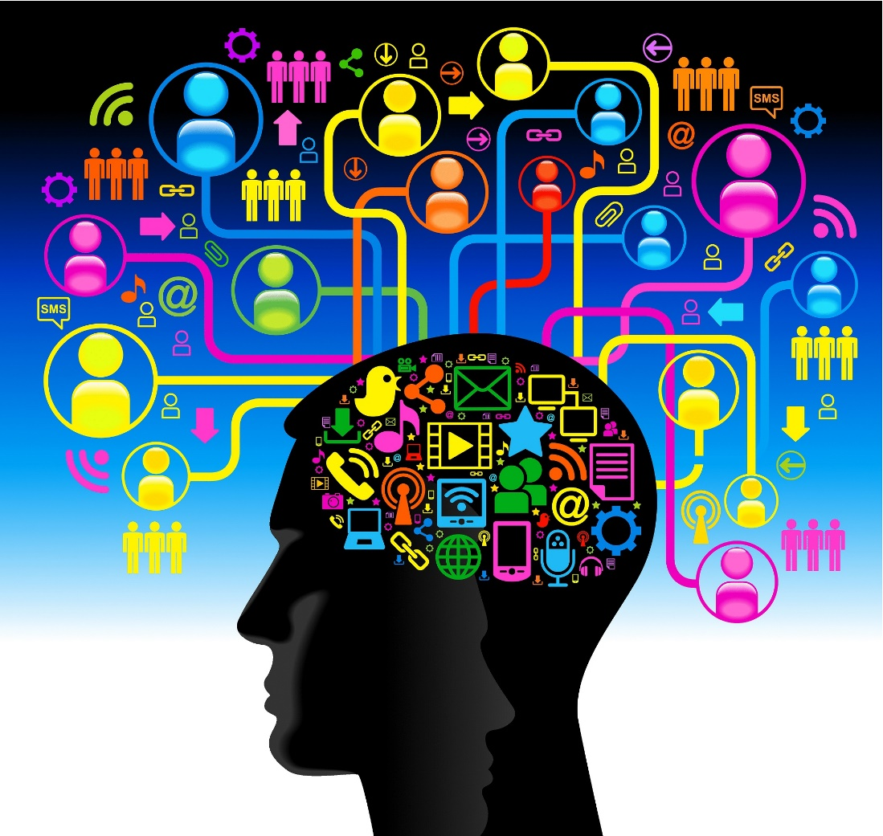
Learning & Decision-making (Johnson 10-12)
http://www.onlineeducationincanada.com/diplomas-certifications/10-examples-online-learning-innovations/
Notes:
Artist Jackson Pollock

Slide 2
Expertise manifests itself in the reading of disciplinary representations
“When functionally-related components are placed close together, which is typical practice in electronics schematics, an analog mapping is being used to supply extra information over and above the information explicitly represented by the components and their connections. Expert designers regard this ‘secondary notation’ as being crucial to comprehensibility[;]…it may well be the principal characteristic that distinguishes [expert and novice] graphical notations.”
--M. Petre (1995). “Readership skills and graphical programming. Communiations of the ACM 38(6), p. 35.

Slide 3
Learning & Decision-making (Johnson 10-12)
Key topics for today’s class
Human subconscious and conscious minds, and their implications for design (Johnson 10)
How humans learn, and implications for design (Johnson 11)
Human decision-making and implications for design (Johnson 12)
Notes:
We’ll start off with a short reading quiz to get things going…Please get out a sheet of paper and write your name and ID at top…
Reading quiz questions will be used to structure today’s class…

Slide 4
Reading Question 1
In a table, identify three key differences between the human subconscious (“System 1”) and conscious (“System 2”) minds:
System 1 | System 2
1.
2.
3.
Notes:
Get out a sheet of paper and put your name and WSU ID at the top

Slide 5
Reading Question 2
Describe one implication for UI design that follows from an understanding of System 1 vs. System 2.

Slide 6
Reading Question 3
According to the book, we learn faster when practice is .
According to the book, we learn faster when vocabulary is .
According to the book, we explore and learn when risk is .
Notes:
Frequent, regular, precise
Task-focused, familiar, consistent
More, more, low

Slide 7
Reading Question 4
How should user interfaces that users will use only infrequently be designed, as compared to user interfaces that users will use daily?
(State design strategy at a high level in a couple of sentences.)

Slide 8
Reading Question 5
The book argues that the principle of consistency should be applied to interactive systems design at the keystroke and conceptual levels. What does it mean for a system to exhibit consistency at the conceptual level? At the keystroke level?

Slide 9
Reading Question 6
According to the book, human decision-making is rarely rational. As a user interface designer, what is one thing you can do to support rational decision-making?
Notes:
OK, when you’re done with this question, please hand in your paper.

Slide 10
Material Relevant to Reading Question 1
In a table, identify three key differences between the human subconscious (“System 1”) and conscious (“System 2”):
System 1 | System 2
1.
2.
3.
Notes:
Get out a sheet of paper and put your name and WSU ID at the top

Slide 11
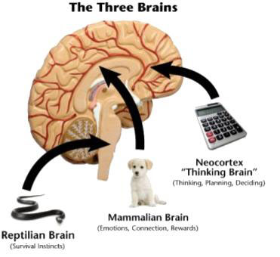
Three important parts of the brain
(1)
Evolution
Notes:
Old brain: Classifies everything into three categories: edible, dangerous, sexy
Midbrain: Controls emotional reactions to things
New brain: Controls intentional, purposeful activity (rational thought)

Slide 12
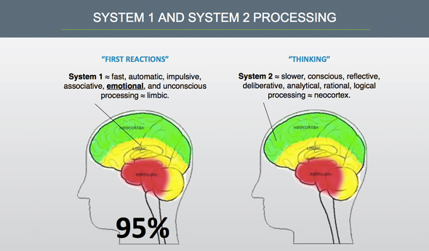
We’re of two minds: unconscious and conscious
(2)
Notes:
System 1 (unconscious, emotional): old brain + midbrain: Collection of automatic “zombie” processes; Can run many processes in parallel; Fast but approximate, “satisficing”; Doesn’t use working memory; Unconscious; governs most of our behavior
System 2 (conscious, rational): cerebral cortex; Slow but precise; Uses working memory; One serial processor; cannot multi-task; Conscious, self-aware; believes it governs our behavior

Slide 13
Comparison of System 1 and System 2
System 1
System 2
Substitutes easier problem for problem it can’t solve
Bases judgments only on what it perceives; if conflicting data not present, it doesn’t exist
Filters perceptions based on goals and beliefs provided by System 2
Often lazy; accepts System 1 estimates even though they are often inaccurate
Effort and will required to operate it
Needed to get things exactly right

Slide 14
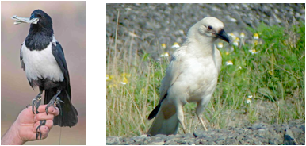
Learning from experience is easy thanks to System 1
Overgeneralization: All Crows are black? No.
Notes:
We evolved to learn general rules from experience. We don’t need a cerebral cortex to be able to do it.
Stay away from leopards; Don’t eat bad-smelling food; Don’t open attachments from unfamiliar senders
But this ability is limited: It’s difficult to generalize from experiences in complex situations. We are also more influenced by our own perceptions and those of our friends/relatives, as opposed to cold/hard documented facts. (My example: I’ll never buy a Volkswagen, even though they are probably fairly reliable, based on a lemon we had when I was a kid.)

Slide 15
Performing learned routines is easy thanks to System 1
Examples:
Riding a bicycle after months of practice
Driving to same workplace after many years
Using a touchpad after a few days of practice
Reading and deleting message from your phone
Automatic: doesn’t use up STM / attention
System 1: “zombie” or “robotic” processes
Compiled mode, parallel processing
Many processors: Can multi-task
Notes:
Performing learned actions is easy:
- Riding a bicycle after many years of practice
Backing out of our driveway and driving to work for the 300th time
- Using a mouse or a touch-pad to move a cursor on a computer display after a few days of practice
- Entering a banking transaction into our old familiar checkbook accounting software
- Reading and then deleting a text message from our long-time mobile phone
More examples:
Backing out of our driveway for the 300th time
Juggling after years of practice
- Entering a banking transaction into our old familiar checkbook accounting software
- Reading and then deleting a text message from our long-time mobile phone

Slide 16
Performing novel actions is hard because it requires System 2
Examples:
Following a new cooking recipe
Driving somewhere you’ve never been
Writing with your non-dominant hand
Switching from Mac to Windows PC (or vice-versa)
Controlled: consumes STM / attention
System 2: Runs mainly in cerebral cortex
Interpreted mode, serial processing
Only one processor: Cannot multi-task
Notes:
Eventually, once novel actions are learned, System 1 can take over
Other examples:
Learning to play a new musical instrument.
Throwing a ball with your non-dominant hand.
- Trying a new kung fu move

Slide 17

Problem solving and calculation are hard thanks to System 2
Problem solving is evolutionarily new
Only a few mammals & birds can do it.
We write programs for ourselves & run them in interpreted mode, rather than compiled mode
But System 2 runs slowly, strains STM, can’t be multi-tasked (only one processor)
Calculation is extremely new
Originated only ~5K years ago
Expensive: mainly done in interpreted mode
(4)
Notes:
Much less important in our evolution was ability to deduce specifics from generalities,
or calculate specifics from specifics.
I’m thinking of a number in the range 1 - 100. Name numbers, & I’ll say if my number is equal, larger, or smaller. What is the most questions it should take to guess my number?
In computer jargon, the human mind has only one serial processor for emulation-mode, controlled execution of processes. That processor is severely limited in its temporary storage capacity and has a clock that is an order of magnitude slower than that of the brain’s highly parallelized and compiled automatic processing.
Modern humans evolved from earlier hominids about 50K years ago, but numbers and numerical calculation didn’t exist until about 3400 B.C., when Mesopotamians (modern day Iraq) invented and started using a number system.
So humans certainly didn’t evolve to do numerical calculations.
When we have to do those, we find it difficult.
Have to write things down, use computers, etc.

Slide 18
Material Relevant to Reading Question 2
Describe one implication for UI design that follows from an understanding of System 1 vs. System 2.
Notes:
Overarching implication: Try to encourage the use of System 1 instead of System 2 where possible. Automatic and efficient processes should be favored over laborious and inefficient ones.

Slide 19
Implications for UI design
Indicate system status and progress toward goal
Guide users towards their goals
Let people fall into learned, automatic routines
Tell users exactly what they need to know
Don’t make people diagnose system problems
Minimize the number and complexity of settings
Let people use perception rather than calculation
Make the system familiar
Let the computer do the math
Notes:
I’m now going to show some examples of how these implications can be applied.

Slide 20
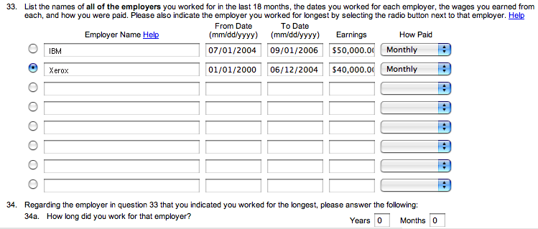
UI Blooper: Requiring calculation that software could do
EDD.CA.gov
Notes:
Can you spot the places where it asks for info it could calculate?

Slide 21
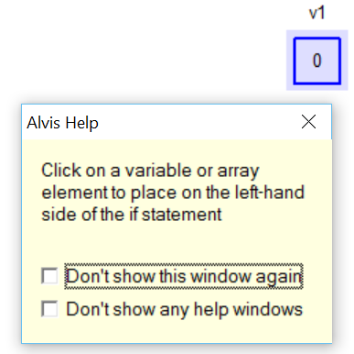
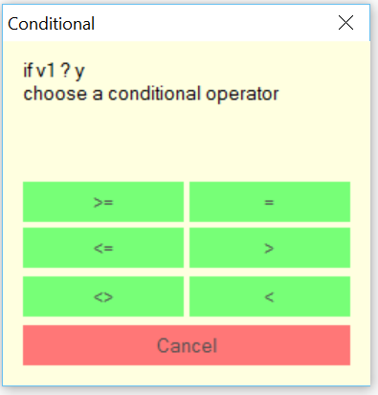
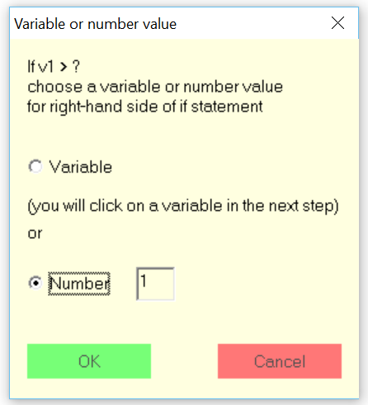
Exemplar: Guide users toward their goals

Slide 22
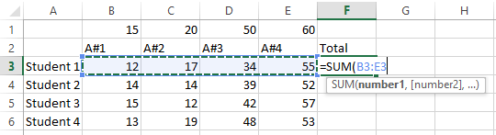
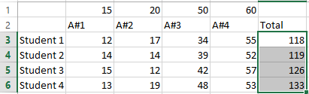
Exemplar: Spreadsheet calculations
Visual specification of calculation ranges
Duplicating calculations via direct manipulation
Notes:
Look at how System 1 is being used instead of System 2 here. Perceptual ability to look at numbers replaces mathematical calculation. However, there is still the need to learn a programming language. Ease of learning this language will turn on the familiarity of the command words.
Can also talk through how one could calculate percentage correct of each score by dividing by the perfect scores at the top

Slide 23
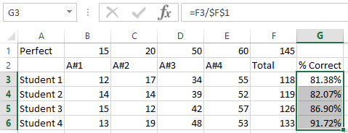
Exemplar: Complex calculations by direct manipulation (close mapping between problem-solving and environment)

Slide 24
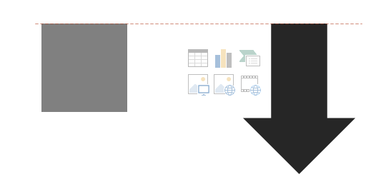
Exemplar: Perception rather than calculation
Provide visual alignment aids rather than making user count pixels

Slide 25
Discussion of Reading Question 3
According to the book, we learn faster when practice is .
According to the book, we learn faster when vocabulary is .
According to the book, we explore and learn when risk is .
Notes:
Frequent, regular, precise: Likely frequency of use will influence how it should be designed.
Task-focused, familiar, consistent: Keep user focused on what they want to get done; use familiar terms so learning is faster; use consistent terms so learning can be leveraged (transferred)
More, more, low: Need to design for low-risk exploration as a means of

Slide 26
Discussion of Reading Question 4
How should user interfaces that users will use only infrequently be designed, as compared to user interfaces that users will use daily?
(State design strategy at a high level in a sentence or two.)
Notes:
Walk-up-and-use systems should anticipate user’s goals and guide them through the steps necessary to achieve those goals. Think about ATMs as an example.
Let’s now talk a bit more about learning (supplementary material)

Slide 27
Two ways of thinking about learning
Knowledge acquisition
Learning = becoming an expert
What is learned interacts with what is already known
Transfer of training
Metaphor/analogy
Misconceptions – Incongruities between current situation and what is already known
Performance improvement
Affects perception, motor behavior, cognition
Initially, System 2 is in control (conscious behavior)
As performance improves, System 1 can take over (routinized behavior)
Notes:
In school, learning is about developing expertise
In context of UIs, learning is really becoming faster at accomplishing tasks
Both types of learning are useful to know about when designing UIs

Slide 28

Learning as knowledge acquisition: Experts act differently from novices
Can retrieve knowledge fluently in context
Knowledge organized into core concepts rather than facts, formulas, syntax
Able to recognize meaningful patterns of information (“chunking”)
Expert chunks are large and semantically rich
Novice chunks are small and focused on syntactic features
(5)

Slide 29
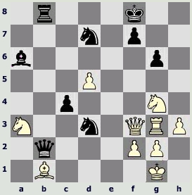
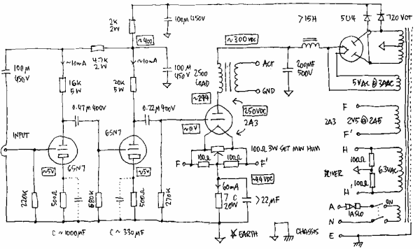
Expert chunks in chess and electronics
Chess expert Electronics technician
Notes:
Chess: Masters vs. Lesser ranked chess players.
Chess masters were able to out play their opponents because if the knowledge they acquired from hours upon hours of playing chess.
Chess masters experiences lead to recognition of meaningful chess configurations (using chunking) which leads to the realization of the best strategy with the most superior moves to win based on these configurations.
Chess masters can chunk together chess pieces in a configuration.
Electronics Technicians.
Experiment: Expert electronics technicians can reproduce large portions of complex circuit diagrams after short term viewing. Chunked several individual circuit elements that performed the function of an amplifier. Likely not possible for novices ☺
Circuit photo: http://www.codinghorror.com/blog/2006/04/uml-circuit-diagrams-and-gods-rules.html

Slide 30
Getting from novice to expert: Constructivist learning theory (Piaget)
People actively create their own understandings by interacting with their environment
When one’s experience aligns with one’s current knowledge framework, one assimilates the experience without changing the framework
When one’s experience contradicts one’s current knowledge framework, one accommodates the experience by modifying one’s framework.
Social constructivism takes this further by suggesting that knowledge is constructed through social interaction

Slide 31
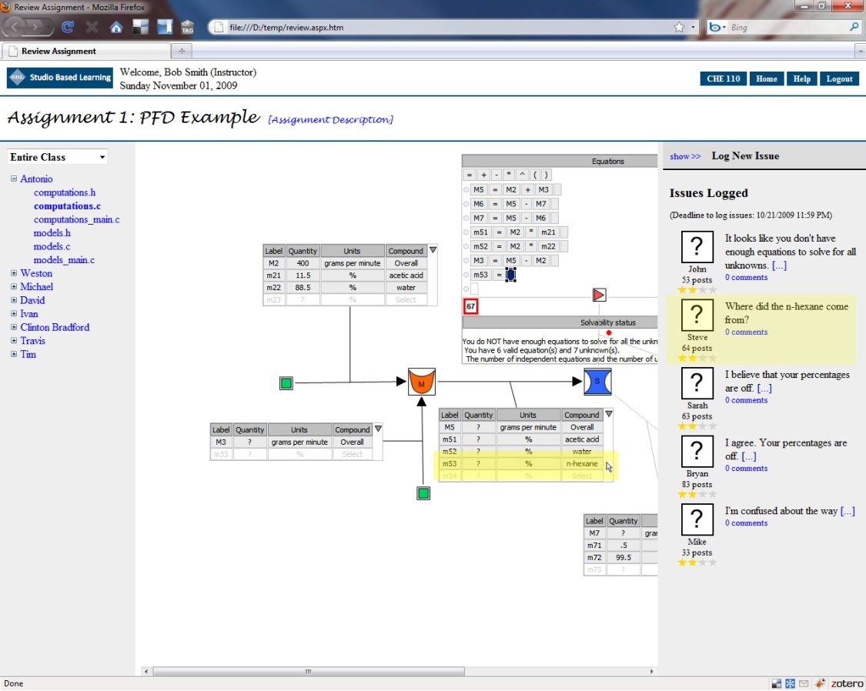
Design implication: Constructivist learning environments
Notes:
Promote learning through
selection of appropriate problems
modeling
coaching
software scaffolding*: Focus learners on important aspects of problem solving by hiding unnecessary details. Provide learners with guidance and narrow down the choices so they don’t make obvious mistakes
active learning that includes exploration, articulation, and reflection
support for social learning communities (social constructivism)
This could be the topic of an entire course! Much learning theory could be cited here.

Slide 32
Learning as performance improvement: Important factors at UI level
Practice
Clear focus on tasks, not task environment
Vocabulary that matches tasks
Ability to learn through exploration (no adverse effects from trying things)
Notes:
Let’s take a look at each of these in more detail…

Slide 33
Clicker: How do you think task completion time varies with amount of practice?
Task completion time linearly decreases with practice
Task completion time remains unchanged with practice
Task completion time decreases quadratically with practice
Task completion time decays exponentially with practice
None of the above

Slide 34
Practice: The Learning Curve
The “learning curve”
Time to Perform Task
Number of Repetitions
Problem-Solving (Steps Uncertain)
Cognitive Skill (Steps Routinized)
NOVICE
CASUAL
EXPERT

Slide 35
Power Law of Practice
T_{n} = T₁n^{-a}
where T₁ is the time of the first trial and a is typically in range [0.2 to 0.6] (Plots as hyperbolic curve)
Alternate version:
log T_{n} = logT₁– a log n
(Plots as straight line; good for linear regression)

Slide 36
Demo: Power Law of Practice in ALVIS
I’ll need two volunteers for this demo (one performer, one timer)
I’ll give the performer a set of task instructions
The timer will be responsible for timing each task trial (3)
We’ll plot the trials to see what happens

Slide 37
ALVIS Demo Task (Use Toolbox tools to complete)
Create an array with 6 elements
Populate the array
Create a variable
If value of first element in array is greater than the value of the variable, set the variable’s value to the value of the first element in the array

Slide 38
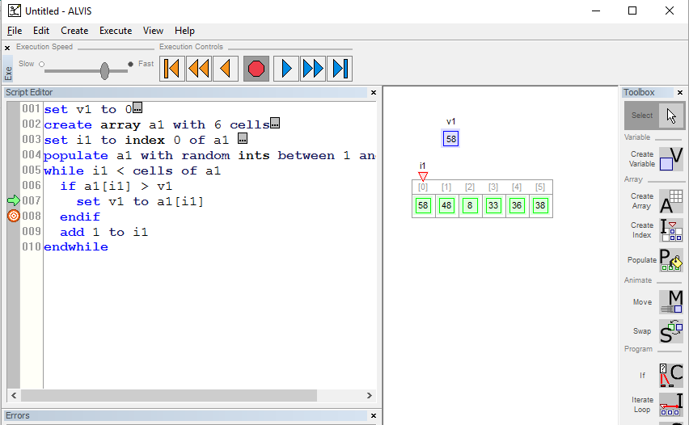
For discussion: How does ALVIS support learning?
Notes:
Tools focus on tasks
Vocabulary attempts to match tasks
Supports learning by exploration
Establishes linkage between tools and code (dual-representation environment)
Supports migration from tools to code as one becomes more expert in programming

Slide 39
Design implication: Provide a variety of methods
Need to provide variety of methods by which users can accomplish tasks
Highly visible but relatively inefficient (for novices)
Invisible but efficient (for experts)
Example
Novices are more likely to use menus to accomplish tasks, whereas experts migrate to keystroke shortcuts
Notes:
Another design implication: 80-20 rule discussed in previous class

Slide 40
Key points of material on learning
Expert behavior differs markedly from novice behavior
Scaffolded designs can help users go from novice to expert
Performance improves exponentially with practice
We need to make seldom-used UIs easy to use but potentially inefficient
We need to build UIs that encourage practice/exploration
We need to facilitate transition from novice (slow, methodical) UI use to expert (fast, routinized) use

Slide 41
Discussion of Reading Question 5
The book argues that the principle of consistency should be applied to interactive systems design at the keystroke and conceptual levels. What does it mean for a system to exhibit consistency at the conceptual level? At the keystroke level?
Notes:
Consistency at the conceptual level “is determined by the mapping between the objects, actions, and attributes of the conceptual model. Do most objects…have the same actions and attributes, or not?” A consistent conceptual model would encompasses objects whose actions and attributes are (mostly) the same.
Consistency at the keystroke level means that similar actions have similar keystroke shortcuts across applications. The textbook example is clipboard operations.
This is a segueway into the material on conceptual models.

Slide 42
Designing software to match tasks makes learning faster
Three steps to designing software to match tasks
Perform a task analysis
Design task-focused conceptual model
Design user interface based on task analysis and conceptual model

Slide 43
Task analysis: What goals and tasks must be supported?
What goals will user achieve by using software?
What tasks must be supported? How are they related?
Which are the most and least important?
What are the task steps?
What are the results of the tasks?
What info/communication is needed to complete tasks?
How will info resulting from each task be used?
What tools are needed to complete tasks?
What terminology do people use when doing tasks?
What problems might occur when completing tasks?
Notes:
Performing a task analysis requires that one answer these questions.
Sample design problems:
Create an interface for a weather app
Create a personal speedgolf app

Slide 44
Example Task Analysis: ALVIS
Goals: Program array iterative algorithms
Tasks:
Create variables; create arrays and fill them with values; iterate through arrays; make comparisons; set variable and array element values
Info needed to complete tasks
Conceptual understanding of variables, arrays, iteration, and Boolean logic
Terminology (see next slide)
Likely problems
Not knowing what an index is
Not knowing how to iterate through an array

Slide 45
Keep terminology task-focused: ALVIS examples
C language | SALSA language | ALVIS Toolbox
int vi; | set v1 to 0 | Create variable
int a1[6] | create array a1 with 6 cells | Create array
#include <time.h> #include <stdlib.h> srand(time(NULL)); for (int i = 0; i < 6; i++) a1[i] = rand(); | populate a1 with random ints between 1 and 100 | Populate
for (int i = 0; i < 6; i++) { } | set i1 to index 0 of a1 while i1 < cells of a1 add 1 to a1 endwhile | Iterate loop
Notes:
It’s about “speaking the user’s language” to promote learning. Use familiar terminology; allow users to build analogies based on what they already know
Task focused:
Use “variable” (what’s an “int?”)
Use “create” because task is to create a variable
Use “populate” to fill an array with values (avoids need to understand iteration)
Use “iterate loop” to create a loop; in empirical studies “for” turns out to be obscure for concept of looping
Potential issue with SALSA language: need for “index” in order to create a loop. Novices may not know what an index is; it’s “geek speak.” How could this be improved?

Slide 46
Conceptual model: How users are to understand application
Make it simple (fewer concepts means easier to learn)
Make it task-focused
Make it consistent
Conceptual level
Keystroke level
Provide flexibility

Slide 47

Example conceptual model: ALVIS
In a nutshell:
Use tools to create algorithms by direct manipulation (analogous to drawing programs)
Each tool allows one to create a graphical representation of a different program element
Perceive relationship between graphical programming elements and code as program is constructed (promotes learning by association)
Execute programs to learn cause-effect relationships by perceiving changes to graphical objects in relationship to where execution arrow is (exploration)
For discussion: Weaknesses of conceptual model?
Notes:
High risk systems discourage exploration, making learning more difficult
Low risk systems reduce stress and encourage exploration, which promotes learning.
Direct manipulation environments with rapidly reversible actions tend to be lower risk and hence promote more exploration. Command line environments (e.g., Unix) tend to be higher risk and discourage exploration.
Weaknesses: Difficult to correct errors by DM; must be done in code

Slide 48
Discussion of Reading Question 6
According to the book, human decision-making is rarely rational. As a user interface designer, what is one thing you can do to support rational decision-making?
Notes:
Mini lecture: Human irrationality
When we face a big chance of a large gain or a small chance of a large loss, we prefer to play it safe (i.e., are risk-averse), but when we face a big chance of a large loss or a small chance of a large gain we prefer to gamble (i.e., are risk-seeking).
We are biased by vivid memories (VW lemon story) and even what is immediately before us

Slide 49
What are the design implications for computer systems?
Decision-support: helping System 2 override System 1
Data visualization: harness System 1 to support System 2
Persuasion: seducing System 1 and bypassing System 2

Slide 50
Guidelines for decision support software
Provide all options (abstract if necessary)
Help users find alternatives
Present unbiased data
Don’t make people perform calculations
Prompt users to make assumptions and assertions explicit

Slide 51
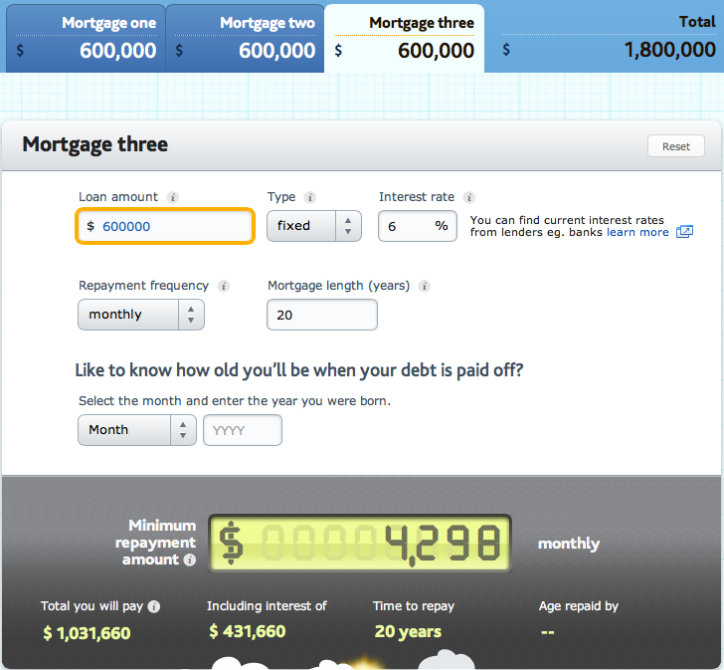
“Don’t make me calculate:” I want that house now, but can I afford it?
Notes:
Decision support: Helping System 2 override System 1. This is a mortgage calculator that provides excellent data when trying to decide on a loan. The “I want it” message from System 1 can be overridden by the “You can’t afford it!” message from System 2.

Slide 52
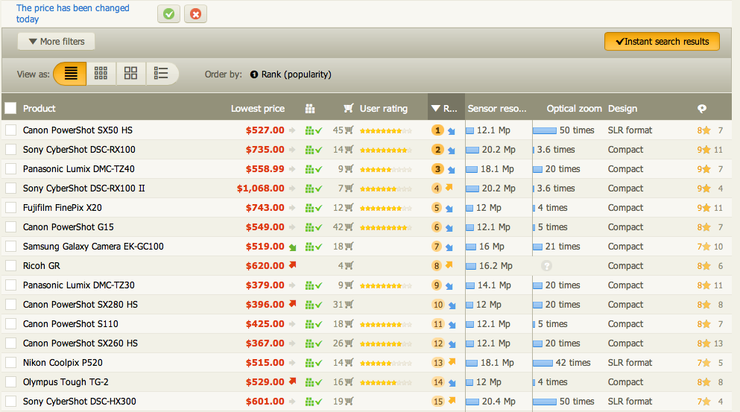
Provide all options: I want to buy a new camera, but which one?
Notes:
Decisional support: The seduction of wanting a new camera right now can tempered by hard data on which one is best.

Slide 53
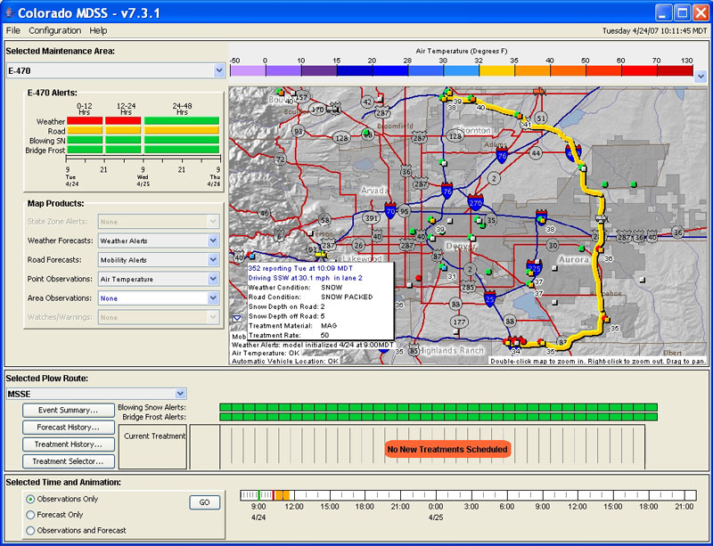
Help users find alternatives: What is the most efficient snow plow route?
Notes:
Software for supporting complex decision making is called “decision support systems” (DDS), and has a scientific journal!

Slide 54
Data visualization: Harness system 1 to support system 2
Exploit automatic processes
Perception of structure
Edge detection
Motion detection
Face recognition
3D vision

Slide 55
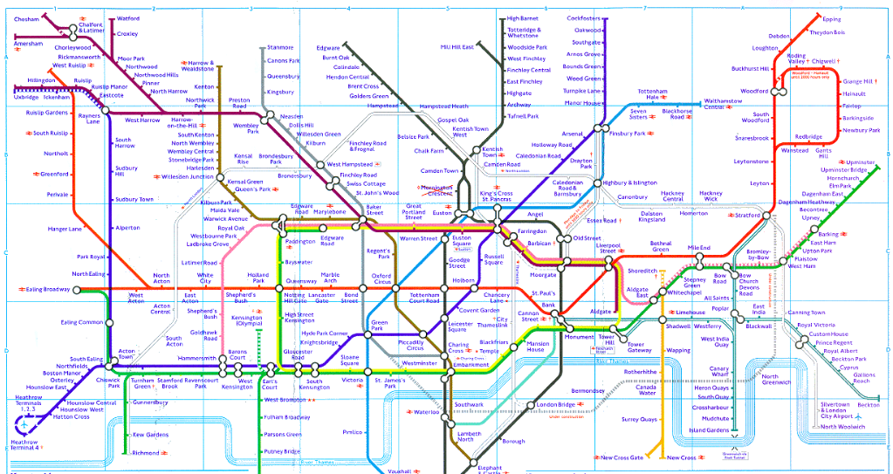
Subway maps present what people care about for the task at hand, omitting unnecessary geo information
London Metro
Notes:
What do people who ride the subway care about?
-What are the stops
-Where do they connect?
-What is my route from A to B?
-Is it relatively close from A to B?

Slide 56
System 1 can be seduced!
How info is presented influences people at least as much as what info is presented
Designers can use presentation techniques to “seduce” system 1 to bypass system 2
Amateurs present rational arguments and stats; pros present powerful stories evoking strong emotional responses

Slide 57
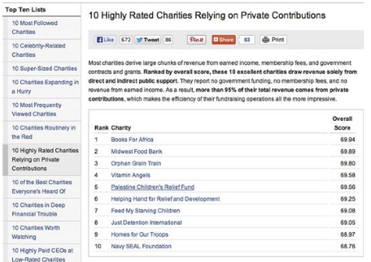

Decision support vs. persuasive system
Charitynavigator.org
FMSC.org
Which is which, and why?
Notes:
Charitynavigator: Help users decide which charities to donate to, free of bias. Users needs facts, so that they can engage system 2 in a rational decision-making process
FMSC.org: Convince users to donate to the organization. Nothing on the site is attempting to help users make a rational decision. Rather, the goal is to seduce system 1 into the donation.
Given this, how would you go about trying to persuade users to back up their computers or to install anti-virus software?

Slide 58
Key points of human decision-making
System 1 and system 2 are both involved in decision-making, and both are needed
System 1: Good at perceptual efficiency
System 2: Good at rational thought
For decision-making, you can
help system 2 override system 1
Exploit system 1 to support system 2
For persuasion, you can seduce system 1 so as to bypass system 2

Slide 59
To do between now and next class
Read Johnson 13-14
Work on “final design” for IA #4! Hand in by start of class Tuesday, and be prepared for some design crits
Get Barnum text (if you haven’t already; I’ve decided to require it)
Have a GREAT weekend!

Slide 60
Image credits
http://ablebrains.typepad.com/.a/6a00d8341ca86d53ef01901b931949970b-popup
http://www.8weeksout.com/2015/08/12/conditioning-and-mental-toughness/
http://www.cksbaseball4u.com/the-evolution-of-the-baseball-bat/
http://gogmat.com/blog/17-gmat-study-guide/191-gmat-math-calculation-shortcuts.html
http://chucksblog.typepad.com/.a/6a00d83451be8f69e201b8d0997c11970c-popup
http://www.mytestbook.com/PrintableWorksheets/Worksheet_Grade3_Math_BarChartLineChart_1502.aspx

