Slide 1


Motor Control & System Responsiveness (Johnson 13 & 14)
http://webdesign.tutsplus.com/articles/applying-fitts-law-to-mobile-interface-design--webdesign-6919
http://www.pcmech.com/article/how-to-fix-input-lag-and-slow-performance-in-google-chrome/

Slide 2
Responsiveness most important factor in user satisfaction
“Over the past five decades, researchers have found consistently that an interactive system’s responsiveness—its ability to keep up with users, keep them informed about its status, and not make them wait unexpectedly—is the most important factor in determining user satisfaction. It is not just one of the most important factors; it is the most important factor. 1 It is more important than ease of learning. It is more important than ease of use. Study after study has confirmed this finding. Thus, with interactive systems, as in show business, timing is everything.”
--Johnson, Ch. 14

Slide 3
Online Course Evaluation #1 is Open
Please respond by start of class on Thursday
It’s worth participation credit
It will help me improve the course

Slide 4
Motor Behavior & System Responsiveness (Johnson 13 & 14)
Key topics for this lecture
Fitts’s & Steering Law, and implications for design
Responsiveness, durations of perceptual & cognitive functions, and implications for design
Design crits of IA#4 (final)

Slide 5

Is human psychomotor movement predictable?
How long does it take, on average, to point to a target on a computer screen using a pointing device such a mouse?
What do you think it depends on?
Do you think it differs from person to person?
Do you think it differs from pointing device to pointing device?
Is it even predictable?
Why should we even care about this?

Slide 6
Fitts’s Law predicts target acquisition time
T = a + b log₂(1 + D/W)
where
T is time to reach the target
D is the distance to the target
W is the width of the target along direction of movement of pointer
a and b are empirically-determined constants that depend on the pointing device
Notes:
What does Fitts’s Law mean in practical terms?

Slide 7
What does Fitts’s Law mean in practical terms?
Fitts’ Law (practical formulation):
The larger the target, and the closer the mouse pointer is to it, the faster a person can move the pointer to the target

Slide 8
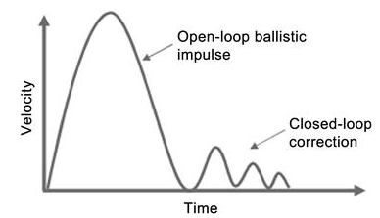
Why does pointing time depend on target and distance?
Notes:
Movement toward target starts slowly, but rapidly accelerates. Initial movement is like a ballistic movement; it’s imprecise, a shot in the general direction.
When the pointer is close to the target, our hand-eye coordination takes over. We enter a hand-eye feedback loop in which we make finer and finer corrections until target is acquired.

Slide 9
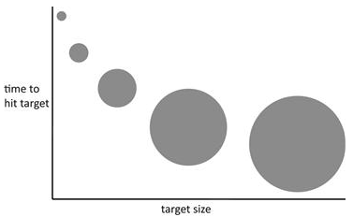
Corollary of Fitts’s Law: Way bigger or closer isn’t much better
→The greater the decrease in target distance, the less the decrease in pointing time
→The greater the increase in target size, the less the decrease in pointing time
Notes:
There are diminishing returns to progressively increasing target size or progressively reducing distance

Slide 10
Question 1
Microsoft Toolbars offer the user the option of displaying a label below each tool. Assuming that the labels do not help users to identify the tool more easily, can users access labeled tools faster?
Yes
No
Why or why not?
Notes:
These questions all have something to do with Fitts’ Law. With a partner, discuss and write down your rationale for each question. You will hand this document in for credit.

Slide 11
Question 2
Suppose you have a palette of tools in a graphics application that consists of a matrix of 16x16-pixel icons laid out as a 2x8 array that lies along the left-hand edge of the screen. Without moving the array from the left-hand side of the screen or changing the size of the icons, can you decrease the time necessary to access the average tool?
Yes
No
Is yes, how? If no, why not?

Slide 12
Question 3
A user is known to be within 10 pixels of the exact center of a large, 1600 X 1200 screen. You need to place a single-pixel target on the screen that the user must point to exactly. Identify the five pixel locations on the screen that the user can access fastest.

Slide 13


Corollary of Fitts’s Law: Screen’s margins have infinite size!
Only applies when a pointer or finger is blocked from moving beyond the edge of the screen
Mouse pointer on desktop or laptop screen
Modern smartphones don’t have edge to physically stop fingers, so this doesn’t apply to them.

Slide 14
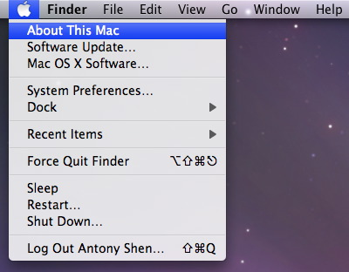
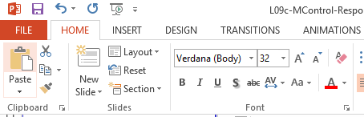
Question 4
Which is quicker to open up (switch to): An apple menu or a Microsoft ribbon?
Apple menu
Microsoft ribbon
Both are equally quick
Apple menu
Microsoft Ribbon
Notes:
Apple, because it’s affixed to the top of the display, providing a nearly infinite target size.

Slide 15
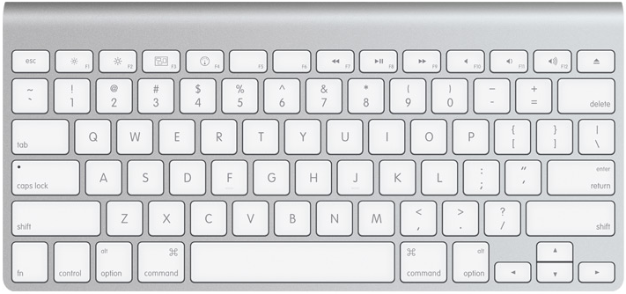
Question 5
The industrial designers who designed the Mac cut the function keys of the Mac in half, so that the total depth of the keyboard was reduced by half a key. Was this a good idea?
Yes
No
Why or why not?

Slide 16

Design implication: Sufficiently big targets
Make click targets sufficiently big. This includes menus, buttons, and links
Make the actual click-target as large as the visible click-target

Slide 17
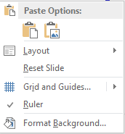
Design implication: Use edges and context menus
Edges of screen have infinite depth!
Context menus can’t be missed; they are exactly where the pointer is!
Notes:
Food for thought: Put most commonly accessed items closest to where the pointer ends up in a context menu. Also, a circular pie menu as a context menu would reduce average target acquisition time because all items are equidistant from pointer.

Slide 18
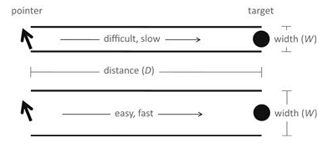
Sister to Fitts’s Law: Steering Law
If you are required to move pointer within a bounded path, the wider the path, the faster the movement:
T = a + b(D/W)
Notes:
That is, when path boundary is narrow, you need to be more careful when you move, so the movement is slower. When the path boundary is wide, you can move more haphazardly (ballistically), and the movement is faster.
Can you think of examples in which this law is relevant?

Slide 19
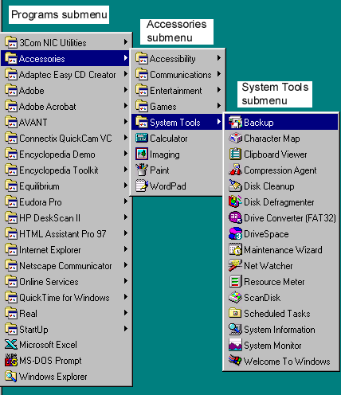

Examples in which Steering Law is Relevant
Cascading menus
Adjusting tab stops in a ruler
http://www.pcmag.com/encyclopedia/term/39312/cascading-menu
Notes:
Interesting points:
Transitions between menus can be made larger algorithmically be providing a larger buffer zone (>-shaped)
Tab stop movement algorithm can make it so that user doesn’t need to stay within ruler to move tab stop. This, in fact, is what Microsoft does in its Office products.
More food for thought: Avoid cascading menus, since they introduce more targets to acquire, and the transition from main to secondary menu is a small target. This can be somewhat mitigated by making the target size larger programmatically (but not graphically)

Slide 20
Motor Behavior & System Responsiveness (Johnson 13 & 14)
Key topics for this lecture
Fitts’s & Steering Law, and implications for design
Responsiveness, durations of perceptual & cognitive functions, and implications for design
Design crits of IA#4 (final)

Slide 21
Responsiveness = compliance with human time requirements and satisfaction
Responsiveness includes
Feedback that input was received
Feedback on how long operations will take
Managing queued events intelligently
Performing low-priority tasks in background
Anticipating common requests
Systems can be slow but responsive
Systems can be fast but unresponsive
Notes:
Systems can tell you WHEN they will have the answer; that’s being responsive.

Slide 22

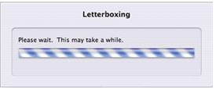
Examples of poor responsiveness
Delayed feedback for keyboard input, scrolling, zooming, object manipulations, map refreshes
“Modal” operations that prevent you from doing other things while you wait
Not indicating how long a time-consuming operation will take
Ignoring user input while performing unrequested operations

Slide 23
Designers can group human cognitive and perceptual limits into “equivalence classes”
We don’t need to be precise; distinctions by order of magnitude are good enough
We also don’t care about durations longer than, say, 100 seconds
Six groups emerge:
0.001 sec
0.01 sec
0.1 sec
1 sec
10 sec
100 sec

Slide 24
Group 1: 0.001 sec
Percep. & Cog. limit | Implications for design
Min. detectable silent audio gap | Delay for audio feedback can’t be more than 0.001 sec

Slide 25
Group 1: 0.01 sec
Percep. & Cog. limit | Implications for design
Preconscious perception Shortest perceivable pen-ink lag Shortest perceivable gap between tones | Present item for 0.01 sec to promote unconscious familiarity Don’t allow lag of more than 0.01 second between stylus movement and ink Tones separated by up to 0.01 sec will be heard as a constant tone; otherwise the tones will be heard as distinct clicks

Slide 26
Group 2: 0.01 sec
Deadline | Percep. & Cog. limit | Implications for design
0.001 sec | Min. detectable silent audio gap | Delay for audio feedback can’t be more than 0.001 sec

Slide 27
Group 3: 0.1 sec (Very popular group!)
Percep. & Cog. limit | Implications for design
Perceive number of 1-4 elements Saccade Audiovisual lock Flinch reflex Cause-effect perception Visual fusion Object identification Editorial window of consciousness Time required to perceive object | Give users at least 0.1 sec to count up to 4 items Feedback for hand-eye coordination must come within 0.1 sec (Feedback must only indicate operation was registered) Audio-visual sync must be within 0.1 sec Confirmatory feedback that system has registered input must be within 0.1 sec (includes “busy” indicators) Speech utterances can’t overlap more than 0.1 sec Animation frames cannot be more than 0.1 sec apart

Slide 28
Group 4: 1 sec
Percep. & Cog. limit | Implications for design
Largest conversational gap between speakers Visual-motor reaction time for unexpected events Attentional blink | Complete user-requested operations within 1 sec; if this can’t be done, show progress bar or busy indicator Complete background (unrequested operations) within 1 sec Allow 1 sec for user to perceive important info before presenting more

Slide 29
Group 5: 10 sec
Percep. & Cog. limit | Implications for design
Longest time a user can concentrate on a task The duration of a subtask (one part of a larger task) | Ensure user can complete one step of a multi-step process (e.g., a wizard) within 10 sec Ensure user can complete user input to an operation within 10 sec
Notes:
Comment: Some operations necessarily take longer and may not be able to be broken up.

Slide 30
Group 6: 100 sec
Percep. & Cog. limit | Implications for design
Time required to make critical decision in emergency situation | Ensure all info needed to make decision is provided or can be located within 100 sec

Slide 31

Guidelines for using busy indicators
Common excuse is that function “should” execute quickly, so none is necessary. What if it doesn’t?
This implies a busy indicator should be at the ready for any function that blocks user interaction while it executes.
There is no downside to doing this (other than the extra programming involved ☺)

Slide 32
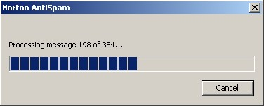
Benefits of using progress indicators
Better than busy indicators, because they let users know what to expect
They can improve perceived responsiveness, even if actual responsiveness isn’t improved!
Should be used for any operations that takes more than few seconds

Slide 33
Guidelines for using progress indicators
Focus on work remaining, not work completed
41 of 50 images copied, not 41 images copied
Show total progress, not progress toward specific task
When showing percentage of operation complete
Start at 1%, not 0%
Show 100% only briefly
Show smooth, linear progress, not bursty progress
Use human terms: “about 3 min.,” not “180 sec”

Slide 34
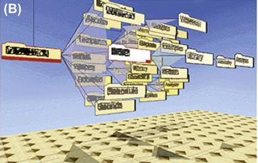
Even better than progress indicators: Progressive results
Don’t wait for all results to be determined before showing user results!
When incrementally loading results, display most important results first
Fill in less important details later
Examples
Show first page of long document
Show first few search results
Show wireframes and thumbnails first
Render video at lower quality first
Notes:
All of this also holds for web apps. Here are some guidelines:
Minimize size/number of images
Show thumbails before full images
Provide overview of page; fill in details later
Use CSS to lay out pages for faster results
Use built-in browser components instead of HTML
Use client-side scripts

Slide 35
Stay ahead of your users; prioritize input
Take advantage of down cycles in the software
Anticipate common requests and pre-compute results
Allow users to abort long operations
Examples
Compute next page of search results while user considers current page
Render next page of document while user views current page
Monitor “cancel” inputs and prioritize them over completing the operation

Slide 36
Motor Behavior & System Responsiveness (Johnson 13 & 14)
Key topics for this lecture
Fitts’s & Steering Law, and implications for design
Responsiveness, durations of perceptual & cognitive functions, and implications for design
Design crits of IA#4 (final)

Slide 37
Design Crits of IA#4 (Final)
We’ll do some today, and some Thursday…
I’ll call on students to come up and present their designs sketches/prototypes
Presenters
Walk us through your design
Be prepared for questions and constructive criticism
Audience members
Keep feedback constructive!
Look for strengths and areas of improvement
Mention a strength before noting an area of improvement

Slide 38
Presenters
Edward Kuo
Sean LaTourette
Andrew Lewis
Siyang Li
Ching-Yen Lin

Slide 39
For next time…
Read Norman Ch. 5 (Human Error)
Complete OCE #1 (by start of class Thursday)

