Slide 1
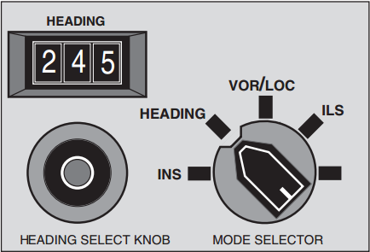
User Errors (Norman 5)
The autopilot heading control in a early 1980s Boeing 747. Taken from “The crash of Korean Air Lines Flight 007,” by Asaf Degani. Available at http://ti.arc.nasa.gov/m/profile/adegani/Crash%20of%20Korean%20Air%20Lines%20Flight%20007.pdf
Notes:
This is the Boeing 747’s autopilot heading control. It is switched here to “Heading,” which says to navigate according to magnetic north. This is not a good bet when flying trans-pacific routes; it’s much preferred to use the more accurate “inertial navigation system” (INS), which can navigate a plane safely through a series of waypoints. All that needs to be done is to rotate the knob to INS. But, two conditions must be true for INS to kick in: (a) plane must be within 7.5 miles of route entered, and (b) must be flying toward the direction of the route entered. Unless two conditions are met, autopilot stays in “Autopilot ARMED” mode; however, the feedback is limited: “INS” is lighted in amber instead of green, but there is no indication that the plane continues to be in “heading” mode!; even if the knob is turned from “Heading” to “INS,” suggesting that it is in fact in “INS” mode.
After the KAL 007 incident, all autopilots were changed to include the CURRENT mode of navigation in addition to the “armed” mode.

Slide 2
We tend to blame humans, not technology
“When a bridge collapses, we analyze the incident to find the causes of the collapse and reformulate the design rules to ensure that form of accident will never happen again. When we discover that electronic equipment is malfunctioning because it is responding to unavoidable electrical noise, we redesign the circuits to be more tolerant of the noise. But when an accident is thought to be caused by people, we blame them and then continue to do things just as we have always done.
--Norman, Ch. 5

Slide 3
Human Error (Norman 5)
Key topics/questions for this lecture
To err is human; stop blaming us!
Root cause analysis: A case study in commercial aviation
Errors: Slips and mistakes
Designing for error
Design crits of IA#4

Slide 4
Is it fair to blame humans for all errors?
We expect them to be fully alert and attentive for long periods of time
We require them to remember or follow complex procedures
We provide them with inadequate information and data for making decisions
We ask them to respond quickly after being idle for hours
We ask them to respond precisely in complex, high workload environments that require attention to multiple tasks
Notes:
Examples: driving, flying a plane, working repetitive tasks on an assembly line
Examples: pilot checklists, safety shutdown procedures at power plants
Examples: Pilots have only rough idea of planes around them, and no clue what planes are on the runway when visibility is low
Examples: Sudden failure after hours of smooth operation
Examples: Air traffic controllers work in highly complex environments

Slide 5
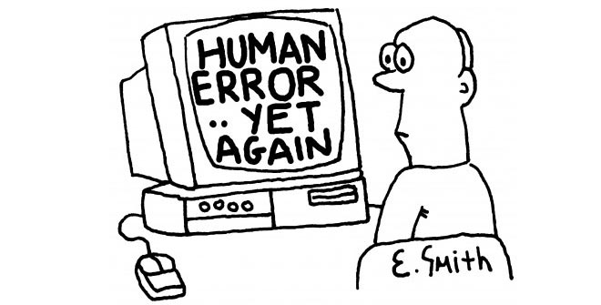
Why do human errors occur?
Inadequate or inaccurate information
Poor match between goals and technology
Difficult/complex procedures
Interruptions
Poor attitude toward error (the “blame and/or train” game) leads to MORE errors!
http://blog.objectiflune.com/financial-companies-human-error/

Slide 6
Human Error (Norman 5)
Key topics/questions for this lecture
To err is human; stop blaming us!
Root cause analysis: A case study in commercial aviation
Errors: Slips and mistakes
Designing for error
Design crits of IA#4

Slide 7
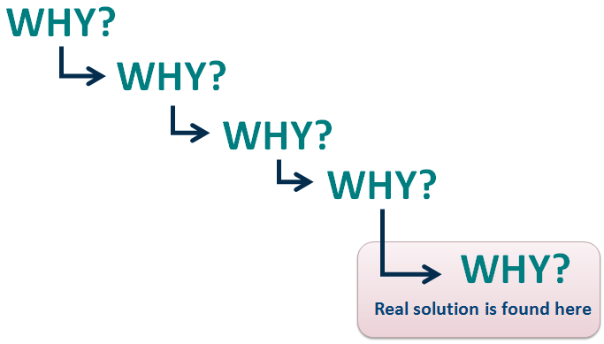
Root cause analysis requires going beyond human error!
“The five whys approach”: Keep asking “why” until you get to the root cause, not just a proximate cause
Don’t stop when you hit “because a human made a mistake!”

Slide 8
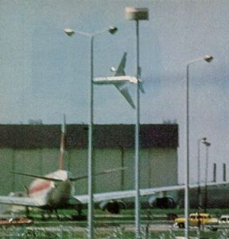
Example of root cause analysis: American Airlines Flight 191
DC-10 with 258 passengers and 13 crew aboard
Departed from Chicago on May 25, 1979, enroute to LA
Left engine detached during takeoff
Plane banked steeply left after airborne, crashing 50 seconds after takeoff
Worst-ever aviation disaster on U.S. soil
Why did this happen?
Notes:
Preview: Can do three different root cause analyses of this incident
Flight 191 loses engine on left wing on takeoff. Engine detaches from wing and flies up and over wing in airstream. This leads to a severing of the hydraulics line on the left wing, loss of hydraulics, a lowering of the left wing slats (with right slats remaining up), asymmetric lift, severe banking to left, and crash after only 50 seconds in the air. All 258 passengers and 13 crew perished.

Slide 9
Root cause analysis #1: Maintenance issue
Why? Engine detached from wing at takeoff
Why? There was metal fatigue at attachment point?
Why? Unauthorized maintenance procedure used to perform maintenance (see https://www.youtube.com/watch?v=NAm-HfI2B20 from 28:05-30:16)
Why? Unauthorized maintenance procedure saved 200 man hours of labor per aircraft and was perceived as safer (only 27 disconnects instead of 72)
Why? Design of pylon and adjacent surfaces made parts difficult to service and prone to damage
→ Design problem, not human problem
Notes:
Start chain with “AA Flight crashed”

Slide 10
Root cause analysis #2: Technical flaw in plane
Why? Plane entered a severe left bank that plummeted it to the ground
Why? Slats on right wing were raised, but slats on left wing were retracted
Why? Engine loss severed hydraulic lines on left wing, leading to retraction of slats on left wing
Why? Wing slats rely on hydraulic pressure to remain raised
Why? There is no slat relief valve to prevent slat retraction in case of hydraulic damage
→ Design problem, not human problem

Slide 11
Root cause analysis #3: Poor cockpit design
Why? Plane entered a severe left bank that plummeted it to the ground
Why? There was not enough air speed to promote the necessary lift (Stall speed was at 159 knots with trimmed left wing)
Why? The pilots were climbing at “takeoff safety airspeed” (V2, 153 knots)
Why? Pilots were following standard procedure when an engine fails
Why? Pilots assumed they had lost an engine, but did not know they had lost the slats on left wing and that they were stalling
Why? Loss of hydraulics in left wing shut off instrumentation used to indicate slat status, and disabled stall warning system
Why? Hydraulic lines powered those instruments and warning systems, and the pilots did not switch to back-up power
Why? There was little time, and switching to back-up power would have required pilot to get out of seat, turn around, locate switch behind him, and turn it on
→ Design problem, not human problem

Slide 12
Epilogue of Flight AA 271 Root Cause Analysis
DC-10’s grounded for one month after accident
Key changes implemented
Engine maintenance procedure must be followed to the letter
Installation of slat relief valves to keep slats open in event of hydraulic failure
Installation of hydraulic shutoff valves to isolate hydraulic ruptures
Require instrumentation and warning systems to be powered automatically by multiple engines in case of failure
DC-10 never experienced an accident like this again, and went on to safely serve aviation industry for decades

Slide 13
Human Error (Norman 5)
Key topics/questions for this lecture
To err is human; stop blaming us!
Root cause analysis: A case study in commercial aviation
Errors: Slips and mistakes
Designing for error
Design crits of IA#4

Slide 14
Reading Question 1
When you commit a slip, your goal is . When you commit a mistake, your goal is .
Correct, correct
Incorrect, correct
Correct, incorrect
Incorrect, incorrect
Notes:
C

Slide 15
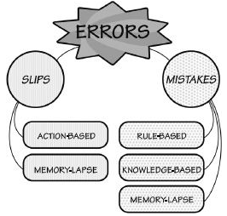
The difference between slips and mistakes
Slips: Goal is correct, but execution is flawed
Mistakes: Goal or plan is incorrect

Slide 16
Slips involve a faulty action or memory lapse
Action based
You moved your hand to type a “y,” but hit the “u” key instead
You bump the mouse when trying to grab it, shifting the cursor to the right
Memory-based
You forgot to turn down the heat before bed
You forget to save a copy of a file to another drive before exiting the program

Slide 17
Mistakes involve a wrong goal or plan
Rule-based: Correct diagnosis of situation, but wrong course of action
In Flight AA 191 case study, maintenance crews correctly diagnosed engine problem, but applied wrong maintenance procedure
Knowledge-based: Incorrect diagnosis of situation leads to wrong course of action
In Flight AA 191 case study, pilots (incorrectly) diagnosed situation as left engine failure, and applied prescribed procedure
Memory lapse: Goals, plans, or evaluation steps forgotten
Two flights in early 1990s crashed on take-off because pilots did not complete take-off checklist prior to takeoff; they had been distracted by last-minute runway changes due to weather
Notes:
Proper actions toward wrong plan or goal means the actions are wrong

Slide 18
Reading Question 2 (Applied)
In AA Flight 191 accident, the pilot diagnosed problem as engine failure, and applied the prescribed procedure (“maintain climb at 153 knots). The plane crashed soon thereafter.
What kind of mistake did the pilot make?
Rule-based
Knowledge-based
Notes:
This turned out to be a knowledge-based mistake→the procedure addressed the wrong problem. The problem wasn’t an engine failure. The problem was the engine was physically lost, causing a loss of hydraulic power. So the pilot applied the correct procedure, given the problem he thought he had. However, he didn’t understand the problem.
Now re-state this scenario to illustrate a rule-based mistake.
Example: “In AA Flight 191 accident, the pilot correctly diagnosed the problem as an engine failure, but applied the wrong rule: He incorrectly thought that when an engine fails, you should increase the plane’s speed to 165 knots and continue to climb. He committed a rule-based mistake. In so doing, however, he saved the plane!

Slide 19
Reading Question 3
In what steps do slips occur in the Seven Stages of Action model?
Plan, Compare
Specify, Perform
Perceive, Interpret
Specify, Perform, Perceive, Interpret
All of the above
Notes:
D

Slide 20
Reading Question 4
In what steps do mistakes occur in the Seven Stages of Action model?
Plan, Compare
Specify, Perform
Perceive, Interpret
Specify, Perform, Perceive, Interpret
All of the above
Notes:
A

Slide 21
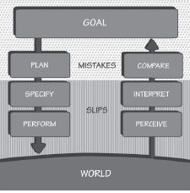
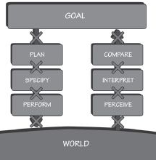
Slips and mistakes can be situated in stages of action model
Slips and Mistakes are in the steps
Memory lapses are in the transitions
Notes:
Can tie this to “system 1” and “system 2” from Johnson text as well!

Slide 22
Capture and description-similarity slips
Capture slips: You replace steps in a sequence with steps from a similar, but more familiar sequence of steps
Example: Eins, zwei, drei, vier funf replaced with Eins zwei, three, four five
Description-similarity slips: Apply familiar set of actions to wrong object
Example: Place canned good in fridge
Example: Throw dirty clothes into garbage

Slide 23
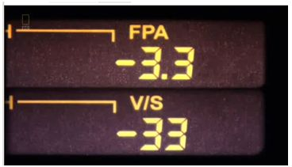
Mode-error slips occur when device has multiple modes
Crash of Inter Flight 148 is classic example
Airbus A320 allows pilots to program autopilot descents in two modes: vertical speed (ft/min) and angle of descent (degrees)
In high-pressure landing situation, a pilot entered -33, intending for it to be an angle of descent (-3.3 deg.)
However, he was in vertical speed mode, so -33 meant -3300 ft/sec
Notes:
Epilogue: Airbus changed the display so that it was clearer which mode the pilot was in. What do you think they did to change the display?

Slide 24
Revisiting KAL Flight 007
Why did it fly into Russian territory?
Notes:
It was a mode slip error induced by a poor autopilot design! This is the Boeing 747’s autopilot heading control. It is switched here to “Heading,” which says to navigate according to magnetic north. This is not a good bet when flying trans-pacific routes; it’s much preferred to use the more accurate “inertial navigation system” (INS), which can navigate a plane safely through a series of waypoints. All that needs to be done is to rotate the knob to INS. But, two conditions must be true for INS to kick in: (a) plane must be within 7.5 miles of route entered, and (b) must be flying toward the direction of the route entered. Unless two conditions are met, autopilot stays in “Autopilot ARMED” mode; however, the feedback is limited: “INS” is lighted in amber instead of green, but there is no indication that the plane continues to be in “heading” mode!; even the knob is turned from “Heading” to “INS,” suggesting that it is in fact in “INS” mode.

Slide 25
Human Error (Norman 5)
Key topics/questions for this lecture
To err is human; stop blaming us!
Root cause analysis: A case study in commercial aviation
Errors: Slips and mistakes
Designing for error
Design crits of IA#4

Slide 26
The need to detect (and learn from) errors
Create a social environment that rewards people who honestly report errors
Build UIs that make it easier to detect errors (have good feedback); slips easier to detect than mistakes
Realize that people are good at “explaining away” errors
Notes:
Example: Commercial pilots can semi-anonymously report errors to NASA, a neutral body
Example: On road to Mammoth Lake, sign for Las Vegas appears. You’re on the wrong road, but you explain away the mistake by thinking that Las Vegas ads appear all over California.

Slide 27
Design implications
Understand causes and then minimize them
Do sensibility (“sanity”) checks: Do things make sense at this point?
Support undo
Provide good feedback to support easy error detection
Don’t regard actions as “errors,” but as “approximations”; steer the user back on course
Make it easy to recover from interruptions
Avoid nuisance warning signals
Add constraints to prevent errors
Notes:
Great example of intentionally disabled warning system occurred in MD-80 take-off accidents (e.g., NW Flight 255 out of Detroit, Aug. 16, 1987). Pilots were not warned of flaps not being properly positioned at takeoff.

Slide 28
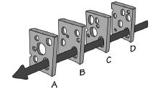
Swiss Cheese model of accidents provides insight
Notes:
Accidents have multiple causes. Unless all the holes of cheese perfectly line up, the accident won’t happen.
Implications:
Accidents don’t have just one cause; they have multiple causes
Decrease chance of accidents by
providing more layers of precaution (slices of cheese)
minimizing chances of slips and mistakes (fewer holes in cheese, or smaller holes)
Providing different mechanisms in different parts of system (difficult for holes to line up; alert users when holes line up)

Slide 29
Key points of lecture
To error is human; don’t blame humans for errors!
Human error is most often the result of design flaws
Get at cause of error through root cause analysis (ask “why” repeatedly)
Two types of human error: slips and mistakes
There are many things we can do to design for error, including preventing errors, aiding detection of errors, and aiding recovery from errors

Slide 30
Human Error (Norman 5)
Key topics/questions for this lecture
To err is human; stop blaming us!
Root cause analysis: A case study in commercial aviation
Errors: Slips and mistakes
Designing for error
Design crits of IA#4

Slide 31
Design Crits of IA#4 (Final)
Let’s look at some IA#4 final designs!
I’ll call on students to come up and present their designs sketches/prototypes
Presenters
Walk us through your design
Be prepared for questions and constructive criticism
Audience members
Keep feedback constructive!
Look for strengths and areas of improvement
Mention a strength before noting an area of improvement

Slide 32
Presenters
Edward Kuo
Sean LaTourette
Andrew Lewis
Siyang Li
Ching-Yen Lin

Slide 33
For next time…
Complete OCE#1 by 11:59 pm tonight!
Read Team Project Overview document (on OSBLE; released later today) and think about project ideas
We will be doing team match-making next Tuesday, so come prepared with project ideas!
Have a great weekend!

