Slide 1
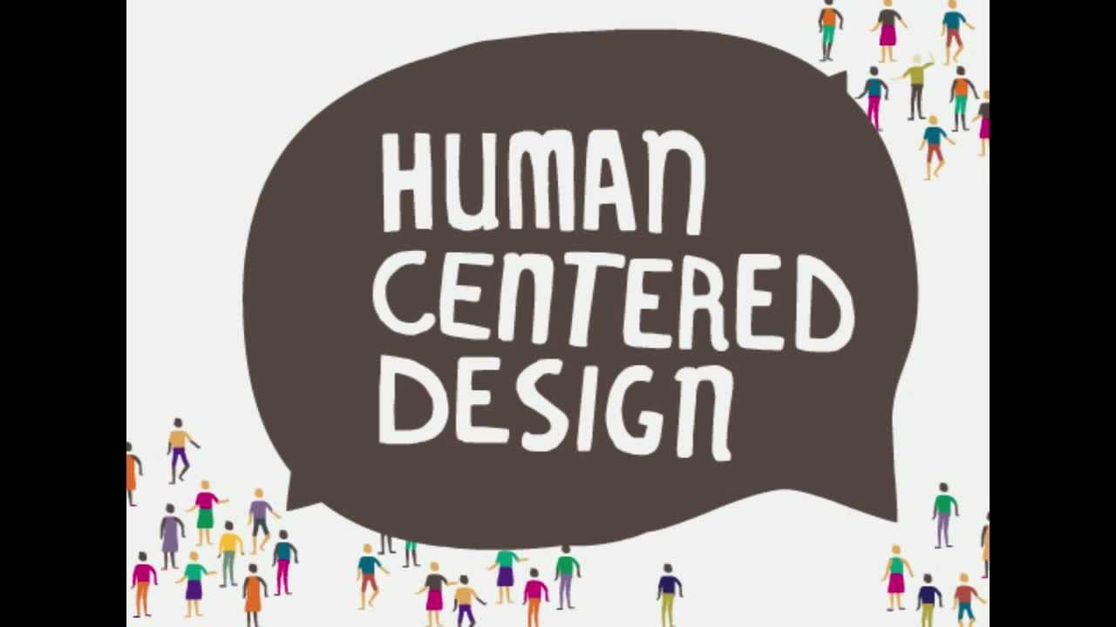
13-User-Centered Design Team Project, & Team Matchmaking
https://www.youtube.com/watch?v=6mcZKWhjr9o
Notes:
Click in….

Slide 2
12-User Centered Design (Barnum 3, Norman 5)
Key topics/questions for this lecture
User-centered design lifecycle
Intro to the team project
Team and topic match-making

Slide 3
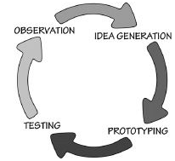
Human-centered design process (Norman)
Notes:
Norman describes the UCD or HCD process at the highest level of abstraction…

Slide 4
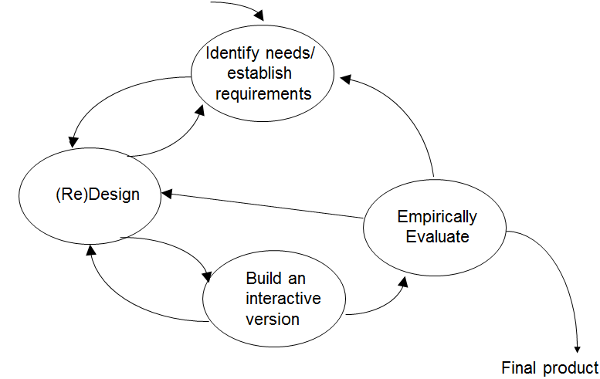
User-centered design process (Preece et al.)
Notes:
Preece, Rogers, Sharp’s schematic adds a bit more detail.

Slide 5
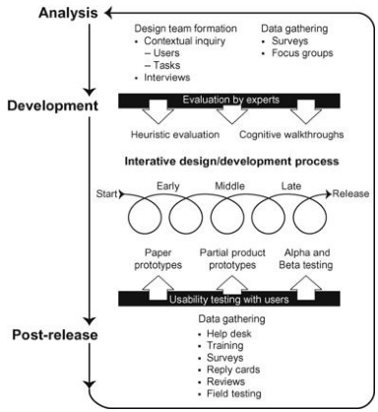
User-centered design process (Barnum)
Notes:
Barnum’s account of user-centered design adds more detail, and also adds a time dimension

Slide 6

Phase 1: Study users to establish requirements
Ensure people who participate in design process match target audience
Observe/talk to potential users in their native environments
Realize that design studies are much different from marketing studies
Notes:
* Demographics not as important as activities performed
* You may need to travel to another country to do this!
* Designers care about what people really need and how they will actually use products. Marketers want to know what people will buy, including how they make purchasing decisions. Designers tend to employ (time consuming) qualitative and observational study methods to study people in depth, understanding how they complete tasks and what environmental factors come into play. Designers typically don’t study many people.
Marketers care about customers. Who will purchase a product? What factors play into purchasing decisions? Marketers use large-scale quantitative studies—often focus groups, surveys/questionnaires. Marketers can use BIG data, A/B testing with thousands of users, to learn about customers.
While what marketers learn tends to be shallow compared to what designers learn. both kinds of information are useful. We need info on what people will buy, and how they will use things once they are purchased.

Slide 7
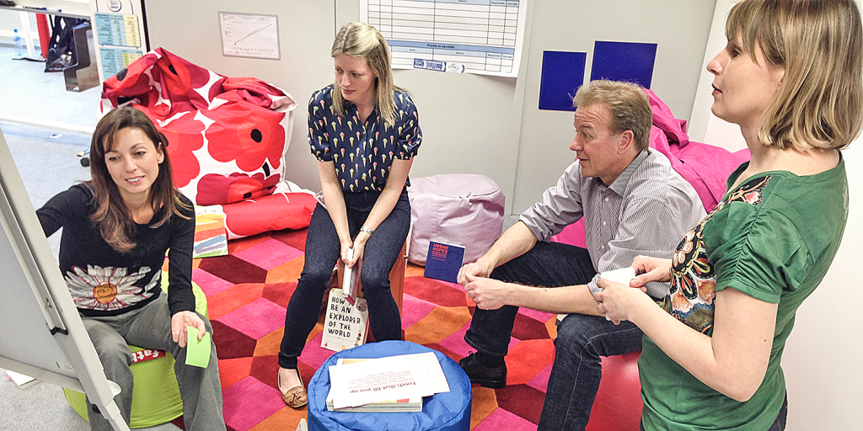
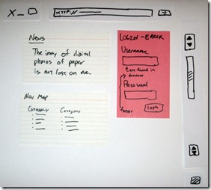
Phase 2: Design and Prototype
Ideation
Generate lots of ideas
Be creative, without regard for constraints
Question everything
Prototyping
Low fidelity materials
“Wizard of oz” method
http://liftuptransformation.com/workshops-for-organisations/
http://jonas.follesoe.no/oldblog/2009-09-26-agile-ux-development-using-low-fidelity-prototypes/
Notes:
Prototyping can be used early on to better understand the design problem/design space. Later on, it can be used to test out alternative designs.

Slide 8
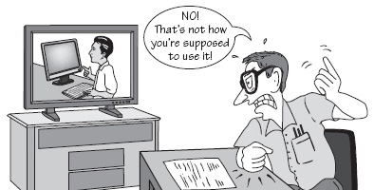
Phase 3: Empirically evaluate with target users
Find 3-5 users who match target population
Have them interact with prototype to complete realistic tasks
Consider recruiting pairs to work together
Record and observe interaction
Consider eliciting participants’ thought processes and impressions afterwards, using video as prompt
http://www.sitepoint.com/choosing-usability-tests-participants/

Slide 9
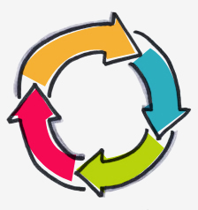
Iterate, iterate, iterate! “Fail frequently, fail fast” –David Kelly
Each iteration reveals new issues and insights
Translate these into new requirements and design refinements
Requirements are the hardest part to get right!
Iteration ends when you’re out of time and/or money

Slide 10
12-User Centered Design (Barnum 3, Norman 5)
Key topics/questions for this lecture
User-centered design lifecycle
Intro to the team project
Team and topic match-making

Slide 11

Team Design Project in Overview
Work in groups of up to three
You will complete two iterations of user-centered design process
You will need to exercise collaboration and teamwork skills while also practicing key HCI skills
Early data gathering
Prototyping
Usability study design and analysis
Written and oral communication
Notes:
Undergrads work with undergrads; grads work with grads

Slide 12
A closer look at project deliverables
Deliverable | Weight | Deadline
TPD#1: Early Data Gathering Conduct 3 contextual inquiries Write report | 10% | 3/23
TPD #2: Lo Fi Prototype Video Iteratively refine lo-fi prototype Create demo video Review other team’s prototypes | 8% 2% | 4/4 4/6
TPD #3: Project presentation Implement hi fi prototype Run hi fi usability study Present results | 10% | 4/20, 4/25 & 4/27
TPD #4: Usability study report Implement hi fi prototype Run hi fi usability study Write report | 10% | 4/27
Notes:
Important note: “hi fi prototype” will be extremely limited. It is not a full-blown implementation. Rather, it must be capable of simulating the behavior of the interface with respect to at least five (and possibly more) core tasks

Slide 13
Suggested timeline for completing team project
Dates | Activities
2/21 – 2/24 | Team formation, visioning and scoping of project
2/25 – 3/6 | Do background research and conduct contextual inquiries
3/7 – 3/23 | Write early data gathering report (TPD #1; due 3/23)
3/24 – 3/31 | Design/refine low fidelity prototypes
4/1 – 4/4 | Create lo fi prototype demo video (TPD #2a; due 4/4)
4/5 – 4/6 | Review other team’s demo videos (TPD #2b; due 4/6)
4/7 – 4/18 | Implement hi fi prototype and run usability studies
4/18 – 4/20 | Prepare project presentation
4/20, 25, 27 | Give final project presentation (TPD #3)
4/20 – 4/27 | Write up usability study report (TPD #4; due 4/27)

Slide 14
12-User Centered Design (Barnum 3, Norman 5)
Key topics/questions for this lecture
User-centered design lifecycle
Intro to the group project
Team and topic match-making

Slide 15
Team and topic match-making
Suggested theme: Sports and activity tracking, analytics, and motivation
Suggested projects:
Speedgolf personal app
Speedgolf tournament scoring system
WSU SRC app to help patrons use facilities effectively and meet fitness goals
Biking workout app & monitoring device
Swimming workout app & monitoring device
Running workout app & monitoring device
Many other projects on this theme are possible!
Notes:
Note the obvious parallels to the “swimmer’s helper” design you have been working on.
One aspect of projects in this theme is the sharing and discussion of personal data and progress. So you should think about how people in these various communities want to connect, collaborate, share, commiserate, etc. through their activities, and you should provide tech solutions to this

Slide 16
Project designs potentially multiple components
Design of a device that makes it possible to monitor the activity and provide dynamic feedback as activity takes place
Design of a web or mobile app that makes it possible to set goals, set up workouts, view/analyze results
Design of a web or mobile app that makes it possible to build communities and connect with others
Notes:
Notes:
Think about your project in terms of a problem to be solved. What is the real problem that people have that needs to be addressed through technology. For example, in case of personal speedgolf app, the problem is one of keeping track of crucial stats during a speedgolf round that can help speedgolfers understand and improve their performances
Monitoring device may need to communicate with additional monitoring devices (e.g., heart rate monitor, bike cadence meter) in order to obtain additional useful data
Monitoring device and web/mobile app could be one in the same; if they’re not, then monitoring device must be able to communicate with app!

Slide 17
List of teams/project themes (to be built during class)
Theme | Team members
Ski App | Jeff A. Wai Lok, Casey
Cycling | Jeff M., Zach
Running | Alex, Edward, Spencer
Social Gaming | Jacob, Josh C.
 | Quang, Chao, Ching-Yen
 | Zak, Joey
Mixed Drink App | Justin, Andew, Jonah
ESL Skills Building | Daniel, Sandra (G)
 | Sung, Siyang
Hiking App | Sean, William, Ryan
WSU Schedule Planner | Josh K., Kris, Max
WSU SRC | Dara, Jordan, Brittany
EECS Grad Student App | Yang, Sameneh (G)
Uncommitted | William, Oliver, Erin, Cammi, Robert
Notes:
This is your chance to form teams. If you have trouble, I’ll put you on teams randomly. Make sure grad students work with grad students, and undergrads work with undergrads

Slide 18
Students enrolled in class (✓ when on team)
✓ | Undergrads
X | Jeff Anderegg
 | William Boston
 | Oliver Carson
X | Josh Carver
X | Wai Lok Cheng
X | Ryan Hannan
X | Dara Higgs
X | Justin Jackson
X | Josh Korn
X | Edward Kuo
X | Sean LaTourette
X | Andrew Lewis
X | Siyang Li
 | Ching-Yen Lin
 | Spencer Maas
X | Brittany Manuel
✓ | Undergrads
X | Jeff Melvin
X | Zak Mohamed
X | Zachary Moore
 | Erin Mullen
X | Quang Nyguyen
X | Sung Park
X | Joey Quaranta
X | Jordan Richards
X | Casey Riehle
X | Jacob Sadoian
X | Maxwell Shoop
X | Jonah Simon
 | Cammi Smith
X | Kris Taylor
 | Robert Wood
x | Alex Yun
✓ | Undergrads
x | Chao Zheng
✓ | Grads
X | Samaneh Aminighanghahi
X | Sandra Bancroft-Billings
X | Daniel Jinguji
X | Yang Zhang

Slide 19
To do between now and Thursday
Make sure you have a team and topic!
Reading:
the lecture slides for Thursday (L14-Early-Data-Gathering)
Andy’ Ko’s “How to understand problems” essay: http://faculty.washington.edu/ajko/info360/readings/how-to-understand-problems.html
How to do a contextual inquiry:
http://www.usabilitybok.org/contextual-inquiry (Click on the “How To” tab)

