Slide 1
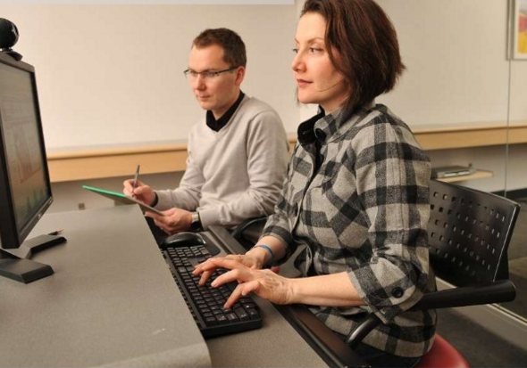
14-Early Data Gathering
http://www.slideshare.net/mniola/introduction-to-ux-research-16626959?qid=06698ebe-b896-488c-b18b-75553f13c4e5&v=&b=&from_search=5
Notes:
Click in….

Slide 2
The importance of studying users in their naturalistic environments
“One of its most critical techniques is to observe the would-be customers in their natural environment, in their normal lives, wherever the product or service being designed will actually be used. Watch them in their homes, schools, and offices. Watch them commute, at parties, at mealtime, and with friends at the local bar. Follow them into the shower if necessary, because it is essential to understand the real situations that they encounter, not some pure isolated experience.”
--Norman, p. 222

Slide 3
14-Early Data Gathering
Key topics/questions for this lecture
UCD: Establishing requirements
Overview of early data gathering methods
How to choose among methods
How to do a Contextual Inquiry (CI)

Slide 4
The first step of the UCD process is to understand users’ needs
Identify needs/
establish
requirements
(Re)Design
Empirically
Evaluate
Build an
interactive
version
Final product

Slide 5

Early empirical research involving users is crucial!
What?
Understand as much as possible about users, activities, tasks, and contexts
Produce stable requirements
How?
Data gathering and analysis
Synthesize data into requirements, personas, scenarios
Iterate!
Why?
Establishing requirements is stage where failure occurs most commonly
Getting requirements right is crucial to designing usable and useful technologies

Slide 6
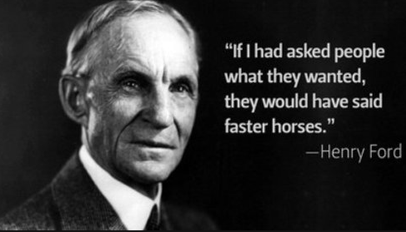
Why “Establish” Requirements?
Users don’t necessarily know what their requirements are
Requirements arise from understanding users’ needs
Requirements can be justified by empirical data
http://apptimize.com/blog/2015/11/netflix-registration-ab-test/

Slide 7
Functional Requirements
What the system should be able to do (traditional focus of requirements gathering activities)
Examples
"User must be able to create a new calendar entry."
"Users must be able to delete an existing calendar entry."
"Users must be able to edit an existing calendar entry."

Slide 8
Usability Requirements
Establish user performance levels for the system, in measurable, observable terms
Task efficiency
Error rates
Learnability
Memorability
Safety
E.g., "Users must be able to add a new calendar entry in 20 seconds"

Slide 9
User Experience Requirements
Establish levels for the user's subjective experience with the system, in observable, measurable terms (Likert scales)
Ease of Use
Satisfaction
Confidence
Ease of Learning
E.g., "On a scale of 1 to 10, users must rate the system a 9 in terms of ease of use."

Slide 10
Clicker Question #1
The following is an example of a functional requirement:
Users must be able to create a new announcement.
Users must commit no more than an average of 1 error per 10 tasks.
On a scale of one to 10, users must rate the system’s ease of use a 9.
The system must be implemented in C#.

Slide 11
Clicker Question #2
What is the difference between a usability requirement and a user experience requirement?
There’s no difference (they’re just different terms for the same thing).
Usability requirements focus on the software design, whereas user experience requirements focus on user experience.
Progress toward usability requirements can be measured; progress toward user experience requirements cannot.
User experience requirements establish goals for the user’s subjective experience, whereas usability requirements establish goals for human performance.

Slide 12
You try it…
With your project team, take a couple of minutes to come up with the following for your team’s target technology:
One functional requirement
One usability requirement
One user experience requirement

Slide 13
14-Early Data Gathering
Key topics/questions for this lecture
UCD: Establishing requirements
Overview of early data gathering methods
How to choose among methods
How to do a Contextual Inquiry (CI)

Slide 14
There are a variety of early data gathering methods to choose from
Questionnaires
Interviews
Focus groups
Field techniques
(Participant) observation
Artifact collection (including documentation)
Audio and video recording
Software log data
Researching similar products
Contextual Inquiry

Slide 15

Questionnaires
A series of questions designed to elicit specific information
Questions may elicit different kinds of answers:
YES/NO
Range of pre-supplied answers (e.g., Likert Scale)
Comments
Can provide quantitative or qualitative data
Good for learning about a large, dispersed group of people
Good for obtaining a representative sample

Slide 16
Guidelines for Questionnaire Design
Start with questions to elicit background and demographic data
Move on to questions specific to your data gathering interests
Group related questions together
Pay attention to ordering
Provide clear instructions
Judiciously choose open and closed response questions

Slide 17
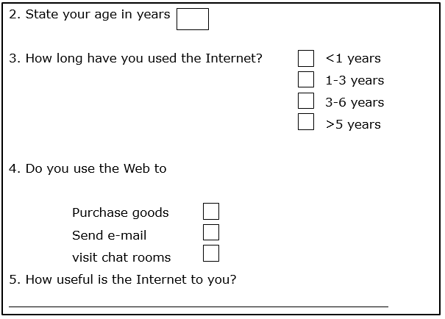
Can you find four flaws in this questionnaire?

Slide 18

Interviews
Three basic types
Structured: Predetermined questions
Semi-structured: Predetermined questions with open-ended follow-up
Unstructured: No predetermined questions
Props can be used to stimulate responses
Can prove helpful to audiotape and transcribe
Good for getting personal perspectives and exploring issues
Can be time-consuming
May be difficult to interview all key stakeholders
http://www.indianscribes.com/blog/preparing-questions-for-a-qualitative-research-interview/
Notes:
Sample scenarios of use, prototypes

Slide 19

Focus Groups
Group interviews
Good for consensus-building
Good for highlighting areas of contention
Require a skilled facilitator for best results
See http://www.webcredible.com/blog-reports/web-usability/focus-groups.shtml for guidelines on running a focus group
http://www.usability.gov/how-to-and-tools/methods/focus-groups.html

Slide 20
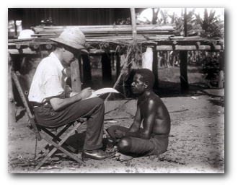
(Ethnographic) Field Techniques
Spend time with stakeholders in their day-to-day environments, observing work as it happens
Gain insights into stakeholders’ real life tasks and problems, firmly grounded in context
Several ethnographic field techniques can help
Participant observation
Audio and videotaping
Artifact collection
Good for understanding the nature and context of the tasks
Requires potentially significant time commitment to conduct study and analyze data
http://www.stevebromley.com/blog/2011/02/09/ethnography-as-an-application-of-3rd-space-theory/

Slide 21
Tips for Applying Ethnographic Field Techniques
Be aware of and open about your biases
Don’t take anything for granted
Naiveté is an important attribute for an ethnographer
Be curious!
Render the ordinary extraordinary; ask lots of questions
“Be reasonable, courteous, and unthreatening” (Hughes et al., 1993)
Be systematic
Ethnography isn’t arbitrary!
It involves using established research techniques to systematically explore a set of research questions

Slide 22
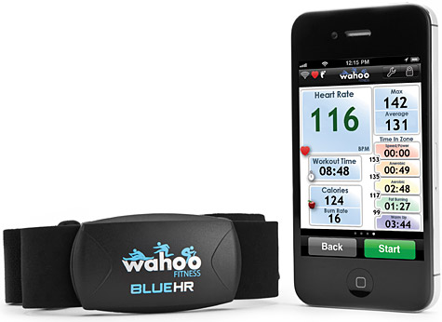
Researching similar products
What products are similar to the one you are designing?
What features do those products have?
Who are the users?
How are the products used?
Are the products well-designed?
Do the products have any missing functionality?
What can you learn from them?
http://www.amazon.com/Wahoo-Heart-Monitor-iPhone-Android/dp/B006NZH0TU

Slide 23
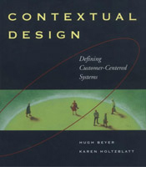
An Offshoot: Contextual Design
Method for collecting and interpreting fieldwork data, with end-goal of developing software
Is widely used in industry
Has seven parts
Contextual inquiry
Work modeling
Consolidation
Work redesign
User environment design
Mockup and test with customers
Putting it into practice
Notes:
See Beyer and Holtzblatt book

Slide 24
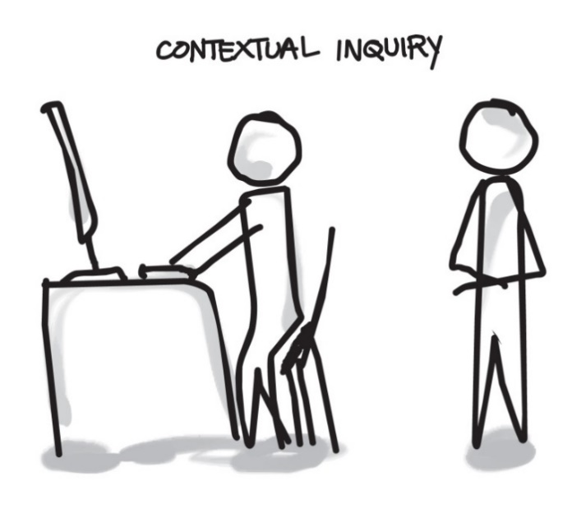
Contextual Inquiry
An in situ interview
Takes place as participant does activity in natural environment
Participant is expert, designer is apprentice
Four main principles:
Context: see what happens in context of activity
Partnership: Participant and designer collaborate; there’s no dominant partner
Interpretation: observations interpreted by participant and designer together
Focus: Inquiry is relevant to the design being developed; a “project focus” is established
http://www.uxpassion.com/blog/usability-contextual-inquiry/

Slide 25
Contextual Inquiry is a focused ethnographic field technique
Much shorter (hour(s) vs. months) than traditional field studies (just an hour or two needed)
More intense and focused than traditional field studies
Active inquiry, rather than just observation
Clear focus on technology design
A useful technique for obtaining empirical data to inform requirements and design

Slide 26
14-Early Data Gathering
Key topics/questions for this lecture
UCD: Establishing requirements
Overview of early data gathering methods
How to choose among methods
How to do a Contextual Inquiry (CI)

Slide 27
With so many choices, how can I choose?
Techniques differ in two key ways
Amount of time, level of detail and risk associated with the findings
Knowledge the analyst requires
Techniques are complementary
Can’t always believe what people say, so also observe what they do

Slide 28
Difficulties you may encounter when gathering data
Identifying and involving broad range of stakeholders: users, managers, developers, customer reps, union reps?
Getting ‘real’ users, not managers:
Traditionally a problem in software engineering, but better now
Req'ts management: version control, ownership
Communication between parties
within development team, between users
different parts of organization use different terminology
Domain knowledge distributed and implicit
difficult to dig up and understand
knowledge articulation: how do you walk?
Availability of key people

Slide 29
Successful data gathering
Focus on identifying the stakeholders’ needs
Involve all the stakeholder groups
Involve more than one representative from each stakeholder group
Triangulate using a combination of data gathering techniques
Support the process with props such as prototypes and task descriptions
Run a pilot session
Know your key research questions
Consider carefully how to record the data

Slide 30
Formulate requirements by interpreting and analyzing data
Aims
Identify requirements
Firmly ground in empirical data
Start soon after data gathering phase
Strive for initial interpretation before deeper analysis
Different approaches emphasize different elements
class diagrams for object-oriented systems,
entity-relationship diagrams for data intensive systems
Following table can help structure requirements descriptions (will use in your projects)
Functional Requirement | Empirical Source/ Justification | Usability Target

Slide 31
For Discussion…
What kinds of data gathering techniques would be appropriate in the following situations, and how would you use them? Assume that you are at the beginning of the development process and have sufficient time and resources to use any of the techniques.

Slide 32
Situation A (Select primary method you would use)
You are developing a new software system to support a small accountant’s office. There is a system running already with which the users are reasonably happy, but it is looking dated and needs upgrading
Questionnaire
Interview
Contextual Inquiry

Slide 33
Situation B (Select primary method you would use)
You are looking to develop an innovative device for diabetes patients to help them record and monitor their blood sugar levels. There are some products already on the market, but they tend to be large and unwieldy. Many diabetes patients rely on manual recording and monitoring methods involving a needle, some chemicals, and a written scale.
Questionnaire
Contextual inquiry
Focus group

Slide 34
14-Early Data Gathering
Key topics/questions for this lecture
UCD: Establishing requirements
Overview of early data gathering methods
How to choose among methods
How to do a Contextual Inquiry (CI)

Slide 35


Example design project: Speedgolf App
Golf at speed!
Speedgolf score = golf strokes + minutes (par = 72 + 54 = 126)
Difficult to track score and hole-by-hole time because it moves so fast!
Speedgolf scorecard:
 | 1 |  | 2 |  | 3
Rob Hogan | 4 | 1:44 | 3 | 1:21 | 4 | 2:08

Slide 36
1. Identify Appropriate Users (You’ll need at least 3)
How would you characterize appropriate users in terms of
Age
Gender
Computer/internet experience
Education level
Level of interest, engagement, and skill in target activity
Technologies owned/used to support target activity
You will need at least 3 total, but ideally you’d get 2 from each significantly different user group
Notes:
Ideally, you would visit 5 individuals in each major user group. However, you are required only to visit 3 for this project.

Slide 37
Who are Speedgolfers?
Generally two distinct groups:
Elite players (professionals)
Amateurs
Groups characterized by level of golf ability and level of running ability
Generally, the elite players are also golf pros (they make a living in the golf industry)
Best place to make contact with speedgolfers: Facebook group “Speedgolf Discussion”
Level of proficiency w/technology and tech used would need to be investigated, but use of smartphone running apps has been observed

Slide 38
2. Schedule Contextual Inquiries
Allow 1-2 hours per contextual inquiry (CI)
If possible, conduct CI in environment in which participants normally perform activity
If possible, conduct CI while user is performing activity
Consider having two team members at each CI: one focused on asking questions, the other focused on note-taking

Slide 39
What would a speedgolf CI look like?
You could run along with speedgolfer as he played Speedgolf
However, speedgolfers are usually too tired to talk ☺
Other strategies:
Record speedgolfer, then sit down with speedgolfer to discuss video
Walk a few holes of golf with speedgolfer
Have speedgolfer record herself while playing

Slide 40
3. Consent and Legal Issues
If you’re visiting a private workplace, make sure you have consent from management
If you are visiting minors, you will need permission from parents or guardians
Have participants read and sign an informed consent form prior to their participation
Notes:
SHOW informed consent form they will use/adapt

Slide 41
4. Preparing for CI
Pen/paper or computer for note-taking
Audio or video-recorder?
Script: Short formal statement read to participants at start of CI. It explains purpose of CI, and ensures confidentiality/anonymity (per informed consent form)
Demographic questionnaire: Collect basic data on each participant by having them fill out a short questionnaire
Consent form

Slide 42
Possible speedgolf CI opening script
“Hello. I am a member of a team that is investigating the design of a software application for speedgolfers. I would like to learn more about your sport and how you play it. My goal is to collect information that will help us better understand the sport, how you play it, and how technology might be designed to support your participation in the sport. To that end, I will ask you to imagine a typical speedgolf round, shot by shot. I will ask questions to better understand how you play, what issues you encounter, and how you use devices and technology to support you. This interview should last no more than an hour. You are free to stop the interview at any time.”

Slide 43
Demographic data to collect on speedgolfers
Name
Age
Years played golf
Years played Speedgolf
Average golf score (hdcp)
5K running time
How often do you play golf? Speedgolf?
Do you time yourself? Keep score?
What tech do you typically use to help you speegolf?

Slide 44
5. Conducting the CI
Put users at ease
User “Master-apprentice” model
Ask questions
Take notes using pen and paper (use recording as back-up)
“It may be tempting to take a computer and make electronic notes. However, this makes it difficult to establish and maintain a comfortable relationship with the people your are visiting.”
Notes:
Put people at ease: “Having people watch you work can be an unsettling experience, and participants are likely to feel uncomfortable. Reassure them that you’re not there to evaluate their performance, but to learn about their workplace, tasks and issues, and to improve the products they use. Be relaxed and friendly, and honest about what you’re trying to achieve.”
Master-apprentice model: You are there to learn about the participant, not to teach. You are the apprentice.
Ask questions: Be curious; render the ordinary extraordinary. Don’t be afraid to ask “stupid” questions; take nothing for granted. Avoid critiquing through questions: Say “What did you expect to happen?” rather than “Why didn’t you know that would happen?”

Slide 45
Possible script to put participant at ease
“I am not here to evaluate you or your performance, but rather to learn about your sport and how you play it, so that I can obtain information on how to design technology that can make your Speedgolf experience even better.”

Slide 46
6. What to look out for
Surrounding environment/facilities
Interruptions
Applications
Issues
Artifacts
Redundant systems
Workarounds
Triggers
Variations
http://www.uxpassion.com/blog/usability-contextual-inquiry/
Notes:
Is environment busy? What does it look like? How is it negotiated? What’s the noise level? Sketch a map.
How frequently are people interrupted? What is the impact?
What apps do people use during the activity? How are they used?
What problems do participants currently have during/after the activity?
What artifacts doe participants use to help them participate in their activities?
How do participants work around limitations in their supporting technologies and artifacts?
What triggers participants to take a particular course of action?
What variability is there in activities and tasks? Is what you’re observing typical?

Slide 47

In a nutshell…
A variety of early data gathering techniques help us understand users, and ultimately establish requirements
We need to match technique to specific questions we need answered
Contextual inquiry useful for collecting rich data on users in their natural environments

Slide 48
To do between now and Tuesday
Look at TPD #1: Early Data Gathering
Read Barnum Ch. 4 (sections on personas and scenarios)
Start recruiting participants and setting up your contextual inquiries!
Have a great weekend!

