Slide 1
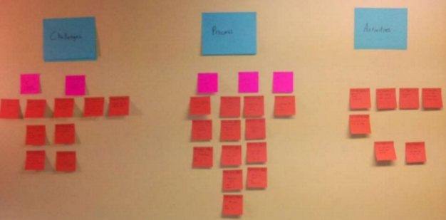
15- Synthesizing Findings of Early Data Gathering
http://www.slideshare.net/mniola/introduction-to-ux-research-16626959
Notes:
Click in….

Slide 2
Quote of the day: Be careful about personas!
“If you follow any classic program of HCI or UX training, personas were likely a significant part of your training. To fulfill the user-centered design process, the training says, you must first understand your user…What better way to achieve that than to add a set of Personas to your project plan?...[However,] what happens…often is he creation of the persona-lite--a rapidly built document that lets the UX team feel like they haven't sold their soul, and project management team feel that they've "checked the box." These thin versions are not informed by direct customer research, and are therefore built on the usually false assumptions of the UX designer tasked with its creation.” --Michael Betts, UX Designer
http://www.extractable.com/insights/11-steps-toward-actionable-personas

Slide 3
15-Synthesizing Findings of Early Data Gathering
Key topics/questions for this lecture
CI Epilogue
Personas
Scenarios
Task analysis

Slide 4
Sample CI: Mobile Workforce https://www.youtube.com/watch?v=Gd5fA9UQDjE
We’ll watch a brief excerpt of a CI performed with an employee while commuting to work
The CI focuses on the employee’s use of technology to coordinate work and family
Notice that the interviewer uses objects in environment to probe for more details on the employee’s practices
Notes:
https://www.youtube.com/watch?v=Gd5fA9UQDjE: Youtube seach: “Contextual inquiry workforce mobility”
https://www.youtube.com/watch?v=mOWeNnSY5M0

Slide 5
7. After a CI is done…
Summarize your notes right away, before you forget!
Digitize your notes
When all CIs are done, synthesize your findings
Requirements
Task analysis
Personas
Scenarios

Slide 6
14-Synthesizing Findings of Early Data Gathering
Key topics/questions for this lecture
CI Epilogue
Personas
Scenarios
Task analysis

Slide 7
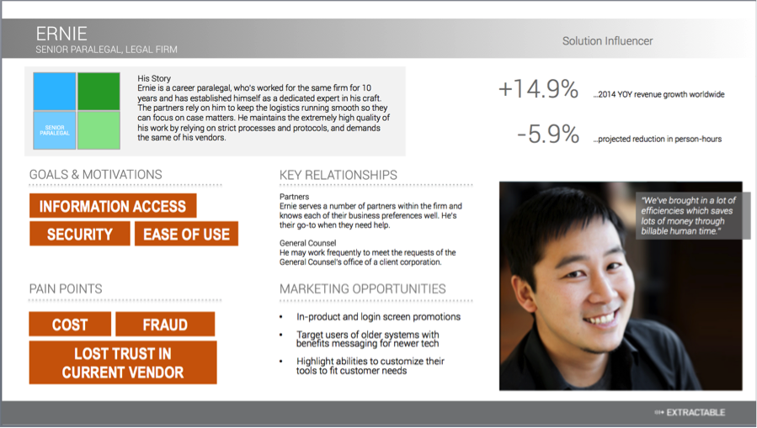
Personas focus designers on specific needs of user groups
Notes:
Key points:
Fictional representations of people based on data collected through early data gathering
Form archetype of a specific user group by compiling patterns of behavior, goals, and motivations
Widely adopted as a key step of early data gathering process
Strengths:
They bring focus to design discussions
Reduce tendency for designers to make false assumptions
Provide common ground for designers to talk about specific users with particular goals, motivations, desires, skill levels, difficulties, contexts of use
Capture clear differences among different user groups
Weaknesses (as alluded to in opening quote!):
Time consuming to create
May be a tendency to create a “persona lite”—a thin and uninformed persona not well informed by user research and built on false assumptions, just to say you did it.
May be a tendency to focus on stereotypes, and to fail to capture the uniqueness of real individuals. Example: Making assumptions about what people look like without actually seeing them by relying on “stock” photographs.
They may be un-actionable—if they don’t capture differences among distinct user groups, they lack value in the design process

Slide 8
The anatomy of a persona
Name and occupation
Role in organization
Location in user group space
Story of persona focused on goals and behaviors
Graphical representation of goals and motivations
Graphical representation of what causes difficulties for persona
Notes:
This slide covers name, role, story, location in user group space, goals & motivations, pain points

Slide 9
The anatomy of a persona
Quote that sums up essence of persona
Key relationships within organization
Profile picture
Marketing opportunities (ignore!)
Notes:
This slide covers picture, quote, key relationships, marketing opportunities. Can also mention the two numbers on the top right. These appear to be the bottom line impact of designing well for this persona, but I’m not sure.

Slide 10
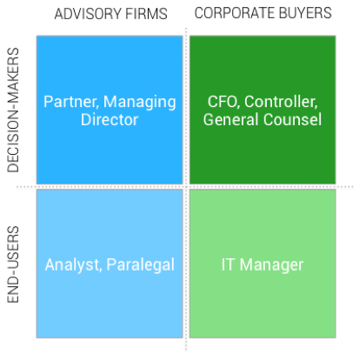
Building actionable personas http://www.extractable.com/insights/11-steps-toward-actionable-personas
Key step: Create “space” of user groups
Notes:
Overall point: The reason for constructing this space is to clearly differentiate among different user groups. Some call this an “audience grid” or “user grid.” Usually, the space is two-dimensional, and each cell in the grid represents a different persona
Other points:
Personas should be based on “real, primary” research, not intuitions!
Determine basis of differentiation: Behaviorial? Demographic? Institutional role? Position within the sport? Social status? Determining type creates common language.
Build personas collaboratively. Have multiple people perform contextual interviews and allow the team to discuss the results afterward. Run personas by subject matter experts for more feedback.

Slide 11
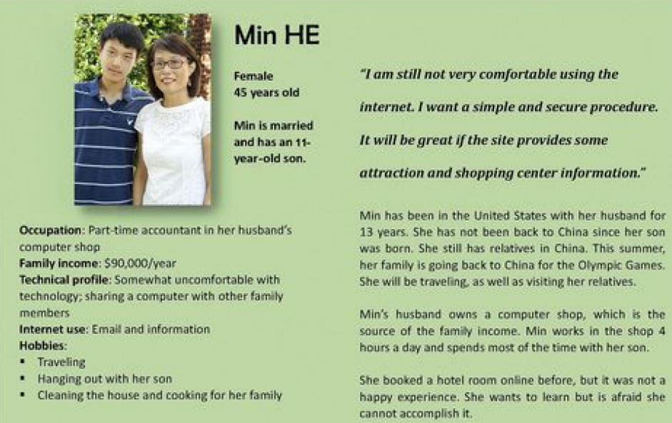
Additional tips for building and using actionable personas http://www.extractable.com/insights/11-steps-toward-actionable-personas
Build in uniqueness
Consider key relationships within persona
Define goals and motivations
Use REAL quotes
Get photographs right!
Be honest!
Don’t get carried away!
Keep personas in sight
Notes:
Build in uniqueness: Personas are “colorful composites” of the contextual interviews. Be sure to capture that uniqueness, so that personas are capable of truly differentiating key user groups
Consider key relationships within persona: What relationships might be relevant to the persona’s behavior and tech needs/wants?
Define goals and motivations: Think about what is driving the user! What drives a speedgolfer?
Use REAL quotes: The design team can’t question real quotes from users. Resist the urge to fabricate quotes; use real ones!
Get photographs right! Remember what we learned about system 1 being excellent at face recognition. The picture is really important, as it will be an instantly recognizable feature of the persona that will stick with us. Make sure the photos are representative of the personas.
Be honest! What are your goals for the product? To gain more customers, or to provide impeccable usability? Put your personas in that lens.
Don’t get carried away! Avoid temptation to include irrelevant details. Restrict persona to one page if possible. Don’t create too many personas (Barnum recommends 2-12, but this shouldn’t be a problem in this class).
Keep personas in sight: They should serve as resources in the design process. They should be open and available during team meetings and as you engage in design activities.

Slide 12

You try it: Build a persona based on your notes from last Thursday
Chris Dedicated amateur College professor
His story
Chris is a dedicated speedgolfer with 33 years of golf experience. He is concerned with time efficiency and self improvement in this sport.
User quote:
“I use a metronome for my pre-shot routine!”
User matrix
GOALS & MOTIVATIONS
Technology profile
Chris is comfortable with tech and would like to incorporate it into his game, but he is dissatiified with currently available tech. He uses a combination of tech at the moment: Watch, smartphone, HR monitor
Speed
Efficiency
Agility
Share exper.
PAIN POINTS
Tech slowdown
Remember score
Notes:
Take 10 minutes to have students work on a persona based on your CI interview notes…Discuss and reflect on results afterwards.

Slide 13
14-Synthesizing Findings of Early Data Gathering
Key topics/questions for this lecture
Mock CI of Speedgolfer Chris
Personas
Scenarios
From scenarios to requirements to tasks
From tasks to state transition diagrams

Slide 14

Scenarios capture personas’ goals
Make persona central character
Establish problem/situation
Create familiar scene
Describe central character’s goal
Ground story in real data
Make story memorable, with vivid (though relevant) details and quotes
Notes:
Ask: What is the difference between a task and a goal?
Answer: Tasks are things users do (steps). Goals are the end result or outcome.
Example: Speedgolf task would be to record the time for a given hole. Speedgolf goal would be to finish a round in under an hour.
Good scenarios should focus on user’s goals Think about storytelling. Here are some guidelines…

Slide 15
Sample scenario: Chris’s speedgolf round
It is Wednesday morning, and Chris is at Palouse Ridge for his usual speedgolf round. Chris will be the first off the tee at 7:00 am. His goal is to play quickly and efficiently—to break one hour while shooting around 80. Five minutes before he tees off, Chris opens his speedgolf app and makes sure that all of his sensors are ready to go—GPS, heartrate monitor, and microphone. He is already excited to view his hole-by-hole stats after his round. Those stats should provide him with valuable insights into how he can improve his game.
Chris hits the “start” button on his app just after he tees off; its time to play speedgolf! For the next 60 minutes, Chris is in the “zone.” As he putts out on each hole, he shouts “holed” and score for that hole to his speedgolf app, which automatically records the score and determines the time for the hole. Occasionally, he shouts “stats” to the app, and it dutifully tells him the elapsed stats for his round.
When Chris holes out on #18, he shouts “holed” and his score. The app knows he is done, and immediately verbalizes key stats to him: Score, time, and speedgolf score (score + time). Chris opens up the app on his smartphone, and views a visual dashboard of his hole-by-hole stats, including strokes, time, and average heartrate. He also can visualize all of these on a rich golf course map that plots each shot, along with elapsed stats at any point in the round.
Chris is amazed by the technology, and since he had a particularly good round, he wants to share it with his speedgolf Facebook group. With the click of a button, he shares the graphical summary, writes a comment, and shares it to Facebook. Three members of the group “like” the post immediately! It’s only 8:05 a.m. but Chris has already had a great day!
Notes:
Let’s look at the scenario I wrote. [Read it aloud]. What key functional, usability, and user experience requirements can be extracted from this scenario?

Slide 16
You try it: Write a scenario
Base your scenario on contextual inquiry data you collected last week
Make your partner the central character
Tell a story of your partner doing the activity you observed; what was their goal?
Make story memorable and relevant
Describe how your partner might use technology in this scenario
Be prepared to present to class!
Notes:
We’ll talk about your scenarios at the end. I’ll present the scenario I wrote a bit later…

Slide 17
14-Synthesizing Findings of Early Data Gathering
Key topics/questions for this lecture
Mock CI of Speedgolfer Chris
Personas
Scenarios
From scenarios to requirements to tasks
From tasks to state transition diagrams

Slide 18
Scenarios provide backdrop for specific tasks, but…
Scenarios hint at requirements and tasks, but don’t explicate them
Ultimately, we design software to meet requirements and to support tasks
How do we derive them?

Slide 19
Brainstorm of functional, usability, and user experience requirements
Functional
Start here
Usability
Start here.
User experience
Start here..
Notes:
Have class participate in the filling in of these requirements”
Functional: Users must be able to… (a) set up a Speedgolf round, (b) monitor round stats during the round, (c) indicate when they are done with a hole, and what score they got, (d) view visual analytics of their round after the fact, (d) customize the use of a variety of sensors to the app, including heartrate monitor, GPS, accelerometer (possibly), and microphone (for audio indication of hole being done), (e) share Speedgolf results via social media. (Additional requirements not evident in scenario: Ability to customize stats per round, set up preferences, customize in-round notifications and/or means of indicating you are done with a hole and what your score is)
Usability: (a) Users must be able to indicate they are done with a hole within 2 seconds, without interrupting play; (b) users must be able to obtain current stats within 2 seconds, without interrupting play; (c) some usability requirement focused on use of post-round analytics, perhaps having to do with how quickly one can view visualizations or obtain information of interest (not clear from scenario)
User experience: (a) On a scale of 1 to 10, users must rate the app a 10 in terms of ease of indicating they’re done with a hole and indicating what score they got for the hole; (b) on a scale of 1 to 10, users must rate the app a 9 in terms of ease of setting up the app for a round of Speedgolf; (c) on a scale of 1 to 10, users must rate the app a 9 in terms of the usefulness of the stats it provides (both in-round and after the round). [Others are possible]

Slide 20
Requirements tables
Functional requirement | Associate usability target(s) | Empirical source/rationale
User experience requirement | Empirical source/rationale
Notes:
Transition: It’s one thing to have requirements; it’s quite another to specify how the requirements will be supported by the software. For that, we need to start specifying tasks in terms of essential use cases, use cases, and task analysis.

Slide 21
Essential Use Case: Shared Calendar (Constantine & Lockwood)
arrangeMeeting
USER INTENTION SYSTEM RESPONSIBILITY arrange a meeting request meeting attendees & constraints
identify meeting attendees & constraints
search calendars for suitable dates
suggest potential dates choose preferred date
book meeting

Slide 22
Use Case: Shared Calendar
1. The user chooses the option to arrange a meeting.
2. The system prompts user for the names of attendees.
3. The user types in a list of names.
4. The system checks that the list is valid.
5. The system prompts the user for meeting constraints.
6. The user types in meeting constraints.
7. The system searches the calendars for a date that satisfies the constraints.
8. The system displays a list of potential dates.
9. The user chooses one of the dates.
10. The system writes the meeting into the calendar.
11. The system emails all the meeting participants informing them of them appointment

Slide 23
Use Case: Shared Calendar (cont.)
Some alternative courses
5. If the list of people is invalid,
5.1 The system displays an error message.
5.2 The system returns to step 2.
8. If no potential dates are found,
8.1 The system displays a suitable message.
8.2 The system returns to step 5.

Slide 24
Hierarchical Task Analysis
Involves breaking a task down into subtasks, then sub-sub-tasks and so on.
Each grouping specifies a plan for how a task might be performed in practice to achieve goal
Starting point: User goal
Identify main tasks to achieve that goal
Subdivide as appropriate

Slide 25
Hierarchical Task Analysis: Example
Borrow a book from the library
0
plan 0:
do 1-3-4.
If book isn’t on the shelf expected, do 2-3-4.
go to the library
find required book
retrieve book from shelf
take book to counter
1
2
3
4
plan 2:
do 2.1-2.4-2.5.
If book not identified from information available, do 2.2-2.3-2.4-2.5
access catalog
access search screen
enter search criteria
identify required book
note location
2.1
2.2
2.3
2.4
2.5

Slide 26
You Try It: Build essential use case, use case, task analysis based on your CI
For this exercise, work with partner from Thurs.!
Based on the contextual inquiry data you collected, identify a core task
Develop an essential use case for the task
Translate into a use case
Translate into a hierarchical task analysis
Be prepared to share your work with the class

Slide 27
14-Synthesizing Findings of Early Data Gathering
Key topics/questions for this lecture
Mock CI of Speedgolfer Chris
Personas
Scenarios
From scenarios to requirements to tasks
From tasks to state transition diagrams

Slide 28
State Transition Diagrams (STNs) illustrate interaction sequences
What they are: Networks in which nodes denote interface states, and arcs denote user interface-level actions that give rise to transitions between states
Options for representing interface states
Interface screen shots: useful when transitions have tangible visual effects in the user interface, e.g., menus appear
Labeled interface states: useful when transitions change interface state without visible effects, e.g., when user initiates "mousedown" event on a draggable object
In most cases, STNs contain a mix of the above
Notes:
Sta

Slide 29
Representing Transitions
Transitions must state specific user interface-level events, e.g.,
Mousedown on "Elbow" object
Click on "Copy" in "File" menu
Type "enter"
Note: Specify user interface-level events at the highest level needed to clearly distinguish a transition
E.g., "Click" instead of "mousedown" followed by "mouseup" is sufficient in most cases

Slide 30
How to Create an STN
Focus on tasks, rather than trying to create a general STN for entire interface
For each task, use the STN to specify user interface-level actions with which users can complete the task
If appropriate, also include incorrect user interface-level actions and what they lead to
E.g., if the user interface anticipates that users will make errors, then include the erroneous user interface-level actions and your system's response to them

Slide 31
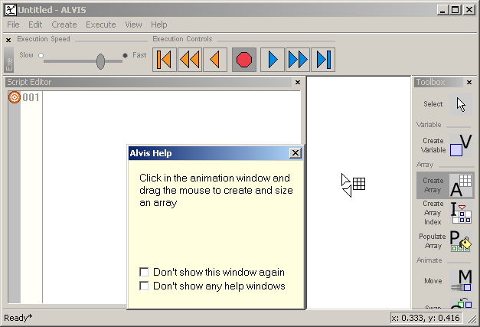
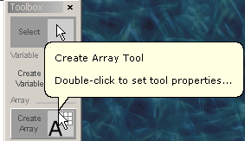


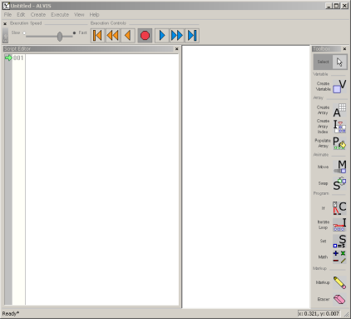
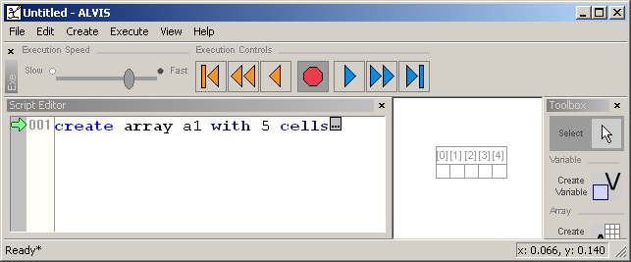
STN for Task “Create an array of size 5 in ALVIS”
Click on
Array Tool
Mousdown on
Animation Canvas
Move mouse to array tool
Mouse move on Animation Canvas
Mouseup on Animation Canvas
Start
Finish

Slide 32
Notes on STNs
Not all transitions are included, because of the space limitations of these slides
You should create an STN for each task sequence in your interface; this example just scratches the surface of on task
A more readily understandable design representation may well be a working low fidelity prototype (see Thursday’s video!)

Slide 33
You Try It
Create a state-transition network that describes how a user might accomplish the task you depicted in the hierarchical task analysis performed earlier.

Slide 34

In a nutshell…
Performing a contextual inquiries focused on sports activities may require you to have interviewee walk you through a typical activity
Personas are rich composites of user groups that provide a vivid means of thinking about users
Scenarios tell vivid stories about personas
Requirements can be derived from scenarios
Use cases, essential use cases, and task analysis help us to specify the details of tasks
State transition networks serve as tools for illustrating interaction sequences within software

Slide 35
Announcements
IA#4-Final graded!
Start recruiting participants and setting up your contextual inquiries!
Midterm exam takes place next Thursday, March 9
Study guide now available on OSBLE
Review session will be held in class next Tuesday; complete practice questions to prepare
You are allowed one page of notes as a cheat sheet for exam

