Slide 1
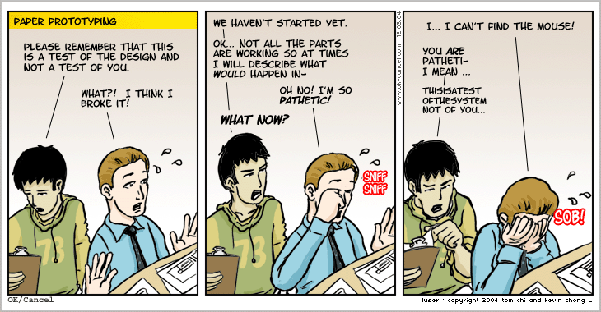
Lecture 15: Prototyping (Greenberg 5)

Slide 2
Announcements
Midterm exam next week!
Prepare “cheat sheet” (both sides of an 8-1/2” x 11” sheet of paper)
Midterm study guide available online on OSBLE
In-class Midterm review takes place on Tuesday
For next Tuesday, complete practice questions in midterm review.

Slide 3
15-Prototyping
Key topics/questions for this lecture
0. Wrap up of last class (STNs)
Intro to Prototyping
Nielsen-Norman Prototyping Video
Lo Fi Prototype Study Demo
Participatory Design
Notes:
Open up L14-Synthesizing-Findings and go over material on state-transition networks starting on slide 28

Slide 4
What is a Prototype?
In other fields: a small scale model that communicates design
In interaction design: A model of a user interface, e.g.,
a series of screen sketches
a storyboard, i.e. a cartoon-like series of scenes
a Powerpoint slide show
a video simulating the use of a system
a cardboard mock-up
a piece of software with limited functionality

Slide 5
Why Create a Prototype?
Fundamental tenet of user-centered design: Involve users early and often
A prototype is much easier to create than an actual implementation, and takes far less time
A prototype communicates design and encourages feedback
A user study with a prototype can provide designers with valuable feedback, even if the prototype isn’t fully functional
People are more likely to give feedback on “rough, unpolished” sketches (see, e.g., Schumann et al., 1996)

Slide 6
Why Create a Prototype? (cont.)
Designers can get answers to specific research questions regarding a design
Of several design alternatives, which is better?
Will a given design work? If not, how can we fix it?
What will users expect in certain interaction scenarios?
Stakeholders can see, hold, interact with an emerging design before it is fully implemented

Slide 7
What Should We Prototype?
Work flow and tasks
Screen layouts and information display
Difficult, controversial areas of design
Prototype should respond to the questions that need answering
Paper mockup can test feasibility of interface design
Limited computer-based prototype can address technical feasibility (e.g., response times)

Slide 8
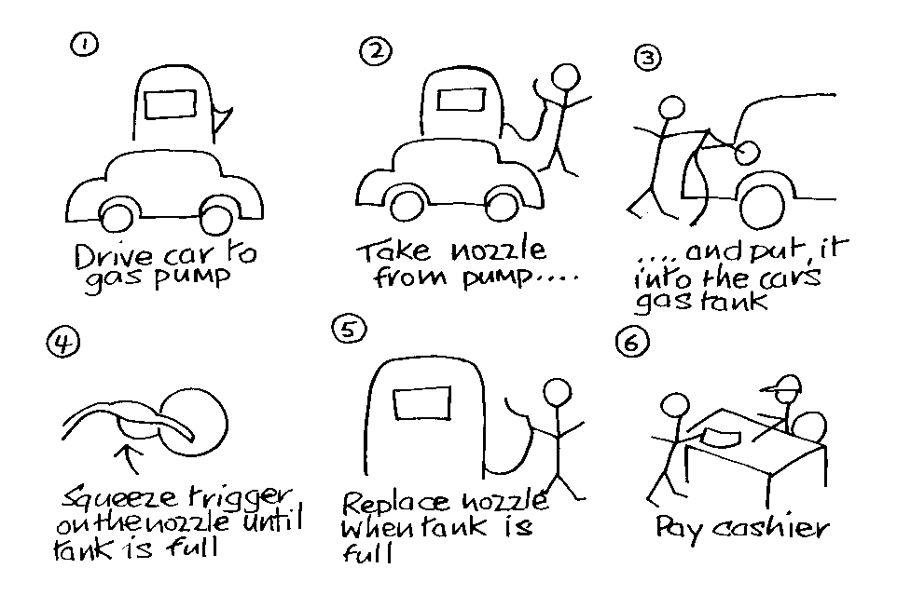
Low Fidelity Prototypes
Use “art supplies”, e.g., Post-it Notes, paper, index cards
Can also be implemented on computer with, e.g., SketchFlow
Are quick, cheap and easily changed
Example: Storyboards
Series of sketches representing progression through task
Supports role-playing; provides context for interaction (as in “wizard-of-oz” study)
ChrisMedia
Artist Song Length Link
C. Wil Rain 3:45 Wil4
Play
Delete
Edit
Goto

Slide 9
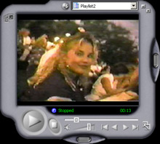
High Fidelity Prototypes
Use materials that users would expect to be used for the final product
Look more like final system than a low-fidelity version
Danger that users will think they have a full system, and then be disappointed
Common high-fidelity prototyping environments include Adobe Flash, .NET, and PhP

Slide 10
Comparison of Low and High Fidelity Prototypes
Low fidelity | High fidelity
Low development cost Only a rough approximation Facilitator-driven Can help identify requirements No error checking, and may poorly simulate actual navigation and flow Usually thrown away | High development cost Look-and-feel of final product User-driven Can help test final product Can incorporate error-checking, and can give excellent feel for actual navigation and flow Can serve as detailed specification for final implementation

Slide 11
Prototyping Requires Compromise
Implementation compromises: slow response times, unfinished icons, limited functionality
Breadth versus depth: Horizontal versus vertical prototypes
Horizontal: provide a wide range of functions, but with little detail
Vertical: provide a lot of detail for only a few functions

Slide 12
Two Different Routes to a Final Product
Evolutionary prototyping
Lots of effort has gone into prototyping and testing; why waste it?
Prototype “evolves” into final product
Evolution must be carefully planned, with quality assurance testing part of the overall process
Throw-away prototyping
Prototype is used to answer design questions, and then thrown away
Less need to worry about robustness and quality assurance
Final product is built from scratch

Slide 13
15-Prototyping
Key topics/questions for this lecture
Intro to Prototyping
Nielsen-Norman Prototyping Video
Lo Fi Prototype Study Demo
Participatory Design
Notes:
Note that this set of lecture slides is a highly condensed version of the slides I have already made available on OSBLE. I will not be publishing the slides I’m using today. They are only for guiding today’s lecture, and are incomplete.

Slide 14
Nielsen/Norman Video on Paper Prototyping
How-to Build Prototypes: 1:58 – 9:55
Demo of Paper Prototype Study: 9:55 ~ 21:20

Slide 15
15-Prototyping
Key topics/questions for this lecture
Intro to Prototyping
Nielsen-Norman Prototyping Video
Lo Fi Prototype Study Demo
Participatory Design
Notes:
Note that this set of lecture slides is a highly condensed version of the slides I have already made available on OSBLE. I will not be publishing the slides I’m using today. They are only for guiding today’s lecture, and are incomplete.

Slide 16
Aside: Tool Support for Prototype Construction
Low fidelity, sketch-based user interface design tools
SILK and DENIM
WOZ Pro
Expression Blend
Interactive GUI Builders with embedded event languages
.NET
Expression Blend
Scripting languages
Perl, Python, Tcl/Tk, JavaScript (with HTML)
Object-oriented programming languages and environments
Java/JBuilder, Visual Studio .NET

Slide 17
Example: Wizard-of-Oz Prototype of ALVIS DM Interface
We ran a wizard-of-oz low fi prototyping study to develop the design of ALVIS’s new direct manipulation interface
I need a volunteer to come to the front to try a task while I demonstrate the “wizard of oz” technique
Task: Write an algorithm that sums the values of an array of 7 random integers between 1 and 100.
Notes:
Alternate paper prototype wizard of oz (task prototype?)

Slide 18
15-Prototyping
Key topics/questions for this lecture
Intro to Prototyping
Nielsen-Norman Prototyping Video
Lo Fi Prototype Study Demo
Participatory Design
Notes:
Note that this set of lecture slides is a highly condensed version of the slides I have already made available on OSBLE. I will not be publishing the slides I’m using today. They are only for guiding today’s lecture, and are incomplete.

Slide 19
Participatory Design
Customers/clients become an active part of design team
Technique developed in Scandinavia in late 1960s and early 1970s
Arose out of labor unions’ pleas to have say in their working conditions
Walkthroughs with low fidelity prototypes a key component of the design process
Enable customers to simulate their work practices
Enable designers to gain key insights into work practices

Slide 20
Aspects of Participatory Design
Finding representatives from the user community? (Interaction may need to be assisted by a facilitator)
Using simple tools such as paper or video scenarios to design cooperatively
Facilitating communication between designers and users about proposed designs
Evaluating prototypes cooperatively

Slide 21
Summary
Prototypes help designers answer questions and get feedback
Different kinds of prototyping are used for different purposes and at different stages of design
Participatory design gives users a place on the design team

Slide 22
Reminders
Midterm exam next Thursday!
Prepare “cheat sheet” (both sides of an 8-1/2” x 11” sheet of paper)
Midterm study released today through OSBLE
In-class Midterm review takes place on Tuesday

