Slide 1
A Task-oriented Service Personalization Scheme for Smart Environments Using Reinforcement Learning
By Bjorn Tegelund, Heesuk Son, Dongman Lee

Slide 2
Goal: Using RL to train a agent that can serve a smart environments
Why choose Reinforcement Learning to achieve this goal.
1. RL is capable of multi-objective decision-making
2. Can make decisions in O(n) along with n possible actions in state s

Slide 3
Define the environment domain
In general, a RL domain should follow the assumptions of MDP
In specific, we need to define:
S --- state space
A --- action space
P --- Transaction function
R --- Reward function

Slide 4
Define the environment domain
Define the S,A,P is trivial
Reward function is harder to define
The agents have no pre-knowledge about the preferences setting in certain state
For instance, if we are having a meeting in a dark room, should the agent turn on the light or TV?

Slide 5


Preference Capturing
The way they used to capture preference is inverse RL
Let
A example of feature:
φ = [0, 1, 1, 0, 0, 1, 0, 0, 1] indicates that tv off, lamp on …

Slide 6
Preference Capturing
Initially, w = [S][A] where S is the number of environment settings, A is number of the device actions
Generating episodes from experts, so that w is learnt from those optimal episodes.
Recover the reward function by calculate the score with preference feature w* φ

Slide 7
Train the agent for each single device using Sarsa(λ)
State set for certain device only consists of environment variables that relevant to it.
For example, lighting devices such as lamp only relevant to brightness. For those devices, the S = [low light intensity, medium light intensity, high light intensity] and action set is as simply as [on, off]
The state space is narrowing down, so that training time is reduced.

Slide 8


Train the agent for each single device using Sarsa(λ)
Reward is separated for environment and device
where
A higher weight is given to the environmental reward, this will prevent agent perform unreasonable actions (e.g. Environment is dark, agent turns on TV or projectors to light the space)

Slide 9
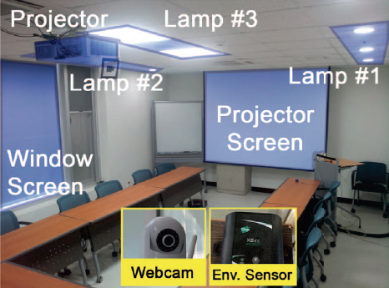
Experiment Setting
Preference capturing is done on a server with an Intel i5 2.90GHz processor and 4GB of RAM
The agents are trained on Raspberry Pi 2 Model B boards, with 900MHz quad-core ARM processors and 1GB of memory

Slide 10
Result and Performance
In their environment setting 34 out of the 35 preferences learnt (7 preferences for each of the 5 tasks) overall accuracy 97%
Training takes on average 130s for lamps and window blinds, and 49s for the projector and projector screen.
Whole training time within 3 mins

