Slide 1
Predictor-Corrector Algorithm for Human Activity Time Series Analysis
April 4, 2017 . Project Update
Fitbit Group: Sayon

Slide 2
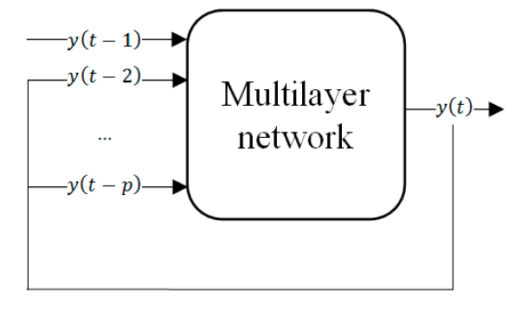
Time-Series Prediction using 4 Hidden Layer NN
Using R library: ‘nnetar’

Slide 3
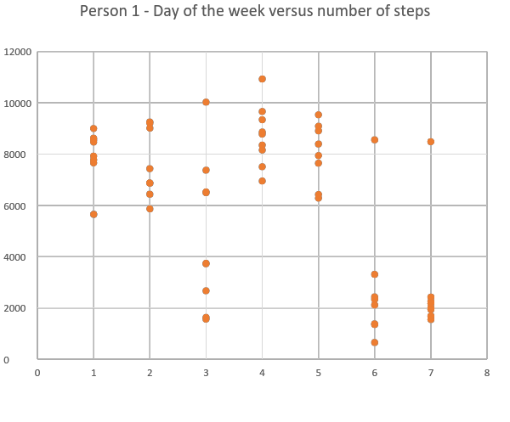
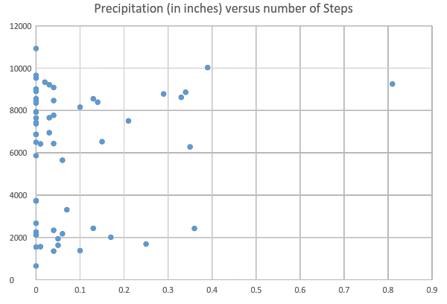
External Factors impacting Step Counts

Slide 4
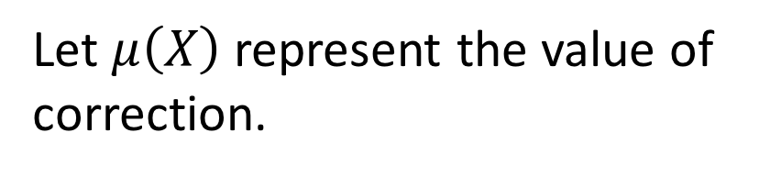
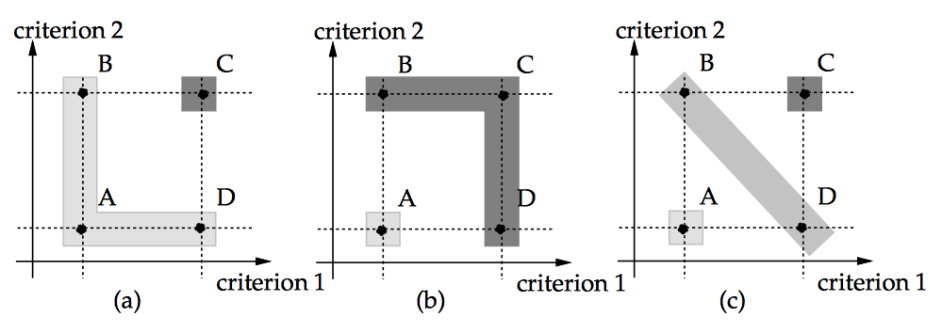



Correction Factor
FRAMEWORK [X]
Temperature
Precipitation
Humidity
Person’s location
Family
Intervention
Things to Do for a person
Statistical Trends [based on new motivation]
Let A, B, C, D be four alternate values of correction possible. The axis represents level of accuracy achieved from each criteria Interaction among the criteria helps to determine contribution towards correction factor.

Slide 5
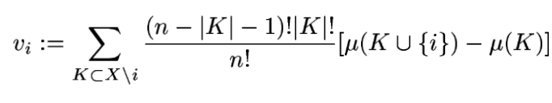
How to find out contribution of each criteria? Multi-Criteria Decision Making
Analytical Hierarchical Processes
Disadvantages:
Weights need to be manually tweaked, not adaptive
Choquet Integrals
Study the interaction between different factors that will impact steps taken.
Adaptive.
Steps
Find interaction score between each criteria
Shapley Values
K is the combination of factors, say Temp & Humidity taken together as one factor,
V=[v1…vn] … value of the entire set of combinations.
Shapley Value is indicative of the average value each factor contributes towards the eventual correction.
Disadvantages:
- Does not give a complete picture.

Slide 6
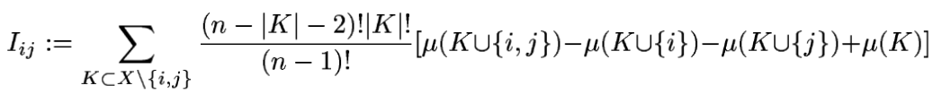
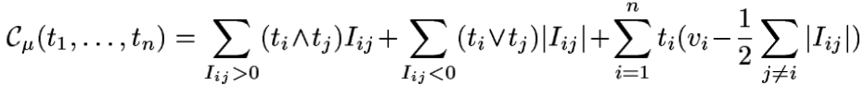
Interaction studied as 2-additive Choquet Integrals
Interaction between correction criteria
Let t1, t2, … , tn be the different Choquet Integral scores for different factors
Positive
Synergy
Negative
Synergy
These values also act as weights in the correction factor.

Slide 7
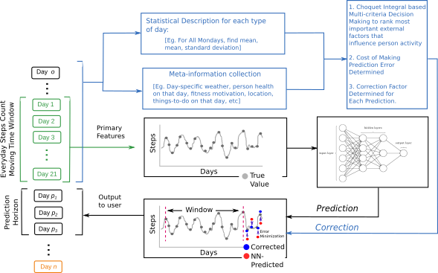
Algorithm

Slide 8
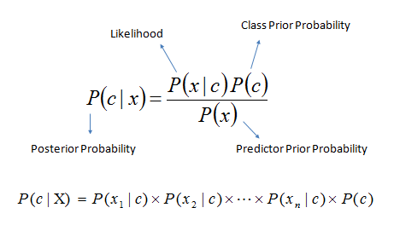
Person 1 – Probability Scores as first criteria for correction
 | Weather Good, but not active | Weather Good, Active | Weather Bad, but active | Weather Bad and not active
Saturday | 0.22 | 0.44 | 0.11 | 0.11
Sunday | 0.22 | 0.33 | 0.11 | 0.22
Monday | 0.0 | 0.75 | 0.0 | 0.25
Tuesday | 0.0 | 0.875 | 0.0 | 0.125
Wednesday | 0.22 | 0.555 | 0.0 | 0.22
Thursday | 0.0 | 0.555 | 0.0 | 0.444
Friday | 0.0 | 0.667 | 0.0 | 0.22

Slide 9
Implementation of Correction Factor
Find out what value NN has predicted.
Find Choquet Integral score to
Determine whether to raise the predicted value. [i.e. positive correction] “Veto Criteria” – If next predicted day weather is good, and there is low dispersion in data for that day, and NN suggests next value is lower than mean and median value of that day → then make the correction such that predicted value increases.
Find the most dominant factors, and raise/lower the correction value in proportion to the score.

Slide 10
Computing Statistical Trends as second factor and computing Choquet Scores to rank influence of different criteria
 | Total Steps | Average | Dispersion | Choquet Score
Saturday | 22134 | 2766 | High [Low with one outlier] | 0.462
Sunday | 22523 | 2815 | High [Low, with one outlier] | 0.502
Monday | 63643 | 7955 | Lowest | 0.880
Tuesday | 60965 | 7619 | Low | 0.687
Wednesday | 43753 | 4861 | High | 0.499
Thursday | 78542 | 8726 | Low | 0.781
Friday | 64204 | 8025 | Low | 0.778

Slide 11
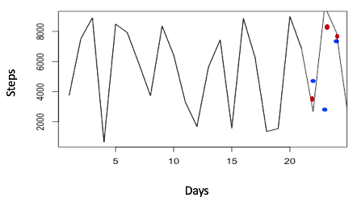
With 14 Days Moving Average
Technique | Average Error Per Measurement
With Prediction | 41.55%
With Prediction and Correction | 12.98%
With 21 Days Moving Average
Predicted using Neural Network (4 Hidden Layers)
Technique | Average Error Per Measurement
With Prediction | 32.14%
With Prediction and Correction | 7.58%
Prediction followed by correction.
In progress, needs validation -->
Number of false increases = 4 in 30 predictions
Number of false decrease = 2 in 30 predictions

Slide 12
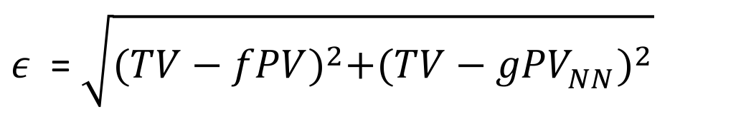
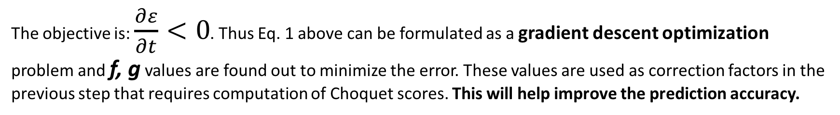
Next day (i.e. the day that was predicted yesterday)
TO DO LIST
Complete Correction Value time-series for all subjects.
Code the optimization problem and revise the corrected prediction results.
Documentation and report.
Get true value. (TV)
Corrected Value after Prediction (PV)
Predicted Value from NN (PV_NN)
F, g are a last layer of correction that will be used for third correction factor

Slide 13
Image Classification Using Heatmap
Goal: To identify specific person by his or her activity pattern.
Step 1: Visualized the data
Convert participant's time series hourly steps into heatmaps
Step 2: re-generate image sample by applying random
transformation, such as height shifts or width shift

Slide 14
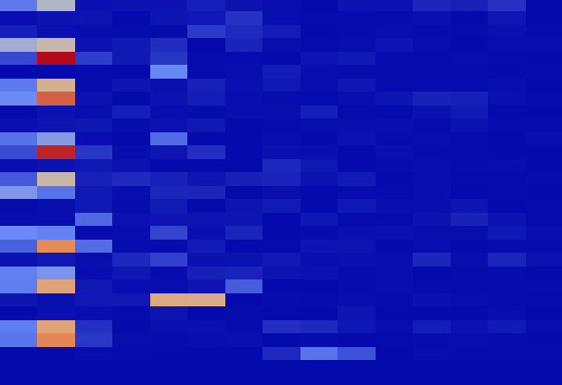
Example of transformation
d
This original heatmap of participant glb70 for Feb. 2016

Slide 15
Example of transformation
d
Examples of transformation heatmap of participant glb70 for Feb. 2016

Slide 16
Image Classification Using Heatmap
Step 3 using python library Keras to train the model
Current result:
25.00% accuracy (50 training iterations)
Update: using weekly heatmap accuracy increased to 75.00%

Slide 17
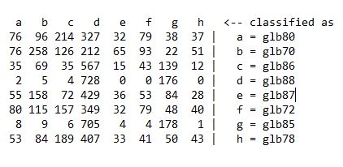
Related work
Transferring Image data into binary code string
Using Weka to train a linear classifier with binary data
result:
Correctly Classified Instances 1433 19.7329 %
Incorrectly Classified Instances 5829 80.2671 %

