Slide 1
Fitbit Activity Time Series Data Prediction
Yang Zhang

Slide 2
Outline
Implemented OAuth client that can fetch Fitbit time series data (15min interval) through Fitbit API
Trained participants oriented classifier based on image processing (heatmaps)
Implemented time series predictor using Long Short-Term Memory algorithm

Slide 3
Image Classification Using Heatmap
Goal: To identify specific person by his or her activity pattern.
Step 1: Visualized the data
Convert participant's time series hourly steps into heatmaps
Step 2: re-generate image sample by applying random
transformation, such as height shifts or width shift
Step 3: Train the model with keras

Slide 4
Result
Using weekly heatmap:
75.00% accuracy
(50 training iterations)

Slide 5
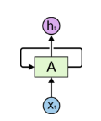
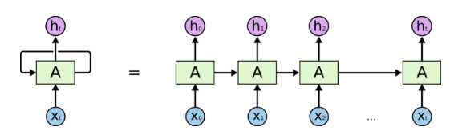
Time Series Prediction with LSTM
LSTM is one kind of recurrent network
A is a chunk of neural network. There is loop that allows information to be passed from one step to next step
This chain-like nature reveals that recurrent neural networks are intimately related to sequences and lists. They’re the natural architecture of neural network to use for such data.

Slide 6
Time Series Prediction with LSTM
Problem with standard recurrent neural network
In theory, RNNs are absolutely capable of handling long term dependencies. However, in practice, RNNs seem to lose long term dependencies with increased gap. This problem was argued by Hochreiter (1991)
LSTMs don’t have this problem!

Slide 7
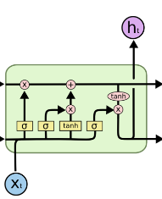
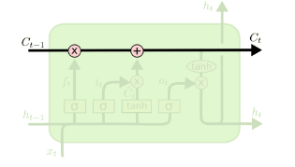
Time Series Prediction with LSTM
The magic of LSTM is there are control gates in each cell.
Forget gate, Input gate, Output gate
The cell is kind of a running belt. It runs straight down the entire chain., with only some minor linear interactions. It’s easy for information to flow along it.

Slide 8
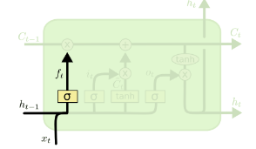
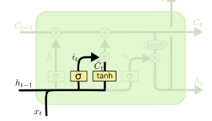

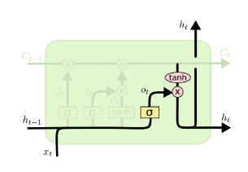
Time Series Prediction with LSTM
C_{T-1}
x
+
The forget gate:
It looks at x_{t} and h_{t-1} and outputs a 0 or 1 (1 represents keep the information completely, 0 vice versa)
The input gate:
It decides if the new information need to be stored
The output gate:
It decide what candidate value to output
+

Slide 9


Time Series Prediction with LSTM
To apply LSTM, time series data need to be reformatted.
For example:
Turn: 112, 118, 132, 129, 121, 135, 148
Into :

Slide 10
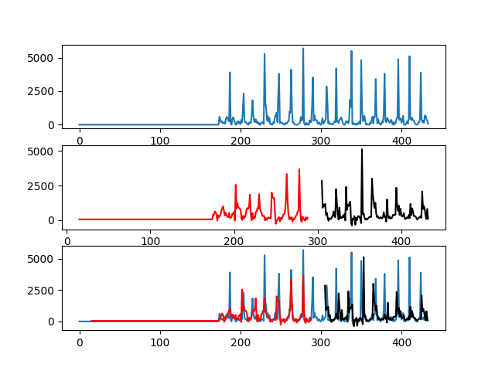
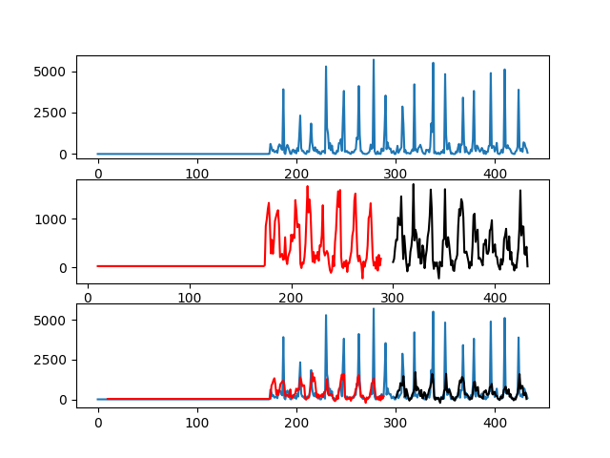
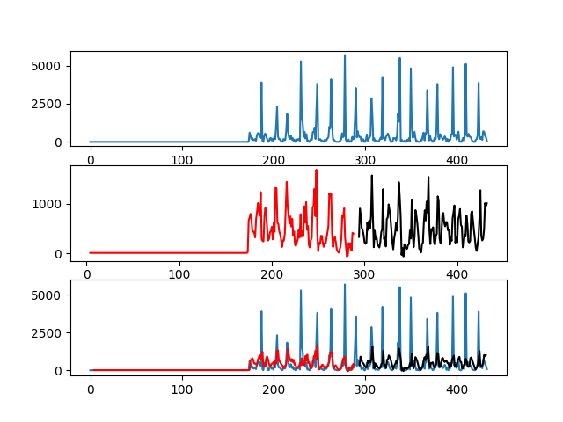
Results from glb72 Feb
Feature size 1
Training accuracy 0.91
Testing accuracy 0.78
Feature size 4
Training accuracy 0.96
Testing accuracy 0.94
Feature size 10
Training accuracy 0.82
Testing accuracy 0.79

Slide 11
Time Series Prediction with LSTM
Participant | Best Feature size | Training Accuracy | Testing Accuracy
glb70_feb | 3 | 0.9752 | 0.9610
glb72_feb | 4 | 0.9635 | 0.9414
glb78_feb | 1 | 0.9533 | 0.9086
glb87_june | 2 | 0.9772 | 0..9332
glb89_june | 3 | 0.9794 | 0.9354
glb91_june | 4 | 0.9660 | 0.9334
Best feature sizes are all below 5

