Slide 1
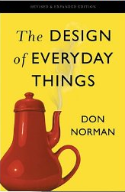
Lecture #03: Applying Norman’s Design Concepts

Slide 2
Norman on Good Design
“The lack of clear communication among the people and organizations constructing parts of a system is perhaps the most common cause of complicated, confusing designs. A usable design starts with careful observations of how the tasks being supported are actually performed, followed by a design process that results in a good fit to the actual ways the tasks get performed. The technical name for this method is task analysis. The name for the entire process is human-centered design” (p. 138).

Slide 3
This Class is About Norman’s Design Concepts (Ch. 1 and 4)
Today’s Class
Reading Quiz
A few additional concepts
Modeling the application of Norman’s Design Concepts
Presentation and Discussion of examples of good and bad design (IA#1)

Slide 4
Reading Quiz Question #1
Which of the following are the elements of Norman’s conceptual model?
Implementation model, design model, interaction model
System image, Designer’s model, User’s model
Designer’s model, Implementer’s model, User’s model
System model, User Model, Interface Model
None of the above

Slide 5
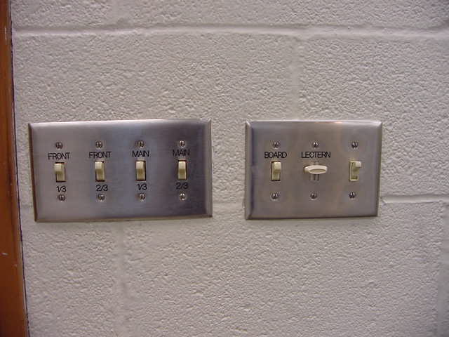
Reading Question #2
What type of constraints do switches have?
Physical
Cultural
Semantic
Logical
None of above
Notes:
Constraints:
Perceived limitations of the actions that are possible with an object, based on object’s appearance
Limit set of possible actions with an object
Helps prevent user from selecting incorrect options
Four types of constraints: Physical, Cultural, Semantic, Logical
Example of

Slide 6
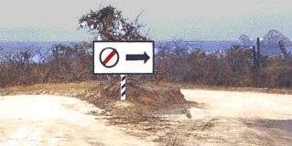
Reading Question #3
What type of constraint is used to determine the correct course of action in the following picture:
A. Physical B. Logical C. Semantic D. Cultural

Slide 7
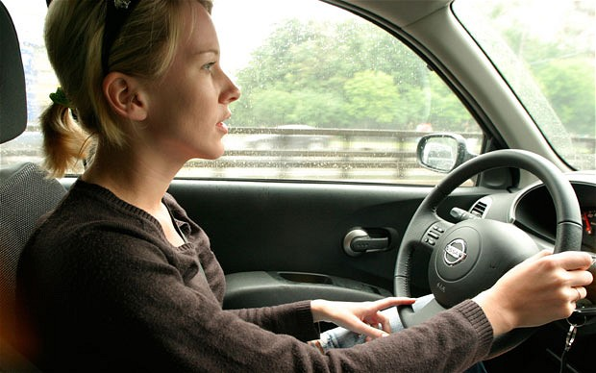
Reading Quiz Question #4
What type of constraint best determines the direction the person is facing in the following picture:
A. Physical B. Cultural C. Logical D. Semantic
Credit: http://www.telegraph.co.uk/news/uknews/road-and-rail-transport/11605509/Women-are-after-all-better-drivers-than-men.html

Slide 8
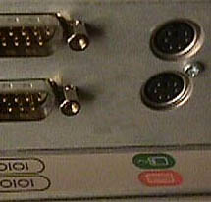
Reading Quiz Question #5
What type of constraint best applies when determining which labels apply to which ports in the following picture:
Physical B. Cultural C. Logical D. Semantic

Slide 9
This Class is About Norman’s Design Concepts (Ch. 1 and 4)
Today’s Class
Reading Quiz
A few additional concepts
Modeling the application of Norman’s Design Concepts
Presentation and Discussion of examples of good and bad design (IA#1)

Slide 10
Supplement: Norman’s model explained (see Figure 1.11)
Designer’s Model
User’s Model
DESIGNER
User model determines what’s understood
USER
Designer implements design model in system image
SYSTEM
System Image conveys design model to user
System Image

Slide 11
Supplement: What are Constraints?
Perceived limitations of the actions that are possible with an object, based on object’s appearance
Limit set of possible actions with an object
Helps prevent user from selecting incorrect options
Four types of constraints
Physical
Cultural
Semantic
Logical

Slide 12
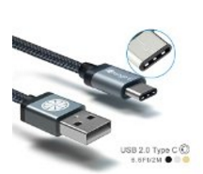
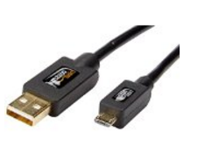
Supplement: Physical constraints (Micro USB vs. USB-A)
USB-A: Reversible!
Micro-USB: Not Reversible!
But: Micro-USB is a legacy cable and easier to find

Slide 13
Supplement: Cultural Constraints
Allowable actions in social situations
Face forward in elevator
Give your seat up to someone older on a bus
Can be universal or culturally specific
Can change over time

Slide 14

Supplement: Semantic Constraints
Semantic = meaning
Possible actions constrained by meaning of situation
Driver faces toward road in a car
Downhill skier faces down mountain (most of the time)
Person faces toward a computer screen while working
http://www.telegraph.co.uk/news/uknews/road-and-rail-transport/11605509/Women-are-after-all-better-drivers-than-men.html
http://www.rjperformancepc.com/tag/highquality-computers/

Slide 15

Supplement: Logical Constraints
Actions constrained by what is left over when all other actions are exhausted
Relationships defined by logical relationships between functional or spatial layout of items (similar to natural mappings)

Slide 16
Cultural Norms, Conventions, Standards
Assumptions about a group of people with regard to how they act or how they use an object
Can be cultural and physical
Examples
Greetings
In US, people expect light switch down to be “off”; in UK down is “on”
People understand concept of “restart”
What flashing a car’s headlights means

Slide 17
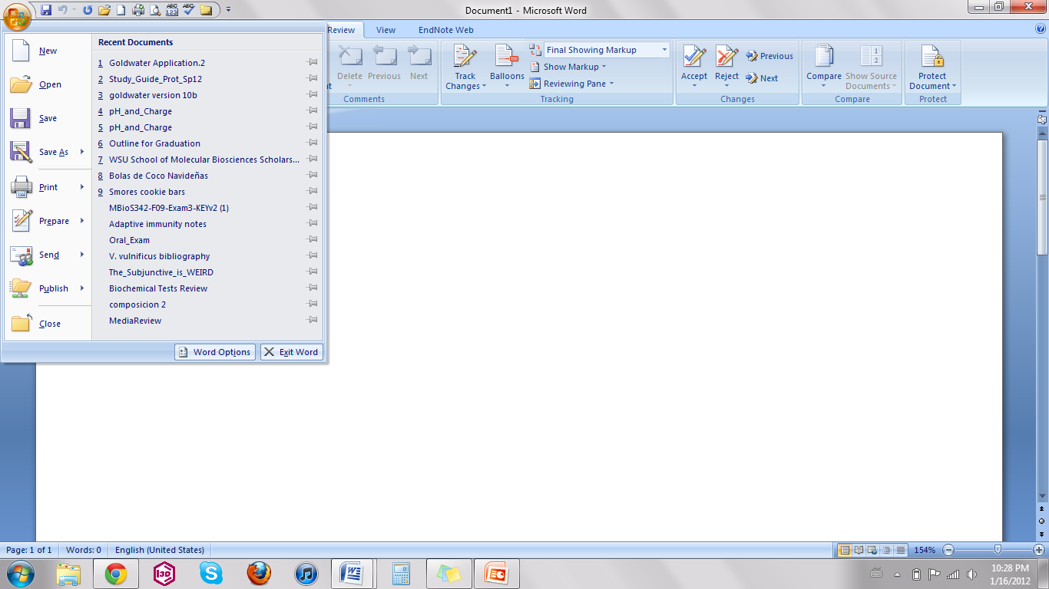
Transfer Effects (not in Norman): MS Word Ribbons
Notes:
Transfer effects
Prior experience influences what functionality we expect for an object and how we operate an object
Learning by analogy and metaphor
Can be both positive and negative
Positive: “This looks like a pair of scissors I’ve used before; therefore, you put your fingers in the holes”;
Negative: “This keyboard looks like a phone pad; maybe I can use it to key in a phone number

Slide 18
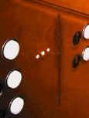
Visibility (Old Norman book)
• This is a control panel for an elevator.
• How does it work?
• Push a button for the floor you want?
• Nothing happens. Push any other button? Still nothing. What do you need to do?
What to do is not visible!
From: www.baddesigns.com
Notes:
Visibility: Make what can be done visible. Visibility suffers when the number of possible actions exceeds the number of controls

Slide 19
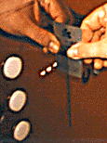
Visibility: Elevator (cont.)
You need to insert your room card in the slot by the buttons to get the elevator to work!

Slide 20
This Class is About Norman’s Design Concepts (Ch. 1 and 4)
Today’s Class
Reading Quiz
A few additional concepts
Modeling the application of Norman’s Design Concepts
Presentation and Discussion of examples of good and bad design (IA#1)

Slide 21
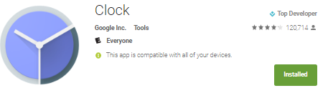
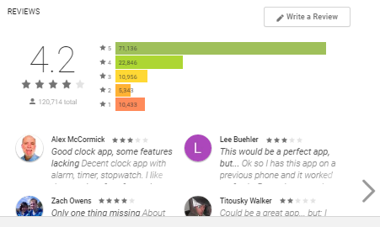
Analysis: Android Clock https://play.google.com/store/apps/details?id=com.google.android.deskclock&hl=en
Conceptual model
Affordances
Signifiers
Natural Mapping
Feedback
Constraints
Notes:
(Show demo while doing analysis)
Conceptual model:
App organized around four core time-keeping functionalities: alarm, clock (multi-time zone), count-down timer, and stopwatch
App uses grid metaphor to organize these functionalities spatially; it may be unclear initially that spatial metaphor also works vertically to reveal additional timers, alarms, etc.
App uses direct manipulation (touch) as interaction mechanism.
Affordances:
Some buttons afford pushing, but some look more like icons so may not afford pushing
Screen affords swiping (?) (Would argue this is really a learned affordance)
Signifiers:
Few, if any, textual labels
You an tap and hold on icon across top to get a textual description (tooltip)
Nearly all signifiers are iconic; they form a language that must be learned, but use suggestive symbology
Natural mapping:
Beautiful natural mapping between top-line icon menu and its functionality (arranged left-to-right, as reinforced through swiping)
Cities are arranged alphabetically (natural mapping?)
Clock timezones are organized temporally based on home time zone. A better natural mapping could use an actual map to show the times.
Unclear how alarms are arranged (possibly order in which they were created?)
Unclear how Settings page is arranged
Feedback:
Strikingly, switching among functionality groups causes the icon associated with the current functionality group to briefly animate. It’s subtle but aesthetically-pleasing
Button toggles are animated
Button presses lead to immediate visual feedback (e.g., stopwatch starting and button toggling from start to stop)
Alarm setting leads to brief status message across bottom of screen + status of alarm on home screen. What’s potentially unclear is whether alarm will sound if phone is silenced (as mine is all the time). Feedback does not convey this.
Constraints:
Physical: It is impossible to set an invalid alarm, given that a clock is used to specify the time. It is impossible to set an invalid timer time, sicne input is via a keypad.
Cultural: Right = future, left = past (?)
Semantic: User will face device.
Logical: None (but remember that these are similar to mappings) Similar to natural mappings

Slide 22
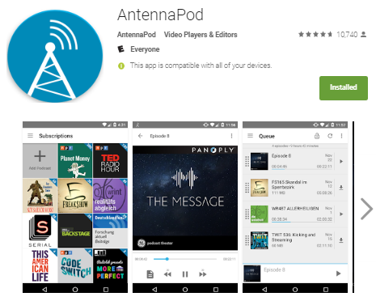
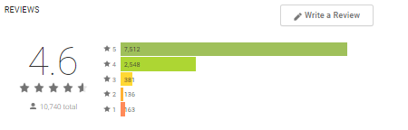
Analysis: AntennaPod
Conceptual model
Affordances
Signifiers
Natural Mapping
Feedback
Constraints
Notes:
(Show demo while doing analysis)
Conceptual model:
App organized around the conceptual entity of a “podcast subscription” (see subscriptions screen) and “podcast” (see episodes, queue, downloads, and playback history screens)
Hamburger menu presents numerous ways of viewing podcasts (episodes, queue, subscriptions, downloads, playback history). You can even see each individual subscription as separate menu item (this can get to be a long list, bit improves accessibility of individual podcasts)
Affordances:
Menu items afford pushing
Screen affords swiping, but only limited swiping swiping supported
Sliders afford sliding
Hamburger menu does not necessarily afford sliding upwards; could need a signifier at bottom
Signifiers:
Menu items are textual labels
Additional features are icons across top of screen; you an tap and hold on icon to get a textual description (tooltip)
Podcasts use logos alongside titles
Natural mapping:
Not many exploited in this app
Audio speed slider uses left to right natural mapping
Playback history shows most recently played at top
Episodes appear to be arranged chronologically
Unclear how podcast subscriptions are mapped in hamburger menu
In downloads, “Running,” “Completed,” and “Log” arranged left to right. Natural?
Playback interface shows time from left to right, with playback controls arranged left to right as well.
Feedback:
Podcast audio plays when play button pressed. Visual feedback on play is more subtle: You can see the time ticking and the slider progressing left to right.
Add to queue: No immediate feedback; have to go look at the queue
Subscription-level actions: Some (e.g., “Mark all as seen”) have no immediate feedback.
Constraints:
Physical: It’s impossible to play before the end of an episode, or prior to the beginning.
Physical: Need constraint to disallow adding invalid podcast URLs (I tried it)
Cultural: Right = future, left = past (?)
Semantic: User will face device.
Logical: None (but remember that these are similar to mappings)

Slide 23
This Class is About Norman’s Design Concepts (Ch. 1 and 4)
Today’s Class
Reading Quiz
A few additional concepts
Modeling the application of Norman’s Design Concepts
Presentation and Discussion of examples of good and bad design (IA#1)

Slide 24
Discussions of Good/Bad Design
Presenters:
Sananeh
Jeff A.
Sandra
William
Oliver
Josh

Slide 25
Announcements
For next class: Read Norman 2 and Read Cognitive Walkthrough Supplement
Individual Assignment #2 due on 1/24

