Slide 1
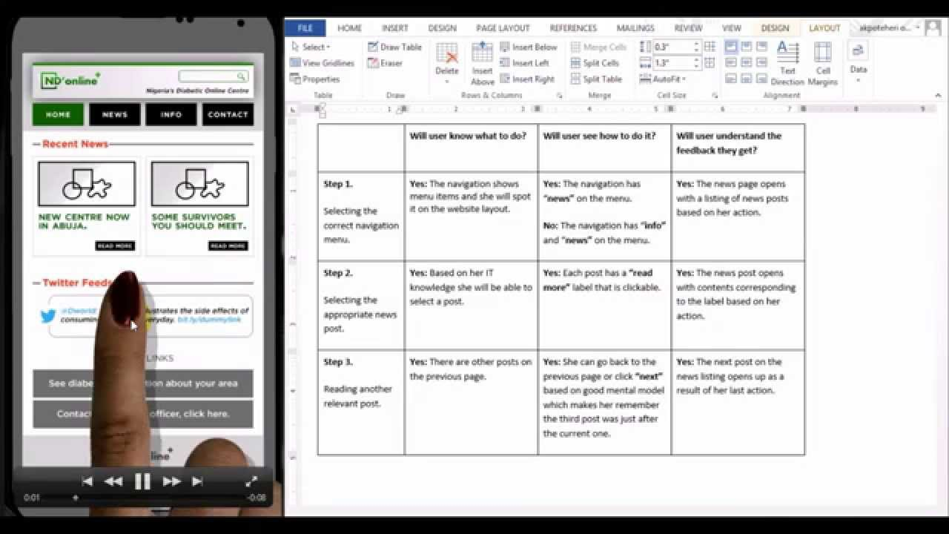
Cognitive Walkthrough (CW Supplement)
https://i.ytimg.com/vi/SpmTHdsQq8k/maxresdefault.jpg

Slide 2
Please click in…

Slide 3
Norman on the tendency to make up stories
“People are innately disposed to look for causes of events, to form explanations and stories. Everyone forms stories (conceptual models) to explain what they have observed. In the absence of external information, people can let their imagination run free as long as the conceptual models they develop account for the facts as they perceive them.” (p. 57)
Notes:
Post hoc, ergo propter hoc – “after the fact, therefore because of it”-- often used to infer causality

Slide 4
This Class is about Quickly Evaluating Designs (CW Supplement)
Today’s Agenda
Programmable thermostat design
The cognitive walkthrough
Design Studio: Presentation of IA #2 Designs

Slide 5
Display toggles between current time and current temp (every 2 sec)
Current Time/Temp
3:15 p.m./
SCREEN #1
(Design 1)
64º
Set Temp
Button color changes when pressed to indicate it is on. Pressing again unholds
65º
Hold
Notes:
The underlined labels are optional in this design
The two dots are an optional way of conveying that you can swipe down to edit presets. We could use these and/or an“Edit Presets” button

Slide 6
These labels could be replaced with appropriate icons
Morning
Afternoon
Evening
Night
Current Time/Temp
SCREEN #1
(Design 2)
3:15 p.m./
64º
Button color changes when pressed to indicate it is on. Pressing again unholds
Set Temp
65º
Hold
Edit Presets…
Notes:
This design builds on the previous one by conveying the current time preset zone (afternoon). The row of labels across the top could double as buttons for editing each preset. This means that the “Edit Presetss…” button could be potentially eliminated.

Slide 7
These labels could be replaced with appropriate icons
Morning (7-12) 63º
Afternoon (12-5) 65º
Evening (5-10) 69º
Night (10-7) 55º
SCREEN #1
(Design 3)
Current Time/Temp
3:15 p.m./
64º
Button color changes when pressed to indicate it is on. Pressing again unholds
Set Temp
65º
Hold
Edit Presets…
Notes:
This design conveys even more of the state: what each preset zone means, and what the actual preset temp is for that zone. We can optionally make these buttons and if we do, we can potentially eliminate the “Edit Presets…” button on the bottom.

Slide 8
3:15 p.m.
Current Temp
SCREEN #1
(Design 4)
64º
Temp Presets
Morning (7-12) 63º
Afternoon (12-5) 65º
Evening (5-10) 69º
Night (10-7) 55º
Hold or Override Current Preset
65º
Hold

Slide 9
These labels could be replaced with appropriate icons
Morning
Afternoon
Evening
Night
SCREEEN #2
(Design 1)
Afternoon
(12 – 5 p.m.)
Set Temp
65º
Back
Notes:
Here, the “Back” button functionality could be duplicated via swipe up.
An animation of a swipe up to the main screen, in either case, could convey a spatial relationship between the main screen and the editing screens.
We could consider a “Restore Previous Value” button to allow the user to undo a change in the temp, but this could get busy.

Slide 10
Morning 63º
Afternoon 65º
Evening 69º
Night 55º
SCREEN #2
(Design 2)
Afternoon
(12 – 5 p.m.)
Set Temp
65º
Notes:
We have eliminated the back button and replaced it with the vertical dots. Will there be a gulf of execution?

Slide 11
Morning (7-12) 63º
Afternoon (12-5) 65º
Evening (5-10) 69º
Night (10-7) 55º
SCREEN #2
(Design 3)
Set Temp
65º
Back
Notes:
The back button replaces the vertical dots here, but we retain the horizontal dots to reinforce the left-to-right navigability through the preset zones.

Slide 12
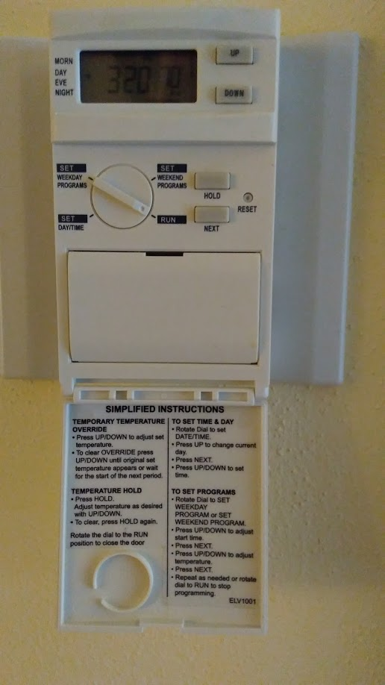
“Override” or “Hold” appears here
Arrow indicates current preset zone
Display cycles between current time and current temp (every 2 sec)
Notes:
The design that inspired me: A Honeywell programmable thermostat with a clever design that leverages design prinicples.

Slide 13
This Class is about Quickly Evaluating Designs (CW Supplement)
Today’s Agenda
Programmable thermostat design
The cognitive walkthrough
Design Studio: Presentation of IA #2 Designs

Slide 14
Cognitive Walkthrough can be seen as an application of Norman’s “seven stages” model
An individual or group simulates a user completing tasks with a user interface
Goals
Identify potential usability problems
Generate ideas for improving user interface design
Advantages:
No real users needed
Can be performed at any stage of development
Disadvantages
Value depends on skill of evaluator(s)
Analysis can be narrow and superficial
Does not estimate severity or scope of problems identified

Slide 15
How to Do a Cognitive Walkthrough
Gather materials
Description of characteristics of typical users
List of core tasks that focus on areas of design that need to be evaluated.
Correct sequences of actions for each task
Representation of user interface to be evaluated
Walk through correct action sequences from perspective of typical users, asking the following questions at each step:
Will the user know what to do next to achieve task? (Form correct goal?)
Will the user notice how to perform the correct action? (Gulf of execution?)
Will the user interpret the system response correctly? (Gulf of evaluation?)
Record successes, failures (and why the interface fails), design suggestions, and comments
Brainstorm potential solutions to problems identified

Slide 16
Cognitive Walkthrough Process
Application: The ALgorithm VIsualization Storyboarder (ALVIS)
Step 1a: Identify core users and tasks
Core Users: First-semester computer science students who are learning to program algorithms
Core task: Designing array-iterative algorithms by
creating and placing variables and arrays
Writing control and iterative logic in SALSA language
Step 1b: Specify task sequences
We'll focus on the following task: Create an array with five cells containing randomly-generated integers between 1 and 50 in descending order

Slide 17
Cognitive Walkthrough Process (cont.)
Step 1b: Specify task sequences
Step 1: Create an array with five cells
Click on “Create Array” button
Position cursor on animation canvas
Drag out array with five cells
Step 2: Modify default properties of “populate" tool
Double-click on populate tool
Modify “value” field to “1 and 50”
Click on >> next to “ordering” field and choose “descending”
Choose “Apply”
Step 3: Populate array
Click on any cell in the array

Slide 18
Cognitive Walkthrough Process (cont.)
Step 2: Walk through correct action sequences, asking the following questions at each step:
Will the user know what to do next? (Form correct goal?)
Will the user notice how to perform the correct action? (Gulf of execution?)
Will the user interpret the system response correctly? (Gulf of evaluation?)
Use provided worksheet!

Slide 19
Cognitive Walkthrough Process (cont.)
Step 3: Summarize results
Identify aspects of the design that worked
Identify potential usability issues
Where possible, use concepts from class to explain usability issues
Step 4: Suggest design changes
For each usability issue, suggest a concrete change to remedy the issue
Use annotated screen sketches to illustrate your suggested changes, as appropriate.

Slide 20
How to fix problems identified by Cognitive Walkthrough
If user doesn’t know what to do next to make progress…
Eliminate task sequence step
Prompt user for correct action
Change another part of the task sequence so that step isn’t necessary
If user fails to notice how to perform the correct action…
Make action more obvious (e.g., label buttons using language familiar to users)
Lead user back on right path by anticipating what user might attempt, and providing hints

Slide 21
How to fix problems identified by Cognitive Walkthrough (cont.)
If user fails to interpret system response correctly…
Provide better feedback (duh!)
Confirm what happened

Slide 22
Individual Assignment #3: Cognitive Walkthrough
You will complete the cognitive walkthrough begun in class by considering the task of writing a “find max” algorithm to find the largest value in the populated array.
See IA #3 prompt for the details
Your solution is due at beginning of class Tuesday (I will go over a possible solution in class next Tuesday)

Slide 23
This Class is about Quickly Evaluating Designs (CW Supplement)
Today’s Agenda
Programmable thermostat design
The cognitive walkthrough
Design Studio: Presentation of IA #2 Designs

Slide 24
IA#2 Presenters
Sandra
Sayonsom
Wai Lok
Shyam
Ryan
Dara

Slide 25
Announcements
Read Johnson Ch. 1-3 for Thursday
Complete IA#3 by next Tuesday

